Slide 1
DOCTORAL DISSERTATION ORAL DEFENSE Data Structures and Algorithms for the Identification of Biological Patterns
Marius Nicolae Major Advisor: Prof. Sanguthevar Rajasekaran
Associate Advisors: Prof. Ion Mandoiu and Prof. Yufeng Wu

Slide 2
Overview
Planted Motif Search
Suffix Array Construction Algorithms
Pattern Matching with k Mismatches (and wild cards)

Slide 3
1. Planted Motif Search
Input: n strings and two integers l and d
Output: l-mers M that appear in all strings such that Hd(M,t_{i})≤d
S₁
t1
S₂
t2
S₃
t3
M=?
…
S_{n}
tn
Applications: find transcription factor binding sites, find gene promoter regions, PCR primer design, find unbiased consensus of protein families etc.

Slide 4
1.1 Previous Work
General algorithm:
for all (t1,t2,…,tk) do
find common neighbors
check which of them are motifs
end
Choices for k:
k=1 [Rajasekaran et. al. 2005]
k=2 [Yu et. al. 2012]
k=3 [Dinh et. al. 2011; Tanaka 2014]
k=n [Pevzner, Sze 2000; Roy, Aluru 2014]
In this work (PMS8, qPMS9) k is variable.
S₁
t1
S₂
t2
S₃
t3
…
S_{n}
tn

Slide 5
1.2 Generate Tuples (t1,t2,…tk)
S₁
t1
S₂
t2
S₃
t3
…
S_{n}
tn

Slide 6
1.3 Generate Neighbors for tuple (t1,t2,…tk)
l
t1
A A . . .
Problem: Given l-mers t1, t2, …, tk find all l-mers M such that for all i=1..k, Hd(M, ti) <= d.
Algorithm GenerateNeighbors(p,t1,t2,..,tk, d1,d2,…,dk):
If p == l+1 then
report M and exit;
end
for a in ∑ do
set M[p]=a
let ti’=ti[2..l] for all i=1,k
let di’=di if a==ti[1] or di-1 otherwise
if not Prune(l-p,t1’,t2’,…,tk’,d1’,d2’,…,dk’) then
GenerateNeighbors(p+1,t1’,t2’,…,tk’,d1’,d2’,…,dk’)
end
end
end
t2
A T . . .
t3
C A . .
M
A
l-1
t1’
A . . .
t2’
T . . .
t3’
A . . .
M
A A . . .

Slide 7
1.4 Pruning Conditions
Problem: Given A and B, is there an M s.t. Hd(A,M)≤d1 and Hd(B,M)≤d2?
Theorem: M exists if and only if Hd(A,B)≤d1+d2
A
Hd≤d1
Hd≤d1+d2
M=?
B
Hd≤d2
Hd(A,B)
A
B
M
d1
Hd(A,B)-d1≤d2

Slide 8

1.4 Pruning Conditions
Problem: Given A, B and C, is there an M s.t. Hd(A,M)≤d1, Hd(B,M)≤d2 and Hd(C,M)≤d3?
Theorem: M exists if and only if:
1. Hd(A,B)≤d1+d2
2. Hd(B,C)≤d2+d3
3. Hd(A,C)≤d1+d3
4. Cd(A,B,C)≤d1+d2+d3
where
Cd(A,B,C)=n1+n2+n3+2*n4
A
Hd≤d1
Hd≤d2
B
M=?
C
Hd≤d3
n0
n1
n2
n3
n4
A
B
C
n1+n4-d1
n2+n4-d2
n3+n4-d3
M
n_{i}<d_{i}, i=1,2,3
d1
M
n₁$≥$d₁
Hd(M,B) = Hd(A,B)-d₁ ≤ d2 (from 1)

Slide 9
1.5 Results

Slide 10
1.5 Results

Slide 11
2. Suffix Array Construction Algorithms
Given string S, find lexicographic order of all suffixes of S
Example:
S=hello
Of interest in text processing as an alternative to suffix trees
0 1 2 3 4
4 o
3 lo
2 llo
1 ello
0 hello
1 ello
0 hello
2 llo
3 lo
4 o
sort
SA=[1,0,2,3,4]

Slide 12
2.1 Previous Work
Introduced in [Manber and Myers, 1990], O(n log n) algorithm
In 2003, 3 linear time algorithms: [Ko and Aluru], [Kӓrkkӓinen and Sanders], [Kim, Sim et. al.]
Practically fast algorithms have superlinear worst case runtime – e.g. BPR by [Schuermann and Stoye, 2007] has worst case runtime O(n²)

Slide 13
2.1 Manber and Myers’ Algorithm
Step0
Step1
Step2
Step3
Step0: bucket sort suffixes
by first char
depth = 1
for step=1 to log N do
for each bucket do
sort suffixes in bucket
w.r.t bucket[suffix+depth]
end
depth = depth * 2
end
aefozaefoyaefox
aefoyaefox
aefox
efozaefoyaefox
efoyaefox
efox
fozaefoyaefox
foyaefox
fox
ozaefoyaefox
oyaefox
ox
x
yaefox
zaefoyaefox
aefozaefoyaefox
aefoyaefox
aefox
efozaefoyaefox
efoyaefox
efox
fozaefoyaefox
foyaefox
fox
ox
oyaefox
ozaefoyaefox
x
yaefox
zaefoyaefox
aefozaefoyaefox
aefoyaefox
aefox
efox
efoyaefox
efozaefoyaefox
fox
foyaefox
fozaefoyaefox
ox
oyaefox
ozaefoyaefox
x
yaefox
zaefoyaefox
aefox
aefoyaefox
aefozaefoyaefox
efox
efoyaefox
efozaefoyaefox
fox
foyaefox
fozaefoyaefox
ox
oyaefox
ozaefoyaefox
x
yaefox
zaefoyaefox
Example:
S=aefozaefoyaefox

Slide 14
2.2 RadixSA - Our Algorithm
Step0
Step1
aefozaefoyaefox
aefoyaefox
aefox
efozaefoyaefox
efoyaefox
efox
fozaefoyaefox
foyaefox
fox
ozaefoyaefox
oyaefox
ox
x
yaefox
zaefoyaefox
aefox
aefoyaefox
aefozaefoyaefox
efox
efoyaefox
efozaefoyaefox
fox
foyaefox
fozaefoyaefox
ox
oyaefox
ozaefoyaefox
x
yaefox
zaefoyaefox
Step0: bucket sort suffixes
by first char
for i=N downto 1 do
sort suffixes in bucket[i]
w.r.t bucket[suffix+depth]
End
Runtime: O(n log n) with
minor modifications
Example:
S=aefozaefoyaefox

Slide 15
2.2 Radix Sort Speedup
Typical LSD radix sort:
for digit=4 downto 1 do
for i=1 to n do
count[x[i][digit]]++
end
for i=1 to n do
Place x[i] in bucket
x[i][digit] using count
end
end
8 passes through data
Optimization:
for i=1 to n do
for digit=4 downto 1 do
count_{digit}[x[i][digit]]++
end
end
for digit=4 downto 1 do
for i=1 to n do
Place x[i] in bucket
x[i][digit] using count_{digit}
end
end
5 passes through data
 | 1 | 2 | 3 | 4
1 | 4 | 5 | 2 | 8
2 | 7 | 4 | 9 | 0
3 | 3 | 2 | 4 | 8
4 | 2 | 3 | 6 | 9
5 | 6 | 4 | 3 | 1
6 | 5 | 2 | 9 | 0
7 | 3 | 6 | 4 | 2

Slide 16
Results

Slide 17
2.4 Average Accesses per Suffix

Slide 18
3. Pattern matching with k mismatches
Given text T and pattern P and integer k, find alignments for which the Hamming Distance is no more than k
Example:
Naïve algorithm: O(nm), where n=|T|, m=|P|
0 1 2 3 4 5 6 7 8 9
T=ababcbcabc
P=abc
k=1
Res=[0,2,4,7]
T
P

Slide 19
3.2 Kangaroo Method [Galil & Giancarlo ‘86]
Runtime O(k) per alignment, total O(nk)
Construct Generalized Suffix tree of T+P
Add support for Lowest Common Ancestor queries in O(1) time
j
d=0
i=0
repeat
a=LCA(P_{i}, T_{j})
i=i+a+1
j=j+a+1
d=d+1
until d > k or i > m
return d
j+a+1
T
0
a+1
P
a=LCA(P₀,T_{j})
LCA(P_{a+1},T_{j+a+1})

Slide 20
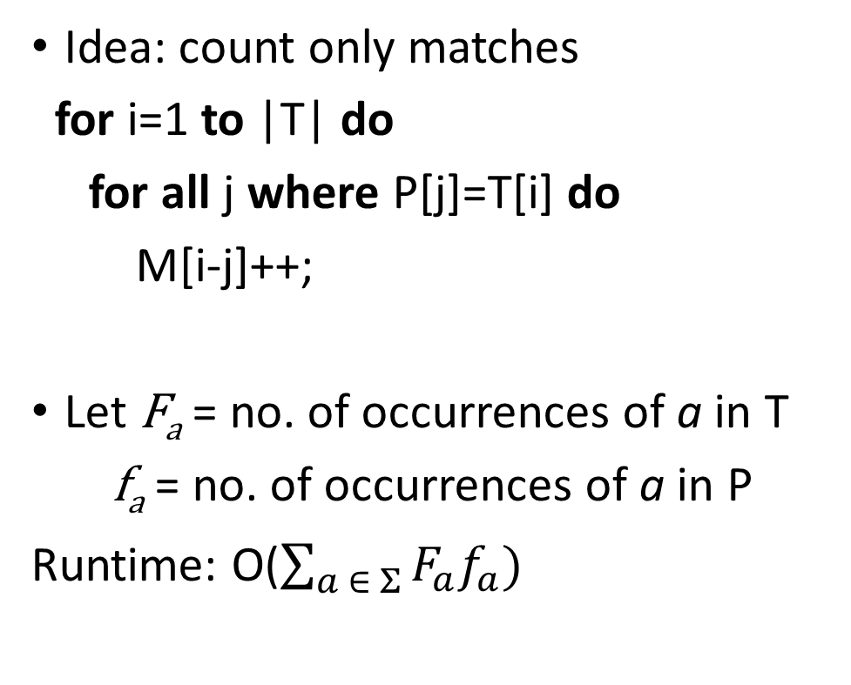
3.3 Marking [Abrahamson ‘87]
Idea: count only matches
for i=1 to |T| do
for all j where P[j]=T[i] do
M[i-j]++;
Let F_{a} = no. of occurrences of a in T
f_{a} = no. of occurrences of a in P
Runtime: O($\sum_{a ∈ Σ}{F_{a}f_{a}})$
i
T
a
j
P
a a a
M
+1

Slide 21
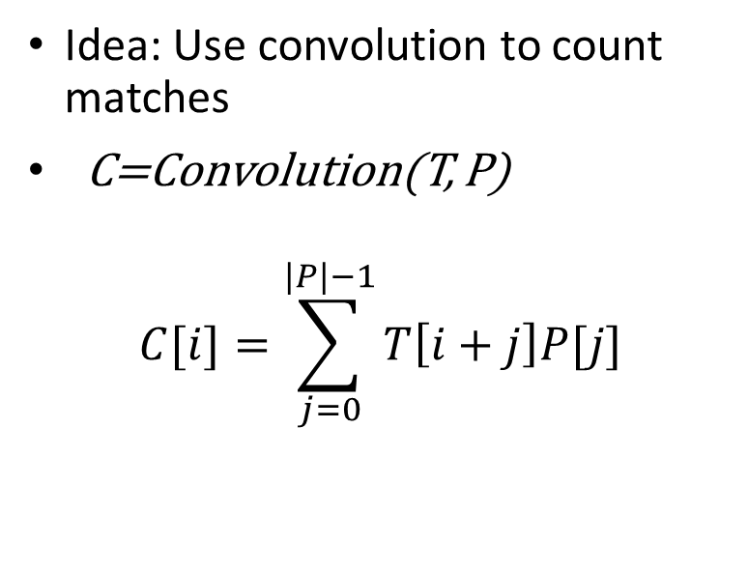
3.4 Convolution [Abrahamson ‘87]
i
i+j
i
i+j
T
a a
T_{a}
1 1
j
j
P
a a a
P_{a}
1 1 1
for a in Σ do
T_{a}[i]=1 if T[i]=a, 0 otherwise
P_{a}[i]=1 if P[i]=a, 0 otherwise
C_{a}=Convolution(T_{a}, P_{a})
M[i]=M[i]+C_{a}[i], for all i
end
M[i]=no. of matches for alignment i
Runtime: O(|Σ|n log m)
Idea: Use convolution to count matches
C=Convolution(T, P)
$$C[i]=\sum_{j=0}^{|P|−1}{T\left[i+j\right]P[j]}$$

Slide 22
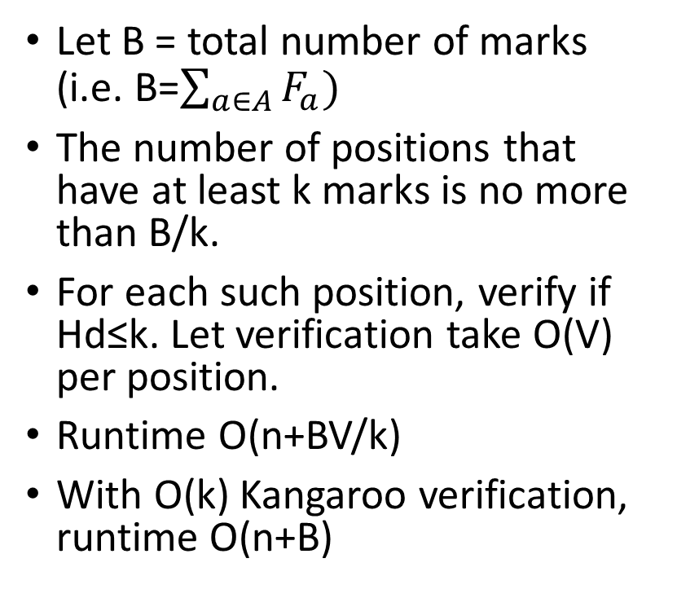
3.5 Filtering [Amir ‘04]
Idea: quickly exclude some of the alignments
Choose 2k positions from P, call this array A
Using marking, count matches only with respect to A
Any alignment with less than k marks has more than k mismatches.
Let B = total number of marks (i.e. B=$\sum_{a∈A}{F_{a})}$
The number of positions that have at least k marks is no more than B/k.
For each such position, verify if Hd≤k. Let verification take O(V) per position.
Runtime O(n+BV/k)
With O(k) Kangaroo verification, runtime O(n+B)
T
a
P
a b a c
M
+1

Slide 23
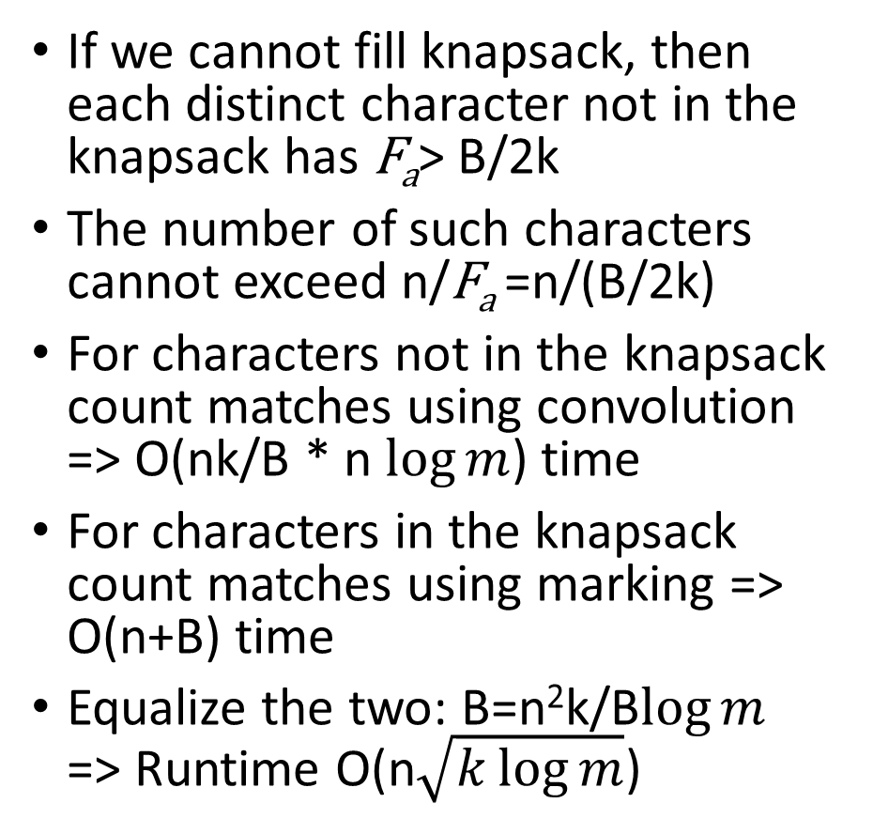
3.6 Knapsack k-mismatches (Our Algorithm)
T
If we cannot fill knapsack, then each distinct character not in the knapsack has F_{a}> B/2k
The number of such characters cannot exceed n/F_{a} =n/(B/2k)
For characters not in the knapsack count matches using convolution => O(nk/B * n $\log{m}$) time
For characters in the knapsack count matches using marking => O(n+B) time
Equalize the two: B=n²k/B$\log{m}$ => Runtime O(n$\sqrt{k\log{m}}$)
a
P
a b a c
M
+1
Knapsack of size 2k and budget B
Every character a in P is an object of size 1 and cost F_{a}
Fill knapsack without exceeding budget B (greedy algorithm)
If we can fill knapsack then mark and filter => Runtime O(n+B)

Slide 24
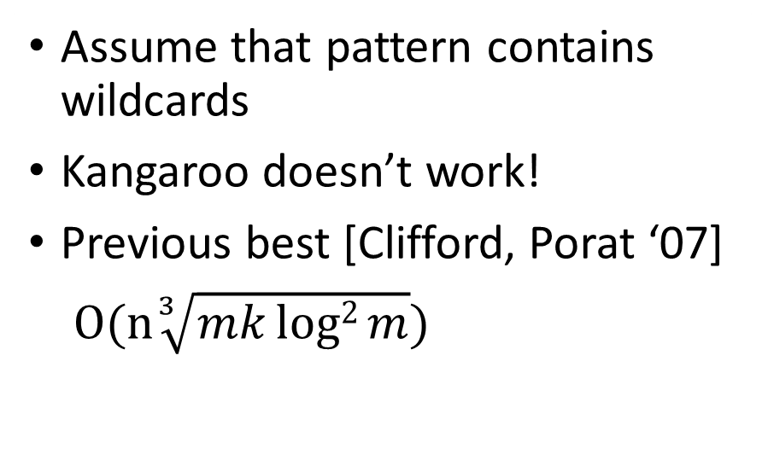
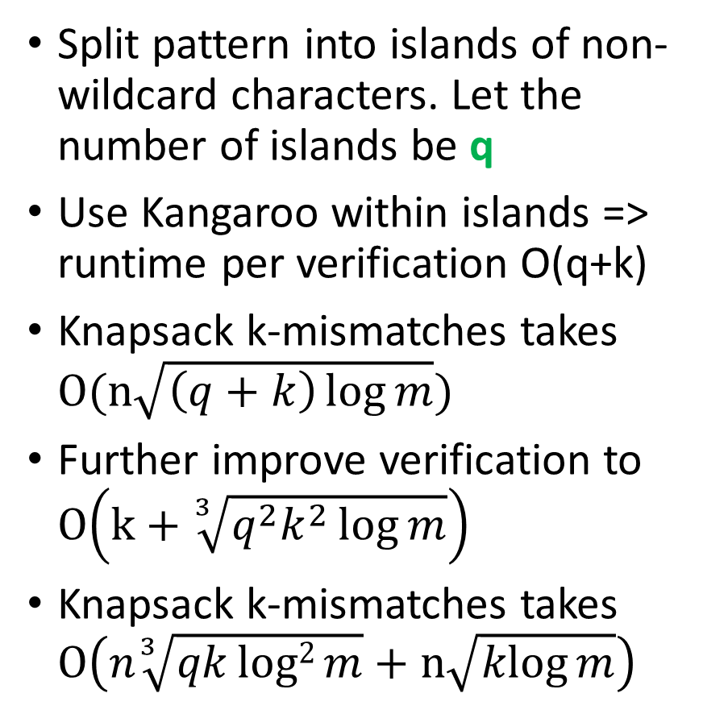
3.7 Knapsack k-mismatches with wildcards
T
Split pattern into islands of non-wildcard characters. Let the number of islands be q
Use Kangaroo within islands => runtime per verification O(q+k)
Knapsack k-mismatches takes $O(n\sqrt{\left(q+k\right)\log{m}})$
Further improve verification to $O\left(k+\sqrt[3]{q^{2}k^{2}\log{m}}\right)$
Knapsack k-mismatches takes $O\left(n\sqrt[3]{qklog2{m}}+n\sqrt{\operatorname{klog}{m}}\right)$
P
? ?
Assume that pattern contains wildcards
Kangaroo doesn’t work!
Previous best [Clifford, Porat ‘07]
$O(n\sqrt[3]{mklog2{m}})$

Slide 25
3.8 Results

Slide 26
3.8 Results

Slide 27
References
[PMS8] Nicolae, Marius, and Sanguthevar Rajasekaran. "Efficient sequential and parallel algorithms for planted motif search." BMC bioinformatics 15.1 (2014): 34.
[qPMS9] Nicolae, Marius, and Sanguthevar Rajasekaran. "qPMS9: An Efficient Algorithm for Quorum Planted Motif Search." Scientific reports 5 (2015).
[Suffix Arrays] Rajasekaran, Sanguthevar, and Marius Nicolae. "An elegant algorithm for the construction of suffix arrays." Journal of Discrete Algorithms 27 (2014): 21-28.
[K-Mismatch] Nicolae, Marius, and Sanguthevar Rajasekaran. "On String Matching with Mismatches." Algorithms 8.2 (2015): 248-270.
[K-Mismatch-Wildcard] Nicolae, Marius, and Sanguthevar Rajasekaran. "On pattern matching with k mismatches and few don't cares." arXiv:1602.00621 [cs.DS].

