Slide 1
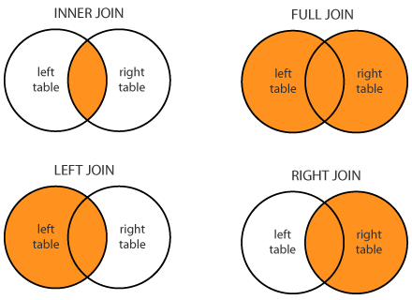
Pagrindiniai Join

Slide 2


Slide 3
Duomenų normalizavimas
Problems Without Normalization
If a table is not properly normalized and have data redundancy then it will not only eat up extra memory space but will also make it difficult to handle and update the database, without facing data loss. Insertion, Updation and Deletion Anamolies are very frequent if database is not normalized. To understand these anomalies let us take an example of a Student table.
rollno name branch hod office_tel
401 Akon CSE Mr. X 53337
402 Bkon CSE Mr. X 53337
403 Ckon CSE Mr. X 53337
404 Dkon CSE Mr. X 53337
In the table above, we have data of 4 Computer Sci. students. As we can see, data for the fields branch, hod(Head of Department) and office_tel is repeated for the students who are in the same branch in the college, this is Data Redundancy.

Slide 4
Duomenų normalizavimas
Insertion Anomaly
Suppose for a new admission, until and unless a student opts for a branch, data of the student cannot be inserted, or else we will have to set the branch information as NULL.
Also, if we have to insert data of 100 students of same branch, then the branch information will be repeated for all those 100 students.
These scenarios are nothing but Insertion anomalies.
Updation Anomaly
What if Mr. X leaves the college? or is no longer the HOD of computer science department? In that case all the student records will have to be updated, and if by mistake we miss any record, it will lead to data inconsistency. This is Updation anomaly.
Deletion Anomaly
In our Student table, two different informations are kept together, Student information and Branch information. Hence, at the end of the academic year, if student records are deleted, we will also lose the branch information. This is Deletion anomaly.

Slide 5
Duomenų normalizavimo taisyklės
Normalization rules are divided into the following normal forms:
First Normal Form
Second Normal Form
Third Normal Form
BCNF
Fourth Normal Form

Slide 6
1 Normalinė forma
For a table to be in the First Normal Form, it should follow the following 4 rules:
It should only have single(atomic) valued attributes/columns.
Values stored in a column should be of the same domain
All the columns in a table should have unique names.
And the order in which data is stored, does not matter.
Pavyzdys

Slide 7
2 Normalinė forma
For a table to be in the Second Normal Form,
It should be in the First Normal form.
And, it should not have Partial Dependency.
Pavyzdys

Slide 8
3 Normalinė forma
A table is said to be in the Third Normal Form when,
It is in the Second Normal form.
And, it doesn't have Transitive Dependency.
Pavyzdys

Slide 9
Boyce and Codd Normal Form (BCNF)
Boyce and Codd Normal Form is a higher version of the Third Normal form. This form deals with certain type of anomaly that is not handled by 3NF. A 3NF table which does not have multiple overlapping candidate keys is said to be in BCNF. For a table to be in BCNF, following conditions must be satisfied:
Records must be in 3rd Normal Form
and, for each functional dependency ( X → Y ), X should be a super Key.
Pavyzdys

Slide 10
4 Normalinė forma
A table is said to be in the Fourth Normal Form when,
It is in the Boyce-Codd Normal Form.
And, it doesn't have Multi-Valued Dependency.
Pavyzdys

Slide 11
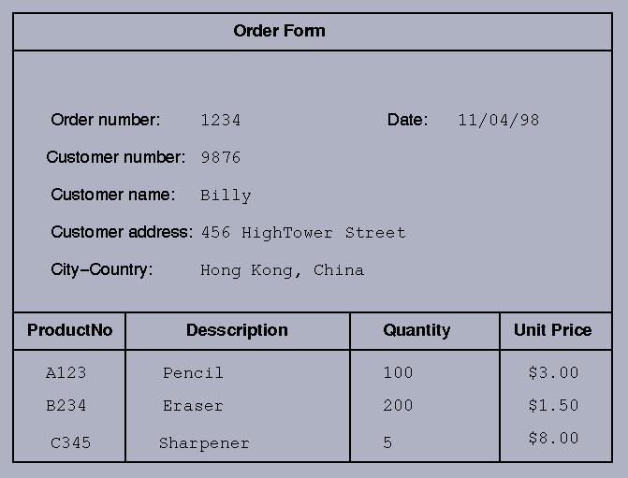
Užduotis

Slide 12
Atsakymas
0NF
ORDER(order#, customer#, name, address, orderdate(product#, description, quantity, unitprice))
1NF
ORDER(order#, customer#, name, address, orderdate)
ORDER_LINE(order#, product#, description, quantity, unitprice)
2NF
ORDER(order#, customer#, name, address, orderdate)
ORDER_LINE(order#, product#, quantity)
PRODUCT(product#, description, unitprice)
3NF
ORDER(order#, customer#, orderdate)
CUSTOMER(customer#, name, address)
ORDER_LINE(order#, product#, quantity)
PRODUCT(product#, description, unitprice)
Atsakymas

Slide 13
Literatūra
https://www.studytonight.com/dbms/database-normalization.php
https://www.guru99.com/database-normalization.html
https://en.wikipedia.org/wiki/Database_normalization
https://www.programva.com/lt/mysql-duomenu-bazes-serveriai/mysql-duomenu-bazes-modelis
https://www.slideserve.com/Patman/duomenu-bazes-db-reliacines-db
https://gid.lt/informatika/duomenu-bazes-kurimo-technologija-3

Slide 14
Ačiū

