Slide 2
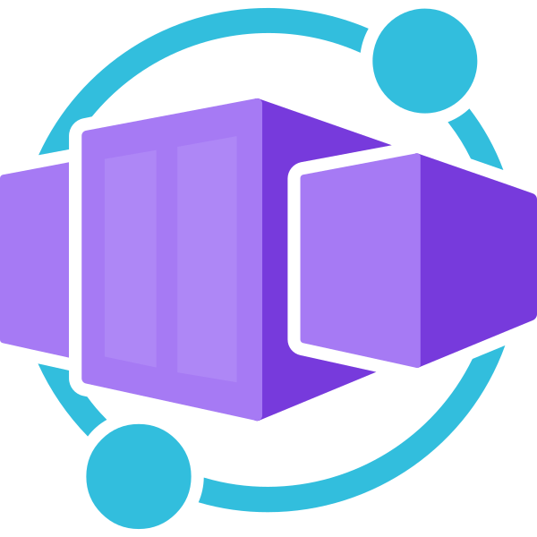
Azure Container Apps

Slide 3
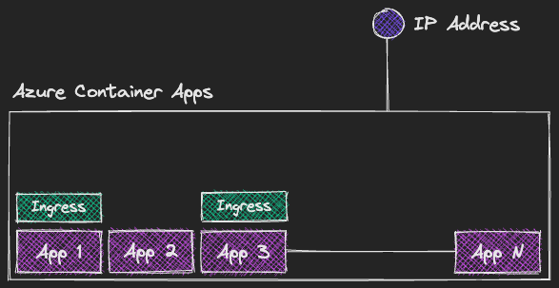
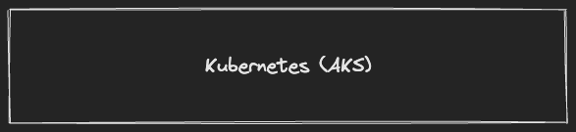
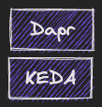

Slide 4






Different container options in Azure
Azure Container Apps
Azure App Service
Azure Container Instances
Azure Kubernetes Service
Azure Functions
Azure Spring Apps
Azure Red Hat OpenShift
https://learn.microsoft.com/en-us/azure/container-apps/compare-options

Slide 5
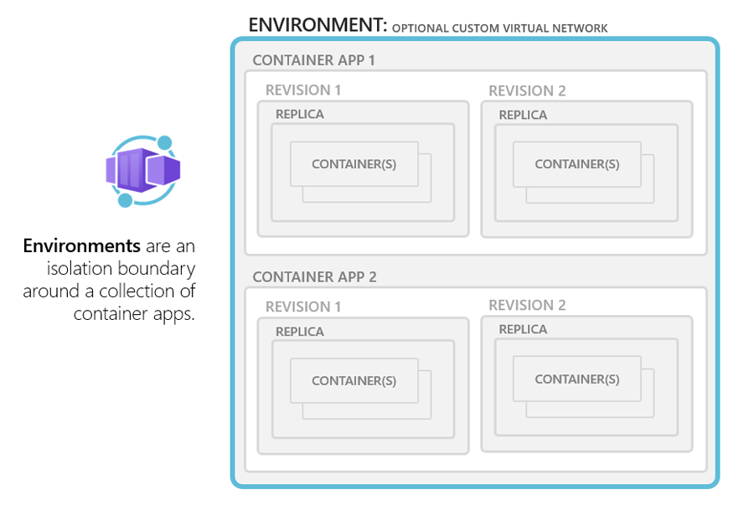
Concepts: Environments

Slide 6
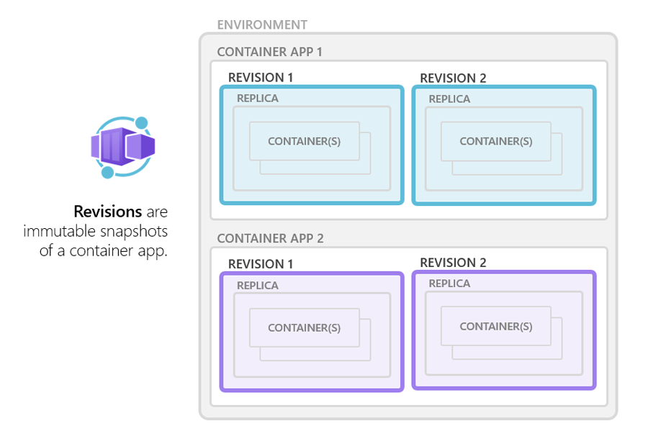
Concepts: Revisions

Slide 7
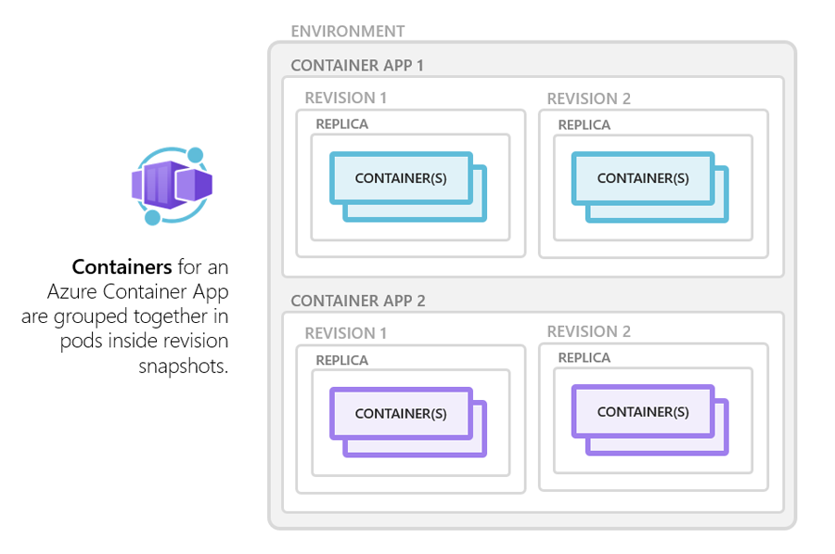
Concepts: Containers

Slide 8
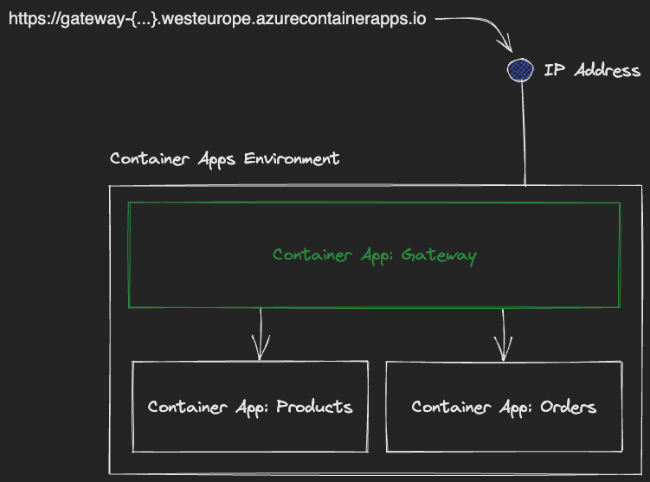

Slide 9
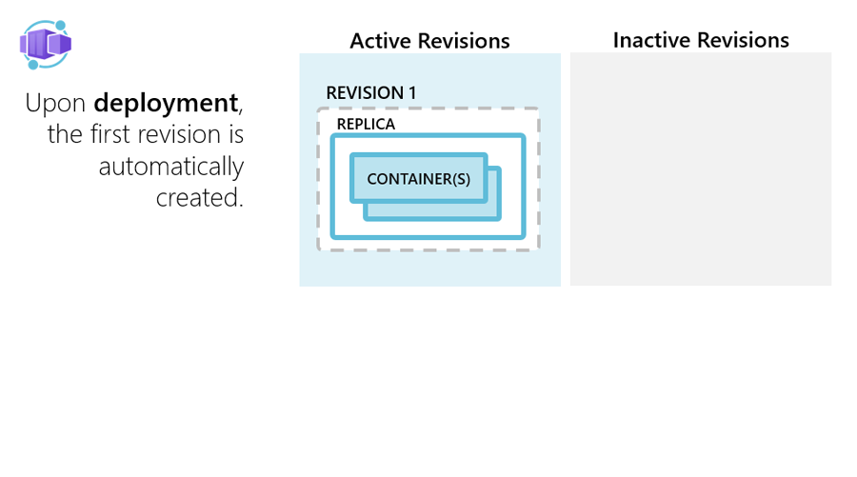
Application lifecycle

Slide 10
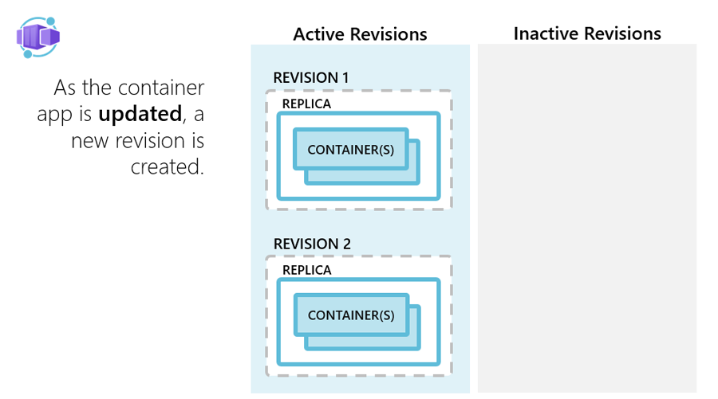
Application lifecycle

Slide 11
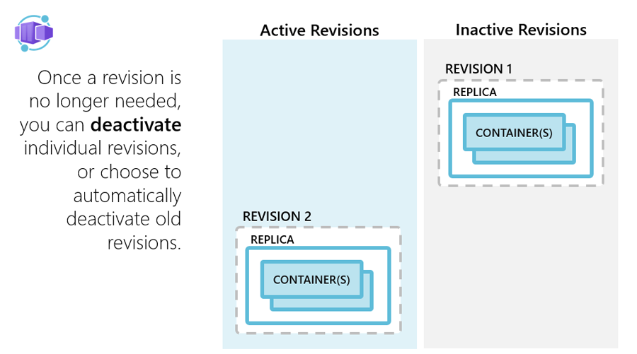
Application lifecycle

Slide 12
Pricing
Resource consumption
Meter | Active Usage Price | Idle Usage Price | Free Grant (Per Month)
vCPU (seconds) | €0.0000314 per second | €0.0000037 per second | 180,000 vCPU-seconds
Memory (GiB-seconds) | €0.0000037 per second | €0.0000037 per second | 360,000 GiB-seconds
Requests
Meter | Price | Free Grant (Per Month)
Requests | €0.517 per milion | 2 milion

Slide 13
Limitations
Some Kubernetes features are not supported or not configurable:
Jobs are not supported (Planned for June 2023)
Graceful shutdown duration is set to 30 seconds.
Deployments are used underneath – scaling in will terminate random instances, which might not be ideal for long running processes.
VM sizes
Max 2vCPU/4GB RAM (Up to 16vCPU/128GB RAM in Deticated plan (Preview))
Container images
Linux based (linux/amd64) container images are required.

Slide 14
Resources
https://learn.microsoft.com/en-us/azure/container-apps
https://azure.microsoft.com/en-us/products/container-apps
https://github.com/microsoft/azure-container-apps
https://keda.sh
https://dapr.io

Slide 15
Thank You
Mariusz Baran

