Slide 2
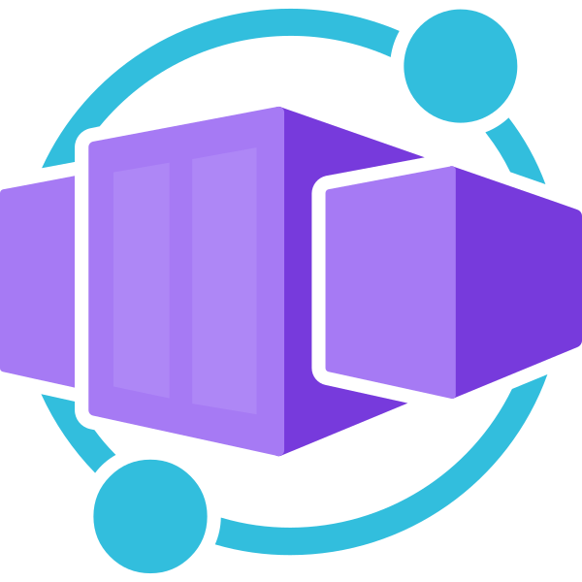
Azure Container Apps

Slide 3
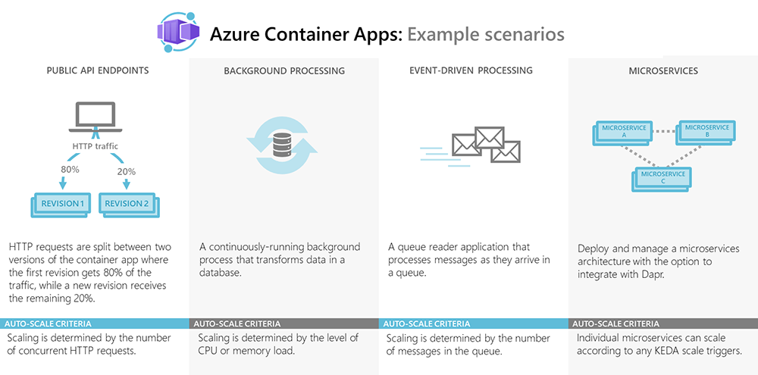
Overview
Azure Container Apps enables you to run microservices and containerized applications on a serverless platform.

Slide 4






Different container options in Azure
Azure Container Apps
Azure App Service
Azure Container Instances
Azure Kubernetes Service
Azure Functions
Azure Spring Apps
Azure Red Hat OpenShift
https://learn.microsoft.com/en-us/azure/container-apps/compare-options

Slide 5
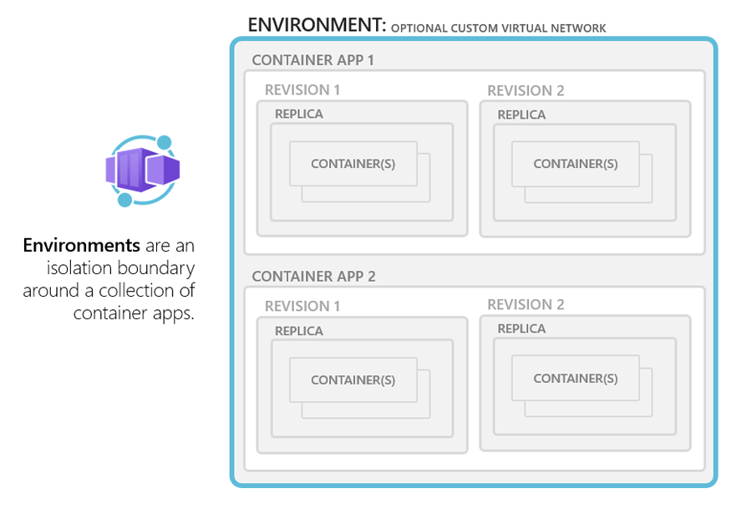
Concepts: Environments

Slide 6
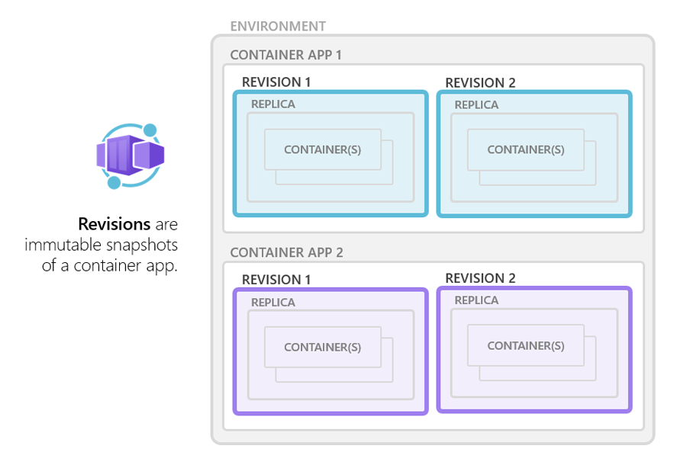
Concepts: Revisions

Slide 7
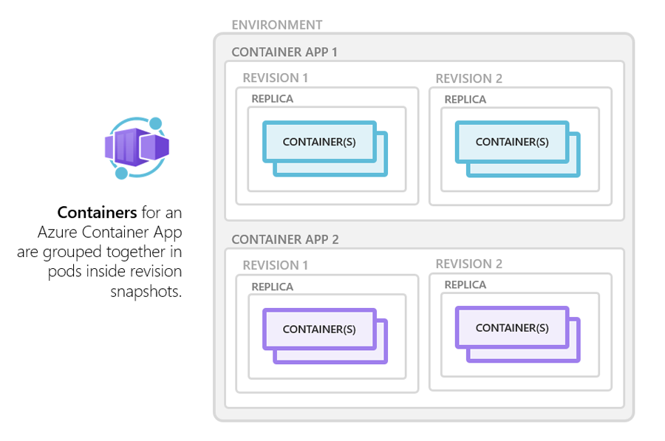
Concepts: Containers

Slide 8
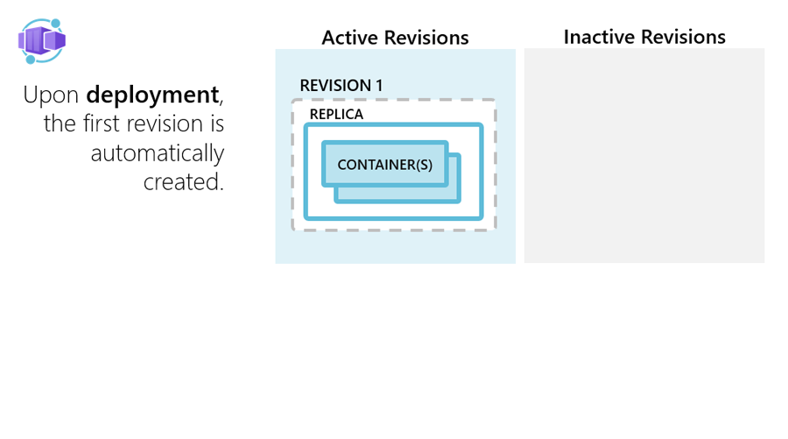
Application lifecycle

Slide 9
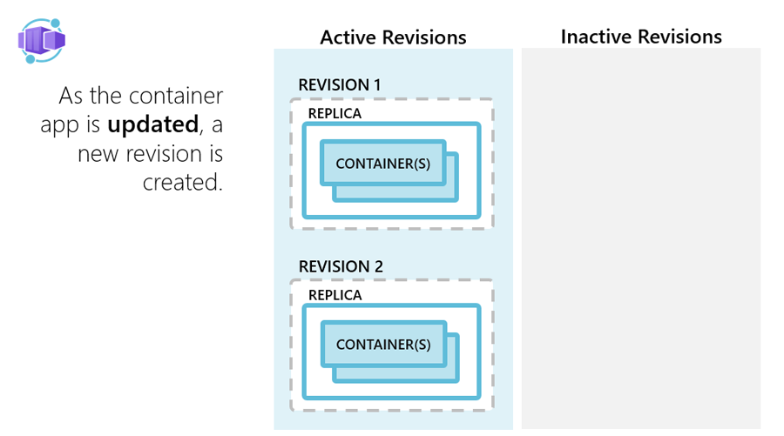
Application lifecycle

Slide 10
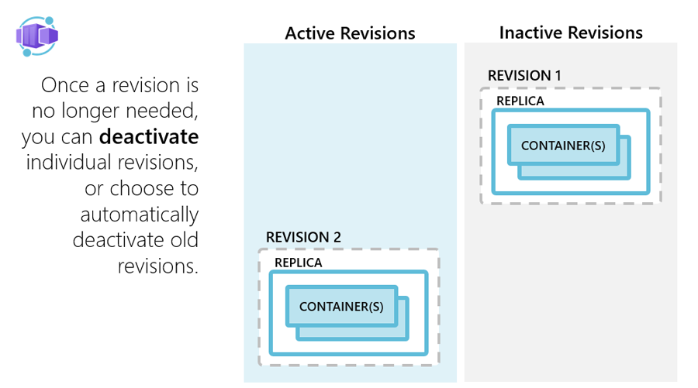
Application lifecycle

Slide 11
Pricing
Resource consumption
Meter | Active Usage Price | Idle Usage Price | Free Grant (Per Month)
vCPU (seconds) | €0.0000314 per second | €0.0000037 per second | 180,000 vCPU-seconds
Memory (GiB-seconds) | €0.0000037 per second | €0.0000037 per second | 360,000 GiB-seconds
Requests
Meter | Price | Free Grant (Per Month)
Requests | €0.517 per milion | 2 milion

Slide 12
Demo

Slide 13
Limitations
Some Kubernetes features are not supported or not configurable:
Jobs – not supported.
Pod – „terminationGracePeriodSeconds” has fixed value of 30 seconds.
Deployments are used underneath – scaling in will terminate random instances – which might not be ideal for long running processes.
VM sizes
Max 2vCPU and 4GB RAM
Container images
Linux based (linux/amd64) container images are required.

Slide 14
Resources
https://learn.microsoft.com/en-us/azure/container-apps
https://azure.microsoft.com/en-us/products/container-apps
https://github.com/microsoft/azure-container-apps
https://keda.sh

Slide 15
Thank You
Mariusz Baran

