Slide 1
Ultimate ubuntu virtual machine appliance
For Firebird

Slide 2
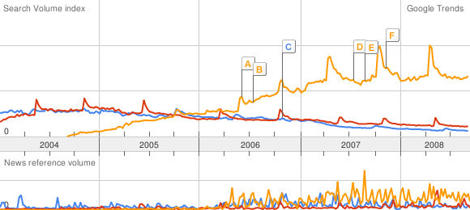
Why Ubuntu ?
Here are some more numbers from Google Trends.
Google searches of “suse” vs “fedora” vs “ubuntu”, over the last 5 years:

Slide 3
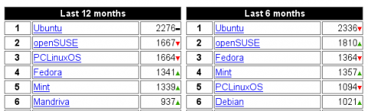
These numbers are corroborated by DistroWatch.com’s popularity ratings:

Slide 4
Old virtual machine
I started as base with an vmware appliance , that still can be downloaded and tested from this URL with vmware or virtualbox
http://www.vmware.com/appliances/directory/339

Slide 5
Applications that should be on the new one
  php 5.2.x
  apache 2.2.x or nginx
  firebird 2.1.x
  flamerobin 0.9.0
  ibwebadmin 2.x
  fpc-2.2.x
  lazarus-0.9.24
  mono default from ubuntu or 2.0
  monodevelop-1.0

Slide 6
What is inside
Ultimate Firebird Appliance contains LAMP like kit to easy start programming in php/mono/oopascal and working with firebird (Two administration tools were included in the virtual machine) also there is added MonoDevelop for C# coding and Lazarus (Delphi like ide) for oopascal for RAD (Rapid application development)‏

Slide 7
What virtualization is used ? KVM/QEMU
https://wiki.ubuntu.com/ScreencastTeam/HowToSetupQEMU
  QEMU is a full system emulator. It can be used to create a sandbox environment in which Ubuntu can be installed and demonstrations can be performed.
  kqemu is a kernel accelerator for QEMU. With kqemu loaded, QEMU is considerably faster.
  kvm is a kernel based accelerator for CPUs which have the VT extensions to their instruction set.
  virt-manager is a graphical frontend to QEMU/KVM, designed to make it easier to start virtual machines, without having to know the command line options.

Slide 8
QEMU -intro
QEMU is free software that implements a fast central processing unit emulator, allowing a user to run one operating system within another one. By using dynamic translation it achieves a reasonable speed . QEMU has two operating modes:
  User mode emulation: QEMU can launch Linux processes compiled for one CPU on another CPU. Linux system calls are converted because of endianness and 32/64 bit mismatches.
  System mode emulation: QEMU emulates a full system, including a processor and various peripherials. It enables easier testing and debugging of system code. It can also be used to provide virtual hosting of several virtual PCs on a single server.

Slide 9
kernel module (kqemu) which speeds up emulation to a level to native executiond by running user mode and virtual 8086 mode code directly on the host computers CPU, and using processor and peripheral emulation only for kernel mode and real mode code.
Advantages of QEMU
  Supports emulating IA-32 (x86) PCs, x86-64, MIPS , Suns SPARC and PowerPC and ARM architectures
  Support for other architectures in both host and emulated systems
  Increased speed—some applications can run in close to real time
  Support for running Linux binaries for other platforms
  Can save and restore the state of the machine (programs running, etc.)
  Virtual network card emulation

Slide 10
Example of QEMUs usage
Install qemu package from universe repository.
$sudo apt-get install qemu kvm
This command will create a 500MB hard disk image in QEMUs "qcow" format.
$qemu-img create -f qcow c.img 500M
The following command will start a virtual machine with 128MB of memory, using the c.img file created with the previous command and booting from a CD-ROM image linux.iso. The virtual machine will have audio support and use the systems clock to run in "real time." Note that one could also replace the -cdrom linux.iso parameter with -cdrom /dev/cdrom or whatever ones CD-ROM device is, and physically boot from installation medium and install to the image specified after -hda, in this case c.img.
$qemu -hda c.img -cdrom linux.iso -boot d -m 128 -enable-audio -localtime
This will create a virtual machine with 64MB of memory, booting from c.img and using the systems CD-ROM drive. The virtual machine will run in full-screen mode.
$qemu -hda c.img -cdrom /dev/cdrom -boot c -m 64 -full-screen

Slide 11
QEMU on Windows
Native port
http://www.h7.dion.ne.jp/~qemu-win/index.html
Qemu Manager 5.0
http://www.davereyn.co.uk/
  Simple, Easy to use GUI for the QEMU emulator.
  Create Virtual Machines with the easy to use wizards.
  Perform all QEMU tasks with a friendly easy to use interface.
  Available for the Windows Platform.

Slide 12
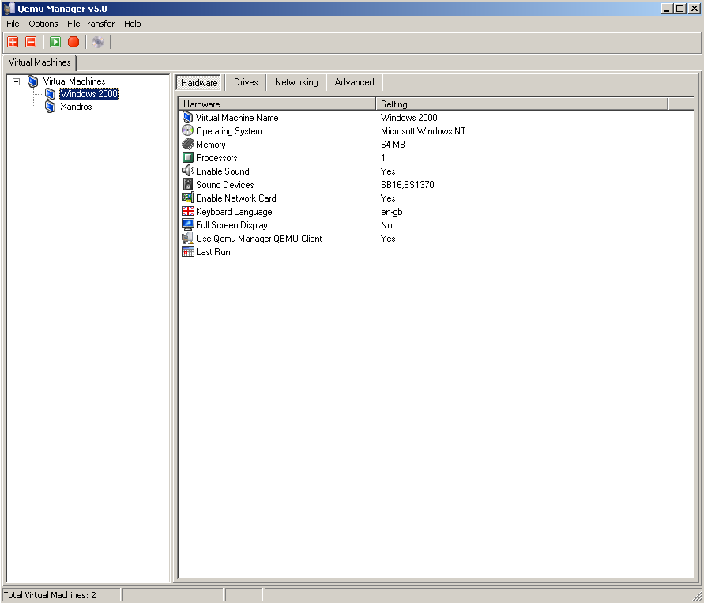

Slide 13
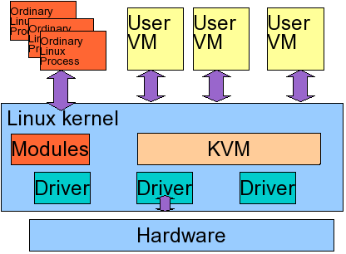
KVM Overview

Slide 14
Various links that helped me
Preparing the software with jeos (first application boot)‏
http://doc.ubuntu.com/ubuntu/serverguide/C/jeos-preparing-firstboot.html

Slide 15
Installing kvm/qemu on my desktop
sudo apt-get install kvm virt-manager libvirt-bin
sudo gpasswd -a mariuz libvirtd
virt-manager
and this example is for debian
http://www.debian-administration.org/articles/545
http://mapopa.blogspot.com/2008/08/installing-kvm-for-conference-for.html

Slide 16
Installing the packages
download the minimal je-os ubuntu install
http://cdimage.ubuntu.com/jeos/releases/hardy/release/
in my case i open it with ktorrent

Slide 17
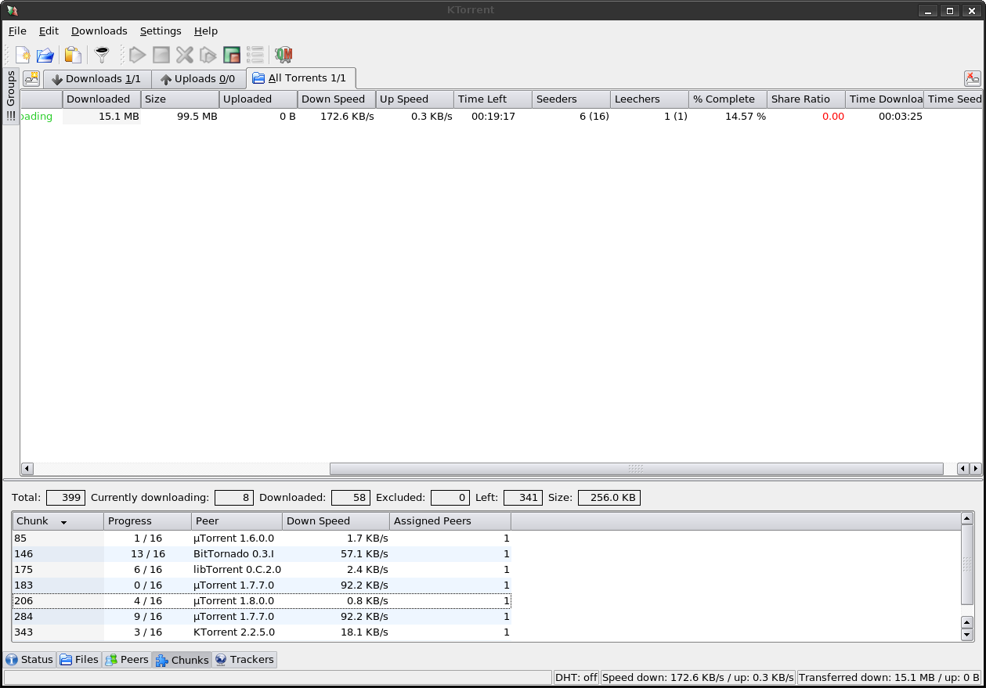

Slide 18
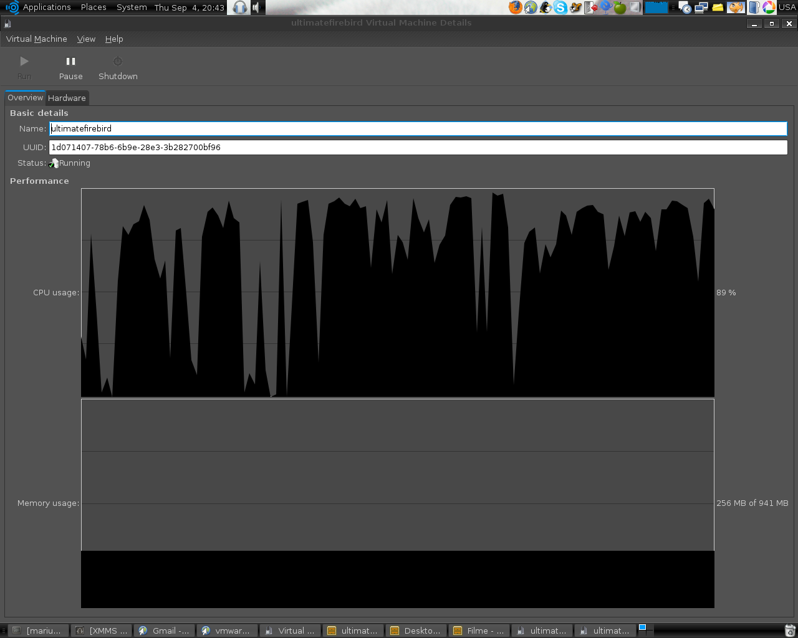
Here is virtual machine cpu monitor

Slide 19
Minimal Ubuntu + LXDE/XFCE Installation
Install Ubuntu base system with JeOS, and only install a command line-based system
In my case in have installed JEOS on an qemu virtual machine then i followed this tutorial
http://lxde.org/wiki/Ubuntu

Slide 20
I have added
$sudo apt-get -y install vim git-core php5-cli; sudo apt-get -y update
$sudo vi /etc/apt/sources.list.d/lxde.list
deb http://ppa.launchpad.net/lxde/ubuntu hardy main
deb-src http://ppa.launchpad.net/lxde/ubuntu hardy main
$sudo apt-get -y update
$sudo apt-get install xorg lxde gdm xfce4 ubuntu-gdm-themes
$sudo /etc/init.d/gdm start

Slide 21
or simpler
you can run this script
$git clone git://github.com/mariuz/firebird_scripts.git
$cd firebird_scripts
$sudo php lxde_install.php
voila minimal deskop and space used is ~ 400M , it doesn even needs compression

Slide 22
Next install firebird
$cd firebird_scripts
$php firebird_install.php
Next installs flamerobin + ibwebadmin
and the example database
$php flamerobin_install.php

Slide 23
Mono and firebird
sudo apt-get install mono-gmcs mono-gac mono-utils monodevelop monodoc-browser monodevelop-nunit monodevelop-versioncontrol monodoc-gtk2.0-manual libmono-firebirdsql1.7-cil

Slide 24
Mono 2.o build it from source
http://www.studentguru.gr/blogs/kingherc/archive/2008/05/22/how-to-mono-1-9-1-and-php-5-on-ubuntu-8-04-hardy.aspx

Slide 25
Installed and compiled the firebird net client 2.5
but seems that it works only with 2.5 from now on
http://www.nabble.com/Example-from-Mono---FirebirdSql.Data.-Are-you-missing-an-assembly-reference-to19456025.html

Slide 26
TO DO:
Install phpGTK
http://gtk.php.net/manual/en/tutorials.installation.php
Test maemo appliance and test firebird+nginx php on it
Install Maemo SDK
http://maemo-hackers.org/apt/pool/main/p/php/php_5.2.4-0mh4.diff.gzdeb
http://www.ptlug.org/wiki/Howto_Installing_Maemo_SDK_4
http://maemovmware.garage.maemo.org/#how_to_use_it
http://inz.fi/blog/2007/10/16/new-php-package-for-maemo/#comments

Slide 27
TO DO
Create firebird package for maemo
http://wiki.maemo.org/Uploading_to_Extras
Install other applications
http://www.mono-live.com/
:install mojoportal for linux / firebird
http://www.mojoportal.com/workingwiththesourcecodeinmonodevelop.aspx

