Slide 1
Firetube - Concept
  Scaling Firebird for web2.5

Slide 2
What is web2.0?
Nobody really knows what it means
But i think of : REST and JSON
Ajax - rich Internet application (gmail/docs)
Folksonomies (collaborative tagging, social classification, social indexing, and social tagging)

Slide 3
In my Browser history I have these examples : docs.google.com wiki.ubuntu.com , google.com/reader,digg.com , youtube.com
It's all about Read/Write web - users are the main content uploaders/creators not the editors or the movie directors

Slide 4
We will try to implement :
1.Video sharing site similar to youtube.com
2.Scalable to millions of users but it can be scaled
down to thousands

Slide 5
Tools Used:
  Firebird 2.x
  Ubuntu
  Nginx as webserver
  Php+Fast-cgi(5.2.x)
  Ffmpeg + Mencoder
  CakePhp as Framework

Slide 6
Other Tools :
  Rsync
  Ssh
  Apc php extension
  Xdebug for profiling
  Git - for code repository and config

Slide 7
Why nginx
Nginx is a fast and efficient web server. It can be configured to serve out files or be a reverse proxy depending on your application. What makes this web server different from Apache is the overall efficiency of the daemon, the number of configuration options and how easy it is to setup.
Nginx was written by Igor Sysoev for rambler.ru, Russia's second-most visited website, where it has been running in production for over two and a half years. Igor has released the source code under a BSD-like license.

Slide 8
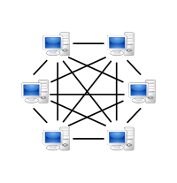
  Code for 100.000.000 users in mind
  and 100.000 servers ~
  Start with 10.000 users / server and each node is described as above
  Share nothing arhitecture
  P2P model (bittorent/dc++)

Slide 9
BitTorrent killed Akmai
  BitTorrent, takes a radical approach to internet decentralization.
  1.Every client is also a server;
  2.Files are broken up into fragments that can be served from multiple locations,

Slide 10
Power to the graphs edges
  Transparently harnessing the network of downloaders to provide both bandwidth and data to other users.
  The more popular the file, in fact, the faster it can be served,
  as there are more users providing bandwidth and fragments of the complete file.

Slide 11
a key Web 2.0 principle
the service automatically gets better the more people use it.
While Akamai must add servers to improve service,
Peer-to-peer — an architecture where there is no special machine or machines that provide a service or manage the network resources.
Instead all responsibilities are uniformly divided among all machines, known as peers.
Peers can serve both as clients and servers the service acts primarily as an intelligent broker,
connecting the edges to each other and harnessing the power of the users themselves.

Slide 12
Cluster
Node 1
Cluster
Node1000
Cluster
Node10000
Cluster
Node1001

Slide 13
EC2@home ClusterNodes are kvm guests
VCluster
Node 1
VCluster
Node1000
Guest - Real Server with kvm

Slide 14
Nginx+
Movie .flv or .ogg
Fastcgi (cakephp)
Firebird 2.x
Job Processor
Ffmpeg
mencoder

Slide 15
Why kvm ? :
  Is included by default in Ubuntu/Fedora
  Is better than xen http://blog.codemonkey.ws/2008/05/truth-about-kvm-and-xen.html
  Is faster than xen/vmware/virtualbox http://www.phoronix.com/scan.php?page=article&item=ubuntu_virt_benchmarks&num=1

Slide 16
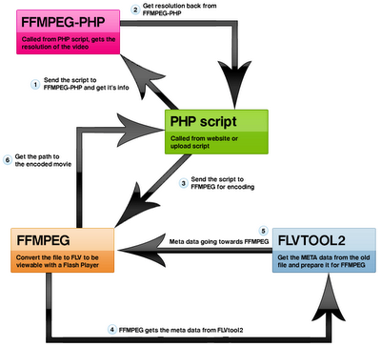
Basic transcode options with ffmpeg php class http://sourceforge.net/projects/phpvideotoolkit

Slide 17

To fully appreciate Nginx, the web server, it helps to understand Batman, the comic book character.
Batman is fast. Nginx is fast. Batman fights crime. Ngine fights wasted CPU cycles and memory leaks. Batman performs well under pressure. Nginx, for its part, excels under heavy server loads.
But Batman would be almost nothing without the Batman utility belt.

Slide 18
Installing Nginx
first you need git-core and php-cli
$sudo apt-get install git-core php5-cli
$cd /opt/build
$git clone git://github.com/mariuz/firebird_scripts.git
$cd firebird_scripts
$sudo php nginx-build.php
if all ok press control-C at the end

Slide 19
Install Firebird 2.1
This will install firebird2.1 super server on hardy/intrepid
$sudo php firebird-install.php

Slide 20
Installing ffmpeg
$sudo php ffmpeg_build.php
$sudo php ffmpeg-php_install.php

Slide 21
To clone the code on local machine $cd /opt/nginx/html
$git clone git://github.com/mariuz/firetube.git

Slide 22
What is imported
Cakephp
Simplehtmldomparser
A simple PHP HTML DOM parser written in PHP5, supports invalid HTML, and provides a very easy way to handle HTML elements
Think jQuery for php
Phpvideotoolkit

Slide 23
Database Partitioning idea
Run On nodes tables
select userid, clusterid from user where user = 'fudo'
response userid=10.001 clusterid =2
then run the query on the node 2
select * from movies where userid = 10.001
response frodo.flv

