Slide 1


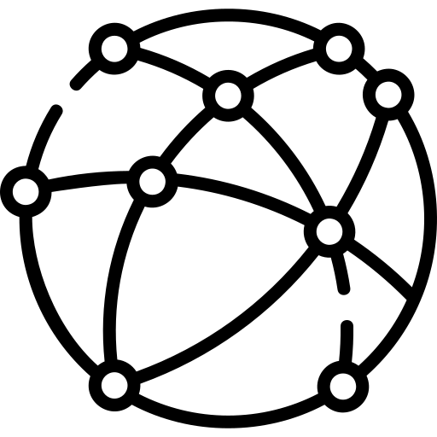







Network generation
Network management
Additional features
Simulation model (Mesa, AgentPy, custom, ...)
p2n.Actor
p2n.Environment
.actors
Network export (unipartite & bipartite)
Micro-level data, network models, etc.
p2n.Creator
.graph
p2n.LocationDesigner
p2n.NetworkInspector (visualization etc.)
.locations
p2n.Location

