Slide 1
SciPy

Slide 2
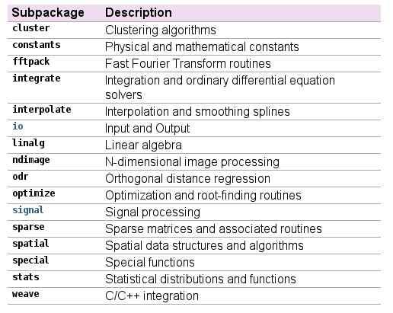
Intro to SciPy
SciPy is a collection of numerical algorithms that is used with NumPy
We'll give a brief overview of the algorithms and then look at the functions.
(docs.scipy.org)

Slide 3
Conventions
The SciPy docs recommend loading the various modules as:
  import numpy as np
  import scipy as sp
  import matplotlib as mpl
  import matplotlib.pyplot as plt
Each subpackage must be imported separately:
  from scipy import linalg, optimize
  Note that some popular functions are available in the main scipy namespace

Slide 4
Getting Help
In addition to the help(), there is a sp.info() function that outputs things without a pager
Python also has a dir() function that lists the names a module defines

Slide 5
Caveats
Every numerical method has its own strengths, weaknesses, and assumptions
  You should research a bit to understand what these methods are doing under the hood
  Many of the SciPy methods are wrappers to well-tested implementations of algorithms that were developed many years (decades even) ago.

Slide 6
Integration

Slide 7
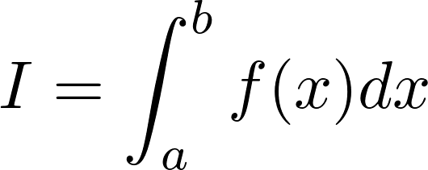
Numerical Integration
We want to compute:
We can imagine 2 situations
  Our function f(x) is defined only at a set of (possibly regularly spaced) points
    Generally speaking, asking for greater accuracy involves using more of the discrete points in the approximation for I
  We have an analytic expression for f(x)
    We have the freedom to pick our integration points, and this can allow us to optimize the calculation of I
Any numerical integration method that represents the integral as a (weighted) sum at a discrete number of points is called a quadrature rule
Fixed spacing between points: Newton-Cotes quadrature

Slide 8










Gridded Data
Discretized data is represented at a finite number of locations
  Integer subscripts are used to denote the position (index) on the grid
  Structured/regular: spacing is constant
  Data is known only at the grid points:

Slide 9
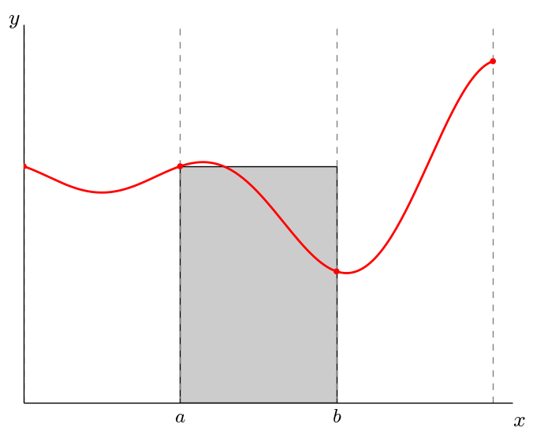
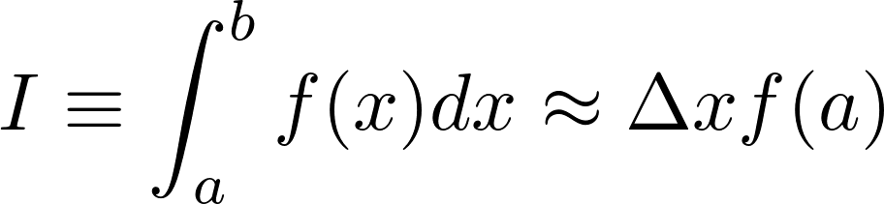
Numerical Integration
Simplest case: piecewise constant interpolant (rectangle rule)

Slide 10
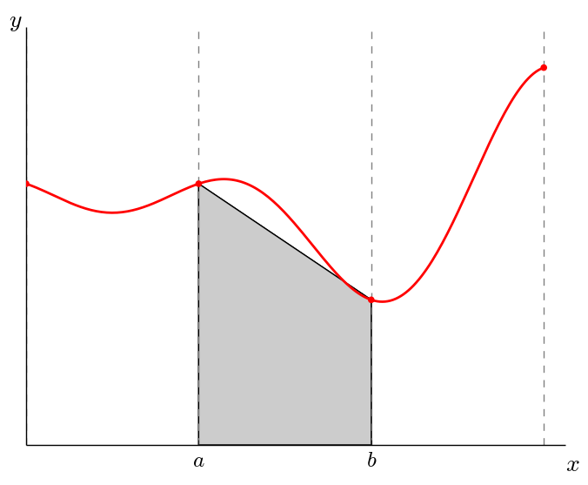
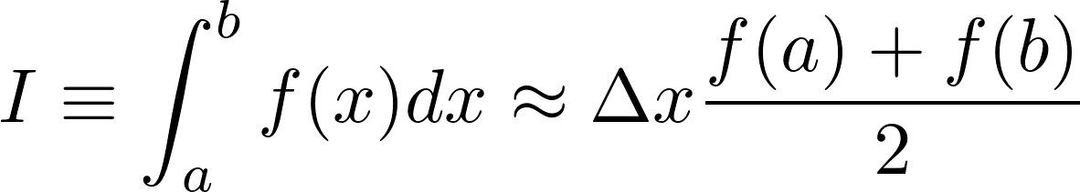
Numerical Integration
One step up: piecewise linear interpolant (trapezoid rule)
This is just the area of a trapezoid

Slide 11
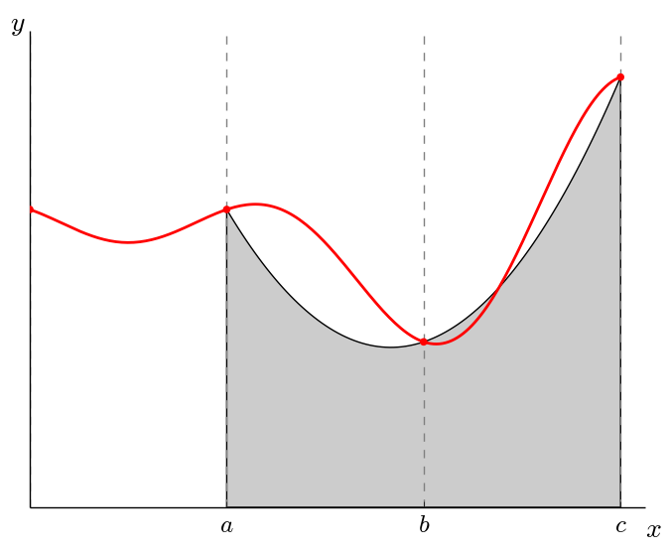
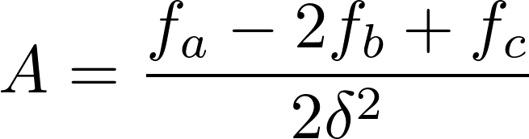
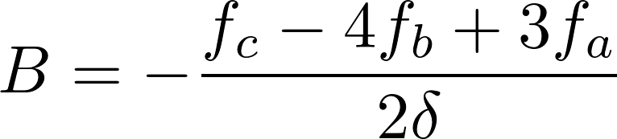

Numerical Integration
Piecewise quadratic interpolant (Simpson's rule)
  3 unknowns and 3 points
  Solving:

Slide 12






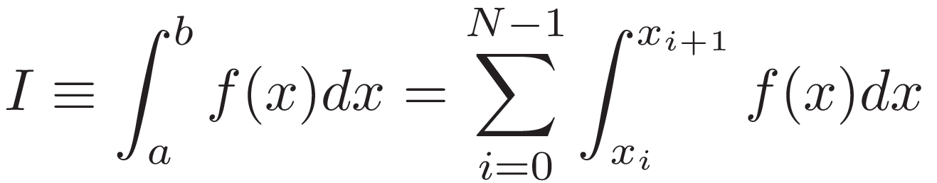
Compound Integration
Break interval into chunks
Integral over a single slab

Slide 13
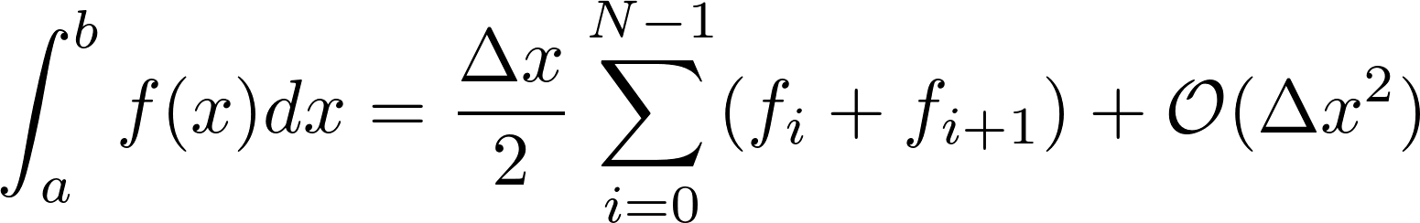
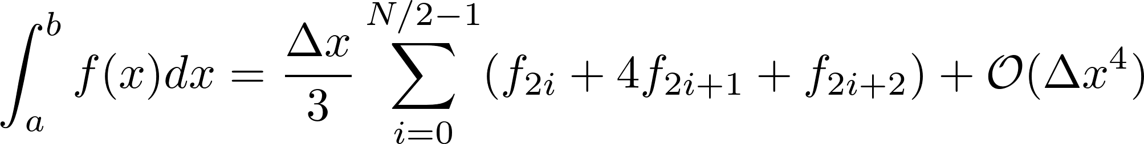
Compound Integration
Compound Trapezoidal
Compound Simpson's
  Integrate pairs of slabs together (requires even number of slabs)

Slide 14
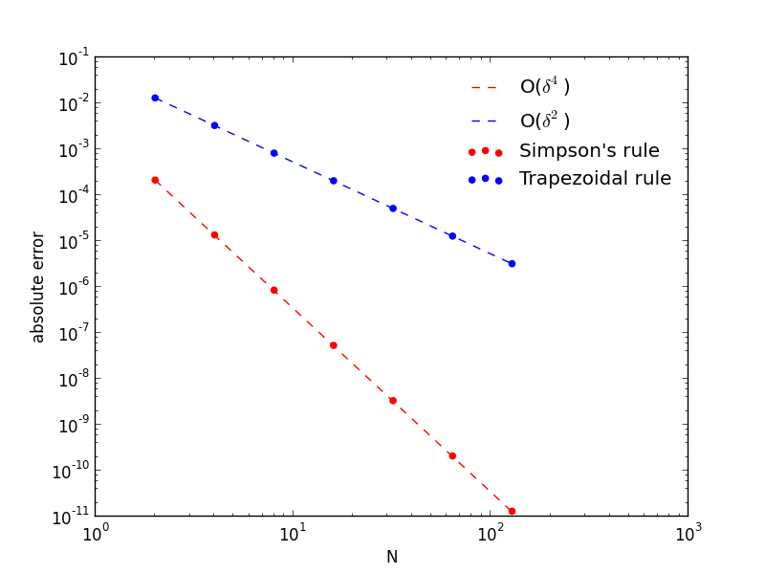
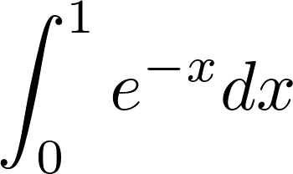
Compound Integration
Always a good idea to check the convergence rate!

Slide 15
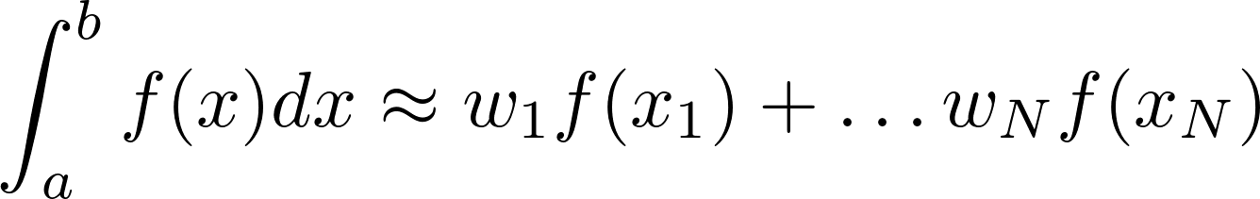
Gaussian Quadrature
Instead of fixed spacing, what if we strategically pick the spacings?
  We want to express
  w's are weights. We will choose the location of points xi

Slide 16
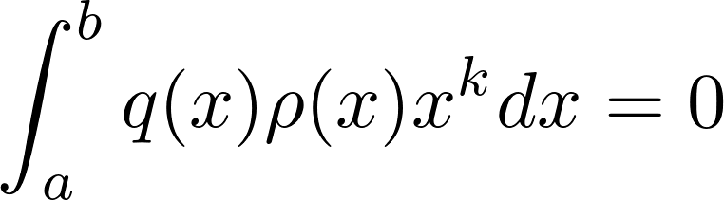
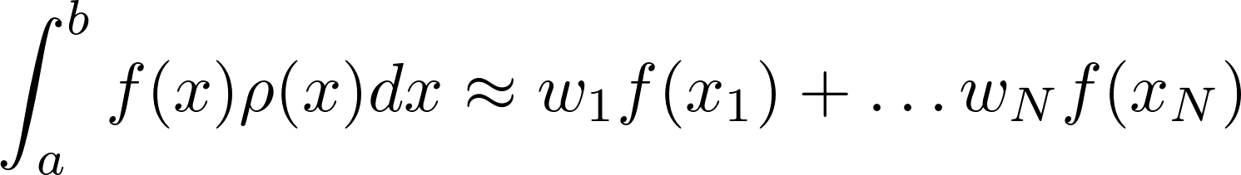
Gaussian Quadrature
(Garcia, Ch. 10)
Gaussian quadrature: fundamental theorem
  q(x) is a polynomial of degree N, such that
  k = 0, ..., N-1 and ρ(x) is a specified weight function.
  Choose x1, x2, ... xN as the roots of the polynomial q(x)
  We can write
  and there will be a set of w's for which the integral is exact if f(x) is a polynomial of degree < 2N!

Slide 17
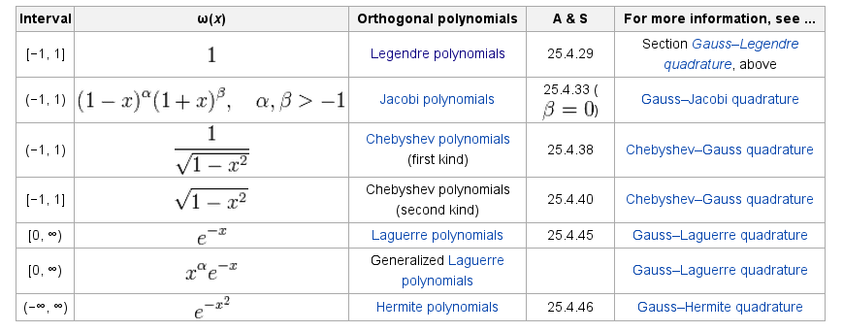
Gaussian Quadrature
Many quadratures exist:
In practice, the roots and weights are tabulated for these out to many numbers of points, so there is no need to compute them.
(Wikipedia)

Slide 18
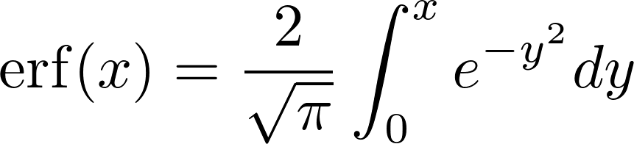
Gaussian Quadrature
(Garcia, Ch. 10)
Example:
erf(1) (exact): 0.84270079295
3-point trapezoidal: 0.825262955597 -0.017437837353
3-point Simpson's: 0.843102830043 0.000402037093266
3-point Gauss-Legendre: 0.842690018485 -1.0774465204e-05
Notice how well the Gauss-Legendre does for this integral.

Slide 19
Interpolation

Slide 20
Interpolation
We frequently have data only at a discrete number of points
  Interpolation fills in the gaps by making an assumption about the behavior of the functional form of the data
Many different types of interpolation exist
  Some ensure no new extrema are introduced
  Some match derivatives at end points
  ...
Generally speaking: larger number of points used to build the interpolant, the higher the accuracy in a local region
  Pathological cases exist
  You may want to enforce some other property on the form of the interpolant

Slide 21


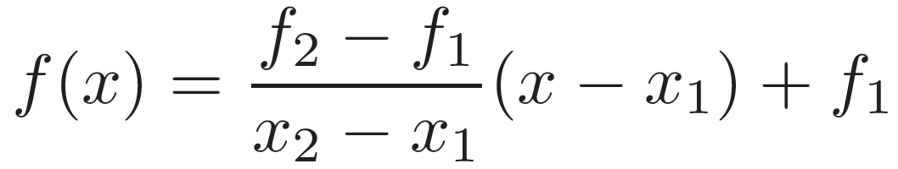
Linear Interpolation
Simplest idea—draw a line between two points
  Exactly recovers the function values at the end points

Slide 22
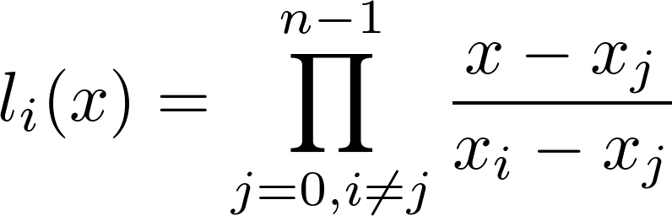
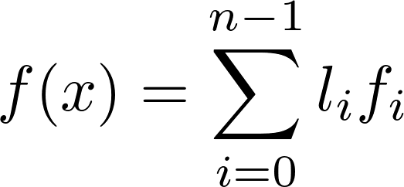
Lagrange Interpolation
General method for building a single polynomial that goes through all the points (alternate formulations exist)
Given n points: x₀, x₁, ... , x_{n-1} , with associated function values: f₀, f₁, ... , f_{n-1}
  construct basis functions:
    Basis function l_{i} is 0 at all x_{j} except for x_{i} (where it is 1)
  Function value at x is:

Slide 23
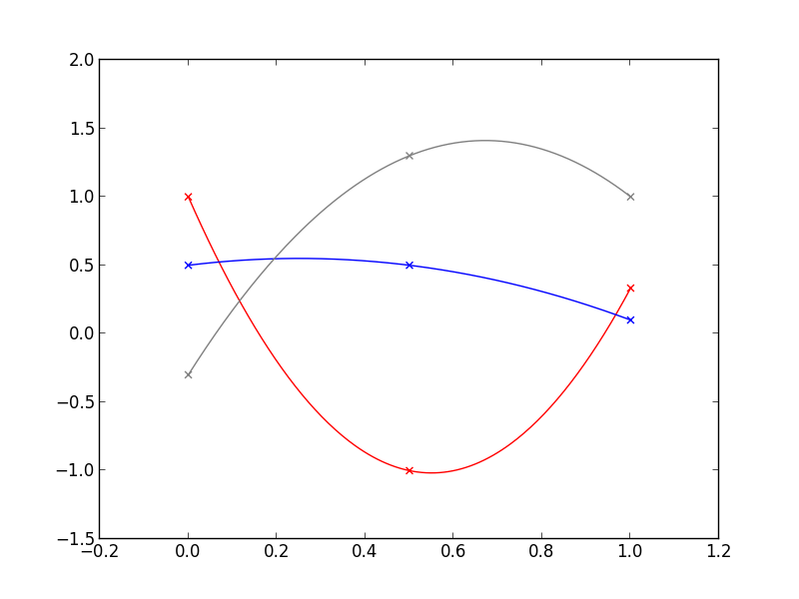
Lagrange Interpolation
Quadratic Lagrange polynomial:

Slide 24
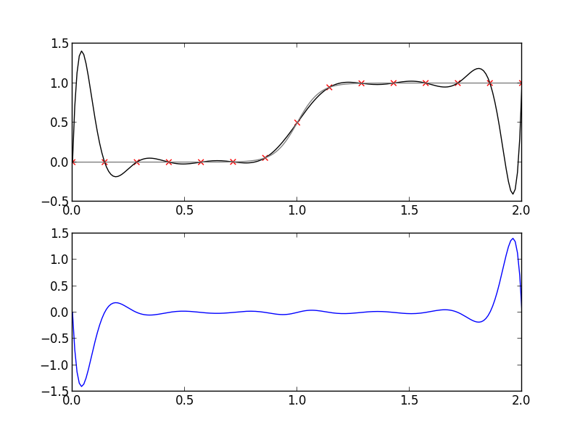
Lagrange Interpolation
High-order is not always better: Interpolation through 15 points sampled uniformly from tanh(). The error is shown below.

Slide 25
Splines
So far, we've only worried about going through the specified points
Large number of points → two distinct options:
  Use a single high-order polynomial that passes through them all
  Fit a (somewhat) high order polynomial to each interval and match all derivatives at each point—this is a spline
Splines match the derivatives at end points of intervals
  Piecewise splines can give a high-degree of accuracy
Cubic spline is the most popular
  Matches first and second derivative at each data point
  Results in a smooth appearance
  Avoids severe oscillations of higher-order polynomial

Slide 26
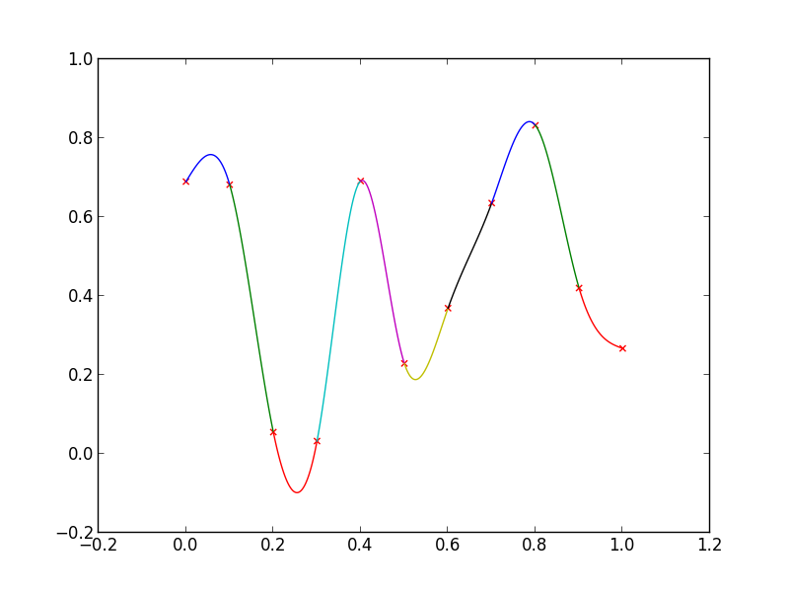
Cubic Splines

Slide 27
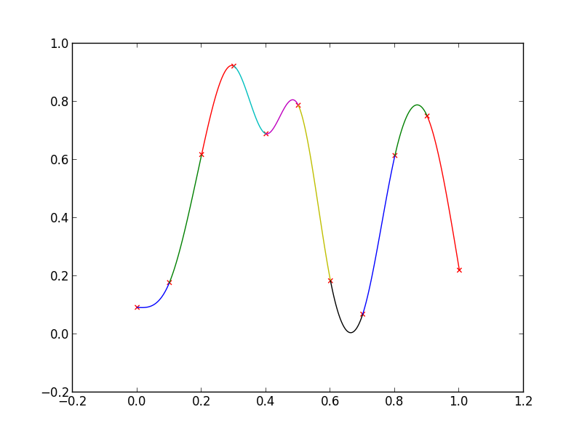
Cubic Splines
Note that the splines can overshoot the original data values

Slide 28
Cubic Splines
Note: cubic splines are not necessarily the most accurate interpolation scheme (and sometimes far from...)
But, for plotting/graphics applications, they look right

Slide 29
Root Finding

Slide 30


Root Finding
Basic methods can be understood by looking at the function graphically
  Function f(x) has a zero at x⋆
  Note the sign of f(x) changes at the root

Slide 31

Bisection
Simplest method: bisection
  Evaluate at x₁ and x₂ : f(x₁) and f(x₂)
  If these are different signs, then the root lies between them
  Evaluate at the midpoint: x_{m} = (x₁ + x₂)/2 getting f(x_{m})
  The root lies in one of the two intervals—repeat the process

Slide 32
Bisection

Slide 33
Bisection
Need two initial points (guesses) that you believe bound the root
  If there are two roots in-between, then you are in trouble
  Some pathological cases: e.g. f(x) = x²
Convergence can be slow—each iteration reduces the error by a factor of 2

Slide 34
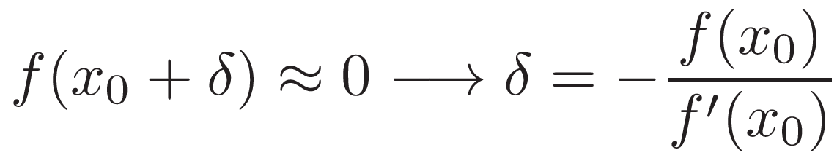

Newton-Raphson
If we know df/dx we can do better
  Start with an initial guess, x₀, that is “close” to the root
  Taylor expansion:
  If we are close, then
  Update
  We can continue, iterating again and again, until the change in the root < ε
Converges fast: usually only a few iterations are needed

Slide 35
Newton-Raphson
Requirements for good convergence:
  Derivative must exists and be non-zero in the interval near the root
  Second derivative must be finite
  x₀ must be close to the root
Can be used with systems (we'll see this later)
Multiple roots?
  Generally: try to start with a good estimate*
*not a guarantee

Slide 36
Newton-Raphson

Slide 37
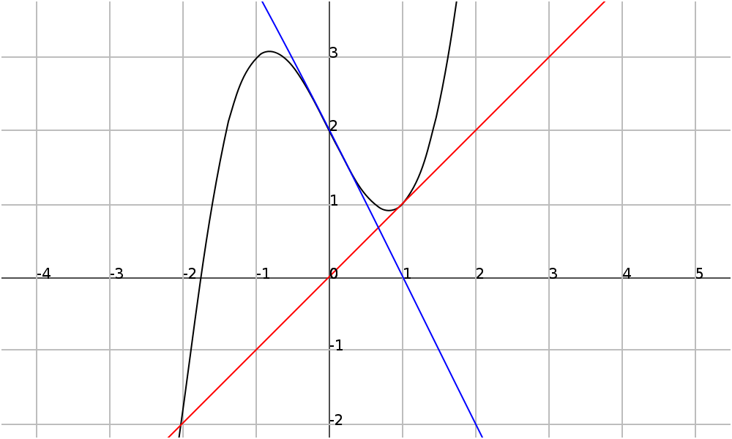
Newton-Raphson
(Wikipedia)
Consider f(x) = x³ { 2x +2
  Start with 0 → 1 → 0 → 1 → 0 ...
  Cycle
(wikipedia)

Slide 38
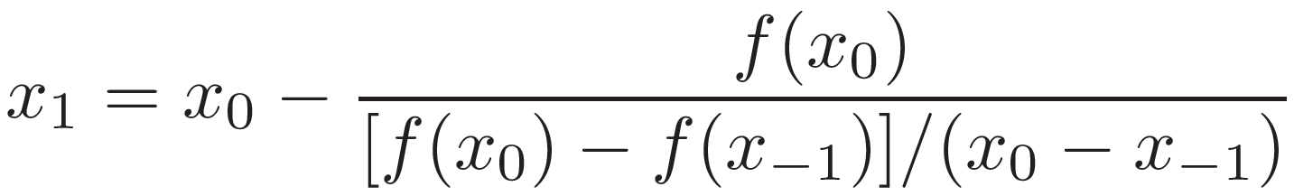
Secant Method
If we don't know df/dx , we can still use the same ideas
  We need to initial guesses: x_{{1} and x₀
  Use approximate derivative
    Used when an analytic derivative is unavailable, or too expensive to compute (e.g. EOS)
Brent's method combines bisection, secant, and other methods to provide a very reliable method

Slide 39
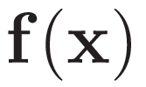


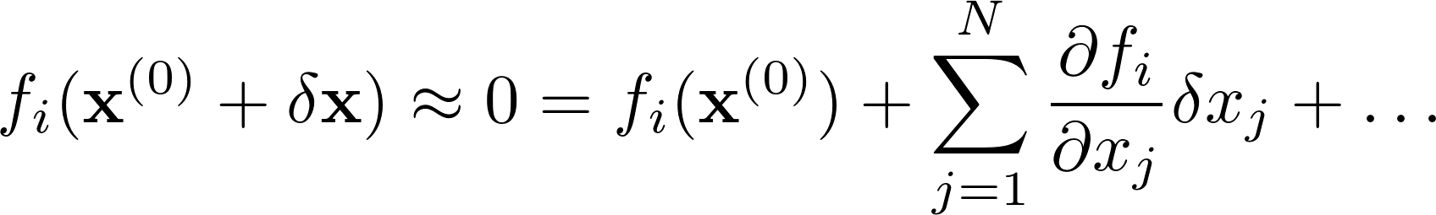

Multivariate Newton's Method
Imagine a vector function:
  Column vector of unknowns:
We want to find the zeros:
  Initial guess:
  Taylor expansion:
  Update to initial guess is:
    Cheaper to solve the linear system than to invert the Jacobian
  Iterate:
N equations + N unknowns
This is the Jacobian

Slide 40
ODEs

Slide 41
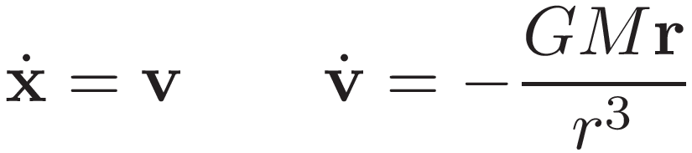
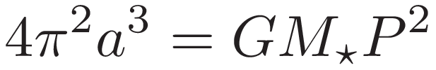
ODEs
Consider orbits around the Sun
  Another simple system that allows us to explore the properties of ODE integrators
  Kepler's law (neglecting orbiting object mass):
  Work in units of AU, solar masses, and years
    GM = 4 ¼²

Slide 42
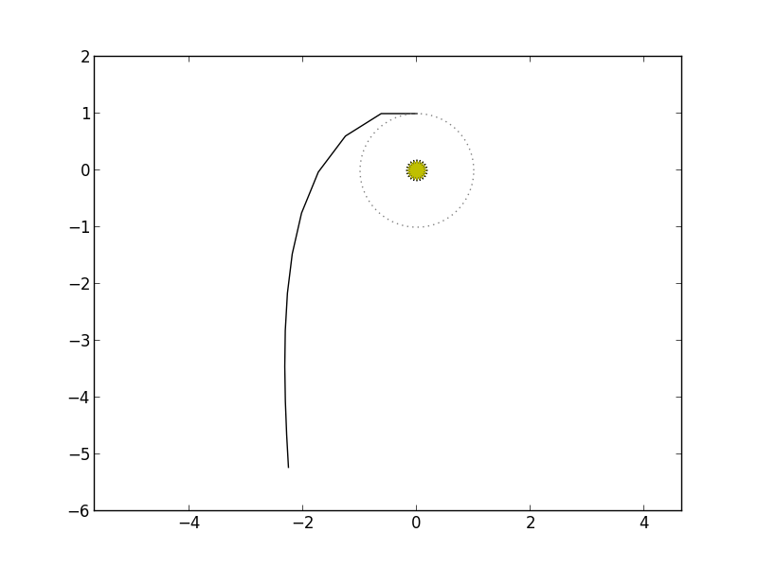

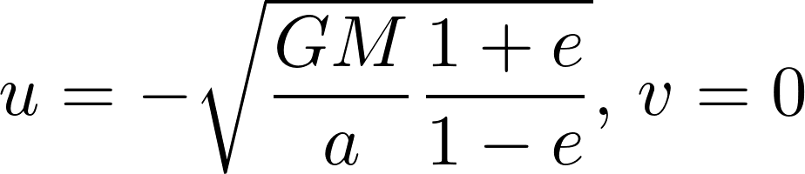
Orbits: Euler's Method
Simplest case: Euler's method
Need to specify a semi-major axis and eccentricity
Initial conditions:
  This is counter-clockwise orbiting
Our planet escapes—clearly energy is not conserved here!

Slide 43
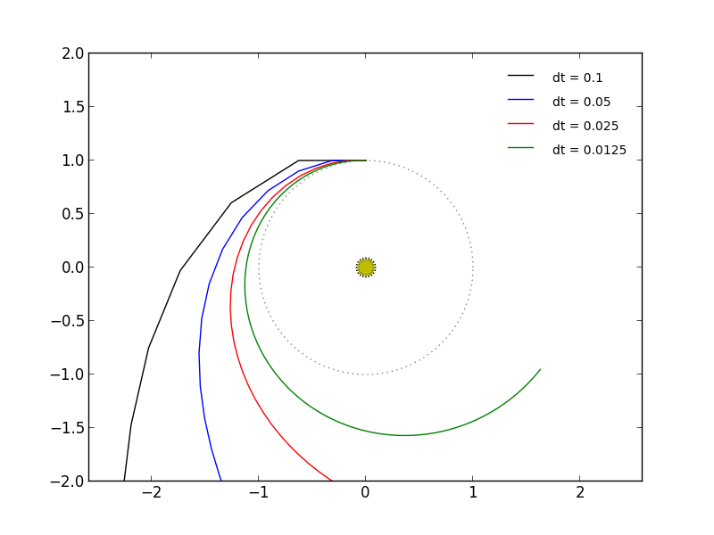
Orbits: Euler's Method
Things get better with a smaller timestep, but this is still first-order
Let's look at the code and see how small we need to get a closed circle

Slide 44
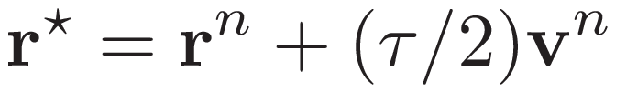
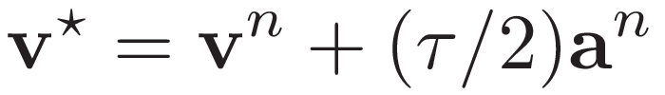

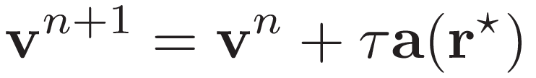
Higher-order Methods
Midpoint or 2nd order Runge-Kutta:
The updates are then:
This is third-order accurate (locally), to start things off, we do:

Slide 45
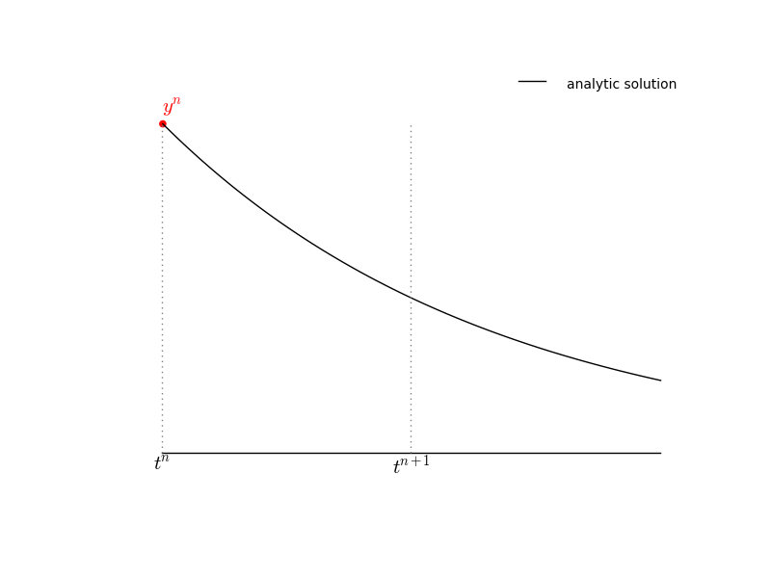
2nd-order Runge-Kutta

Slide 46
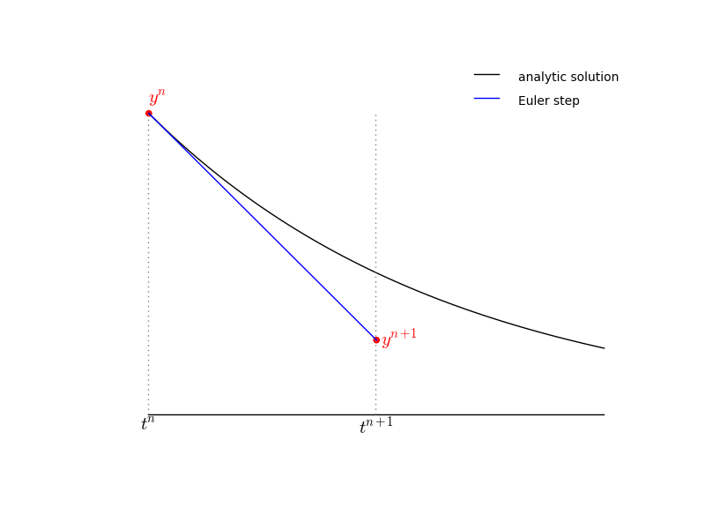
2nd-order Runge-Kutta

Slide 47
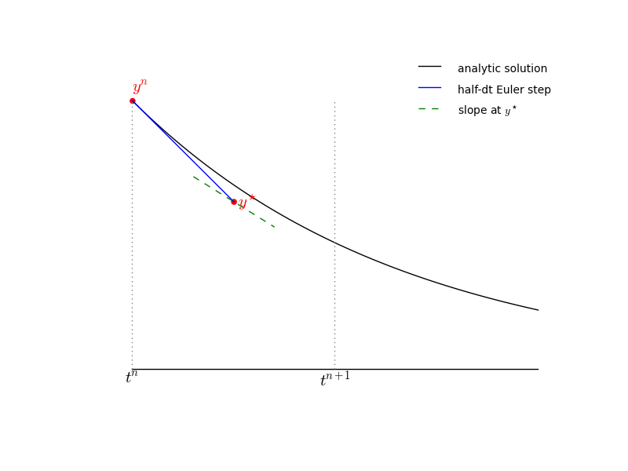
2nd-order Runge-Kutta

Slide 48
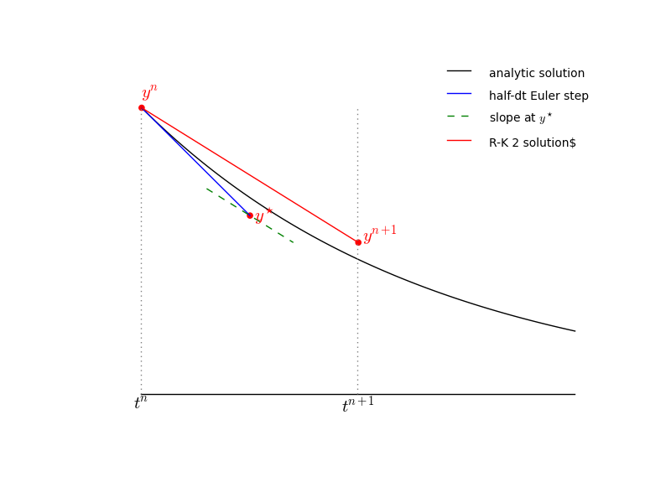
2nd-order Runge-Kutta

Slide 49





4th-order Runge-Kutta
One of the most popular methods is 4th-order Runge-Kutta
  Consider system:
  Update through ¿ :
Notice the similarity to Simpson's integration
Derivation found in many analysis texts

Slide 50
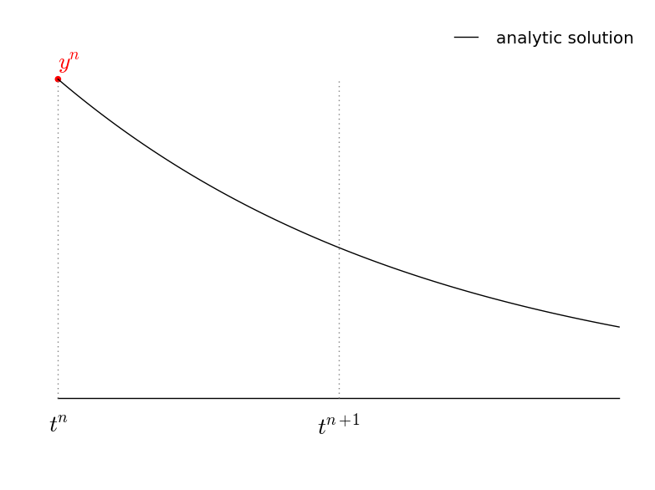
4th-order Runge-Kutta

Slide 51
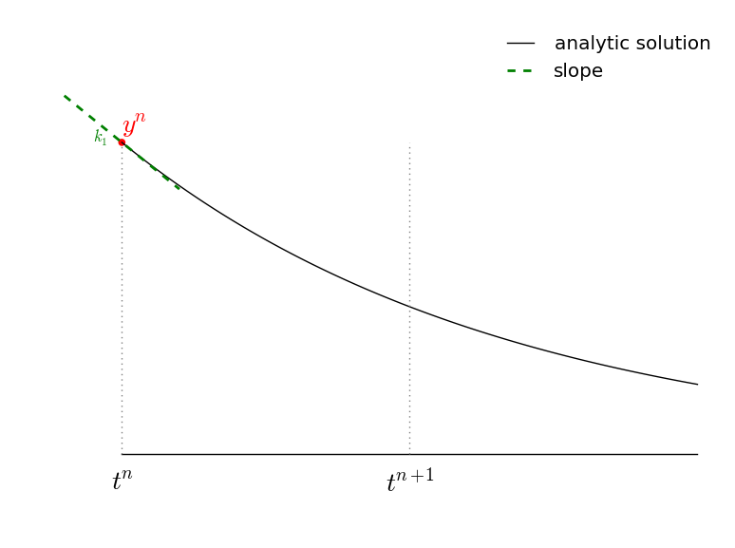
4th-order Runge-Kutta

Slide 52
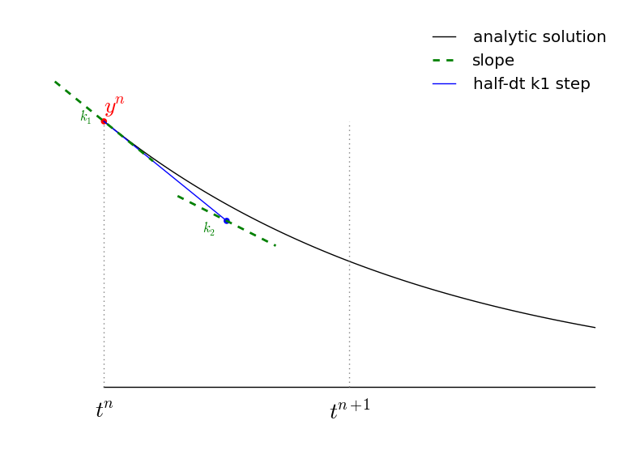
4th-order Runge-Kutta

Slide 53
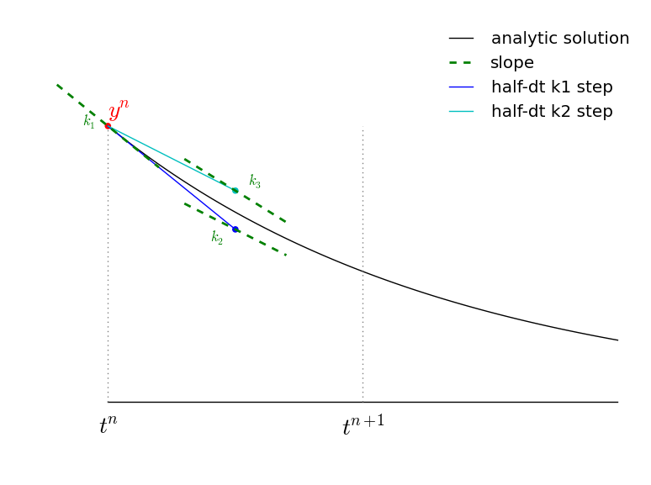
4th-order Runge-Kutta

Slide 54
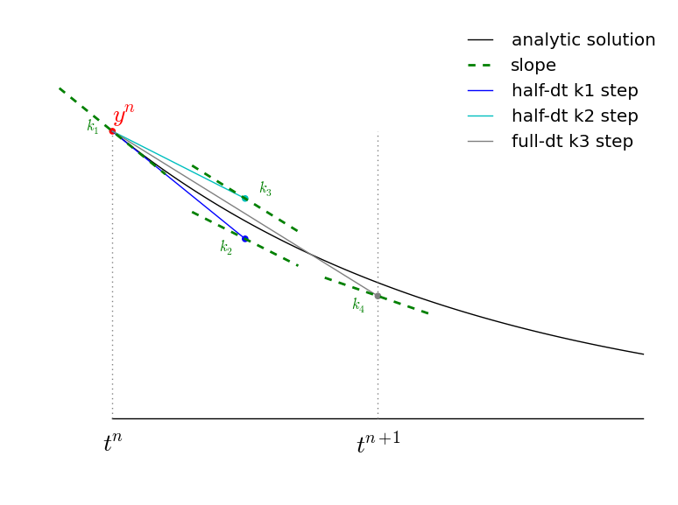
4th-order Runge-Kutta

Slide 55
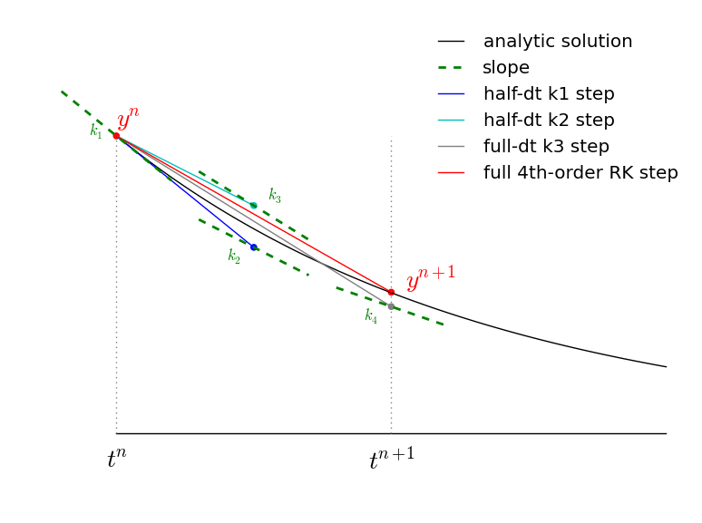
4th-order Runge-Kutta

Slide 56
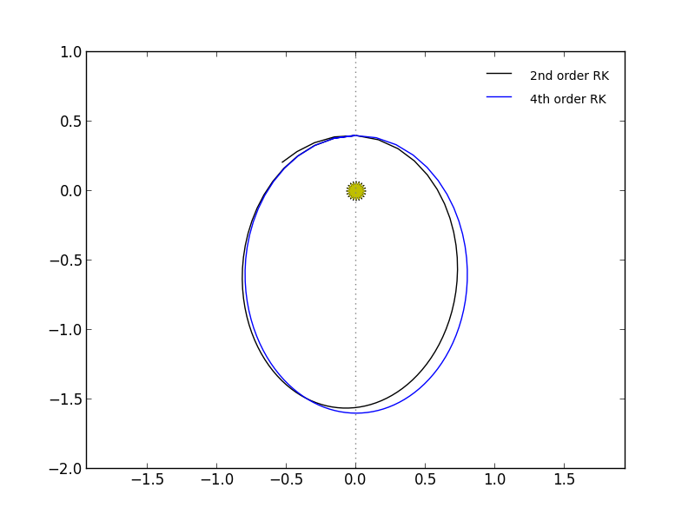
4th-order Runge-Kutta
This looks great! Let's look at the code...

Slide 57

4th-order Runge-Kutta
Even with a coarse timestep, RK4 does very well.

Slide 58
Adaptive Stepping
We need a smaller timestep where the solution changes most rapidly
  We can get away with large timesteps in regions of slow evolution
Monitoring the error can allow us to estimate the optimal timestep to reach some desired accuracy
Lot's of different techniques for this in the literature
  Take two half steps and compare to one full state
  Compare higher and lower order methods
Example from Garcia...

Slide 59

Ex: Highly Elliptical Orbit
Consider a highly elliptical orbit: a = 1.0, e = 0.95
  Sun-grazing comet
Just to get a reasonable-looking solution, we needed to use ¿ = 0.0005
This takes 2001 steps

Slide 60

Ex: Highly-Elliptical Orbit
Solutions with various uniform timesteps

Slide 61

Ex: Highly-Elliptical Orbit
Look at the total energy
  At perihelion, conservation is the worse
  Perihelion is where the velocity is greatest, and therefore the solution changes the fastest
We can take a larger timestep at aphelion than perihelion

Slide 62

Adaptive Stepping
Adaptive stepping, asking for ² = 10^{{7} , with initial timestep the same as the non-adaptive case (¿ = 0.005)
This takes only 215 steps

Slide 63

Adaptive Stepping
Energy conservation is now far superior

Slide 64

Adaptive Stepping
Timestep varies significantly over the evolution

Slide 65
Adaptive Stepping/Error Estimation
You should always perform some sort of error estimation
Specifying absolute and relative errors in the state variables ensures you know about the quality of the solution
The SciPy ODE packages can control all of this for you

Slide 66



Stiff Equations / Implicit Methods
Consider the ODE (example from Byrne & Hindmarsh 1986):
This has the exact solution:
  Looking at this, we see that there are two characteristic timescales for change, ¿₁ = 1 and ¿₂ = 10^{{3}
  A problem with dramatically different timescales for change is called stiff
Stiff ODEs can be hard for the methods we discussed so far
  Stability requires that we evolve on the shortest timescale

Slide 67
VODE
For stiff systems, robust integration packages exist.
VODE is a popular one (F77, but also in SciPy)
  Uses a 5th-order implicit method, with error estimation (alternately, a 15th order explicit method)
  Can either use a user-supplied Jacobian or compute one numerically
  Two types of tolerances: absolute and relative—these have a big influence on your solution
  Will do adaptive timesteps to reach your specified stop time

Slide 68
Fitting

Slide 69
Fitting Data
(discussion following Garcia)
We get experimental/observational data as a sequence of times (or positions) and associate values
  N points: (x_{i}, y_{i})
  Often we have errors in our measurements at each of these values: ¾_{i} for each y_{i}
To understand the trends represented in our data, we want to find a simple functional form that best represents the data—this is the fitting problem
  The scipy.optimize module offers routines to do fitting
We'll look at least squares fitting
  Two cases: general linear and nonlinear

Slide 70



Fitting Data
We want to fit our data to a function:
  Here, the a_{j} are a set of parameters that we can adjust
  We want to find the optimal set of a_{j} that make Y best represent our data
The distance between a point and the representative curve is
  Least squares fit minimizes the sum of the squares of all these errors
  With error bars, we weight each distance error by the uncertainty in that measurement, giving:
This is what we minimize

Slide 71






Ex: Linear Regression
Minimization: derivative of Â² with respect to all parameters is zero:
  Define:
Result: simple linear system to solve:

Slide 72


Goodness of the Fit
Typically, if M is the number of parameters (2 for linear), then N ≫ M
  Average pointwise error should be
  Number of degrees of freedom is N { M
    i.e. larger M makes it easier to fit all the points
    See discussion in Numerical Recipes for more details and limitations
  Putting these ideas into the Â² expression suggests that we consider
    If this is < 1, then the fit is good
    But watch out, ≪ 1 may also mean our errors were too large to begin with, we used too many parameters, ...

Slide 73


General Linear Least Squares
Garcia and Numerical Recipes provide a good discussion here
We want to fit to
  Note that the Y s may be nonlinear but we are still linear in the a s
  Here, Y_{j} are our basis set—they can be x^{j} in which case we fit to a general polynomial
Minimize:
Linear
system

Slide 74

Errors in Both x and y
Depending on the experiment, you may have errors in the dependent variable
  For linear regression, our function to minimize becomes:
    Denominator is the total variance of the linear combination we are minimizing:
    (think about propagation of errors)
We cannot solve analytically for the parameters, but we can use our root finding techniques on this.
  See NR and references therein for more details

Slide 75




General Non-linear Fitting
(Yakowitz and Szidarovszky)
Consider fitting directly to a function where the parameters enter nonlinearly:
  We want to minimize
  Set the derivatives to zero:
This is a nonlinear system—we use something like the multivariate root find

Slide 76
FFTs

Slide 77


Fourier Transform
Fourier transform converts a physical-space (or time series) representation of a function into frequency-space
  Equivalent representation of the function, new view into its behavior
  Inverse operation exists
You can think of F(k) as being the amount of the function f represented by a frequency k
For discrete data, the discrete analog of the Fourier transform gives:
  Amplitude and phase at discrete frequencies (wavenumbers)
  Allows for an investigation into the periodicity of the discrete data
  Allows for filtering in frequency-space

Slide 78


Discrete Fourier Transform
The discrete Fourier transform (DFT) operates on discrete data
  Usually we have evenly-spaced, real data
    E.g. a time-series from an experiment
    Simulation data for a velocity field
DFT transforms the N spatial/temporal points into N frequency points
  Transform:
  Inverse:
  This is the form used in NumPy, Garcia's text, and others

Slide 79
DFT Example
Implementing the discrete Fourier transform is simple
  Double sum: for each wavenumber, we sum over all the spatial points
def dft(f_n):
N = len(f_n)
f_k = numpy.zeros( (N), dtype=numpy.complex128)
for k in range(N):
for n in range(N):
f_k[k] += f_n[n]*numpy.exp(-2.0*math.pi*1j*n*k/N)
return f_k

Slide 80


Discrete Fourier Transform
What are the significance of the Re and Im parts?
  Recall that we are integrating with e^{{2¼ i k x}
  Euler's formula: e^{i x} = cos(x) + i sin(x)
  Real part represents the cosine terms, symmetric functions
  Imaginary part represents the sine terms, antisymmetric functions
  Can also think in terms of an amplitude and a phase
  If f_{n} is Real, then:
An FFT is simply an efficient way to implement the sums in the DFT

Slide 81
Python/NumPy's FFT
numpy.fft: http://docs.scipy.org/doc/numpy/reference/routines.fft.html
fft/ifft: 1-d data
  By design, the k=0, ... N/2 data is first, followed by the negative frequencies. These later are not relevant for a real-valued f(x)
  k's can be obtained from fftfreq(n)
  fftshift(x) shifts the k=0 to the center of the spectrum
rfft/irfft: for 1-d real-valued functions. Basically the same as fft/ifft, but doesn't return the negative frequencies
2-d and n-d routines analogously defined

Slide 82
Real Space vs. Frequency Space
Imagine transforming a real-valued function, f , with N data points
  The FFT of f will have N/2 complex data points
  Same amount of information in each case, but each complex point corresponds to 2 real numbers.
    This is a consequence of the analytic Fourier transform satisfying F({k) = F⋆(k) if f(x) is real
  Most FFT routines will return N complex points—half of them are duplicate, i.e. they don't add to the information content
    Often, there are specific implementations optimized for the case where the function is real (e.g. rfft)
  This affects normalization (note k=0 different)
This is also referred to as aliasing.
The maximum frequency, 1/ (2 ¢x) is called the Nyquist frequency

Slide 83

Normalization
When plotting, we want to put the physical scale back in, as well as make the correspondence to the continuous representation
  Wavenumber to frequency:
    In index space, the smallest wavelength is from one cell to the next, and the smallest frequency is 1/N
    Adding points to our data means we open up higher and higher frequencies
    Lowest frequency: 1/L; highest frequency: 1/Δx
  Amplitudes: rewrite inverse expression:
  Another interpretation: F_{k} / N ⇔ F_{k} dk
This is what we plot
This looks like the continuous form

Slide 84
FFT Tips
Different FFT codes make different assumptions about the normalization, etc.
Make sure the FFT does what you expect it should be working on a single-frequency sine first.

Slide 85
Gotyas...
Be careful about how you define the points
  The FFT considers the data without any spatial coordinates—it just considers distance in terms of the number of points
  Using the NumPy linspace() routine puts a point at both the start and end of the interval
    e.g., np.linspace(0, 1, 5) = [ 0. 0.25 0.5 0.75 1.]
    The FFT routine treats the first and last point as distinct
    If you define sin(2¼ x) on this data, the first and last point will be equivalent, and the FFT picks up an extra (non-periodic) signal
  You should do np.linspace(0, 1, 5, endpoint=False) instead

Slide 86
Linear Algebra

Slide 87
Numerical Linear Algebra
The basic problem we wish to solve is: A x = b
  It is generally simpler to solve this system directly than to first find the inverse and then multiply A⁻¹ b
Gaussian elimination works with a general matrix
  Faster methods exist for banded, sparse, symmetric, ... matrices
  Explicit code for doing Gaussian elimination posted on our course page. See any numerical text for a discussion of the algorithm.

Slide 88



Gaussian Elimination
The main, general technique for solving a linear system Ax=b is Gaussian-Elimination
  Doesn't require computing an inverse
  For special matrices, faster techniques may apply
Forward-elimination + Back-substitution steps
Round-off can cause issues and lead to systems that are unsolvable
  Example from Garcia
  in limit ² → 0

Slide 89



Gaussian Elimination
Worked ex (from Garcia):
Eliminate x1 from the second and third eqs
Eliminate x2 from the last eq.
Forward
elimination

Slide 90
Gaussian Elimination
/ \ / \
| 4.000 3.000 4.000 10.000 | | 2.000 |
| 2.000 -7.000 3.000 0.000 | | 6.000 |
| -2.000 11.000 1.000 3.000 | | 3.000 |
| 3.000 -4.000 0.000 2.000 | | 1.000 |
\ / \ /
/ \ / \
| 3.000 -4.000 0.000 2.000 | | 1.000 |
| 0.000 -4.333 3.000 -1.333 | | 5.333 |
| 0.000 8.333 1.000 4.333 | | 3.667 |
| 0.000 8.333 4.000 7.333 | | 0.667 |
\ / \ /
/ \ / \
| 3.000 -4.000 0.000 2.000 | | 1.000 |
| 0.000 8.333 4.000 7.333 | | 0.667 |
| 0.000 0.000 -3.000 -3.000 | | 3.000 |
| 0.000 0.000 5.080 2.480 | | 5.680 |
\ / \ /
/ \ / \
| 3.000 -4.000 0.000 2.000 | | 1.000 |
| 0.000 8.333 4.000 7.333 | | 0.667 |
| 0.000 0.000 5.080 2.480 | | 5.680 |
| 0.000 0.000 0.000 -1.535 | | 6.354 |
\ / \ /
/ \ / \
| 3.000 -4.000 0.000 2.000 | | 1.000 |
| 0.000 8.333 4.000 7.333 | | 0.667 |
| 0.000 0.000 5.080 2.480 | | 5.680 |
| 0.000 0.000 0.000 -1.535 | | 6.354 |
\ / \ /
Sometimes we do partial pivoting: swap rows to put the one with the largest (scaled) element on top.
solved x: [ 6.04615385 2.21538462 3.13846154 -4.13846154]
A.x: [ 2. 6. 3. 1.]

Slide 91
Caveats
Singular matrix
  If the matrix has no determinant, then we cannot solve the system
  Common way for this to enter: one equation in our system is a linear combination of some others
  Not always easy to detect from the start

Slide 92


Gaussian Elimination
Condition number
  Measure of how close to singular we are
  Think of it as a measure of how much x would change due to a small change in b (large condition number means G-E inaccurate)
  Formal definition:
    Further elucidation requires defining the norm
  Rule of thumb (Yakowitz & Szidarovszky, Eq. 2.31):
    If x⋆ is the exact solution and x is the computed solution, then
Simple ill-conditioned example: see G. J. Tee, ACM SIGNUM Newsletter, v. 7, issue 3, Oct. 1972, p. 19 (posted)

Slide 93

Tridiagonal Solve
Tridiagonal systems come up very often in physical systems
Efficient, O(N), algorithm derived from looking at the Gaussian elimination sequence (see e.g. Wikipedia):
  Standard data layout.
Note that a₀ = c_{N{1} = 0

Slide 94
LU Decomposition
LU Decomposition is an alternate to Gaussian elimination
  See Pang/Wikipedia for details
Basic idea:
  Find upper and lower triangular matrices such that A = LU
  Express Ax =b as Ly = b and Ux = y
  Most of the work in the solve is in doing the decomposition, so if you need to solve for many different b's, this is more efficient
This is often used in stiff integration packages

Slide 95
BLAS/LINPACK/LAPACK
BLAS (basic linear algebra subroutines)
  These are the standard building blocks (API) of linear algebra on a computer (Fortran and C)
  Most linear algebra packages formulate their operations in terms of BLAS operations
  Three levels of functionality:
    Level 1: vector operations (® x + y )
    Level 2: matrix-vector operations (® A x + ¯ y )
    Level 3: matrix-matrix operations (® A B + ¯ C )
  Available on pretty much every platform
    Some compilers provide specially optimized BLAS libraries (-lblas) that take great advantage of the underlying processor instructions
    ATLAS: automatically tuned linear algebra software

Slide 96
BLAS/LINPACK/LAPACK
LINPACK
  Older standard linear algebra package from 1970s designed for architectures available then
  Superseded by LAPACK
LAPACK
  The standard for linear algebra
  Built upon BLAS
  Routines named in the form xyyzzz
    x refers to the data type (s/d are single/double precision floating, c/z are single/double complex)
    yy refers to the matrix type
    zzz refers to the algorithm (e.g. sgebrd = single precision bi-diagonal reduction of a general matrix)
  Ex: single precision routines: http://www.netlib.org/lapack/single/
See Top 500 list

Slide 97

http://www.netlib.org/lapack/lug/node24.html

Slide 98
Python Support for Linear Algebra
Basic methods in numpy.linalg
  http://docs.scipy.org/doc/numpy/reference/routines.linalg.html
More general stuff in SciPy (scipy.linalg)
  http://docs.scipy.org/doc/scipy/reference/linalg.html
SciPy calls the LAPACK routines under the hood (in the SciPy docs, you can click on the “source” link to see the explicit calls).

Slide 99
Python Support for Linear Algebra
Numpy has a matrix type built from the array class
  * operator works element by element for arrays but does matrix product for matrices
  Vectors are automatically converted into 1×N or N×1 matrices
  Matrix objects cannot be > rank 2
  Matrix has .H, .I, and .A attributes (transpose, inverse, as array)
  See http://www.scipy.org/NumPy_for_Matlab_Users for more details
Some examples...
  http://www.scipy.org/Tentative_NumPy_Tutorial

