Slide 1
Course 2 Module 5 Programming Assignment Assignment is to ETL MIMIC data into the OMOP CONDITION_OCCURRENCE table
Detailed instructions with Slide Notes

Slide 2
ETL Steps
Assignment is to ETL MIMIC data into the OMOP CONDITION_OCCURRENCE table
Understand source/target data models
Profile source tables
Create ETL mappings
Write transformation code
Execute transformation
Perform data quality assessment
Package documentation
Notes:
This is an overview of the seven steps for ETL. The assignment focuses on Steps 1 thru 4 and Step 6
Place your finished deliverables into one or more slides. Add notes to provide additional information/context about what you have done

Slide 3
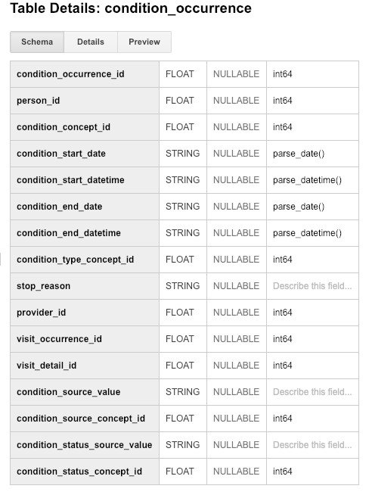
Step 1: Understand source/target data models
CONDITION_OCCURRENCE is the TARGET OMOP table.
Read the OMOP documentation about the type of data stored in CONDITION_OCCURRENCE and for three fields below that are in that table:
person_id
visit_occurrence_id
condition_source_value
Definitions of each variable from OMOP documentation in NOTES below.
Notes:
Paste into one or more slides, the key table or tables from MIMIC that hold data that can be used to fill in the OMOP CONDITION_OCCURRENCE table.
Choose the MIMIC table screenshots from this slide to indicate which MIMIC table or tables would be used in the ETL process. Delete the MIMIC tables that you will not use.
The definition of the variables from OMOP documentation:
person_id (int) - A foreign key identifier to the Person who is experiencing the condition. The demographic details of that Person are stored in the PERSON table. – This will be same as to SUBJECT_ID in MIMIC data.
visit_occurrence_id (int) - A foreign key to the visit in the VISIT_OCCURRENCE table during which the Condition was determined (diagnosed). – This is equivalent to HADM_ID in MIMIC data.
condition_source_value (Char (50)) -The source code for the Condition as it appears in the source data. This code is mapped to a Standard Condition Concept in the Standardized Vocabularies and the original code is stored here for reference. This will be exactly same as to MIMIC data (ICD_9code) .

Slide 4
Step 1: Understand source/target data models
CONDITION_OCCURRENCE is the TARGET OMOP table.
Select one or more MIMIC tables from the table screen shots on the next slides that you feel are most related to the three fields in CONDITION_OCCURRENCE.
Notes:
Paste into one or more slides, the key table or tables from MIMIC that hold data that can be used to fill in the OMOP CONDITION_OCCURRENCE table.
Choose the MIMIC table screenshots from this slide to indicate which MIMIC table or tables would be used in the ETL process. Delete the MIMIC tables that you will not use.

Slide 5
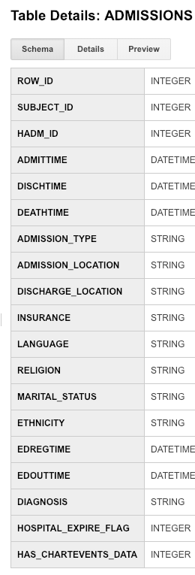
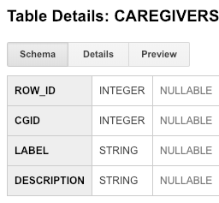
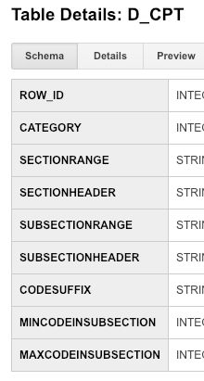
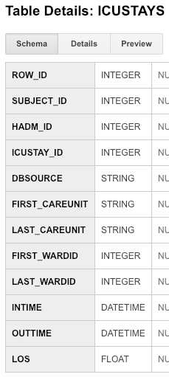
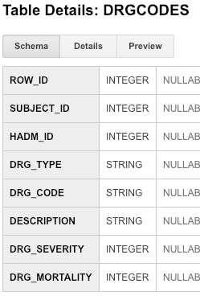
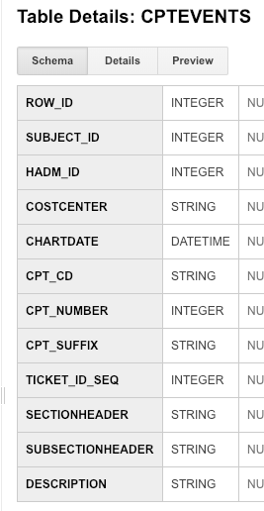
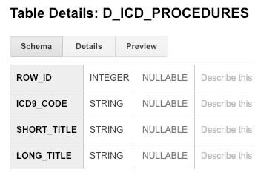
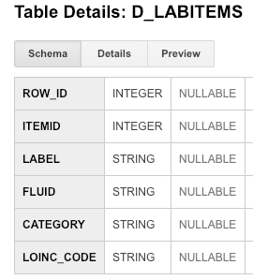
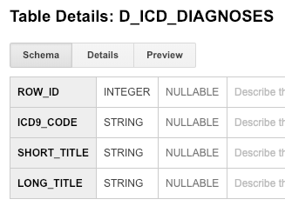
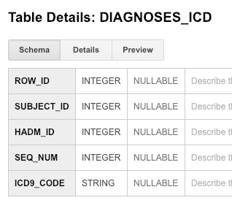
Use these screen captures (and next slide) to select one or more MIMIC tables that contain data for OMOP CONDITION_OCCURRENCE table
Notes:
Paste into one or more slides, the key table or tables from MIMIC that hold data that can be used to fill in the OMOP CONDITION_OCCURRENCE table.
Choose the MIMIC table screenshots from this slide to indicate which MIMIC table or tables would be used in the ETL process. Delete the MIMIC tables that you will not use.

Slide 6
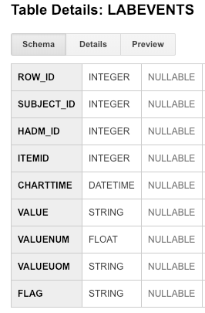
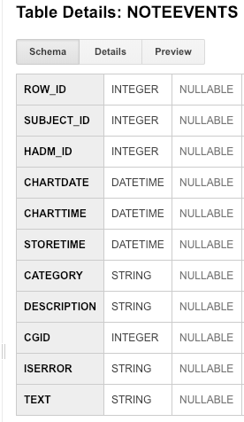
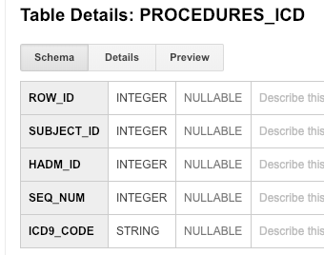
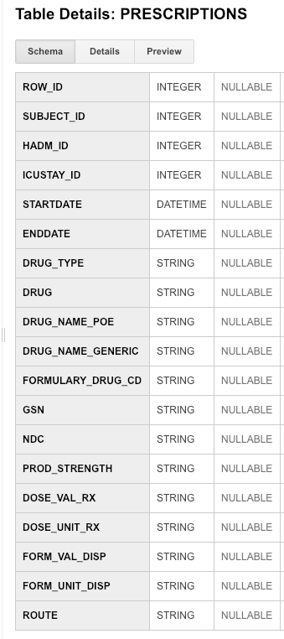
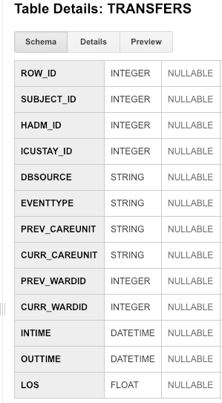
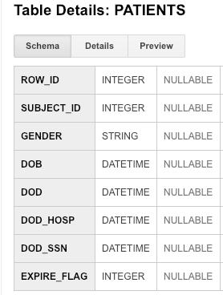
Use these screen captures (and previous slide) to select one or more MIMIC tables that contain data for OMOP CONDITION_OCCURRENCE table
Notes:
Paste into one or more slides, the key table or tables from MIMIC that hold data that can be used to fill in the OMOP CONDITION_OCCURRENCE table.
Choose the MIMIC table screenshots from this slide to indicate which MIMIC table or tables would be used in the ETL process. Delete the MIMIC tables that you will not use.

Slide 7
Step 1: Understand source/target data models
This is the main table I will use.
This one will be then joined to the target table so that ICD9 codes will be readable language.
Paste one or more MIMIC table(s) from the previous two slides that contain data for ETL into OMOP CONDITION_OCCURRENCE here!
Notes:
Paste into one or more slides, the key table or tables from MIMIC that hold data that can be used to fill in the OMOP CONDITION_OCCURRENCE table.
Choose the MIMIC table screenshots from this slide to indicate which MIMIC table or tables would be used in the ETL process. Delete the MIMIC tables that you will not use.

Slide 8
Step 2: Profile source table or tables
Using the White Rabbit profiling data from the 100 patient MIMIC database provided in the Assessment to comment on the distribution of the SUBJECT_ID field from one of the MIMIC tables selected in Step 1
DIAGNOSES_ICD
ID#41976 had 266 entries in Diagnoses_ID then follows with a longtail with most patients having more than one diagnosis.
ICD9_CODE 4019 (hyptertension), 42731 (atrial fibrillation), 5849(acute kidney failure) were the top 3 diagnoses.
Notes:
Use the White Rabbit data profiling Excel spreadsheet that is linked to the assignment to describe key profiling findings from the table or tables you identified in ETL Step 1. See rubric for the types of topics to include here.
ANSWERS
DIAGNOSES_ICD
ID#41976 had 266 entries in Diagnoses_ID then follows with a longtail with most patients having more than one diagnosis.
ICD9_CODE 4019 (hyptertension), 42731 (atrial fibrillation), 5849(acute kidney failure) were the top 3 diagnoses.

Slide 9
Step 3: Create ETL mappings
person_id (int) - A foreign key identifier to the Person who is experiencing the condition.– This will be same as to SUBJECT_ID in MIMIC data as this describes unique key identifier to the person and it is integers.
visit_occurrence_id (int) - A foreign key to the visit in the VISIT_OCCURRENCE table during which the Condition was determined (diagnosed). – This is equivalent to HADM_ID in MIMIC data as this is the unique admission id and it is integers.
condition_source_value (Char (50)) -The source code for the Condition as it appears in the source data. -This will be exactly same as to MIMIC data (ICD9_code) as this is what describes the diagnosis (condition) experienced by the patient in MIMIC data.
Notes:
For each MIMIC table or tables (one table per slide) from Step 1, paste the screenshot of the MIMIC table on left side. Show field mappings from the MIMIC table to the OMOP CONDITION_OCCURRENCE table using arrows. Only provide mappings to the OMOP person_id, visit_occurrence_id, and condition_source_value. One MIMIC table may provide a mapping to all three OMOP tables as shown here.
Provide an explanation for each mapping why the MIMIC field relates to the OMOP field you selected on the slide
Answer: The definition of the variables from OMOP documentation:
person_id (int) - A foreign key identifier to the Person who is experiencing the condition.– This will be same as to SUBJECT_ID in MIMIC data as this describes unique key identifier to the person and it is integers.
visit_occurrence_id (int) - A foreign key to the visit in the VISIT_OCCURRENCE table during which the Condition was determined (diagnosed). – This is equivalent to HADM_ID in MIMIC data as this is the unique admission id and it is integers.
condition_source_value (Char (50)) -The source code for the Condition as it appears in the source data. -This will be exactly same as to MIMIC data (ICD9_code) as this is what describes the diagnosis (condition) experienced by the patient in MIMIC data.

Slide 10
Step 4: Write transformation code
WITH person1 as (select distinct mp.subject_id as person_id,
mp.subject_id as person_source_value from mimic3_demo.PATIENTS mp),
person2 as (select distinct p1.person_id, p1.person_source_value
,mp.GENDER as gender_source_value
,CASE mp.GENDER
WHEN 'F' then 8532
WHEN 'M' then 8507
ELSE 0 END as gender_concept_id
from person1 p1 join mimic3_demo.PATIENTS mp on p1.person_id = mp.subject_id),
person3 as (select distinct p2.person_id, p2.person_source_value
,p2.gender_source_value, p2.gender_concept_id
,extract(year from mp.dob) as year_of_birth
,extract(month from mp.dob) as month_of_birth
,extract(day from mp.dob) as day_of_birth
,dob as birth_datetime
from person2 p2 join mimic3_demo.PATIENTS mp on p2.person_id = mp.subject_id),
person4 as (select distinct p3.person_id, p3.person_source_value
,p3.gender_source_value,p3.gender_concept_id
,p3.year_of_birth, p3.month_of_birth, p3.day_of_birth, p3.birth_datetime
,ma.ethnicity as race_source_value
,case ma.ethnicity
when 'WHITE' then 8527
when 'BLACK/AFRICAN AMERICAN' then 8516
when 'ASIAN' then 8515
when 'HISPANIC/LATINO-PUERTO RICAN' then 44814653
when 'HISPANIC OR LATINO' then 44814653
when 'UNKNOWN/NOT SPECIFIED' then 44814653
when 'OTHER' then 44814653
when 'AMERICAN INDIAN/ALASKA NATIVE FEDERALLY RECOGNIZED TRIBE' then 8657
when 'UNABLE TO OBTAIN' then 44814650
else 0 end as race_concept_id
from person3 p3 join mimic3_demo.ADMISSIONS ma on p3.person_id = ma.subject_id),
person as (select distinct p4.person_id, p4.person_source_value
,p4.gender_source_value,p4.gender_concept_id
,p4.year_of_birth, p4.month_of_birth, p4.day_of_birth, p4.birth_datetime
,p4.race_source_value, p4.race_concept_id
,ethnicity as ethnicity_source_value
,case ma.ethnicity
when 'WHITE' then 38003564
when 'BLACK/AFRICAN AMERICAN' then 38003564
when 'ASIAN' then 38003564
when 'HISPANIC/LATINO-PUERTO RICAN' then 38003563
when 'HISPANIC OR LATINO' then 38003563
when 'UNKNOWN/NOT SPECIFIED' then 44814653
when 'OTHER' then 38003564
when 'AMERICAN INDIAN/ALASKA NATIVE FEDERALLY RECOGNIZED TRIBE' then 38003564
when 'UNABLE TO OBTAIN' then 44814650
else 0 end as ethnicity_concept_id
from person4 p4 join mimic3_demo.ADMISSIONS ma on p4.person_id = ma.subject_id)
select * from person
Paste the SQL statements that transform data from one or more MIMIC tables into the three OMOP CONDITION_OCCURRENCE fields (patient-id, visit_occurrence_id, condition_source_value) into the Coursera Submission Site
Transformation code shown here is from the Course 2 videos showing transformation of MIMIC PATIENTS to OMOP PERSON
Notes:
Paste the SQL statements that transform data in one or more MIMIC tables to the correct column or columns in OMOP CONDITION_OCCURRENCE into the Coursera Submission Site.
ANSWER:
WITH diag1 as (select distinct md.subject_id as patient_id from mimic3_demo.DIAGNOSES_ICD md),
diag2 as (select distinct d1.patient_id
,md.HADM_ID as visit_occurrence_id
from diag1 d1 join mimic3_demo.DIAGNOSES_ICD md on d1.patient_id = md.subject_id),
diag3 as (select distinct d2.patient_id
, d2. visit_occurrence_id
, md.ICD9_CODE as condition_source_value
from diag2 d2 join mimic3_demo.DIAGNOSES_ICD md on d2.patient_id = md.subject_id)
select * from diag3

Slide 11
Step 5: Execute transformation code
Execute the ETL code from Step 4 but do not submit the output table.
Use the output table for Step 6.
There is no submission for this Step.
Notes:
Execute the ETL code from Step 4 but do not submit output table. Use output table for Step 6.
There is no submission for this Step.
SELECT patient_id, count(patient_id) as NUM_Diagnosis
from diag3
group by patient_id
order by NUM_Diagnosis desc
SELECT patient_id, count(visit_occurrence_id) as NUM_VISIT
from diag3
group by patient_id
order by NUM_VISIT desc

Slide 12
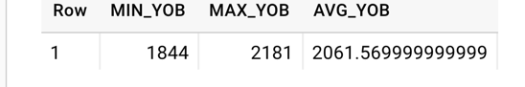
Step 6: Perform data quality assessment
Define, implement, execute one or more data quality measures.
Submit final DQ measure and an explanation why you created your measure(s).
Example output table from the Course 2 videos showing transformation of MIMIC PATIENTS to OMOP PERSON
OK to paste link to a GoogleDoc instead.
Notes:
Paste the output from your data quality SQL executed on the OMOP CONDITION_OCCURRENCE table generated in Step 5 into this slide.
OK to paste link to a GoogleDoc instead.

Slide 13
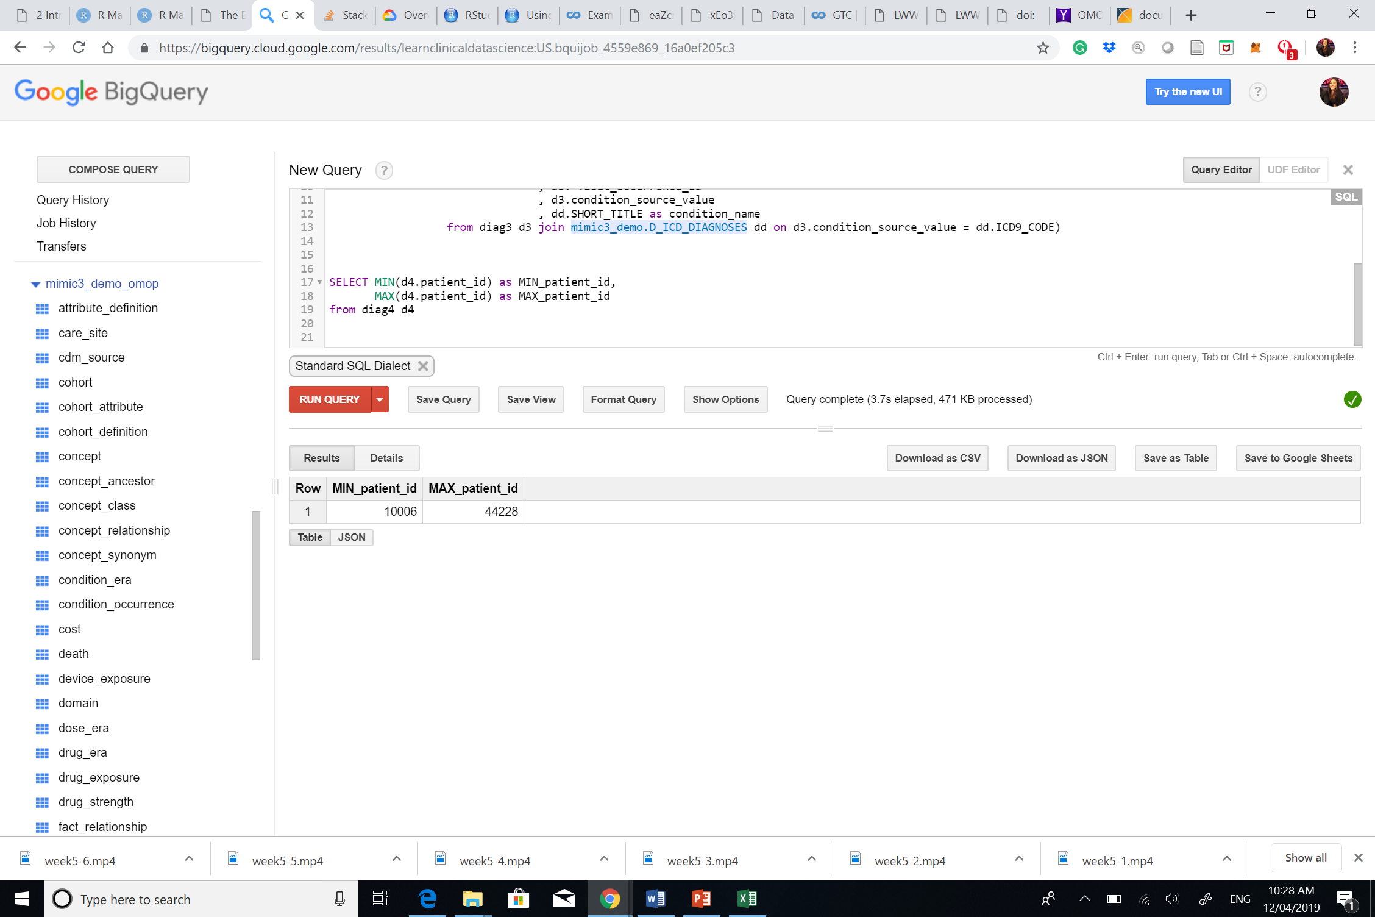
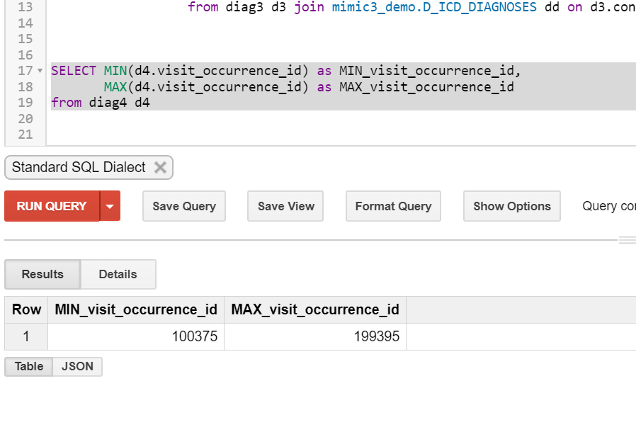
Data quality measures:
patient_id and visit_occurrence_id
Check if there are any negative values (which will be error as ther are no negative values in mimic subject_id and HADM_ID ). The range is as expected.

Slide 14
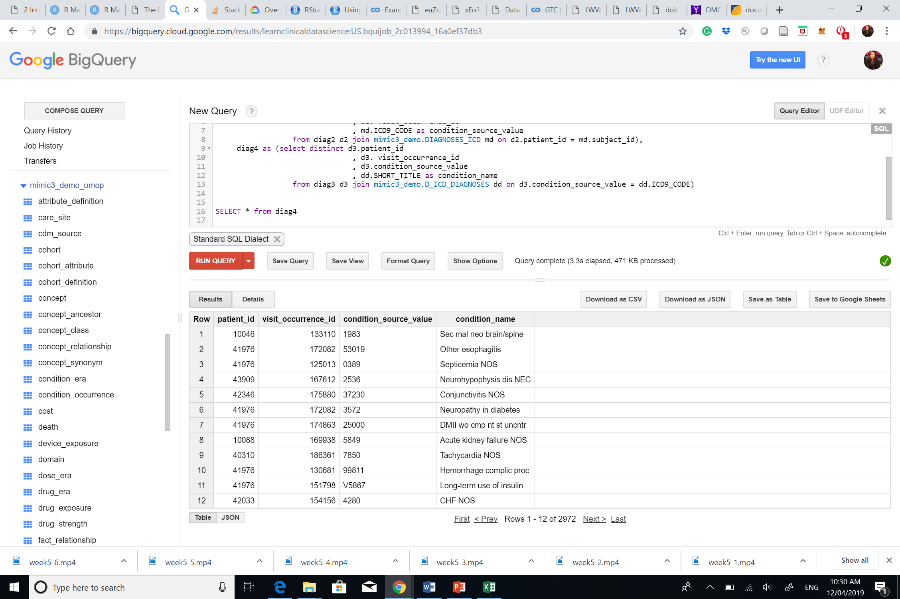
Check if the ICD9_codes from condition_source_value still matches with the labels from MIMICS.

Slide 15
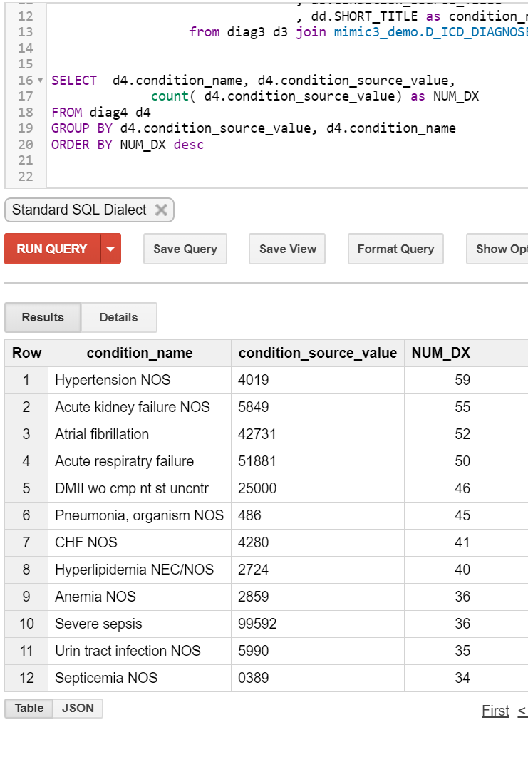
Checking the Top 5 Diagnoses

Slide 16
Step 7: Package documentation
Congratulations! The materials in the previous slides constitute a complete ETL package.
There is no submission for this Step.

