Slide 1
Lazy FCA
Faculty of Computer Science
Data Science
Moscow
2022
Preraped by Kislitsyna Maria

Slide 2

Dataset
Data Science
Lazy FCA
5 rows × 23 columns
 | Gender | Customer Type | Age | Type of Travel | Class | Flight Distance | Inflight wifi service | Departure/Arrival time convenient | Ease of Online booking | Gate location | ... | Inflight entertainment | On-board service | Leg room service | Baggage handling | Checkin service | Inflight service | Cleanliness | Departure Delay in Minutes | Arrival Delay in Minutes | satisfaction
0 | Female | Loyal Customer | 52 | Business travel | Eco | 160 | 5 | 4 | 3 | 4 | ... | 5 | 5 | 5 | 5 | 2 | 5 | 5 | 50 | 44.0 | True
1 | Female | Loyal Customer | 36 | Business travel | Business | 2863 | 1 | 1 | 3 | 1 | ... | 4 | 4 | 4 | 4 | 3 | 4 | 5 | 0 | 0.0 | True
2 | Male | disloyal Customer | 20 | Business travel | Eco | 192 | 2 | 0 | 2 | 4 | ... | 2 | 4 | 1 | 3 | 2 | 2 | 2 | 0 | 0.0 | False
3 | Male | Loyal Customer | 44 | Business travel | Business | 3377 | 0 | 0 | 0 | 2 | ... | 1 | 1 | 1 | 1 | 3 | 1 | 4 | 0 | 6.0 | True
4 | Female | Loyal Customer | 49 | Business travel | Eco | 1182 | 2 | 3 | 4 | 3 | ... | 2 | 2 | 2 | 2 | 4 | 2 | 4 | 0 | 20.0 | True

Slide 3
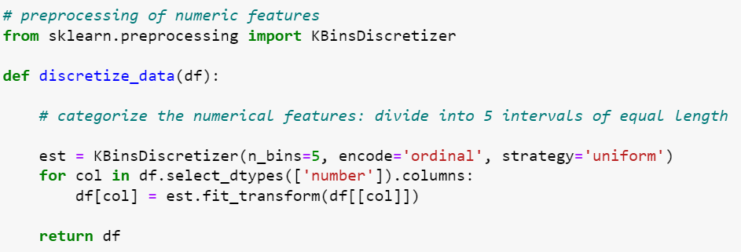
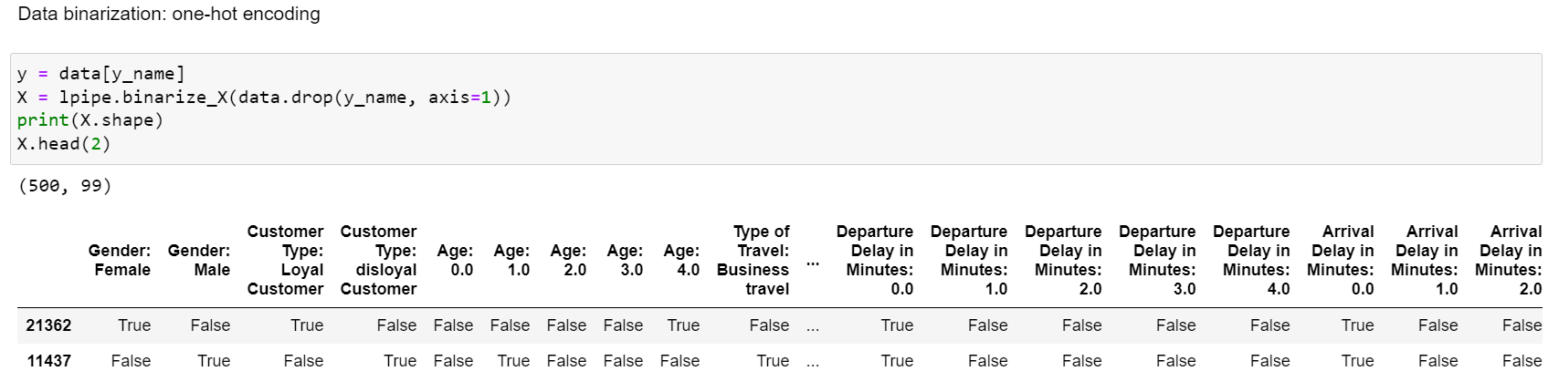
Preparation of dataset
Data Science
Lazy FCA
Empty numeric values were replaced with column averages, categorical values were replaced with ‘unknown’

Slide 4
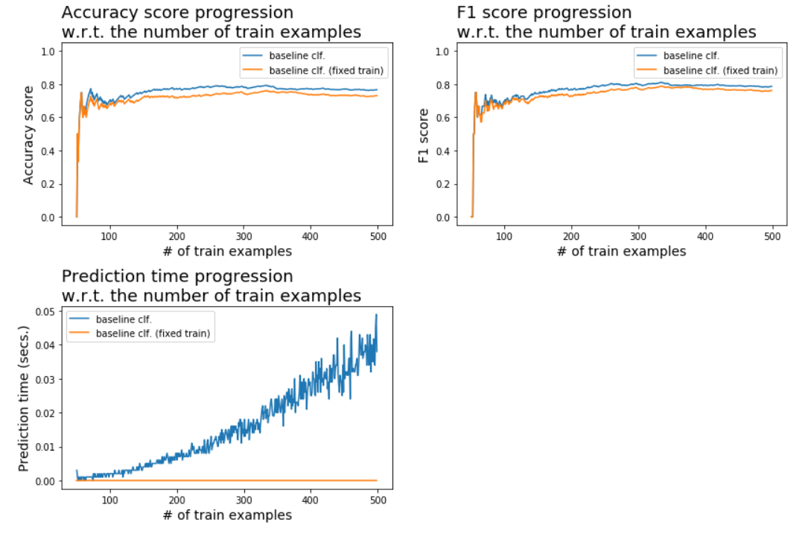
Accuracy and F1 score
Data Science
Lazy FCA
5 rows × 23 columns
{'accuracy_score': 0.7562200315830624,
'accuracy_score_fixedtrain': 0.7212799822789326,
'f1_score': 0.7625785966832718,
'f1_score_fixedtrain': 0.7376621185160739,
't_preds': 0.01560578982035319,
't_preds_fixedtrain': 0.0}

Slide 5
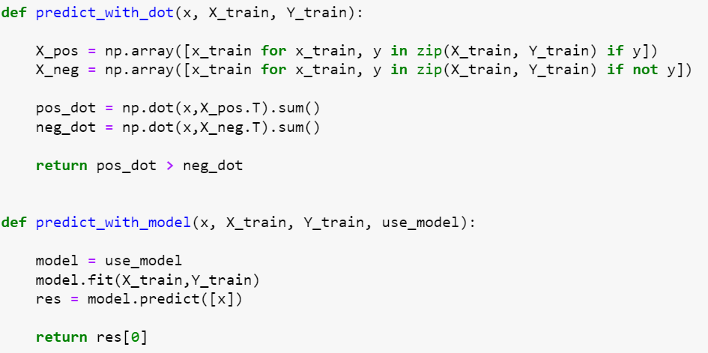
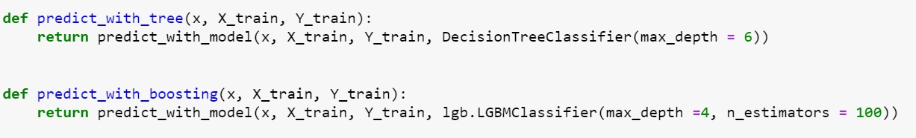
Modification of the algorithm
Data Science
Lazy FCA
5 rows × 23 columns
Instead of crossing sets, we use the matrix multiplication function in numpy. Let's add the ability to use algorithms (decision tree and gradient boosting) in lazy pipeline.

Slide 6
Final results
Data Science
Lazy FCA
5 rows × 23 columns
 | model_name | upd_time | fixed_time | accuracy_score | accuracy_score_fixedtrain | f1_score | f1_score_fixedtrain | t_preds | t_preds_fixedtrain
0 | predict_with_dot | 0.148907 | 0.037977 | 0.747410 | 0.817870 | 0.581582 | 0.741756 | 0.000331 | 0.000084
1 | predict_with_tree | 0.727553 | 0.263840 | 0.836064 | 0.785045 | 0.803344 | 0.728630 | 0.001617 | 0.000584
2 | predict_with_boosting | 10.372624 | 4.307353 | 0.862641 | 0.807403 | 0.823205 | 0.762033 | 0.023050 | 0.009572

