Slide 1


ONLINE PAYMENT FRAUD DETECTION

Slide 2
TEAM MEMBERS:
SUBIN SIBY
MUT23MCA-2058
SAHALA MOL V S
MUT23MCA-2055
NAEEMA KUNHIMON
MUT23MCA-2047
SHERIN MARIYA ROBERT
MUT23MCA-2056
GUIDE:DR.GEETHU S
ASSISTANT PROFESSOR
DEPARTMENT OF COMPUTER APPLICATIONS

Slide 3
INTRODUCTION
The primary goal of this project is to implement supervised machine learning models for fraud detection, with the goal of analyzing prior transaction information.
The goal is to predict whether a transaction is a legal transaction or a fraudulent transaction

Slide 4
LITERATURE REVIEW

Slide 5
S.NO | TITLE | AUTHOR & YEAR | KEY FINDINGS
1 | Online payment fraud: from anomaly detection to risk management. | Paulo Vanini, Sebastiano Rossi, Ermin and Thomas Domenig. Published online on 13 march 2023. | Integrated approach of anomaly detection and risk modeling and improve fraud detection capability.
2 | Fraud_Detection_ML: Machine Learning based on online payment Fraud Detection. | Maged Farouk, Nashwa S Ragaba, Diaa Salama,Omnia Elrashidy Journal of Computing and Communication Vol.3 , No.1 , PP. 116-131 , 2024 Published on: 1 January 2024 | This paper explores an effective framework for detecting online payment fraud. Gradient Boosting is identified as the optimal solution due to its high accuracy and robustness across different datasets.

Slide 6
S.NO | TITLE | AUTHOR & YEAR | KEY FINDINGS
3 | Leveraging Machine Learning Algorithms for Real-Time Fraud Detection in Digital Payment Systems. | Nakra, V., Pandian, P. K. G., Paripati, L., Choppadandi, A., & Chanchela, P. (2024). International Journal of Multidisciplinary Innovation and Research Methodology (IJMIRM), 3(2), 165-171. | The study proposes an ensemble approach combining logistic regression and deep learning to improve fraud detection in digital payment systems, emphasizing the role of feature engineering and the potential for significant financial savings.
4 | Financial Fraud Detection Model: Based on Random Forest | Kazmi, S. H. A., Liu, C., Chan, Y., & Fu, H. (2015). Financial Fraud Detection Model: Based on Random Forest. International Journal of Economics and Finance, 7(7), 178-188. doi:10.5539/ijef.v7n7p178. | This study presents a financial fraud detection model using Random Forest (RF), demonstrating its high accuracy in detecting fraud in large datasets. The research, based on data from Chinese listed companies, highlights the effectiveness of RF, especially when analyzing key financial variables.

Slide 7
S.NO | TITLE | AUTHOR & YEAR | KEY FINDINGS
5 | Financial Fraud Detection Based on Machine Learning: A Systematic Literature Review | Abdulalem Ali, Shukor Abd Razak, Siti Hajar Othman, Taiseer Abdalla Elfadil Eisa, Arafat Al-Dhaqm, Maged Nasser, Tusneem Elhassan, et al. Published on: 26 Sept 2022 | This review paper comprehensively analyzes machine learning techniques used in financial fraud detection, highlighting key trends, challenges, and advancements in the field.
6 | Predictive-Analysis-based Machine Learning Model for Fraud Detection with Boosting Classifiers | M. Valavan, S. Rita. Department of Statistics, Periyar University, Salem, Tamil Nadu, India. Published on: 6 April 2022 | This paper explores the effectiveness of various machine learning algorithms, such as Decision Tree, Random Forest, Linear Regression, and Gradient Boosting, in detecting and predicting fraud, particularly in loan cases.

Slide 8
S.NO | TITLE | AUTHOR & YEAR | KEY FINDINGS
7 | An Analysis of the Most Used Machine Learning Algorithms for Online Fraud Detection | Minastireanu, E. A., & Mesnita, G. (2019). An Analysis of the Most Used Machine Learning Algorithms for Online Fraud Detection. Informatica Economica, 23(1). | The paper reviews online fraud detection techniques, highlighting that supervised learning algorithms-Support Vector Machine (SVM), Artificial Neural Network (ANN), and Decision Tree (DT)are most effective for detecting fraud, particularly in credit card transactions. It identifies key factors like accuracy, coverage, and cost efficiency as crucial for evaluating these algorithms.
8 | Machine Learning based Approach to Financial Fraud Detection Process in Mobile Payment System | Choi, D., & Lee, K. (2017). Machine learning-based approach to financial fraud detection process in mobile payment system. IT Convergence Practice (INPRA), 5(4), 12-24. | The research explores a dual approach to mobile payment fraud detection, combining supervised and unsupervised machine learning methods to manage large datasets and address data imbalance.

Slide 9
PRODUCT BACKLOG

Slide 10
BACKLOG ID | USER STORIES | PRODUCT BACKLOG
111 | As a user, I want to perform a literature review to understand the project objectives and context | Review academic papers, industry reports, and existing solutions related to fraud detection. exploring the dataset clean the dataset preprocess the dataset
112 | As a user, I want to preprocess data and perform feature engineering for fraud detection. | Scale and normalize numerical features Perform feature selection Split data into training, validation, and test sets.
113 | As a user, I want to evaluate different models and analyze their performance for fraud detection. | Choose candidate algorithms based on literature review findings Implement initial models and compare performance. Fine-tune hyperparameters for the best-performing model. Cross-validate model performance to check for overfitting

Slide 11
BACKLOG ID | USER STORIES | PRODUCT BACKLOG
114 | As a user, I want to evaluate the model & analysing the metrics | Evaluate model accuracy, precision, recall, F1-score. Generate confusion matrix and classification report Assess model performance using AUC-ROC curve. Interpret model results for clinical relevance.
115 | As a user, I want to improve the model & test it | Adjust settings to improve the model’s accuracy Check where the model is making mistakes and try to fix them. Try combining multiple models to get better results. Compare how different models work and pick the best one.
116 | As a user, I want to do Final checks and Make a report | Make sure the model works well with different types of data. Explain in simple terms how the model makes its decisions. Write down a short guide on how to use the model. Double-check everything

Slide 12

Burndown Chart
Backlog ID | USER STORIES | Initial Estimate | Jul-22 | Jul-25 | Jul-29 | Aug-02 | Aug-05 | Aug-06 | Aug-13 | Aug-19
 |  | day 0 | day 1 | day 2 | day 3 | day 4 | day 5 | day 6 | day 7 | day 8
111 | literature review | 2 | 1 |  |  | 1
111 | gather dataset | 2 |  | 1 |  |  |  |  | 1
111 | clean dataset | 2 |  |  | 1 |  | 1
111 | preprocessing | 2 |  |  |  | 1 |  | 1
remaining effort |  | 8 | 7 | 6 | 5 | 3 | 2 | 1 | 0 | 0
ideal trend |  | 8 | 7 | 6 | 5 | 4 | 3 | 2 | 1 | 0

Slide 13
DATA PROCESSING
ep
Data Collection:
Gather Data from significant sources
Data Cleaning :
Remove or handle irrelevant or duplicate data
Encoding categorical Data:
Convert categorical features into numerical values

Slide 14
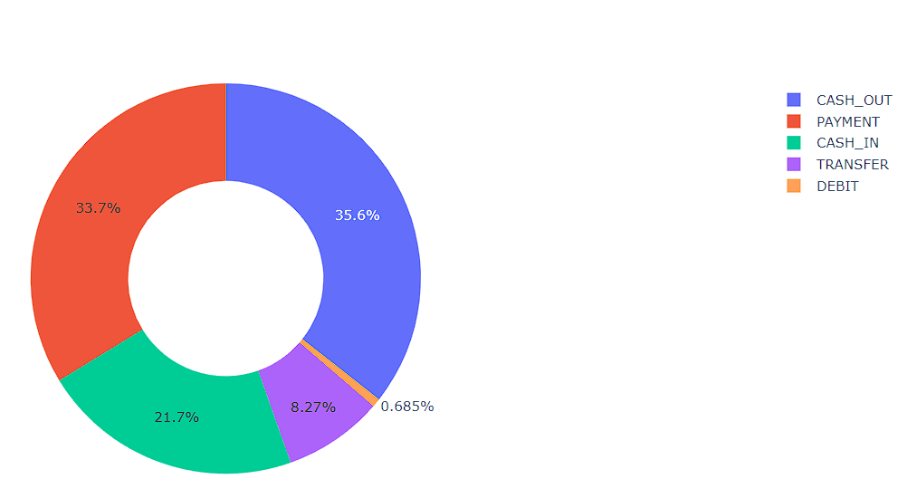
DATA PREPROCESSING STEPS
Understand the Dataset
Importing libraries
Handle Missing Values
Outlier Detection
Data Splitting

Slide 15
MODEL SELECTION

Slide 16
MODEL SELECTION
We are planning to use 4 models in this project, and they are:
K-Nearest Neighbors (KNN)
Support Vector Machine (SVM)
Decision Tree
Random Forest

Slide 17
K-NEAREST NEIGHBORS (KNN)
Overview:
KNN Approach: Compares transactions to nearest neighbors.
Legitimate: Close to legitimate neighbors, likely legitimate.
Fraud Detection: Close to fraudulent neighbors, likely fraud.
Why These Models Were Used:
Simple and effective for spotting fraud by comparing new transactions to past cases.
Advantages of These Models:
Simple to Implement.
Effective for Similar Patterns

Slide 18
SUPPORT VECTOR MACHINE (SVM)
Overview:
SVM Approach: Separates fraud from legitimate.wade
Hyperplane: Maximizes margin between classes.
Effective: Works well in complex, high-dimensional spaces.
Why These Models Were Used:
Great at handling complex data and finding clear boundaries between fraudulent and legitimate transactions..
Advantages of These Models:
Handles Complex Data.
Clear Separation.

Slide 19
DECISION TREE
Overview:
Decision Tree: Splits transactions into branches.
Features: Uses transaction details like amount, frequency, location.
Classification: Each decision point leads to fraud or legitimate outcome.
Why These Models Were Used:
Easy to understand and explain, providing clear rules for identifying fraud.
Advantages of These Models:
Handles Complex Data.
Clear Separation.

Slide 20
RANDOM FOREST
Overview:
Random Forest: Creates multiple decision trees.
Ensemble Method: Combines results from random subsets.
Enhanced Detection: Averages tree results to reduce errors.
Why These Models Were Used:
Combines multiple decision trees for higher accuracy, especially useful for large datasets with rare fraud cases.
Advantages of These Models:
High Accuracy.
Effective for Imbalanced Data.
Resistant to Overfitting

Slide 21
CONCLUSION
Effective fraud detection and prevention are crucial in today's digital landscape, driven by rapid technological advancements.
Adopting best practices such as continuous monitoring and multi-layered security measures, like two-factor authentication, is essential to safeguarding against fraud.
Looking ahead, future innovations will continue to enhance these defenses, underscoring the importance of a steadfast commitment to security.
Staying proactive and adaptive in our approach will ensure robust protection against evolving threats.

Slide 22
REFERENCES
https://www.kaggle.com
https://link.springer.com/article/10.1186/s40854-023-00470-w
https://journals.ekb.eg/article_339929.html
https://www.revistaie.ase.ro/content/89/01%20-%20minastireanu,%20mesnita.pdf
https://isyou.info/inpra/papers/inpra-v5n4-02.pdf
https://papers.ssrn.com/sol3/papers.cfm?abstract_id=2625215
https://ijmirm.com/index.php/ijmirm/article/view/97
https://premiumedutech.com/wp-content/uploads/2023/12/paper-3.pdf
https://www.mdpi.com/2076-3417/12/19/9637

Slide 23
THANK YOU

