Slide 1

DRAINAGE SAFETY SENTINEL
Presented By:
Jomol Jeejo k
Karthika Santhosh
Mariya Babu
Selin Varghese
Guided by:
Ms.Sruthy M.S
Assistant Professor

Slide 2
PROBLEM STATEMENT
Drainage cleaning often exposes workers to life-threatening conditions due to the accumulation of toxic gases such as methane, ammonia, and hydrogen sulfide. These gases are colorless, odorless in small concentrations, and extremely dangerous, leading to health hazards or even fatalities. Despite the severity of the issue, most drainage systems lack an efficient and cost-effective solution for continuous monitoring and early detection of multiple toxic gases. Manual inspections without proper safety measures continue to claim lives. Therefore, there is a critical need for an intelligent, automated system that can monitor, classify, and alert authorities about hazardous gas levels in real time to enhance safety and reduce casualties.

Slide 3
AREA OF THE PROJECT
Embedded Systems
IoT (Internet of Things)
Environmental Monitoring
Machine Learning
Cloud Integration
Web Development (UI/UX)

Slide 4
SKILL SET
Cloud integration (Firebase / AWS / Thingspeak)
Arduino Programming
ESP32 and sensor interfacing
Wireless Communication
Data collection and preprocessing
Machine Learning (classification algorithms)
Cloud integration (Firebase / AWS)
HTML, CSS, JavaScript for UI
Dataset handling (CSV, Excel)

Slide 5
DESCRIPTION & FEATURES OF THE PROPOSED SYSTEM
Multi-node Architecture: At least 4 wireless nodes (with ESP32), one as a gateway, rest as sensor nodes.
Gas Detection: Each node is equipped with specific number of gas sensors to detect and quantify gas presence.
Calibration and Data Collection: Each node will be calibrated and tested to collect at least 50 readings . Output will be stored as CSV dataset.
Classification of Hazard Levels Gases will be categorized as :Good, Average, Less Hazardous, Hazardous using ML algorithms trained on the collected data.

Slide 6
Cloud Storage: Data from all nodes is sent wirelessly to the gateway and then to the cloud server for secure storage and access.
Web Dashboard: Real-time data visualizations (e.g., charts, hazard warnings) using a responsive website (HTML/CSS/JS).

Slide 7
ABSTRACT
Drainage workers are often exposed to harmful gases like methane, ammonia, and hydrogen sulfide, which are undetectable without proper equipment and can lead to serious health risks or fatalities. The Drainage Sentinel Detection project aims to develop a cost-effective, real-time gas monitoring system using IoT and machine learning. The system comprises four wireless nodes each built with an ESP32 microcontroller and five calibrated digital gas sensors. These nodes collect gas concentration data and send it wirelessly to a central gateway, which then uploads it to a cloud server for storage and analysis. Using machine learning algorithms, the gas levels are classified into four categories: Good, Average, Less Hazardous, and Hazardous. A web-based dashboard displays real-time data and hazard warnings for remote access and decision-making. The project integrates embedded systems, cloud storage, AI/ML, and responsive web design to provide an intelligent and scalable safety solution for drainage maintenance environments.

Slide 8
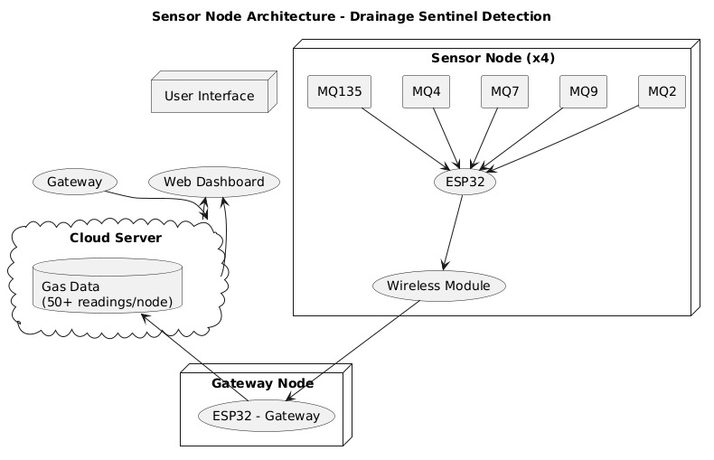
ARCHITECTURE DIAGRAM

Slide 9
STATUS
- Finalized sensor node architecture
- Chosen sensors and modules (MQ series, ESP32)
- Planning phase for calibration and data collection

Slide 10
THANK YOU

