Slide 1
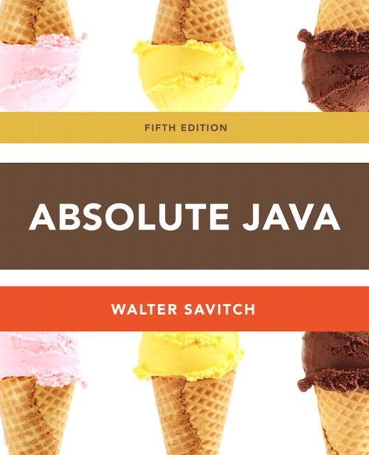
Chapter 5
Defining Classes II
Slides prepared by Rose Williams, Binghamton University
Kenrick Mock, University of Alaska Anchorage

Slide 2
Variables and Memory
A computer has two forms of memory
Secondary memory is used to hold files for "permanent" storage
Main memory is used by a computer when it is running a program
Values stored in a program's variables are kept in main memory

Slide 3
Variables and Memory
Main memory consists of a long list of numbered locations called bytes
Each byte contains eight bits: eight 0 or 1 digits
The number that identifies a byte is called its address
A data item can be stored in one (or more) of these bytes
The address of the byte is used to find the data item when needed

Slide 4
Variables and Memory
Values of most data types require more than one byte of storage
Several adjacent bytes are then used to hold the data item
The entire chunk of memory that holds the data is called its memory location
The address of the first byte of this memory location is used as the address for the data item
A computer's main memory can be thought of as a long list of memory locations of varying sizes

Slide 5
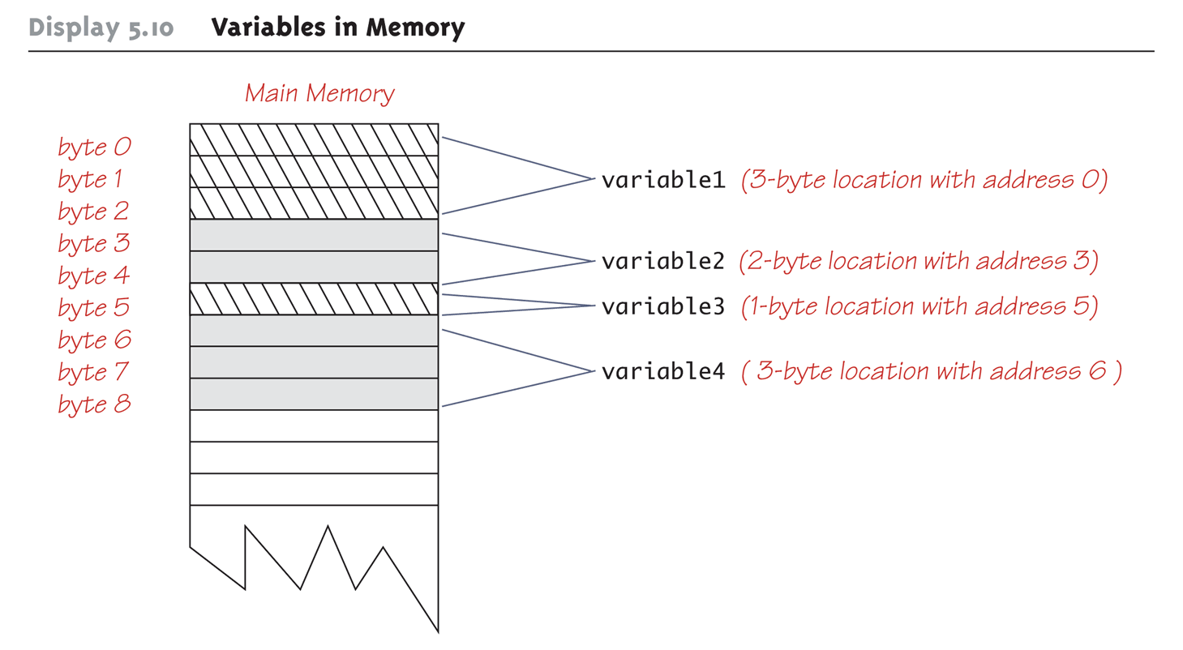
Variables in Memory

Slide 6
References
Every variable is implemented as a location in computer memory
When the variable is a primitive type, the value of the variable is stored in the memory location assigned to the variable
Each primitive type always require the same amount of memory to store its values

Slide 7
References
When the variable is a class type, only the memory address (or reference) where its object is located is stored in the memory location assigned to the variable
The object named by the variable is stored in some other location in memory
Like primitives, the value of a class variable is a fixed size
Unlike primitives, the value of a class variable is a memory address or reference
The object, whose address is stored in the variable, can be of any size

Slide 8
References
Two reference variables can contain the same reference, and therefore name the same object
The assignment operator sets the reference (memory address) of one class type variable equal to that of another
Any change to the object named by one of theses variables will produce a change to the object named by the other variable, since they are the same object
variable2 = variable1;

Slide 9
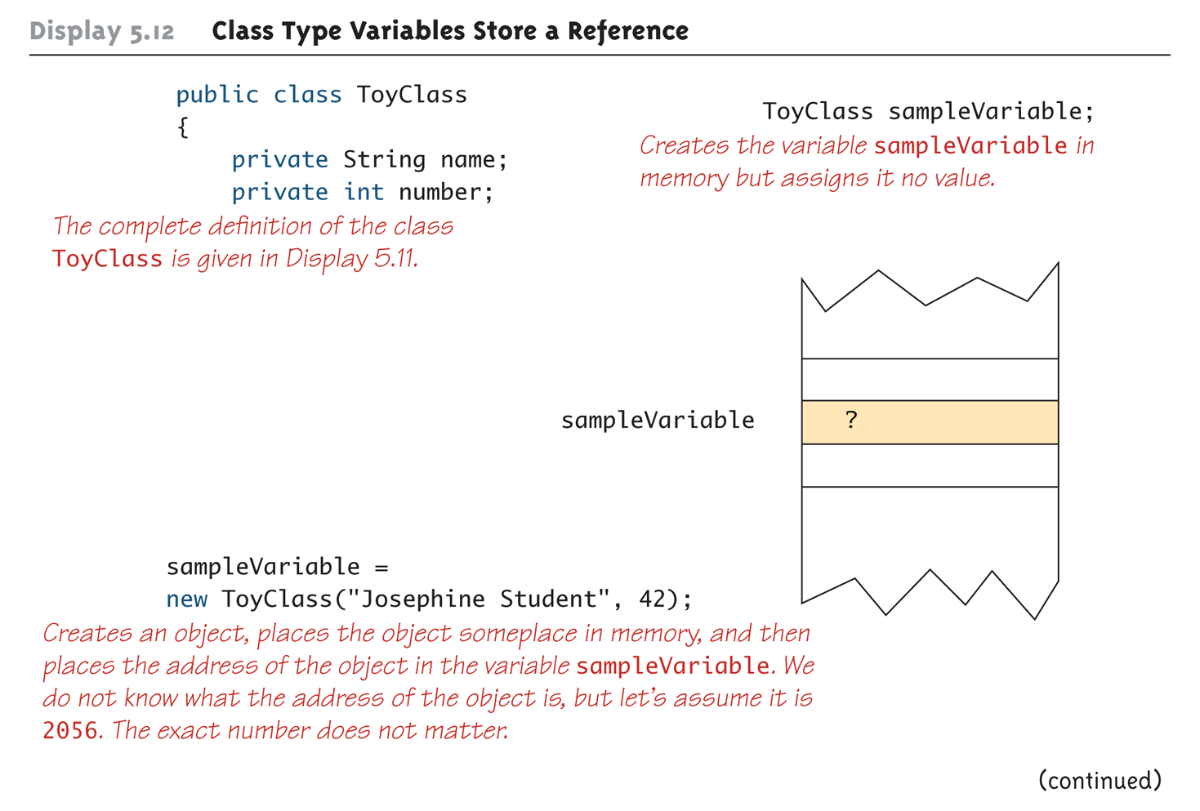
Class Type Variables Store a Reference (Part 1 of 2)

Slide 10
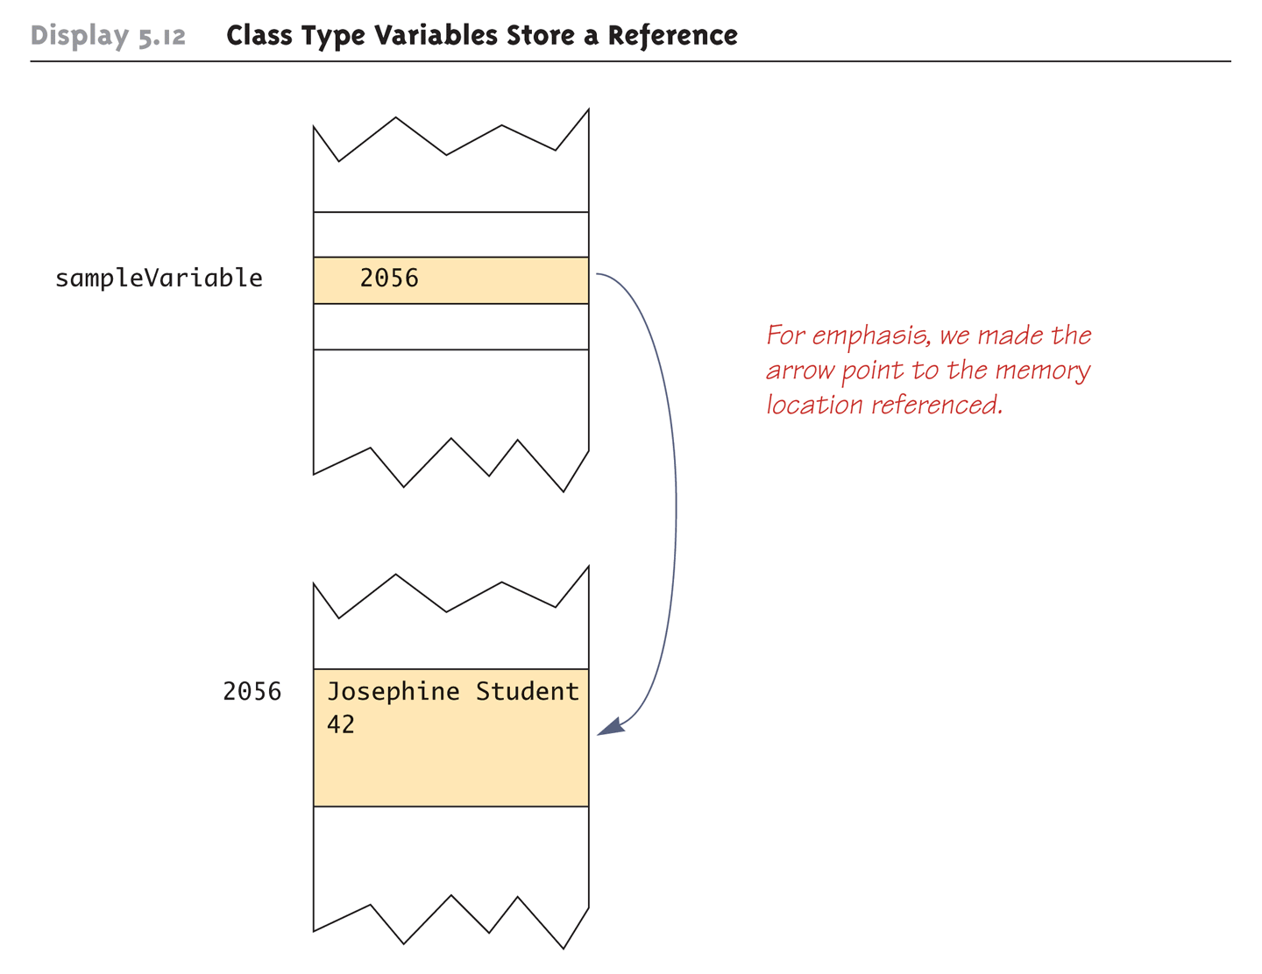
Class Type Variables Store a Reference (Part 2 of 2)

Slide 11
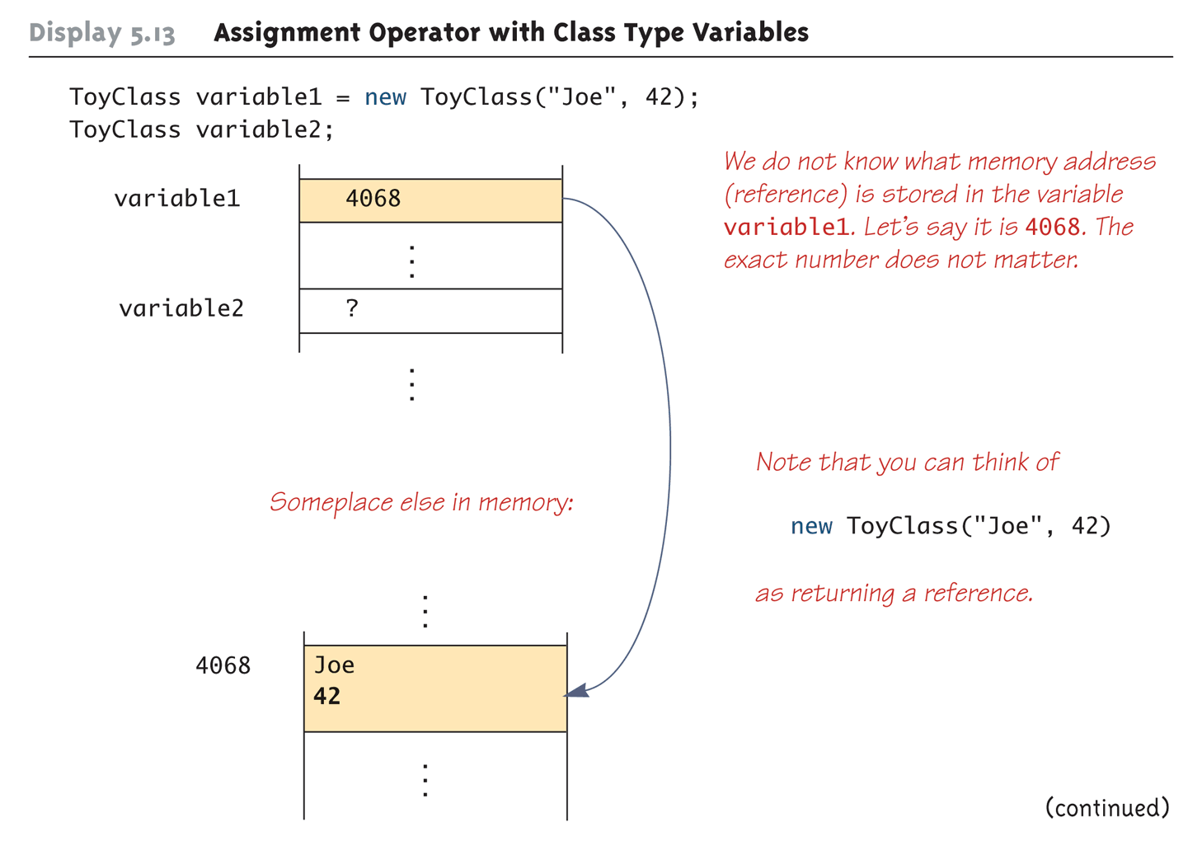
Assignment Operator with Class Type Variables (Part 1 of 3)

Slide 12
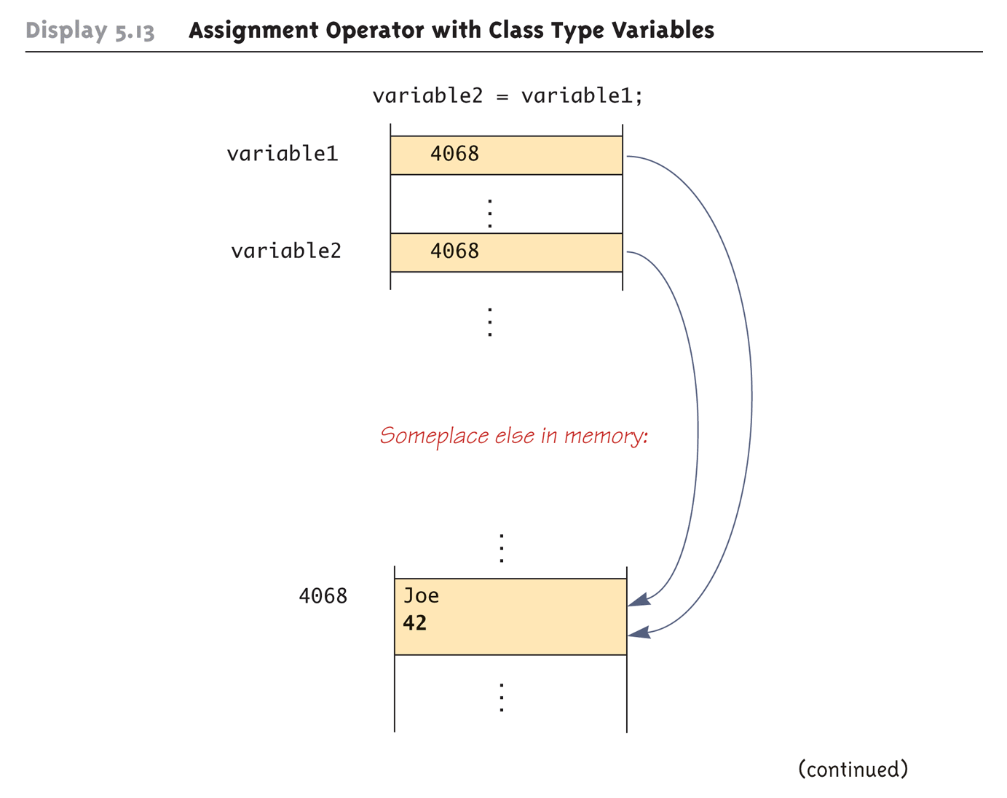
Assignment Operator with Class Type Variables (Part 2 of 3)

Slide 13
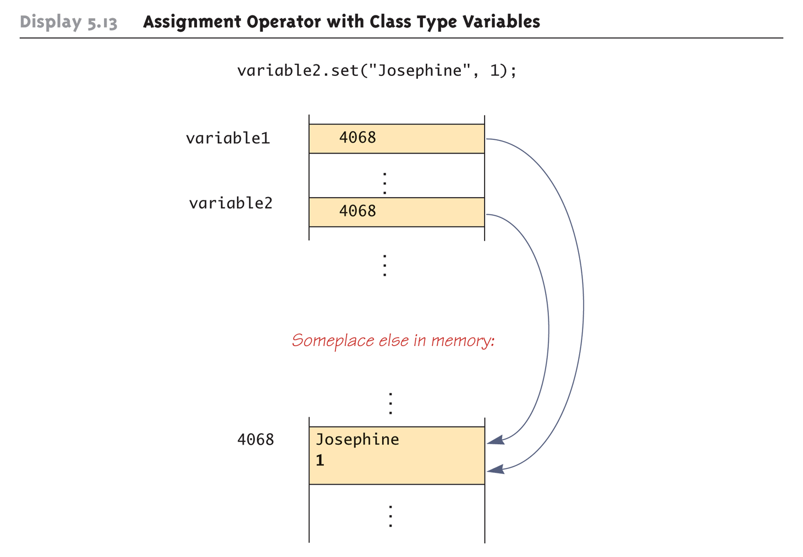
Assignment Operator with Class Type Variables (Part 3 of 3)

Slide 14
Class Parameters
All parameters in Java are call-by-value parameters
A parameter is a local variable that is set equal to the value of its argument
Therefore, any change to the value of the parameter cannot change the value of its argument
Class type parameters appear to behave differently from primitive type parameters
They appear to behave in a way similar to parameters in languages that have the call-by-reference parameter passing mechanism

Slide 15
Class Parameters
The value plugged into a class type parameter is a reference (memory address)
Therefore, the parameter becomes another name for the argument
Any change made to the object named by the parameter (i.e., changes made to the values of its instance variables) will be made to the object named by the argument, because they are the same object
Note that, because it still is a call-by-value parameter, any change made to the class type parameter itself (i.e., its address) will not change its argument (the reference or memory address)

Slide 16
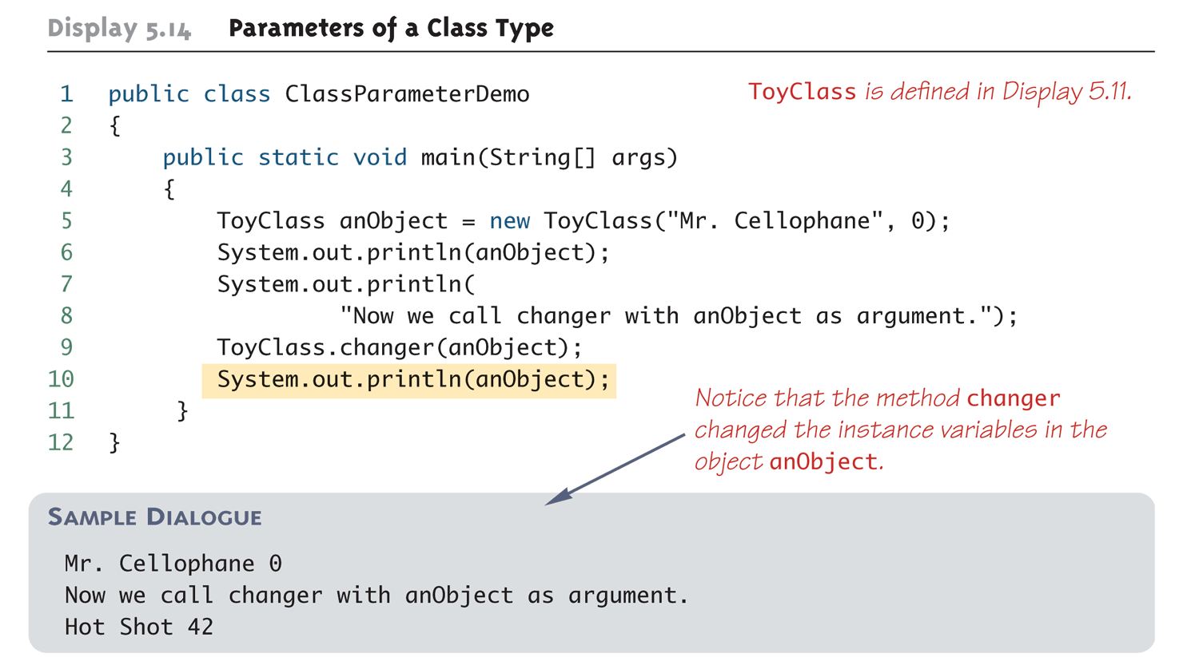
Parameters of a Class Type

Slide 17
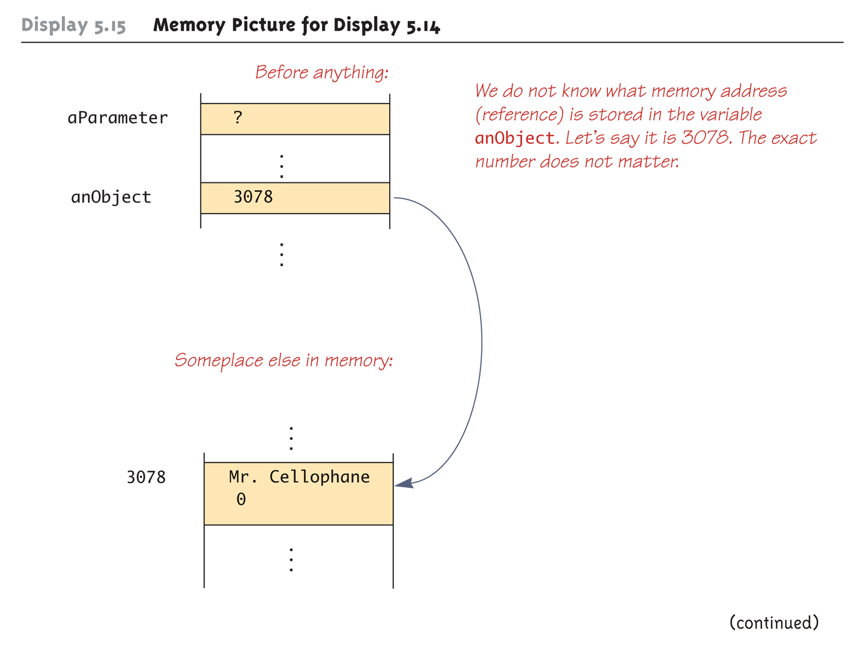
Memory Picture for Display 5.14 (Part 1 of 3)

Slide 18
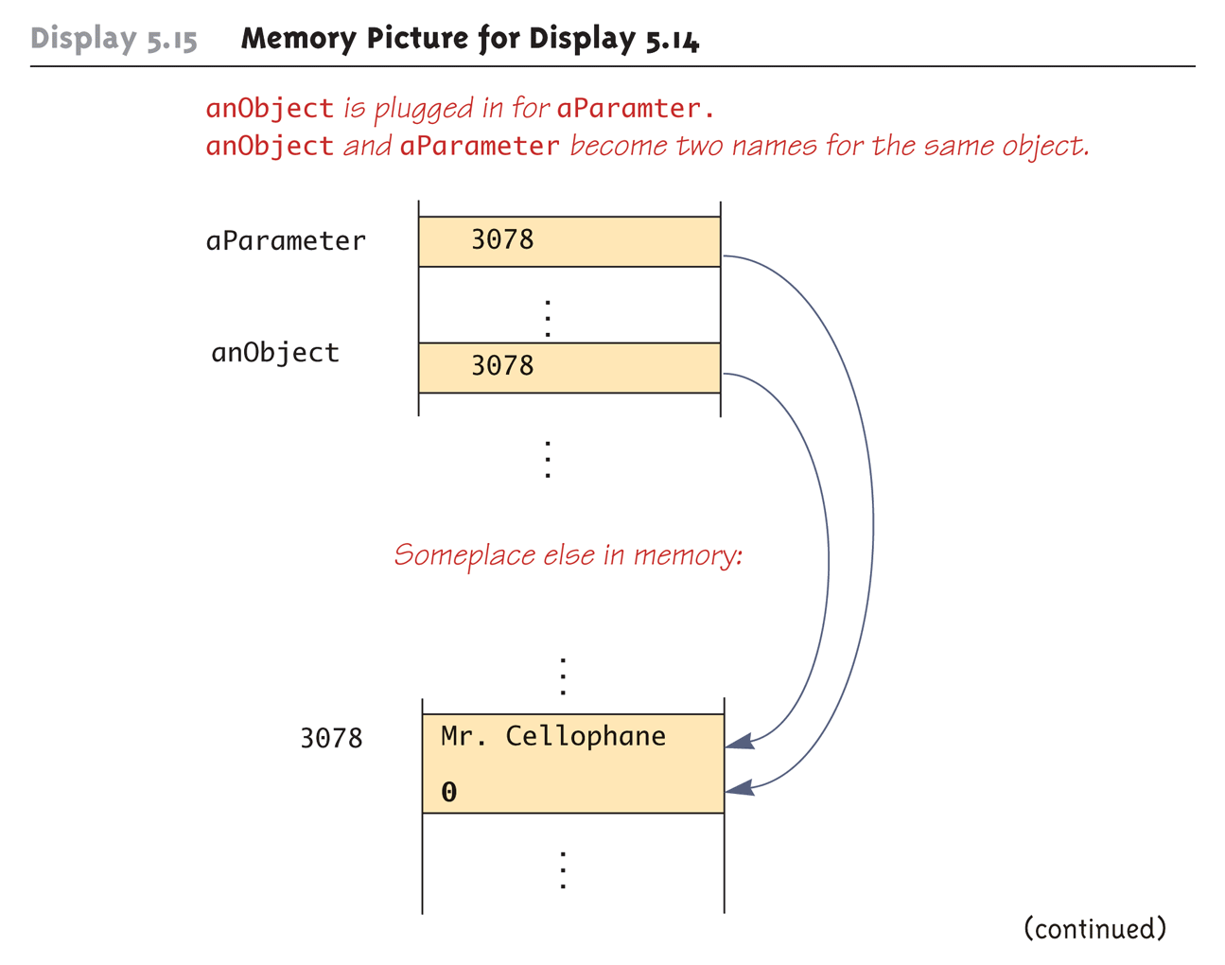
Memory Picture for Display 5.14 (Part 2 of 3)

Slide 19
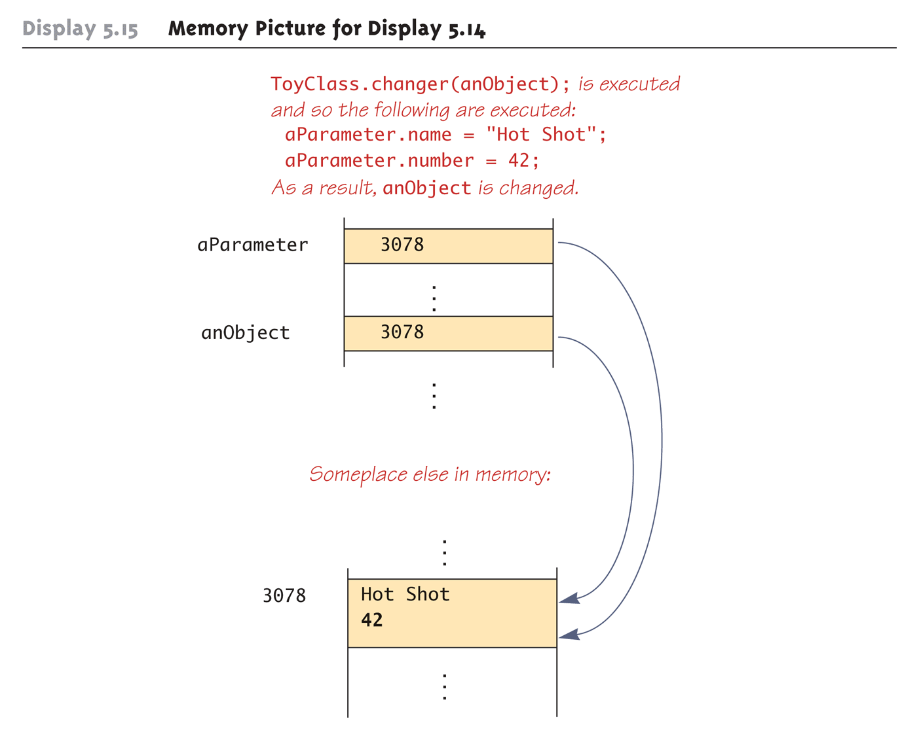
Memory Picture for Display 5.14 (Part 3 of 3)

Slide 20
Differences Between Primitive and Class-Type Parameters
A method cannot change the value of a variable of a primitive type that is an argument to the method
In contrast, a method can change the values of the instance variables of a class type that is an argument to the method

Slide 21
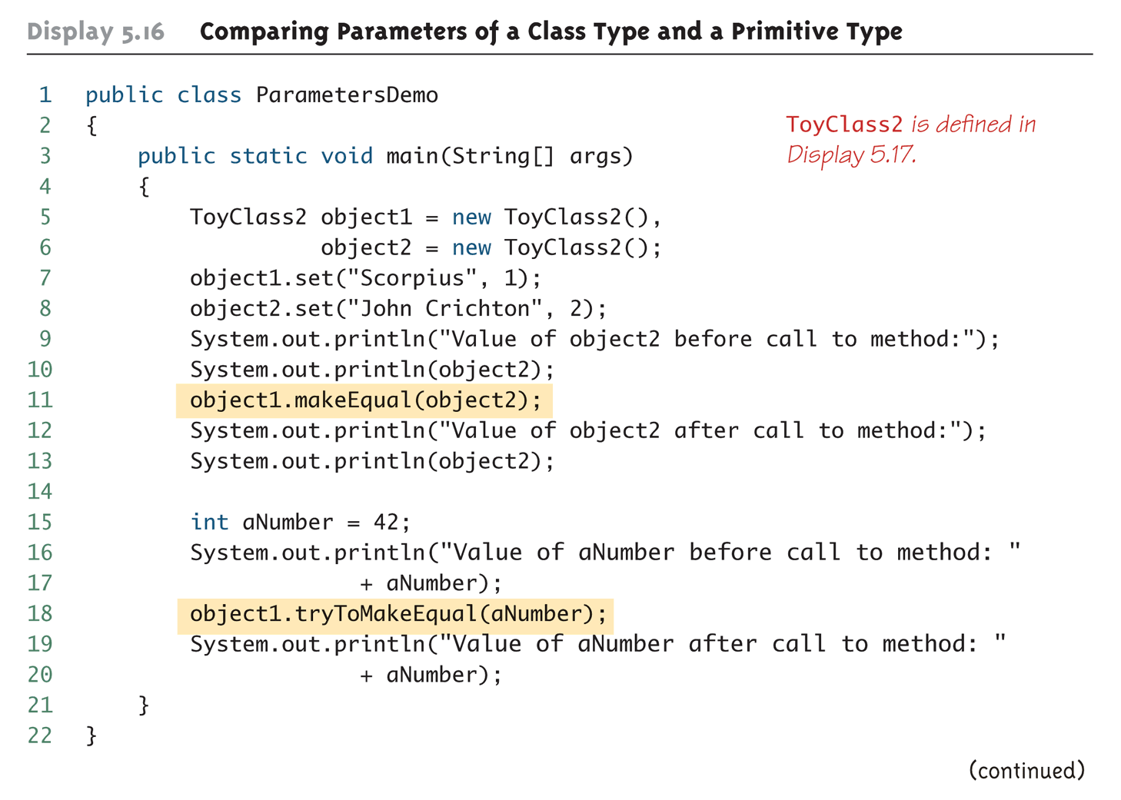
Comparing Parameters of a Class Type and a Primitive Type (Part 1 of 2)

Slide 22
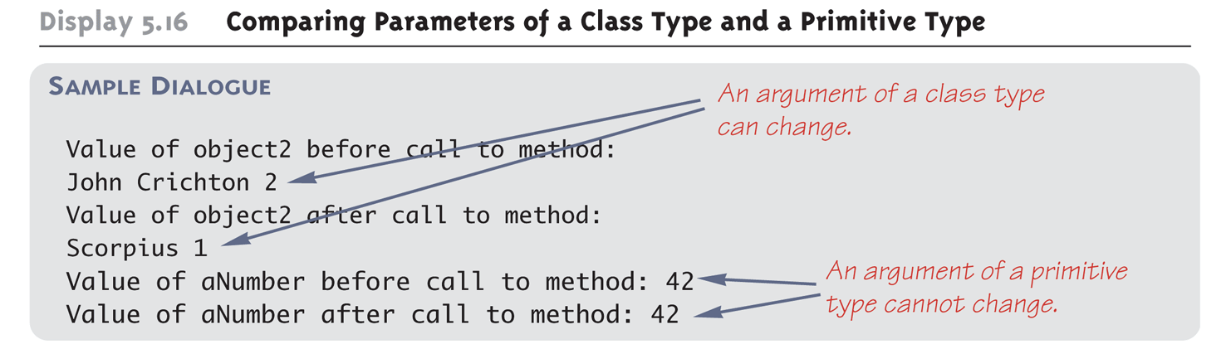
Comparing Parameters of a Class Type and a Primitive Type (Part 2 of 2)

Slide 23
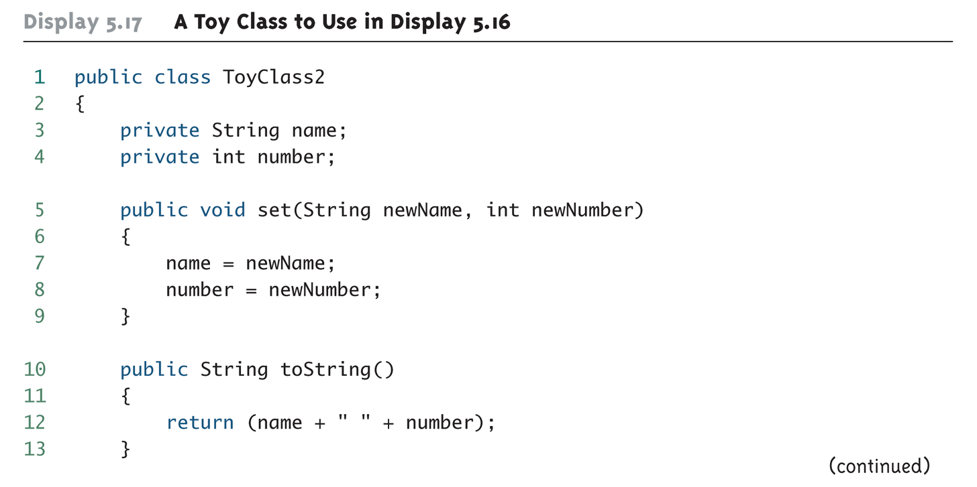
A Toy Class to Use in Display 5.16 (Part 1 of 2)

Slide 24
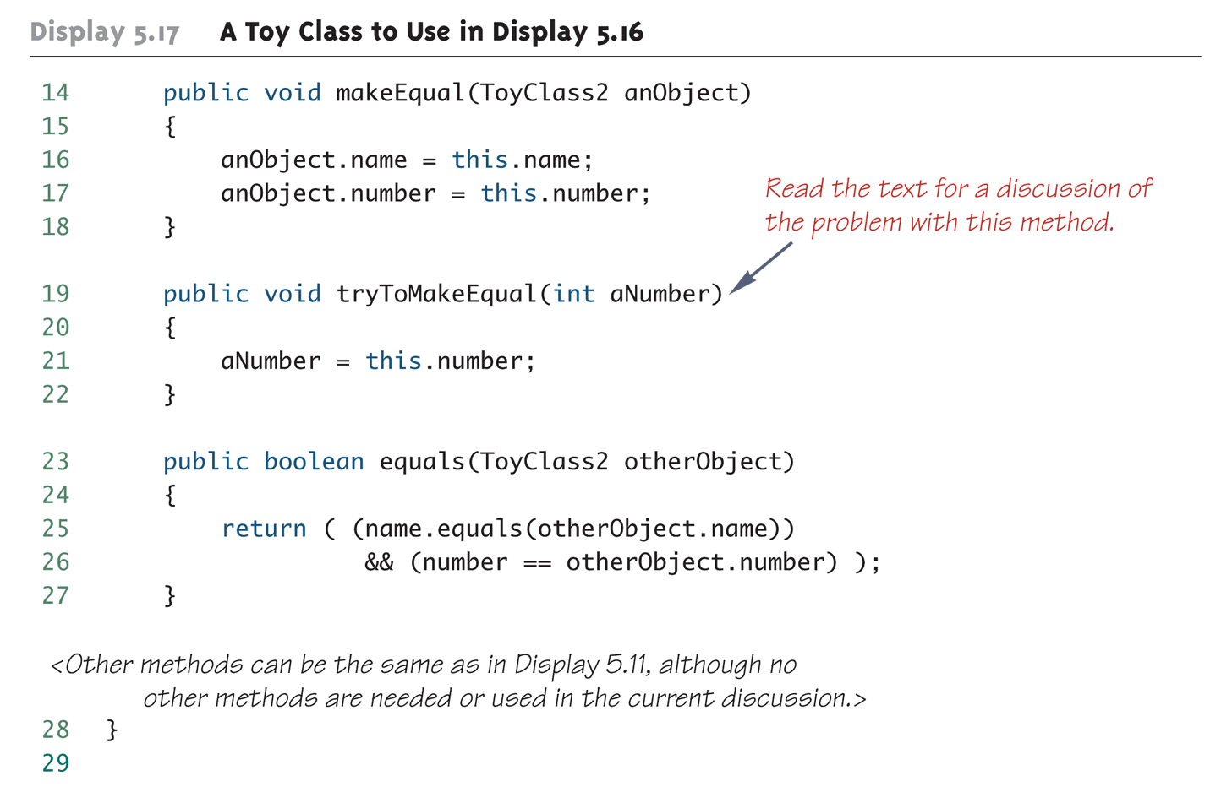
A Toy Class to Use in Display 5.16 (Part 2 of 2)

Slide 25
Pitfall: Use of = and == with Variables of a Class Type
Used with variables of a class type, the assignment operator (=) produces two variables that name the same object
This is very different from how it behaves with primitive type variables
The test for equality (==) also behaves differently for class type variables
The == operator only checks that two class type variables have the same memory address
Unlike the equals method, it does not check that their instance variables have the same values
Two objects in two different locations whose instance variables have exactly the same values would still test as being "not equal"

Slide 26
The Constant null
null is a special constant that may be assigned to a variable of any class type
YourClass yourObject = null;
It is used to indicate that the variable has no "real value"
It is often used in constructors to initialize class type instance variables when there is no obvious object to use
null is not an object: It is, rather, a kind of "placeholder" for a reference that does not name any memory location
Because it is like a memory address, use == or != (instead of equals) to test if a class variable contains null
if (yourObject == null) . . .

Slide 27
Pitfall: Null Pointer Exception
Even though a class variable can be initialized to null, this does not mean that null is an object
null is only a placeholder for an object
A method cannot be invoked using a variable that is initialized to null
The calling object that must invoke a method does not exist
Any attempt to do this will result in a "Null Pointer Exception" error message
For example, if the class variable has not been initialized at all (and is not assigned to null), the results will be the same

Slide 28
The new Operator and Anonymous Objects
The new operator invokes a constructor which initializes an object, and returns a reference to the location in memory of the object created
This reference can be assigned to a variable of the object's class type
Sometimes the object created is used as an argument to a method, and never used again
In this case, the object need not be assigned to a variable, i.e., given a name
An object whose reference is not assigned to a variable is called an anonymous object

Slide 29
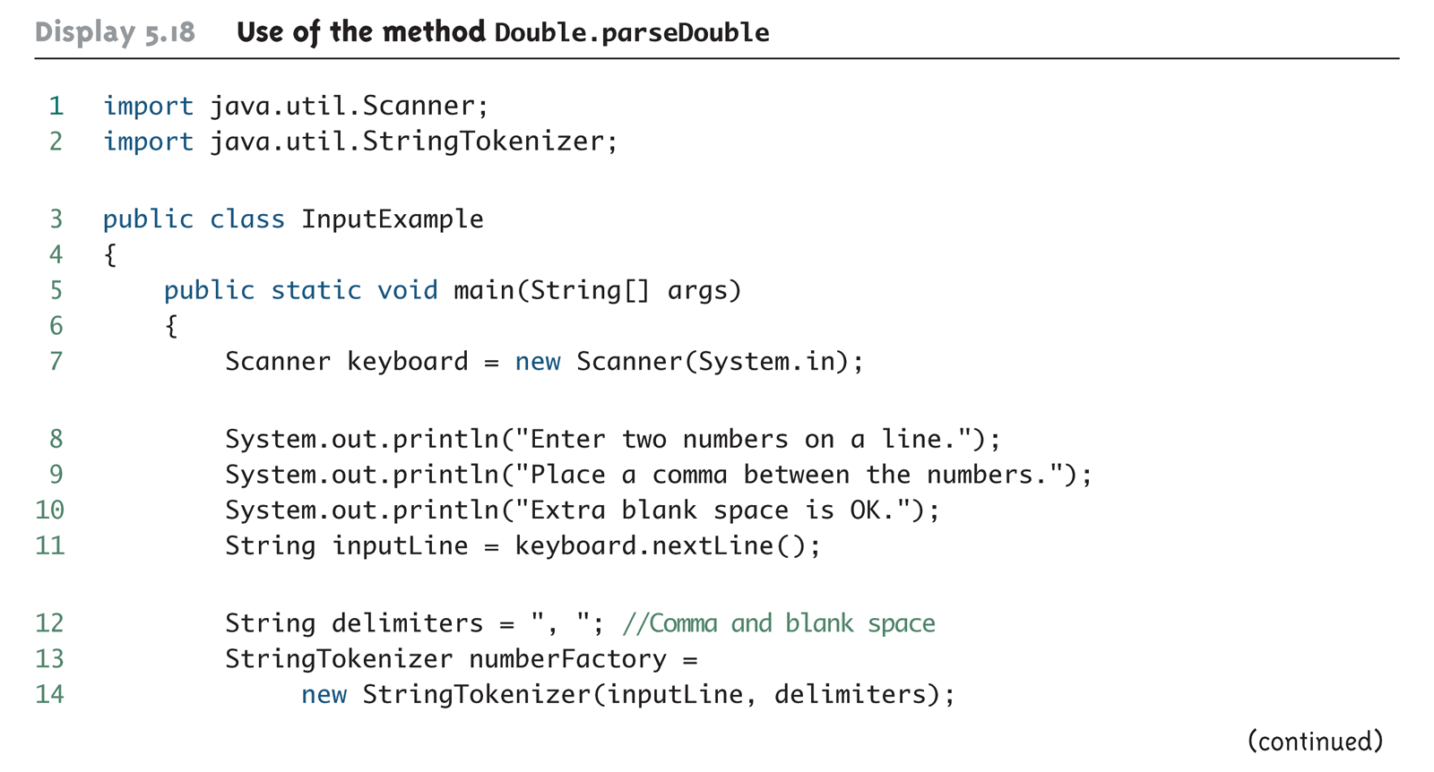
Another Approach to Keyboard Input Using Double.parseDouble (Part 1 of 3)

Slide 30
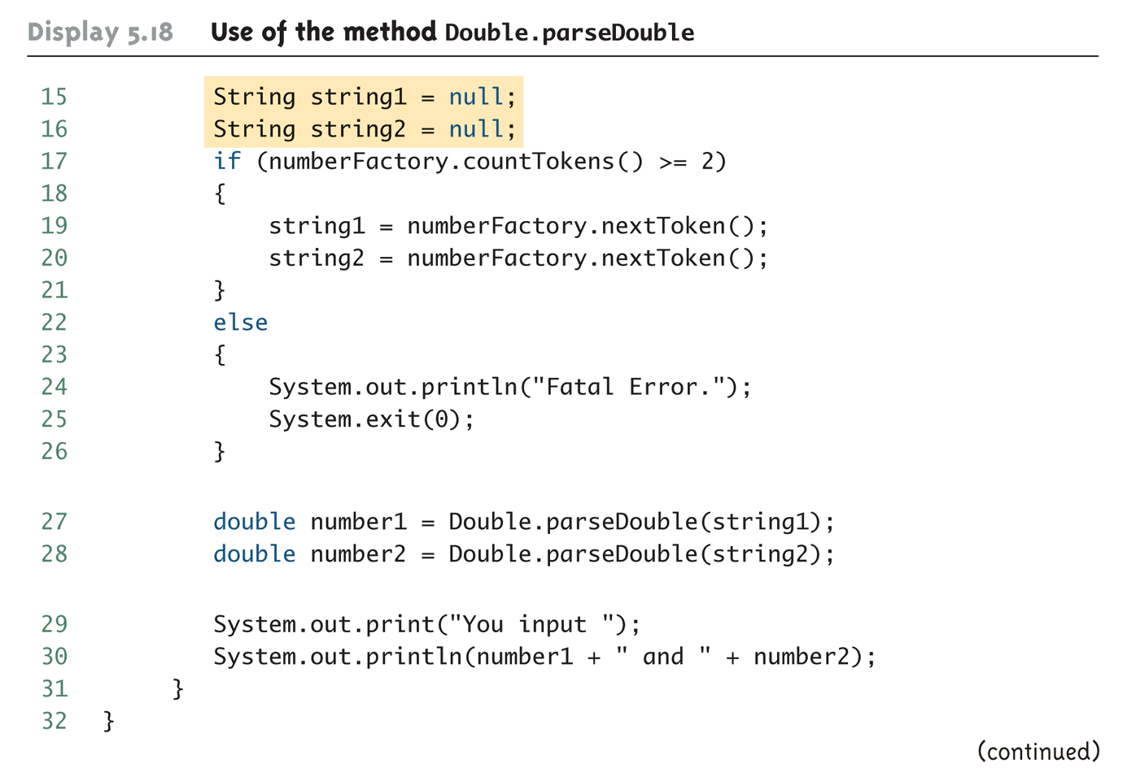
Another Approach to Keyboard Input Using Double.parseDouble (Part 2 of 3)

Slide 31
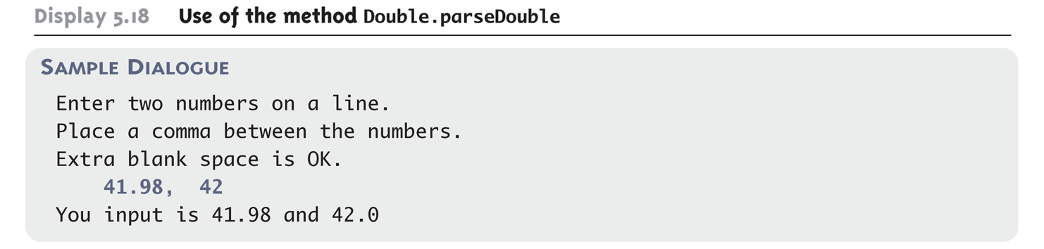
Another Approach to Keyboard Input Using Double.parseDouble (Part 3 of 3)

Slide 32
Using and Misusing References
When writing a program, it is very important to insure that private instance variables remain truly private
For a primitive type instance variable, just adding the private modifier to its declaration should insure that there will be no privacy leaks
For a class type instance variable, however, adding the private modifier alone is not sufficient

Slide 33
Designing A Person Class: Instance Variables
A simple Person class could contain instance variables representing a person's name, the date on which they were born, and the date on which they died
These instance variables would all be class types: name of type String, and two dates of type Date
As a first line of defense for privacy, each of the instance variables would be declared private
public class Person
{
private String name;
private Date born;
private Date died; //null is still alive
. . .

Slide 34
Designing a Person Class: Constructor
In order to exist, a person must have (at least) a name and a birth date
Therefore, it would make no sense to have a no-argument Person class constructor
A person who is still alive does not yet have a date of death
Therefore, the Person class constructor will need to be able to deal with a null value for date of death
A person who has died must have had a birth date that preceded his or her date of death
Therefore, when both dates are provided, they will need to be checked for consistency

Slide 35
A Person Class Constructor
public Person(String initialName, Date birthDate,
Date deathDate)
{
if (consistent(birthDate, deathDate))
{ name = initialName;
born = new Date(birthDate);
if (deathDate == null)
died = null;
else
died = new Date(deathDate);
}
else
{ System.out.println("Inconsistent dates.");
System.exit(0);
}
}

Slide 36
Designing a Person Class: the Class Invariant
A statement that is always true for every object of the class is called a class invariant
A class invariant can help to define a class in a consistent and organized way
For the Person class, the following should always be true:
An object of the class Person has a date of birth (which is not null), and if the object has a date of death, then the date of death is equal to or later than the date of birth
Checking the Person class confirms that this is true of every object created by a constructor, and all the other methods (e.g., the private method consistent) preserve the truth of this statement

Slide 37
Designing a Person Class: the Class Invariant
/** Class invariant: A Person always has a date of birth,
and if the Person has a date of death, then the date of
death is equal to or later than the date of birth.
To be consistent, birthDate must not be null. If there
is no date of death (deathDate == null), that is
consistent with any birthDate. Otherwise, the birthDate
must come before or be equal to the deathDate.
*/
private static boolean consistent(Date birthDate, Date
deathDate)
{
if (birthDate == null) return false;
else if (deathDate == null) return true;
else return (birthDate.precedes(deathDate ||
birthDate.equals(deathDate));
}

Slide 38
Designing a Person Class: the equals and datesMatch Methods
The definition of equals for the class Person includes an invocation of equals for the class String, and an invocation of the method equals for the class Date
Java determines which equals method is being invoked from the type of its calling object
Also note that the died instance variables are compared using the datesMatch method instead of the equals method, since their values may be null

Slide 39
Designing a Person Class: the equals Method
public boolean equals(Person otherPerson)
{
if (otherPerson == null)
return false;
else
return (name.equals(otherPerson.name) &&
born.equals(otherPerson.born) &&
datesMatch(died, otherPerson.died));
}

Slide 40
Designing a Person Class: the matchDate Method
/** To match date1 and date2 must either be the
same date or both be null.
*/
private static boolean datesMatch(Date date1,
Date date2)
{
if (date1 == null)
return (date2 == null);
else if (date2 == null) //&& date1 != null
return false;
else // both dates are not null.
return(date1.equals(date2));
}

Slide 41
Designing a Person Class: the toString Method
Like the equals method, note that the Person class toString method includes invocations of the Date class toString method
public String toString( )
{
String diedString;
if (died == null)
diedString = ""; //Empty string
else
diedString = died.toString( );
return (name + ", " + born + "-" + diedString);
}

Slide 42
Copy Constructors
A copy constructor is a constructor with a single argument of the same type as the class
The copy constructor should create an object that is a separate, independent object, but with the instance variables set so that it is an exact copy of the argument object
Note how, in the Date copy constructor, the values of all of the primitive type private instance variables are merely copied

Slide 43
Copy Constructor for a Class with Primitive Type Instance Variables
public Date(Date aDate)
{
if (aDate == null) //Not a real date.
{
System.out.println("Fatal Error.");
System.exit(0);
}
month = aDate.month;
day = aDate.day;
year = aDate.year;
}

Slide 44
Copy Constructor for a Class with Class Type Instance Variables
Unlike the Date class, the Person class contains three class type instance variables
If the born and died class type instance variables for the new Person object were merely copied, then they would simply rename the born and died variables from the original Person object
born = original.born //dangerous
died = original.died //dangerous
This would not create an independent copy of the original object

Slide 45
Copy Constructor for a Class with Class Type Instance Variables
The actual copy constructor for the Person class is a "safe" version that creates completely new and independent copies of born and died, and therefore, a completely new and independent copy of the original Person object
For example:
born = new Date(original.born);
Note that in order to define a correct copy constructor for a class that has class type instance variables, copy constructors must already be defined for the instance variables' classes

Slide 46
Copy Constructor for a Class with Class Type Instance Variables
public Person(Person original)
{
if (original == null)
{
System.out.println("Fatal error.");
System.exit(0);
}
name = original.name;
born = new Date(original.born);
if (original.died == null)
died = null;
else
died = new Date(original.died);
}

Slide 47
Pitfall: Privacy Leaks
The previously illustrated examples from the Person class show how an incorrect definition of a constructor can result in a privacy leak
A similar problem can occur with incorrectly defined mutator or accessor methods
For example:
public Date getBirthDate()
{
return born; //dangerous
}
Instead of:
public Date getBirthDate()
{
return new Date(born); //correct
}

Slide 48
Mutable and Immutable Classes
The accessor method getName from the Person class appears to contradict the rules for avoiding privacy leaks:
public String getName()
{
return name; //Isn't this dangerous?
}
Although it appears the same as some of the previous examples, it is not: The class String contains no mutator methods that can change any of the data in a String object

Slide 49
Mutable and Immutable Classes
A class that contains no methods (other than constructors) that change any of the data in an object of the class is called an immutable class
Objects of such a class are called immutable objects
It is perfectly safe to return a reference to an immutable object because the object cannot be changed in any way
The String class is an immutable class

Slide 50
Mutable and Immutable Classes
A class that contains public mutator methods or other public methods that can change the data in its objects is called a mutable class, and its objects are called mutable objects
Never write a method that returns a mutable object
Instead, use a copy constructor to return a reference to a completely independent copy of the mutable object

Slide 51
Deep Copy Versus Shallow Copy
A deep copy of an object is a copy that, with one exception, has no references in common with the original
Exception: References to immutable objects are allowed to be shared
Any copy that is not a deep copy is called a shallow copy
This type of copy can cause dangerous privacy leaks in a program

Slide 52
Packages and Import Statements
Java uses packages to form libraries of classes
A package is a group of classes that have been placed in a directory or folder, and that can be used in any program that includes an import statement that names the package
The import statement must be located at the beginning of the program file: Only blank lines, comments, and package statements may precede it
The program can be in a different directory from the package

Slide 53
Import Statements
We have already used import statements to include some predefined packages in Java, such as Scanner from the java.util package
import java.util.Scanner;
It is possible to make all the classes in a package available instead of just one class:
import java.util.*;
Note that there is no additional overhead for importing the entire package

Slide 54
The package Statement
To make a package, group all the classes together into a single directory (folder), and add the following package statement to the beginning of each class file:
package package_name;
Only the .class files must be in the directory or folder, the .java files are optional
Only blank lines and comments may precede the package statement
If there are both import and package statements, the package statement must precede any import statements

Slide 55
The Package java.lang
The package java.lang contains the classes that are fundamental to Java programming
It is imported automatically, so no import statement is needed
Classes made available by java.lang include Math, String, and the wrapper classes

Slide 56
Package Names and Directories
A package name is the path name for the directory or subdirectories that contain the package classes
Java needs two things to find the directory for a package: the name of the package and the value of the CLASSPATH variable
The CLASSPATH environment variable is similar to the PATH variable, and is set in the same way for a given operating system
The CLASSPATH variable is set equal to the list of directories (including the current directory, ".") in which Java will look for packages on a particular computer
Java searches this list of directories in order, and uses the first directory on the list in which the package is found

Slide 57
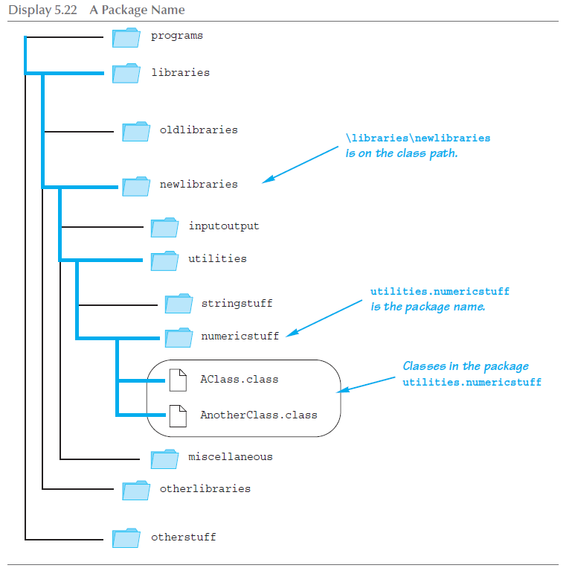
A Package Name

Slide 58
Pitfall: Subdirectories Are Not Automatically Imported
When a package is stored in a subdirectory of the directory containing another package, importing the enclosing package does not import the subdirectory package
The import statement:
import utilities.numericstuff.*;
imports the utilities.numericstuff package only
The import statements:
import utilities.numericstuff.*;
import utilities.numericstuff.statistical.*;
import both the utilities.numericstuff and
utilities.numericstuff.statistical packages

Slide 59
The Default Package
All the classes in the current directory belong to an unnamed package called the default package
As long as the current directory (.) is part of the CLASSPATH variable, all the classes in the default package are automatically available to a program

Slide 60
Pitfall: Not Including the Current Directory in Your Class Path
If the CLASSPATH variable is set, the current directory must be included as one of the alternatives
Otherwise, Java may not even be able to find the .class files for the program itself
If the CLASSPATH variable is not set, then all the class files for a program must be put in the current directory

Slide 61
Specifying a Class Path When You Compile
The class path can be manually specified when a class is compiled
Just add –classpath followed by the desired class path
This will compile the class, overriding any previous CLASSPATH setting
You should use the –classpath option again when the class is run

Slide 62
Name Clashes
In addition to keeping class libraries organized, packages provide a way to deal with name clashes: a situation in which two classes have the same name
Different programmers writing different packages may use the same name for one or more of their classes
This ambiguity can be resolved by using the fully qualified name (i.e., precede the class name by its package name) to distinguish between each class
package_name.ClassName
If the fully qualified name is used, it is no longer necessary to import the class (because it includes the package name already)

Slide 63
Introduction to javadoc
Unlike a language such as C++, Java places both the interface and the implementation of a class in the same file
However, Java has a program called javadoc that automatically extracts the interface from a class definition and produces documentation
This information is presented in HTML format, and can be viewed with a Web browser
If a class is correctly commented, a programmer need only refer to this API (Application Programming Interface) documentation in order to use the class
javadoc can obtain documentation for anything from a single class to an entire package

Slide 64
Commenting Classes for javadoc
The javadoc program extracts class headings, the headings for some comments, and headings for all public methods, instance variables, and static variables
In the normal default mode, no method bodies or private items are extracted
To extract a comment, the following must be true:
The comment must immediately precede a public class or method definition, or some other public item
The comment must be a block comment, and the opening /* must contain an extra * ( /** . . . */ )
Note: Extra options would have to be set in order to extract line comments ( // ) and private items

Slide 65
Commenting Classes for javadoc
In addition to any general information, the comment preceding a public method definition should include descriptions of parameters, any value returned, and any exceptions that might be thrown
This type of information is preceded by the @ symbol and is called an @ tag
@ tags come after any general comment, and each one is on a line by itself
/**
General Comments about the method . . .
@param aParameter Description of aParameter
@return What is returned
. . .
*/

Slide 66
@ Tags
@ tags should be placed in the order found below
If there are multiple parameters, each should have its own @param on a separate line, and each should be listed according to its left-to-right order on the parameter list
If there are multiple authors, each should have its own @author on a separate line
@param Parameter_Name Parameter_Description
@return Description_Of_Value_Returned
@throws Exception_Type Explanation
@deprecated
@see Package_Name.Class_Name
@author Author
@version Version_Information

Slide 67
Running javadoc
To run javadoc on a package, give the following command:
javadoc –d Documentation_Directory Package_Name
The HTML documents produced will be placed in the Documentation_Directory
If the –d and Documentation_Directory are omitted, javadoc will create suitable directories for the documentation
To run javadoc on a single class, give the following command from the directory containing the class file: javadoc ClassName.java
To run javadoc on all the classes in a directory, give the following command instead: javadoc *.java

Slide 68
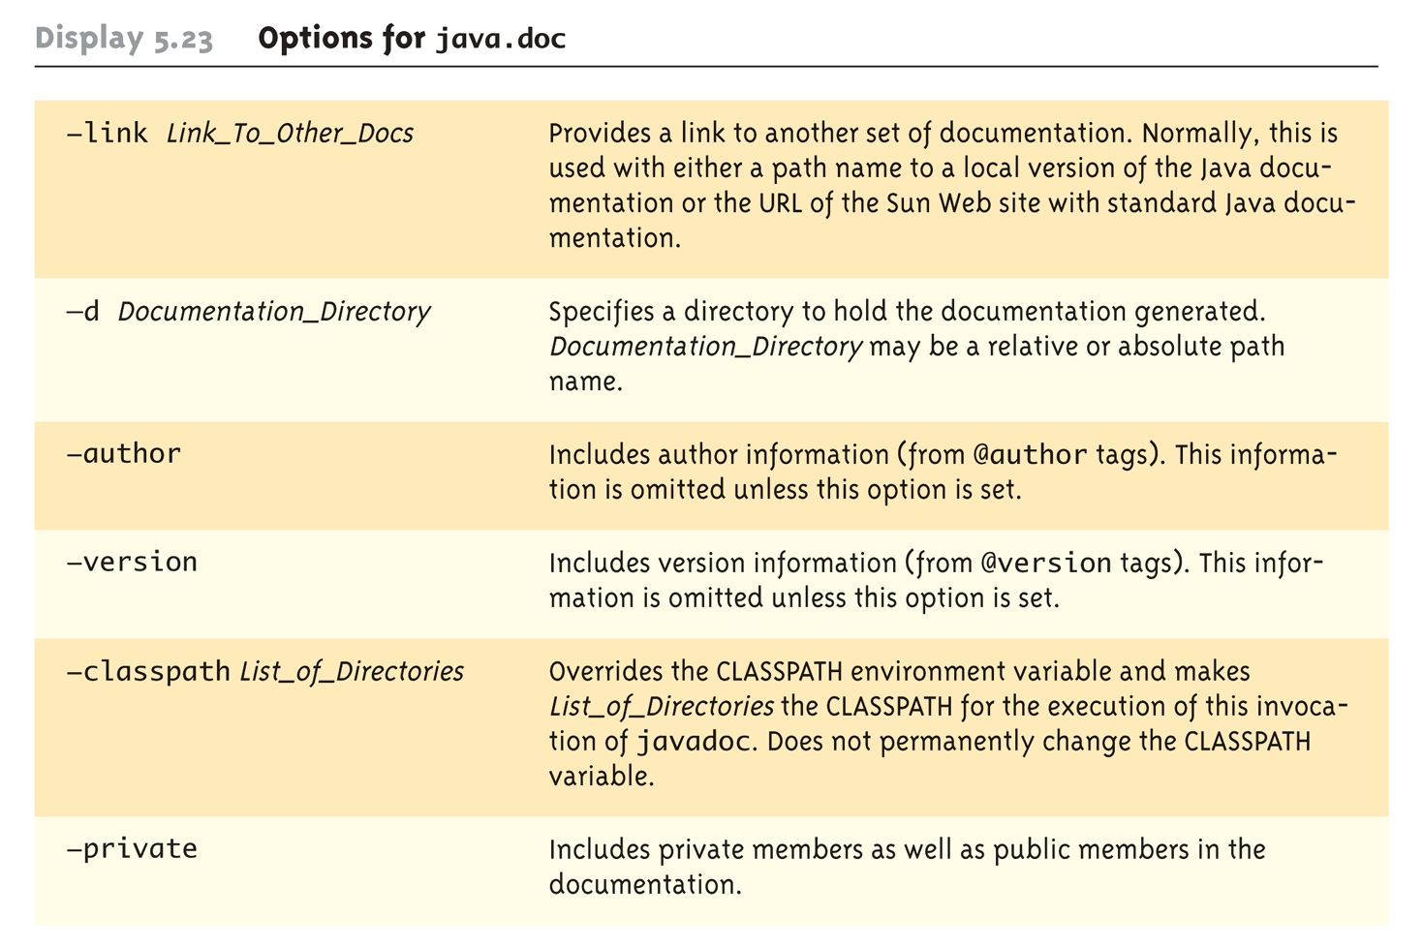
Options for javadoc

