Slide 1
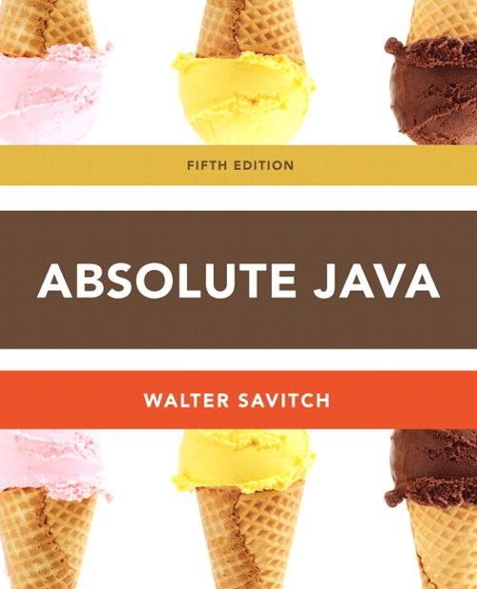
Chapter 12
UML and Patterns
Slides prepared by Rose Williams, Binghamton University
Kenrick Mock, University of Alaska Anchorage

Slide 2
Introduction to UML and Patterns
UML and patterns are two software design tools that can be used within the context of any OOP language
UML is a graphical language used for designing and documenting OOP software
A pattern in programming is a kind of template or outline of a software task
A pattern can be realized as different code in different, but similar, applications

Slide 3
UML
Pseudocode is a way of representing a program in a linear and algebraic manner
It simplifies design by eliminating the details of programming language syntax
Graphical representation systems for program design have also been used
Flowcharts and structure diagrams for example
Unified Modeling Language (UML) is yet another graphical representation formalism
UML is designed to reflect and be used with the OOP philosophy

Slide 4
History of UML
As OOP has developed, different groups have developed graphical or other representations for OOP design
In 1996, Brady Booch, Ivar Jacobson, and James Rumbaugh released an early version of UML
Its purpose was to produce a standardized graphical representation language for object-oriented design and documentation
Since then, UML has been developed and revised in response to feedback from the OOP community
Today, the UML standard is maintained and certified by the Object Management Group (OMG)

Slide 5
UML Class Diagrams
Classes are central to OOP, and the class diagram is the easiest of the UML graphical representations to understand and use
A class diagram is divided up into three sections
The top section contains the class name
The middle section contains the data specification for the class
The bottom section contains the actions or methods of the class

Slide 6
UML Class Diagrams
The data specification for each piece of data in a UML diagram consists of its name, followed by a colon, followed by its type
Each name is preceded by a character that specifies its access type:
A minus sign (-) indicates private access
A plus sign (+) indicates public access
A sharp (#) indicates protected access
A tilde (~) indicates package access

Slide 7
UML Class Diagrams
Each method in a UML diagram is indicated by the name of the method, followed by its parenthesized parameter list, a colon, and its return type
The access type of each method is indicated in the same way as for data

Slide 8
UML Class Diagrams
A class diagram need not give a complete description of the class
If a given analysis does not require that all the class members be represented, then those members are not listed in the class diagram
Missing members are indicated with an ellipsis (three dots)

Slide 9
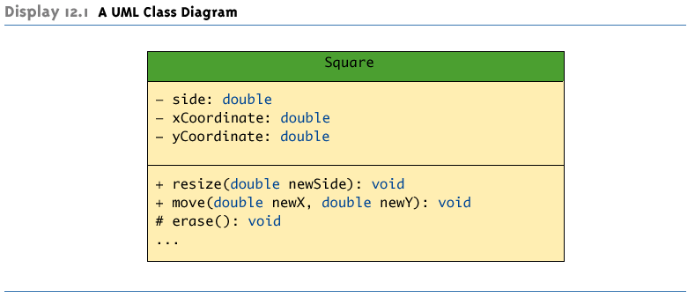
A UML Class Diagram

Slide 10
Class Interactions
Rather than show just the interface of a class, class diagrams are primarily designed to show the interactions among classes
UML has various ways to indicate the information flow from one class object to another using different sorts of annotated arrows
UML has annotations for class groupings into packages, for inheritance, and for other interactions
In addition to these established annotations, UML is extensible

Slide 11
Inheritance Diagrams
An inheritance diagram shows the relationship between a base class and its derived class(es)
Normally, only as much of the class diagram is shown as is needed
Note that each derived class may serve as the base class of its derived class(es)
Each base class is drawn above its derived class(es)
An upward pointing arrow is drawn between them to indicate the inheritance relationship

Slide 12
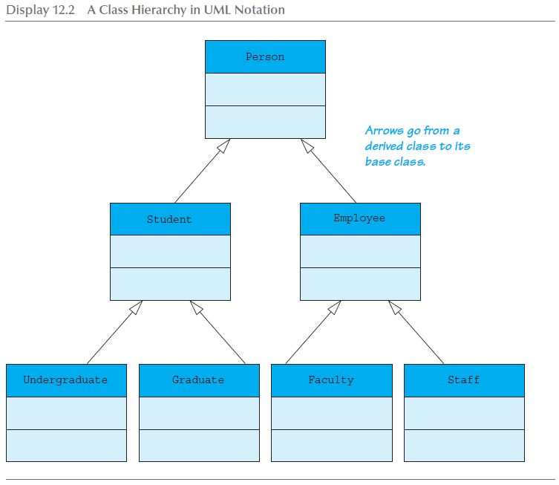
A Class Hierarchy in UML Notation

Slide 13
Inheritance Diagrams
The arrows also help in locating method definitions
To look for a method definition for a class:
Examine the class definition first
If the method is not found, the path of connecting arrows will show the order and direction in which to search
Examine the parent class indicated by the connecting arrow
If the method is still not found, then examine this parent's parent class indicated by the connecting arrow
Continue until the method is found, or until the top base class is reached

Slide 14
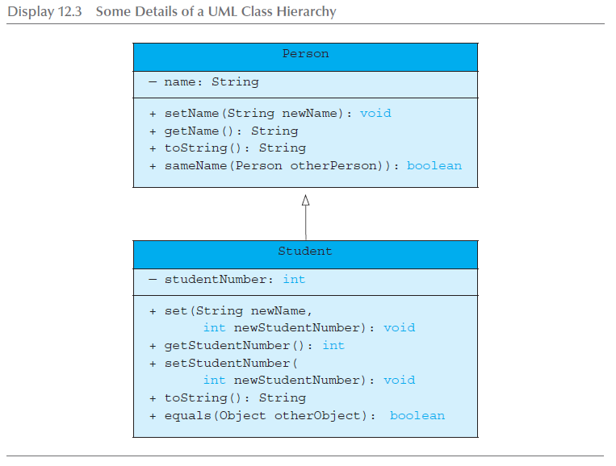
Some Details of a UML Class Hierarchy

