Slide 1
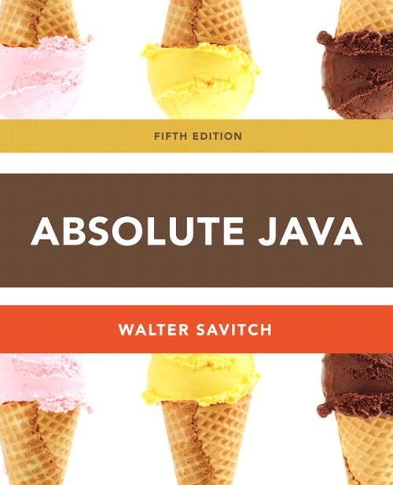
Chapter 6
Arrays
Slides prepared by Rose Williams, Binghamton University
Kenrick Mock, University of Alaska Anchorage

Slide 2
Introduction to Arrays
An array is a data structure used to process a collection of data that is all of the same type
An array behaves like a numbered list of variables with a uniform naming mechanism
It has a part that does not change: the name of the array
It has a part that can change: an integer in square brackets
For example, given five scores:
score[0], score[1], score[2], score[3], score[4]

Slide 3
Creating and Accessing Arrays
An array that behaves like this collection of variables, all of type double, can be created using one statement as follows:
double[] score = new double[5];
Or using two statements:
double[] score;
score = new double[5];
The first statement declares the variable score to be of the array type double[]
The second statement creates an array with five numbered variables of type double and makes the variable score a name for the array

Slide 4
Creating and Accessing Arrays
The individual variables that together make up the array are called indexed variables
They can also be called subscripted variables or elements of the array
The number in square brackets is called an index or subscript
In Java, indices must be numbered starting with 0, and nothing else
score[0], score[1], score[2], score[3], score[4]

Slide 5
Creating and Accessing Arrays
The number of indexed variables in an array is called the length or size of the array
When an array is created, the length of the array is given in square brackets after the array type
The indexed variables are then numbered starting with 0, and ending with the integer that is one less than the length of the array
score[0], score[1], score[2], score[3], score[4]

Slide 6
Creating and Accessing Arrays
double[] score = new double[5];
A variable may be used in place of the integer (i.e., in place of the integer 5 above)
The value of this variable can then be read from the keyboard
This enables the size of the array to be determined when the program is run
double[] score = new double[count];
An array can have indexed variables of any type, including any class type
All of the indexed variables in a single array must be of the same type, called the base type of the array

Slide 7
Declaring and Creating an Array
An array is declared and created in almost the same way that objects are declared and created:
BaseType[] ArrayName = new BaseType[size];
The size may be given as an expression that evaluates to a nonnegative integer, for example, an int variable
char[] line = new char[80];
double[] reading = new double[count];
Person[] specimen = new Person[100];

Slide 8
Referring to Arrays and Array Elements
Each array element can be used just like any other single variable by referring to it using an indexed expression: score[0]
The array itself (i.e., the entire collection of indexed variables) can be referred to using the array name (without any square brackets): score
An array index can be computed when a program is run
It may be represented by a variable: score[index]
It may be represented by an expression that evaluates to a suitable integer: score[next + 1]

Slide 9
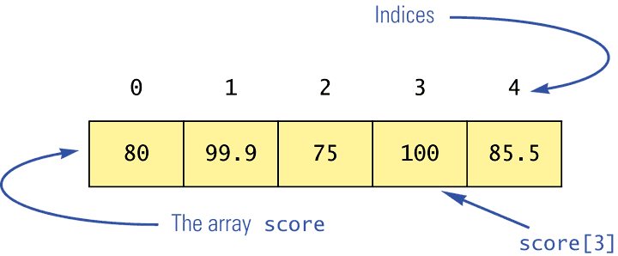
Using the score Array in a Program
The for loop is ideally suited for performing array manipulations:
for (index = 0; index < 5; index++)
System.out.println(score[index] +
" differs from max by " +
(max-score[index]) );

Slide 10
Three Ways to Use Square Brackets [] with an Array Name
Square brackets can be used to create a type name:
double[] score;
Square brackets can be used with an integer value as part of the special syntax Java uses to create a new array:
score = new double[5];
Square brackets can be used to name an indexed variable of an array:
max = score[0];

Slide 11
The length Instance Variable
An array is considered to be an object
Since other objects can have instance variables, so can arrays
Every array has exactly one instance variable named length
When an array is created, the instance variable length is automatically set equal to its size
The value of length cannot be changed (other than by creating an entirely new array with new)
double[] score = new double[5];
Given score above, score.length has a value of 5

Slide 12
Pitfall: Array Index Out of Bounds
Array indices always start with 0, and always end with the integer that is one less than the size of the array
The most common programming error made when using arrays is attempting to use a nonexistent array index
When an index expression evaluates to some value other than those allowed by the array declaration, the index is said to be out of bounds
An out of bounds index will cause a program to terminate with a run-time error message
Array indices get out of bounds most commonly at the first or last iteration of a loop that processes the array: Be sure to test for this!

Slide 13
Initializing Arrays
An array can be initialized when it is declared
Values for the indexed variables are enclosed in braces, and separated by commas
The array size is automatically set to the number of values in the braces
int[] age = {2, 12, 1};
Given age above, age.length has a value of 3

Slide 14
Initializing Arrays
Another way of initializing an array is by using a for loop
double[] reading = new double[100];
int index;
for (index = 0;
index < reading.length; index++)
reading[index] = 42.0;
If the elements of an array are not initialized explicitly, they will automatically be initialized to the default value for their base type

Slide 15
Pitfall: An Array of Characters Is Not a String
An array of characters is conceptually a list of characters, and so is conceptually like a string
However, an array of characters is not an object of the class String
char[] a = {'A', 'B', 'C'};
String s = a; //Illegal!
An array of characters can be converted to an object of type String, however

Slide 16
Pitfall: An Array of Characters Is Not a String
The class String has a constructor that has a single parameter of type char[]
String s = new String(a);
The object s will have the same sequence of characters as the entire array a ("ABC"), but is an independent copy
Another String constructor uses a subrange of a character array instead
String s2 = new String(a,0,2);
Given a as before, the new string object is "AB"

Slide 17
Pitfall: An Array of Characters Is Not a String
An array of characters does have some things in common with String objects
For example, an array of characters can be output using println
System.out.println(a);
Given a as before, this would produce the output
ABC

