Slide 1
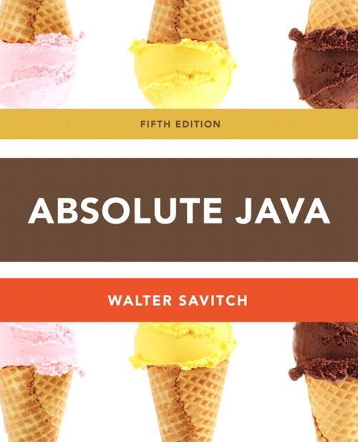
Chapter 5
Defining Classes II
Slides prepared by Rose Williams, Binghamton University
Kenrick Mock, University of Alaska Anchorage

Slide 2
Static Methods
A static method is one that can be used without a calling object
A static method still belongs to a class, and its definition is given inside the class definition
When a static method is defined, the keyword static is placed in the method header
public static returnedType myMethod(parameters)
{ . . . }
Static methods are invoked using the class name in place of a calling object
returnedValue = MyClass.myMethod(arguments);

Slide 3
Pitfall: Invoking a Nonstatic Method Within a Static Method
A static method cannot refer to an instance variable of the class, and it cannot invoke a nonstatic method of the class
A static method has no this, so it cannot use an instance variable or method that has an implicit or explicit this for a calling object
A static method can invoke another static method, however

Slide 4
Tip: You Can Put a main in any Class
Although the main method is often by itself in a class separate from the other classes of a program, it can also be contained within a regular class definition
In this way the class in which it is contained can be used to create objects in other classes, or it can be run as a program
A main method so included in a regular class definition is especially useful when it contains diagnostic code for the class

Slide 5
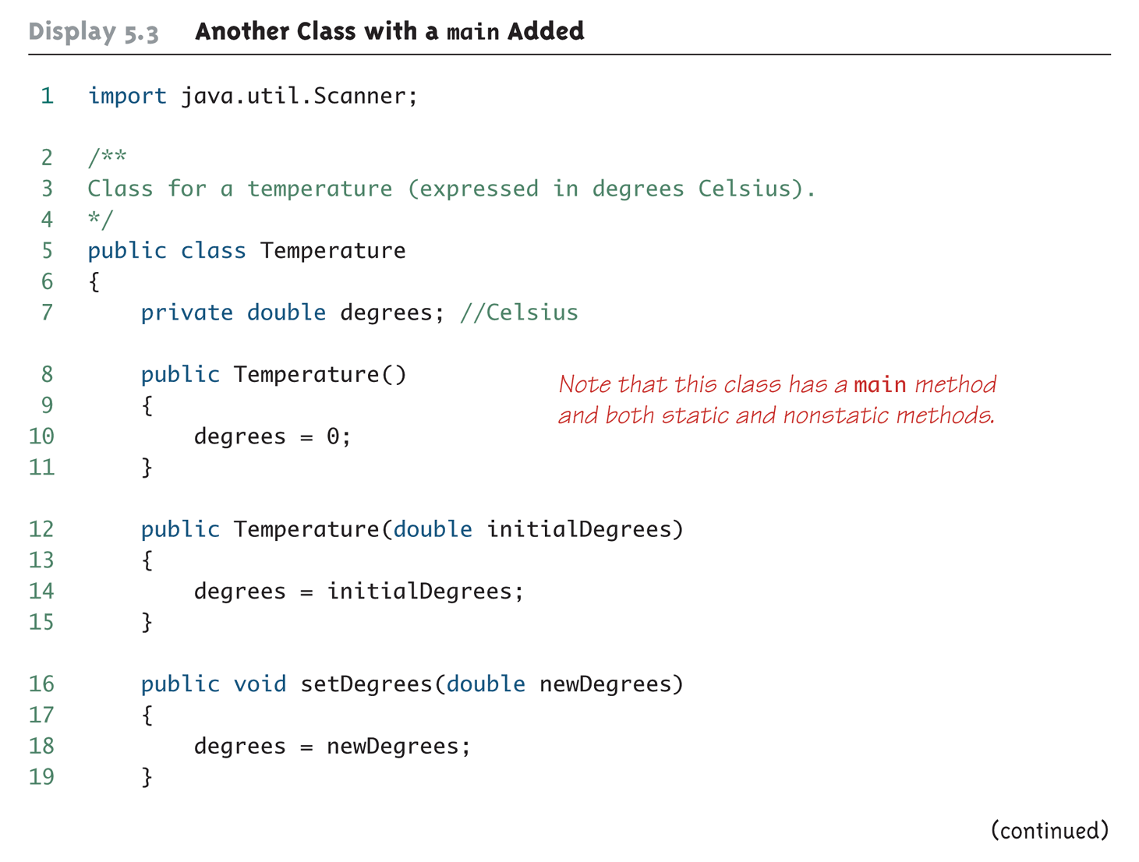
Another Class with a main Added (Part 1 of 4)

Slide 6
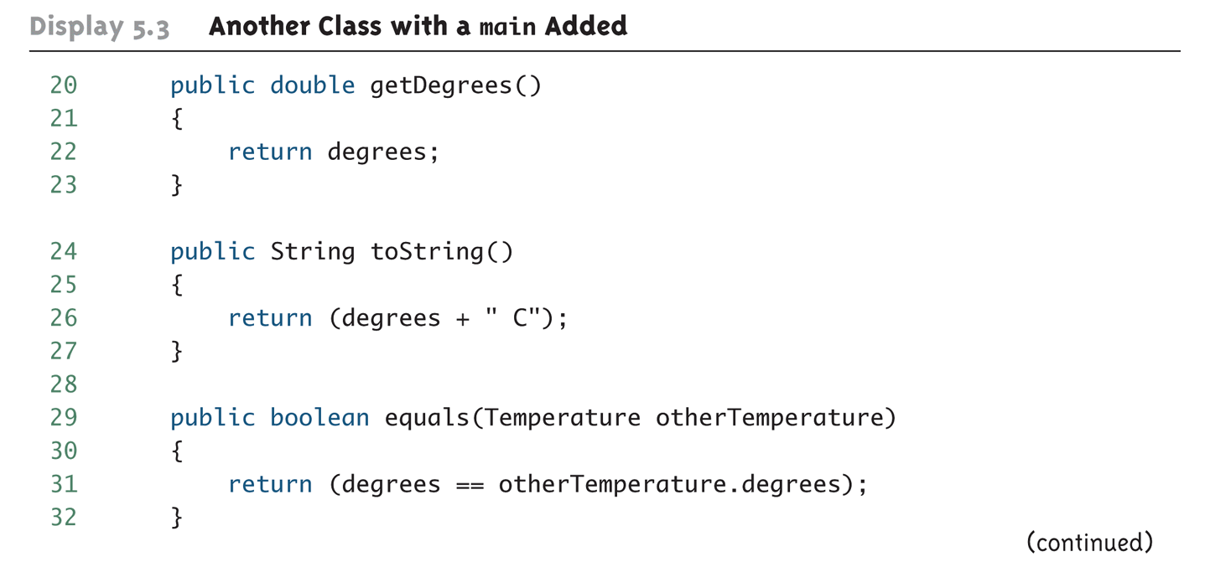
Another Class with a main Added (Part 2 of 4)

Slide 7
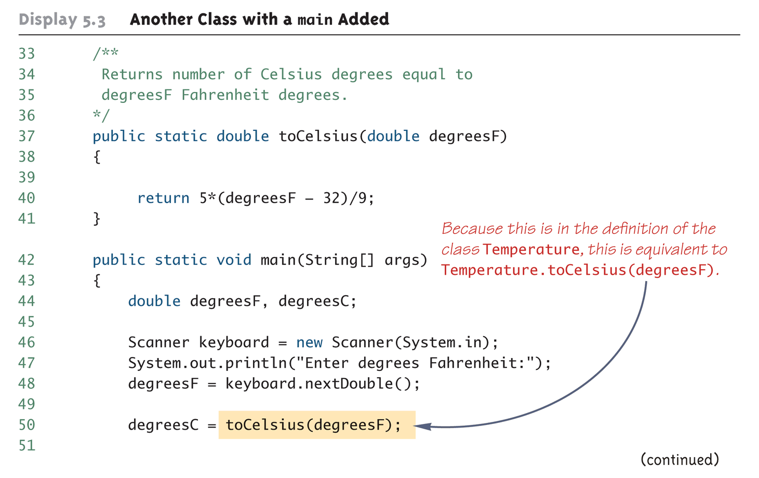
Another Class with a main Added (Part 3 of 4)

Slide 8
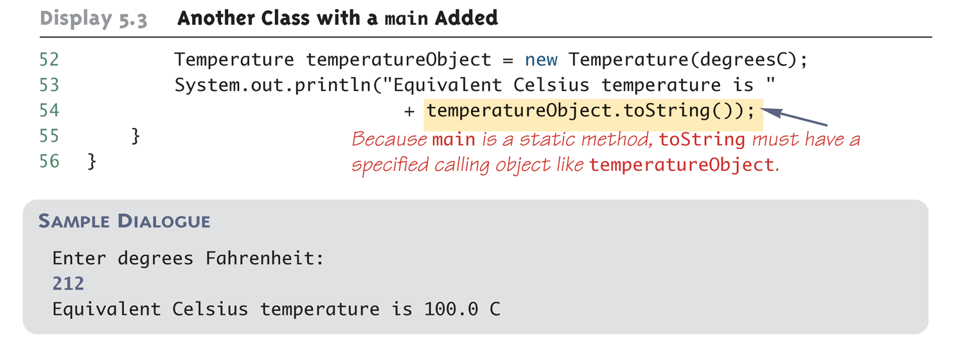
Another Class with a main Added (Part 4 of 4)

Slide 9
Static Variables
A static variable is a variable that belongs to the class as a whole, and not just to one object
There is only one copy of a static variable per class, unlike instance variables where each object has its own copy
All objects of the class can read and change a static variable
Although a static method cannot access an instance variable, a static method can access a static variable
A static variable is declared like an instance variable, with the addition of the modifier static
private static int myStaticVariable;

Slide 10
Static Variables
Static variables can be declared and initialized at the same time
private static int myStaticVariable = 0;
If not explicitly initialized, a static variable will be automatically initialized to a default value
boolean static variables are initialized to false
Other primitive types static variables are initialized to the zero of their type
Class type static variables are initialized to null
It is always preferable to explicitly initialize static variables rather than rely on the default initialization

Slide 11
Static Variables
A static variable should always be defined private, unless it is also a defined constant
The value of a static defined constant cannot be altered, therefore it is safe to make it public
In addition to static, the declaration for a static defined constant must include the modifier final, which indicates that its value cannot be changed
public static final int BIRTH_YEAR = 1954;
When referring to such a defined constant outside its class, use the name of its class in place of a calling object
int year = MyClass.BIRTH_YEAR;

Slide 12
The Math Class
The Math class provides a number of standard mathematical methods
It is found in the java.lang package, so it does not require an import statement
All of its methods and data are static, therefore they are invoked with the class name Math instead of a calling object
The Math class has two predefined constants, E (e, the base of the natural logarithm system) and PI (π, 3.1415 . . .)
area = Math.PI * radius * radius;

Slide 13
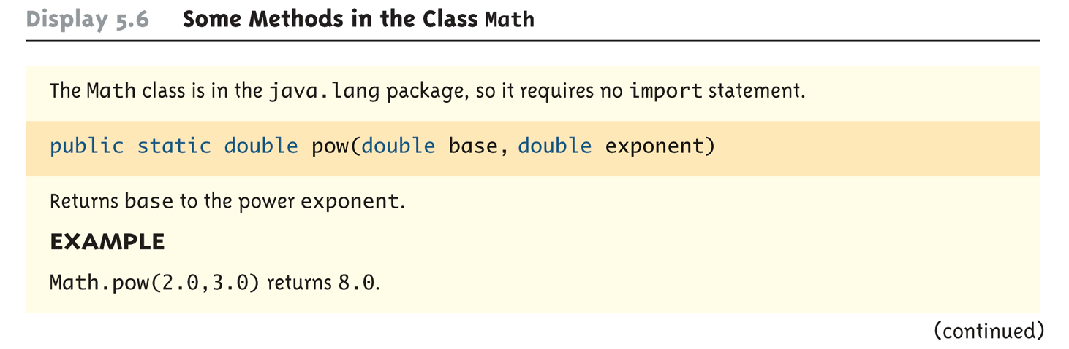
Some Methods in the Class Math (Part 1 of 5)

Slide 14
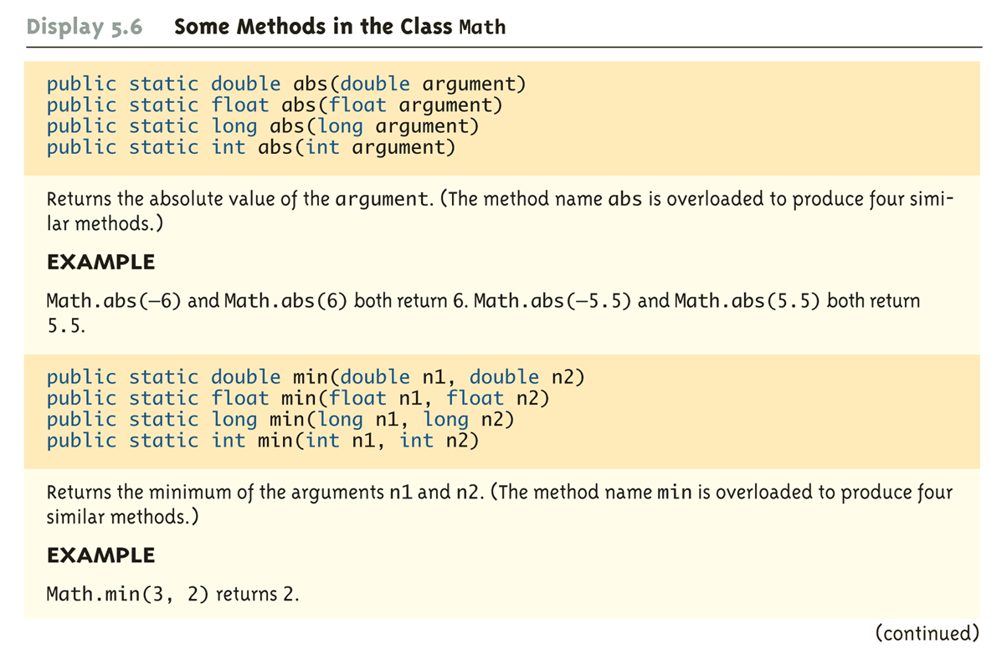
Some Methods in the Class Math (Part 2 of 5)

Slide 15
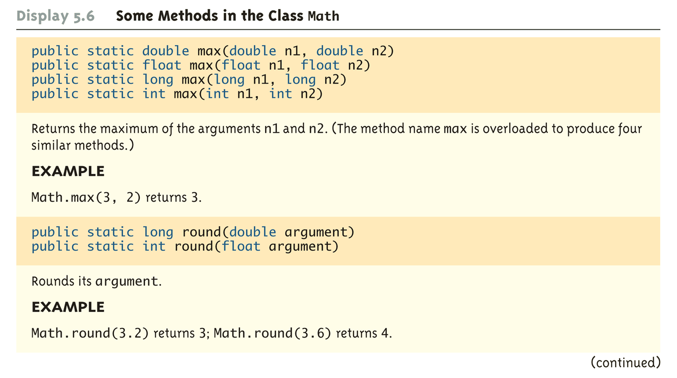
Some Methods in the Class Math (Part 3 of 5)

Slide 16
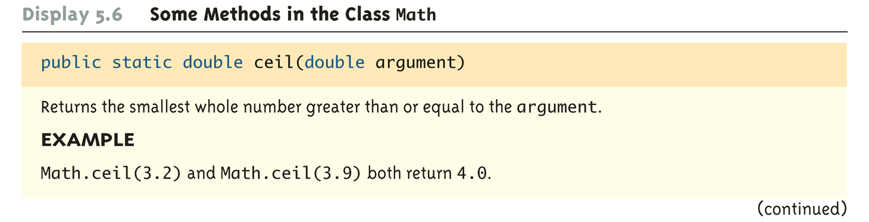
Some Methods in the Class Math (Part 4 of 5)

Slide 17
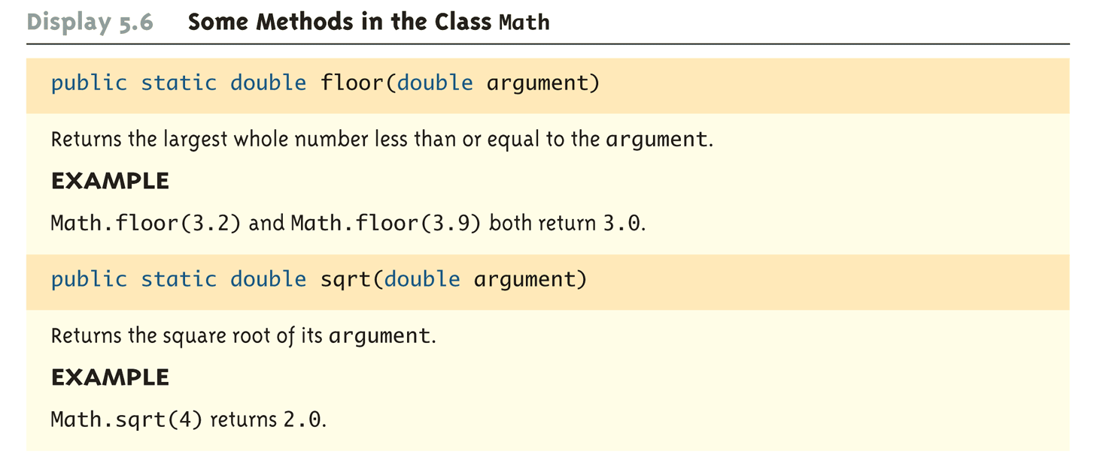
Some Methods in the Class Math (Part 5 of 5)

Slide 18
Random Numbers
The Math class also provides a facility to generate pseudo-random numbers
A pseudo-random number appears random but is really generated by a deterministic function
There is also a more flexible class named Random
Sample use:
Returns a pseudo-random number greater than or equal to 0.0 and less than 1.0
public static double random()
double num = Math.random();

Slide 19
Wrapper Classes
Wrapper classes provide a class type corresponding to each of the primitive types
This makes it possible to have class types that behave somewhat like primitive types
The wrapper classes for the primitive types byte, short, long, float, double, and char are (in order) Byte, Short, Long, Float, Double, and Character
Wrapper classes also contain a number of useful predefined constants and static methods

Slide 20
Wrapper Classes
Boxing: the process of going from a value of a primitive type to an object of its wrapper class
To convert a primitive value to an "equivalent" class type value, create an object of the corresponding wrapper class using the primitive value as an argument
The new object will contain an instance variable that stores a copy of the primitive value
Unlike most other classes, a wrapper class does not have a no-argument constructor
Integer integerObject = new Integer(42);

Slide 21
Wrapper Classes
Unboxing: the process of going from an object of a wrapper class to the corresponding value of a primitive type
The methods for converting an object from the wrapper classes Byte, Short, Integer, Long, Float, Double, and Character to their corresponding primitive type are (in order) byteValue, shortValue, intValue, longValue, floatValue, doubleValue, and charValue
None of these methods take an argument
int i = integerObject.intValue();

Slide 22
Automatic Boxing and Unboxing
Starting with version 5.0, Java can automatically do boxing and unboxing
Instead of creating a wrapper class object using the new operation (as shown before), it can be done as an automatic type cast:
Integer integerObject = 42;
Instead of having to invoke the appropriate method (such as intValue, doubleValue, charValue, etc.) in order to convert from an object of a wrapper class to a value of its associated primitive type, the primitive value can be recovered automatically
int i = integerObject;

Slide 23
Constants and Static Methods in Wrapper Classes
Wrapper classes include useful constants that provide the largest and smallest values for any of the primitive number types
For example, Integer.MAX_VALUE, Integer.MIN_VALUE, Double.MAX_VALUE, Double.MIN_VALUE, etc.
The Boolean class has names for two constants of type Boolean
Boolean.TRUE and Boolean.FALSE are the Boolean objects that correspond to the values true and false of the primitive type boolean

Slide 24
Constants and Static Methods in Wrapper Classes
Wrapper classes have static methods that convert a correctly formed string representation of a number to the number of a given type
The methods Integer.parseInt, Long.parseLong, Float.parseFloat, and Double.parseDouble do this for the primitive types (in order) int, long, float, and double
Wrapper classes also have static methods that convert from a numeric value to a string representation of the value
For example, the expression
Double.toString(123.99);
returns the string value "123.99"
The Character class contains a number of static methods that are useful for string processing

Slide 25
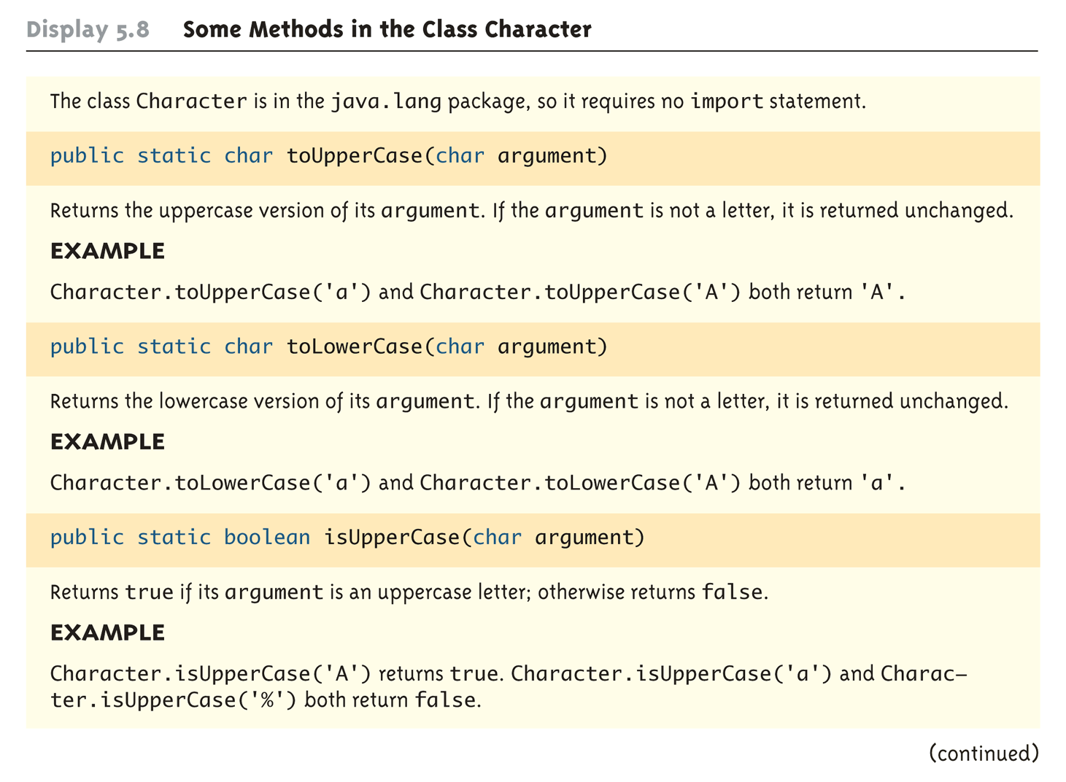
Some Methods in the Class Character (Part 1 of 3)

Slide 26
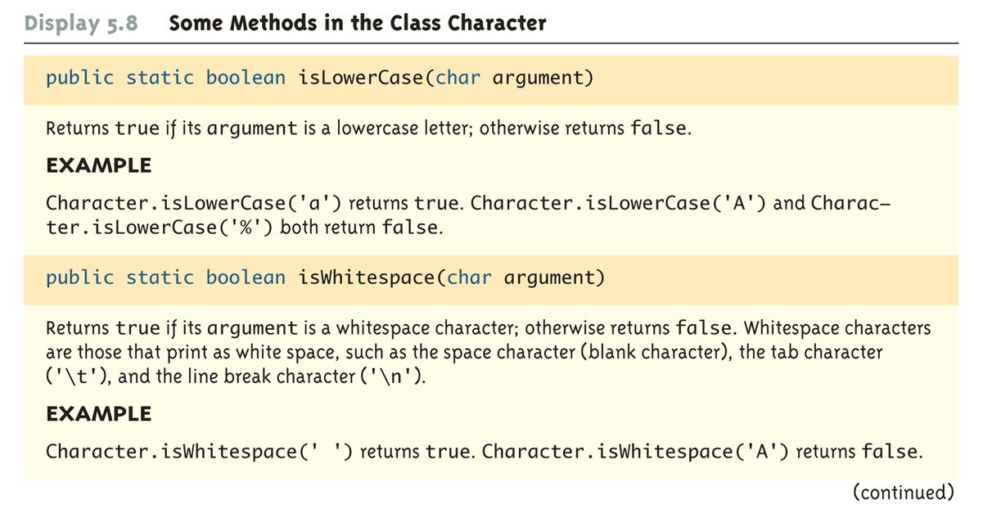
Some Methods in the Class Character (Part 2 of 3)

Slide 27
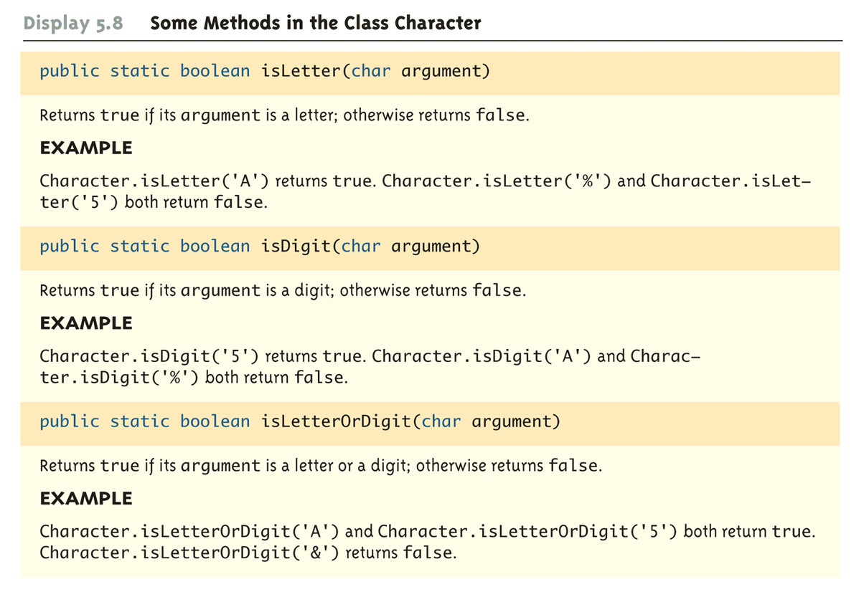
Some Methods in the Class Character (Part 3 of 3)

