Slide 1
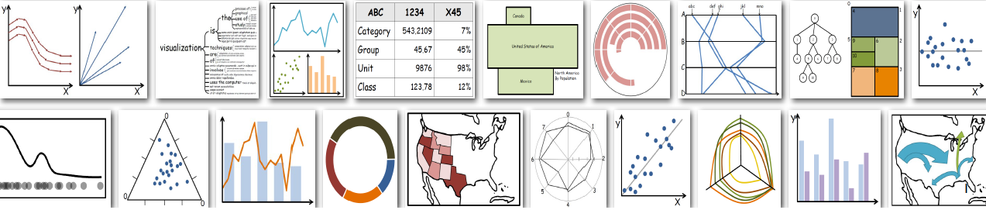
Business Analytics
Python-Seaborn

Slide 2
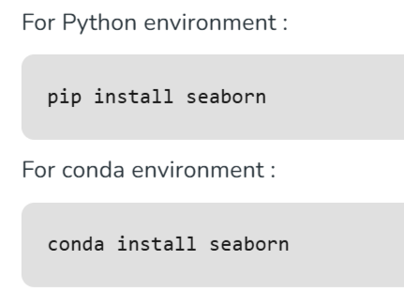
Seaborn Library
Seaborn is a Python data visualization library based on matplotlib. It provides a high-level interface for drawing attractive and informative statistical graphics.
Installation of Seaborn Library

Slide 3
Basic Plot Types
🔹 Categorical Plots
Bar Plot: sns.barplot()
Count Plot: sns.countplot()
Box Plot: sns.boxplot()
Violin Plot: sns.violinplot()
Strip/Swarm Plot: sns.stripplot(), sns.swarmplot()
🔹 Relational Plots
Scatter Plot: sns.scatterplot()
Line Plot: sns.lineplot()
🔹 Distribution Plots
Histogram: sns.histplot()
KDE Plot: sns.kdeplot()
Joint Plot: sns.jointplot()
Pair Plot: sns.pairplot()
🔹 Matrix Plots
Heatmap: sns.heatmap()
Clustermap: sns.clustermap()

Slide 4
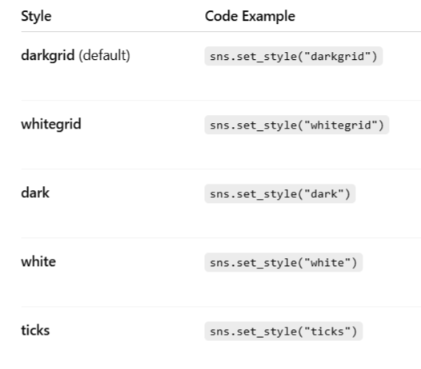
Styles (Background Themes)

Slide 5
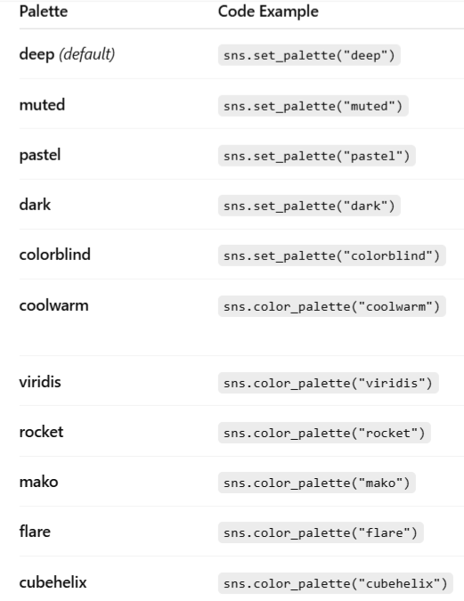
Palettes (Color Themes)

Slide 6
Example
A school wants to analyze how students perform in different subjects across the academic year. The principal collects the average exam scores for each month in Math, Science, and English. By plotting a heatmap, the school can visually identify patterns of high or low performance and spot months when students need more support.

Slide 7
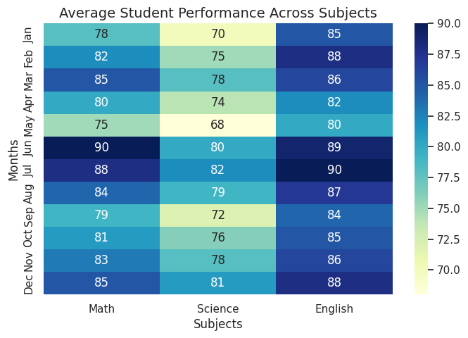
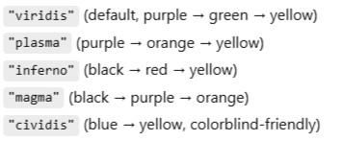
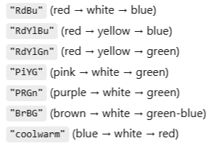
import matplotlib.pyplot as plt
import seaborn as sns
import pandas as pd
# Sample data: average exam scores per month
data = {
'Math': [78, 82, 85, 80, 75, 90, 88, 84, 79, 81, 83, 85],
'Science': [70, 75, 78, 74, 68, 80, 82, 79, 72, 76, 78, 81],
'English': [85, 88, 86, 82, 80, 89, 90, 87, 84, 85, 86, 88]
}
# Months
months = ["Jan", "Feb", "Mar", "Apr", "May", "Jun",
"Jul", "Aug", "Sep", "Oct", "Nov", "Dec"]
# Create DataFrame
df = pd.DataFrame(data, index=months)
# Create heatmap
plt.figure(figsize=(8, 5))
sns.heatmap(df, annot=True, cmap="YlGnBu")
plt.title("Average Student Performance Across Subjects", fontsize=14)
plt.xlabel("Subjects")
plt.ylabel("Months")
plt.show()

Slide 8
Why use Seaborn’s datasets?
Seaborn comes with ready-made datasets for practicing data visualization and analysis.
These datasets are clean, structured, and easy to understand.
import seaborn as sns
import matplotlib.pyplot as plt
import pandas as pd
# Load sample datasets
tips = sns.load_dataset("tips") # restaurant bills dataset
iris = sns.load_dataset("iris") # flower dataset
flights = sns.load_dataset("flights") # airline passengers dataset

Slide 9
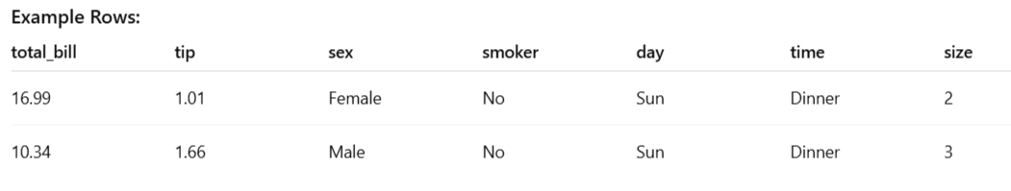
1. Tips Dataset
Description: Restaurant bills and tips (used for regression, categorical, and distribution plots).
Shape: 244 rows × 7 columns
Columns:
total_bill → Total bill (float)
tip → Tip amount (float)
sex → Gender of payer (Male/Female)
smoker → Whether smoker (Yes/No)
day → Day of the week (Thur, Fri, Sat, Sun)
time → Meal time (Lunch, Dinner)
size → Party size (int)

Slide 10
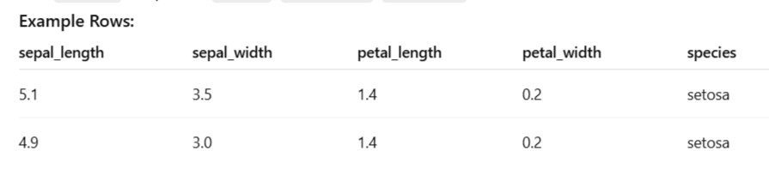
2. Iris Dataset
Description: Classic dataset of Iris flowers (used for classification, pairplots, scatterplots).
Shape: 150 rows × 5 columns
Columns:
sepal_length → Sepal length (cm)
sepal_width → Sepal width (cm)
petal_length → Petal length (cm)
petal_width → Petal width (cm)
species → Species (setosa, versicolor, virginica)

Slide 11
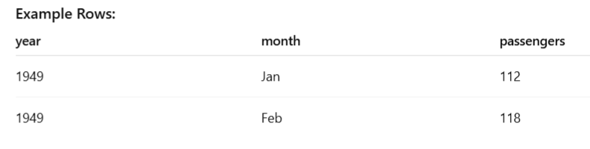
3. Flights Dataset
Description: Monthly airline passengers from 1949–1960 (used for line plots, heatmaps, clustermaps).
Shape: 144 rows × 3 columns
Columns:
year → Year (int)
month → Month (string, Jan–Dec)
passengers → Number of passengers (int)

Slide 12
Example
Imagine you are the manager of a restaurant. You want to analyze your billing records to see:
On which day of the week customers give higher tips.
This helps you understand customer patterns, so you can make better staffing or
marketing decisions (e.g., assigning more staff on high-tip days).
📂 Dataset Used: Tips
day → Day of the week (Thu, Fri, Sat, Sun).
tip → Tip amount given by customers.

Slide 13
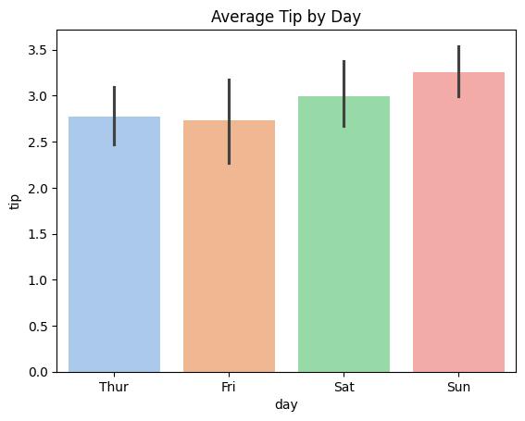
sns.barplot(x="day", y="tip", data=tips, hue="day", palette="pastel", legend=False)
plt.title("Average Tip by Day")
plt.show()
Note: By default, barplot computes the mean of the y variable (tip here) for each category on the x axis (day)
hue="day"
Normally hue is used to split bars by another category

Slide 14
Example
Imagine you are the restaurant manager. You want to know:
On which day of the week you serve the most customers.
This helps you decide:
Staff scheduling (more waiters/cooks on busy days).
Inventory planning (ordering more supplies for high-traffic days).
Marketing promotions (offer discounts on slower days).
Dataset Used: Tips
day → Day of the week (Thu, Fri, Sat, Sun).
Each row in the dataset represents one dining table (customer group).

Slide 15
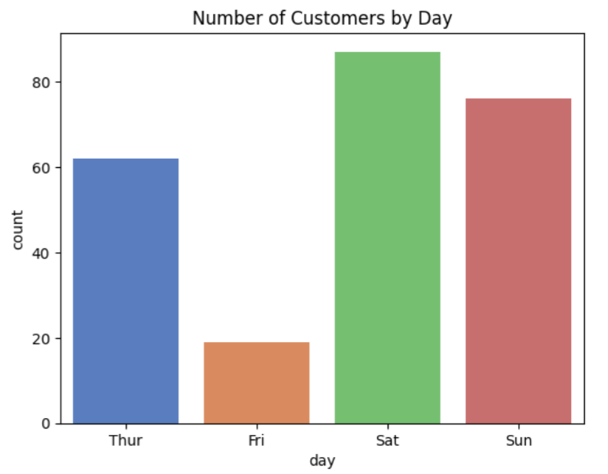
sns.countplot(x="day", data=tips, palette="muted")
plt.title("Number of Customers by Day")
plt.show()

Slide 16
Example
Imagine you are the restaurant manager. You’re curious:
Do male and female customers leave different tip amounts?
Are there any outliers (very high or very low tips)?
This can help understand customer behavior and possibly design targeted promotions.
📂 Dataset Used: Tips
sex → Gender of the customer (Male/Female).
tip → Tip amount given.

Slide 17
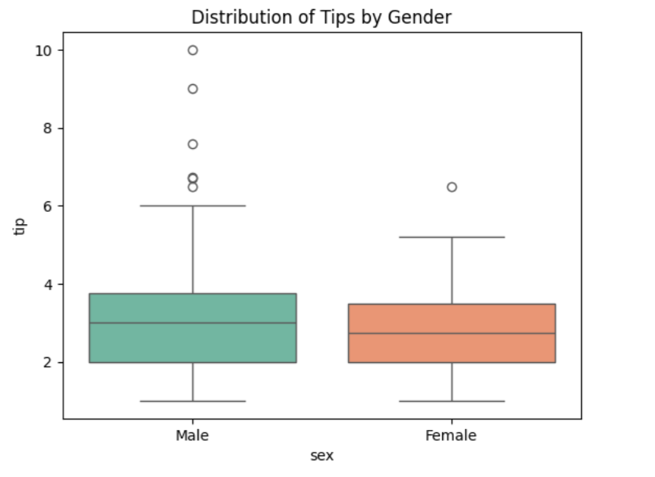
sns.boxplot(x="sex", y="tip", data=tips, palette="Set2")
plt.title("Distribution of Tips by Gender")
plt.show()

Slide 18
Example
Imagine you are the restaurant manager. You want to compare customer spending patterns at:
Lunch vs Dinner.
This helps decide:
Which time is more profitable.
Where to focus promotions (e.g., lunch specials if lunch bills are lower).
How to plan staffing & resources.
📂 Dataset Used: Tips
time → When the meal was served (Lunch/Dinner).
total_bill → Total amount of the customer’s bill.

Slide 19
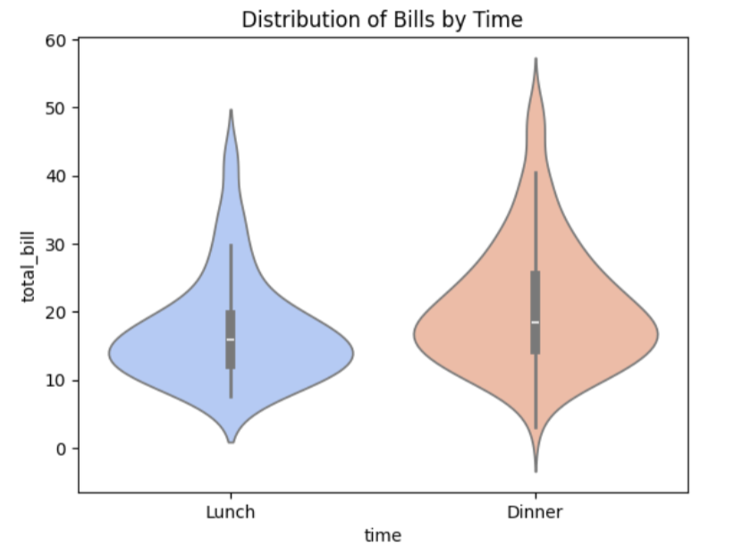
sns.violinplot(x="time", y="total_bill", data=tips, palette="coolwarm")
plt.title("Distribution of Bills by Time")
plt.show()

Slide 20
Example
As a restaurant manager, sometimes you don’t just want averages — you want to see the actual tip values.
Do tips cluster around certain amounts (e.g., 2–5 dollars)?
Are there outliers (very high tips)?
Do weekends show more generous tipping patterns?
This is where strip plots and swarm plots help.
📂 Dataset Used: Tips
day → Day of the week.
tip → Tip amount.

Slide 21
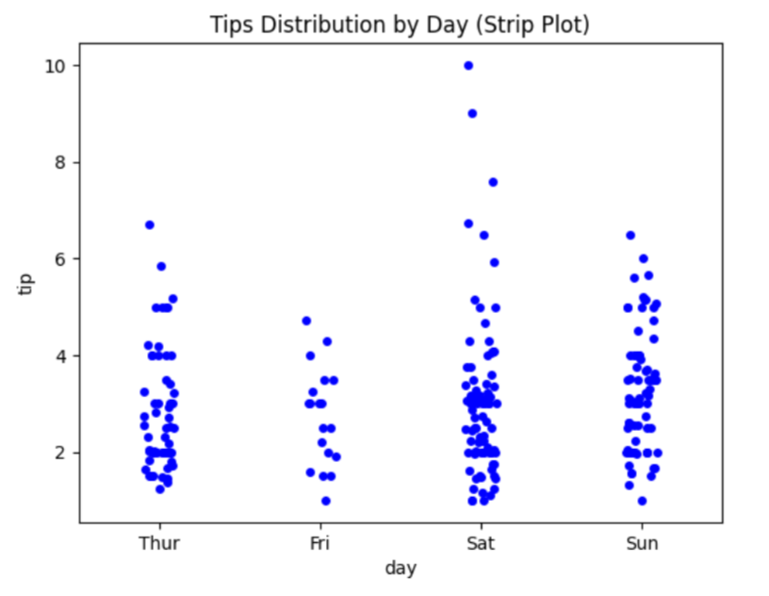
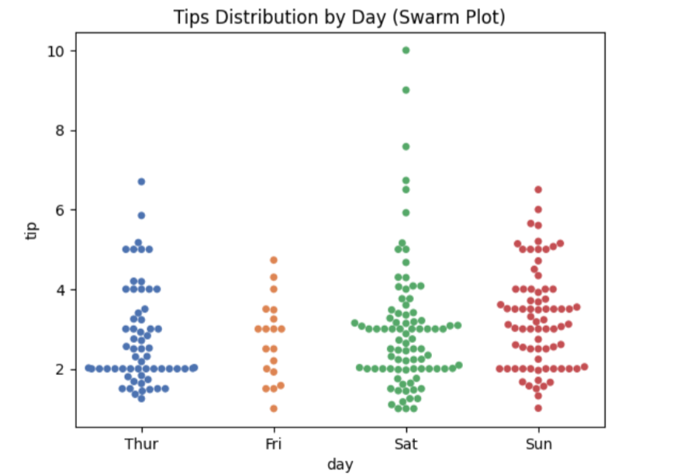
sns.stripplot(x="day", y="tip", data=tips, jitter=True, color="blue")
plt.title("Tips Distribution by Day (Strip Plot)")
plt.show()
sns.swarmplot(x="day", y="tip", data=tips, palette="deep")
plt.title("Tips Distribution by Day (Swarm Plot)")
plt.show()
Strip Plot | Swarm Plot
Random (with jitter) | Smart, automatic spacing
Can still overlap (if dense) | Avoids overlap completely
Large datasets, quick visualization | Smaller datasets, clear view of all points

Slide 22
Example
Imagine you are the restaurant manager. You want to understand the relationship between:
Total Bill (how much the customer spends)
Tip (how much they leave as a tip)
This helps answer:
Do customers usually tip more when the bill is larger?
Does this trend vary by gender or by meal time (Lunch/Dinner)?
Dataset Used: Tips
total_bill → Total customer bill (x-axis).
tip → Tip amount given (y-axis).
sex → Gender of the customer (colored by hue).
time → Meal time (Lunch/Dinner, shown by style markers).

Slide 23
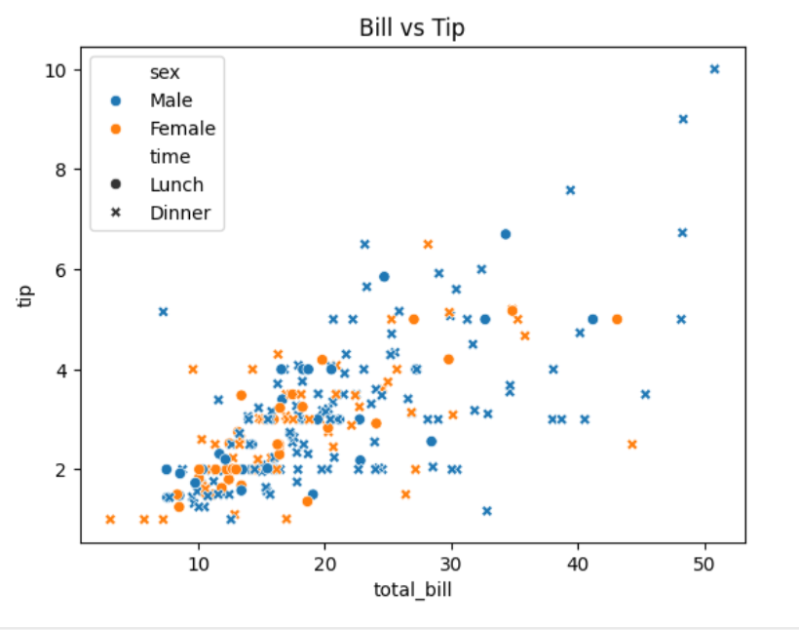
sns.scatterplot(x="total_bill", y="tip", hue="sex", style="time", data=tips)
plt.title("Bill vs Tip")
plt.show()

Slide 24
Example
Imagine you are an airline company manager or a transportation analyst. You want to analyze:
How airline passenger traffic has changed year by year.
Whether there is a steady growth trend in air travel.
Are there any years where passenger numbers dipped or grew faster?
This helps in long-term planning for:
Increasing staff and crew.
Planning new routes or seasonal offers
Dataset Used: Flights
year → Calendar year (1949–1960).
passengers → Number of passengers (in thousands).

Slide 25
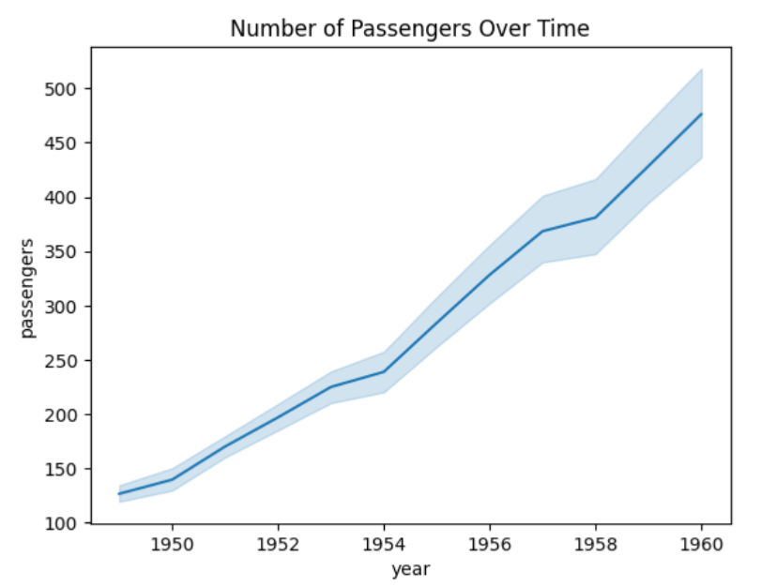
sns.lineplot(x="year", y="passengers", data=flights)
plt.title("Number of Passengers Over Time")
plt.show()

Slide 26
Example
As a restaurant manager, you want to know:
What bill amounts are most frequently generated.
Are most customer bills small, medium, or large?
This helps in:
Menu pricing (setting meal prices in the popular spending range).
Inventory planning (knowing how much customers usually order).
Dataset Used: Tips
total_bill → The total amount of a customer’s bill.

Slide 27
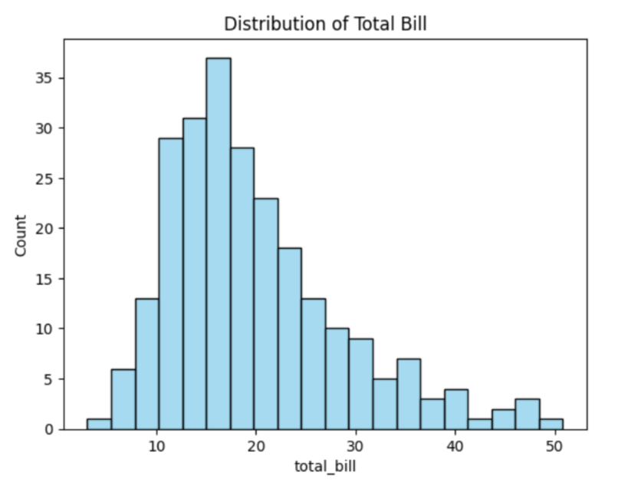
sns.histplot(tips["total_bill"], bins=20, kde=False, color="skyblue")
plt.title("Distribution of Total Bill")
plt.show()

Slide 28
Example
As a restaurant manager, instead of just seeing counts (like in a histogram),
you want a smooth curve that shows where tip values are concentrated.
Do most customers tip low, medium, or high amounts?
Are there multiple peaks (common tipping habits)?
This helps in understanding tipping behavior trends.
📂 Dataset Used: Tips
tip → The amount of tip left by customers.

Slide 29
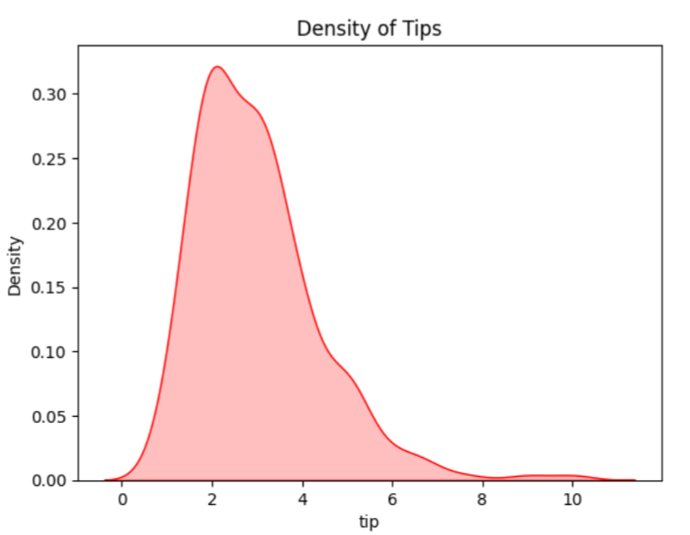
sns.kdeplot(tips["tip"], fill=True, color="red")
plt.title("Density of Tips")
plt.show()

Slide 30
Example
Imagine you are the restaurant manager. You don’t just want to see the relationship between bill size and tips — you also want to know the distribution of each variable separately.
A Joint Plot combines:
A scatter plot (bill vs tip → relationship).
Histograms or KDE plots (for each variable’s distribution).
This gives a complete view of both correlation and spread.
📂 Dataset Used: Tips
total_bill → Total customer bill.
tip → Tip amount given.
sex → Gender of the customer (colored by hue).

Slide 31
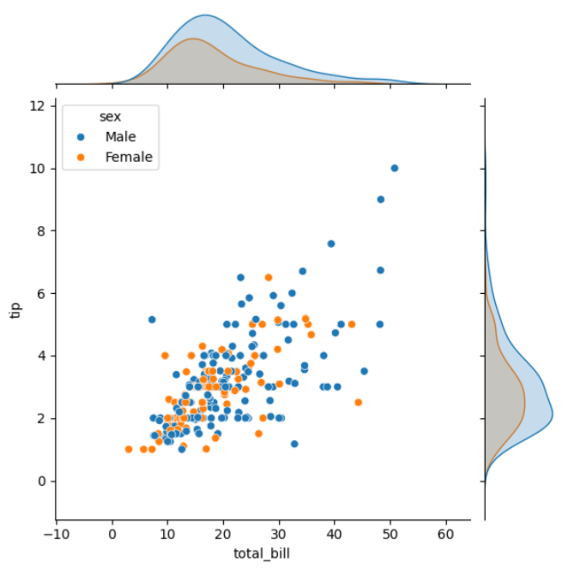
sns.jointplot(x="total_bill",
y="tip", data=tips, kind="scatter", hue="sex")
plt.show()
Do customers who spend more also tip more?
Does tipping behavior differ between male and female customers?

Slide 32
Example
Imagine you are a botanist studying the famous Iris dataset 🌸. You want to compare:
Sepal length vs Sepal width
Petal length vs Petal width
All possible combinations of these features
This helps in:
Understanding patterns in flower measurements.
Identifying which features are best for classifying flower species.
Training machine learning models for species prediction.
📂 Dataset Used: Iris
sepal_length
sepal_width
petal_length
petal_width
species (Setosa, Versicolor, Virginica)

Slide 33
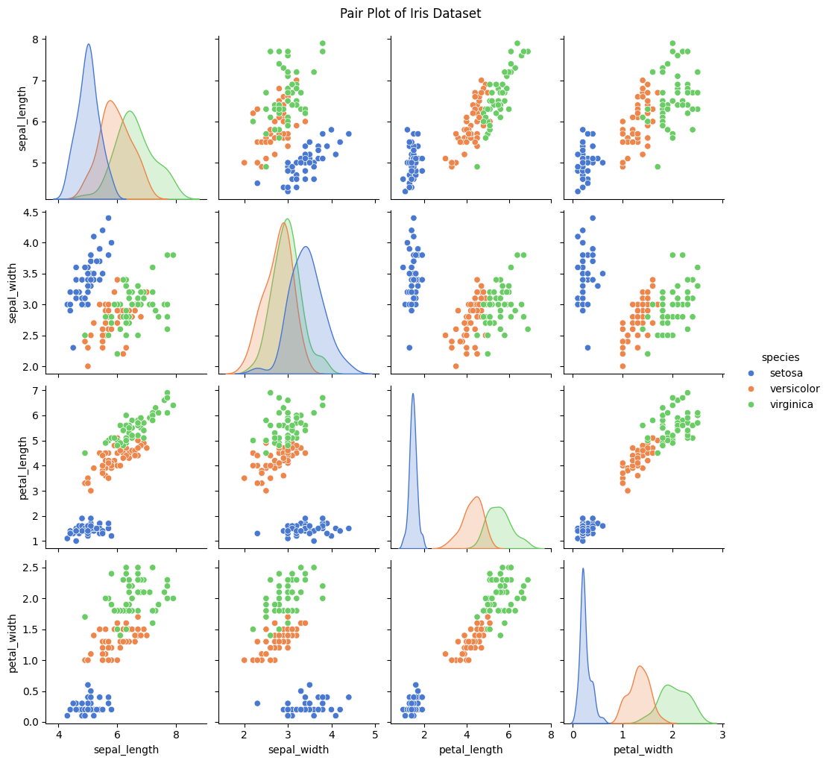
sns.pairplot(iris,
hue="species", palette="muted")
plt.title("Pair Plot of
Iris Dataset", y=1.02)
plt.show()

Slide 34
Example
Imagine you are an airline operations manager ✈️ analyzing passenger data from 1949–1960.
You want to know:
Which months attract the most passengers?
How has air travel demand changed year by year?
When should airlines add more flights or larger planes?
A heatmap helps by showing passenger counts across months (rows) and years (columns).
Darker colors → more passengers.
Lighter colors → fewer passengers.
📂 Dataset Used: Flights
year → 1949–1960
month → Jan–Dec
passengers → Number of airline passengers

Slide 35
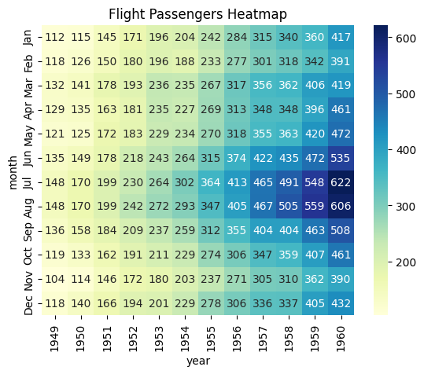
flights_pivot = flights.pivot(index="month", columns="year", values="passengers")
sns.heatmap(flights_pivot, annot=True, fmt="d", cmap="YlGnBu")
plt.title("Flight Passengers Heatmap")
plt.show()
To make a heatmap, we need a matrix (rows × columns).
pivot() reshapes the data:
index="month" → months go to the rows.
columns="year" → years go to the columns.

Slide 36
Example
Suppose an airline company wants to analyze seasonal travel patterns across multiple years. They have passenger data from 1949 to 1960, broken down month by month.
With the heatmap, we saw the raw passenger numbers for each month/year combination.
But management also wants to know:
Which months behave similarly across years?
Which years show similar travel demand patterns?
That’s where a clustermap helps.
What the Clustermap Shows
The rows (months) are reordered so that months with similar passenger trends are grouped together (e.g., July & August may cluster since they’re peak summer travel months).
The columns (years) are reordered so that years with similar overall passenger growth cluster (e.g., earlier years with low traffic group together, later years with higher traffic form another cluster).
The color scale still shows the passenger counts, but now you also get a hierarchical tree (dendrogram) on top and side, visually showing similarity between rows and columns.
Real-World Use Case
An airline analyst could use this to:
Identify peak travel months that consistently cluster together → helpful for scheduling extra flights.
Detect years with unusual passenger growth patterns (e.g., if one year clusters differently, maybe due to economic events or crises).
Compare seasonal demand cycles across decades to plan marketing strategies or dynamic pricing.

Slide 37
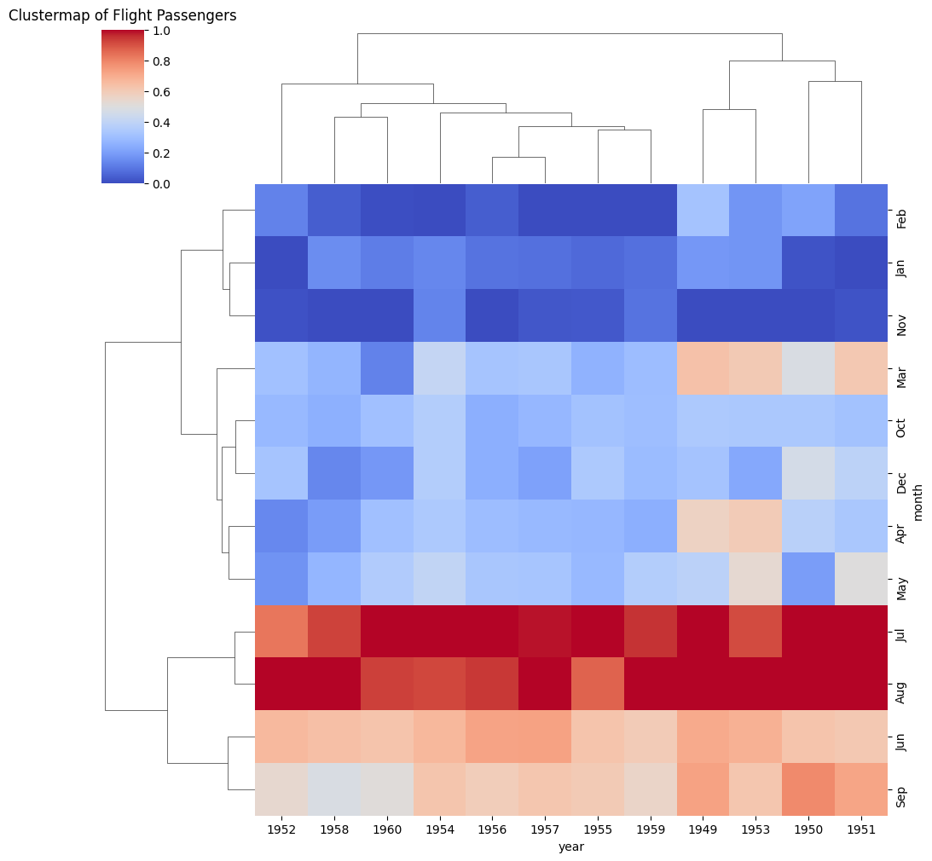
sns.clustermap(flights_pivot,
cmap="coolwarm",
standard_scale=1)
plt.title("Clustermap of Flight
Passengers", y=1.02)
plt.show()

Slide 38
Practice Questions: Tip Dataset
Plot the average tip percentage (tip/total_bill) by day of the week. (Which day shows the highest tipping percentage?)
Use a boxplot to compare the total bill distributions between smokers and non-smokers. (Does smoking status affect spending?)
Create a violin plot to compare the tip distribution by time (Lunch vs Dinner). (Do customers tip more generously at lunch or dinner?)
Make a strip plot showing party size vs. tip. (Is there a trend that larger groups tip more?)
Use a heatmap (correlation matrix) to visualize relationships between total_bill, tip, and size. (Which variables are most strongly correlated?)

Slide 39
Practice Questions: Iris Dataset
Plot a histogram of sepal_length. (What’s the most common sepal length range?)
Use a kdeplot to visualize the distribution of petal_width by species. (Which species has the widest petals?)
Create a pairplot for all numerical features with species as hue. (Which two features best separate the species?)
Use a boxplot to compare sepal_width across species. (Which species has the widest sepals?)
Plot a scatterplot of petal_length vs petal_width colored by species. (Do the species cluster separately?)

Slide 40
Practice Questions: Flight Dataset
Plot a lineplot of passengers per year. (Is there a clear upward trend in air travel?)
Create a heatmap of passengers by year and month (pivoted table). (Which month typically has the most passengers?)
Use a clustermap on the same pivoted table. (Do certain months group together based on passenger counts?)
Plot a boxplot of passengers grouped by month. (Which month shows the most variation in passenger counts?)
Plot a lineplot of passengers per month across years using hue = year. (Do seasonal trends repeat annually?)

Slide 41
THANK YOU!
Q/A?

