Slide 1
Customer Segmentation using Machine Learning
Internship Project in Data Science & Analytics
Presented By: Vincy Anton J

Slide 2
Abstract
This project applies K-Means clustering to segment customers based on income, age and spending behavior.

Slide 3
Objective
To group customers into meaningful clusters for better marketing strategy and decision making.

Slide 4
Dataset Description
Mall Customers Dataset
- 200 records
- Features: Gender, Age, Annual Income, Spending Score

Slide 5
Technologies Used
Python, Pandas, NumPy, Matplotlib, Seaborn, Scikit-learn

Slide 6
Exploratory Data Analysis
EDA performed to understand customer patterns and distribution.

Slide 7
Elbow Method
Used to determine optimal clusters.
Optimal K = 5

Slide 8
K-Means Clustering
Algorithm used to segment customers into distinct groups.

Slide 9
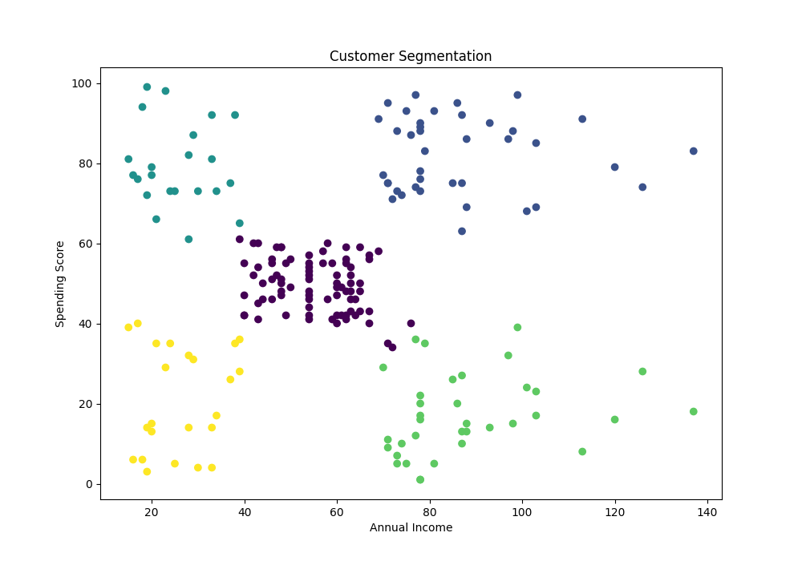
Results
Customers segmented into 5 clusters based on behavior and income.

Slide 10
Conclusion
Customer segmentation improves targeted marketing and business strategy.

