Slide 1
Car Brand Recognition
Naming the make of a car from a single photo with deep learning
Deep Learning semester project
Notes:
Hello everyone. This project is a car brand recognition system: you give it a photo of a car and it tells you which of 49 brands made it, for example Audi, BMW, Ferrari or Toyota. I will walk through the data, the model, the results, and the website where you can try it yourself.

Slide 2
The problem: which brand is this car?
Input: one photo of a car, any angle
Output: the brand, from 49 makes, with a confidence score
Hard because a brand spans many shapes, colours and years, while different brands can look alike
Use cases: parking and tolls, listings, insurance, fleet analytics
49
brands to tell apart
16,185
labelled photos in the dataset
Notes:
Recognising a car brand sounds easy for people, but cars from the same brand look very different across models and years, and cars from different brands can look alike. Applications include smart parking, traffic analysis, used-car listings and insurance. Our goal: build a classifier that takes any car photo and outputs the brand, and deploy it as a web app anyone can use.

Slide 3
Dataset: Stanford Cars
7,331
train photos
813
validation photos
8,041
test photos (official split)
Notes:
We used the public Stanford Cars dataset, a secondary dataset. It has 16185 photos, each labelled with make, model and year, 196 classes in total. We kept only the make, which gives 49 brands. We use the official test split of 8041 photos only for the final evaluation, and hold out ten percent of each brand's training photos for validation. The chart shows the imbalance: Chevrolet has over 1,700 photos while some brands have under 100, so we report macro F1 as well as accuracy and use mild class weights.

Slide 4
The pipeline, end to end
1
2
3
Data
Preprocess
Train
Stanford Cars, make extracted as label
224 x 224 RGB, train / val / test
transfer learning + fine-tuning
4
5
6
Evaluate
Export
Deploy
accuracy, F1, confusion matrix
Keras to ONNX, 24 MB
Vercel site, runs in the browser
Notes:
Here is the whole workflow. We download the dataset and turn the make-model-year labels into brand labels. We resize every photo to 224 by 224 pixels. A pre-trained EfficientNetV2 network is trained in two stages. We evaluate on the held-out test photos, export the model to the ONNX format, and the website runs that ONNX file directly in the browser.

Slide 5
Model: transfer learning with EfficientNetV2-B0
Photo
EfficientNetV2-B0
Average pool
Dropout + Dense
224 x 224 x 3
ImageNet weights, 5.9M params
1280 features
softmax, 49 brands
Stage 1: linear probe
Stage 2: fine-tuning
Backbone frozen, only the final layer is trained. Test accuracy 60.4%.
Upper blocks unfrozen and trained for 12 epochs with augmentation. Test accuracy 86.8%.
Notes:
Training a deep network from scratch needs millions of images. Instead we start from EfficientNetV2-B0, already trained on ImageNet, so it knows edges, shapes and textures. On top we add a dropout layer and a dense softmax layer with one output per brand. Stage one freezes the backbone and trains only the new layer, which is a quick baseline. Stage two unfreezes the upper blocks and fine-tunes everything with data augmentation. The network has about six million parameters, so it is small enough to run in a web browser.

Slide 6
Training setup
Setting | Value
Backbone | EfficientNetV2-B0, ImageNet weights
Optimiser | AdamW, weight decay 1e-4, peak LR 2e-4, cosine decay
Loss | Cross-entropy, label smoothing 0.1, class weights
Batch / epochs | 32 / 12
Augmentation | flip, rotation, shift, zoom, brightness, contrast
Model selection | best validation accuracy
Hardware | CPU only (4 cores)
Notes:
These are the training details. We use the AdamW optimiser with a cosine learning-rate schedule and one warm-up epoch. Label smoothing of point one keeps the model from becoming over-confident. Because brands have very different numbers of photos, we weight samples by the inverse square root of their class frequency. Augmentation - flips, small rotations, shifts, zoom, brightness and contrast - helps the model generalise. Everything trained on a CPU, no GPU needed, and the best epoch was picked using the validation set, never the test set.

Slide 7
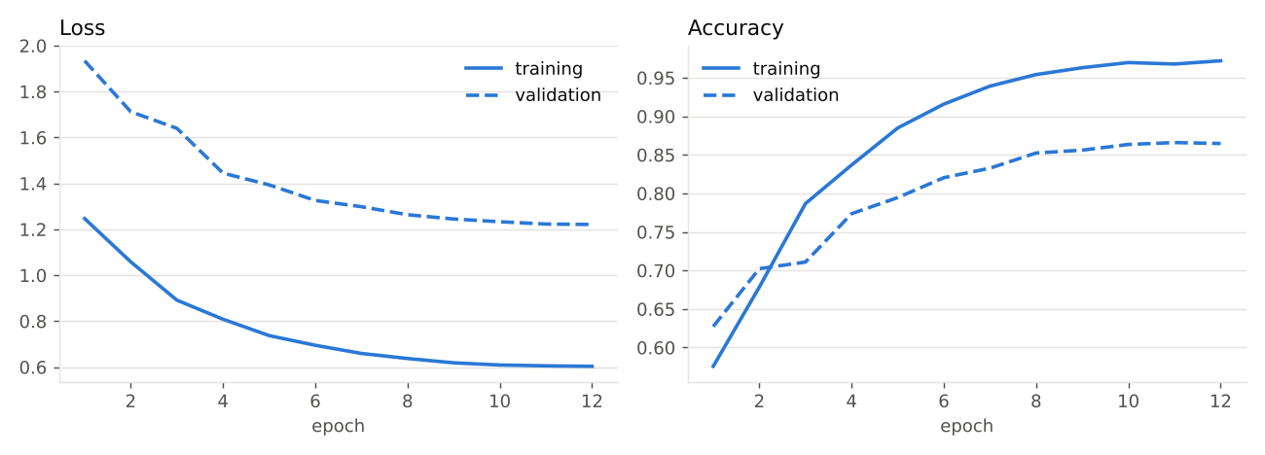
Training curves
Best validation accuracy: 86.6% (813 photos, used only to choose the epoch).
Notes:
The left plot shows loss and the right shows accuracy for each epoch. Solid lines are the training set, dashed lines are validation. The best validation accuracy was 86.6%. Validation accuracy keeps improving while training accuracy stays close, so we are not badly over-fitting.

Slide 8
Results on unseen test photos
86.8%
top-1 accuracy
95.8%
top-3 accuracy
0.87
macro F1
Notes:
On the 8041 official test photos, which the model never saw, fine-tuning reaches 86.8% top-1 accuracy and 95.8% top-3 accuracy. Macro F1 is 0.87, meaning every brand counts equally regardless of size. Compared with only training the final layer, which gives 60.4%, fine-tuning adds 26.3 percentage points.

Slide 9
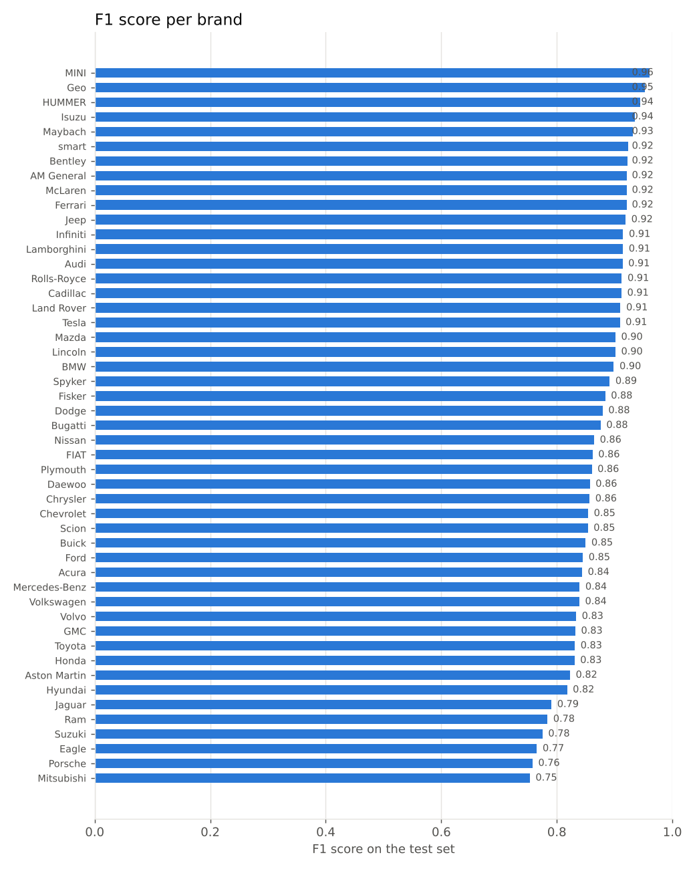
Easy and hard brands
Best
MINI 0.96
Geo 0.95
HUMMER 0.94
Isuzu 0.94
Maybach 0.93
Hardest
Mitsubishi 0.75
Porsche 0.76
Eagle 0.77
Suzuki 0.78
Ram 0.78
Notes:
Per-brand F1 scores. The easiest brands are MINI, Geo, HUMMER, Isuzu, Maybach. The hardest are Mitsubishi, Porsche, Eagle, Suzuki, Ram. Brands that are represented by a single model, or that have few photos, tend to be harder, and brands whose models resemble each other get confused.

Slide 10
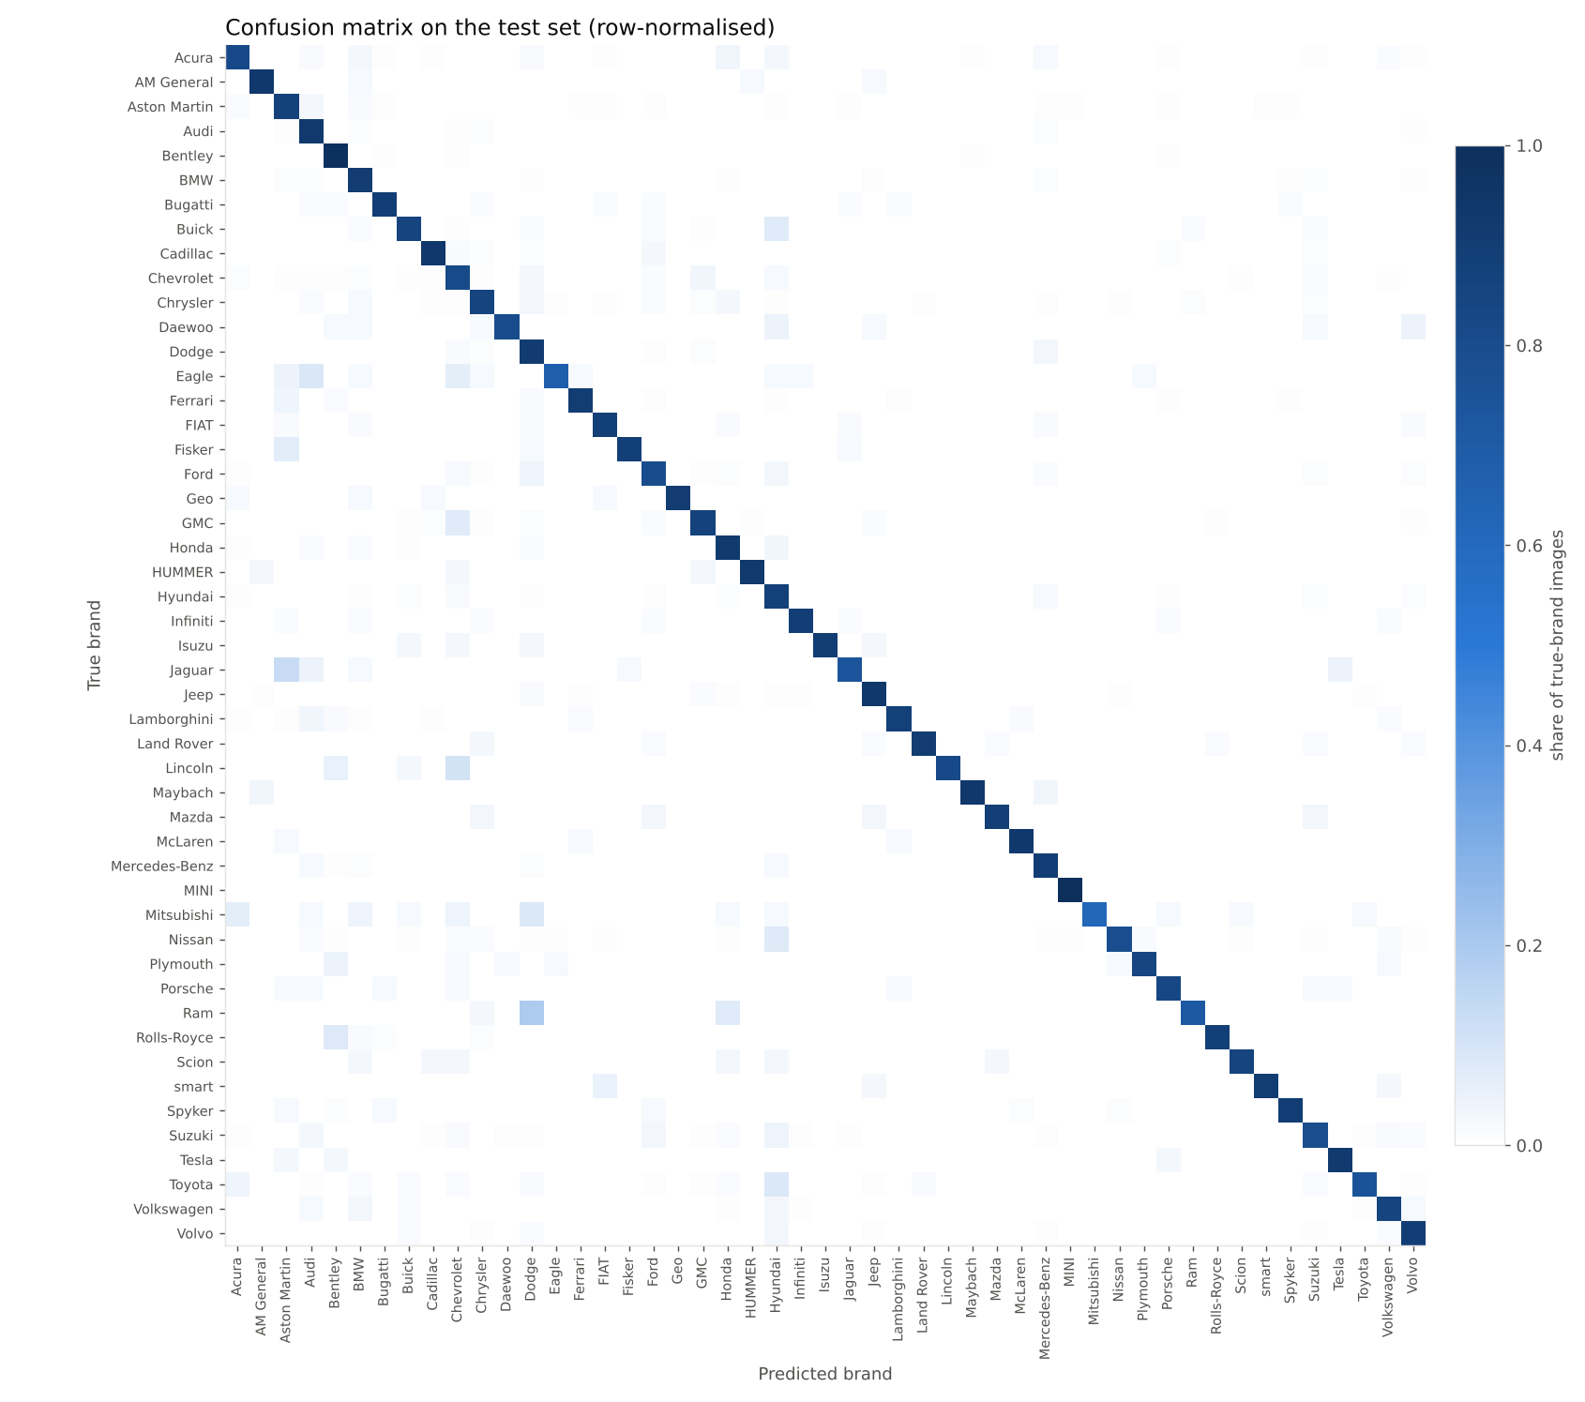
What does the model mix up?
Most frequent mix-ups
True | Predicted as | Photos
Chevrolet | GMC | 31
Chevrolet | Dodge | 22
Ford | Dodge | 20
Chevrolet | Hyundai | 18
Dodge | Mercedes-Benz | 18
Notes:
The confusion matrix shows, for each true brand, which brand the model predicted. A strong diagonal means correct answers. The table lists the most frequent mistakes. These are mostly brands that share a parent company, a body style or a similar design, which is also where a human would hesitate.

Slide 11
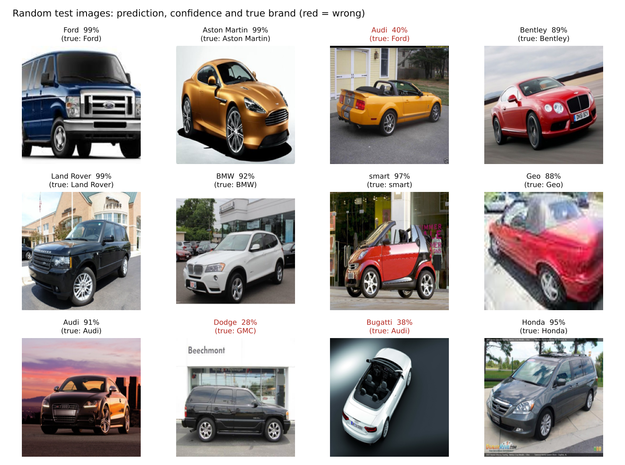
Sample predictions
Notes:
Here are twelve random test photos with the predicted brand, the confidence and the true brand. Wrong answers are shown in red. Note that these are random, not hand-picked.

Slide 12
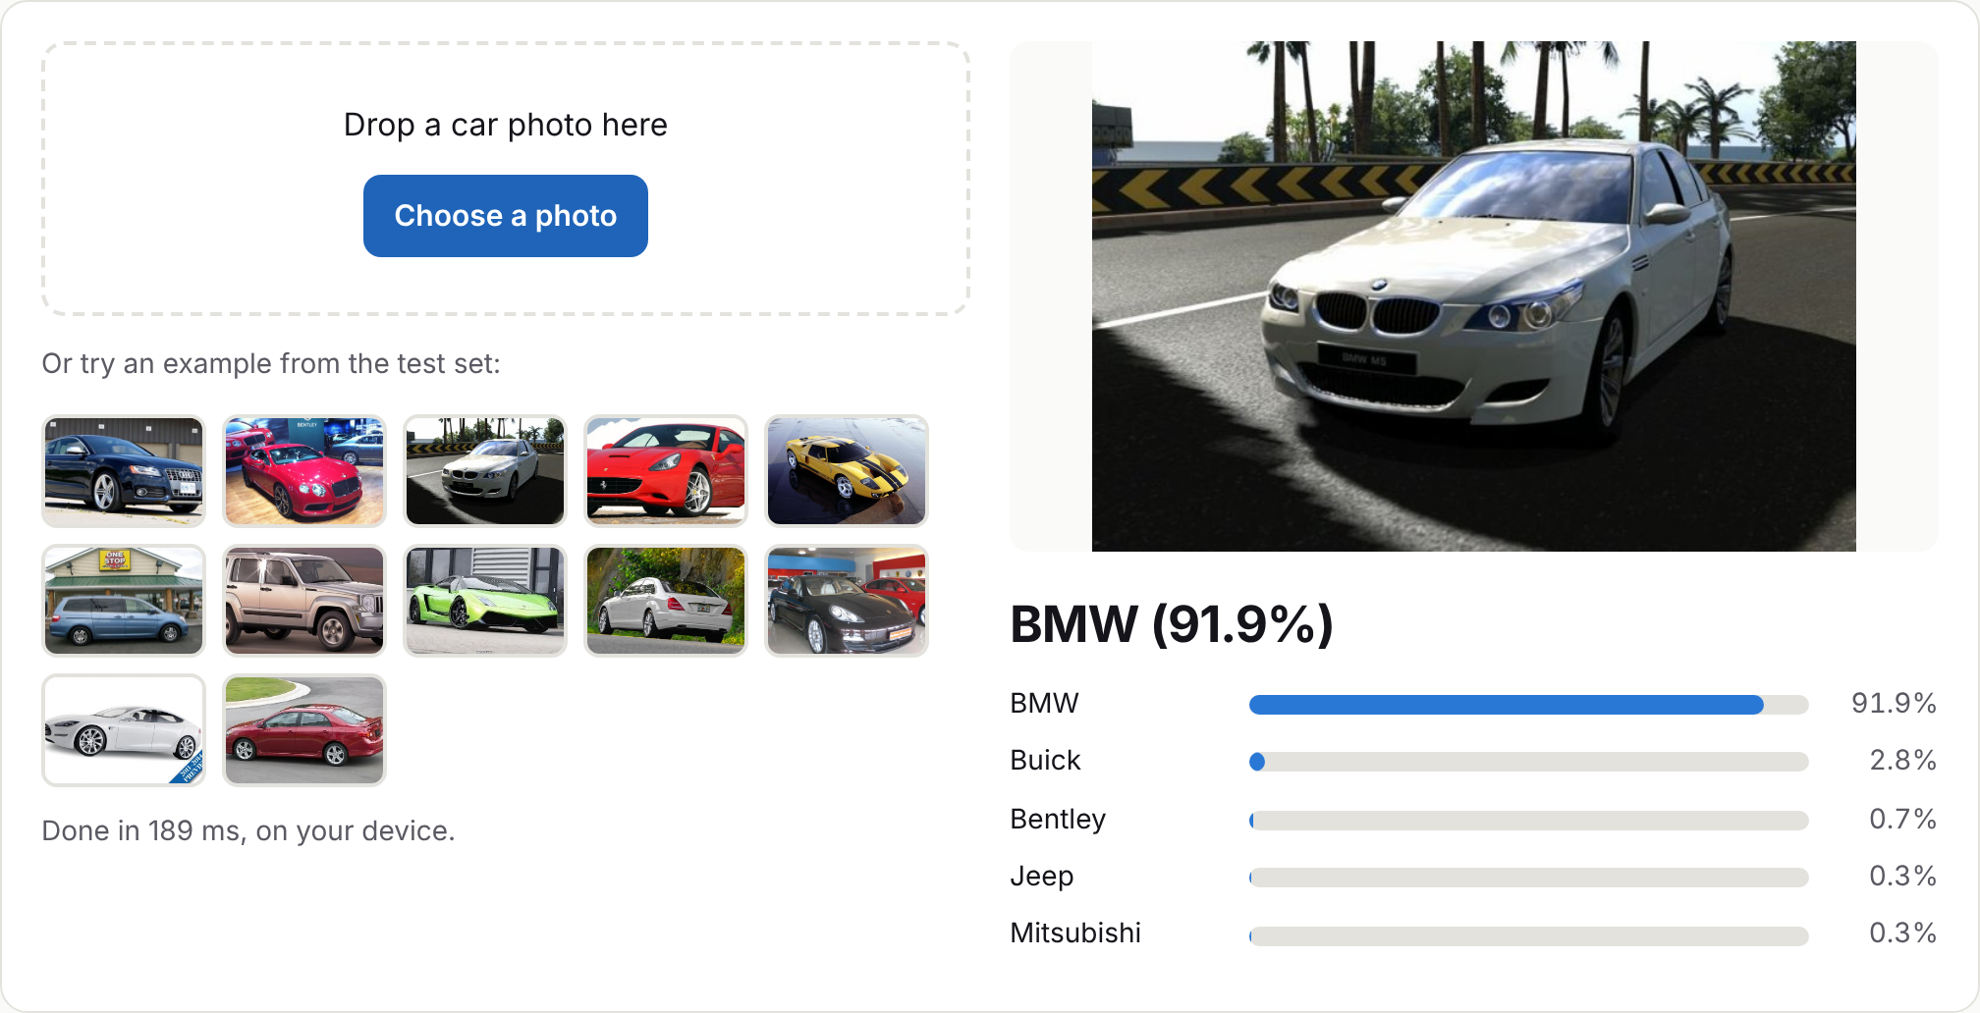
Deployment: a website that runs the model
Keras model exported to ONNX (24 MB), same predictions as the original
ONNX Runtime Web runs inference in the browser, no backend
The photo stays on the user's device
Static site on Vercel: demo, dataset and code, results, project links
Notes:
The trained model is converted to ONNX and shipped with the website. When you upload a photo, ONNX Runtime Web runs the model inside your browser using WebAssembly. That means there is no server to maintain, it is fast, and your photo never leaves your device. The site is a static site hosted on Vercel, and it also shows the dataset, code, results, and links to the report, slides, video and GitHub.

Slide 13
Limitations and future work
Limitations
Future work
Some brands appear through a single model
Mostly cars from 2000-2012
No 'unknown' or 'not a car' class
Small brands have few training photos
Detect and crop the car first
More recent, larger dataset
Add an 'unknown' class
Higher resolution and test-time augmentation
Notes:
Honest limitations: several brands are represented by only one model in the dataset, so other models from that brand may be missed. Most photos show cars from before 2013, so brand-new designs are out of distribution. The model has no unknown class, so it always names one of the 49 brands, and low confidence is the signal to distrust it. For future work we could add a detection step to crop the car, train on a larger and more recent dataset, add an unknown class, and use a higher resolution.

Slide 14
Conclusion
A fine-tuned EfficientNetV2-B0 recognises 49 car brands with 86.8% top-1 and 95.8% top-3 accuracy on unseen photos.
Fine-tuning improved the frozen-backbone baseline from 60.4% to 86.8%.
The model runs in the browser, so the whole app is a static website.
Thank you
Notes:
To conclude: transfer learning with a small modern network gives strong brand recognition even on a CPU, and exporting to ONNX lets us deploy the whole thing as a static website. Thank you for watching, and please try the demo and check the code on GitHub.

