Slide 1
Strategic Transformation of Dubai’s Mid-Market Hospitality Sector (2026–2030)
Hybrid Consulting + Economic Advisory Case

Slide 2
Executive Context
Occupancy stabilized (~70–75%) but margins under structural pressure.
  High OTA dependency (15–25% commission impact).
  Rising labor and utility cost intensity.
  Increasing regional competitive pressure (Saudi, Qatar).

Slide 3
Working Hypothesis & Analytical Framework
Hypothesis: Margin compression is driven primarily by distribution mix inefficiency and cost rigidity — not demand weakness.
  Test 1: Occupancy stability assessment (Demand resilience).
  Test 2: OTA commission impact quantification (Revenue leakage).
  Test 3: ADR sensitivity analysis (Pricing leverage).
  Test 4: Cost elasticity modeling (Margin resilience).

Slide 4
Core Diagnosis – Structural Margin Compression
Revenue leakage via distribution inefficiencies.
  Limited ADR optimization sophistication.
  High fixed-cost operational structure.
  Weak direct booking ecosystem maturity.

Slide 5
Illustrative Financial Impact
+2% ADR uplift → ~5–7% EBITDA improvement.
  5pp OTA share reduction → 3–4% revenue recovery.
  4% cost efficiency → margin stabilization.
  Combined strategy → 4–6pp EBITDA margin recovery.

Slide 6
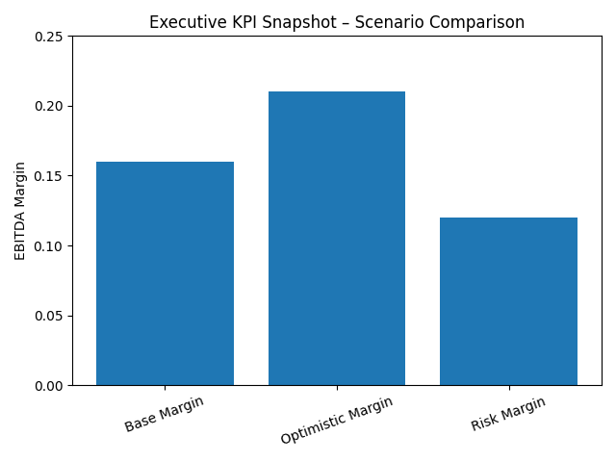
Executive KPI Snapshot – Scenario Comparison

Slide 7
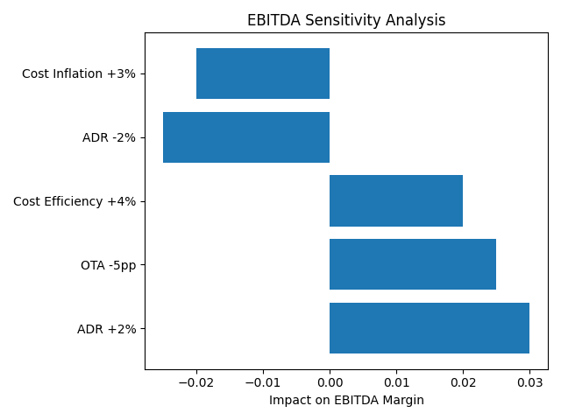
EBITDA Sensitivity Analysis

Slide 8
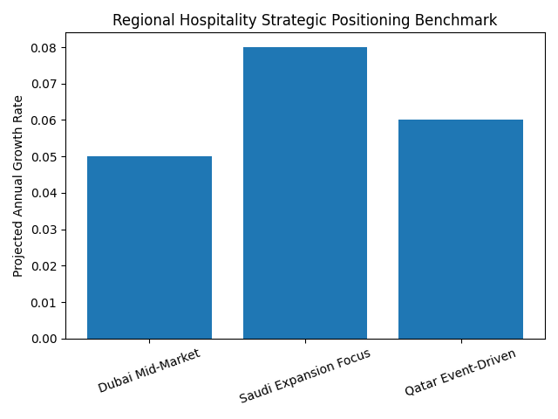
Regional Strategic Benchmarking

Slide 9
Strategic Transformation Pillars
1. Revenue Management Excellence
  2. Digital & Direct Booking Ecosystem
  3. Experience-Led Differentiation
  4. Operational & Asset Optimization

Slide 10
Implementation Roadmap (2026–2030)
Phase 1: Revenue optimization & cost audit (0–12 months).
  Phase 2: Digital transformation & loyalty expansion (1–3 years).
  Phase 3: Asset-light growth & ecosystem integration (3–5 years).

