Slide 1
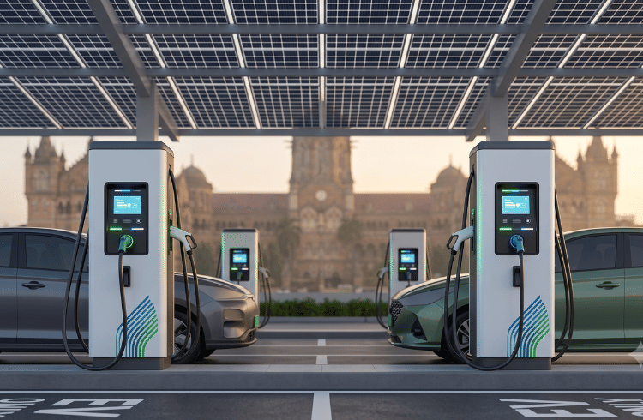
EV CHARGEMAP INTELLIGENCE
Data-Driven Identification of High-Priority EV Charging Locations in India
Internship Project – Data Analytics
Submitted by:
Mariyam Naseer
Company:
Alpha Innovation Private Limited
Internship Duration:
15 August 2026 – 15 October 2026
Excel | SQL | Python | Machine Learning | Power BI

Slide 2
ALPHA INNOVATION PRIVATE LIMITED
n
Company Overview | Data Analytics Internship
Technology & Digital
Data Analytics
Innovation
Digital Solutions
Practical Project
The internship provides practical exposure to technology, data analytics, innovation and industry-oriented project development.

Slide 3
INTERNSHIP DETAILS
Organization
Alpha Innovation Private Limited
Domain
Data Analytics
Internship Duration
15 August 2026 – 15 October 2026
Role
Data Analytics Intern
Project
EV ChargeMap Intelligence
Primary Focus
EV Charging Infrastructure Analysis

Slide 4
PROJECT OVERVIEW
EV ChargeMap Intelligence
Data-Driven Identification of High-Priority EV Charging Locations in India.
The project analyzes EV charging infrastructure using data cleaning, statistical analysis, machine learning and business intelligence techniques.
Core Question:
Where should EV charging infrastructure be prioritized, and what data supports that decision?
Analytical Pipeline:
Data Collection → Data Cleaning → Analysis → Machine Learning → Priority Scoring → Power BI Dashboard

Slide 5
PROBLEM STATEMENT
The rapid growth of electric mobility increases the need for reliable and accessible EV charging infrastructure.
However, charging infrastructure may not be evenly distributed across locations.
Key Questions:
Where is charging infrastructure concentrated?
Which locations show infrastructure imbalance?
Which stations have unusually high charging capacity?
What operational patterns exist?
How can data analytics support infrastructure prioritization?

Slide 6
PROJECT OBJECTIVES
1. Analyze EV charging infrastructure across India.
2. Clean and standardize charging station data.
3. Measure operational performance using key KPIs.
4. Detect unusual high-capacity charging stations.
5. Segment charging stations using K-Means clustering.
6. Develop a project-specific Station Priority Score.
7. Build an interactive Power BI dashboard for analytical insights.

Slide 7
BUSINESS CONTEXT
Why EV Charging Infrastructure Matters
The transition toward electric mobility increases the need for accessible, reliable and appropriately distributed charging infrastructure.
Key Business Requirements:
• Accessible charging locations
• Reliable charging availability
• Appropriate charging capacity
• Balanced infrastructure distribution
• Data-driven expansion planning
Analytical Perspective:
EV Adoption → Charging Demand → Infrastructure Requirements → Data Analysis → Priority Identification

Slide 8
DATASET OVERVIEW
Dataset 01 — EV Charging Stations
1,000 records
Core infrastructure dataset containing station location, charging capacity, operational status and operator information.
Dataset 02 — Indian EV Sales
2015–2025
Contains year, vehicle category, segment, sales quantity and EV penetration data.
Dataset 03 — India Cities Lat/Lng
188 cities
Contains city, latitude, longitude, population and administrative information.

Slide 9
DATA SOURCES
1. EV Charging Stations Dataset
Source: Project charging station dataset.
Purpose: Analyze station locations, charging capacity and operational status.
2. Indian EV Sales Dataset
Source: Kaggle
Period: 2015–2025
Purpose: Understand national EV adoption and sales trends.
3. India Cities Lat/Lng Dataset
Source: Public city geographic dataset
Records: 188 cities
Purpose: Provide geographic and population context for city-level analysis.

Slide 10
PROJECT METHODOLOGY
The project follows a structured data analytics workflow:
1. Data Collection
Collected EV charging, EV sales and city geographic datasets.
2. Data Audit & Cleaning
Checked missing values, duplicates, inconsistent state names and data quality.
3. Exploratory Data Analysis
Analyzed charging capacity, operational status, state-wise infrastructure and EV sales trends.
4. Statistical Analysis
Used mean, median, standard deviation and IQR to understand data distribution and anomalies.
5. Machine Learning
Applied K-Means clustering to identify groups of charging stations.
6. Priority Analysis
Developed a project-specific Station Priority Score using infrastructure and operational indicators.
7. Business Intelligence
Created an interactive Power BI dashboard for visual analysis and decision support.

Slide 11
EXCEL WORKING MODULE
Excel was used as the initial data preparation and validation tool.
Key Activities:
• Data quality and duplicate checks
• Identification of missing and unknown values
• State name standardization
• Operational Flag creation
• Active Charging Points calculation
• PivotTable analysis
• KPI validation and visualization
Key Validated Results:
1,000 Charging Stations
2,364 Total Charging Points
969 Operational Stations
96.9% Operational Rate
2,320 Active Charging Points

Slide 12
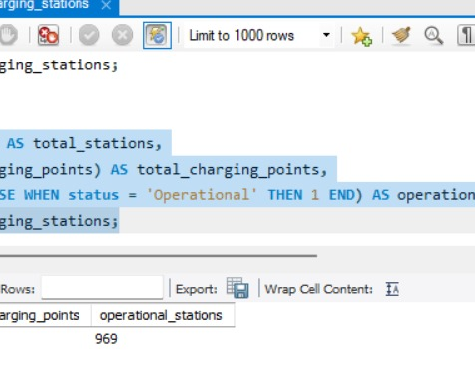
SQL WORKING MODULE
MySQL was used to query and validate the EV charging station dataset.
Key Activities:
• Database and table creation
• Dataset import and validation
• KPI calculation
• Status-wise analysis
• Top charging station analysis
• Data quality verification
Key Results:
1,000 Stations
2,364 Charging Points
969 Operational Stations
2,320 Active Charging Points

Slide 13
PYTHON WORKING ENVIRONMENT
Python was used for data analysis, statistical analysis, visualization and machine learning.
Tools & Libraries:
• Python
• Pandas
• NumPy
• Matplotlib
• Seaborn
• Scikit-learn
• Jupyter Notebook
Major Python Tasks:
• Data cleaning and transformation
• Statistical analysis
• Exploratory data visualization
• Anomaly detection using IQR
• K-Means clustering
• Infrastructure gap analysis
• Station Priority Score calculation

Slide 14
DATA AUDIT & QUALITY CHECK
The EV charging station dataset was audited before analysis to improve data reliability.
Key Quality Checks:
• Total records: 1,000
• Duplicate station IDs: 0
• Unknown cities: 578
• Unknown states: 6
• Unknown operators: 975
• Latitude and longitude: Numeric
• Charging points: No blank or zero values
• Station status: 5 operational categories
Data Quality Approach:
Identify Issues → Validate Records → Standardize Values → Preserve Reliable Data → Analyze

Slide 15
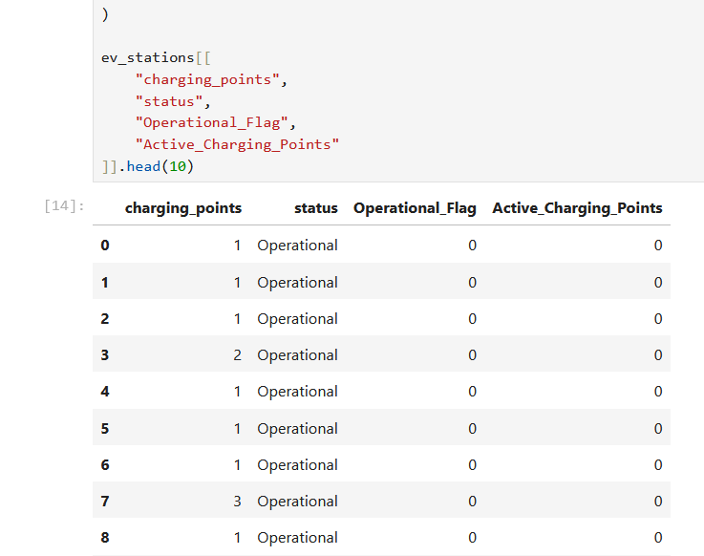
DATA CLEANING & FEATURE ENGINEERING
DATA CLEANING
• Standardized state and city names
• Checked duplicate station IDs
• Validated latitude and longitude
• Reviewed unknown values
• Verified charging point data
FEATURE ENGINEERING
• Operational_Flag
• Active_Charging_Points
• Clean_State
• Clean_City

Slide 16
KEY PERFORMANCE INDICATORS
1,000
Charging Stations
2,364
Total Charging Points
969
Operational Stations
96.9%
Operational Rate
2,320
Active Charging Points
98.1%
Active Charging Point Rate
These KPIs provide a high-level view of the size, availability and operational performance of the charging infrastructure dataset.

Slide 17
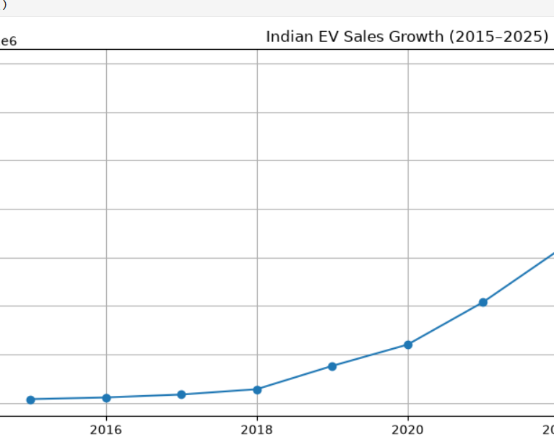
EV SALES GROWTH ANALYSIS(2015-2025)
KEY INSIGHTS
• High-speed e2W sales increased from 15,000 in 2015 to 1,390,000 in 2025.
• EV sales show a strong upward trend over the period.
• The growth indicates increasing EV adoption in India.
• Rising EV adoption increases the importance of evaluating charging infrastructure.
NOTE:
Sales data represents national-level EV adoption and is used as supporting demand context.

Slide 18
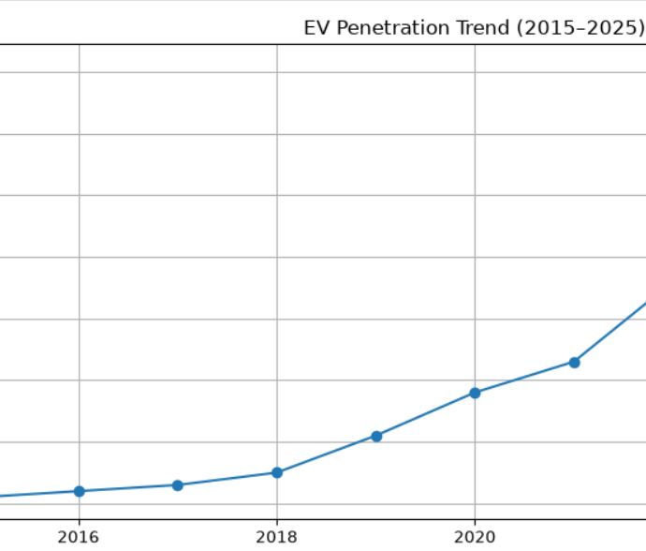
EV PENETRATION TREND (2015-2025)
KEY INSIGHTS
• EV penetration for high-speed e2W increased from 0.1% in 2015 to 7.1% in 2025.
• The trend shows gradual growth in EV adoption over the period.
• Increasing EV penetration provides useful demand-side context for charging infrastructure analysis.
ANALYTICAL NOTE
This dataset represents national-level EV trends and is not used as a direct state-level demand measure.

Slide 19
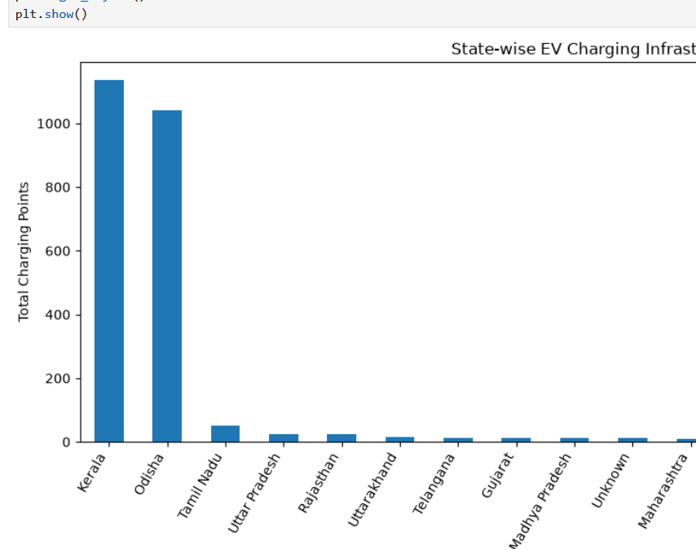
STATE-WISE CHARGING INFRASTRUCTURE
KEY INSIGHTS
• Kerala charging stations with 1,135 charging points. has 520
• Odisha has 370 charging stations with 1,041 charging points.
• The remaining states have substantially fewer charging points in this dataset.
• The distribution indicates variation in charging infrastructure across states.
ANALYTICAL NOTE
These figures represent the project dataset of 1,000 charging stations and do not represent the complete EV charging infrastructure of India.

Slide 20
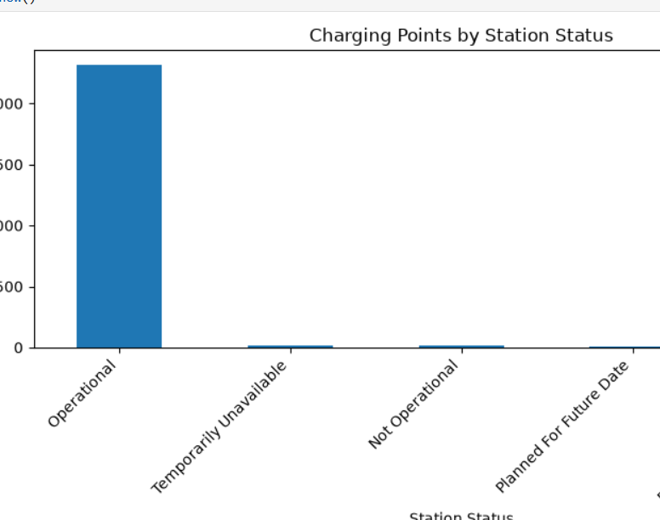
CHARGING STATION STATUS ANALYSIS
KEY INSIGHTS
• 969 stations are operational.
• 15 stations are not operational.
• 10 stations are temporarily unavailable.
• 5 stations are planned for future operation.
• 1 station is partly operational.
• Operational stations account for 2,320 charging points.
ANALYTICAL INSIGHT
The dataset shows a high operational rate, while a small number of stations require attention due to non-operational or temporary availability status.

Slide 21
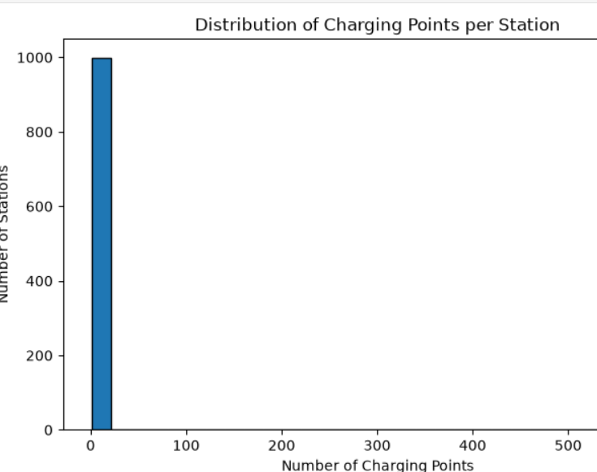
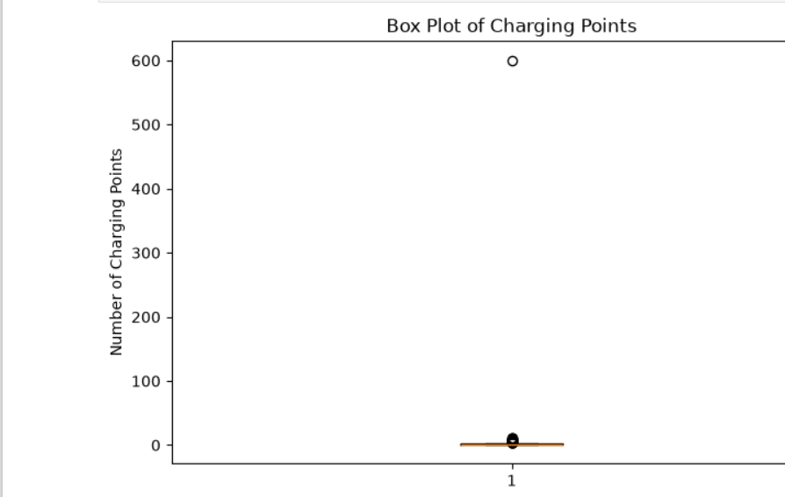
CHARGING POINT DISTRIBUTION & STATISTICAL ANALYSIS
KEY STATISTICS
• Mean: 2.36 charging points per station
• Median: 1 charging point
• Standard Deviation: 18.96 charging point
• Minimum: 1 charging point
• Maximum: 600 charging points
KEY INSIGHT
The large difference between the mean and median, along with the maximum value of 600, indicates a highly uneven distribution and the presence of high-capacity outliers.

Slide 22
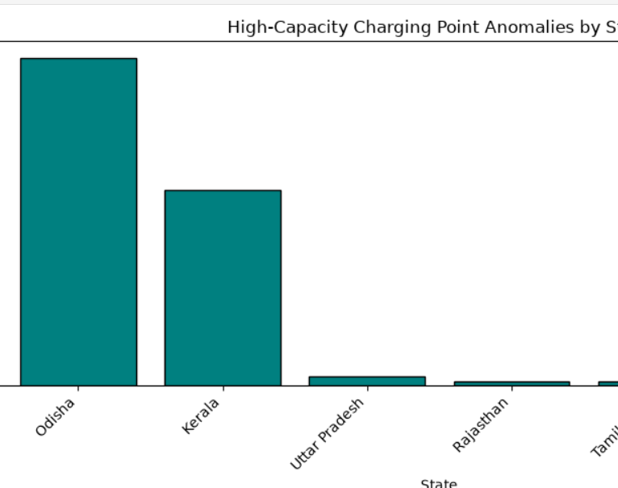
ANOMALY DETECTION & HIGH-CAPACITY STATIONS
ANOMALY DETECTION
•IQR method was used to identify unusually high charging capacities.
• Q1 = 1 and Q3 = 2
• Upper outlier limit = 3.5 charging points
• 87 stations were identified as high-capacity anomalies.
• These stations contain 1,057 charging points in total.
KEY FINDING
One Odisha station has 600 charging points and is the largest capacity outlier in the dataset.
The record was verified and retained for analysis.

Slide 23
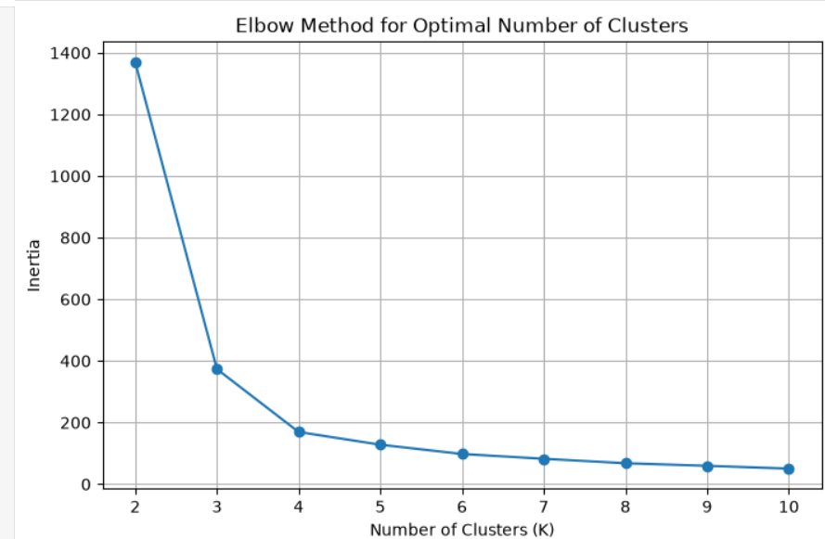
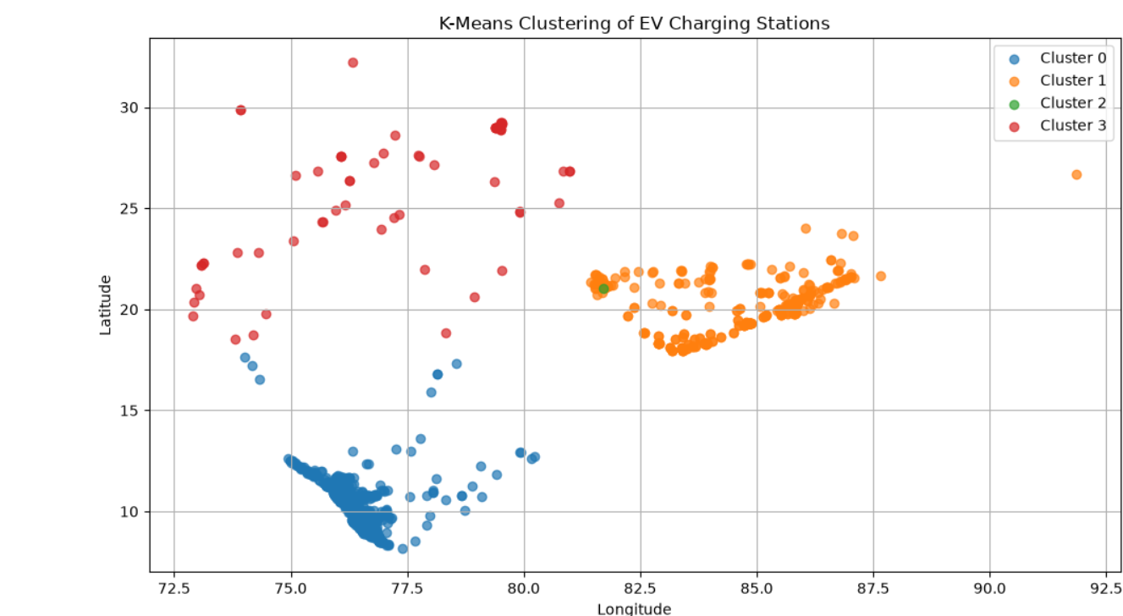
K-MEANS CLUSTERING & ELBOW METHOD
METHOD
K-Means clustering was applied using:
• Latitude
• Longitude
• Charging Points
The features were standardized before clustering.
KEY RESULT
The Elbow Method indicated K = 4 as a suitable clustering choice.
Four clusters were created to identify groups of charging stations with similar geographic and capacity characteristics.

Slide 24
K-MEANS CLUSTER ANALYSIS
CLUSTER DISTRIBUTION
• Cluster 0: 563 stations
• Cluster 1: 374 stations
• Cluster 2: 1 station
• Cluster 3: 62 stations
KEY OBSERVATIONS
• Cluster 0 represents the largest group of charging stations.
• Cluster 1 forms the second-largest group with relatively lower average charging capacity.
• Cluster 2 contains a single 600-point station, identifying the major high-capacity outlier.
• Cluster 3 represents a smaller geographic and infrastructure group.
ANALYTICAL VALUE
Clustering helps identify different patterns in station location and charging capacity that may not be visible from simple summary statistics.

Slide 25
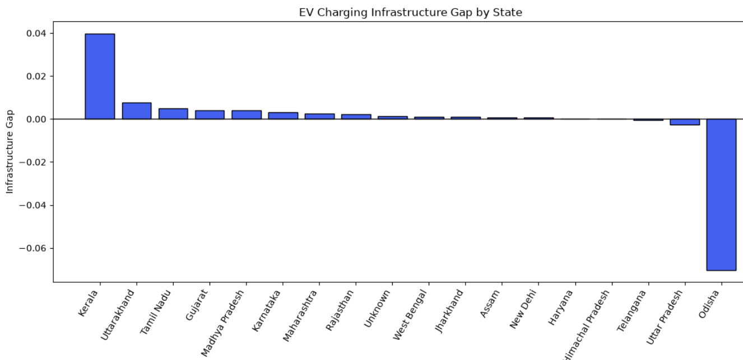
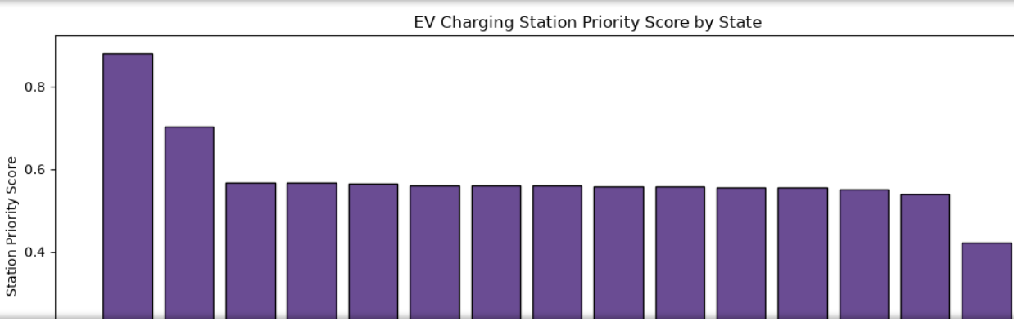
INFRASTRUCTURE GAP & STATION PRIORITY SCORE
INFRASTRUCTURE GAP
Infrastructure Gap = Station Share − Charging Point Share
• Positive value: relatively more stations than charging points.
• Negative value: relatively more charging points than stations.
PRIORITY SCORE
A project-specific score was developed using:
• 40% Infrastructure Gap
• 30% Operational Gap
• 30% Infrastructure Availability Gap
The score helps compare states using the selected infrastructure indicators.
Note: The Station Priority Score is a project-specific analytical model, not an official government recommendation.

Slide 26
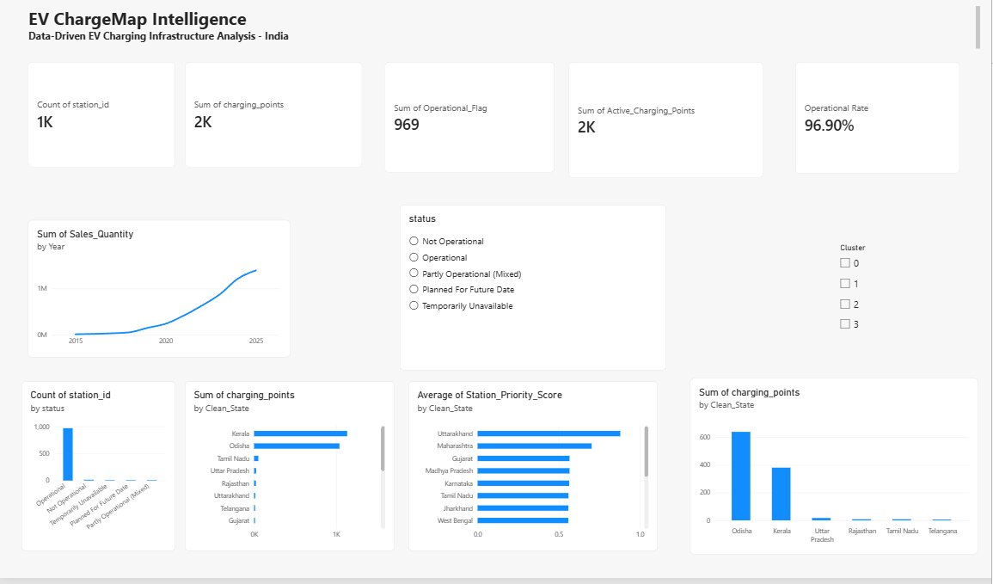
POWER BI DASHBOARD
Interactive dashboard developed to monitor EV charging infrastructure and support data-driven analysis.
Dashboard Components:
• 5 KPI Cards
• EV sales trend
• Station status analysis
• State-wise charging infrastructure
• Station Priority Score
• Status and cluster filters
Power BI was used to convert analytical results into an interactive business intelligence dashboard.

Slide 27
KEY INSIGHTS, CHALLENGES & LEARNING OUTCOMES
KEY INSIGHTS
• 96.9% of stations in the dataset are operational.
• Kerala and Odisha contain the highest charging-point concentrations.
• 87 high-capacity anomalies were identified.
• K-Means clustering identified 4 station groups.
• The project-specific priority score supports comparative infrastructure analysis.
CHALLENGES
• Handling unknown and inconsistent location values.
• Standardizing state and city names.
• Managing extreme charging-capacity outliers.
• Integrating multiple analytical tools.
LEARNING OUTCOMES
• Data cleaning and feature engineering
• SQL querying and validation
• Python-based statistical analysis
• Machine learning with K-Means
• Power BI dashboard development

Slide 28
CONCLUSION & FUTURE SCOPE
CONCLUSION
The EV ChargeMap Intelligence project demonstrates how data analytics can be used to examine EV charging infrastructure, identify infrastructure patterns and support comparative priority analysis.
The project combined Excel, SQL, Python, statistical analysis, machine learning and Power BI to transform raw data into meaningful analytical insights.
FUTURE SCOPE
• Incorporate real-time charging station availability.
• Add EV traffic and charging-demand data.
• Improve city-level geographic matching.
• Include additional population and mobility indicators.
• Develop an advanced location-allocation model for future stations.
FINAL OUTCOME
A complete data analytics workflow was developed from data preparation to interactive business intelligence reporting.

Slide 29
THANK YOU
EV ChargeMap Intelligence
Data-Driven EV Charging Infrastructure Analysis – India
Alpha Innovation Private Limited
Data Analytics Internship | 15 August 2026 – 15 October 2026

