Slide 1
BEFORE THE BREAKDOWN
Supply Chain Risk & Resilience Analytics
Internship Project-Data Analytics
Internship period: 15 August 2026 – 15 October 2026

Slide 2
Internship & Details
Organization: Alpha Innovation Private Limited
Domain: Data Analytics
Internship Duration: 15 August 2026- 15 October 2026
Project Title: Supply Chain Risk & Resilience Analytics
Project Type: Data Analytics Internship Project
Student Name: Mariyam Naseer
Course: Bachelor Of Computer Application
College: Integral University

Slide 3
Company Overview
Alpha Innovation Private Limited provided an internship environment focused on practical learning and application of data analytics concepts.
During the internship, the project involved:
• Working with business-related datasets
• Data cleaning and transformation
• Data analysis
• Risk identification
• Dashboard development
• Extracting meaningful business insights

Slide 4
Project Introduction
Supply chain management involves suppliers, inventory, transportation, deliveries and other operational activities.
Any disruption in these activities can affect:
• Product availability
• Delivery time
• Inventory levels
• Supplier performance
• Business costs
This project uses data analytics to identify major supply-chain risk areas and support better business decision-making.

Slide 5
Problem Statement
Supply-chain operations can face different types of risks such as:
• Delivery delays
• Low inventory availability
• Supplier reliability issues
• Transportation-related risks
• External disruptions
Problem:
How can data analytics be used to identify major supply-chain risks and determine the areas that require attention?

Slide 6
Project Objectives
The main objectives of this project are:
To clean and prepare supply-chain data.
• To analyze delivery performance.
• To identify inventory-related risks.
• To evaluate supplier risk.
• To identify major risk areas.
• To analyze supplier-country risk distribution.
• To create a visual dashboard.
• To generate actionable business insights.

Slide 7
Project Scope
The project focuses on four main areas:
Data Preparation
• Data cleaning
• Data transformation
• Creation of calculated fields
Risk Analysis
• Inventory Risk
• Delivery Risk
• Supplier Risk
Visualization
• PivotTables
• Charts
• KPI indicators
• Dashboard
Business Insights
• Identifying major risk areas
• Supporting data-driven decisions

Slide 8
Learning Outcomes
Through this project, I learned:
• How to work with a large dataset.
• Data cleaning and transformation using Power Query.
• Creating calculated columns for analysis.
• Using PivotTables for data analysis.
• Creating charts and dashboards.
• Identifying patterns and risks in business data.
• Converting analytical results into business insights.
• Presenting data findings in a clear and simple way.

Slide 9
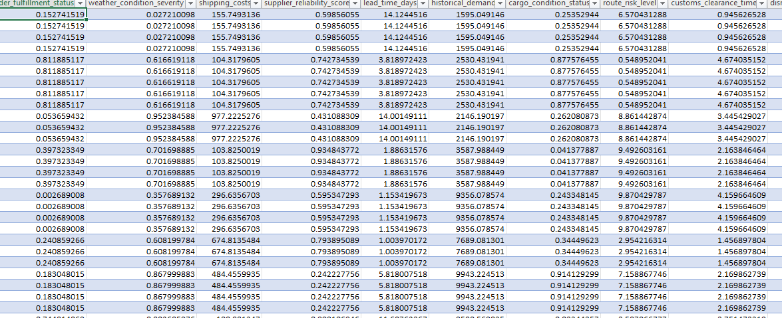
Dataset Introduction
The project uses a public supply-chain logistics dataset for analyzing supply-chain risks and operational performance.
Dataset Size:
• 113,097 records
• 18 original columns
• 1,000 products
• 3,524 supplier IDs
• 94 supplier countries
The dataset covers suppliers, inventory, delivery, costs, disruptions and risk factors.

Slide 10
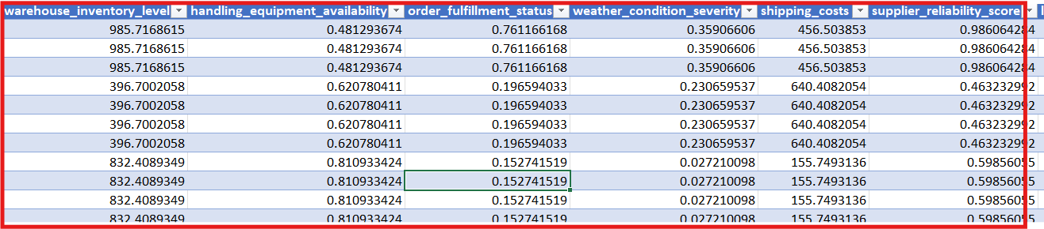
Important Dataset Variables
The dataset contains several variables used for supply-chain risk analysis:
• Product ID – Identifies the product
• Supplier ID – Identifies the supplier
• Supplier Country – Supplier's country
• Warehouse Inventory Level – Available inventory
• Historical Demand – Previous demand
• Lead Time Days – Delivery/supply lead time
• Supplier Reliability Score – Measures supplier reliability
• Delivery Time Deviation – Difference in delivery time
• Delay Probability – Probability of delivery delay
• Shipping Costs – Transportation-related cost

Slide 11
Project Methodology
RAW DATA
↓
DATA CLEANING
↓
DATA TRANSFORMATION
↓
RISK CALCULATION
↓
PIVOTTABLE ANALYSIS
↓
DASHBOARD CREATION
↓
INSIGHTS & RECOMMENDATIONS

Slide 12
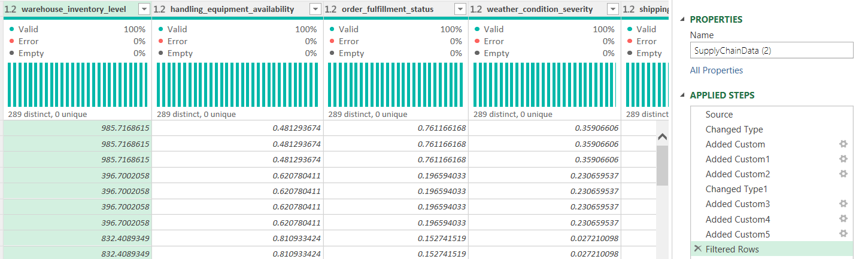
Data Cleaning Using Power Query
Power Query was used to prepare the dataset for analysis.
The main activities included:
• Loading the dataset into Power Query
• Checking column quality and data types
• Reviewing data errors
• Creating calculated columns
• Removing incorrect transformation steps
• Preparing the cleaned dataset for analysis

Slide 13
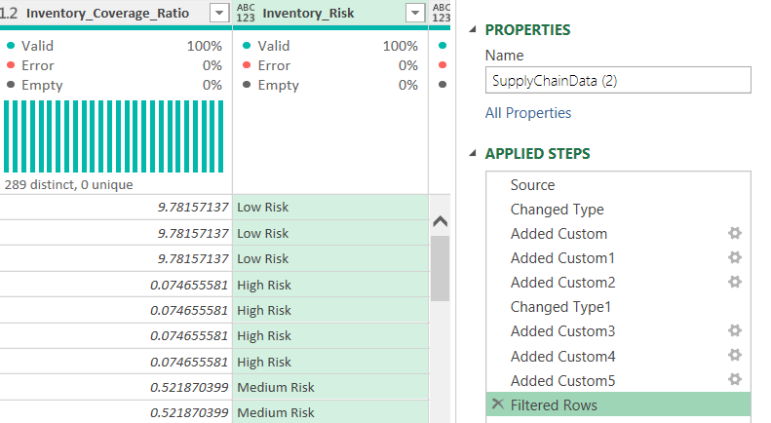
Data Transformation
Power Query was used to create additional fields required for risk analysis.
Calculated fields created:
• Delay Probability % – Converts delay probability
into percentage
• Delivery Status – Classifies records as Delayed
or On Time / Early
• Inventory Coverage Ratio – Compares inventory
level with historical demand
• Inventory Risk – Classifies inventory as High, Medium or Low Risk
• Supplier Risk – Classifies suppliers based on reliability score
• Delivery Risk – Classifies delivery performance based on time deviation.

Slide 14
Risk Metrics & Classification
Risk categories were created using project-defined thresholds to identify potential supply-chain problems.
Inventory Risk
Below 0.5 → High Risk
0.5 to below 1 → Medium Risk
1 or above → Low Risk
Supplier Risk
Reliability below 0.4 → High Risk
0.4 to below 0.7 → Medium Risk
0.7 or above → Low Risk
Delivery Risk
Deviation above 5 days → High Risk
Deviation above 0 to 5 days → Medium Risk
0 or below → Low Risk
Note: These thresholds were defined for this project to support comparative risk analysis.

Slide 15
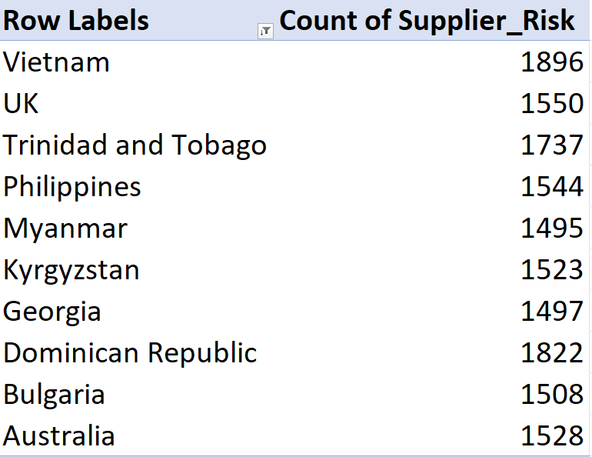
Supplier Risk Analysis
Supplier reliability is an important factor in supply-chain risk.
Supplier reliability scores were analyzed to
classify suppliers into High, Medium and Low Risk.
The analysis helps identify suppliers that may
require closer monitoring.
Supplier risk was also compared with delivery risk
to identify potential risk patterns.
Supplier country information was used to understand
the distribution of supplier-related risk.

Slide 16
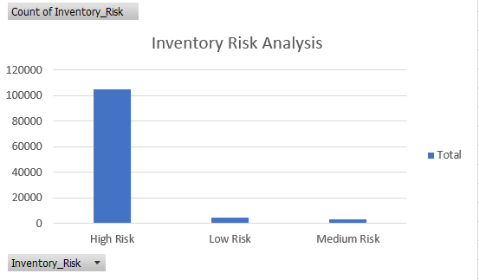
Inventory Risk Analysis
Inventory levels were analyzed to identify potential stockout risks.
• Inventory Coverage Ratio was calculated by comparing
warehouse inventory with historical demand.
• Records were classified into High, Medium
and Low Inventory Risk.
• High inventory risk indicates that available
inventory is low compared with demand.
• The analysis helps identify areas where
inventory planning may need improvement.
Key Finding:
High Inventory Risk is the largest category in the analyzed dataset.

Slide 17
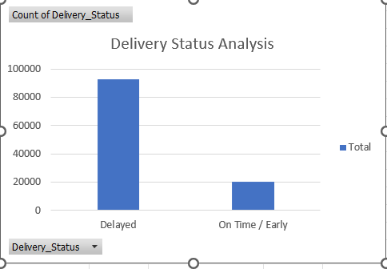
Delivery Risk Analysis
• Delivery performance was analyzed using delivery time deviation.
• Records were classified into High, Medium
and Low Delivery Risk.
• Delayed orders were identified using
delivery status.
• The analysis helps identify areas where
delivery performance may need improvement.
• Delivery risk was compared with
risk to identify possible risk patterns.
Key Finding:
Delayed records are substantially higher than On Time / Early records in the analyzed dataset.

Slide 18
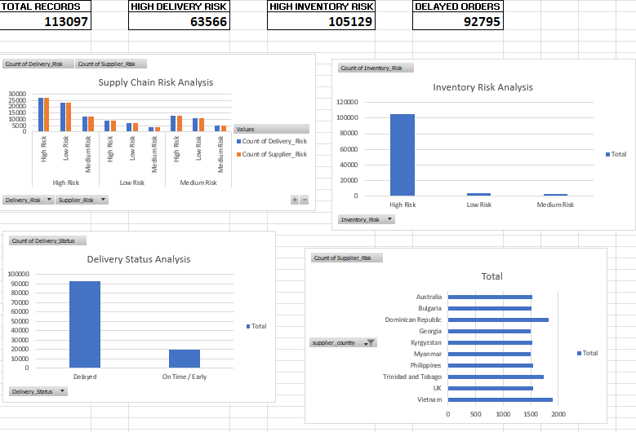
Supply Chain Risk Dashboard
The dashboard provides a summarized view of major supply-chain risk indicators.
• Total records analyzed
• High delivery risk
• High inventory risk
• Delayed orders
• Supplier-country risk distribution
Purpose: To provide a quick view of
major risk areas and support data-driven decision making

Slide 19
Dashboard KPI Explanation
.
. Total Records 113,097 Total supply-chain records analyzed | . High Delivery Risk 63,566 Records classified as high delivery risk.
. High Inventory Risk 105,129 Records classified as high inventory risk. | . Delayed Orders 92,795 Records identified as delayed.
overview of the major risk areas identified in the
dataset. These KPIs provide a quick

Slide 20
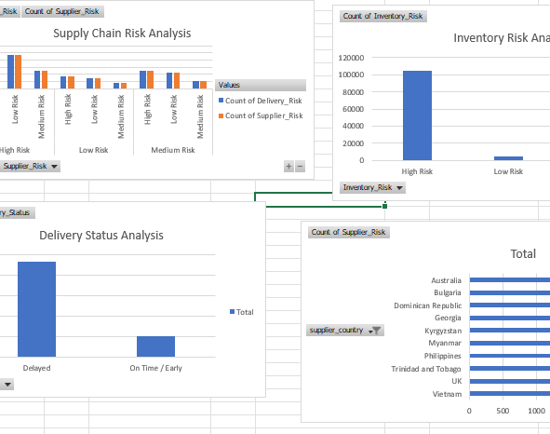
Working Module – Supplier Risk Analysis
Supplier reliability score was used to classify supplier risk.
Suppliers were categorized into High Risk, Medium Risk, and Low Risk.
Supplier country was analyzed to understand the distribution of supplier-related risk.
Delivery risk was compared with supplier risk to identify possible risk patterns.
The analysis helps identify suppliers that may require closer monitoring.
Key Finding : Supplier risk varies across suppliers and countries, highlighting areas that require monitoring.

Slide 21
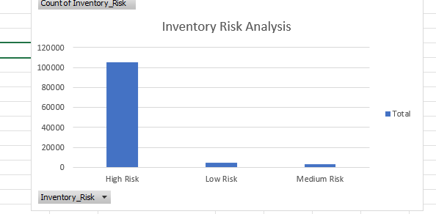
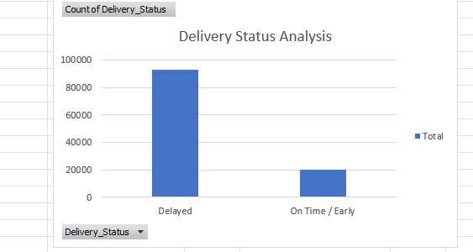
Working Module - Inventory & Delivery Risk
Inventory Risk
Inventory levels were analyzed to identify potential stockout risks.
Inventory Coverage Ratio was calculated using warehouse inventory and historical demand.
Records were classified into High, Medium and Low Inventory Risk.
Delivery Risk
Delivery Time Deviation was used to assess delivery performance.
Records were classified into High, Medium and Low Delivery Risk.
Delivery Status was categorized as Delayed or On Time / Early.
Key Finding: Inventory risk is the largest risk category, while delayed records are substantially higher than on-time/early records

Slide 22
Key Findings & Business Insights
113,097 supply-chain records were analyzed.
105,129 records were classified as High Inventory Risk.
92,795 records were identified as Delayed.
63,566 records were classified as High Delivery Risk.
Supplier risk was distributed across multiple supplier countries.
Inventory and delivery emerged as the major
risk areas in the analyzed dataset.
📦 INVENTORY
High inventory risk was the largest risk category.
🚚 DELIVERY
Delayed records were substantially higher than On Time / Early records.
🌍 SUPPLIERS
Supplier risk varied across different supplier countries.
Overall Insight:
The analysis highlights inventory availability and delivery performance as important areas for supply-chain risk monitoring.

Slide 23
Business Recommendations
Improve Inventory Planning – Maintain sufficient stock based on historical demand.
Monitor High-Risk Suppliers – Regularly review suppliers with low reliability scores.
Reduce Delivery Delays – Identify causes of delivery-time deviations and improve logistics planning.
Strengthen Supplier Management – Closely monitor suppliers and countries showing higher risk levels.
Use Data for Early Action – Regularly track risk indicators to identify potential problems before they become major disruptions.
Recommendation:
Focus on inventory planning, supplier monitoring and delivery performance to improve supply-chain resilience.

Slide 24
Challenges Faced
Working with a large supply-chain dataset containing more than 113,000 records.
Understanding different supply-chain variables and their relationship with risk.
Handling data transformation and Power Query errors during the analysis.
Creating meaningful risk categories from raw data.
Organizing multiple PivotTables and charts for dashboard development.
Presenting a large amount of analytical information in a simple and understandable format.
Challenge:
Converting a large and complex dataset into clear, meaningful business insights was one of the major challenges of the project.

Slide 25
Solutions / How Challenges Were Handled
Large Dataset: Used Power Query and PivotTables to handle and summarize 113,097 records efficiently.
Data Understanding: Studied important supply-chain variables before performing risk analysis.
Data Errors: Identified and corrected transformation errors during Power Query processing.
Risk Classification: Created project-defined risk categories using calculated metrics and clear thresholds.
Dashboard Organization: Used separate PivotTables and charts to present important risk indicators.
Simple Presentation: Converted complex analysis into KPIs, charts, and key business findings.
💡 Solution:
Power Query, PivotTables, calculated risk metrics, and dashboard visualizations helped convert complex raw data into clear and useful business insights.

Slide 26
Conclusion
The project analyzed 113,097 supply-chain records to identify major risk areas.
Power Query was used for data cleaning and transformation.
Risk metrics were created for inventory, suppliers, and delivery performance.
PivotTables and charts helped identify important patterns and risk areas.
The analysis showed that inventory and delivery risks were major concerns in the dataset.
The project demonstrates how data analytics can support better supply-chain monitoring and decision-making.
💡 Conclusion:
Data-driven risk analysis can help organizations identify vulnerable areas early and take appropriate actions to
improve supply-chain resilience.

Slide 27
Future Scope
Real-Time Monitoring: Connect live supply-chain data for continuous risk monitoring.
Predictive Analytics: Use machine learning to predict possible delays and disruptions.
Advanced Risk Scoring: Combine more supply-chain factors into a comprehensive risk score.
Automated Alerts: Generate alerts when inventory or delivery risk reaches a critical level.
Advanced Dashboard: Develop an interactive Power BI dashboard for deeper analysis.
Geographical Analysis: Analyze supplier and logistics risks based on location.
💡 Future Scope:
The project can be extended with real-time data, predictive models, automated alerts, and advanced
business intelligence dashboards.

Slide 28
Daily Internship Tasks ( Day 1-5 )
Day | Task Performed | Outcome
Day 1 | Understood project requirements and supply-chain problem | Project scope finalized
Day 2 | Explored dataset and studied important variables | Dataset structure understood
Day 3 | Cleaned and transformed data using Power Query | Clean dataset prepared
Day 4 | Created calculated fields and risk categories | Risk metrics generated
Day 5 | Created PivotTables for supplier and inventory analysis | Risk patterns identified

Slide 29
Daily Internship Tasks ( Day 5-10 )
Day | Task Performed | Outcome
Day 6 | Analyzed delivery performance and delays | Major delivery risks identified
Day 7 | Created dashboard KPIs and charts | Dashboard developed
Day 8 | Developed supplier, inventory and delivery modules | Analytical modules completed
Day 9 | Prepared findings, recommendations and documentation | Business insights finalized
Day 10 | Reviewed final PPT and project output | Final project completed
💡 Summary:
The project progressed from data preparation to analysis, visualization, insights, and final documentation.

Slide 30
Project Outcome & Learning Summary
Gained practical experience in Data Analytics using Excel and Power Query.
Learned how to clean and transform a large dataset.
Learned to create risk metrics and classifications.
Developed PivotTables, KPIs, and charts for analysis.
Learned how to convert analytical results into business insights.
Improved understanding of supply-chain risk and resilience.
Gained experience in preparing a professional analytics project and presentation.
💡 Overall Learning:
The project provided practical experience in transforming raw data into meaningful insights
for business decision-making.

Slide 31
THANK YOU
Thank you for your time and consideration.
Supply Chain Risk & Resilience Analytics
Internship Project – Data Analytics
Alpha Innovation Private Limited

