Slide 1

REAL-TIME BMI
MONITOR
Gayathri Rajesh 24BEC1296
A Manasa Reddy 24BEC1070
Mariyam Shaji 24BEC1346
V Pardhu Sai Harsha 24BEC1091

Slide 2

OBJECTIVE
The aim of this project is to design a smart, real-time BMI health checker using digital logic components. By utilizing a 4-to-16 decoder, OR gate networks, and a 2-to-4 decoder, the system classifies a person’s BMI category based on encoded Height and Weight inputs. The outputs are then clearly displayed as Underweight, Normal, Overweight, or Obese using LED indicators.This project demonstrates interactive digital solution with practical applications in gyms, clinics, and health awareness stations.

Slide 3
COMPONENTS REQUIRED
4-to-16 Active low Decoder (IC 74154)
2-to-4 Line Decoder (IC 74139)
Not gate (IC7404)
OR Gate IC (IC 7432)
LEDs (4 Nos.)
Resistors (220Ω – 330Ω)
Power Supply (5V DC)
Breadboard / PCB
Connecting Wires
Input Switches / DIP Switches

Slide 4
METHODOLOGY
Identifying the Need :
Monitoring health is crucial, and BMI is a simple measure of fitness. This project provides a fast, accurate, and interactive BMI checker decoders for real-time uses.
Input simulation :
Two 2-bit switches simulate the inputs for:
Height (H1, H0) → represents four height ranges
Weight (W1, W0) → represents four weight ranges
Each combination of height and weight is used to determine the BMI category.
Logic Development :
Height (H1 H0) — 2-bit ranges (use midpoint for BMI calculation)
00 → 1.40 – 1.60 m (mid ≈ 1.50 m)
01 → 1.60 – 1.65 m (mid ≈ 1.625 m)
10 → 1.66 – 1.75 m (mid ≈ 1.705 m)
11 → 1.76 – 1.85 m (mid ≈ 1.805 m)

Slide 5
Weight (W1 W0) — 2-bit encoding (kg):
00 → 40 – 50 kg (mid = 45.0 kg)
01 → 51 – 60 kg (mid = 55.5 kg)
10 → 61 – 75 kg (mid = 68.0 kg)
11 → 76 – 95 kg (mid = 85.5 kg)
Output coding (2-bit BMI code)
00 → Underweight
01 → Normal
10 → Overweight
11 → Obese
I computed these by using the formula
BMI = Weight / height^2
Underweight <18.5
Normal 18.5–24.9
Overweight 25–29.9
Obese ≥30.

Slide 6
Circuit Construction :
Inputs (Height & Weight):
Use 4 toggle switches to represent H1, H0, W1, W0.
These switches are connected as inputs to the 4-to-16 decoder(Not gates + active low decoder).
Decoder setup (4-to-16):
The 4-to-16 decoder generates 16 unique outputs (D0–D15) for each Height–Weight combination.
Each output corresponds to a pre-defined BMI value.
Logic generation (BMI Code):
Use OR gates to combine decoder outputs as per BMI category equations:
Bit1 = D2 + D3 + D6 + D7 + D11 + D15
Bit0 = D0 + D1 + D2 + D3 + D5 + D7 + D9 + D10 + D14
Category Decoder (2-to-4):
Connect Bit1 and Bit0 as inputs to the 2-to-4 decoder.
The decoder generates one-hot outputs, activating only one line at a time.

Slide 7
Power supply:
Connect all ICs (decoder) to +5V (Vcc) and GND.
Connect toggle switches to Vcc for logic HIGH (1) and to GND for logic LOW (0).
OUTPUT & TESTING :
Expected Output (BMI Code → LED)
00 → Underweight LED ON
01 → Normal LED ON
10 → Overweight LED ON
11 → Obese LED ON
The system was tested with various input combinations to verify accurateness.

Slide 8
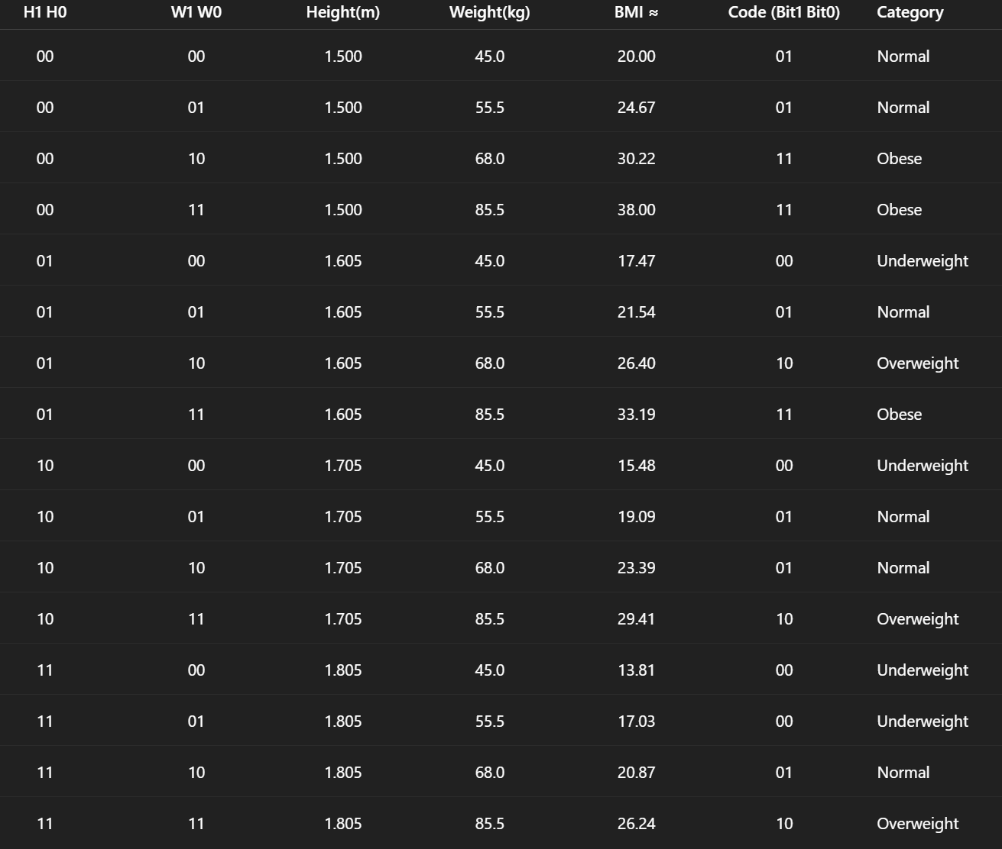
TRUTH TABLE :
00 → Underweight,
01 → Normal,
10 → Overweight,
11 → Obese

Slide 9
LOGIC EXPRESSION :
Bit1 = D2 + D3 + D6 + D7 + D11 + D15
Bit0 = D0 + D1 + D2 + D3 + D5 + D7 + D9 + D10 + D14
Underweight (Y0) = ~Bit1 · ~Bit0
Normal (Y1) = ~Bit1 · Bit0
Overweight (Y2) = Bit1 · ~Bit0
Obese (Y3) = Bit1 · Bit0

Slide 10
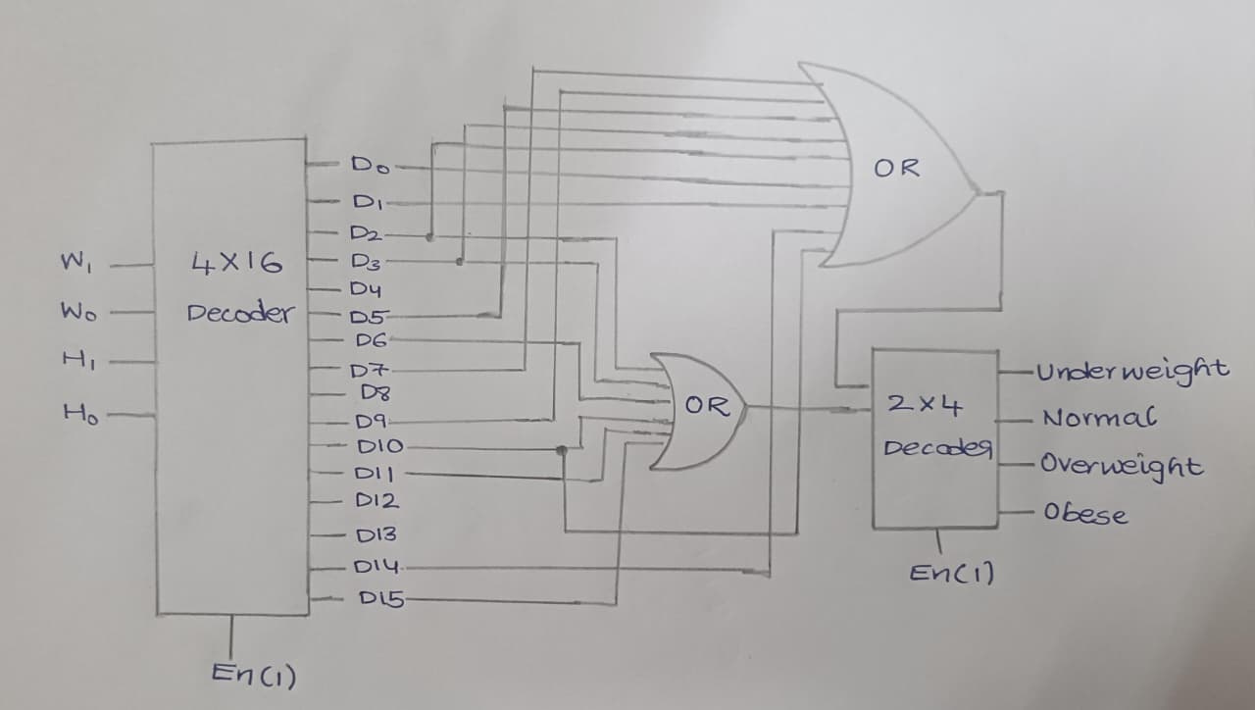
CIRCUIT DIAGRAM :

Slide 11
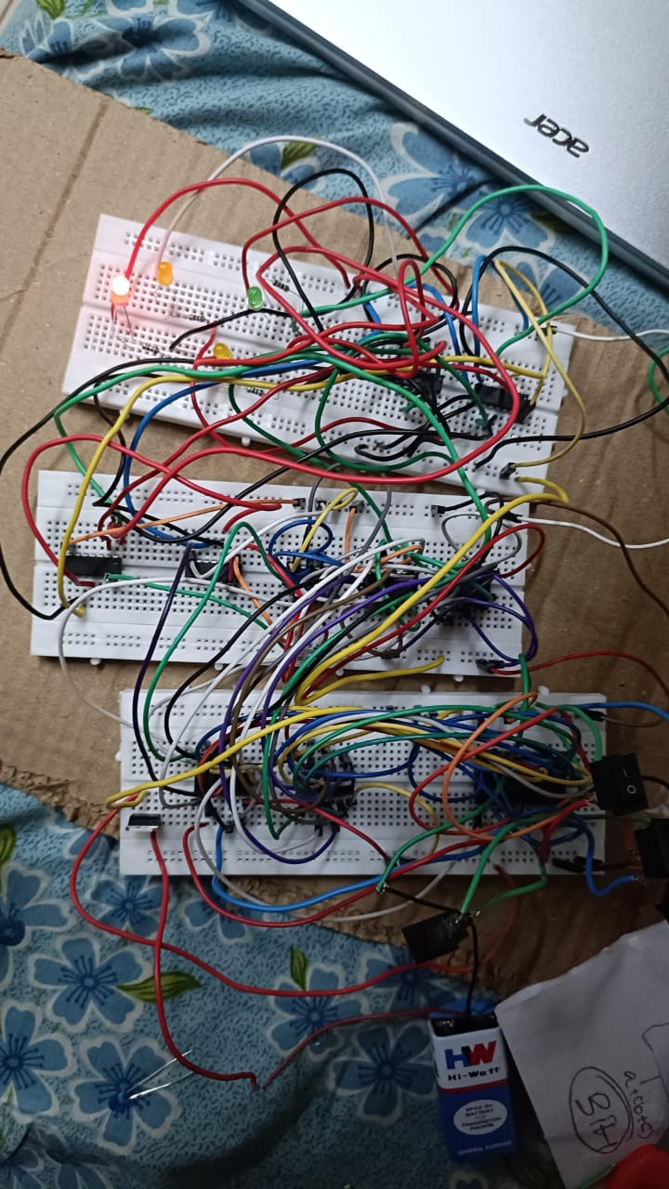
Real time circuit :

Slide 12
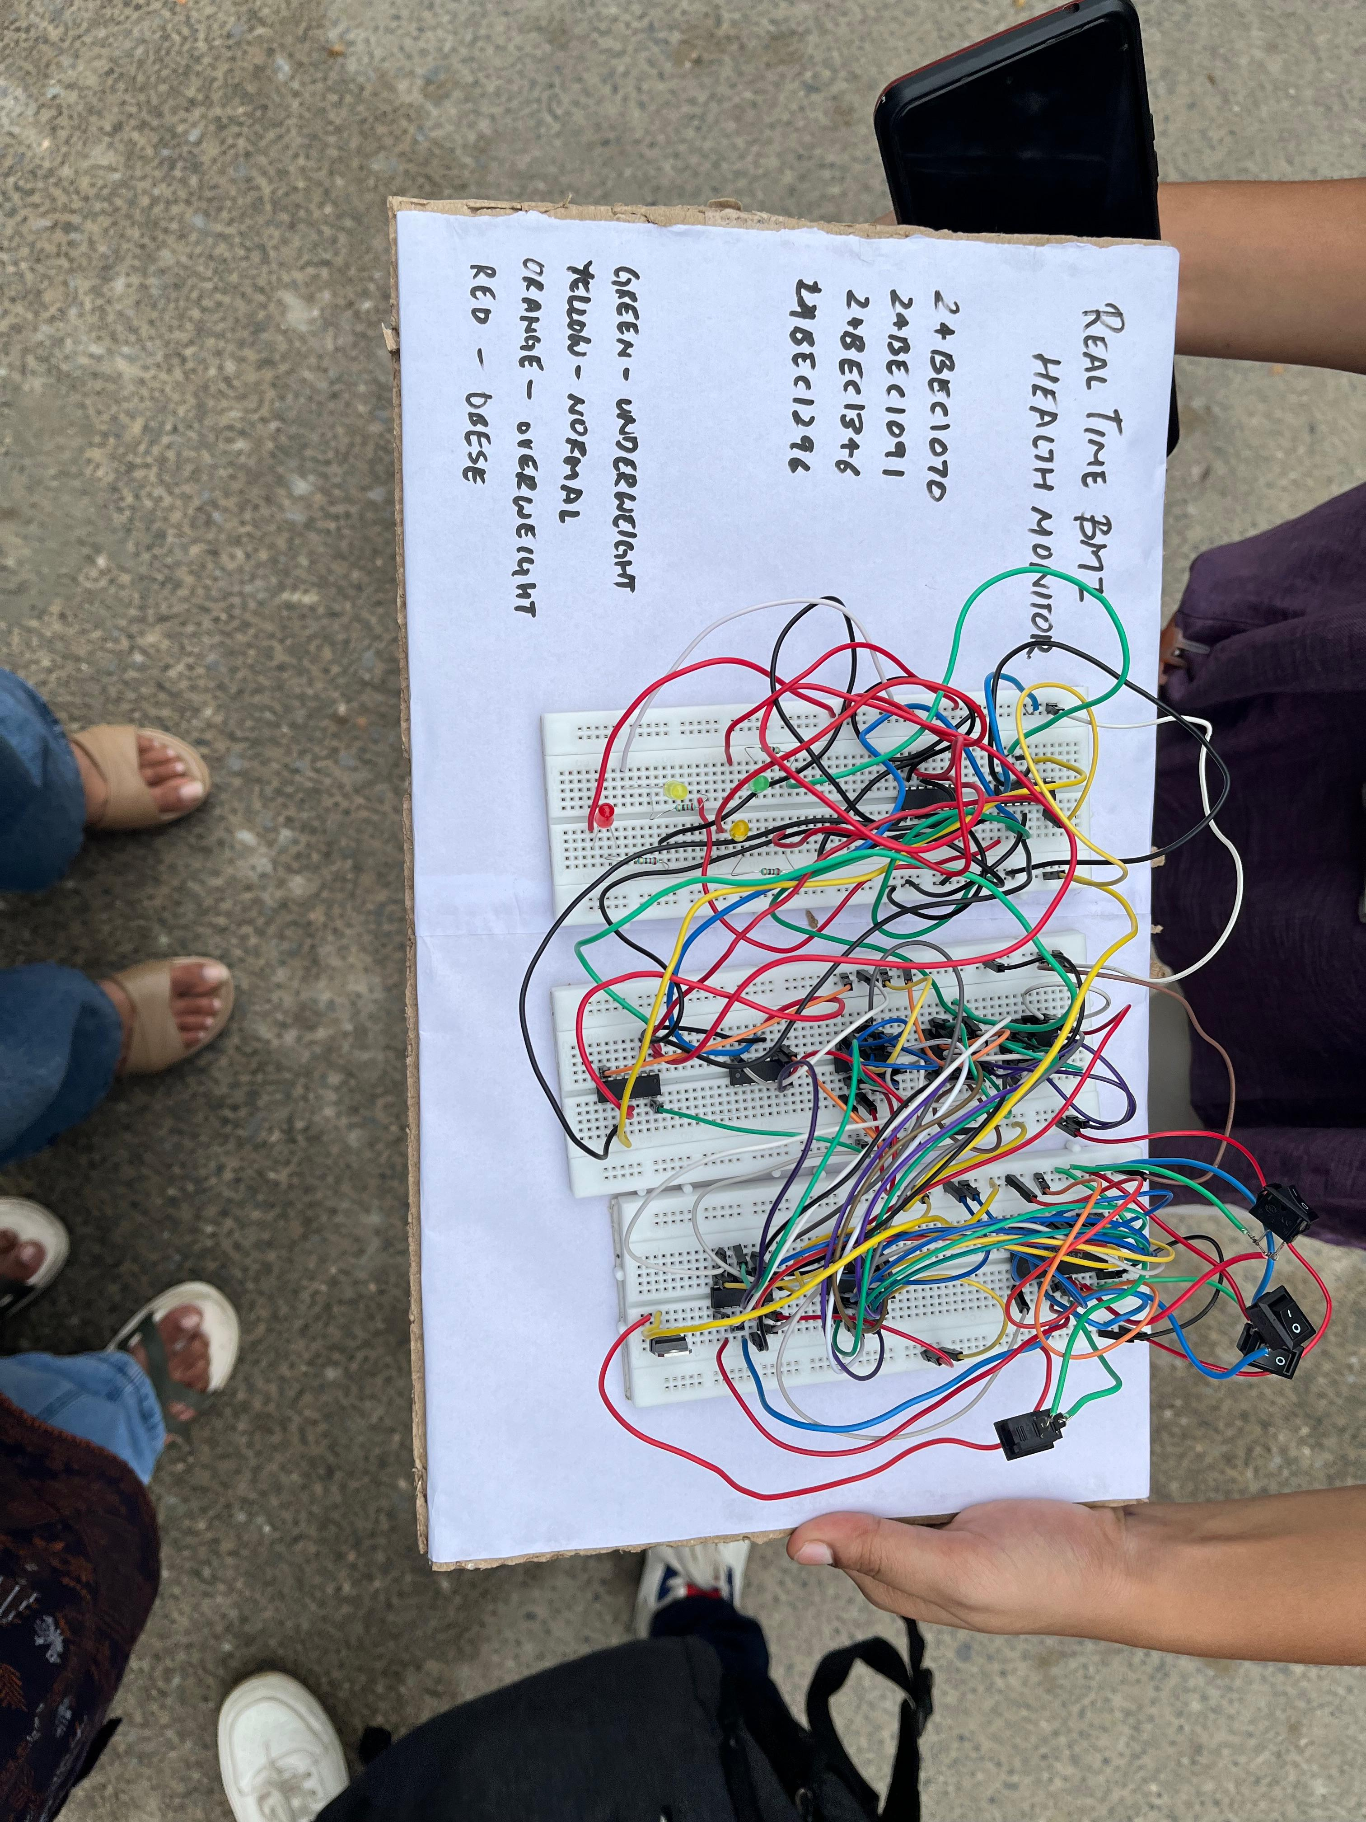

Slide 13
Codes

Slide 14
Data flow modelling :
module BMI(H1n, H0n, W1n, W0n, Underweight, Normal, Overweight, Obese); input H1n, H0n, W1n, W0n; output Underweight, Normal, Overweight, Obese; wire H1n, H0n, W1n, W0n; wire [15:0] D; wire Bit1, Bit0; assign D[0] = (~H1n & ~H0n & ~W1n & ~W0n); assign D[1] = (~H1n & ~H0n & ~W1n & W0n); assign D[2] = (~H1n & ~H0n & W1n & ~W0n); assign D[3] = (~H1n & ~H0n & W1n & W0n); assign D[4] = (~H1n & H0n & ~W1n & ~W0n); assign D[5] = (~H1n & H0n & ~W1n & W0n); assign D[6] = (~H1n & H0n & W1n & ~W0n); assign D[7] = (~H1n & H0n & W1n & W0n); assign D[8] = ( H1n & ~H0n & ~W1n & ~W0n); assign D[9] = ( H1n & ~H0n & ~W1n & W0n); assign D[10] = ( H1n & ~H0n & W1n & ~W0n); assign D[11] = ( H1n & ~H0n & W1n & W0n); assign D[12] = ( H1n & H0n & ~W1n & ~W0n);
assign D[13] = ( H1n & H0n & ~W1n & W0n); assign D[14] = ( H1n & H0n & W1n & ~W0n); assign D[15] = ( H1n & H0n & W1n & W0n); assign Bit1 = D[2] | D[3] | D[6] | D[7] | D[11] | D[15]; assign Bit0 = D[0] | D[1] | D[2] | D[3] | D[5] | D[7] | D[9] | D[10] | D[14]; assign Underweight = (~Bit1) & (~Bit0); assign Normal = (~Bit1) & ( Bit0); assign Overweight = ( Bit1) & (~Bit0); assign Obese = ( Bit1) & ( Bit0); endmodule

Slide 15
Structural modelling :
module BMI(H1n, H0n, W1n, W0n, Underweight, Normal, Overweight, Obese); input H1n, H0n, W1n, W0n; output Underweight, Normal, Overweight, Obese; wire H1n, H0n, W1n, W0n; wire [15:0]t; wire Bit1, Bit0; wire nBit1, nBit0; and a0(t[0], ~H1n, ~H0n, ~W1n, ~W0n); and a1(t[1], ~H1n, ~H0n, ~W1n, W0n); and a2(t[2], ~H1n, ~H0n, W1n, ~W0n); and a3(t[3], ~H1n, ~H0n, W1n, W0n); and a4(t[4], ~H1n, H0n, ~W1n, ~W0n); and a5(t[5], ~H1n, H0n, ~W1n, W0n); and a6(t[6], ~H1n, H0n, W1n, ~W0n); and a7(t[7], ~H1n, H0n, W1n, W0n); and a8(t[8], H1n, ~H0n, ~W1n, ~W0n); and a9(t[9], H1n, ~H0n, ~W1n, W0n); and a10(t[10], H1n, ~H0n, W1n, ~W0n); and a11(t[11], H1n, ~H0n, W1n, W0n); and a12(t[12], H1n, H0n, ~W1n, ~W0n);
and a13(t[13], H1n, H0n, ~W1n, W0n); and a14(t[14], H1n, H0n, W1n, ~W0n); and a15(t[15], H1n, H0n, W1n, W0n); or or1(Bit1, t[2], t[3], t[6], t[7], t[11], t[15]); or or2(Bit0, t[0], t[1], t[2], t[3], t[5], t[7], t[9], t[10], t[14]); not n16(nBit1, Bit1); not n17(nBit0, Bit0); and a16(Underweight, nBit1, nBit0); and a17(Normal,nBit1, Bit0); and a18(Overweight, Bit1, nBit0); and a19(Obese, Bit1, Bit0); endmodule

Slide 16
Behavioural modelling :
module BMI(H1, H0, W1, W0, Underweight, Normal, Overweight, Obese); input H1, H0, W1, W0; output reg Underweight, Normal, Overweight, Obese; reg [1:0] Bit; reg [3:0] D_in; always @(*) begin D_in = {H1, H0, W1, W0}; Underweight = 0; Normal = 0; Overweight = 0; Obese = 0; Bit = 2'b00; case (D_in) 4'b0000: Bit = 2'b01; 4'b0001: Bit = 2'b01; 4'b0010: Bit = 2'b11; 4'b0011: Bit = 2'b11; 4'b0100: Bit = 2'b00; 4'b0101: Bit = 2'b01;
4'b0110: Bit = 2'b10; 4'b0111: Bit = 2'b11;
4'b1000: Bit = 2'b00; 4'b1001: Bit = 2'b01; 4'b1010: Bit = 2'b01; 4'b1011: Bit = 2'b10; 4'b1100: Bit = 2'b00; 4'b1101: Bit = 2'b00; 4'b1110: Bit = 2'b01; 4'b1111: Bit = 2'b10; default: Bit = 2'b00; endcase case (Bit) 2'b00: Underweight = 1; 2'b01: Normal = 1; 2'b10: Overweight = 1; 2'b11: Obese = 1; endcase end endmodule

Slide 17
Test bench :
module tb_bmi_structural; reg H1n, H0n, W1n, W0n; wire Underweight, Normal, Overweight, Obese; BMI uut(H1n, H0n, W1n, W0n, Underweight, Normal, Overweight, Obese); integer i; initial begin for (i=0; i<16; i=i+1) begin {H1n,H0n,W1n,W0n} = i; #10; end $finish; end endmodule

Slide 18
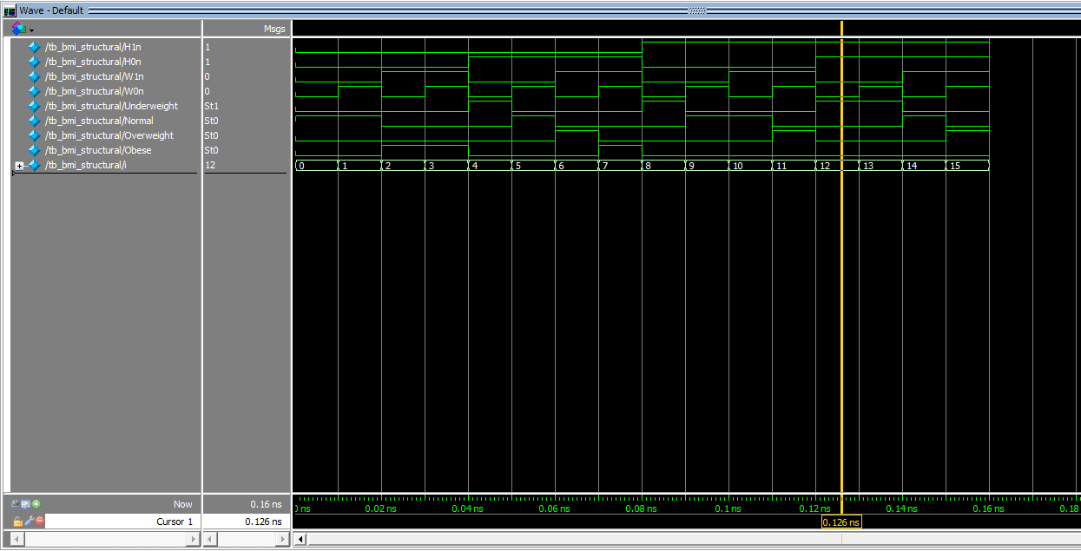
Output waveform :

Slide 19
References :
S. K. Khare et al., "Design of Body Mass Index Calculator Using Combinational Circuits," International Journal of Computer Applications, Vol. 113, No. 3, 2015. I. S. Faradisa, R. P. Muhammad, and D. A. Girindraswari, "A Design of Body Mass Index (BMI) and Body Fat Percentage Device Using Fuzzy Logic," Indonesian Journal of Electronics, Electromedical Engineering, and Medical Informatics (IJEEEMI), vol. 4, no. 2, pp. 65–72, May 2022.

Slide 20
THANK YOU

