Slide 1
Surveilling Surveillance
Model Evaluation & Threshold Analysis for Philadelphia
Mariya Mushtaq • Thesis Update • March 2026

Slide 2
Background: The Original Paper
"Surveilling Surveillance" (Sheng et al., AIES 2021) — Stanford Policy Lab
Goal: Estimate prevalence of surveillance cameras across 16 cities using Street View
Model: Faster R-CNN (ResNet-50 + FPN), trained on ~3,155 GSV images (~1,696 cameras)
Two classes: Directed Camera & Dome Camera
Their pipeline: Model detection → Human verification → Statistical correction
Reported performance: Precision = 0.58, Recall = 0.63
For Philadelphia: 348 verified detections / 100K images → 0.38 cameras/km (~2,600 estimated)
Key limitation they acknowledged: confuses cameras with street lamps, building structures, parking meters

Slide 3
What I Did: Three-Part Evaluation
1. Threshold Analysis
(500 Random Philly Images)
2. ALPR Ground Truth
(99 Known Camera Locations)
3. Manual Labeling
(Both Datasets)
• Sampled 500 images from philly_meta.csv
• Ran detector at threshold=0
• 69 detections across 52 images
• Analyzed score distribution
• Used dFlock ALPR locations as ground truth
• Downloaded 4 headings × 99 locations = 396 images
• Ran detector at threshold=0
• 64 detections across 46 images
• Labeled all detections as correct/incorrect
• Built ROC and Precision-Recall curves
• Compared to original paper's metrics
• Assessed if threshold tuning can help

Slide 4
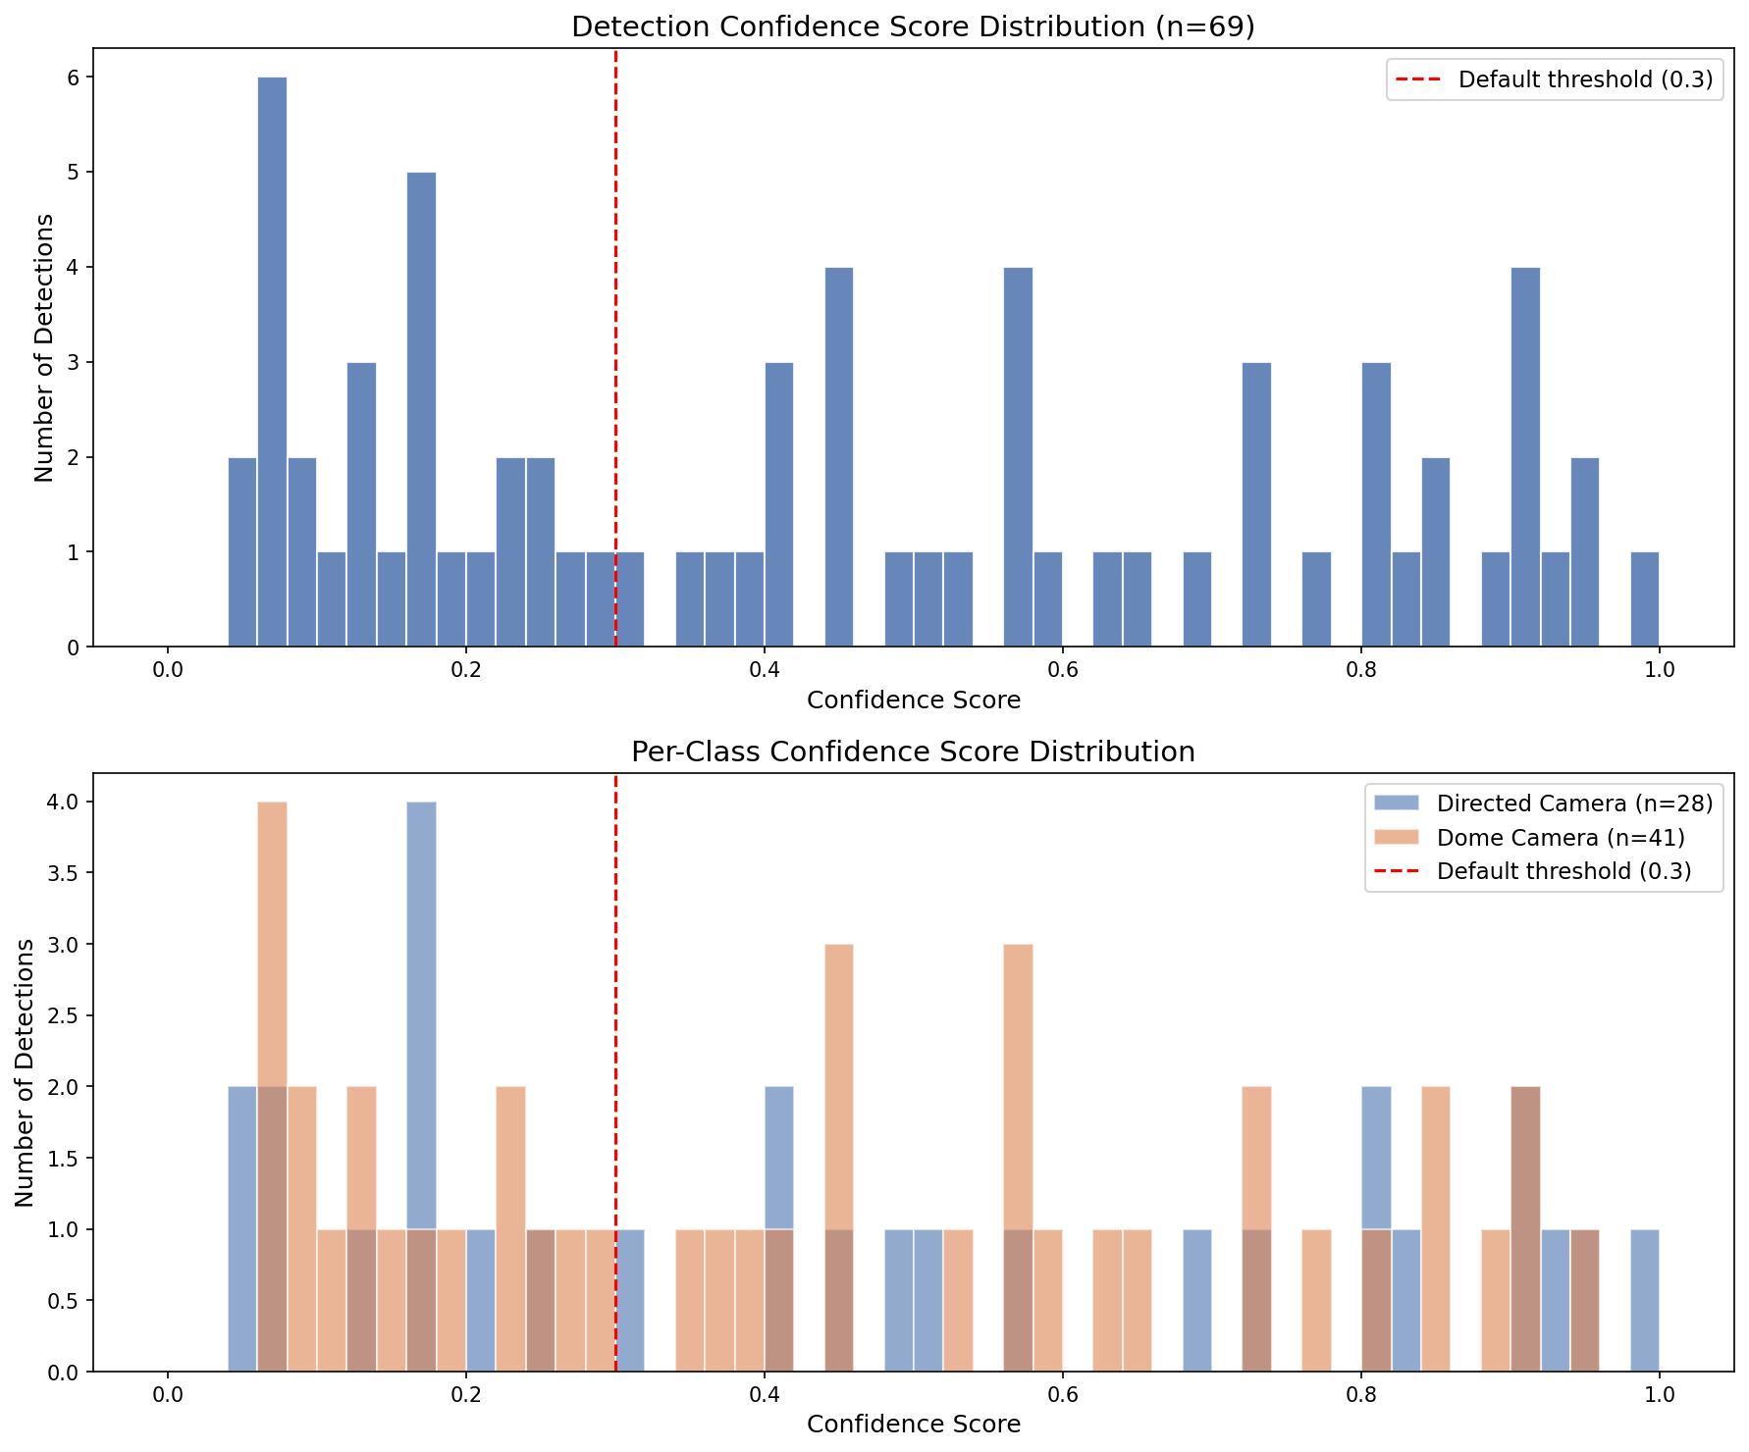
Score Distribution: 500-Image Philly Sample
69 total detections
52 images with detections
28 Directed, 41 Dome
Mean score: 0.453
Median score: 0.419
Bimodal distribution:
• Cluster at 0.0–0.2 (noise??)
• Spread across 0.3–1.0

Slide 5
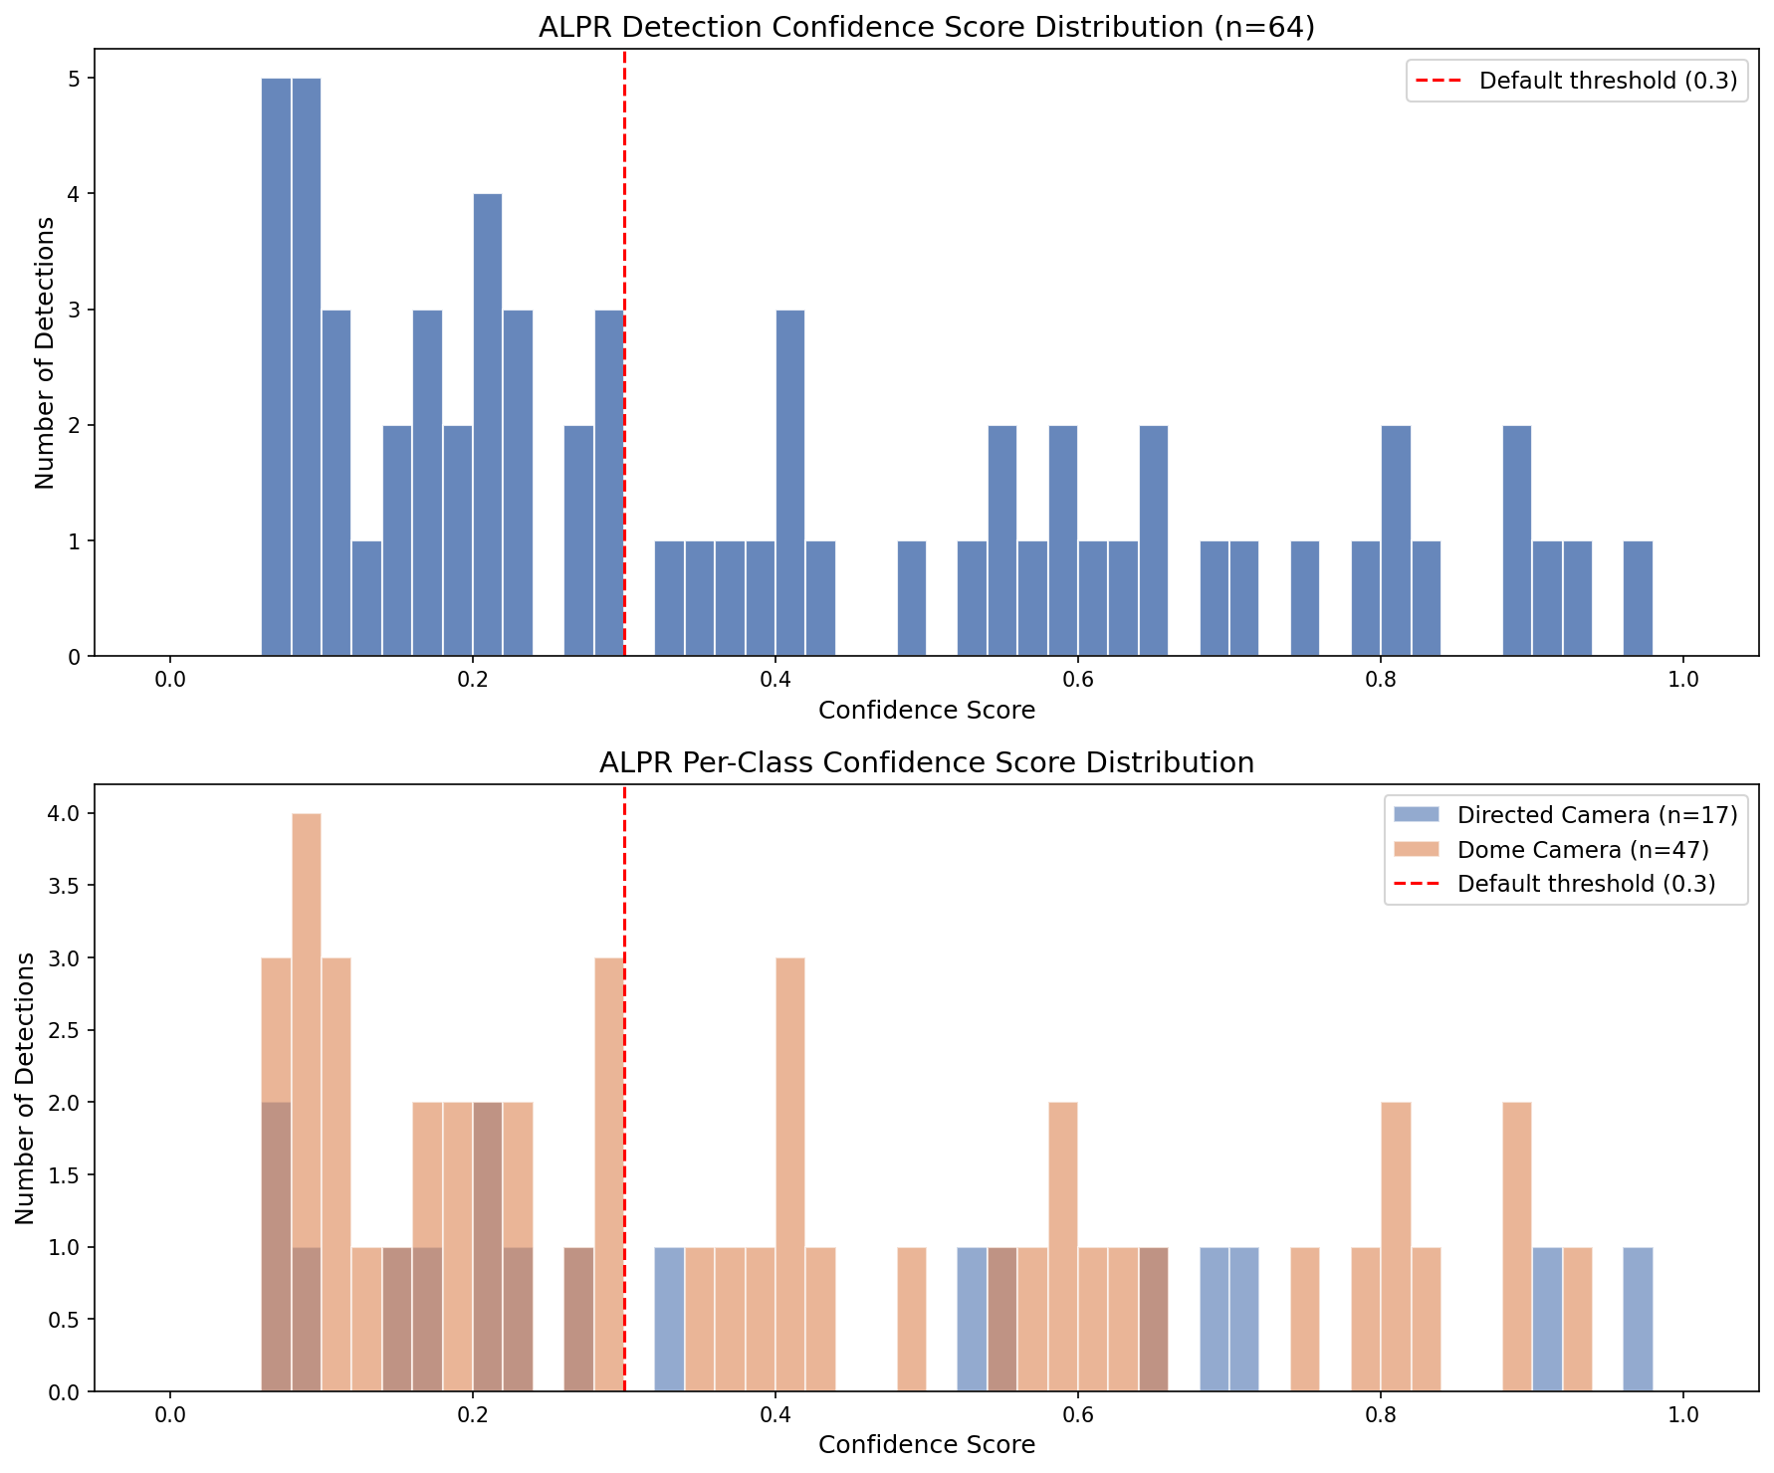
Score Distribution: ALPR Ground Truth (99 Known Locations)
396 images (99 locs × 4 headings)
46 images with detections (11.6%)
64 total detections
17 Directed, 47 Dome
Mean score: 0.388
Per-location breakdown:
• 38/99 locations detected (38.4%)
• 61 locations had ZERO detections
• Only 18 locations with score ≥ 0.5

Slide 6
Manual Labeling: What's Actually Correct?
500-Image Philly Sample (69 detections)
ALPR Ground Truth (64 detections)
Labeled all 69 detections as correct/incorrect
29 correct (42%) — 40 incorrect FP (58%)
Common false positives:
• Roof structures shaped like cameras
• TV antennas, street lights, leaves
• Water pipes, poles, wire structures
Precision flat across score bands:
Even at 0.9+ confidence → 50% wrong
Labeled all 64 detections as correct/incorrect
35 correct (55%) — 29 incorrect (45%)
Common false positives:
• Street lights (dome shape confusion)
• Airplanes, similar-shaped structures
Key observation:
Model misclassified type too -- 'correct' detections sometimes had wrong class (dome vs directed)

Slide 7
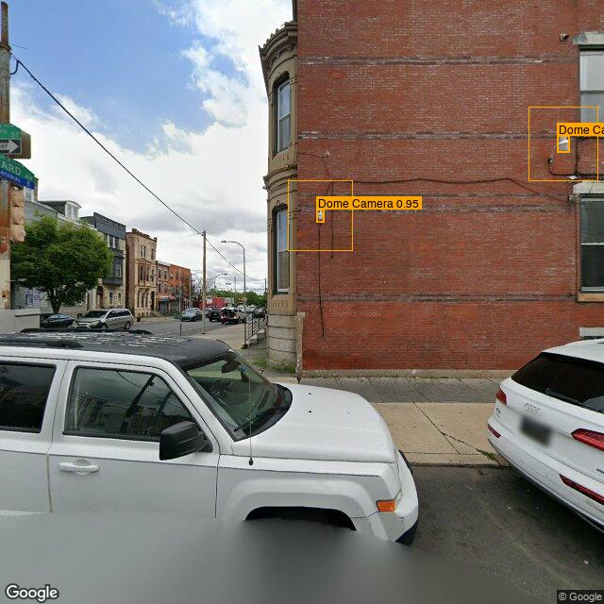
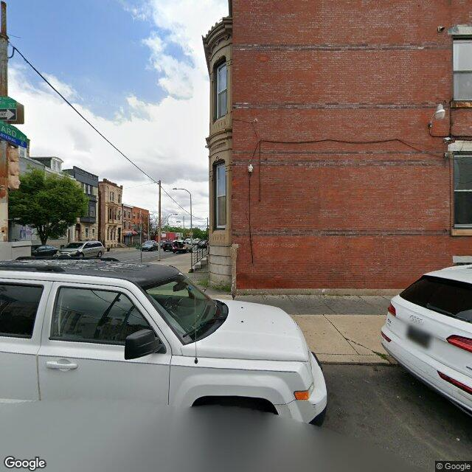
Detection Examples: Surveillance Camera Data (Philly Street View)
Detection
Actual Image
"class": "Dome Camera",
"class_id": 1,
"score": 0.952299,
"class": "Dome Camera",
"class_id": 1,
"score": 0.903165,

Slide 8
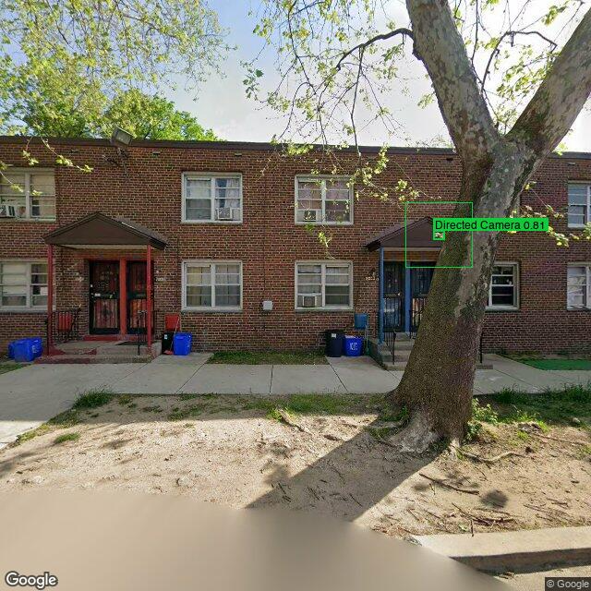
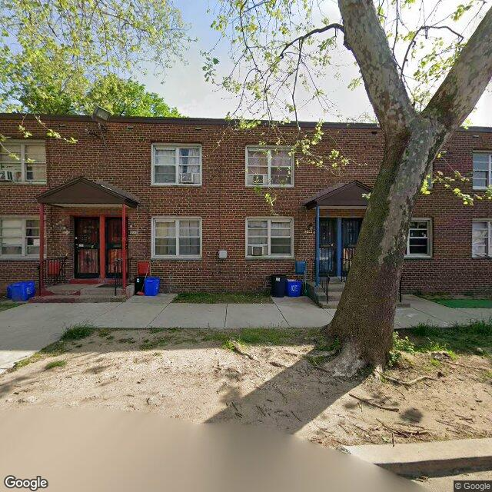
Detection Examples: Surveillance Camera Data (Philly Street View)
Detection
Actual Image
"class": "Directed Camera",
"class_id": 0,
"score": 0.812302

Slide 9
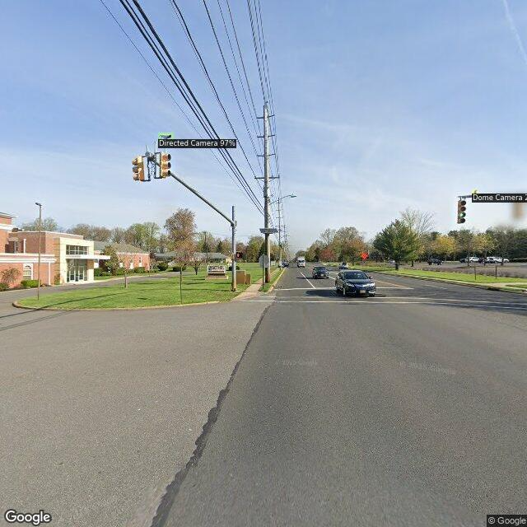
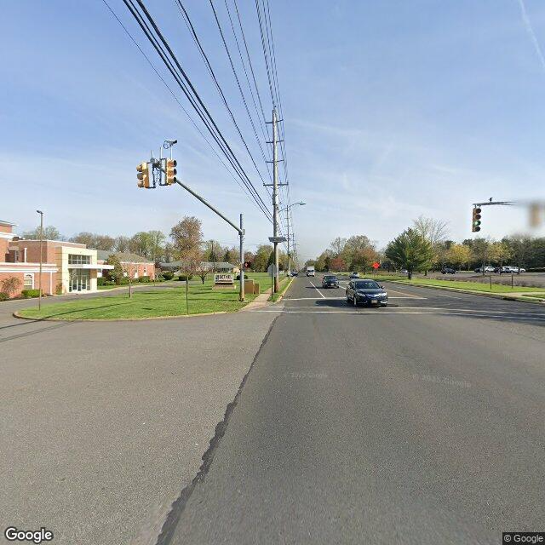
Detection Examples: ALPR Data (Street View at Known ALPR Locations)
Detection
Actual Image
"class": "Directed Camera",
"class_id": 0,
"score": 0.969999,
"class": "Dome Camera",
"class_id": 1,
"score": 0.199853

Slide 10
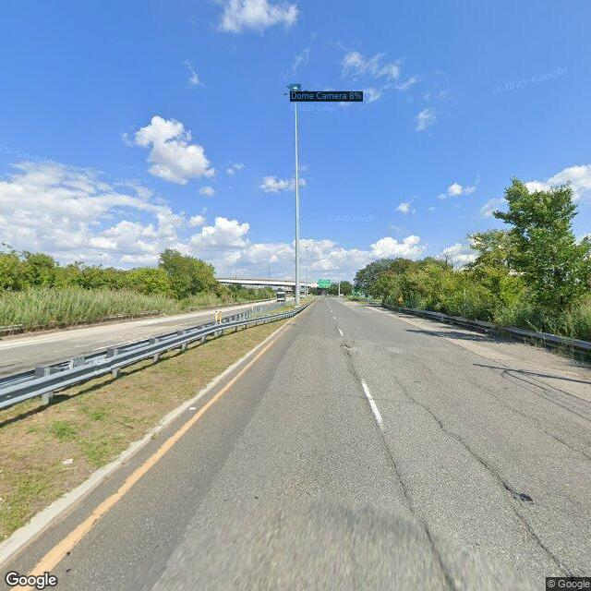
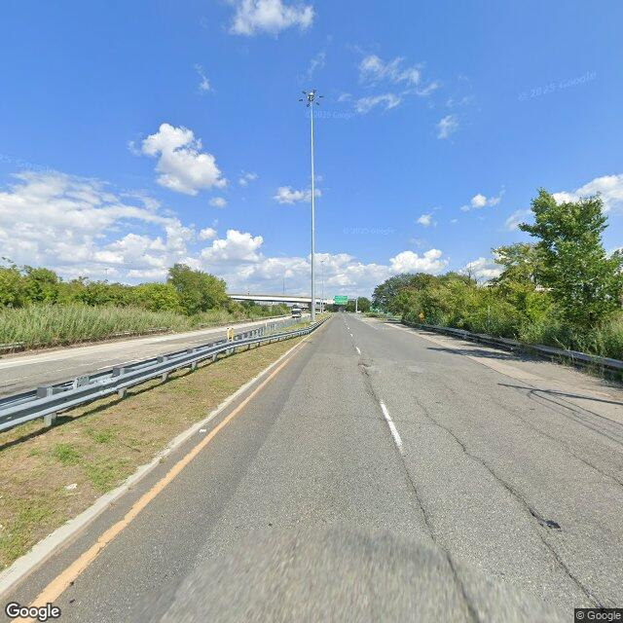
Detection Examples: ALPR Data (Street View at Known ALPR Locations)
Detection
Actual Image
"class": "Dome Camera",
"class_id": 1,
"score": 0.083138

Slide 11
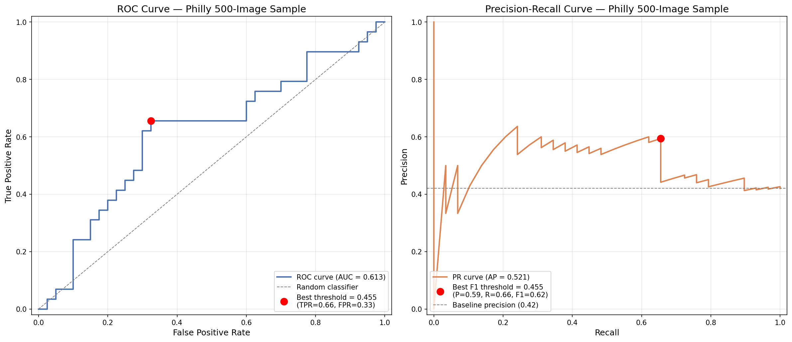
ROC & Precision-Recall: 500-Image Philly Sample
Results
ROC AUC = 0.613
Avg Precision = 0.521
Best threshold = 0.455
P=0.59, R=0.66, F1=0.62
Slightly better than
random -- scores are
weakly informative

Slide 12
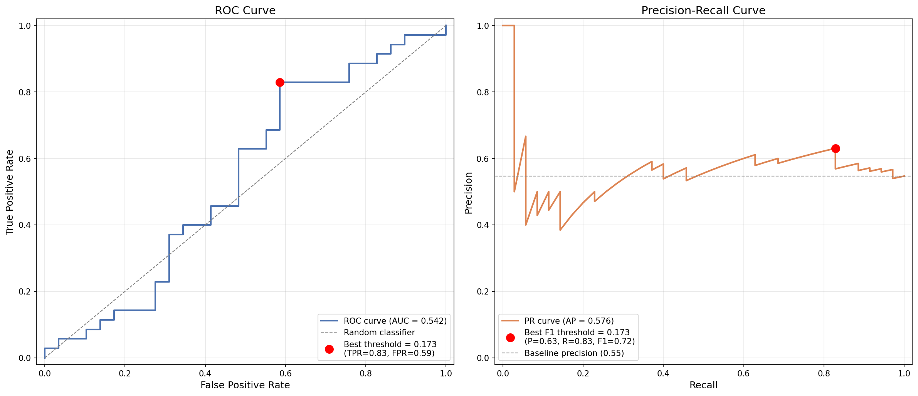
ROC & Precision-Recall: ALPR Ground Truth
Results
ROC AUC = 0.542
Avg Precision = 0.576
Best threshold = 0.173
P=0.63, R=0.83, F1=0.72
Nearly random -- confidence scores are NOT informative for separating TP from FP on ALPR locations

Slide 13
How Do Our Results Compare to the Paper?
Metric
Paper (Sheng et al.)
Our Philly Sample
Our ALPR Data
Precision
0.58
0.59 (at t=0.45)
0.63 (at t=0.17)
Recall
0.63
0.66 (at t=0.45)
0.83 (at t=0.17)
ROC AUC
Not reported
0.613
0.542
False positives
Street lamps, bldg structures
Roofs, antennas, lights
Street lights, airplanes
Human verification
Required (3 annotators)
Required
Required
Threshold used
0.75 (segmentation)
0.45 (detection)
0.17 (detection)
Our precision matches the paper's almost exactly (0.58–0.59). The model behaves consistently — it was always a weak filter requiring human review.

Slide 14
Why Is the Model Struggling?
Small training set — Only ~3,155 images with ~1,696 cameras (modern detectors need 10K+)
Limited visual diversity — Trained mostly on San Francisco cameras; Philly infrastructure looks different
No hard negative mining — Never explicitly trained to distinguish cameras from street lights/poles
Paper's own recall was only 0.63 — They acknowledged limitations and compensated with human verification
Different model than paper — Paper used DeepLab V3+ (segmentation); repo updated to Faster R-CNN post-publication
ALPR cameras look different — Pole-mounted license plate readers ≠ dome/directed surveillance cameras

Slide 15
Key Takeaways
→ Threshold tuning alone won't fix this
ROC AUC of 0.54–0.61 means confidence scores are near-random for separating TP from FP
→ Our results match the paper's reported performance
Precision ~0.58 is consistent — this is the model's ceiling
→ The model was designed as a filter, not a standalone detector
The paper always used human verification; the model was never meant to work alone
→ ALPR detection is harder than general surveillance detection
Only 38% of known ALPR locations detected vs. general cameras — different visual characteristics

Slide 16
Next Steps: Options for Discussion
Option A: Run Full Pipeline + Replicate Paper
Run detector on all of Philly at low threshold (~0.2), manually verify positives
Use recall correction (0.63) to estimate camera prevalence — directly comparable to paper's Philadelphia estimate
Use ALPR ground truth as independent validation of the methodology
Option B: Improve the Model
Fine-tune with hard negatives (street lights, antennas) and ALPR-specific positives
More aggressive data augmentation (rotation, scale, color jitter)
Risk: Time-intensive, requires compute, may not dramatically improve performance

