Slide 1
Assalamu Walaikum
Database Management System
Presentation on Library Management System
Presented by:
Mst. Riktah Begum
Md. Mahabubar Rahman
Sadia Islam Sharna
Mst. Mariya Rahman

Slide 2
Introduction
Objectives
To develop an efficient Library Management System
To store and manage book and student information
To automate book issue and return processes
To reduce manual errors and save time
To provide quick and easy access to data
To improve overall library management system
A Library Management System is a software application designed to manage and organize library operations efficiently.
It helps in maintaining records of books, students, and transactions such as issuing and returning books.
This system reduces manual work, minimizes errors, and improves overall productivity of the library.
It provides quick access to information and ensures better management of library resources.

Slide 3


Features
Search Books by title/author
Fine calculation system
Book Management (Add, Update, Delete books)
Member Management
Issue and Return Books
Report generation
User authentication (Admin/User)

Slide 4
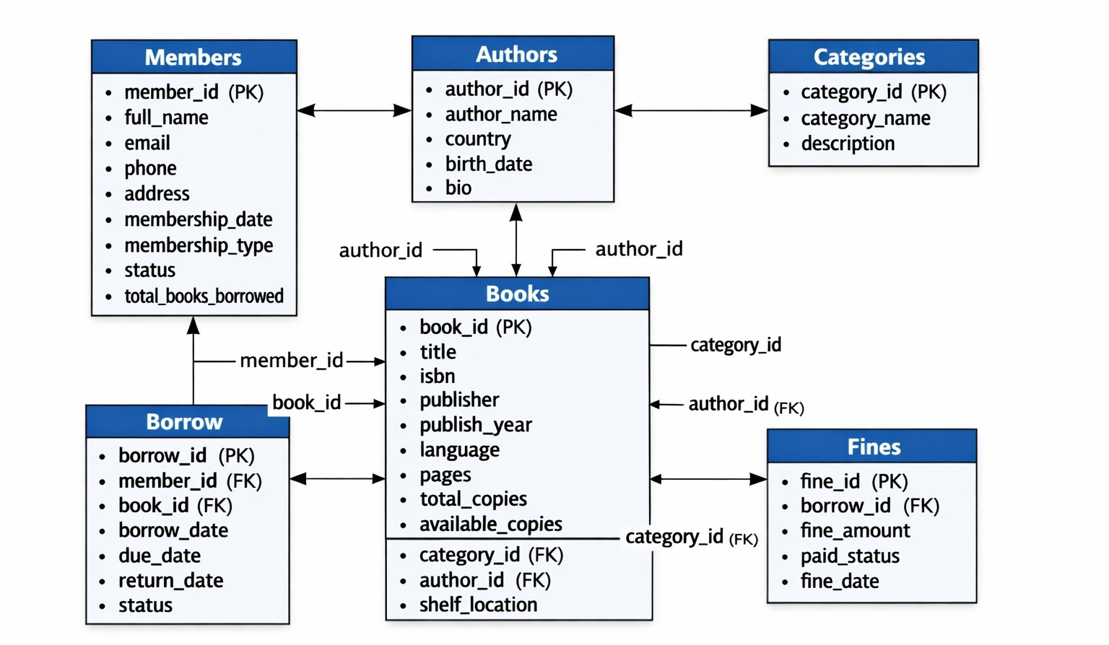
Schema Diagram
System Flow : Authors → Categories → Books → Members → Borrow → Fines

Slide 5
Relational Schema
1. Authors
Authors(author_id, author_name, country, birth_date, bio)
Primary Key: author_id
2. Books
Books(book_id, title, isbn, publisher, publish_year, language, pages, total_copies, available_copies, category_id, author_id, shelf_location)
Primary Key: book_id
Foreign Keys:
  category_id → Categories(category_id)
  author_id → Authors(author_id)
3. Borrow
Borrow(borrow_id, member_id, book_id, borrow_date, due_date, return_date, status)
Primary Key: borrow_id
Foreign Keys:
  member_id → Members(member_id)
  book_id → Books(book_id)

Slide 6
Relational Schema
4. Categories
Categories(category_id, category_name, description)
Primary Key: category_id
5. Fines
Fines(fine_id, borrow_id, fine_amount, paid_status, fine_date)
Primary Key: fine_id
Foreign Key:
  borrow_id → Borrow(borrow_id)
6. Members
Members(member_id, full_name, email, phone, address, membership_date, membership_type, status, total_books_borrowed)
Primary Key: member_id

Slide 7
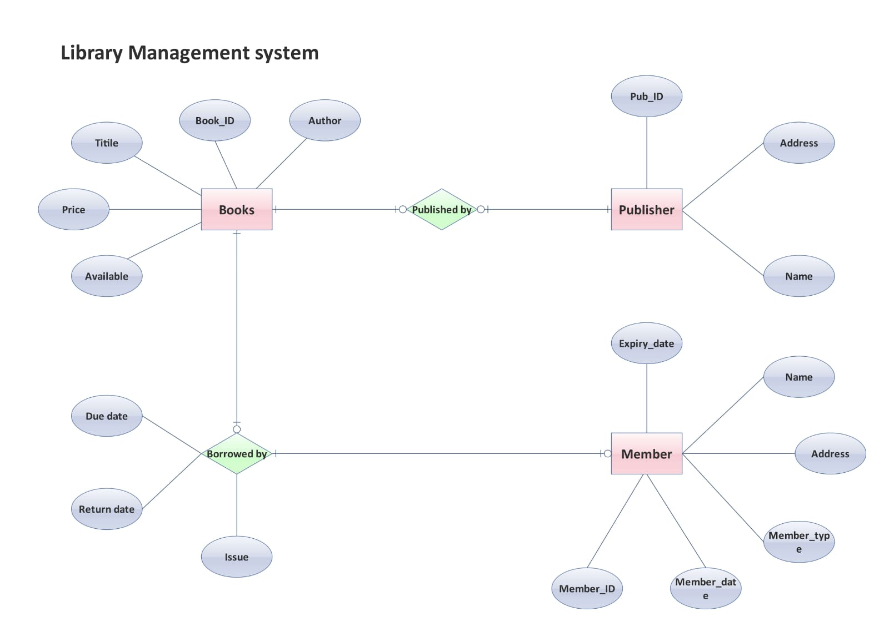
ER Diagram

Slide 8
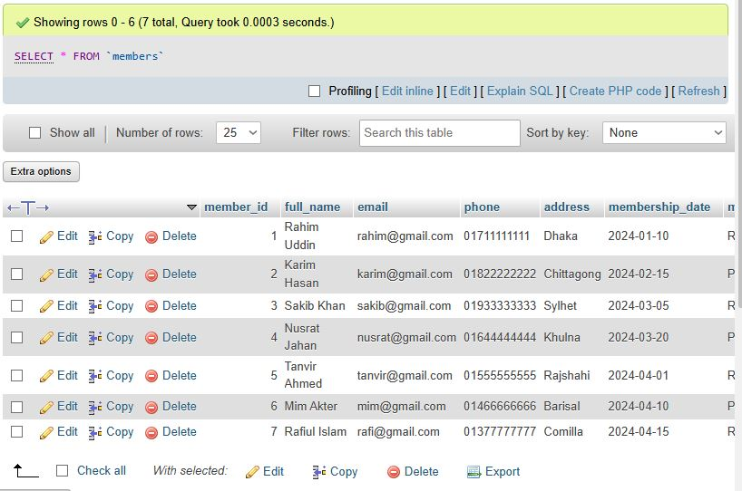
Relational Database
CREATE TABLE Members (
member_id INT PRIMARY KEY AUTO_INCREMENT,
full_name VARCHAR(100),
email VARCHAR(100) UNIQUE,
phone VARCHAR(20),
address TEXT,
membership_date DATE,
membership_type VARCHAR(50),
status VARCHAR(20),
total_books_borrowed INT DEFAULT 0
);

Slide 9
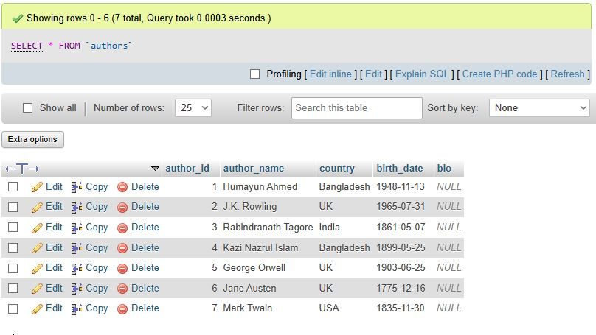
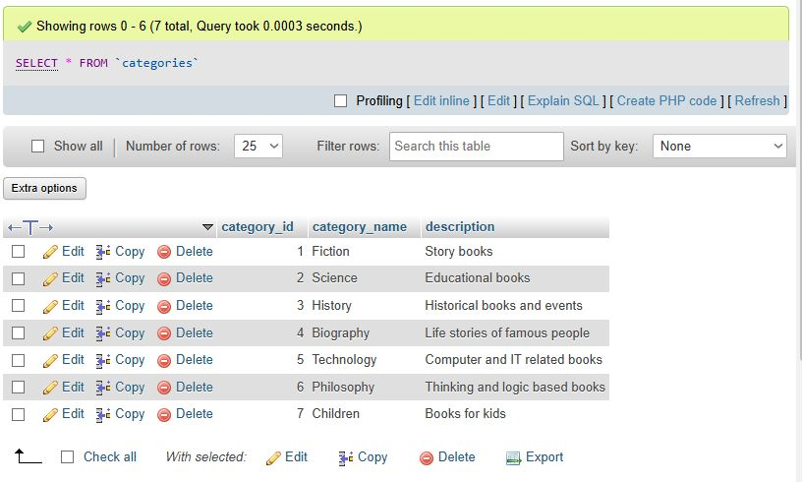
Relational Database
CREATE TABLE Authors (
author_id INT PRIMARY KEY AUTO_INCREMENT,
author_name VARCHAR(100),
country VARCHAR(50),
birth_date DATE,
bio TEXT
);
CREATE TABLE Categories (
category_id INT PRIMARY KEY AUTO_INCREMENT,
category_name VARCHAR(50),
description TEXT
);

Slide 10
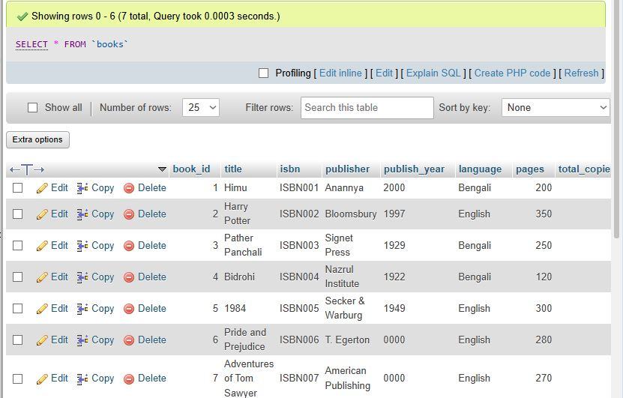
Relational Database
CREATE TABLE Books (
book_id INT PRIMARY KEY AUTO_INCREMENT,
title VARCHAR(150),
isbn VARCHAR(50) UNIQUE,
publisher VARCHAR(100),
publish_year YEAR,
language VARCHAR(50),
pages INT,
total_copies INT,
available_copies INT,
category_id INT,
author_id INT,
shelf_location VARCHAR(50),
FOREIGN KEY (category_id) REFERENCES Categories(category_id),
FOREIGN KEY (author_id) REFERENCES Authors(author_id)
);

Slide 11
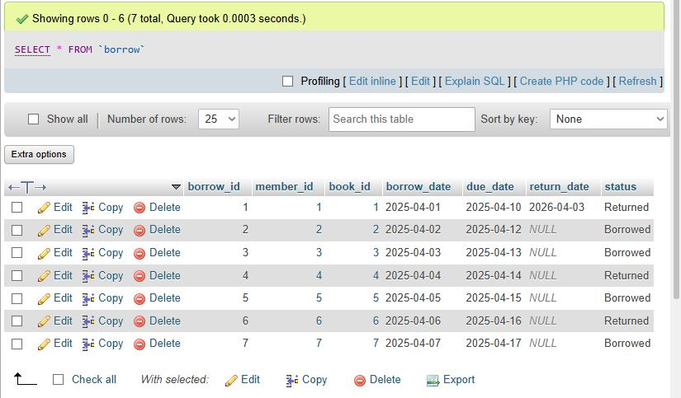
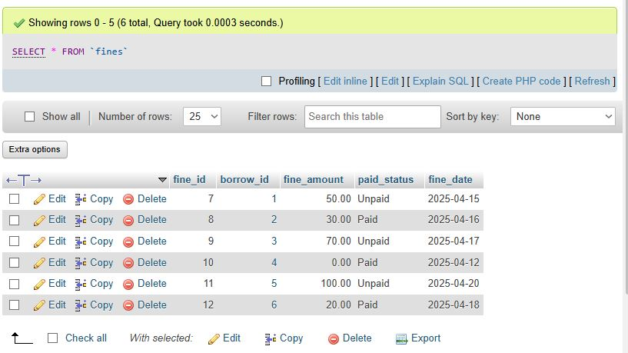
Relational Database
CREATE TABLE Borrow (
borrow_id INT PRIMARY KEY AUTO_INCREMENT,
member_id INT,
book_id INT,
borrow_date DATE,
due_date DATE,
return_date DATE,
status VARCHAR(20),
FOREIGN KEY (member_id) REFERENCES Members(member_id),
FOREIGN KEY (book_id) REFERENCES Books(book_id)
);
CREATE TABLE Fines (
fine_id INT PRIMARY KEY AUTO_INCREMENT,
borrow_id INT,
fine_amount DECIMAL(10,2),
paid_status VARCHAR(20),
fine_date DATE,
FOREIGN KEY (borrow_id) REFERENCES Borrow(borrow_id)
);

Slide 12
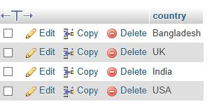
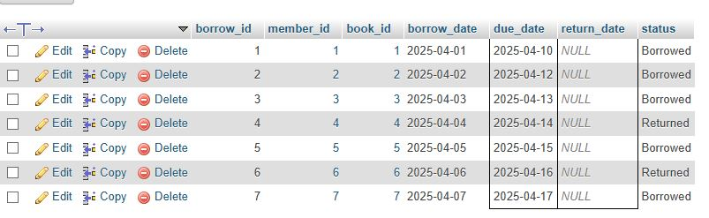
Result of Some Features with Query
SELECT DISTINCT country
FROM Authors;
SELECT * FROM Borrow
WHERE due_date < CURDATE() AND return_date IS NULL;

Slide 13
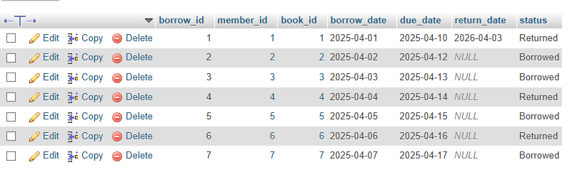
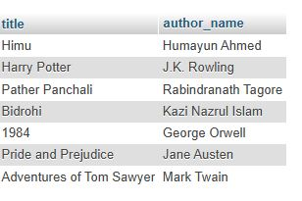
Result of Some Features with Query
UPDATE Borrow
SET return_date = CURDATE(), status = 'Returned'
WHERE borrow_id = 1;
SELECT Books.title, Authors.author_name
FROM Books
INNER JOIN Authors
ON Books.author_id = Authors.author_id;

Slide 14
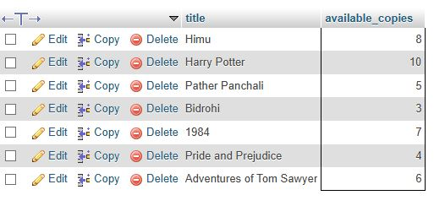
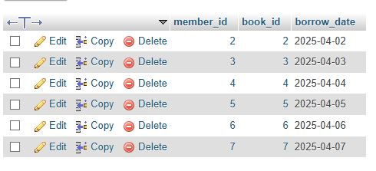
Result of Some Features with Query
SELECT title, available_copies
FROM Books
WHERE available_copies > 0;
SELECT member_id, book_id, borrow_date
FROM Borrow
WHERE return_date IS NULL;

Slide 15
Advantages of the System
Limitations
High Initial Setup Cost
Requires Technical Knowledge
System Failure Risk
Data Security Vulnerabilities
Dependence on Electricity & Internet
Regular Maintenance Required
Limited Flexibility Without Updates
Efficient Book Management
Time-Saving Automation
Accurate Record Keeping
Easy Search and Retrieval
Improved Member Management
Automated Fine Calculation
Better Data Security and Control

Slide 16
Future Work
Conclusion
Future Work
Integration with Mobile Application
Online Book Reservation & Renewal System
AI-Based Recommendation System
Advanced Reporting and Analytics Dashboard
RFID / Barcode Integration for Automation
The Library Management System is an efficient solution for managing library operations. It automates tasks, reduces errors, and improves overall productivity. With future enhancements, it can become more advanced and user-friendly.

Slide 17
Thank You
Questions & Answers

