Slide 1
Bank Loan
Case Study
MARIYA SHAJI

Slide 2
Agenda
Project Description
Approach
Insights
Tech Stack Used
Result

Slide 3
Project Description
Objective: Analyze historical loan data to uncover patterns influencing loan repayment behavior.
Business Risks:
• Lost business — capable applicants rejected
• Financial loss — high-risk applicants approved
Dataset: Includes demographic, loan, and past repayment details.
Customer Classification:
• Payment difficulties – late on one or more installments
• No difficulties – repaid on time
Goal: Identify factors driving loan default to improve approval decisions and reduce risk

Slide 4
Approach
Data Cleaning And Preparation
Reduced dataset from 122 → 32 key features by removing:
• Columns with >50% missing values
• Duplicates, irrelevant or low-variance fields
Detected invalid ages (e.g., 1001 years); replaced with Work Experience + 18 to maintain realistic age–experience consistency.
Flagged 2–3 extreme income values (>₹10 crore) as outliers and excluded them to prevent distortion — less than 0.01% of data removed.
Handled missing values in EXT_SOURCE_1–3 using mean imputation to retain creditworthiness data.
Floored fractional family sizes (e.g., 3.7 → 3) for consistency in grouping and analysis
Imported cleaned data into MySQL Workbench for querying and Power BI for visualization and trend analysis.

Slide 5
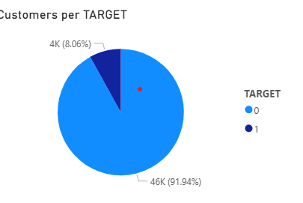
Analysis And Findings
Customer Reliability Based on Repayment Status
Created a view that calculated count of customers based on target.
Represented visuals using pie chart for clear comparison.
Out of 50,000 customers, 46,000 (91%) have no repayment issues (Target = 0).
Insights: This indicates a highly reliable customer base with very low default risk, making the portfolio largely safe.

Slide 6
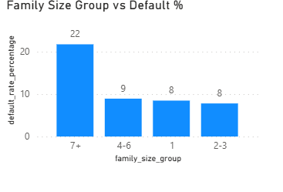
Analysis And Findings
Family Size vs Default %
Insight :
Larger families show significantly higher default risk, indicating repayment ability weakens as family size increases.
Statistical Evidence:
t = 2.71, p = 0.0068 → Difference is statistically significant.

Slide 7
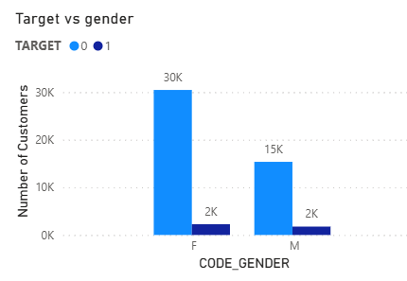
Analysis And Findings
Gender vs Default Risk
Insight:
Male applicants have a slightly higher default rate (2/15) compared to females (1/15). While the difference is modest, the association is statistically significant due to the large dataset.
Statistical Evidence:
χ² = 172.31, p = 0.0000 → Gender is significantly linked to default behavior.

Slide 8
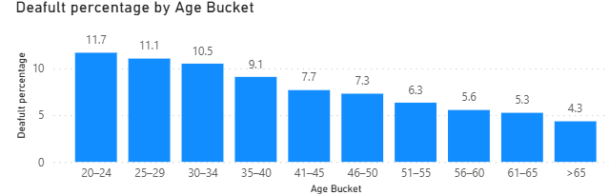
Analysis And Findings
Default Rate by Age
Insight: The default rate steadily decreases from ~11.7% in younger groups to ~4.3% in older groups , indicating improving repayment reliability with age . Suggesting Age is one of strong indicator for default risk.
Statistical Insight:
Younger borrowers are more likely to default than older ones.
(t = –17.8, p < 0.001)

Slide 9
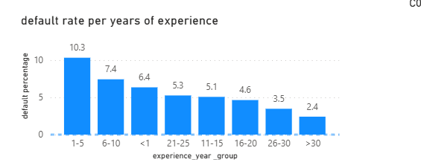
Analysis And Findings
Default Rate by Work Experience.
Insight: Default risk is highest for customers with 1–5 years of experience (10.33%). After that, the default rate mostly decreases as experience increases, reaching the lowest level for customers with >30 years of experience (2.41%), indicating that more experienced customers are generally more financially reliable.
Statistical Insight:
Shorter job history strongly linked to default.
(t = –17.4, p < 0.001)

Slide 10
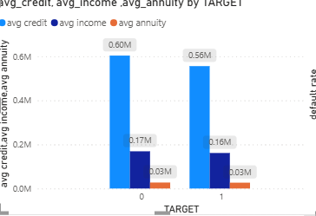
Analysis And Findings
Average Income, Credit, and Annuity by Target
Insight: Customers with no repayment issues (Target = 0) have slightly higher average income, credit, and annuity compared to customers who default (Target = 1). This suggests that higher financial capacity is associated with better repayment behavior.
Statistical Insight:
Lower-income borrowers are more likely to default (t = –5.19, p < 0.001)
Larger credit amounts increase default risk.(t = –8.43, p < 0.001)

Slide 11
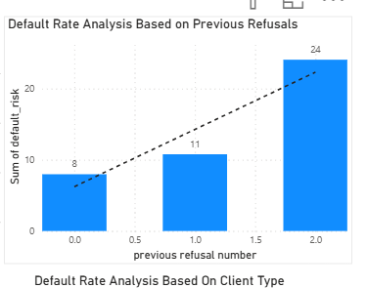
Analysis And Findings
Default Rate by Previous Refusals
Insights: The default risk increases with the number of previous refusals, indicating that past credit behavior is a strong indicator of repayment risk.
.

Slide 12
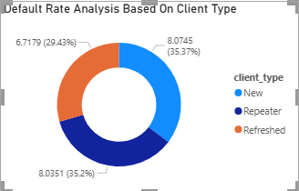
Analysis And Findings
Default Rate by Client Type
Insight: Default rates are 8.1% for New and Repeater clients and 6.7% for Refresher clients, indicating that Refresher clients are slightly more reliable in repayment

Slide 13
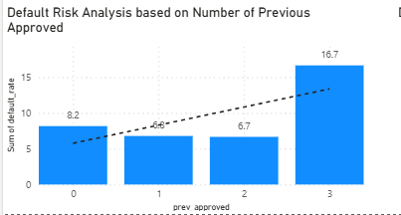
Analysis And Findings
Default Rate by Number of Previous Applications
Insight: Default rates are relatively low for customers with 0–2 previous applications (6.7–8.2%), but increase sharply to 16.7% for customers with 3 previous applications, indicating higher repayment risk for frequent past applicants.

Slide 14
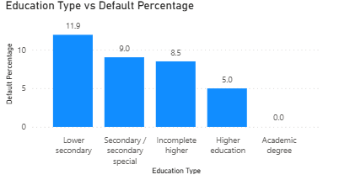
Analysis And Findings
Default Rate by Education Level
Insight: Default rate decreases with higher education, from 11.93% for Lower Secondary to 0% for Academic Degree, indicating better repayment reliability among more educated customers.
Statistical Insight:
Lower education levels correspond to higher default rates.
(χ² = 213.8, p < 0.001)

Slide 15
Insight table
Factor | Trend / Observation | Interpretation (Impact on Default)
Family Size | 🔺 Default % increases with family size | Larger families → weaker repayment capacity
Gender | ♂️ Slightly higher default among males | Gender difference not statistically strong
Age | 🔻 Default % decreases with age | Older customers → more reliable
Work Experience | 🔻 Default % decreases as experience grows | Experienced customers → financially stable
Education Level | 🔻 Higher education → lower default rate | Education improves financial literacy & reliability
Previous Refusals | 🔺 Default risk rises with refusals | Past credit issues predict future risk
Previous Applications | 🔺 Risk increases after 3+ prior applications | Frequent loan seekers → higher default chance
Client Type | 🔻 Refresher clients have lowest default rate | Returning, known customers → safer
Income / Credit / Annuity | 🔻 Higher averages for safe customers | Better financial capacity → better repayment
External Credit Scores (EXT_SOURCE_) | 🔻 Strong negative correlation with default | Higher external scores → lower default risk

Slide 16
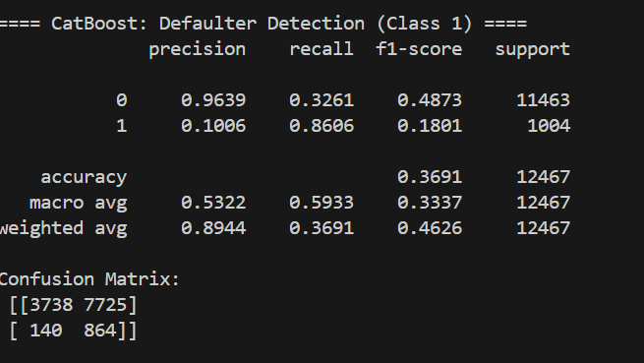
Loan Defaulter Prediction – ML Component
Model: CatBoost(tree-based boosting)
Challenge: Highly imbalanced dataset — only ~8% of applicants were defaulters.
Techniques Used:
Applied class weights to give more importance to defaulters.
Performed threshold tuning to maximize recall (~85%).
Used cross-validation to ensure model stability.
Goal: Detect as many potential defaulters as possible (high recall) — even if some safe applicants are flagged.

Slide 17
Model Evaluation & Business Impact
Metric | Value | What It Means (Simple)
Precision (Non-Defaulters) | 0.32 | Out of all applicants predicted as safe, 32% were actually safe.
Precision (Defaulters) | 0.10 | Out of all applicants predicted as risky, only 10% were actual defaulters (expected due to class imbalance).
Recall (Defaulters) | 0.86 | The model catches 86% of true defaulters — the most important metric for banks.
Recall (Non-Defaulters) | 0.96 | The model correctly identifies 96% of safe applicants, reducing unnecessary rejections.

Slide 18
Loan Defaulter Prediction – ML Component
66% of applicants are flagged as risky, but the model is able to catch 85% of all true defaulters inside that flagged group.
Only 33% of flagged applicants are actually safe, which is acceptable because reviewing a few extra applicants is far better than missing a true defaulter, which can lead to huge financial loss.
For safe applicants the model is 96% accurate.
This high accuracy allows the bank to auto-approve a large portion of low-risk customers without manual review, speeding up loan processing by 33%.
This balance allows the bank to minimize default losses while keeping operations efficient, which is the exact goal of a risk-prediction system.

Slide 19
Summary
Cleaned and prepared applicant demographic, financial, and behavioral data.
Identified key patterns: higher age, work experience, income stability, and education reduce default risk.
Factors like previous refusals, large family size, certain housing types, and specific occupations increase risk.
Built a CatBoost classification model optimized for recall due to imbalanced data.
Model catches 85% of defaulters and maintains 96% accuracy for safe applicants.
Designed a decision framework to auto-approve low-risk profiles and manually review high-risk ones.

Slide 20
Business Recommendation
Use the model for pre-screening: Auto-approve safe applicants (96% accuracy) to speed up processing.
Manually review high-risk profiles: The model catches 85% of defaulters, reducing default losses.
Stronger checks for high-risk segments: Previous refusals, low education, unstable jobs, large families, and risky housing/occupations.
Tiered loan limits: Offer smaller or stricter loans to medium-risk applicants.
Retrain the model regularly: Update every quarter to reflect new customer behavior

Slide 21
Tech Stack
Stage | Tool | Purpose
Data Cleaning | MS Excel | Handled missing values, formatted columns, treated outliers
Data Analysis | MySQL Workbench 8.3 | Wrote queries, created views, aggregated and compared metrics
Data Visualization | Power BI | Built dashboards (bar, pie, doughnut, trend charts) for key insights
Modeling | Python (CatBoost) | Trained ML models to predict defaulters, optimized recall
Presentation | PowerPoint | Compiled visuals and insights into business-ready slides

Slide 22
Key Learnings
Through this project, I learned that:
Real-world data is rarely clean or balanced. It requires logical decisions and domain understanding to prepare it for analysis.
Simple models, built thoughtfully, can be powerful. What matters is using the right features and aligning insights with business goals — not unnecessary complexity.
Iteration transforms analysis. Each revision of this project — from cleaning to modeling — made it stronger and more insightful.
Reflection drives improvement. After every project, evaluating what worked and what can be improved helps me grow as an analyst.

Slide 23
Thank you
Mariya Shaji

