Slide 1
Bank Loan Case Study
MARIYA SHAJI

Slide 2
Agenda
Project Description
Approach
Insights
Tech Stack Used
Result

Slide 3
Project Description
Objective: Analyze historical loan data to uncover patterns influencing loan repayment behavior.
Business Risks: • Lost business — capable applicants rejected • Financial loss — high-risk applicants approved
Dataset: Includes demographic, loan, and past repayment details.
Customer Classification: • Payment difficulties – late on one or more installments • No difficulties – repaid on time
Goal: Identify factors driving loan default to improve approval decisions and reduce risk

Slide 4
Approach Data Cleaning And Preparation
Reduced dataset from 122 → 32 key features by removing: • Columns with >50% missing values • Duplicates, irrelevant or low-variance fields
Detected invalid ages (e.g., 1001 years); replaced with Work Experience + 18 to maintain realistic age–experience consistency.
Flagged 2–3 extreme income values (>₹10 crore) as outliers and excluded them to prevent distortion — less than 0.01% of data removed.
Handled missing values in EXT_SOURCE_1–3 using mean imputation to retain creditworthiness data.
Floored fractional family sizes (e.g., 3.7 → 3) for consistency in grouping and analysis
Imported cleaned data into MySQL Workbench for querying and Power BI for visualization and trend analysis.

Slide 5
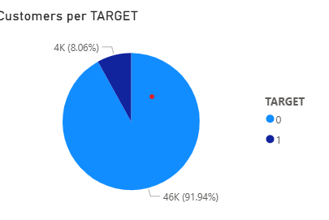
Analysis And Findings
Customer Reliability Based on Repayment Status
Created a view that calculated count of customers based on target.
Represented visuals using pie chart for clear comparison.
Out of 50,000 customers, 46,000 (91%) have no repayment issues (Target = 0).
Insights: This indicates a highly reliable customer base with very low default risk, making the portfolio largely safe.

Slide 6
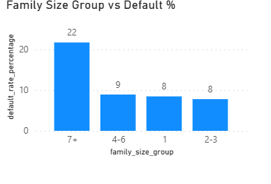
Analysis And Findings
Family Size vs Default %
Grouped customers by family size.
Created buckets, calculated default risk for each bucket and visualized using column chart.
Insight : Larger families show significantly higher default risk, indicating repayment ability weakens as family size increases.

Slide 7
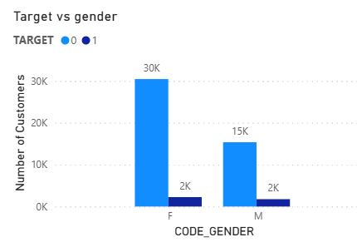
Analysis And Findings
Gender vs Default Risk
Using SQL, applicants were grouped by gender and repayment status (Target). A clustered column chart was used to visualize the distribution.
Insight: Results show that around 1/15 of female applicants and 2/15 of male applicants are at default risk. While males have a slightly higher proportion of defaults, the difference is not strong enough to be considered a significant indicator.

Slide 8
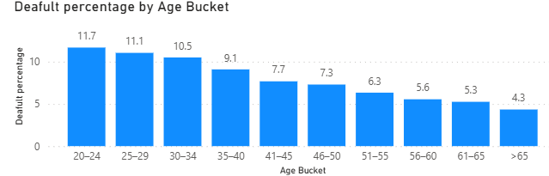
Analysis And Findings
Default Rate by Age
SQL analysis was used to bucket customers by age and calculate default percentages, visualized with a column chart.
Insight: The default rate steadily decreases from ~11.7% in younger groups to ~4.3% in older groups , indicating improving repayment reliability with age . Suggesting Age is one of strong indicator for default risk.
Statistical Insight

Slide 9
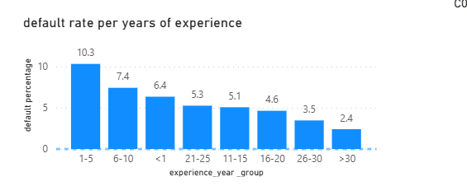
Analysis And Findings
Default Rate by Work Experience
Customers were grouped into experience buckets, and default percentages were calculated using SQL and visualized with a column chart.
Insight: Default risk is highest for customers with 1–5 years of experience (10.33%). After that, the default rate mostly decreases as experience increases, reaching the lowest level for customers with >30 years of experience (2.41%), indicating that more experienced customers are generally more financially reliable.
Statistical Insight

Slide 10
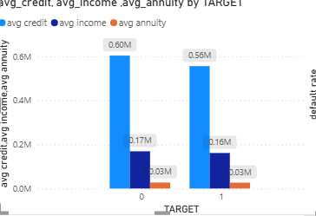
Analysis And Findings
Average Income, Credit, and Annuity by Target
Customers were grouped by Target (0 = No repayment issues, 1 = Default) and the average income, credit amount, and annuity were calculated using SQL and visualized using clustered column chart.
Insight: Customers with no repayment issues (Target = 0) have slightly higher average income, credit, and annuity compared to customers who default (Target = 1). This suggests that higher financial capacity is associated with better repayment behavior.
Statistical Insight

Slide 11
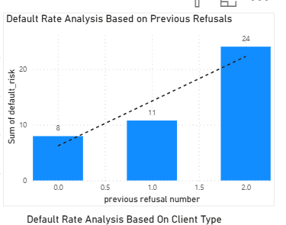
Analysis And Findings
Default Rate by Previous Refusals
Customers were grouped based on the number of previous credit refusals, and default percentages were calculated using SQL and visualized with a trend line chart.
Insights: The default risk increases with the number of previous refusals, indicating that past credit behavior is a strong indicator of repayment risk.
.

Slide 12
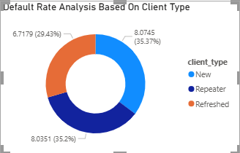
Analysis And Findings
Default Rate by Client Type
Customers were grouped by client type (New, Repeater, Refresher), and default percentages were calculated using SQL. Results were visualized using a doughnut chart.
Insight: Default rates are 8.1% for New and Repeater clients and 6.7% for Refresher clients, indicating that Refresher clients are slightly more reliable in repayment

Slide 13
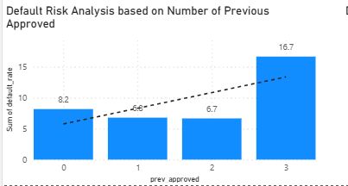
Analysis And Findings
Default Rate by Number of Previous Applications
Customers were grouped by the number of previous loan applications, and default percentages were calculated using SQL and visualized with a bar chart.
Insight: Default rates are relatively low for customers with 0–2 previous applications (6.7–8.2%), but increase sharply to 16.7% for customers with 3 previous applications, indicating higher repayment risk for frequent past applicants.

Slide 14
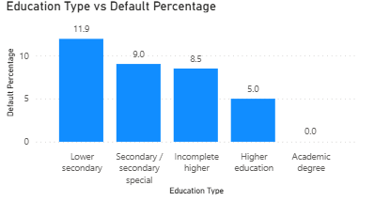
Analysis And Findings
Default Rate by Education Level
Approach: Grouped customers by education type and calculated default percentages using SQL, visualized with a bar chart.
Insight: Default rate decreases with higher education, from 11.93% for Lower Secondary to 0% for Academic Degree, indicating better repayment reliability among more educated customers.
Statistical Insight
Lower education levels correspond to higher default rates. (χ² = 213.8, p < 0.001)

Slide 15
Insight table
Factor | Trend / Observation | Interpretation (Impact on Default)
Family Size | 🔺 Default % increases with family size | Larger families → weaker repayment capacity
Gender | ♂️ Slightly higher default among males | Gender difference not statistically strong
Age | 🔻 Default % decreases with age | Older customers → more reliable
Work Experience | 🔻 Default % decreases as experience grows | Experienced customers → financially stable
Education Level | 🔻 Higher education → lower default rate | Education improves financial literacy & reliability
Previous Refusals | 🔺 Default risk rises with refusals | Past credit issues predict future risk
Previous Applications | 🔺 Risk increases after 3+ prior applications | Frequent loan seekers → higher default chance
Client Type | 🔻 Refresher clients have lowest default rate | Returning, known customers → safer
Income / Credit / Annuity | 🔻 Higher averages for safe customers | Better financial capacity → better repayment
External Credit Scores (EXT_SOURCE_) | 🔻 Strong negative correlation with default | Higher external scores → lower default risk

Slide 16
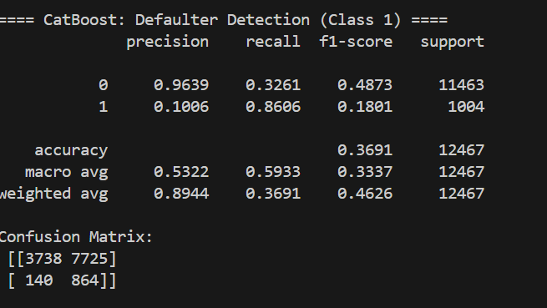
Loan Defaulter Prediction – ML Component
Model: CatBoost / LightGBM (tree-based boosting)
Challenge: Highly imbalanced dataset — only ~8% of applicants were defaulters.
Techniques Used:
Applied class weights to give more importance to defaulters.
Performed threshold tuning to maximize recall (~85%).
Used cross-validation to ensure model stability.
Goal: Detect as many potential defaulters as possible (high recall) — even if some safe applicants are flagged.

Slide 17
Model Evaluation & Business Impact
Metric | Value | Interpretation
Accuracy | 0.87 | Model correctly predicts ~87% of applicants overall
Precision (Defaulters) | 0.10 | Some safe applicants may be flagged for manual review
Recall (Defaulters) | 0.86 | Successfully identifies 86% of actual defaulters
F1-Score | 0.18 | Balance leans toward recall to minimize missed defaulters
Key Insights
The model prioritizes recall since missing a true defaulter is financially riskier than reviewing a few false positives.
High recall ensures the system catches most risky applicants early, supporting safer loan approvals.
Applicants flagged by the model can be manually verified to improve precision without compromising safety.
Preventing just a small percentage of missed defaulters can result in significant loss reduction for the bank.

Slide 18
Loan Defaulter Prediction – ML Component
Metric | Value | Interpretation
Recall (Defaulters) | 85% | Most risky applicants detected
Precision (Defaulters) | 10% | Some safe applicants flagged
Precision (Safe Customers) | 91% | Most reliable customers correctly approved
Interpretation:
The model acts as a risk-alert system, catching most defaulters early.
Trade-off: Some false positives expected — acceptable for credit screening.
Business Use: • Auto-approve low-risk applicants. • Route high-risk applicants for manual review.

Slide 19
Summary
Loan default rate is low (~8%), showing a largely stable customer base.
Behavioral and demographic factors (age, experience, education, family size) influence default risk.
Credit history and external scores are the most reliable predictors of repayment.
Combined data and model insights support a risk-alert system that prioritizes high-risk applicants for review

Slide 20
Business Recommendation
Strengthen screening for risky profiles — younger, larger families, poor credit history.
Offer customized terms (smaller amounts or higher rates) to borderline applicants.
Prioritize approvals for low-risk segments — strong credit scores and consistent repayment record.
Integrate model insights into loan approval workflow for faster, data-driven decisions

Slide 21
Tech Stack
Stage | Tool | Purpose
Data Cleaning | MS Excel | Handled missing values, formatted columns, treated outliers
Data Analysis | MySQL Workbench 8.3 | Wrote queries, created views, aggregated and compared metrics
Data Visualization | Power BI | Built dashboards (bar, pie, doughnut, trend charts) for key insights
Modeling | Python (LightGBM, CatBoost) | Trained ML models to predict defaulters, optimized recall
Presentation | PowerPoint | Compiled visuals and insights into business-ready slides

Slide 22
Key Learnings
Through this project, I learned that:
Real-world data is rarely clean or balanced. It requires logical decisions and domain understanding to prepare it for analysis.
Simple models, built thoughtfully, can be powerful. What matters is using the right features and aligning insights with business goals — not unnecessary complexity.
Iteration transforms analysis. Each revision of this project — from cleaning to modeling — made it stronger and more insightful.
Reflection drives improvement. After every project, evaluating what worked and what can be improved helps me grow as an analyst.
Growth comes from persistence and clarity. What began as an average project evolved into a solid case study through continuous learning and refinement.

Slide 23
Thank you
Mariya Shaji

