Slide 1
Vendor performance ANALYSIS
MARIYA SHAJI

Slide 2
Agenda
Introduction
Approach
EDA with Python
Visualization Using PowerBi

Slide 3
Introduction
Dataset of 10 lakh records across 5 tables: Sales, Purchase, Vendor, Brand, Product.
Objective: Identify top-performing vendors and brands, understand cost drivers, and improve profitability.
Tools used: BigQuery (Data Aggregation) · Python (EDA & Insights) · Power BI (Dashboard Visualization).
Building the Analytical Dataset
Joined five raw tables in BigQuery using vendor and product relationships to create a clean, unified dataset.
Aggregated metrics at vendor–brand level for holistic performance comparison.
Engineered business KPIs:
Profit Margin (%), Gross Profit, Stock Turnover, Sales-to-Purchase Ratio , Profit Margin , Gross Profit
Derived new features to capture operational cost, efficiency, and pricing trends.
Verified data consistency using statistical summaries and cross-table validation.

Slide 4
EDA WITH PYTHON
Univariate Analysis
I started by analyzing individual features such as Total Sales Value, Total Purchase Value, Profit, Gross Profit, Freight Cost, and Excise Cost.
Using histograms and boxplots, I visualized the spread and detected outliers — particularly in sales and profit columns, where a few records had unusually high values.
These outliers were reviewed, and unrealistic data points were removed or capped to ensure fair representation of typical business behavior.

Slide 5
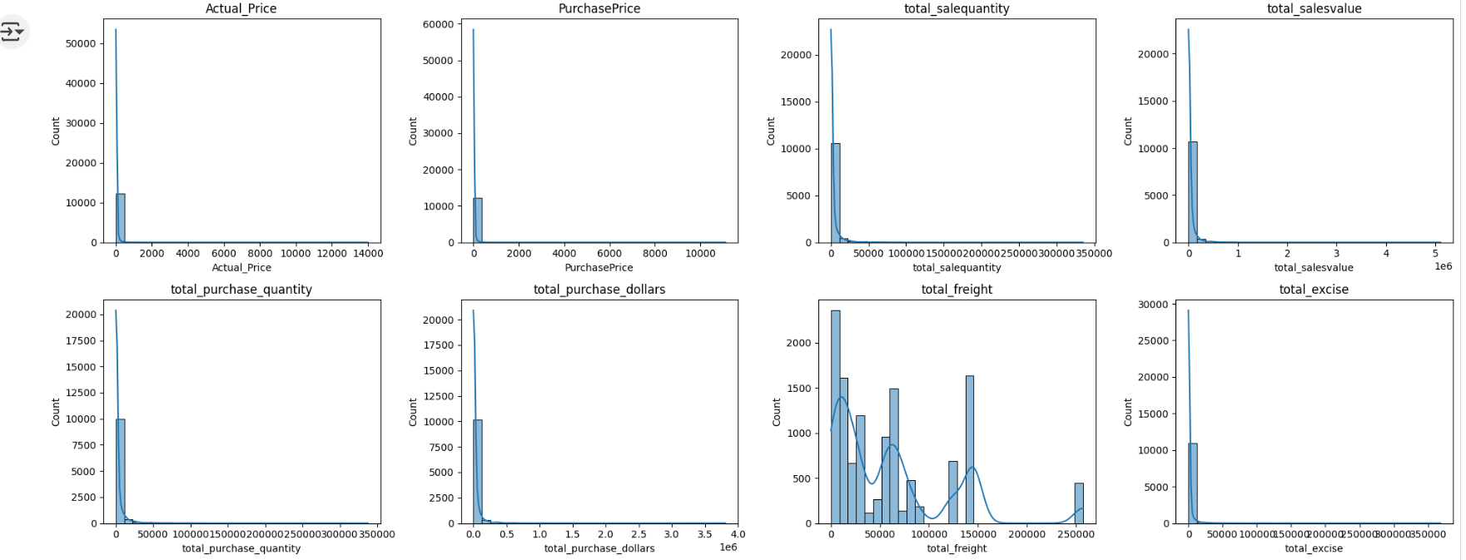
EDA WITH PYTHON

Slide 6
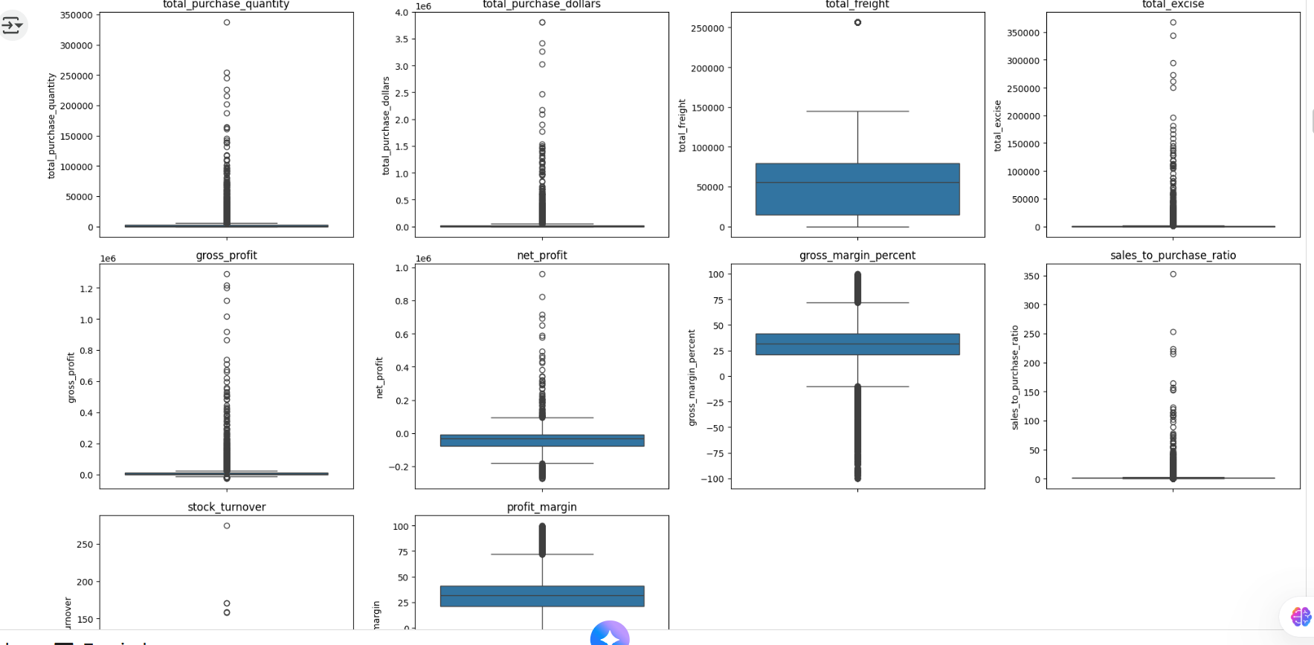
EDA WITH PYTHON

Slide 7
Key Relationships Impacting Profitability
Sales and Purchase Volumes Move Together Strong positive correlation between total purchase quantity and total sales quantity (r ≈ 0.99) shows efficient inventory movement and healthy demand fulfillment.
Higher Procurement Drives Higher Sales Total purchase value and sales value (r ≈ 0.82) confirm that vendors investing more in stock typically achieve stronger revenue performance.
Freight Cost Negatively Impacts Profitability Rising freight and logistics expenses are linked with lower net profit (r ≈ –0.43), indicating the need for better supply chain cost control.

Slide 8
Key Relationships Impacting Profitability
Sales-to-Purchase Ratio is a Key Efficiency Indicator A strong positive correlation (r ≈ 0.74) with profit margin highlights that vendors converting purchases to sales efficiently achieve the best profitability.
Higher Sales Don’t Always Mean Higher Margins Profit margin shows a slight negative link (r ≈ –0.18) with sales price, suggesting competitive pricing pressures or cost escalation at higher sales levels.
Stock Turnover and Profit Are Weakly Linked Stock turnover has a small negative correlation (r ≈ –0.05) with gross profit, implying that faster inventory movement doesn’t guarantee better margins — efficiency must be balanced with pricing strategy.

Slide 9
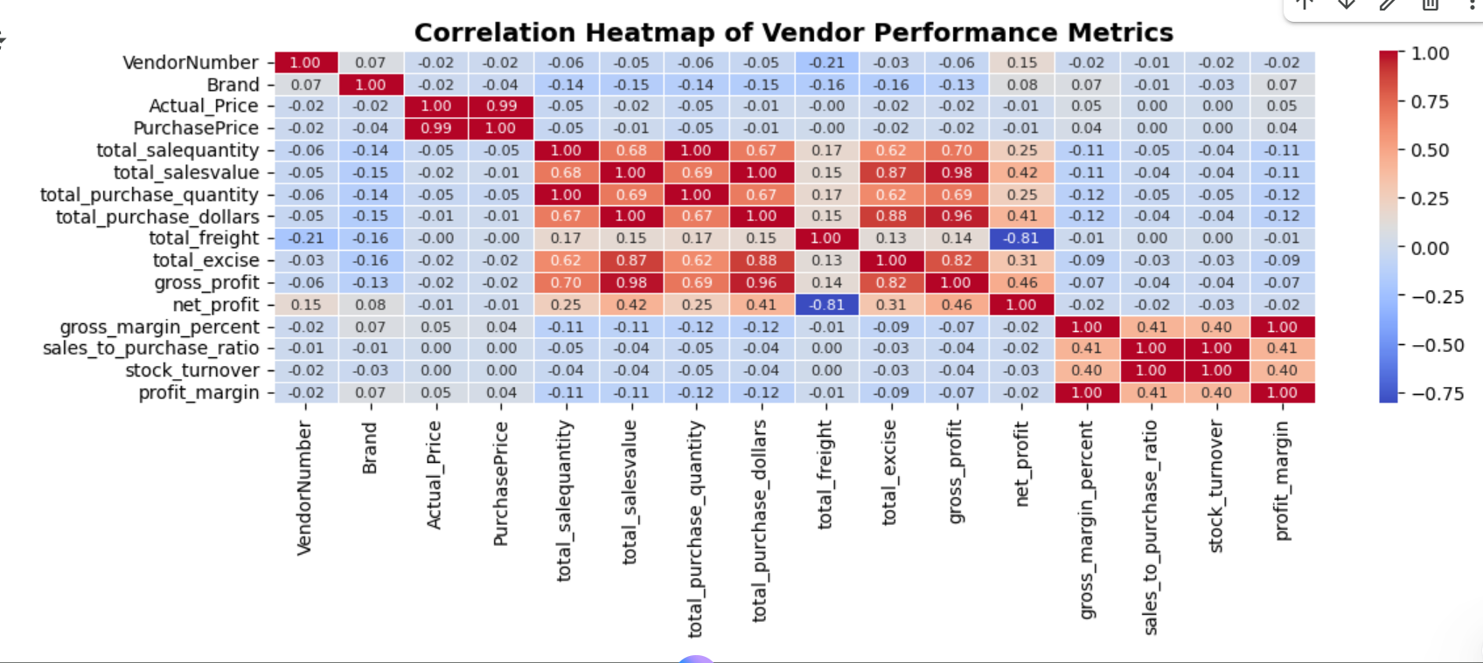
Key Relationships Impacting Profitability

Slide 10
Brand Segmentation – Sales vs Profit Margin (4-Quadrant Model)
Objective: Segment brands based on their sales performance and profitability to identify strategic actions.
Quadrant Definition:
🟩 Stars – High Sales, High Margin → Top-performing brands; maintain leadership and ensure stock availability.
🟦 Volume Drivers – High Sales, Low Margin → Focus on cost control and pricing optimization.
🟨 Promote / Invest – Low Sales, High Margin → Profitable but underperforming; ideal candidates for marketing or promotional campaigns.
🟥 Phase Out – Low Sales, Low Margin → Poor performers; consider phasing out, bundling, or repositioning.

Slide 11
Brand Segmentation – Sales vs Profit Margin (4-Quadrant Model)
Insights:
Majority of profits are generated by Star and Volume Driver brands.
Promote/Invest brands have high profitability potential but low visibility — perfect promotion targets.
Phase Out brands contribute least to sales and margins, creating cost drag on overall performance.
Business Recommendation: Prioritize marketing efforts on Promote/Invest brands to unlock profit growth. Optimize Volume Drivers for efficiency and protect Stars from stock-outs.

Slide 12
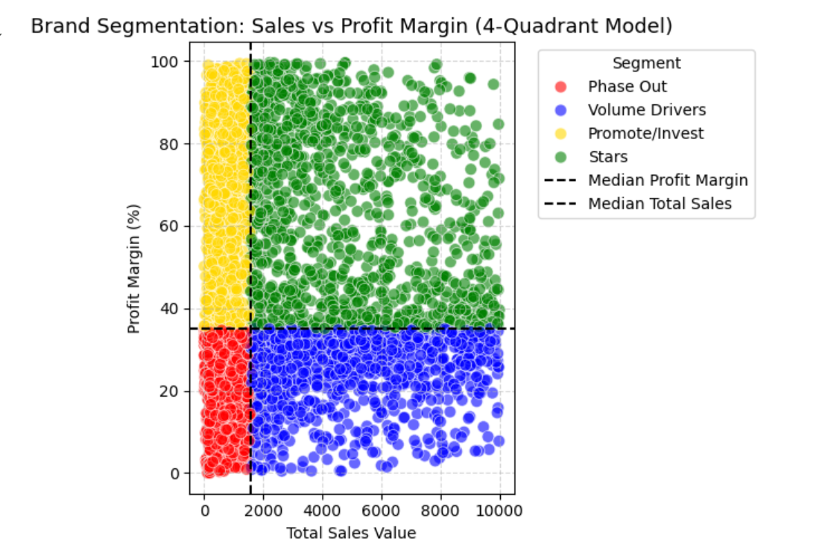
Brand Segmentation – Sales vs Profit Margin (4-Quadrant Model)

Slide 13
Top 10 Vendors and Brands based on Total sALES
Objective: Identify key vendors and brands driving overall sales revenue.
Insights:
Diageo North America Inc. and Martignetti Companies lead vendor performance, contributing the highest sales volume.
Top brands include Jack Daniel’s No.7 Black, Tito’s Handmade Vodka, and Grey Goose, which dominate overall sales share.
High concentration among a few brands indicates strong brand equity but also dependency risk.
Business Takeaway: Strengthen relationships with top vendors while identifying mid-performing vendors for capacity expansion and new marketing opportunities.

Slide 14
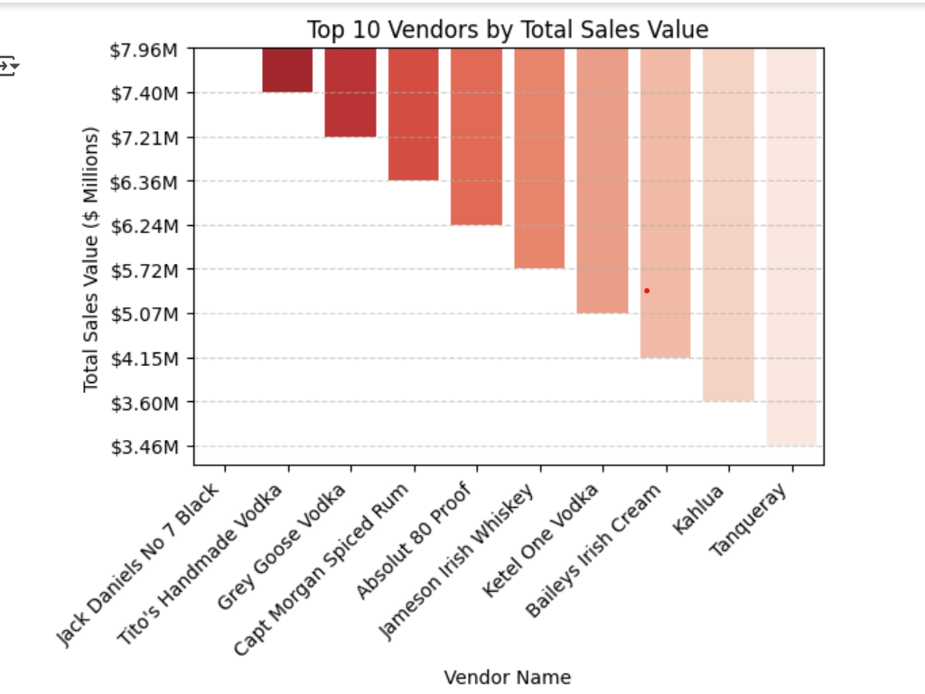
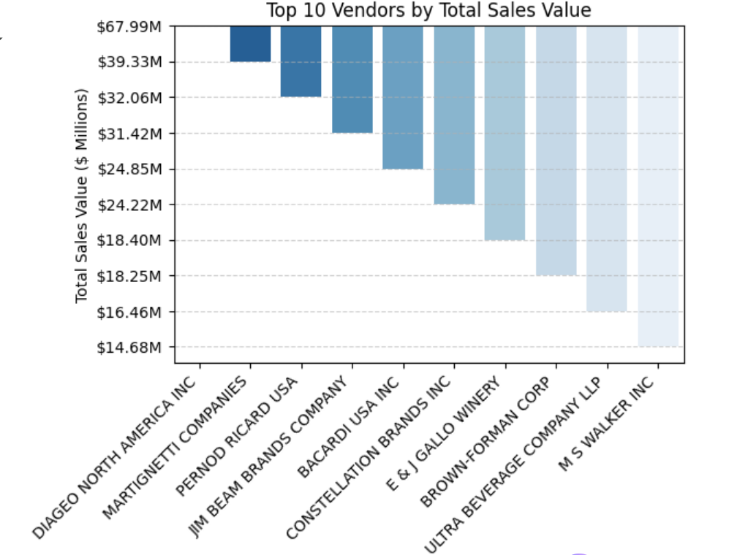
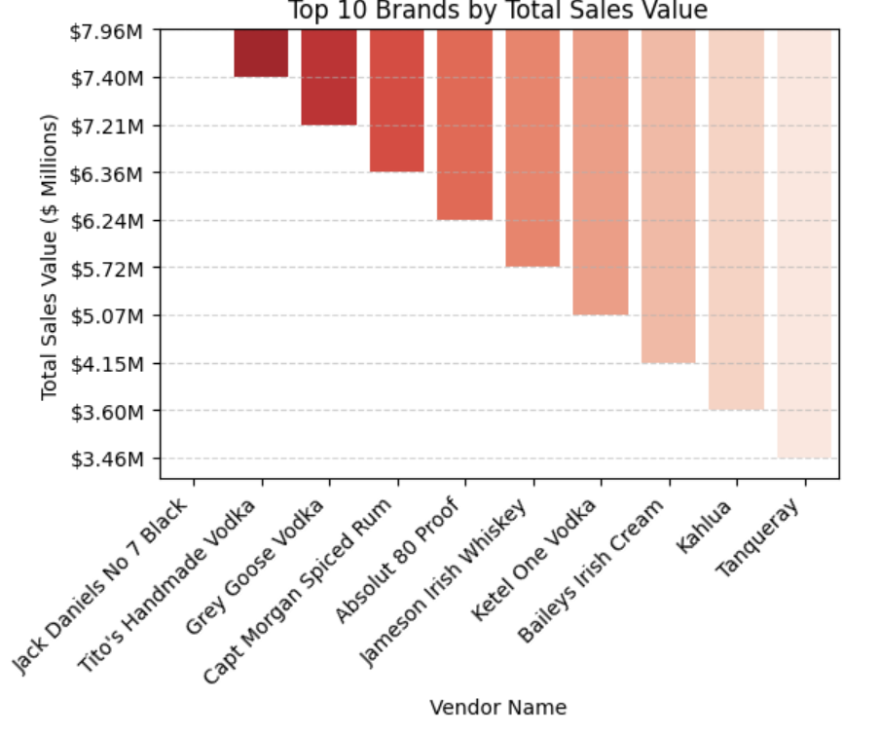
Top 10 Vendors and Brands based on Total sALES

Slide 15
Top 10 Vendors – Purchase Contribution
Insights:
The Top 10 vendors contribute ~65.8% of total purchases, led by Diageo North America Inc. (16.3%).
The Pareto curve shows that around Top 10 vendors drive nearly 65% of purchase value, confirming a moderate concentration pattern.
This means procurement decisions and supplier relationships are heavily influenced by a small vendor group.
The remaining vendors account for only 35% of purchases, indicating possible over-fragmentation or low-volume suppliers.
Business Implication:
Prioritize relationship management and strategic contracts with the top 10 vendors. Evaluate low-contribution vendors for consolidation or performance review.

Slide 16
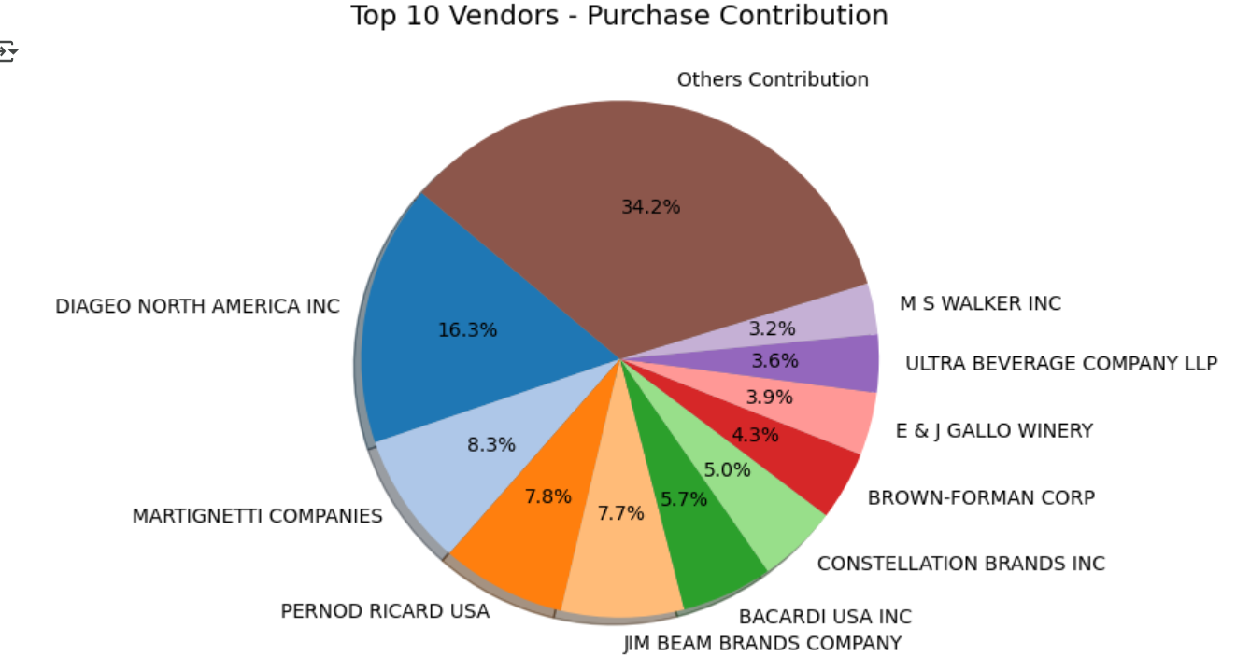
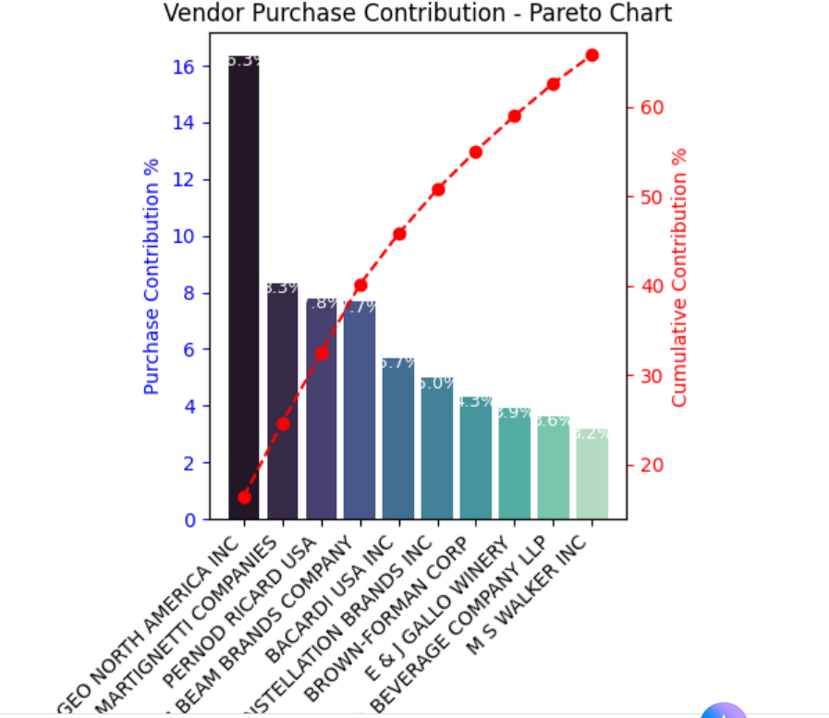
Top 10 Vendors – Purchase Contribution

Slide 17
Order Size Categorization (S, M, L)
Goal: Segment orders by quantity to study how order size affects unit price.
Method: Used pd.qcut() to split purchase quantity into 3 equal groups:
S = Small orders (lowest 33%) , M = Medium orders (middle 33%, L = Large orders (top 33%)
Insight:
Small orders → higher & more variable prices — often premium or low-volume products.
Large orders → lower, stable prices — due to bulk purchase discounts.
Expensive items are bought in small quantities, cheaper ones in bulk.
Bulk buying → lower cost per unit..

Slide 18
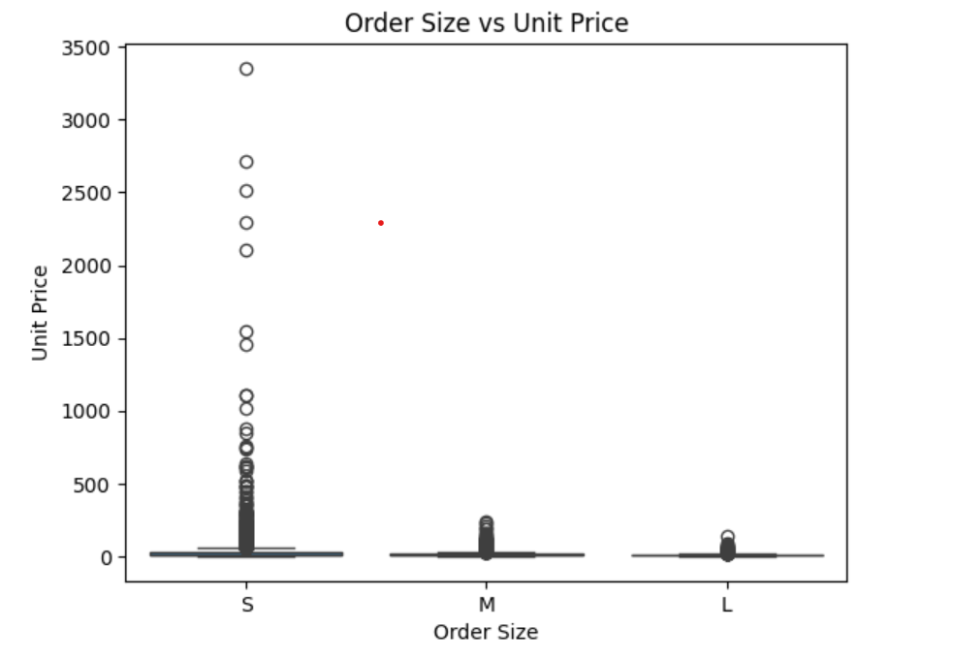
Order Size Categorization (S, M, L)
.

Slide 19
Profit Margin Comparison – Top vs Low Vendors (95% Confidence)
.
Observation:
Top Vendors (Blue):
Mean Profit Margin ≈ 31.2% , Narrow Confidence Interval (30.7–31.6%) → consistent and stable profits.
Low Vendors (Red):
Mean Profit Margin ≈ 41.5% , Wider Confidence Interval (40.4–42.6%) → higher but more variable profits.
Insight:
Vendors with high sales (Top) operate on low margins but steady turnover — volume-based strategy.
Vendors with low sales earn higher margins — premium or niche products with limited sales volume.

Slide 20
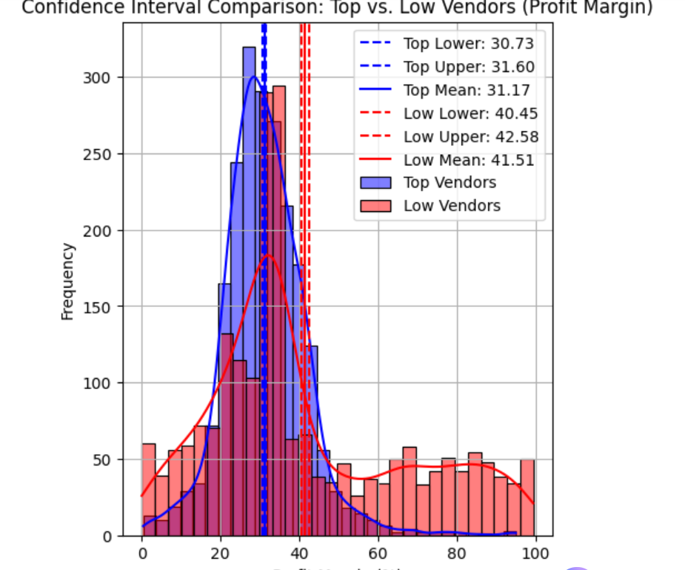
Profit Margin Comparison – Top vs Low Vendors (95% Confidence)
.

Slide 21
Turning insights to business ACTIONs
Profit Concentration: Top vendors make about 65% of total purchases — keep strong partnerships with them.
Brand Opportunity: Brands with high margins but low sales need marketing push to grow revenue.
Cost Optimization: Cutting freight and excise costs can directly raise profit margins.
Vendor Mix: Balance big stable vendors with small high-margin ones for steady and strong profits.
Action Plan:
Strengthen ties with top vendors.
Reduce supply chain costs.
Promote high-margin, low-sales brands.
.

Slide 22


Thank you
Mariya Shaji
mariyashaji41@gmail.com

