Slide 1
Statistical analysis and classification of the adult income dataset
Adult Income dataset (1994 US Census)
Prepared by: Mariia Zakharova & Gabija Benetaitė
Notes:
In this project we analysed the Adult Income dataset from the 1994 US Census. Our main question: which characteristics of a person are connected with earning more than 50 thousand dollars a year, and can we predict it? I will go through the dataset, preprocessing, descriptive statistics, hypothesis testing, regression analysis and the decision tree classifier.

Slide 2
Adult income: 1994 US census data
Adult Income, 1994 US census: 48,842 people (adult.data 32,561 + adult.test 16,281).
15 variables (6 numerical, 9 categorical).
Target: income >50K.
We kept the original train/test split.
24.9% of people in train earn more than $50K.
Type | Variables
Numerical | Age, education num, hours per week, capital gain, capital loss, fnlwgt.
Categorical | Workclass, education, marital status, occupation, relationship, race, sex, native country.
Target | Income: more or less than $50K per year.
Notes:
The dataset is the Adult Income dataset from the 1994 US census. It comes as a training file with 32,561 people and a test file with 16,281, almost 49 thousand in total, with 15 variables. The target is whether a person earns more than 50 thousand dollars a year. We kept the original train/test split. In the training data 24.9 percent earn more than 50K, so the classes are imbalanced.

Slide 3
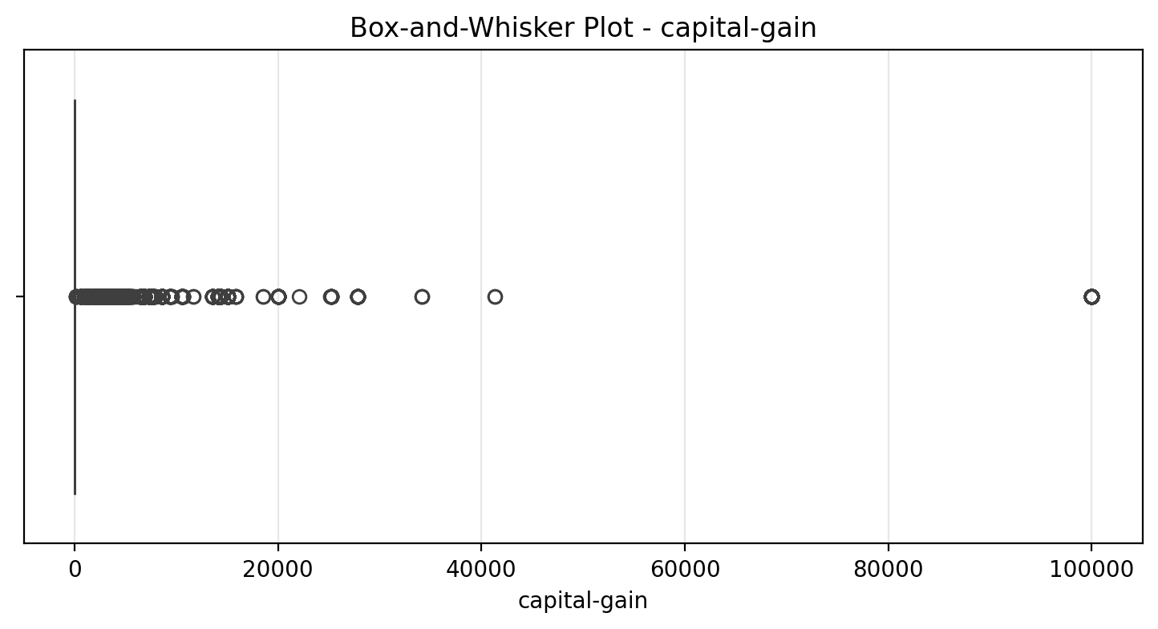
Data preprocessing
Train and test cleaned separately; encoding and scaling learned on train only (no data leak).
Removed the dot in the test labels (>50K. → >50K).
Deleted rows with missing values: 2,399 in train (7.37%), 1,221 in test (7.50%).
Deleted duplicate rows: 23 in train, 5 in test.
Outliers found with z-score and IQR; all values kept (real values, not errors).
capital-gain, capital-loss: log(1 + x); skewness of capital-gain 11.9 → 3.07.
New features: has-capital, is-married, is_us, capital-net, age-group, hours-category.
Encoding: sex 0/1, native-country → is_us, one-hot for 5 variables; dropped education and fnlwgt. 42 columns, numerical ones standardized.
91.6% of capital-gain values are 0, so there is no box and every non-zero value is an outlier.
Notes:
Train and test were cleaned separately, and everything that learns from the data, like the encoding and scaling, was learned on the training data only, so no information leaks from the test set. We removed the dot in the test labels, deleted rows with missing values and duplicates. Outliers were checked with z-score and IQR, but we kept all values because they are real. The boxplot shows why the methods flag so much: 91.6 percent of capital gains are zero, so every non-zero value becomes an outlier. Capital gain and loss were log-transformed. We added new features and encoded the categorical variables, giving 42 columns.

Slide 4
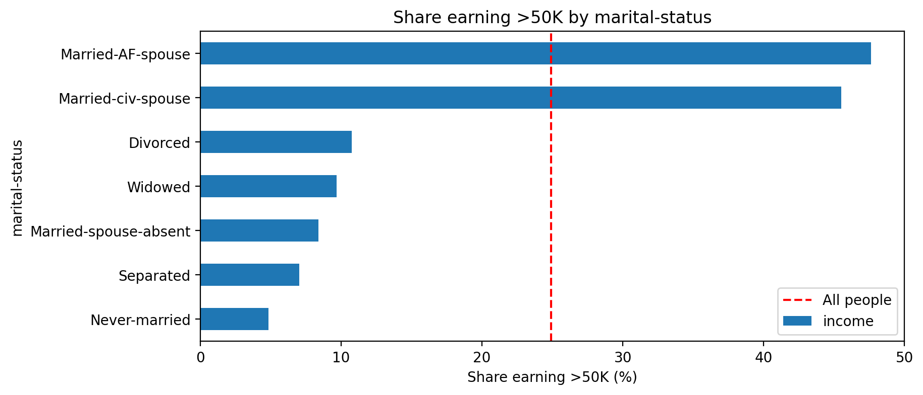
What is related to income
Variable (train) | correlation with income
Married-civ-spouse | 0.45
education-num | 0.34
has-capital | 0.31
capital-gain-log | 0.29
age | 0.24
hours-per-week | 0.23
Never-married | -0.32
Own-child | -0.23
45.5% of married people earn >50K, only 6.8% of the others.
The top bar (Married-AF-spouse) is only 21 people.
Notes:
On the left are the strongest correlations with income in the training data. Being married has the strongest positive correlation, then education, having capital gains and age. Never married and living with parents are negative. The chart shows the share earning more than 50K by marital status: 45.5 percent of married people earn more than 50K, only 6.8 percent of the others. The top bar, Married-AF-spouse, is only 21 people, so it is not reliable.

Slide 5
Hypothesis testing
Test | H0 | Result | Decision
One-sample t-test | Mean working hours = 40 | 40.94 h, p < 0.001 | Reject
One proportion z-test | Share earning >50K = 25% | 24.80%, p = 0.314 | Do not reject
Pearson correlation | Age and hours are not correlated | r = 0.10, p < 0.001 | Reject (very weak)
Two-sample t-test | Women and men work the same hours | 36.9 h vs 42.9 h, p < 0.001 | Reject
Two proportions z-test | Same share of women and men earn >50K | 11.4% vs 31.3%, p < 0.001 | Reject
χ² goodness of fit | Sex split is 50/50 | 32.5% women, 67.5% men | Reject
χ² independence | Income does not depend on education | χ² = 5,996, p < 0.001 | Reject
χ² homogeneity | Income distribution is the same in all race groups | χ² = 453, p < 0.001 | Reject
Train and test together, 45,194 people, α = 0.05.
Notes:
We ran eight hypothesis tests at the 5 percent significance level. Only one null hypothesis was not rejected: the share of people earning more than 50K, 24.8 percent, is not significantly different from 25 percent. People work on average 40.9 hours, slightly but significantly more than 40. Age and hours are correlated, but very weakly. Men work about 6 hours more per week than women and are almost three times as likely to earn more than 50K. Two thirds of the sample are men. Income depends on education and differs between race groups. With this many people even small differences become significant, so we also look at the size of the effect.

Slide 6
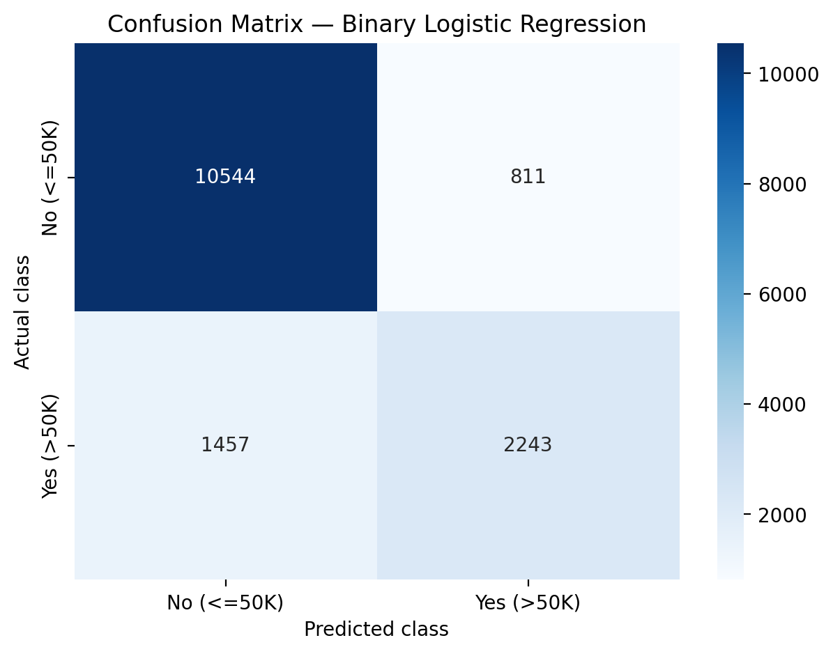
Regression
Linear regression (hours-per-week)
hours = 27.33 + 0.070 × age + 0.696 × education-num + 5.73 × male. F = 899 is significant, but R² = 0.078 on test, so it explains very little.
Logistic regression (income >50K), test set
Accuracy | Precision | Recall | F1 | ROC-AUC
0.849 | 0.734 | 0.606 | 0.664 | 0.905
Always predicting ≤50K: accuracy 0.754.
Notes:
First, the linear regression for working hours, with age, education and sex as predictors. The model is significant, F equals 899, but R squared on the test set is only 0.078, so it explains very little. Second, the logistic regression for income. On the test set the accuracy is 84.9 percent, compared with 75.4 percent for always predicting the low class, and ROC-AUC is 0.905. Recall is 0.61, so the model misses about 40 percent of high earners, as the confusion matrix shows. If asked: being married multiplies the odds of high income by about 9, being male by 2.4.

Slide 7
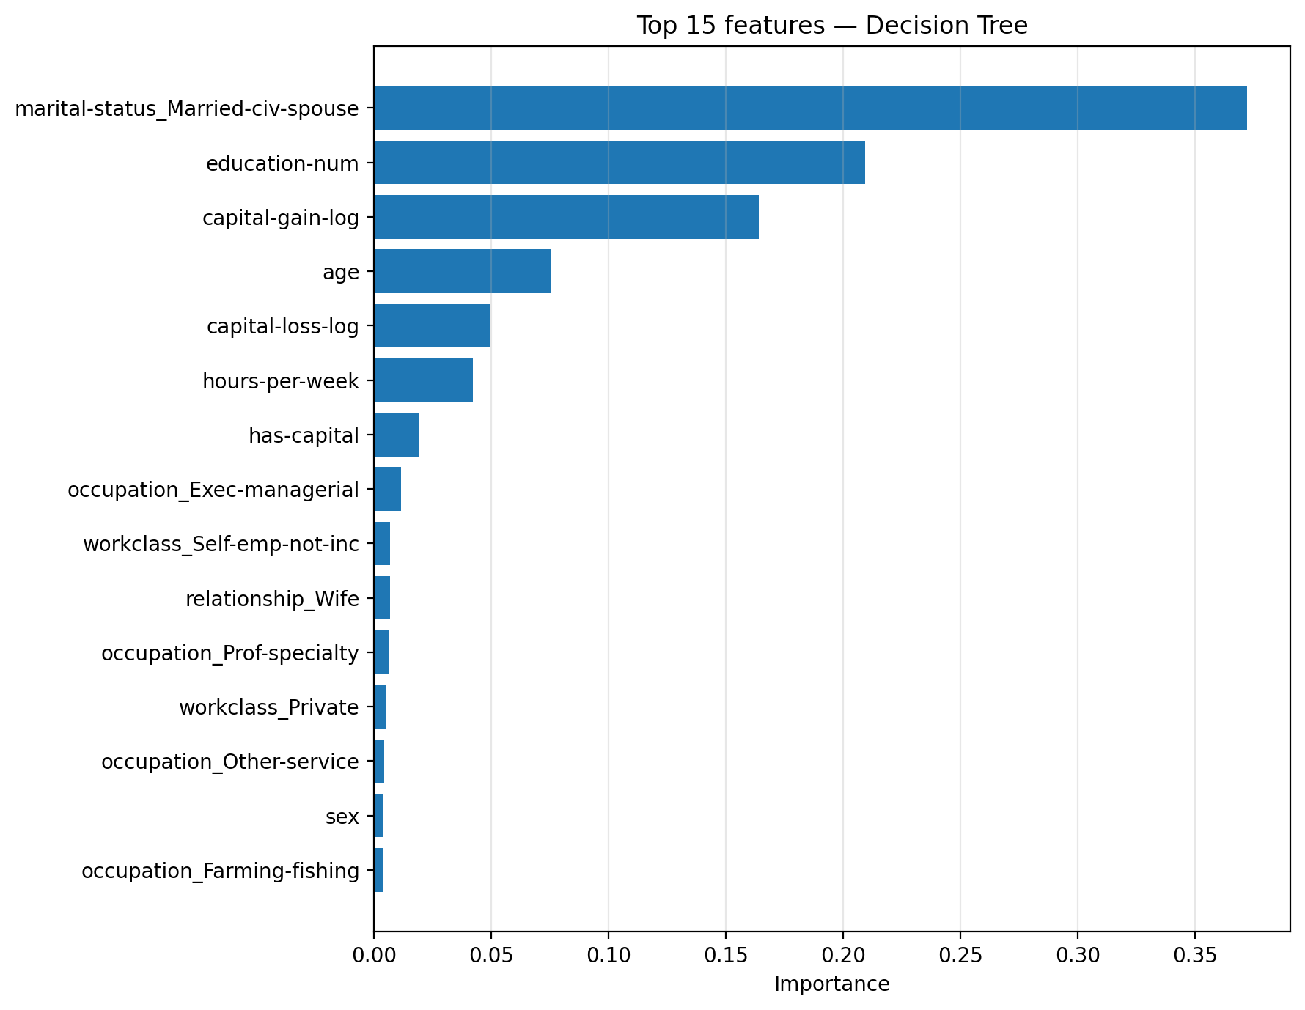
Decision tree
Tree | Train accuracy | CV F1
No limits | 97.7% | 0.624
max_depth = 9 | 86.4% | 0.667
min_samples_leaf = 20 (final) | 87.2% | 0.678
Settings chosen with 5-fold cross-validation on train. The test set is used only once, for the final tree.
Final tree, test set
Accuracy | Precision | Recall | F1 | ROC-AUC
0.850 | 0.742 | 0.600 | 0.663 | 0.896
Notes:
The tree settings were chosen with 5-fold cross-validation on the training data, using F1 for the high-income class. The chart shows why: training F1 keeps rising with depth, but cross-validation F1 stops improving after about depth 9 - deeper trees only memorise the training data. A tree with no limits has 97.7 percent training accuracy. The final tree needs at least 20 people per leaf. On the test set, used only once, it reaches 85.0 percent accuracy and ROC-AUC 0.896.

Slide 8
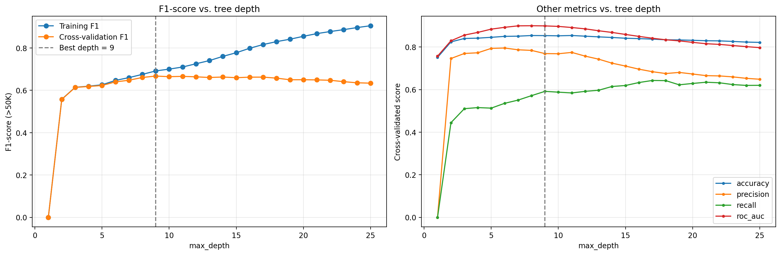
Decision tree

Slide 9
Model comparison
Model | Test accuracy
Always predicting ≤50K | 75.4%
Naive Bayes (published in adult.names) | 83.9%
C4.5 decision tree (published) | 84.5%
NBTree (best published) | 85.9%
Our logistic regression | 84.9%
Our decision tree | 85.0%
Notes:
Here we compare our models with the results published together with the dataset in the adult.names file. Always predicting the low-income class gives 75.4 percent. The published Naive Bayes reached 83.9 percent, the C4.5 decision tree 84.5 and the best published model, NBTree, 85.9 percent. Our logistic regression reaches 84.9 and our decision tree 85.0 percent - better than Naive Bayes and C4.5, and only about one percentage point below the best published result.

Slide 10
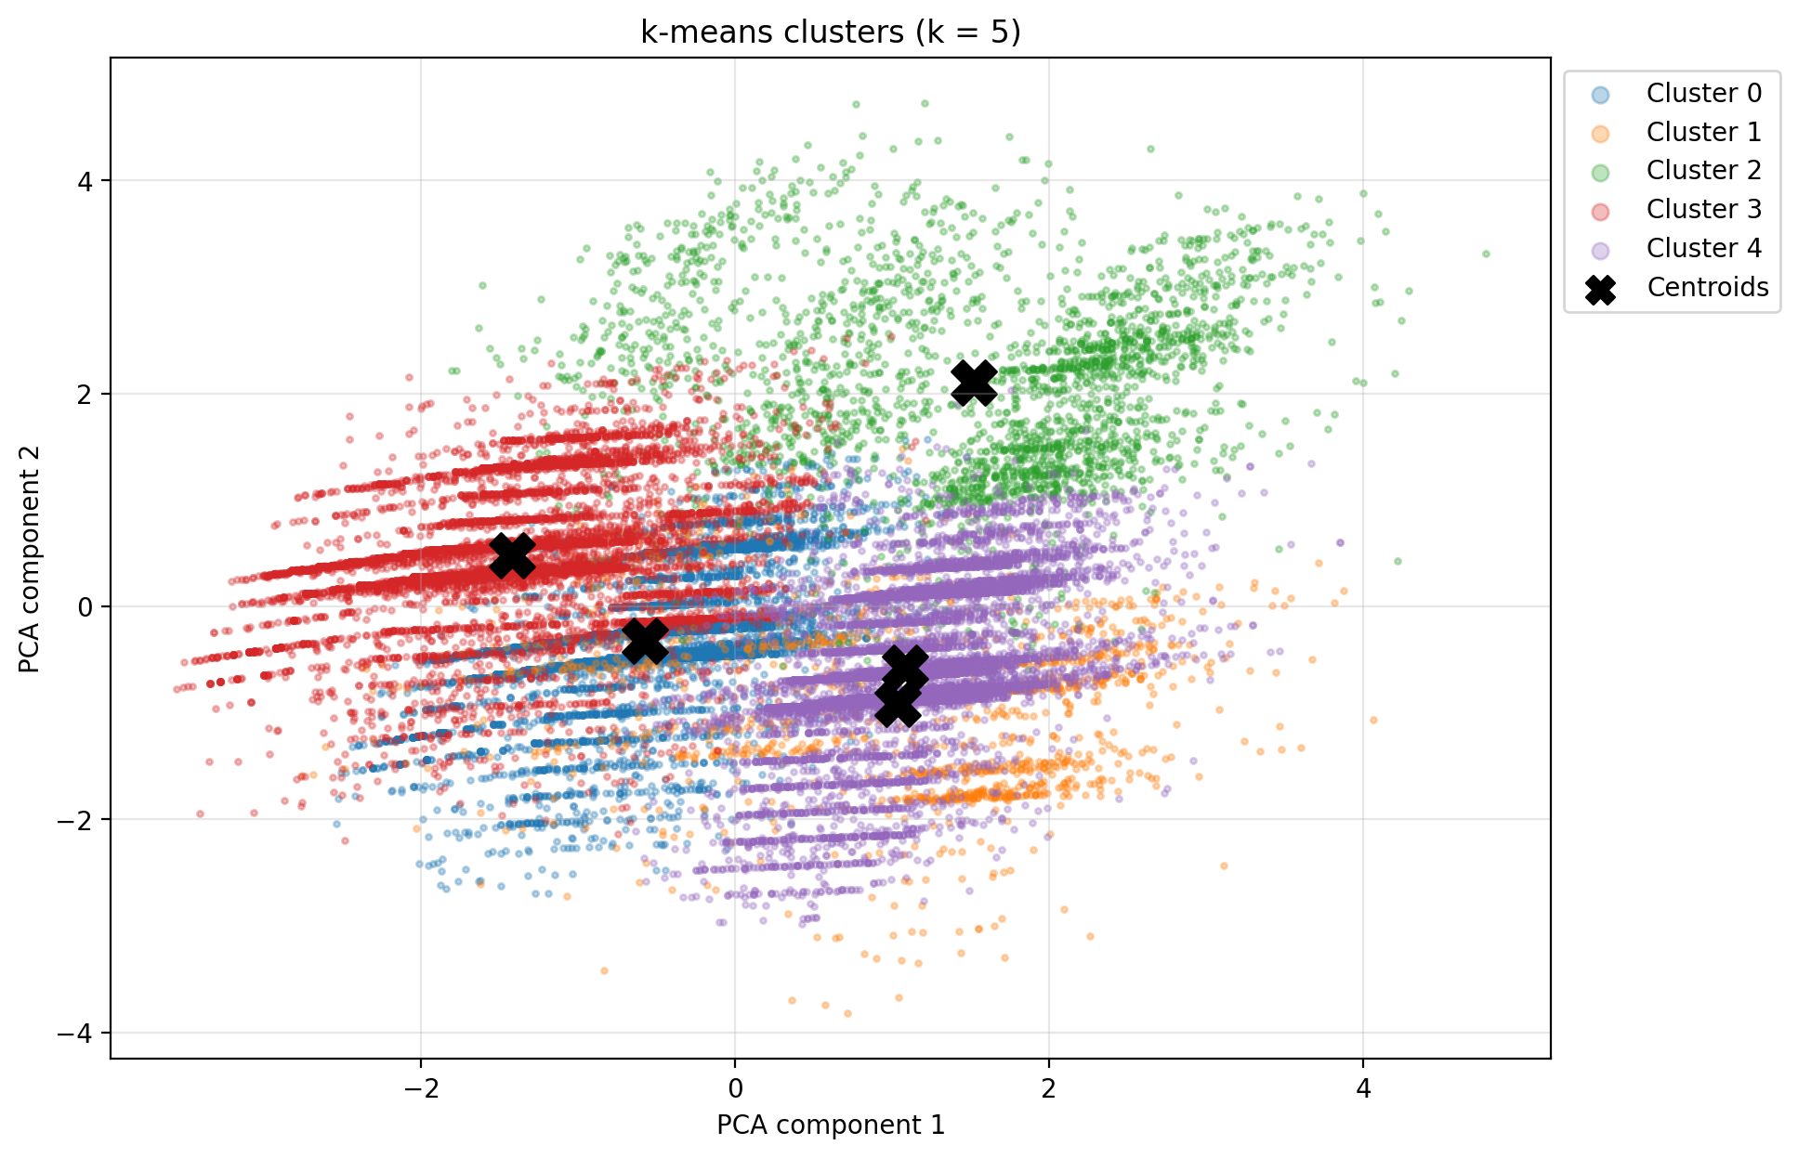
Clustering (k-means)
k-means on train, 7 standardized features (age, education-num, hours-per-week, capital-gain-log, capital-loss-log, sex, is-married). Income is not used.
Elbow method and silhouette (0.317) both choose k = 5.
Cluster | Who | Share | Earn >50K
0 | Young single men (~32) | 23% | 6.1%
1 | Capital loss (~42) | 5% | 51.6%
2 | Capital gain (~44) | 8% | 63.8%
3 | Women, mostly not married | 29% | 8.2%
4 | Married men (~43) | 35% | 38.6%

Slide 11
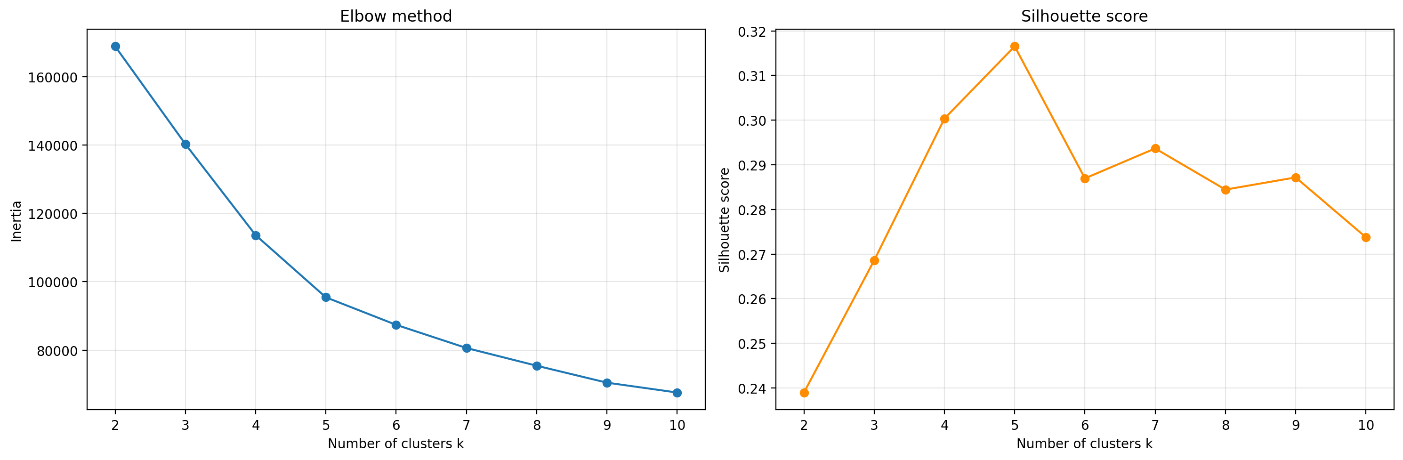
Clustering (k-means)

Slide 12
Conclusions
Being married, education, capital gains and age are the factors most related to income in every part of the analysis.
Men work about 6 hours more per week and earn more than $50K almost three times as often as women (31.3% vs 11.4%).
Our logistic regression (84.9%) and decision tree (85.0%) predict income almost as well as the best published model (85.9%), while working hours cannot be predicted well (R² = 0.078).
k-means, without using income, found 5 groups whose share of high earners ranges from 6% to 64%.
Notes:
To conclude: the same factors - being married, education, capital gains and age - are linked to income in every part of the analysis. There is a clear gender gap. Our classification models reach about 85 percent accuracy, close to the best published result, while working hours cannot be predicted well.

