Slide 1
Statistical analysis and classification of the adult income dataset
Adult Income dataset (1994 US Census)
Prepared by: Mariia Zakharova & Gabija Benetaitė
github.com/marizxv/t4e_DataScience_school
Notes:
In this project we analysed the Adult Income dataset from the 1994 US Census. Our main question: which characteristics of a person are connected with earning more than 50 thousand dollars a year, and can we predict it? I will go through the dataset, preprocessing, descriptive statistics, hypothesis testing, regression analysis and the decision tree classifier.

Slide 2
Adult income: 1994 US census data
Adult Income, 1994 US census: 48,842 people (adult.data 32,561 + adult.test 16,281).
15 variables (6 numerical, 9 categorical).
Target: income >50K.
We kept the original train/test split.
24.9% of people in train earn more than $50K.
Type | Variables
Numerical | Age, education num, hours per week, capital gain, capital loss, fnlwgt.
Categorical | Workclass, education, marital status, occupation, relationship, race, sex, native country.
Target | Income: more or less than $50K per year.
Notes:
The dataset is the Adult Income dataset from the 1994 US census. It comes as a training file with 32,561 people and a test file with 16,281, almost 49 thousand in total, with 15 variables. The target is whether a person earns more than 50 thousand dollars a year. We kept the original train/test split. In the training data 24.9 percent earn more than 50K, so the classes are imbalanced.

Slide 3
Data preprocessing
Everything that learns from the data is fitted on train and only applied to test (to avoid data leak)
Cleaning
New features
Encoding
Removed the dot in test labels (>50K. → >50K).
Deleted rows with missing values: 2 399 train (7.37%), 1 221 test (7.50%)
Deleted duplicates: 23 train, 5 test
Left: 30 139 train, 15 055 test
has-capital, is-married, is_us, capital-net
age-group (e.g. 17–24)
hours-category (part-time, full-time, overtime)
sex 0/1, native-country → is_us
One-hot: workclass, marital-status, occupation, relationship, race
Dropped education (same as education-num) and fnlwgt
Numerical standardized → 42 columns

Slide 4
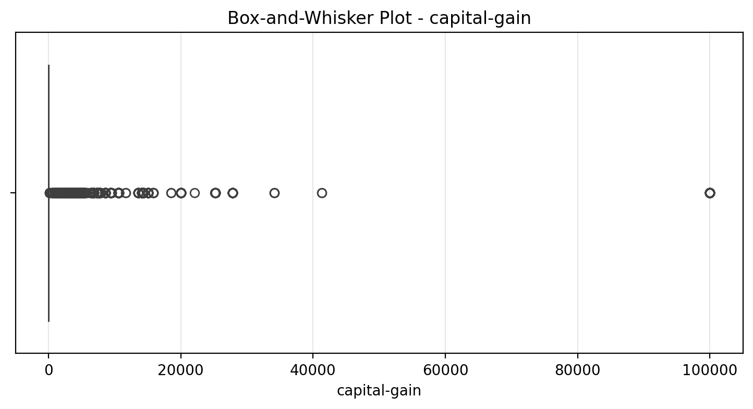
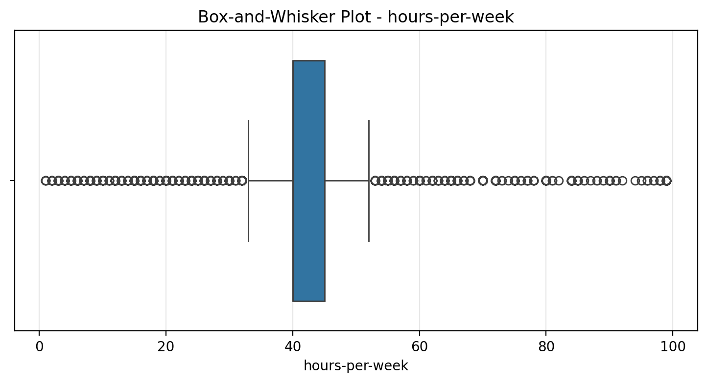
Outliers
Found with z-score and IQR and kept, because they were representing real people, not errors
capital-gain and capital-loss: log(1 + x), skewness of capital-gain 11.9 → 3.07
91.6% have exactly 0: no box, every non-zero value is an outlier dot
47.2% work exactly 40 h: box is only 40–45 h, IQR marks 26% as outliers

Slide 5
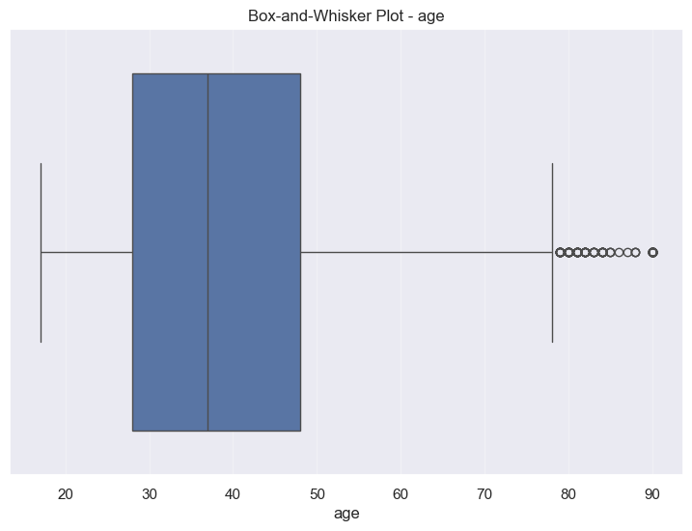
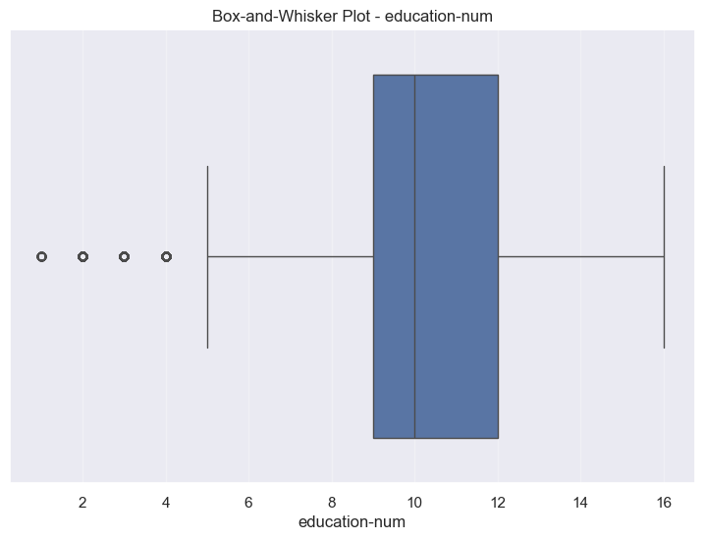
Outliers

Slide 6
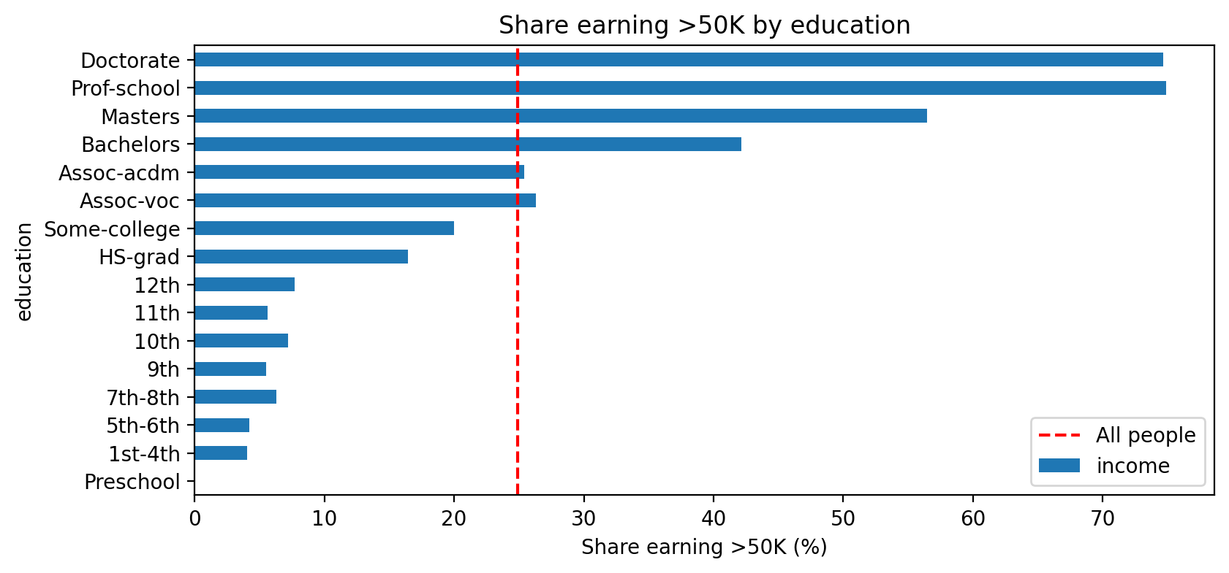
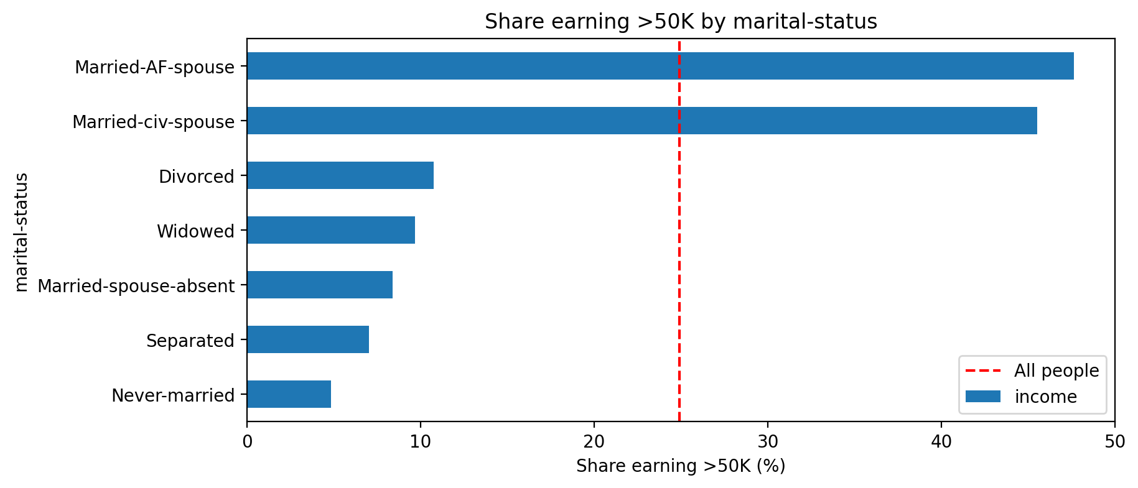
What is related to income
Married: 45.5% earn >50K
Others: 6.8%
Correlation with income (train) | r
Married-civ-spouse | 0.45
education-num | 0.34
has-capital | 0.31
capital-gain-log | 0.29
age | 0.24
hours-per-week | 0.23
Own-child | −0.23
Never-married | −0.32
No correlation above 0.45: no single variable predicts income, models must combine them

Slide 7
Hypothesis tests
45 194 people (train + test), α = 0.05
Test | H0 | Result | Decision
One-sample t-test | mean working hours = 40 | 40.94 h, p < 0.001 | reject H0
One proportion z-test | share earning >50K = 25% | 24.80%, p = 0.314 | do not reject
Pearson correlation | age and hours not correlated | r = 0.10, p < 0.001 | reject (very weak)
Two-sample t-test | women and men work the same hours | 36.9 h vs 42.9 h, p < 0.001 | reject H0
Two proportions z-test | same share of women and men earn >50K | 11.4% vs 31.3%, p < 0.001 | reject H0
χ² goodness of fit | sex split 50/50 | 32.5% women, 67.5% men | reject H0
χ² independence | income does not depend on education | χ² = 5 996, p < 0.001 | reject H0
χ² homogeneity | same income split in all race groups | χ² = 453, p < 0.001 | reject H0

Slide 8
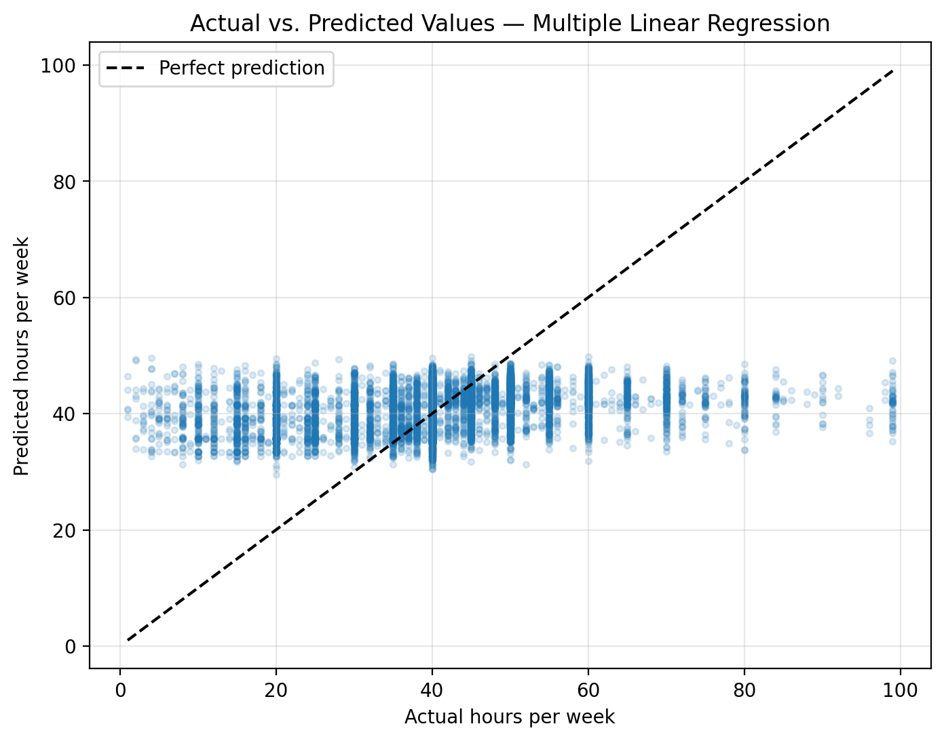
Multiple linear regression
Predicts hours-per-week; fitted on train, evaluated on test
hours = 27.33 + 0.070 × age
+ 0.696 × education-num
+ 5.73 × male
Metric (test) | Value
MAE | 7.74 h
MSE | 134.14
RMSE | 11.58 h
MAPE | 30.9%
R² | 0.078
Significant (F = 899), but weak: explains only 8% of the differences

Slide 9
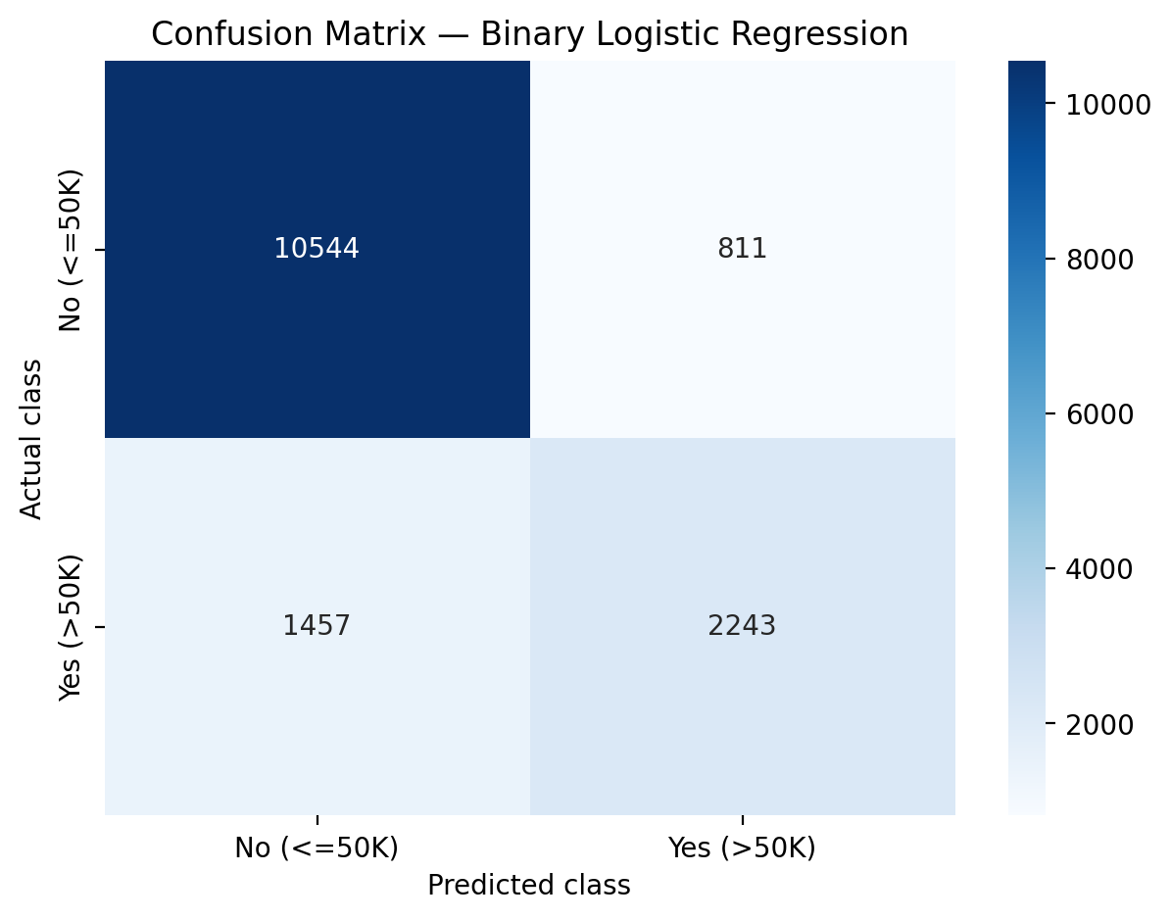
Binary logistic regression
Variable | Odds ratio
Married-civ-spouse | ×9.1
relationship: Wife | ×3.7
male | ×2.4
occupation: Exec-managerial | ×2.2
each step of education-num | ×1.32
relationship: Own-child | ×0.54
Test set (baseline: always “<=50K”)
Accuracy | Baseline | Precision | Recall | F1 | ROC-AUC
0.849 | 0.754 | 0.734 | 0.606 | 0.664 | 0.905

Slide 10
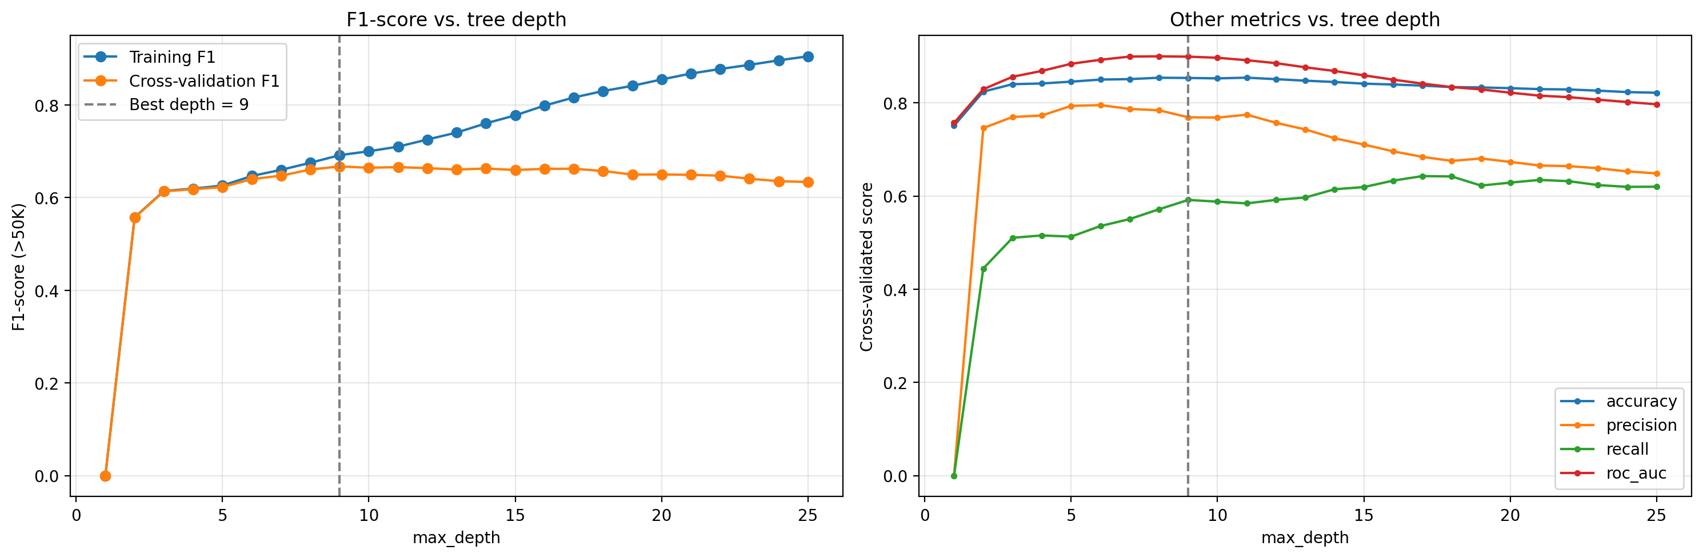
Decision tree classification
Tree | Train accuracy | CV F1
No limits | 97.7% | 0.624
max_depth = 9 | 86.4% | 0.667
min_samples_leaf = 20 (final) | 87.2% | 0.678
Settings chosen with 5-fold cross-validation on train. The test set is used only once and for the final tree.
Final tree, test set
Accuracy | Precision | Recall | F1 | ROC-AUC
0.850 | 0.742 | 0.600 | 0.663 | 0.896
Notes:
The tree settings were chosen with 5-fold cross-validation on the training data, using F1 for the high-income class. The chart shows why: training F1 keeps rising with depth, but cross-validation F1 stops improving after about depth 9 - deeper trees only memorise the training data. A tree with no limits has 97.7 percent training accuracy. The final tree needs at least 20 people per leaf. On the test set, used only once, it reaches 85.0 percent accuracy and ROC-AUC 0.896.

Slide 11

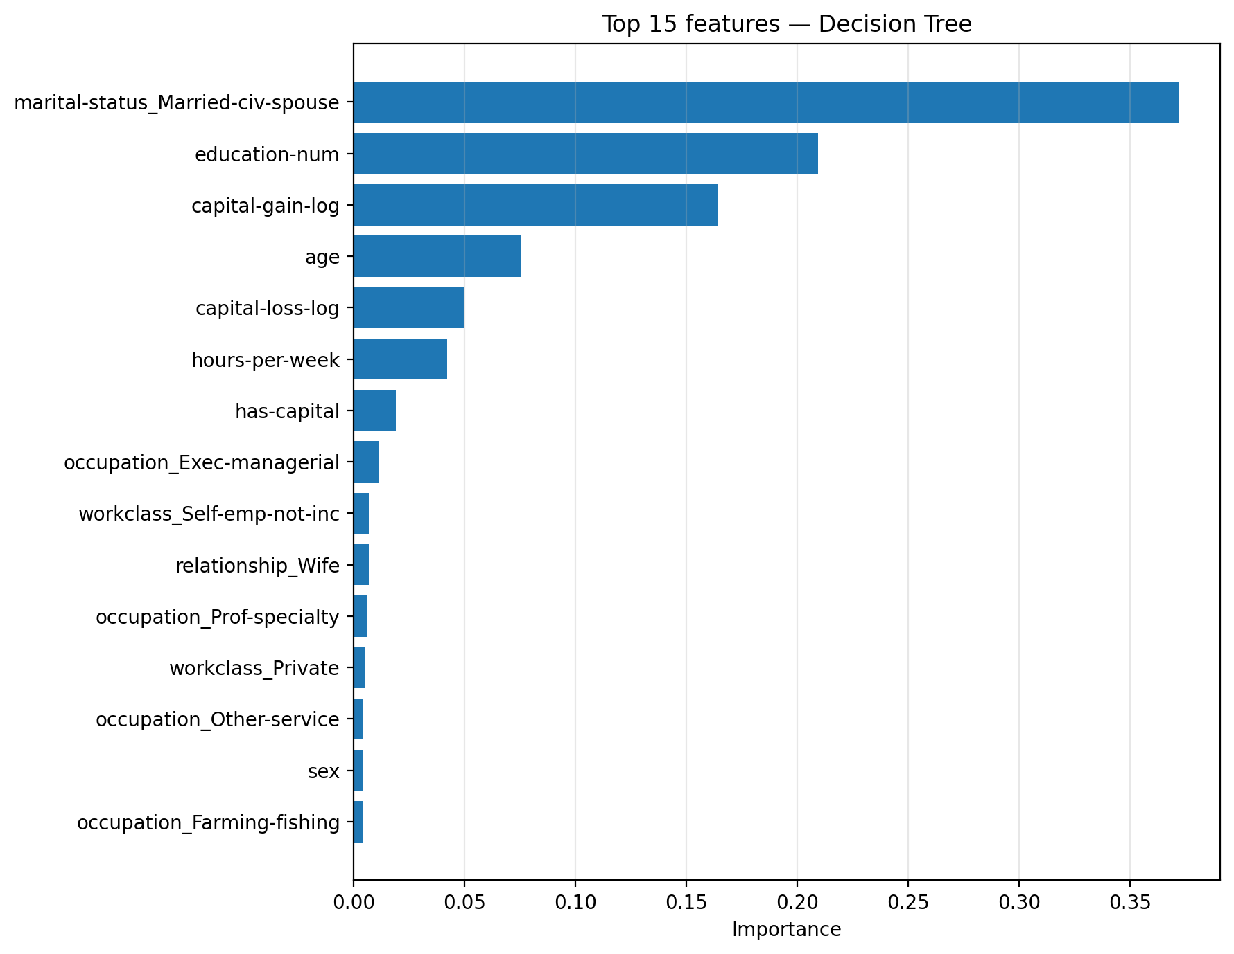
Decision tree classification

Slide 12
Model comparison
Test accuracy, same train/test split
Model | Accuracy
Always predicting <=50K (baseline) | 75.4%
Naive Bayes (published) | 83.9%
C4.5 decision tree (published) | 84.5%
Our logistic regression | 84.9%
Our decision tree | 85.0%
NBTree (best published) | 85.9%
Both models ≈ 85%, in the published range (84–86%)
Two very different models, same result: the limit is in the data
About 40% of high earners look like low earners in these variables

Slide 13
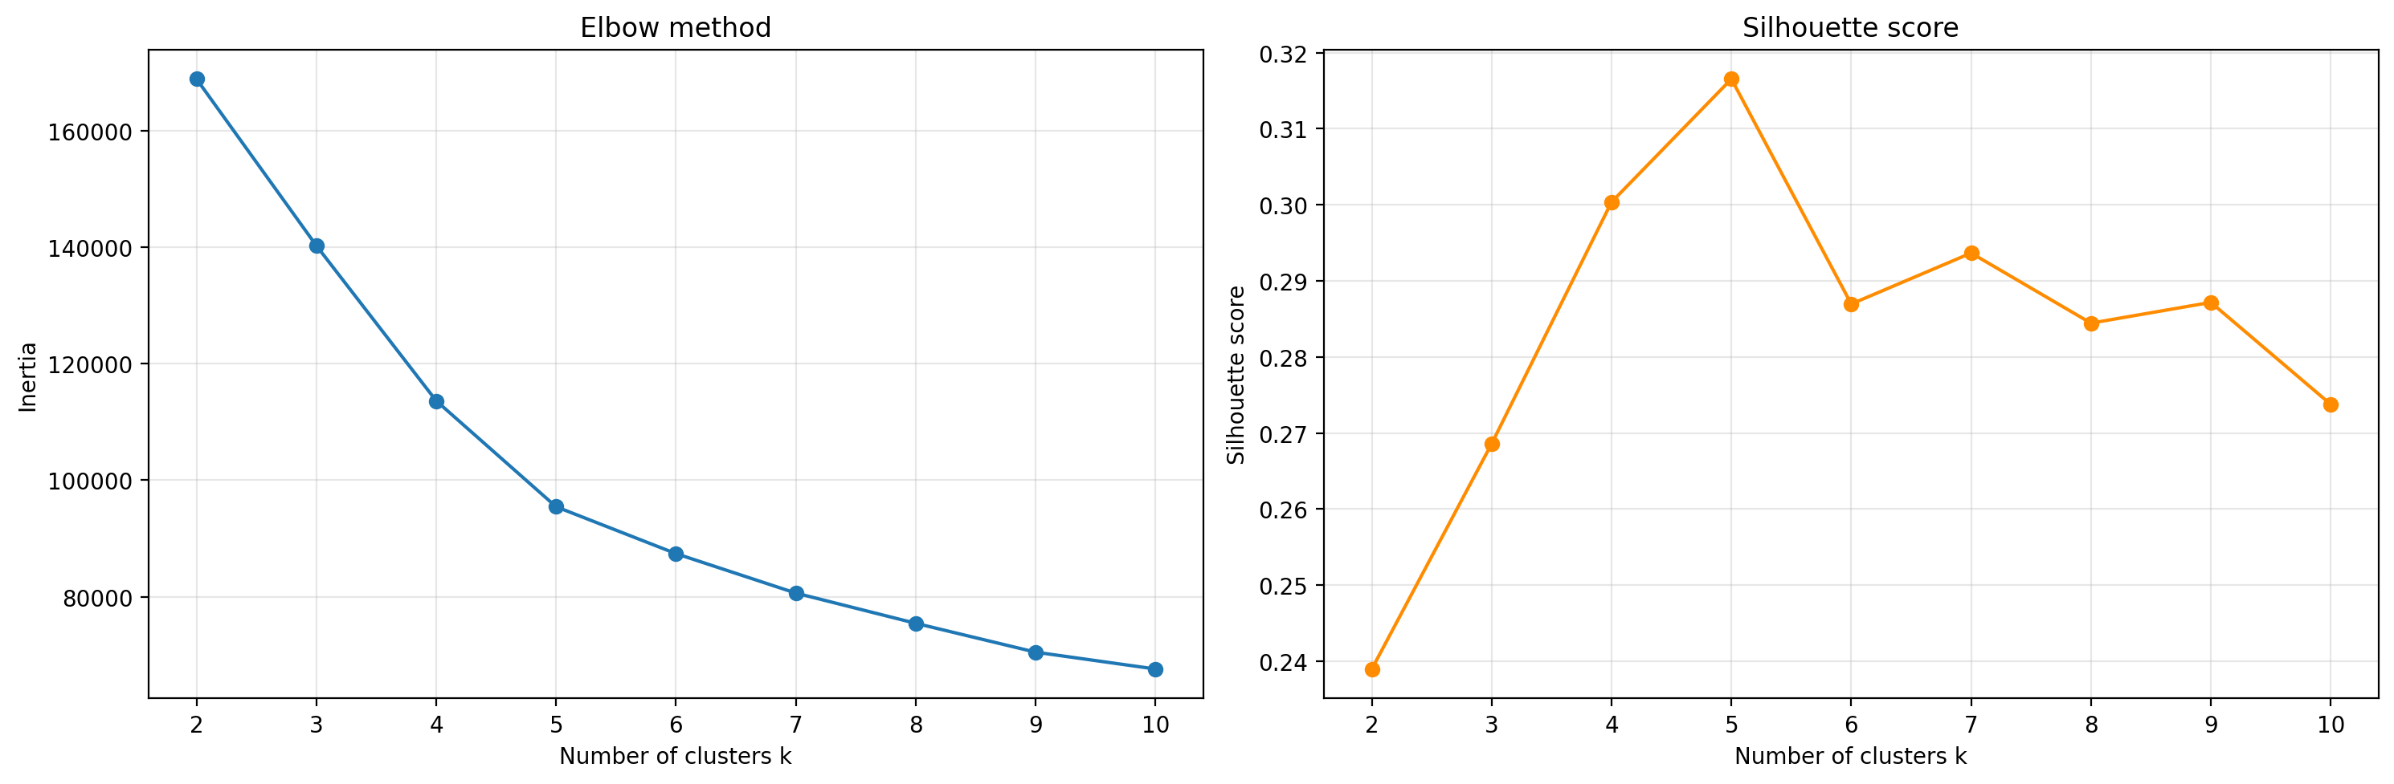
Clustering
(k-means)
k-means on train, 7 standardized features (age, education-num, hours-per-week, capital-gain-log, capital-loss-log, sex, is-married). Income is not used.
Elbow method and silhouette (0.317) both choose k = 5.
Cluster | Who | Share | Earn >50K
0 | Young single men (~32) | 23% | 6.1%
1 | Capital loss (~42) | 5% | 51.6%
2 | Capital gain (~44) | 8% | 63.8%
3 | Women, mostly not married | 29% | 8.2%
4 | Married men (~43) | 35% | 38.6%

Slide 14
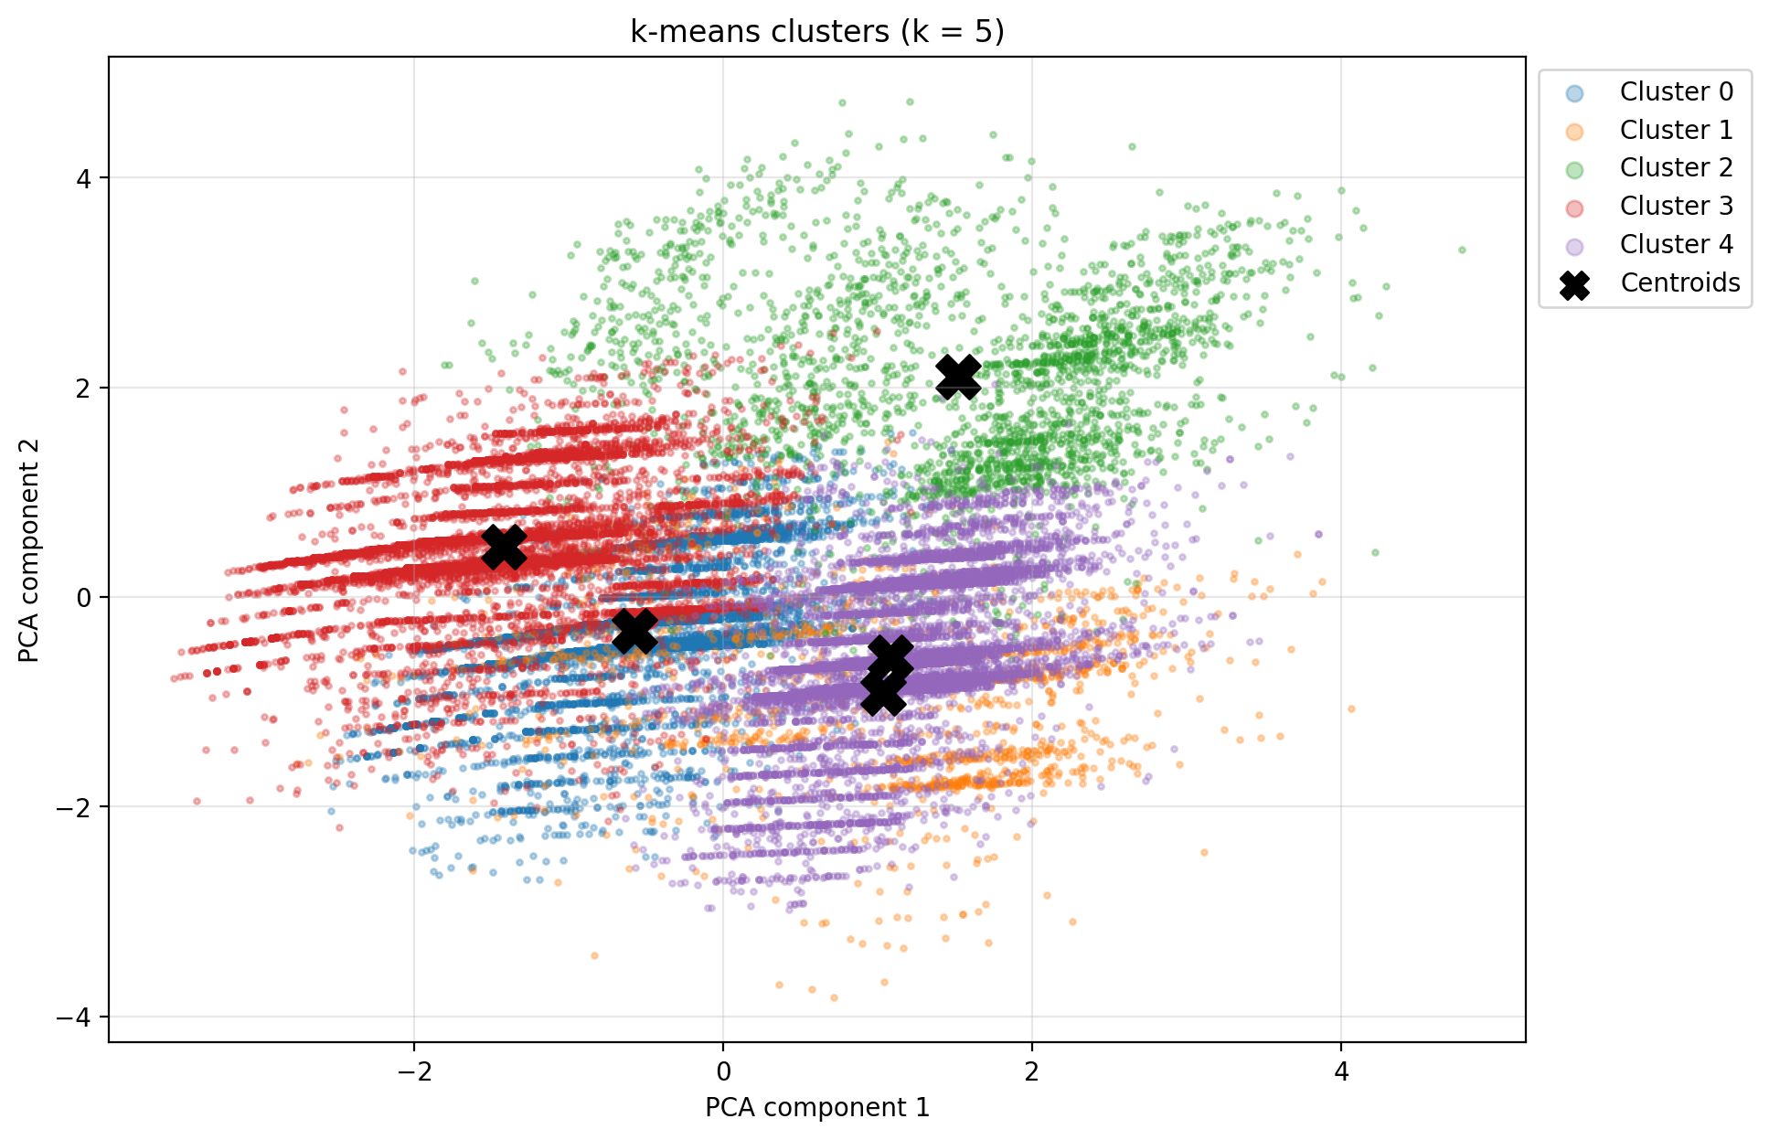
Clustering (k-means)

Slide 15
Conclusions
Being married, education, capital gains and age are the factors most related to income in every part of the analysis.
Men work about 6 hours more per week and earn more than $50K almost three times as often as women (31.3% vs 11.4%).
Our logistic regression (84.9%) and decision tree (85.0%) predict income almost as well as the best published model (85.9%), while working hours cannot be predicted well (R² = 0.078).
k-means, without using income, found 5 groups whose share of high earners ranges from 6% to 64%.
Original train/test split kept, settings chosen on train only: the test results are honest.
About 40% of high earners are still missed: a limit of the census data.
Notes:
To conclude: the same factors - being married, education, capital gains and age - are linked to income in every part of the analysis. There is a clear gender gap. Our classification models reach about 85 percent accuracy, close to the best published result, while working hours cannot be predicted well.

