Slide 1
Code Nashai / Flame Freefall
Flame
Freefall
Prevention
Material flammability
Detection
Make NASA combustion evidence
usable for the next research decision.
Smoke and sensors
Suppression
Find relevant experiments. Audit the comparison.
Export the evidence and its limits.
Droplet extinction
Code Nashai / Muhammad Marjan Ahmed / Solo builder
Challenge response: Flame in Freefall | NASA Space Apps 2026 | Independent project; no NASA endorsement
1 / 7
Notes:
I am Muhammad Marjan Ahmed, the solo builder behind Code Nashai. Flame Freefall turns NASA combustion records into a traceable research workflow across prevention, detection and suppression. Our goal is to help researchers make a better-supported next research decision. This is an independent challenge response, not NASA-approved safety software.

Slide 2
Code Nashai / Flame Freefall
The hard part is knowing what transfers.
A spacecraft-fire researcher asks:
Which experiments inform a study
near a proposed Lunar atmosphere?
Find
Compare
Interpret
Tables and reports are
spread across investigations.
Matching oxygen alone
does not match the experiment.
A nearby result can still
have limited applicability.
The opportunity: preserve context from the research question to the source.
Source: supplied challenge-details.md; NASA PSI investigations and governed source reports
2 / 7
Notes:
The challenge is not simply finding a paper. An engineer needs to know whether its experiment supports the question being asked. Fuel geometry, oxygen, pressure, flow and measurement methods matter. Microgravity findings do not automatically validate Lunar-gravity behavior. Flame Freefall makes those transfer limits visible.

Slide 3
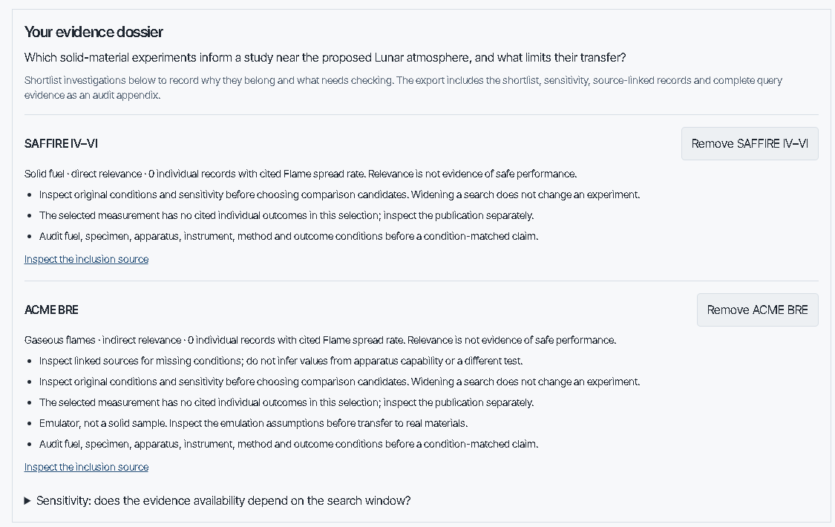
Code Nashai / Flame Freefall
One question. A traceable evidence dossier.
1
Set the question
Choose job and conditions.
2
Inspect the evidence
Check relevance and source limits.
3
Keep the reasoning
Export settings, records and citations.
Actual local dossier capture, cropped from the saved workflow run; not a live deployment check.
Implemented: system/site/app/decide; lib/decision.ts; lib/psi-comparison.ts; docs/evidence-method.md
3 / 7
Notes:
The working product records the research question verbatim. Explicit controls determine retrieval. Investigations have source-supported direct or indirect relevance assignments, and unmatched classifications remain visible as unknown. This is an actual cropped local browser capture from the saved implementation workflow; it is not a fresh live-site screenshot. The dossier retains the shortlist, settings, underlying records and dataset identity. The deterministic Explorer works without an AI service.

Slide 4
Code Nashai / Flame Freefall
Demo: an atmosphere match is a starting point.
Research question
What informs a solid-material study
near a proposed Lunar atmosphere?
SAFFIRE IV–VI
ACME BRE
Direct solid-fuel evidence.
Inspect setup and missing fields.
Indirect condensed-fuel emulation.
Keep its physical geometry distinct.
Widening the oxygen search window changes the retrieved evidence.
The experiment has not changed. Neither has its transfer limit.
Local executable scenario: research/research-scenario-verification.json | Retrieval overlap is not safety or gravity validation
4 / 7
Notes:
In the implemented Lunar scenario, shortlist SAFFIRE IV–VI and ACME BRE. SAFFIRE provides direct solid-fuel evidence; BRE is a gaseous experiment emulating aspects of condensed-fuel burning. Doubling the oxygen retrieval tolerance admits one full SAFFIRE record in the engineering scenario. That is sensitivity of evidence availability, not a safety margin. Then inspect an actual source-backed comparison.

Slide 5
Code Nashai / Flame Freefall
Two temperatures. No invented conclusion.
77°C
57°C
Audit the comparison
Fuel description differs.
Oxygen and pressure differ.
Method and dimensions
remain incomplete.
VI-3 / two-sided PMMA
VI-4 / one-sided PMMA
Reported observations from Table 2
Inspect both results. Do not infer a controlled effect.
NASA NTRS 20240002981, Table 2 | records saffire-iv-vi:VI-3 and VI-4 | Max temperature at SFU outlet
5 / 7
Notes:
The comparison audit surfaces two real outlet-temperature observations from SAFFIRE Table 2. It preserves their source identities and shows the setup differences. Because key metadata are missing and the conditions differ, it refuses a condition-matched claim. We do not subtract the temperatures or attribute the difference to specimen configuration. This is a useful source audit with an explicit next evidence check. Source: https://ntrs.nasa.gov/citations/20240002981

Slide 6
Code Nashai / Flame Freefall
AI helps you ask. Code preserves the evidence.
1,951
1,838
23
Indexed records
Test / test-point records
Stable governed documents
Built to inspect
Boundaries stay visible
Source-linked normalization
Python / TypeScript query parity
Deterministic measurement widgets
Missing metadata and source conflicts
Unknown observation independence
No material-safety or prediction claim
Local dataset: psi-data/derived/runs.json | Safeguards: main.py, psi_query.py, turn_guard.py | Internal checks, not safety validation
6 / 7
Notes:
NASA PSI tables and source reports feed source-preserving ingest, deterministic query twins, a static Next.js evidence interface, and optional FastAPI/ChatKit conversation. Structured PSI numbers render in code-owned widgets rather than generated prose. Narrative retrieval is separately cited. There are 1,951 indexed records; only 1,838 are individual test or test-point records, not proven independent replicates. Code was built with AI assistance; no independent expert or user validation is claimed.

Slide 7
Code Nashai / Flame Freefall
Make the next research decision defensible.
For researchers and aerospace engineers
Next: prove the benefit
A source-backed shortlist.
An auditable comparison.
A reproducible starting point.
Observe researcher task completion.
Review relevance with domain experts.
Resolve critical source metadata.
Try the evidence workflow
/decide/ → shortlist → audit → export
Project: github.com/marjan-ahmed/flame-freefall
Designed to support research; measured time savings and safety outcomes are not established.
Code Nashai | Muhammad Marjan Ahmed | Prior work disclosed in SUBMISSION.md; competition eligibility remains unresolved
7 / 7
Notes:
Our intended contribution is a defensible starting point for spacecraft-fire research. The next milestone is observed task completion with researchers and independent domain review, not another feature count. Explore the repository for the implemented workflow and reproduction instructions. The project predates the event; organizer eligibility clarification remains unresolved. Team: Code Nashai. Solo builder: Muhammad Marjan Ahmed. No NASA endorsement, measured time-saving claim, or safety qualification is asserted.

