Slide 1
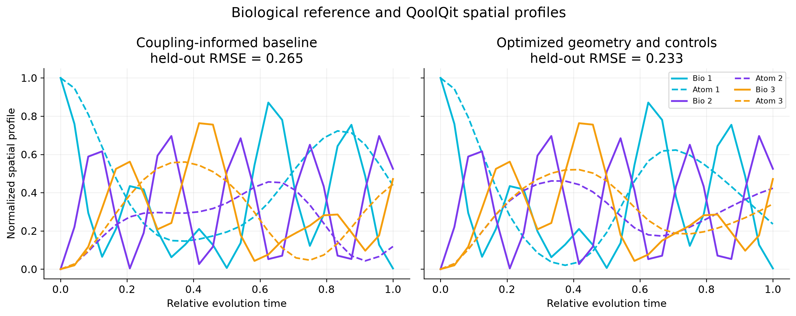
BioRydberg 2.0
Syed Marjan Ghazi • Pasqal QoolQit Contest 2026
Geometry-Aware Quantum Transport
Research question
Can bounded atom geometry and laser controls improve a neutral-atom spatial pattern match to a three-site coherent transport reference?
Method
Biological matrix exponential
Coupling-informed 2D register
QoolQit compile + LocalEmulator
Two-seed bounded differential evolution
Result: RMSE 0.2650 → 0.2329 on odd time samples excluded from tuning
12.1% lower held-out RMSE
Interpretation: improved normalized site-distribution similarity only. The biological hopping and driven Rydberg Hamiltonians remain physically distinct.
Notes:
Sources: results/study_summary.json and results/tables/study_metrics.csv, generated with QoolQit 1.4.0. Official model and SDK documentation: https://docs.pasqal.com/qoolqit/. Contest requirements: https://www.pasqal.com/resources/the-qoolqit-contest-is-live/.

Slide 2
Experience with QoolQit 1.4.0
Local, credential-free execution on Python 3.12.9
What worked well
Challenges and feedback
Dimensionless model
Initial-state examples
Register geometry, drive amplitude, detuning, and duration stayed readable before hardware compilation.
A localized Rydberg initial state materially changes this use case. More QoolQit examples would make that capability easier to discover.
Composable execution
Register + Drive + QuantumProgram + AnalogDevice + LocalEmulator formed a clear reproducible path.
Sweep ergonomics
Compilation and emulation were fast after import, but batch execution, caching, and progress telemetry would simplify optimization studies.
Useful observables
Site occupations, stored evaluation times, and the register interaction matrix supported direct validation.
Result extraction
Using QoolQit’s stored result times avoided exact floating-point lookup failures. A documented array-first extraction pattern would help.
Verification
10 automated tests passed, including a compiled local-emulator run.
Next step
Test local detuning controls and noise robustness, then compile the same transparent workflow for Pasqal hardware when access is available.
No cloud or QPU execution claimed
Notes:
Development observations are from the repository's executed experiments and tests. API reference and execution model: https://docs.pasqal.com/qoolqit/. Official source: https://github.com/pasqal-io/qoolqit.

