Slide 1
“Update on Lifelong Learning (L2) Quadrupeds” 2021
Presenter: Ali Marjaninejad
Notes:
Be critical of your own work. You don’t need to answer everything but the things you are addressing should be presented and studied in a crystal-clear way (bullet proof facts or mention wherever there can be a pitfall).

Slide 2
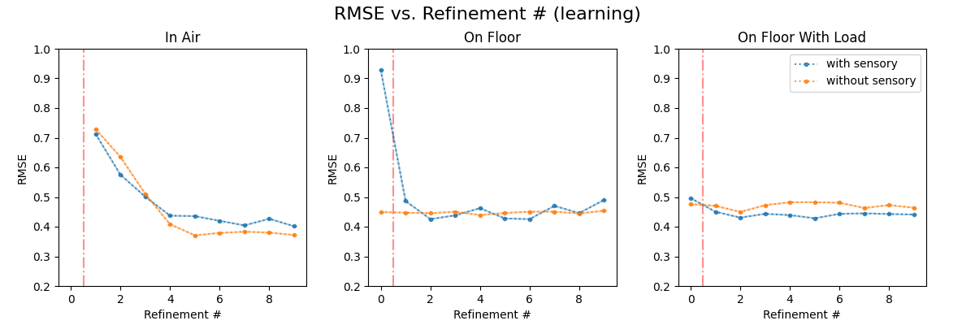
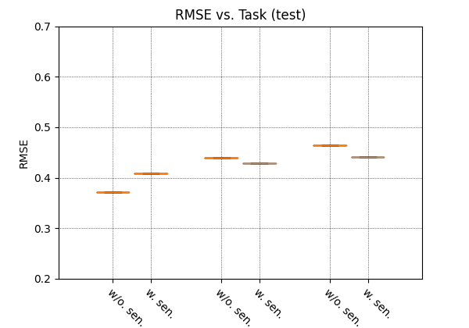
Without BN 1 run (cyclical)

Slide 3
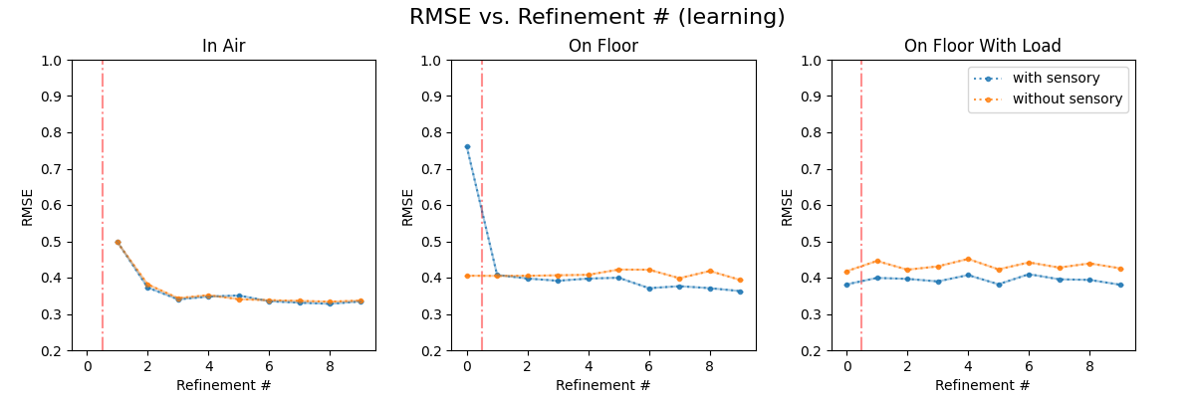
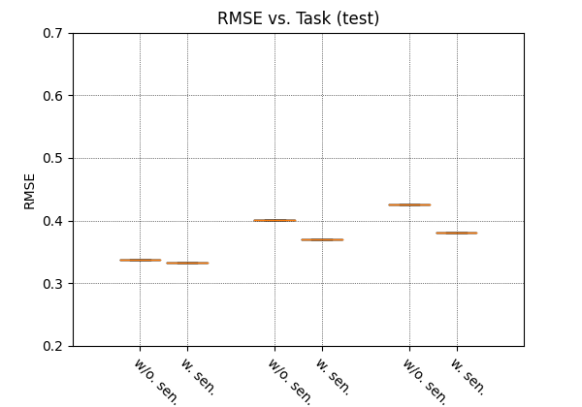
With BN 1 run (cyclical)

Slide 4
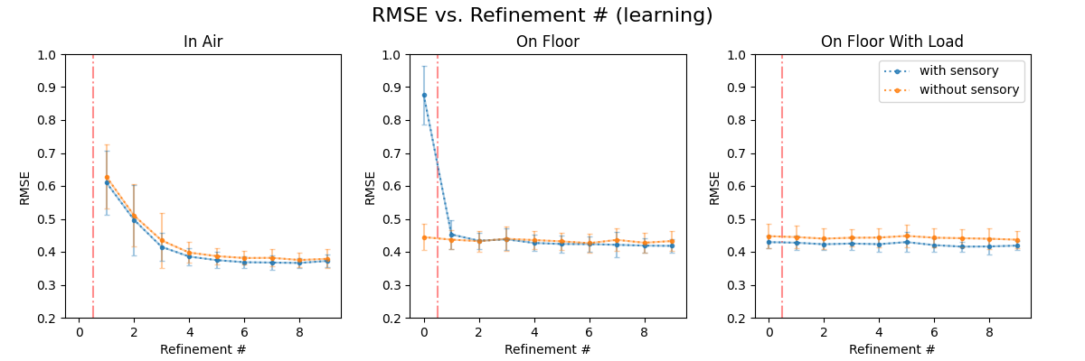
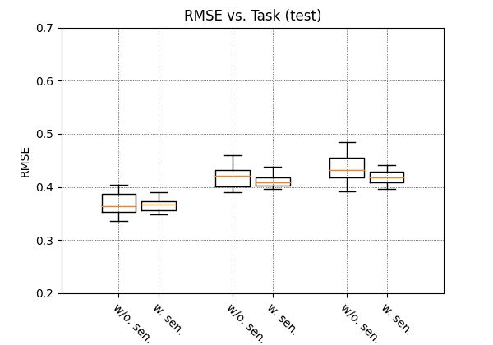
Without BN 15 runs (cyclical)

Slide 5
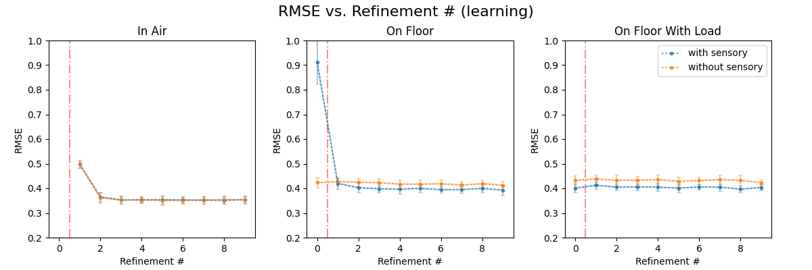
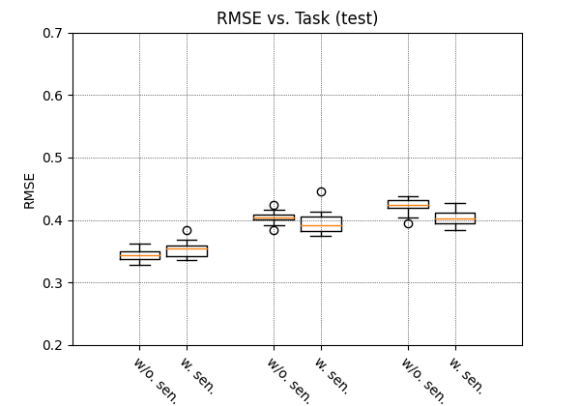
With BN 15 runs (cyclical)

