Slide 1
“Update on Lifelong Learning (L2) Quadrupeds” 2021
Topic: The effect of feedback on the stiff cat
Notes:
Be critical of your own work. You don’t need to answer everything but the things you are addressing should be presented and studied in a crystal-clear way (bullet proof facts or mention wherever there can be a pitfall).

Slide 2
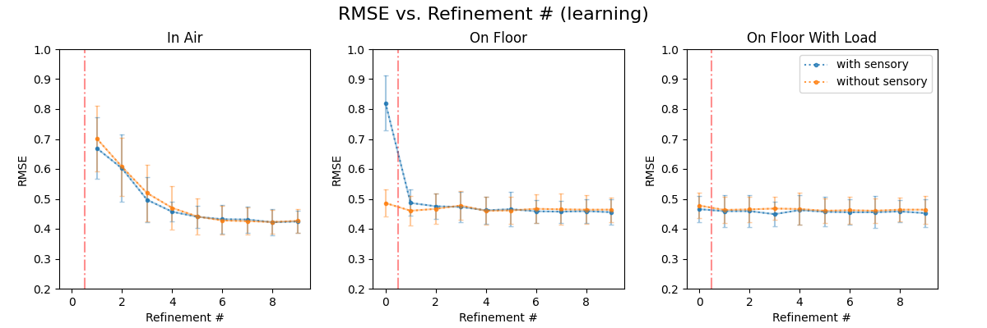
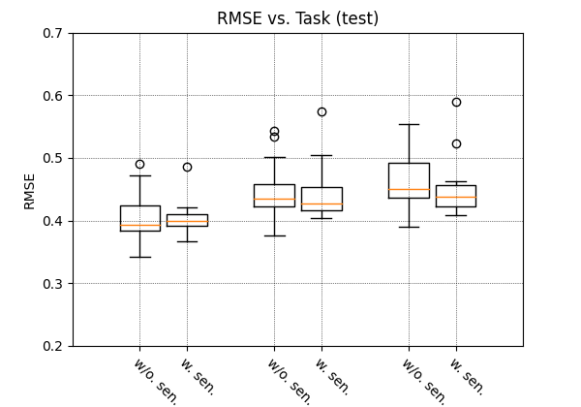
Singe ANN, Without Feedback (cyclical)

Slide 3
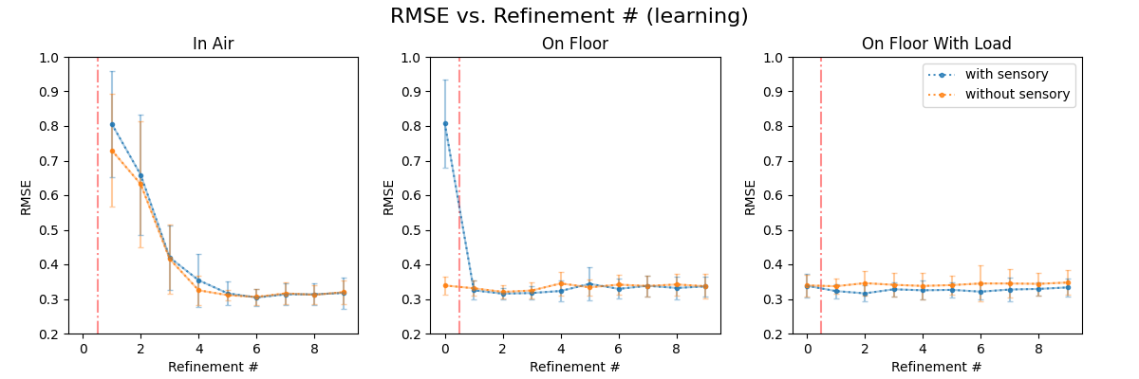
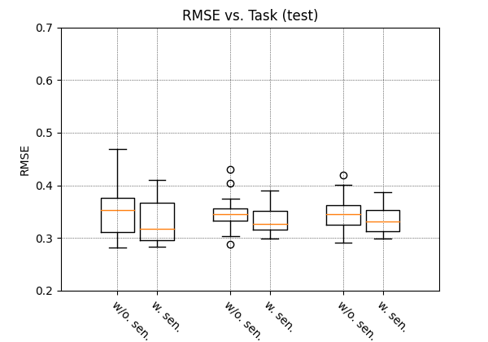
Singe ANN, With Feedback (cyclical)

Slide 4
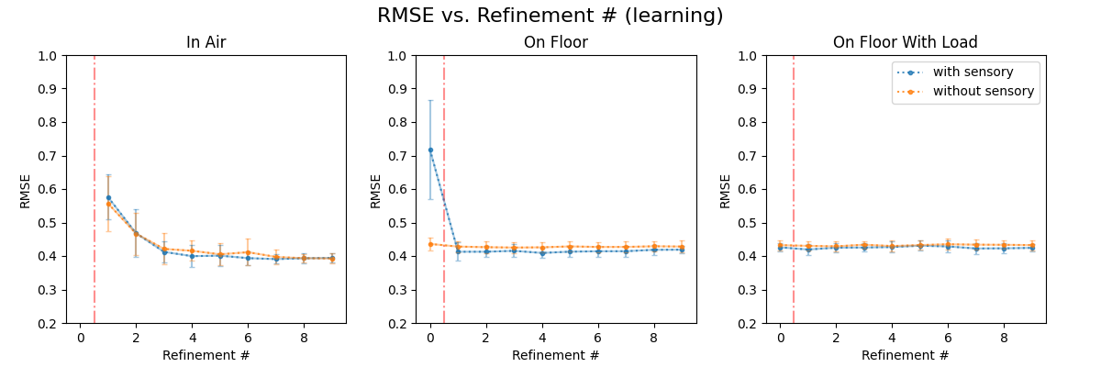
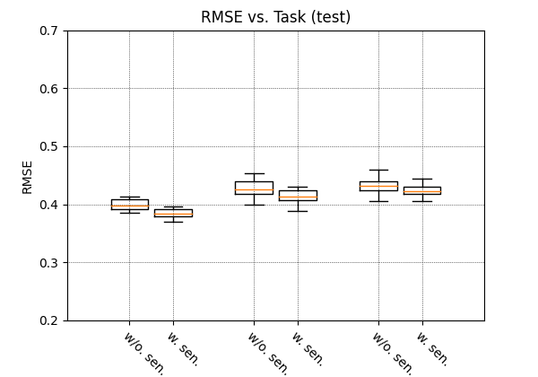
Multiple ANNs, Without Feedback (cyclical)

Slide 5
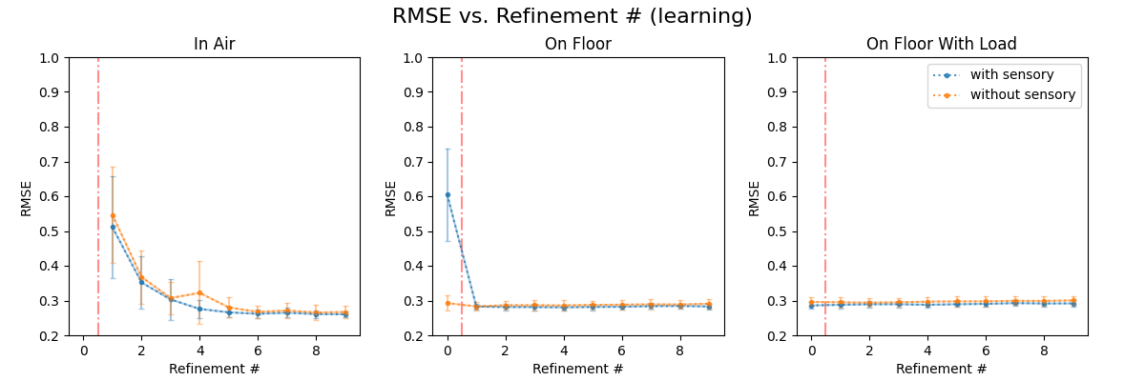
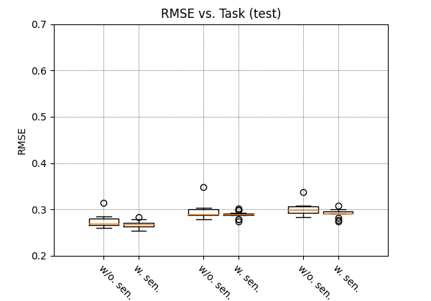
Multiple ANNs, With Feedback (cyclical)

