Slide 1

Web Scraping and Regression Project

Slide 2

What makes a house expensive?
Predicting home price via Linear Regression
Marjan Rezvani

Slide 3

Project outline:
Data
Model
Predictions
Conclusion and Future Steps

Slide 4

Data Collected
Century21.com
a real-estate property website
10 features
1753 observations
Target : Price

Slide 5

Tools:
BeautifulSoup and Requests libraries
Pandas and NumPy
Sklearn
Matplotlib, Seaborn

Slide 6

Algorithms
Web Scraping
Feature Engineering
Analysis
Models
Model Evaluation and Selection

Slide 7
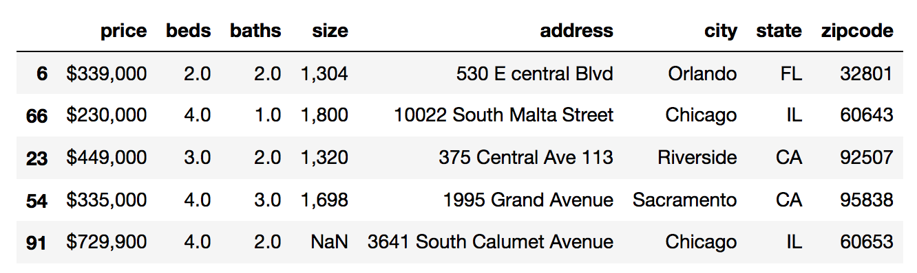
Sample of data

Slide 8
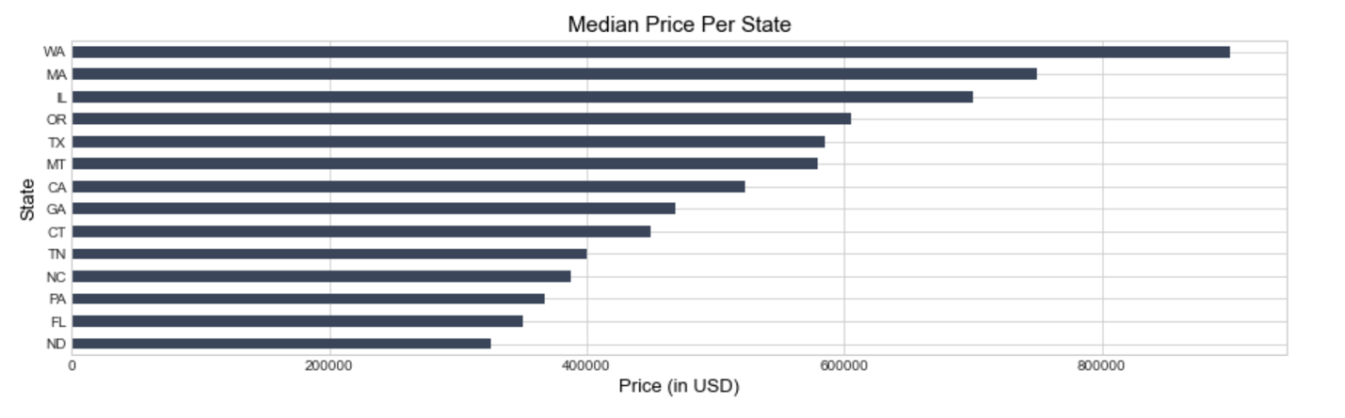
Average Price Per State

Slide 9
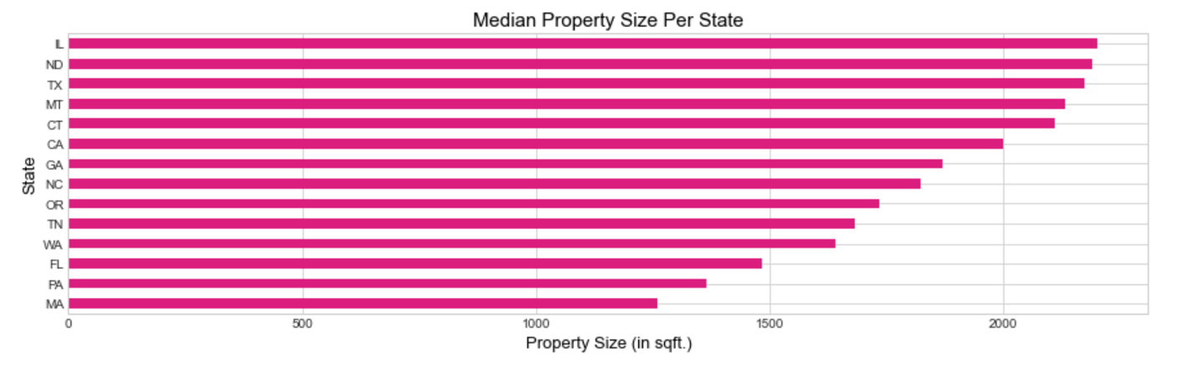
Median Property Size Per State

Slide 10
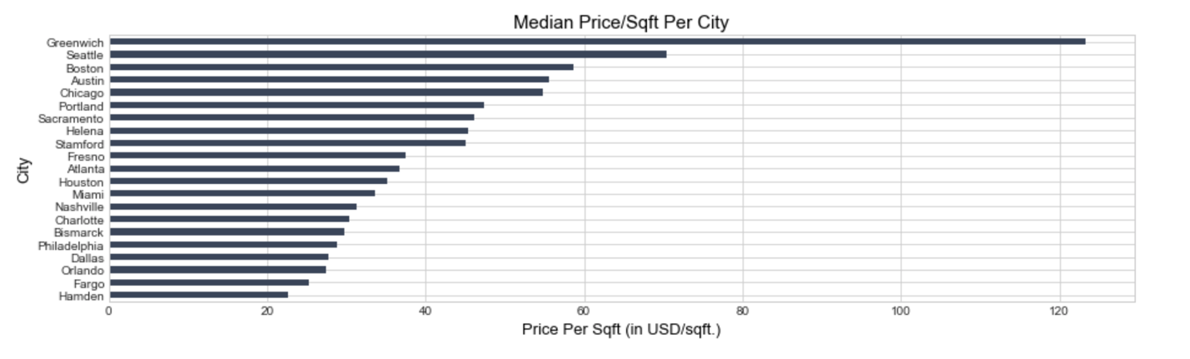
Cities: Average Price per sq.ft.

Slide 11
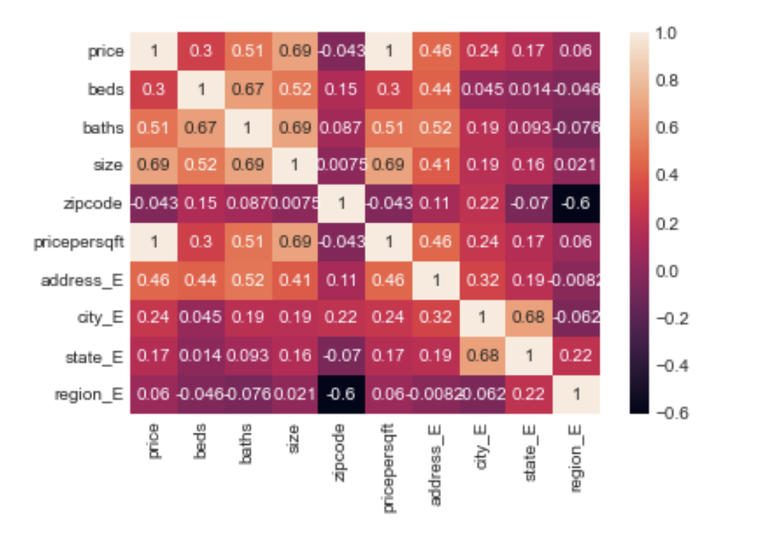
Size is Highly Correlated with Price

Slide 12
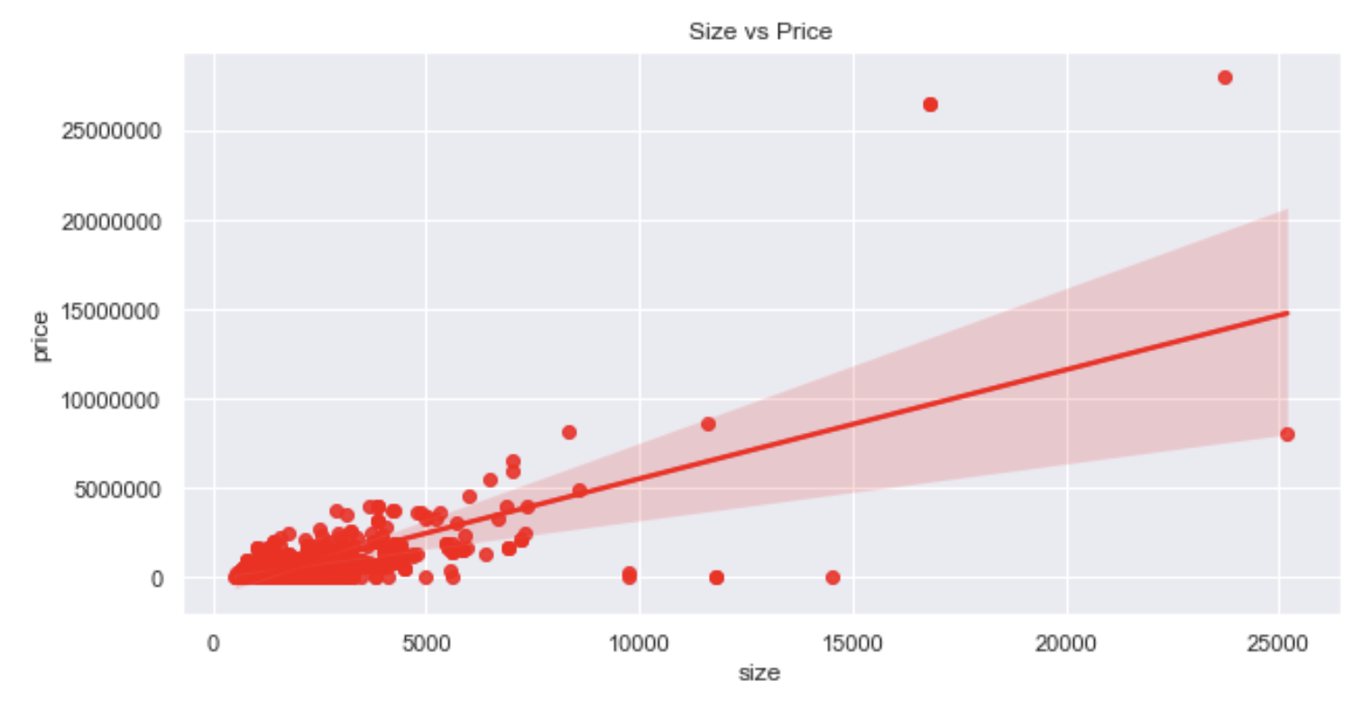
The larger the size, the housing price tends to be higher

Slide 13
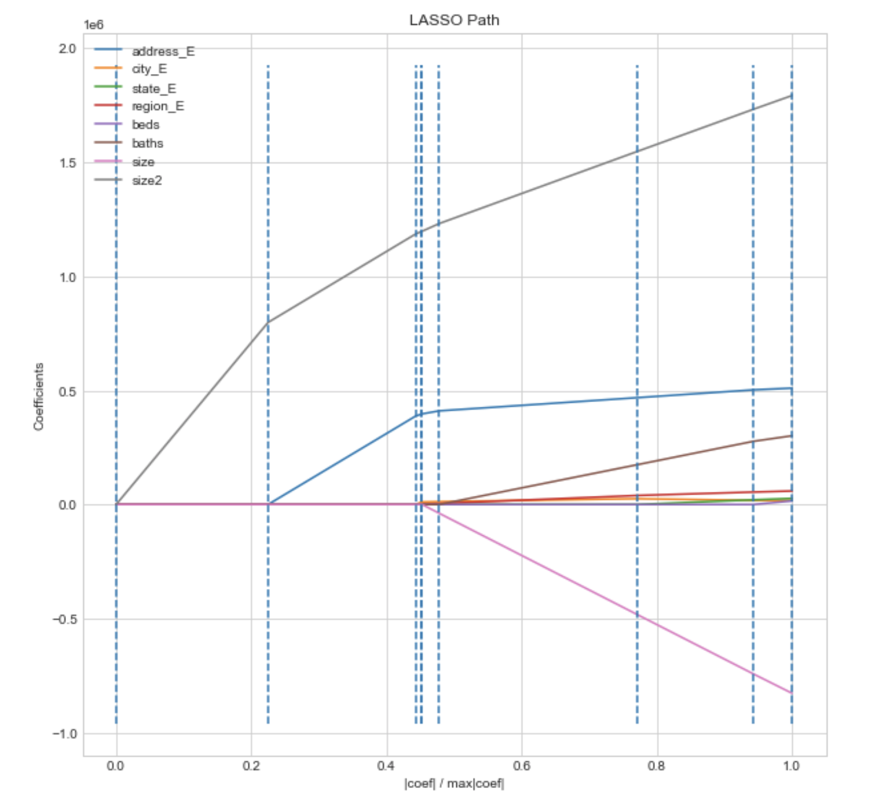
Visualization for all the LASSO models across a range of different alpha values

Slide 14
Models Accuracy
Linear Regression | Polynomial Regression | Lasso Regression | Ridge Regression
0.8437278269210082 | 0.9023538924173838 | 0.782733965768202 | 0.712747428001326

Slide 15
Challenges
Difficulty in web scraping and finding appropriate dataset from Realtor websites to work on
Did not find more appropriate datasets for various factors like schools, crime rate, income levels, which may affect on house price

Slide 16
Conclusions:
In this project I have provided a model that have been used for
estimating real estate property's value.
I got better results by doing appropriate feature engineering, after trying different ones.

Slide 17
Future works:
Collect more features
Examine predictor by a subset
Provide timeseries forcast

Slide 18
Related works:
https://github.com/ar2849/Metis-Project-Two/blob/main/Project%20-%202%20Metis%20Deck.pdf
https://medium.com/@websitescraper.com/how-to-scrape-zillow-for-real-estate-listings-using-python-and-lxml-aac3eb0c26d7
https://github.com/CodeSigma91/Project_WebScraping/blob/master/analysis%20and%20visualization.ipynb
https://github.com/jiveshs98/Python-Scraping-Real-Estate-Data/blob/master/century21.ipynb

Slide 19
Questions?

Slide 20
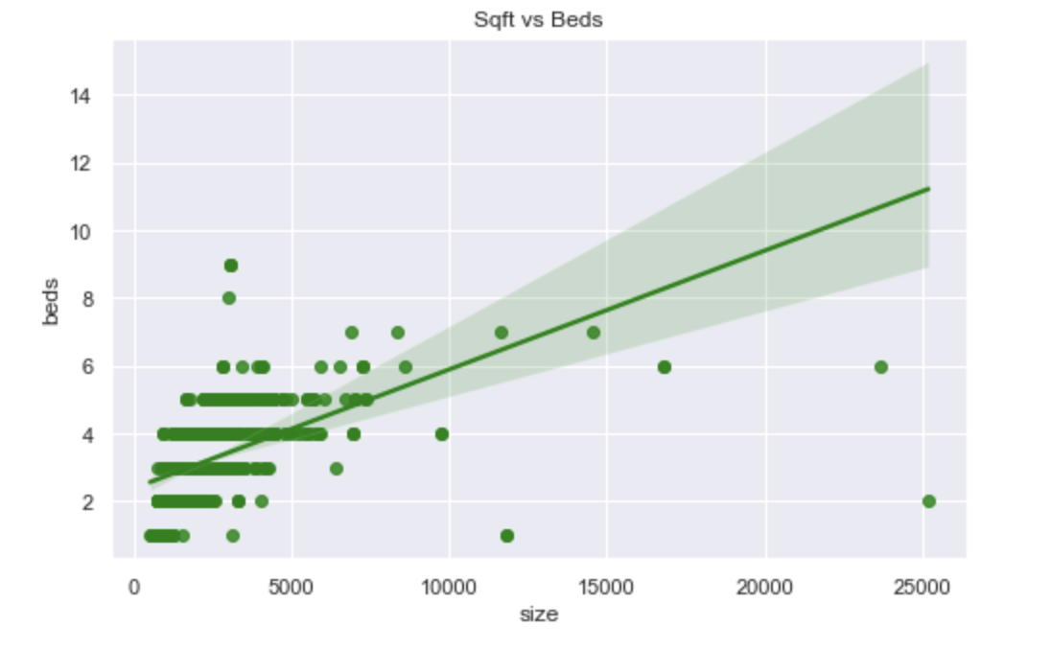
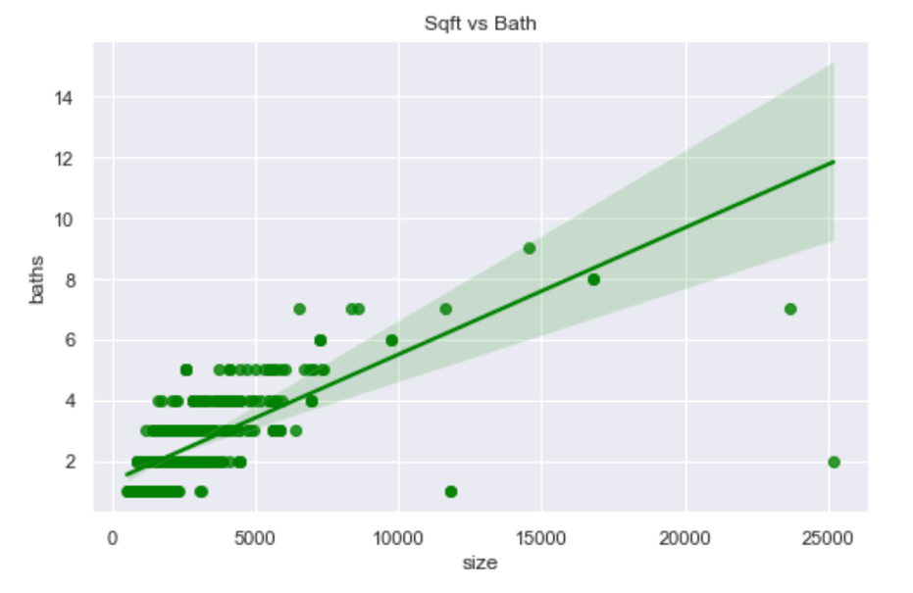
Appendix

Slide 21
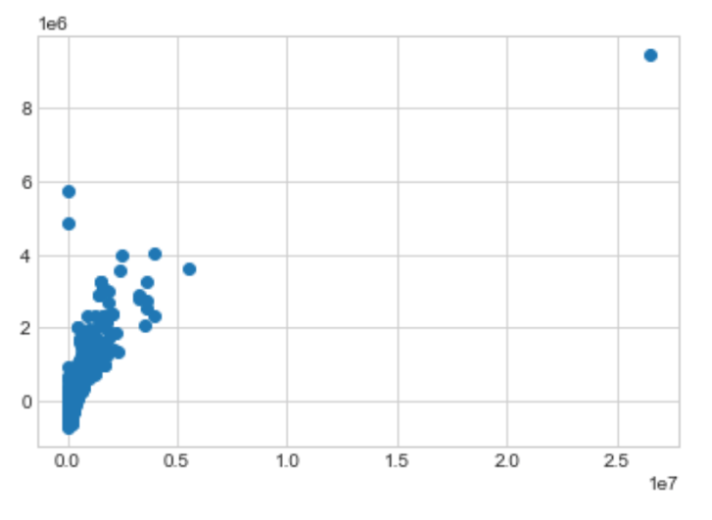
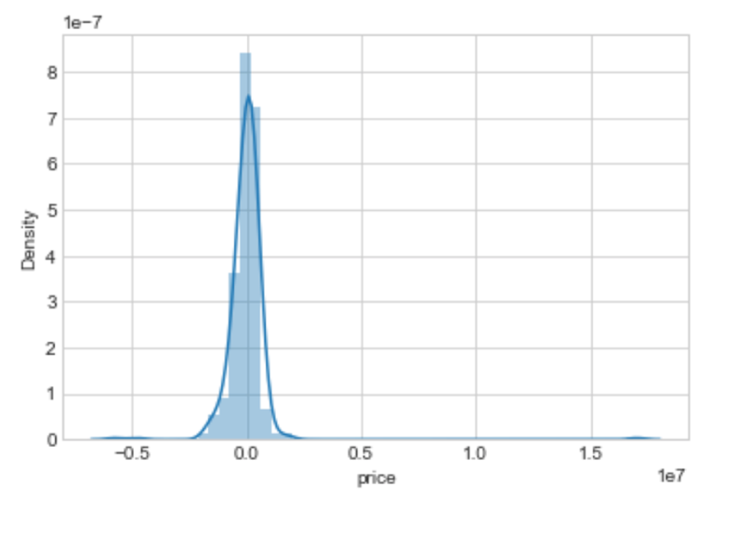
Scatter plot for y_test and predictions
Normal distribution plot for y_test-predictions

Slide 22
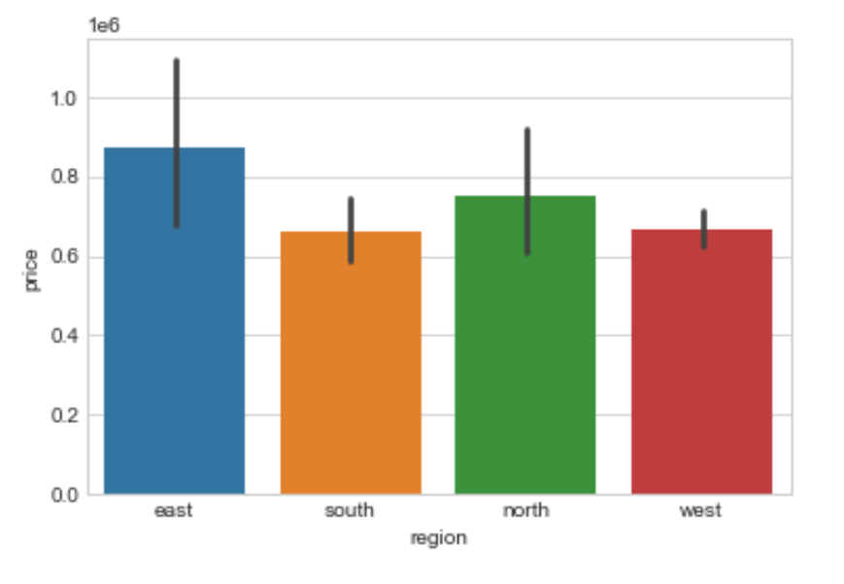
Price in Regions

