Slide 1
Psychometrics and Structural Equation Modeling
Item Response Theory Part II

Slide 2
Topic overview
Polytomous IRT models (ordered-categorical, Likert items)
Estimation of item and person parameters
More about item and test information
Computerized adaptive testing
Differential item functioning (test bias)

Slide 3

Ordinal Item Response Models
Rather than simply modeling $P\left(Y=1\right)$ for binary items, for ordinal items, we need to model the probability of responses falling into one of $K$ categories
e.g., Likert scale items, rankings, “low-middle-high” designations
Two main models: the Graded Response Model (‘difference’ model) and the Partial Credit Model (‘divide-by-total’ model).

Slide 4
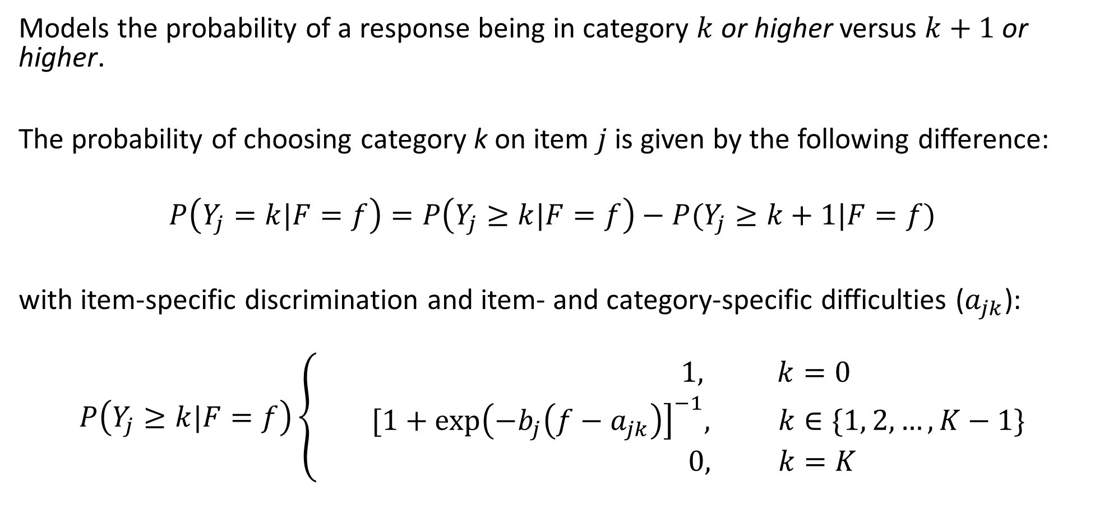
Graded Response Model
Models the probability of a response being in category $k$ or higher versus $k+1$ or higher.
The probability of choosing category k on item $j$ is given by the following difference:
$$P\left(Y_{j}=k|F=f\right)=P\left(Y_{j}≥k|F=f\right)−P(Y_{j}≥k+1|F=f)$$
with item-specific discrimination and item- and category-specific difficulties ($a_{jk}$):
$$P\left(Y_{j}≥k|F=f\right)\left\{\begin{aligned} 1, k=0 \\ [1+\exp{{\left(−b_{j}\left(f−a_{jk}\right)\right]}^{−1}, k∈\{1, 2,…,K−1\}} \\ 0, k=K \end{aligned}\right.$$

Slide 5
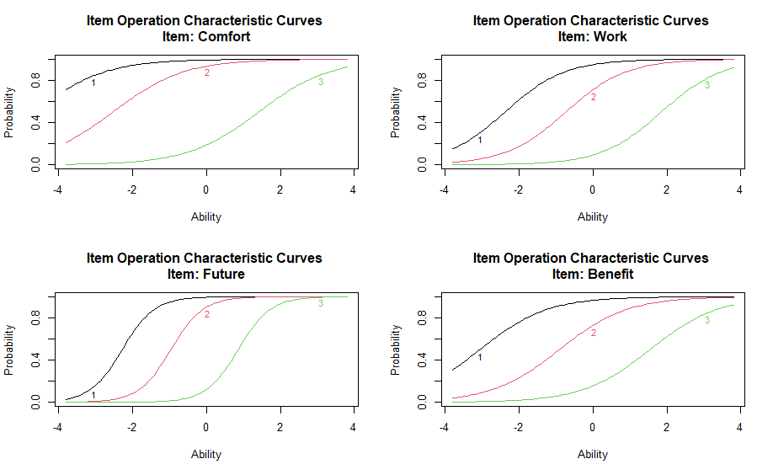
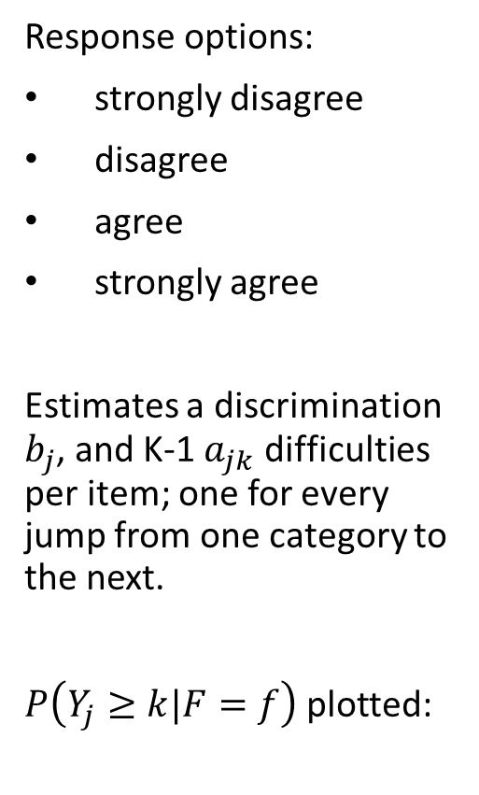
Attitudes to Science and Technology
Response options:
strongly disagree
disagree
agree
strongly agree
Estimates a discrimination $b_{j}$, and K-1 $a_{jk}$ difficulties per item; one for every jump from one category to the next.
$P\left(Y_{j}≥k|F=f\right)$ plotted:

Slide 6
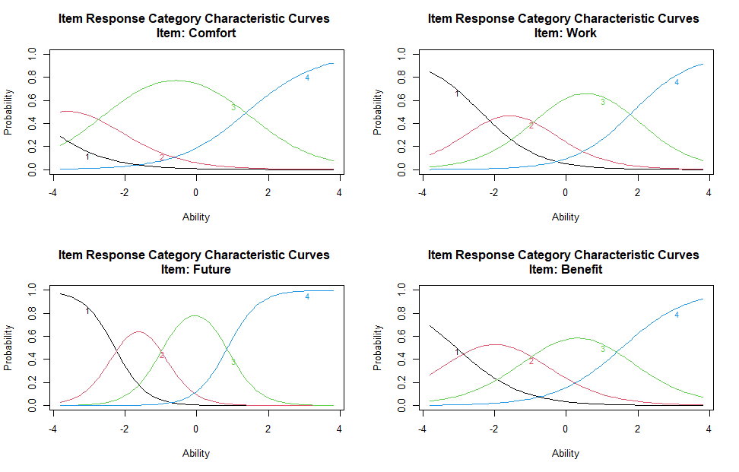

Attitudes to Science and Technology
This yields K ICCs:
$$P\left(Y_{j}=k|F=f\right)=P\left(Y_{j}≥k|F=f\right)−P(Y_{j}≥k+1|F=f)$$

Slide 7
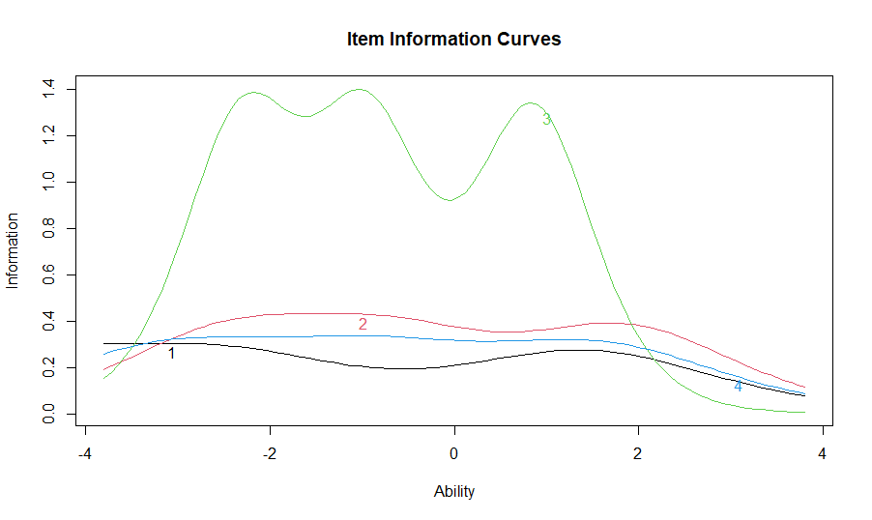
Attitudes to Science and Technology
We now get more complex item information curves, each the sum of K-1 category information curves:

Slide 8

Generalized Partial Credit Model
The probability of choosing category k on item $j$ is given by:
$P\left(Y_{j}=k|F=f\right)=\frac{\exp\left(\sum_{1}^{k}{{b_{j}(f}_{ }−a_{jk})}\right) }{1+\sum_{1}^{K}{\exp\left(\sum_{1}^{k}{{b_{j}(f}_{ }−a_{jk})}\right)}}$
This ‘dividides-by-the-total’, i.e. over the total effect of all categories $K$ at F = f.

Slide 9
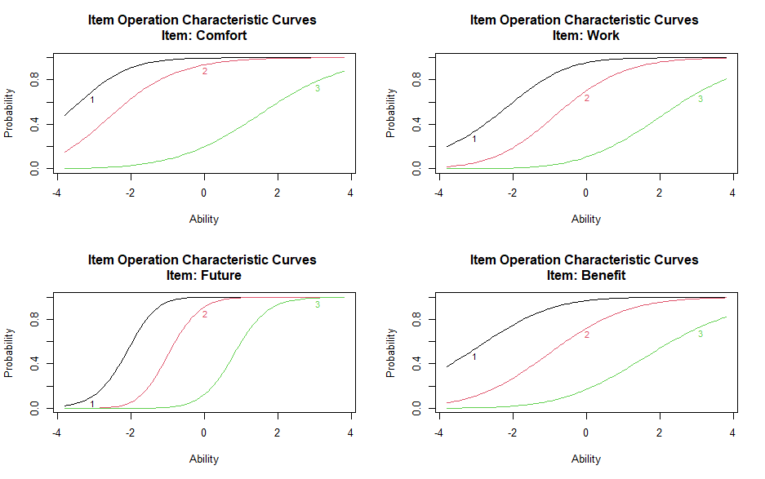
Attitudes to Science and Technology
Again, this yields K-1 curves:

Slide 10
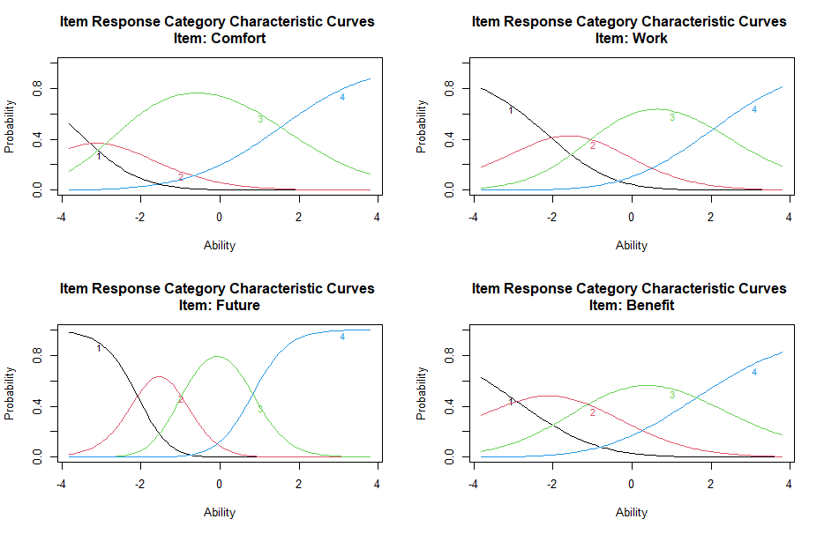
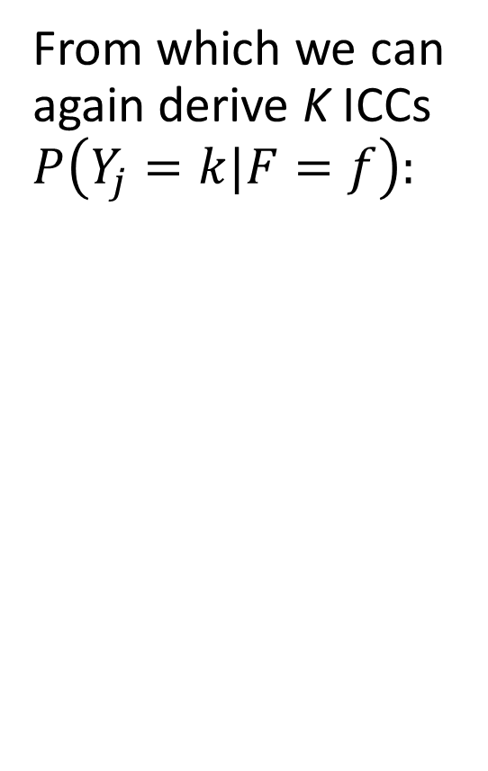
Attitudes to Science and Technology
From which we can again derive K ICCs $P\left(Y_{j}=k|F=f\right):$

Slide 11
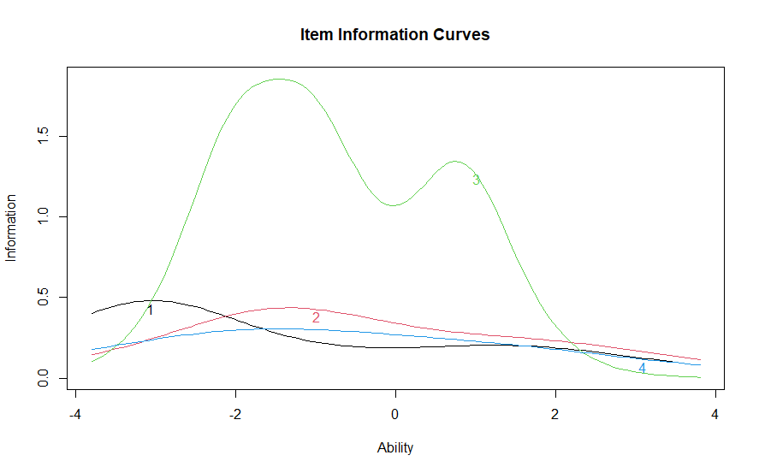
Attitudes to Science and Technology
This again results in flexible IICs:

Slide 12

Ordinal Item Response Models
Both the graded response and generalized partial credit models can be restricted and expanded based on the theoretical needs of an analysis
One common decision is whether to fix the difficulties ($a_{jk}=a_{k}$) and/or the discrimination parameters ($b_{j}=b$) equal for all items (ordinal Rasch models).

Slide 13
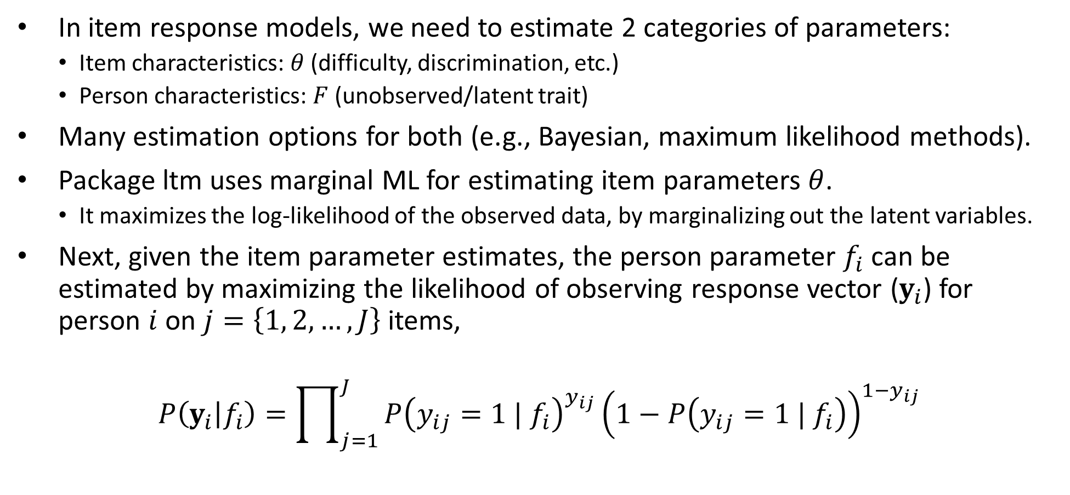
IRT Parameter Estimation
In item response models, we need to estimate 2 categories of parameters:
Item characteristics: $θ$ (difficulty, discrimination, etc.)
Person characteristics: $F$ (unobserved/latent trait)
Many estimation options for both (e.g., Bayesian, maximum likelihood methods).
Package ltm uses marginal ML for estimating item parameters $θ$.
It maximizes the log-likelihood of the observed data, by marginalizing out the latent variables.
Next, given the item parameter estimates, the person parameter $f_{i}$ can be estimated by maximizing the likelihood of observing response vector ($y_{i}$) for person $i$ on $j=\left\{1, 2, …, J\right\}$ items,
$$P\left(y_{i} | f_{i}\right)=\prod_{j=1}^{J}{P{\left(y_{ij}=1 | f_{i}\right)}^{y_{ij}}{\left(1−P\left(y_{ij}=1 | f_{i}\right)\right)}^{1−y_{ij}}}$$

Slide 14
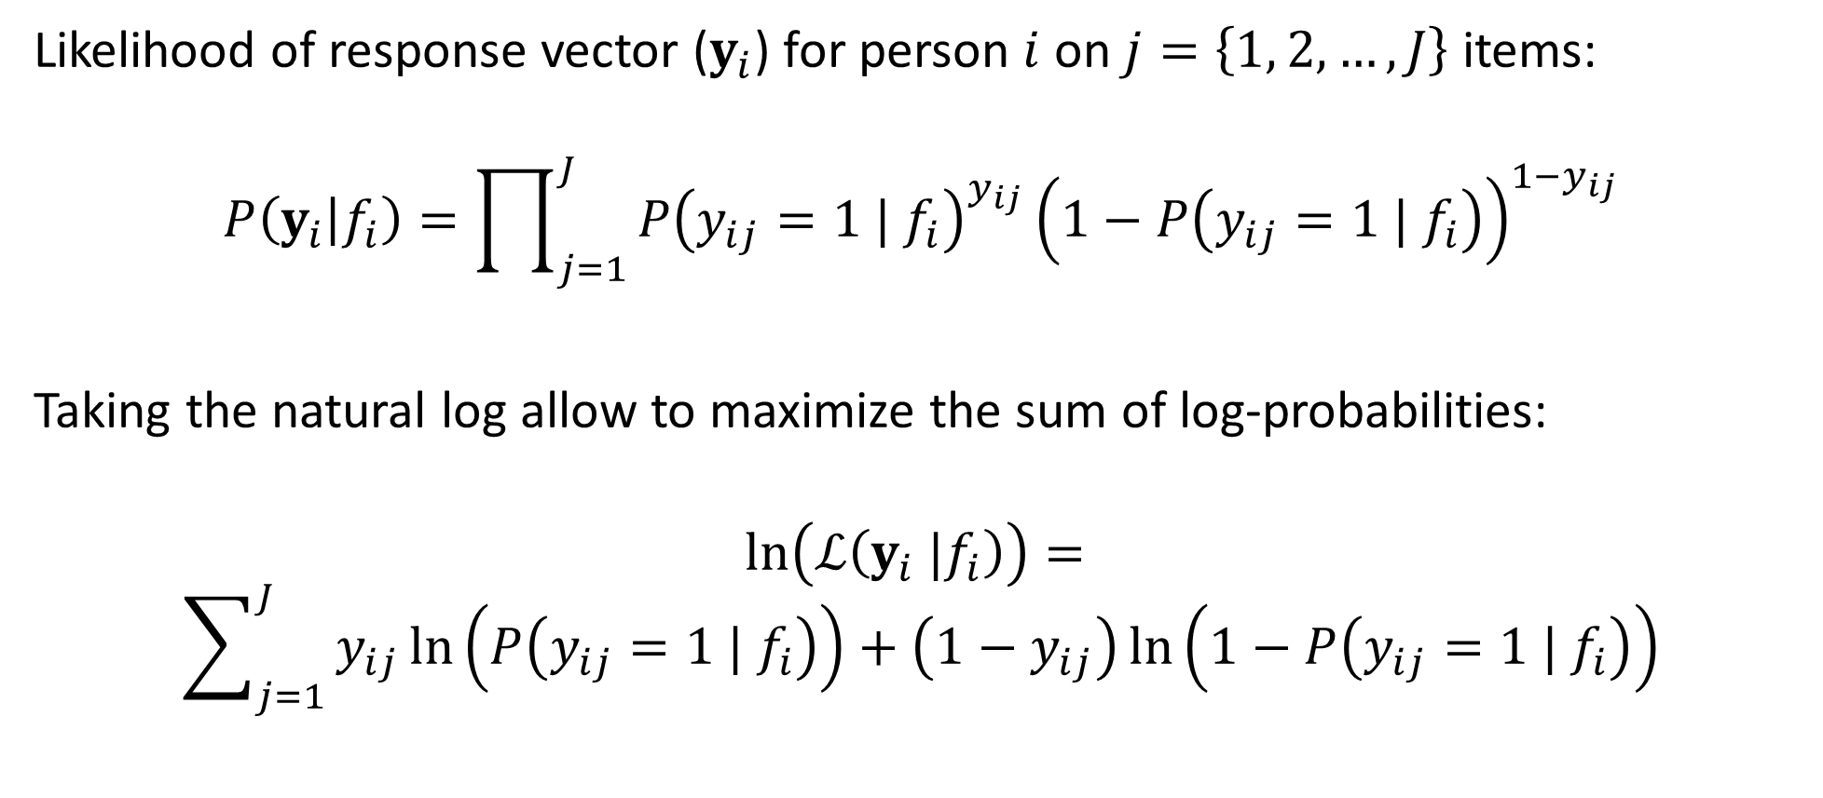
IRT Parameter Estimation
Likelihood of response vector ($y_{i}$) for person $i$ on $j=\left\{1, 2, …, J\right\}$ items:
$$P\left(y_{i} | f_{i}\right)=\prod_{j=1}^{J}{P{\left(y_{ij}=1 | f_{i}\right)}^{y_{ij}}{\left(1−P\left(y_{ij}=1 | f_{i}\right)\right)}^{1−y_{ij}}}$$
Taking the natural log allow to maximize the sum of log-probabilities:
$$\ln\left(ℒ\left(y_{i} |f_{i}\right)\right)=$$
$$\sum_{j=1}^{J}{y_{ij}\ln\left(P\left(y_{ij}=1 | f_{i}\right)\right)+\left(1−y_{ij}\right)\ln\left(1−P\left(y_{ij}=1 | f_{i}\right)\right)}$$

Slide 15
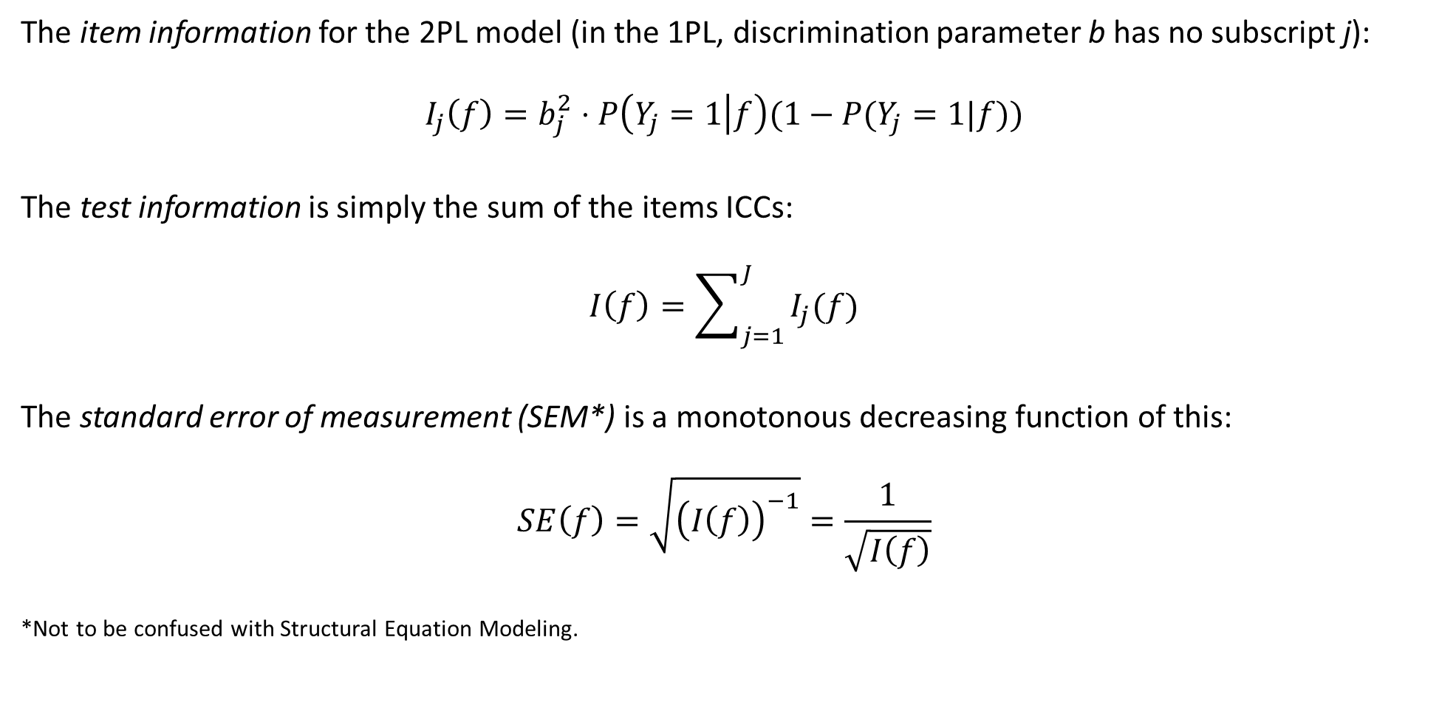
IRT Parameter Estimation: Uncertainty
The item information for the 2PL model (in the 1PL, discrimination parameter b has no subscript j):
$$I_{j}\left(f\right)=b_{j}^{2}⋅P\left(Y_{j}=1 | f\right)(1−P(Y_{j}=1|f))$$
The test information is simply the sum of the items ICCs:
$$I\left(f\right)=\sum_{j=1}^{J}{I_{j}(f)}$$
The standard error of measurement (SEM*) is a monotonous decreasing function of this:
$$SE\left(f\right)=\sqrt{{\left(I\left(f\right)\right)}^{−1}}=\frac{1}{\sqrt{I\left(f\right)}}$$
*Not to be confused with Structural Equation Modeling.

Slide 16
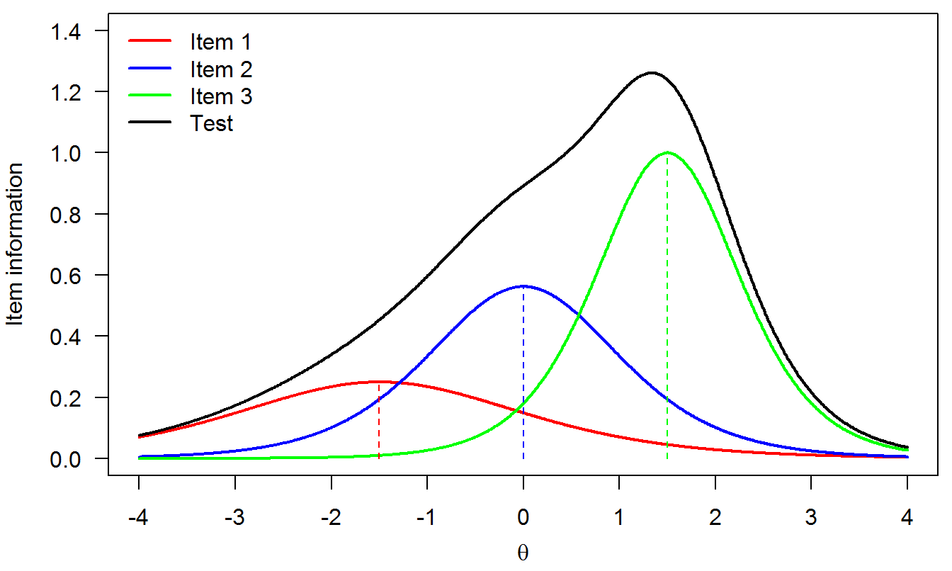
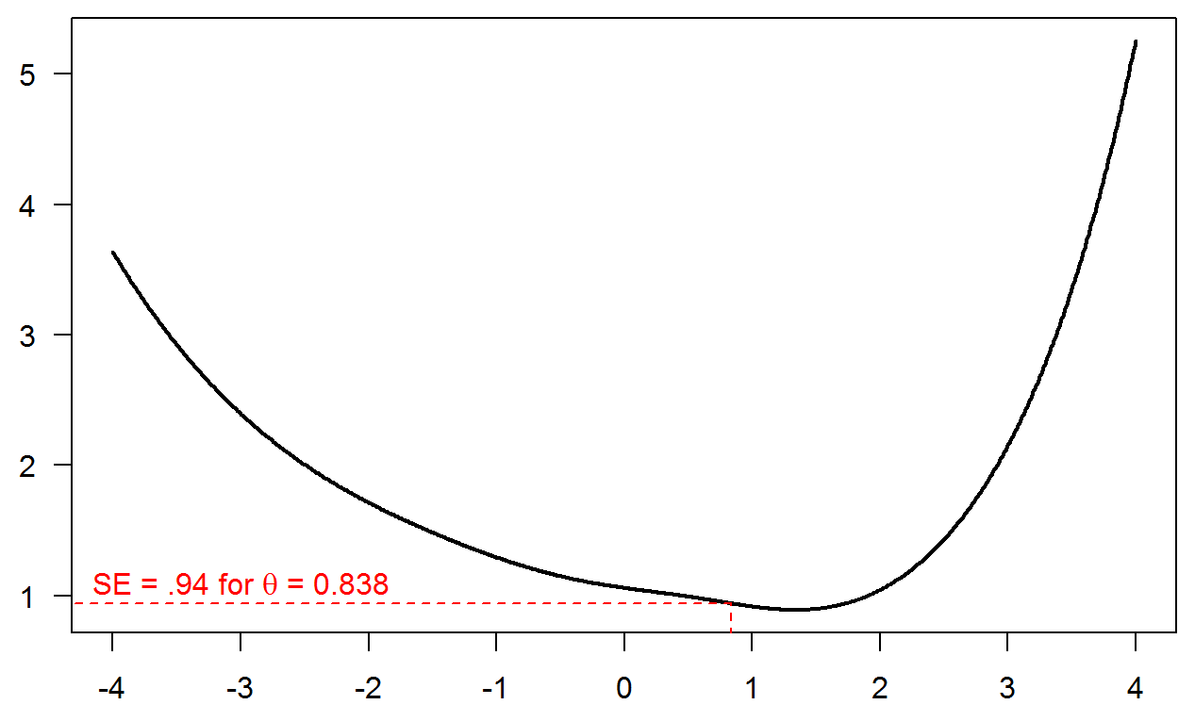


IRT Parameter Estimation Uncertainty
Item and Test Information Curves
Standard Errors at Different Levels of f
f
f

Slide 17
Computer Adaptive Testing (CAT)
Sometimes presenting all items in a test to each individual is impossible or inefficient
If a respondent gets a number of harder questions right, is it worth asking them easier questions to assess their ability?
If a patient endorses ideas of self-harm, are items on milder symptoms even needed?
Adaptive testing in general means that we select the next test item to present based on:
the respondent’s current estimated level of the trait, and
the parameters of items not yet administered.
This allows to maximize the information gained about a respondent within a minimum number of items.

Slide 18
CAT: Ingredients
Item bank
Item parameters (e.g. from a 1-3PL, PCM or GRM) estimated on a large, representative sample
Starting rule
What distribution to assume for respondents latent trait value, before any item has been administered, and how to choose the first item to administer.
Ability updating rule
How to (re)estimate the latent trait after administering (and scoring) an item.
Item selection rule
How to choose the next item to administer.
Stopping rule
How to determine whether testing should be continued or halted.
May possible choices, in practice will be driven by test context and test goal(s).
f

Slide 19
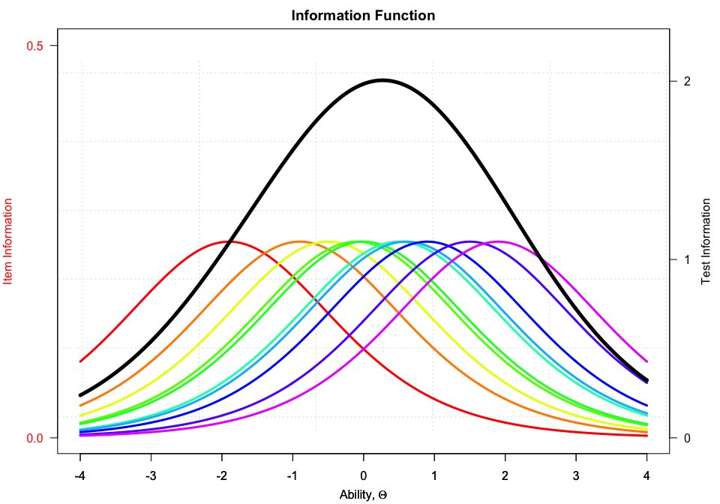
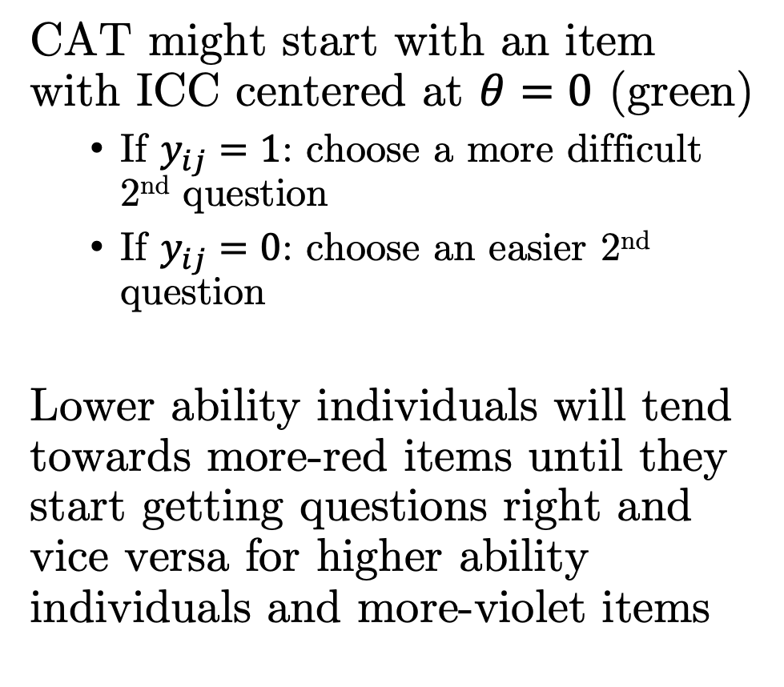
CAT
CAT might start with an item with ICC centered at $θ=0$ (green)
If $y_{ij}=1$: choose a more difficult 2nd question
If $y_{ij}=0$: choose an easier 2nd question
Lower ability individuals will tend towards more-red items until they start getting questions right and vice versa for higher ability individuals and more-violet items

Slide 20
CAT: Starting rules
Depends on test context and goal.
What item would the test start with if we want:
To reduce test anxiety?
Maximize information / minimize SEM?
Immediately challenge respondents?

Slide 21
CAT: Ability updating and item selection rules
For ability updating, can use any of the procedures available for estimating the value of F, given estimated item parameters, e.g.:
Bayesian modal
Maximum likelihood
Expected a posteriori (EAP)
…
Item selection rule will depend on test context and goal.
Maximizing information for the current respondent
Maximizing information near the cut-off
Minimizing exposure of all or specific items
Random
….
Combinations

Slide 22
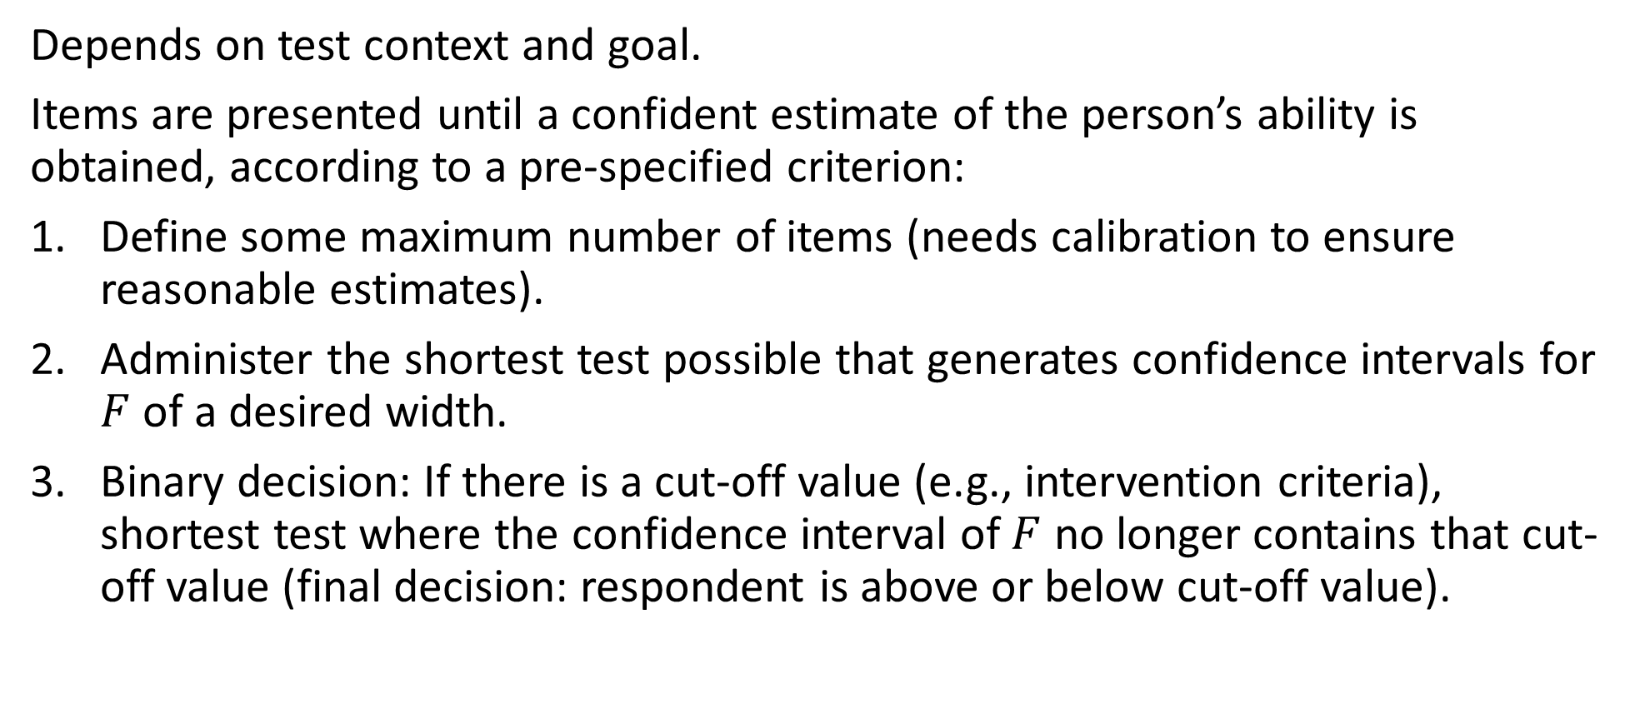
CAT: Stopping rules
Depends on test context and goal.
Items are presented until a confident estimate of the person’s ability is obtained, according to a pre-specified criterion:
Define some maximum number of items (needs calibration to ensure reasonable estimates).
Administer the shortest test possible that generates confidence intervals for $F$ of a desired width.
Binary decision: If there is a cut-off value (e.g., intervention criteria), shortest test where the confidence interval of $F$ no longer contains that cut-off value (final decision: respondent is above or below cut-off value).

Slide 23
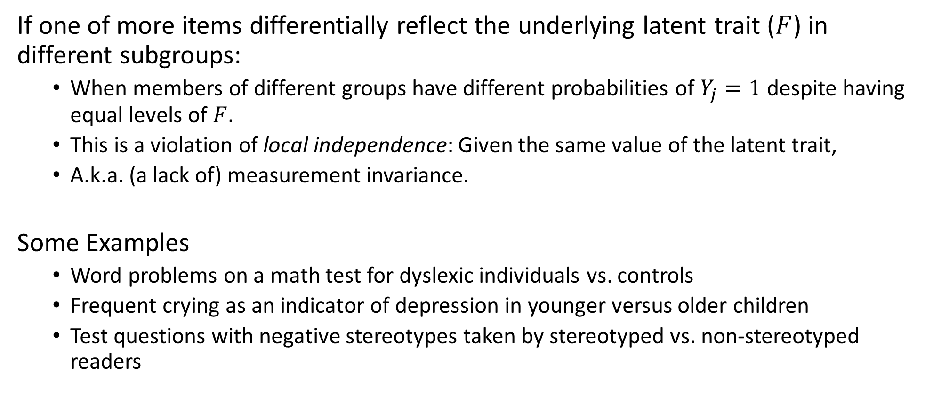
Differential Item Functioning
If one of more items differentially reflect the underlying latent trait ($F$) in different subgroups:
When members of different groups have different probabilities of $Y_{j}=1$ despite having equal levels of $F$.
This is a violation of local independence: Given the same value of the latent trait,
A.k.a. (a lack of) measurement invariance.
Some Examples
Word problems on a math test for dyslexic individuals vs. controls
Frequent crying as an indicator of depression in younger versus older children
Test questions with negative stereotypes taken by stereotyped vs. non-stereotyped readers

Slide 24
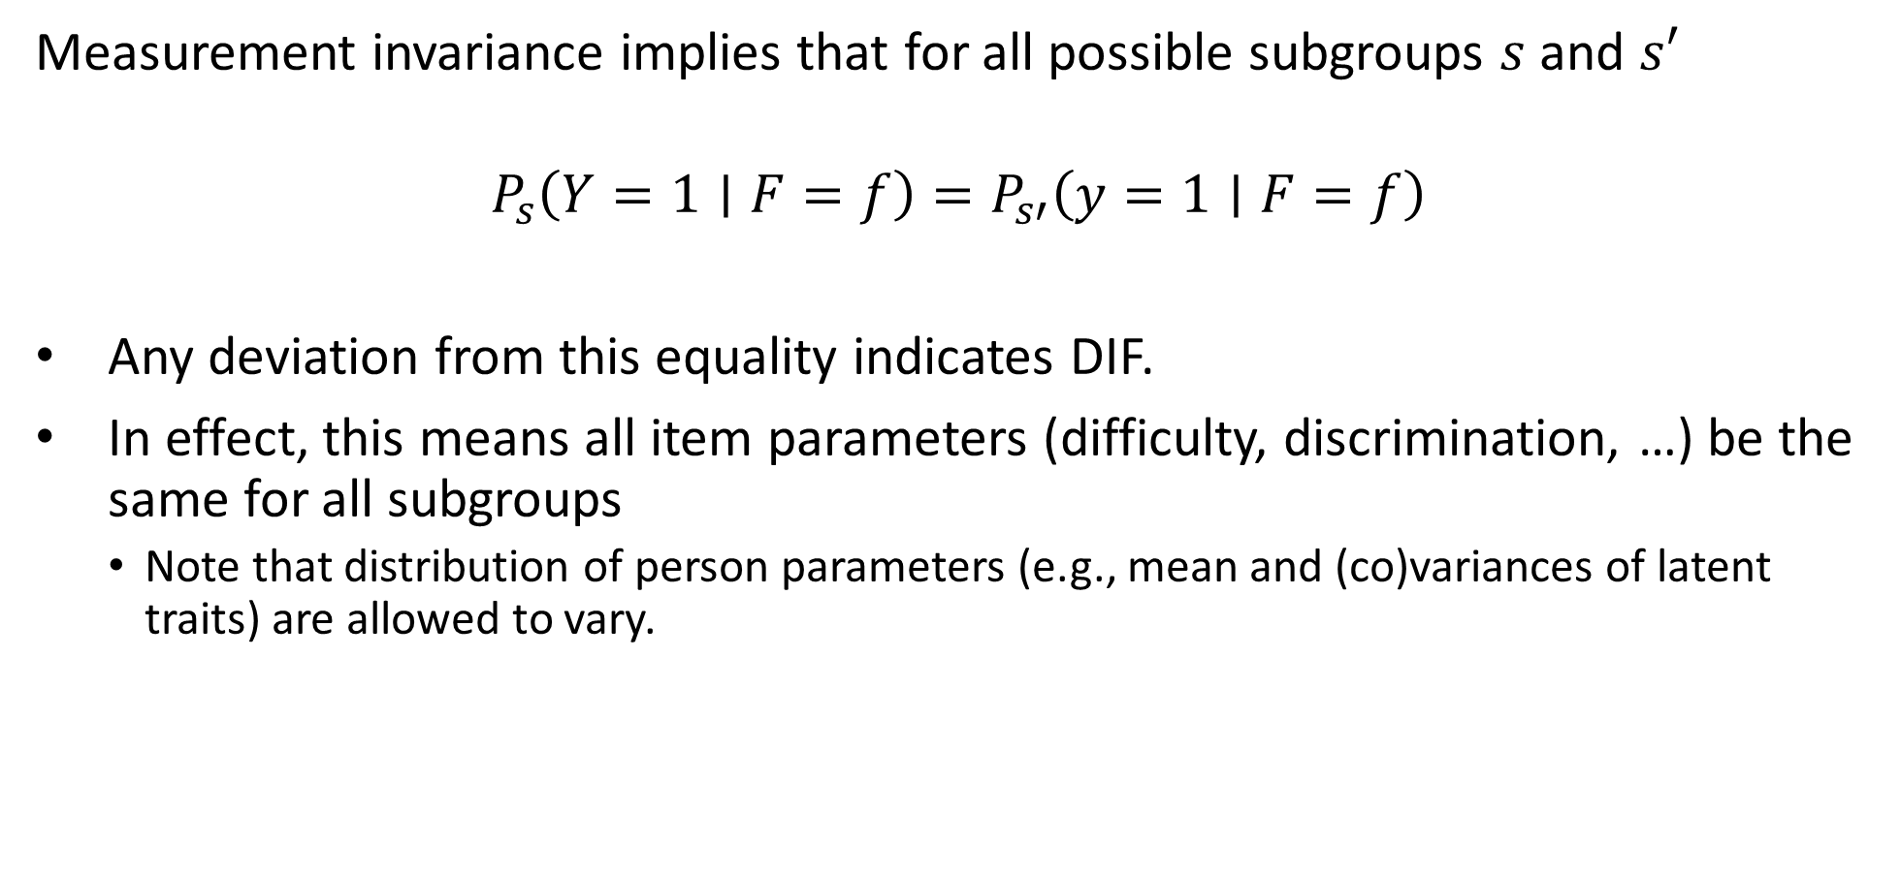
Differential Item Functioning
Measurement invariance implies that for all possible subgroups $s$ and $s′$
$$P_{s}\left(Y=1∣F=f\right)=P_{s′}\left(y=1∣F=f\right)$$
Any deviation from this equality indicates DIF.
In effect, this means all item parameters (difficulty, discrimination, …) be the same for all subgroups
Note that distribution of person parameters (e.g., mean and (co)variances of latent traits) are allowed to vary.

Slide 25
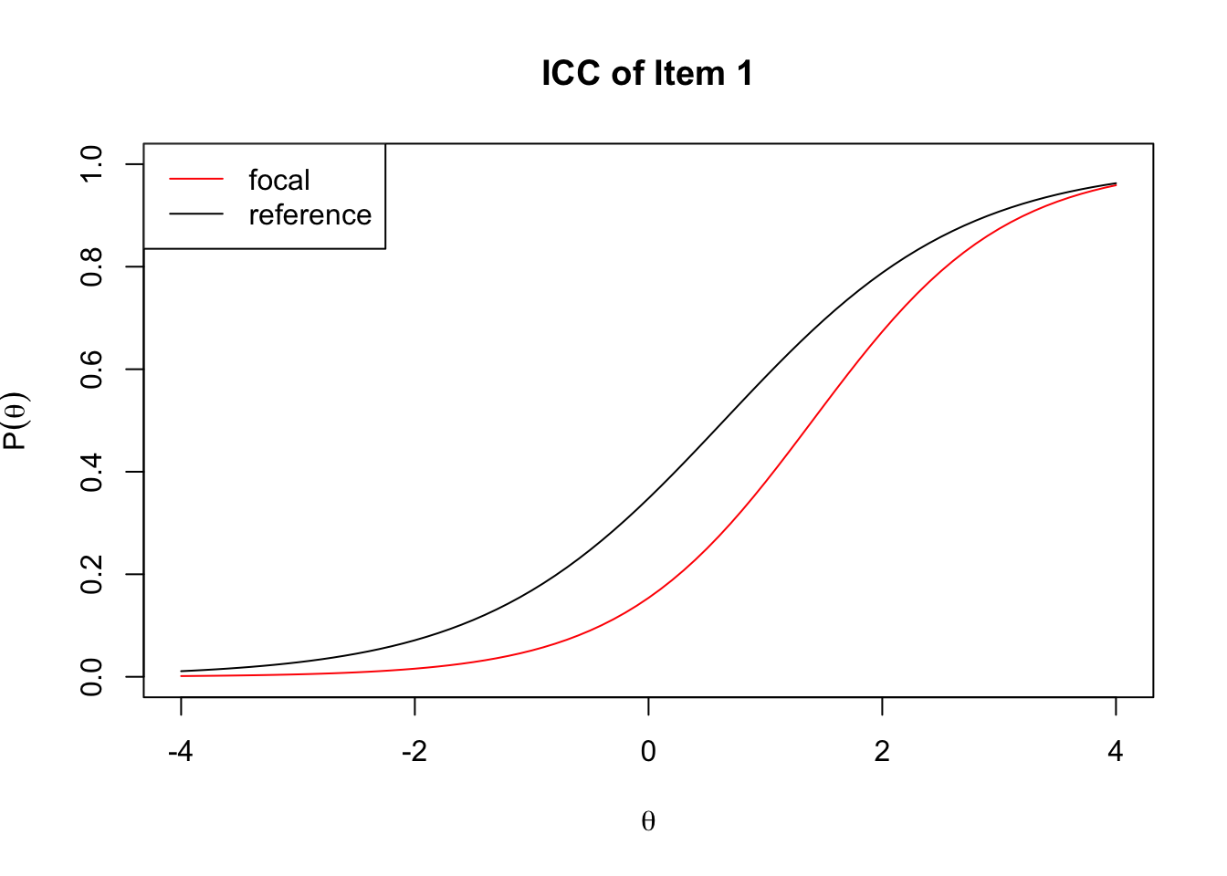
DIF: Graphical Example
Item 1 has
greater difficulty (shifted right) and
greater discrimination (steeper slope)
in the focal group compared with the reference group.
This is called ‘item bias’: The item is more indicate, more difficult for some (groups of) respondents than others.

Slide 26
Differential Test Functioning
Differentially functioning items in turn can distort ability estimates, leading to e.g.:
(individual level) Unfair decisions, e.g. some individuals or groups having a lower probability of being admitted to education or jobs.
(group level) Invalid conclusions in research.
Mild DIF in a few items can be suppressed at the test level if DIF is not correlated across items (so it will cancel out inability estimates or test scores)
At large sample sizes, we can often detect very minor DIF effects, that will not affect real-world decisions or conclusions.
At the same time, even small amounts of DIF can magnify if correlated between items.

Slide 27
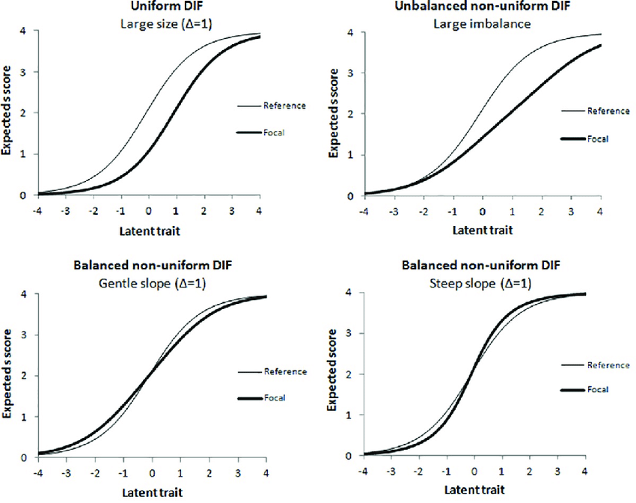
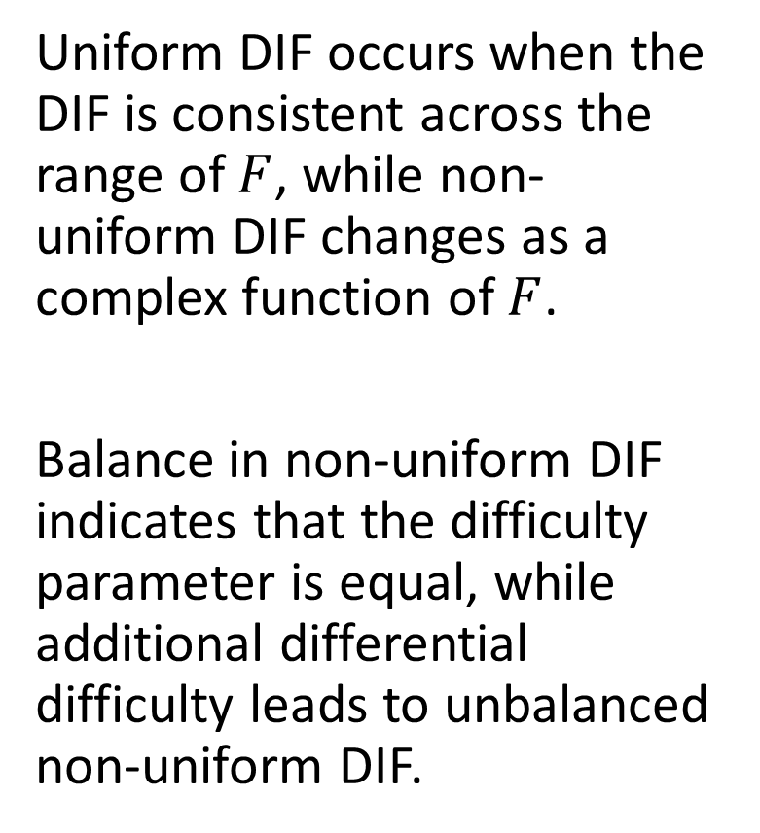
Uniform and Non-Uniform DIF
Uniform DIF occurs when the DIF is consistent across the range of $F$, while non-uniform DIF changes as a complex function of $F$.
Balance in non-uniform DIF indicates that the difficulty parameter is equal, while additional differential difficulty leads to unbalanced non-uniform DIF.

Slide 28
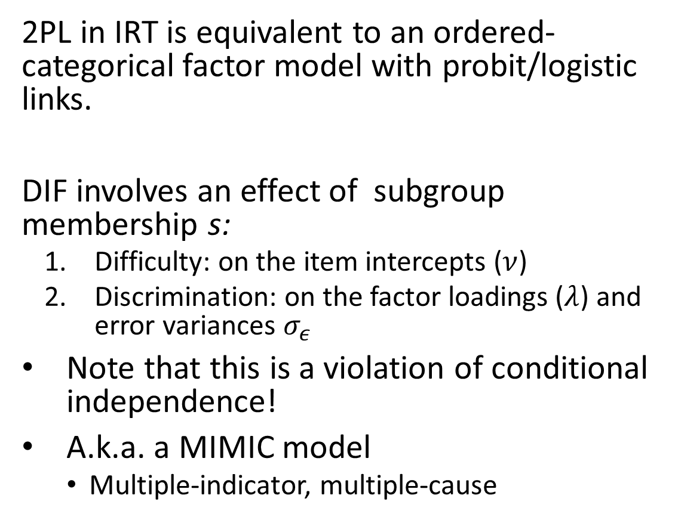
DIF in IRT and Factor Analysis
2PL in IRT is equivalent to an ordered-categorical factor model with probit/logistic links.
DIF involves an effect of subgroup membership s:
Difficulty: on the item intercepts ($ν$)
Discrimination: on the factor loadings ($λ$) and error variances $σ_{ε}$
Note that this is a violation of conditional independence!
A.k.a. a MIMIC model
Multiple-indicator, multiple-cause

Slide 29
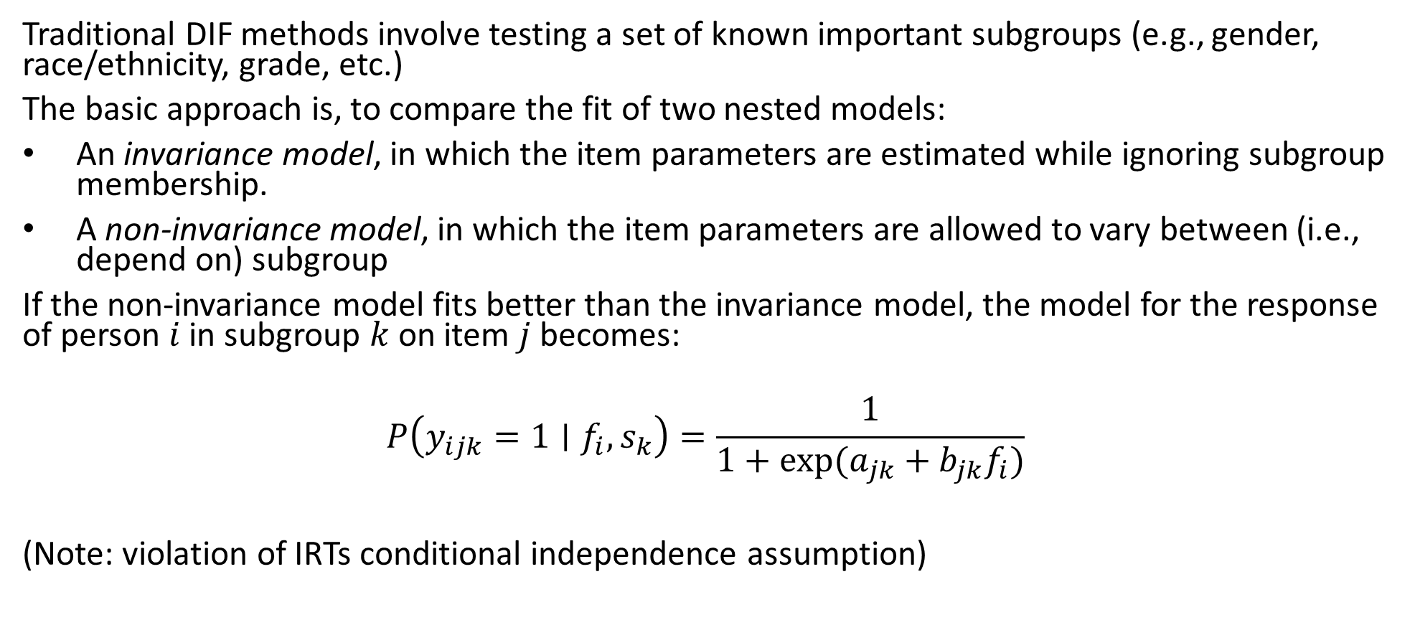
Traditional DIF Modeling
Traditional DIF methods involve testing a set of known important subgroups (e.g., gender, race/ethnicity, grade, etc.)
The basic approach is, to compare the fit of two nested models:
An invariance model, in which the item parameters are estimated while ignoring subgroup membership.
A non-invariance model, in which the item parameters are allowed to vary between (i.e., depend on) subgroup
If the non-invariance model fits better than the invariance model, the model for the response of person $i$ in subgroup $k$on item $j$ becomes:
$$P\left(y_{ijk}=1∣f_{i}, s_{k}\right)=\frac{1}{1+exp⁡(a_{jk}+b_{jk}f_{i})}$$
(Note: violation of IRTs conditional independence assumption)

Slide 30
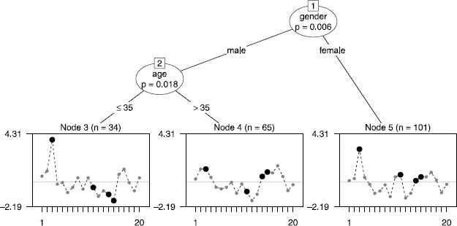
Modern developments in DIF testing
Subgroups and memberships may be unknown a-priori, so need to combine subgroup detection with DIF detection
Rasch trees recover observed, previously unknown subgroups.
Users specify a set of possible covariates that may describe subgroups, Rasch tree finds the variables and subgroups that show the largest differences in item parameter estimates.

Slide 31
Some modern developments in DIF testing
Subgroups and memberships may be unknown a-priori, so need to combine subgroup detection with DIF detection
Rasch trees recover observed, previously unknown subgroups.
Users specify a set of possible covariates that may describe subgroups, Rasch tree finds the variables and subgroups that show the largest differences in item parameter estimates.
Clustering or latent class methods may be combined with DIF detection methods.
There may be no subgroups, but values of item parameters may be affected by continuous covariates.
This can be assessed using moderated factor analysis.

