Slide 1
Factor Analysis

Slide 2
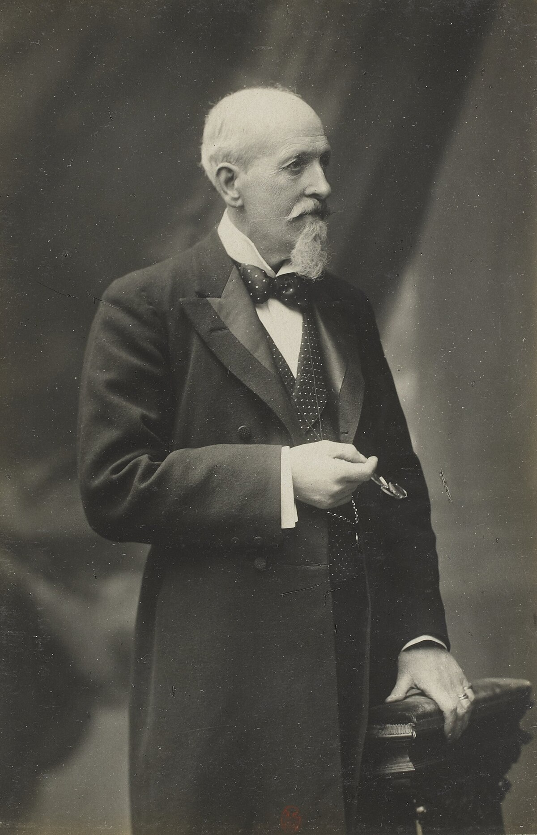
The History of Factor Analysis
“…...we reach the profoundly important conclusion that there really exists a something that we may provisionally term “General Sensory Discrimination” and similarly a “General Intelligence” and further that the functional correspondence between these two is not appreciably less than absolute. (Italics in the original.)
(Spearman, 1904)”

Slide 3
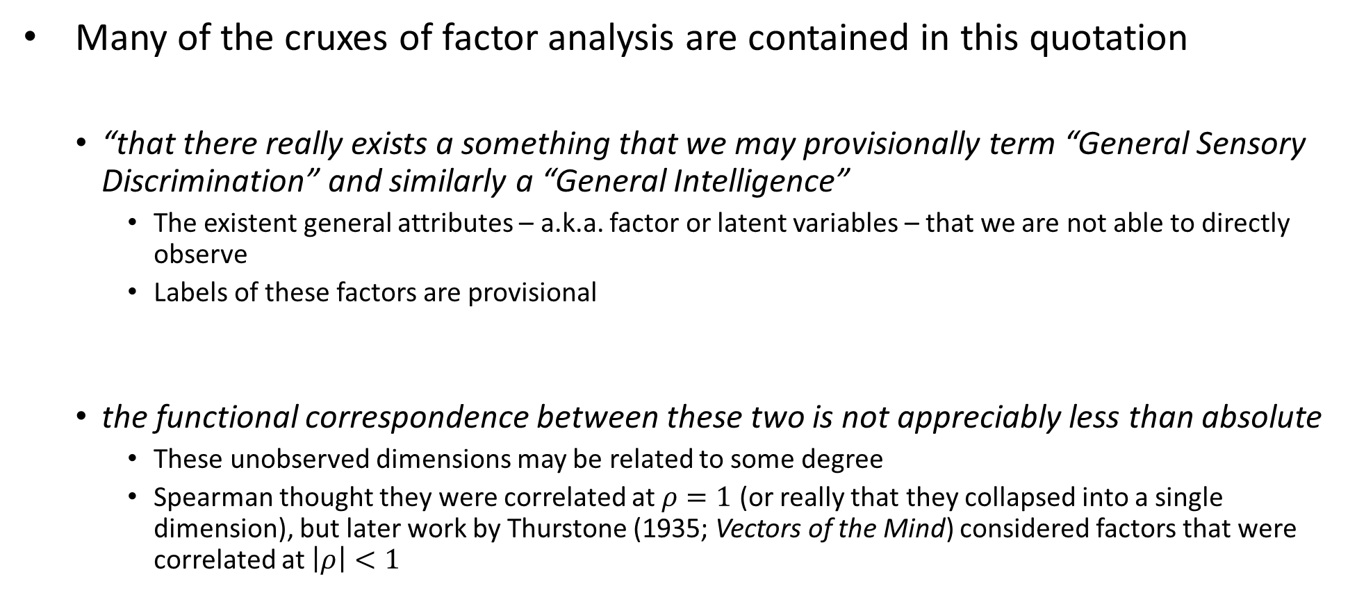
The History of Factor Analysis
Many of the cruxes of factor analysis are contained in this quotation
“that there really exists a something that we may provisionally term “General Sensory Discrimination” and similarly a “General Intelligence”
The existent general attributes – a.k.a. factor or latent variables – that we are not able to directly observe
Labels of these factors are provisional
the functional correspondence between these two is not appreciably less than absolute
These unobserved dimensions may be related to some degree
Spearman thought they were correlated at $ρ=1$ (or really that they collapsed into a single dimension), but later work by Thurstone (1935; Vectors of the Mind) considered factors that were correlated at $\left|ρ\right|<1$

Slide 4
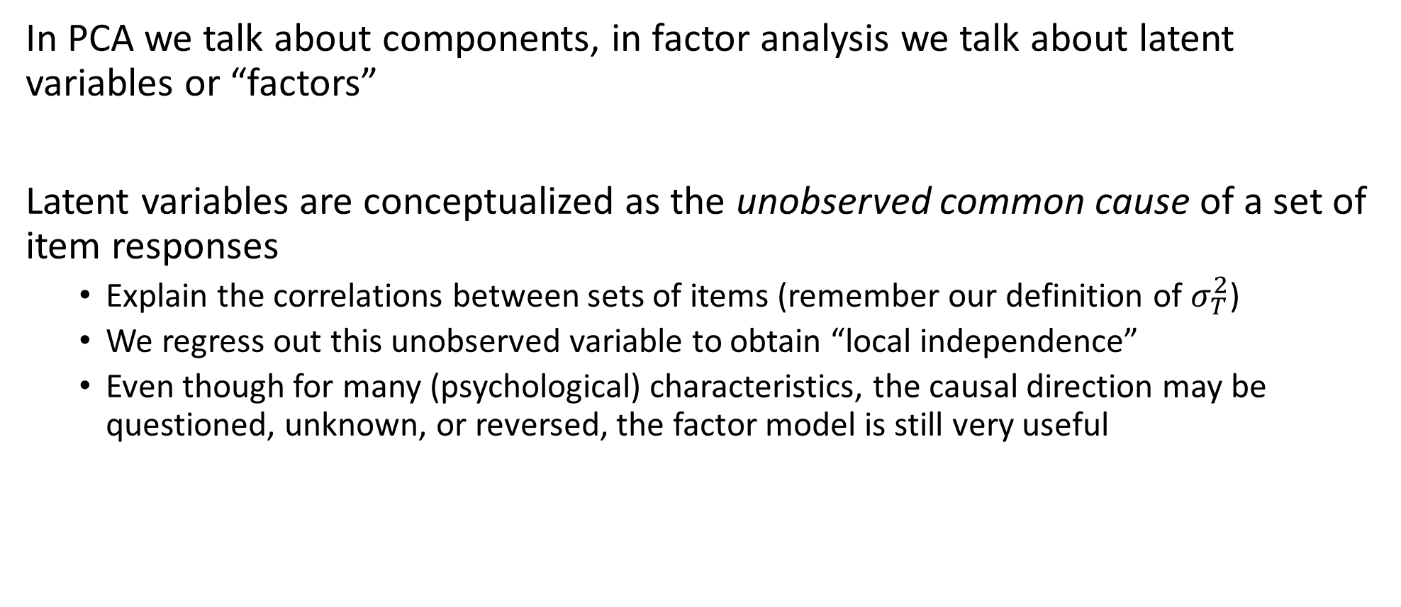
Latent Variables in Factor Analysis
In PCA we talk about components, in factor analysis we talk about latent variables or “factors”
Latent variables are conceptualized as the unobserved common cause of a set of item responses
Explain the correlations between sets of items (remember our definition of $σ_{T}^{2}$)
We regress out this unobserved variable to obtain “local independence”
Even though for many (psychological) characteristics, the causal direction may be questioned, unknown, or reversed, the factor model is still very useful

Slide 5
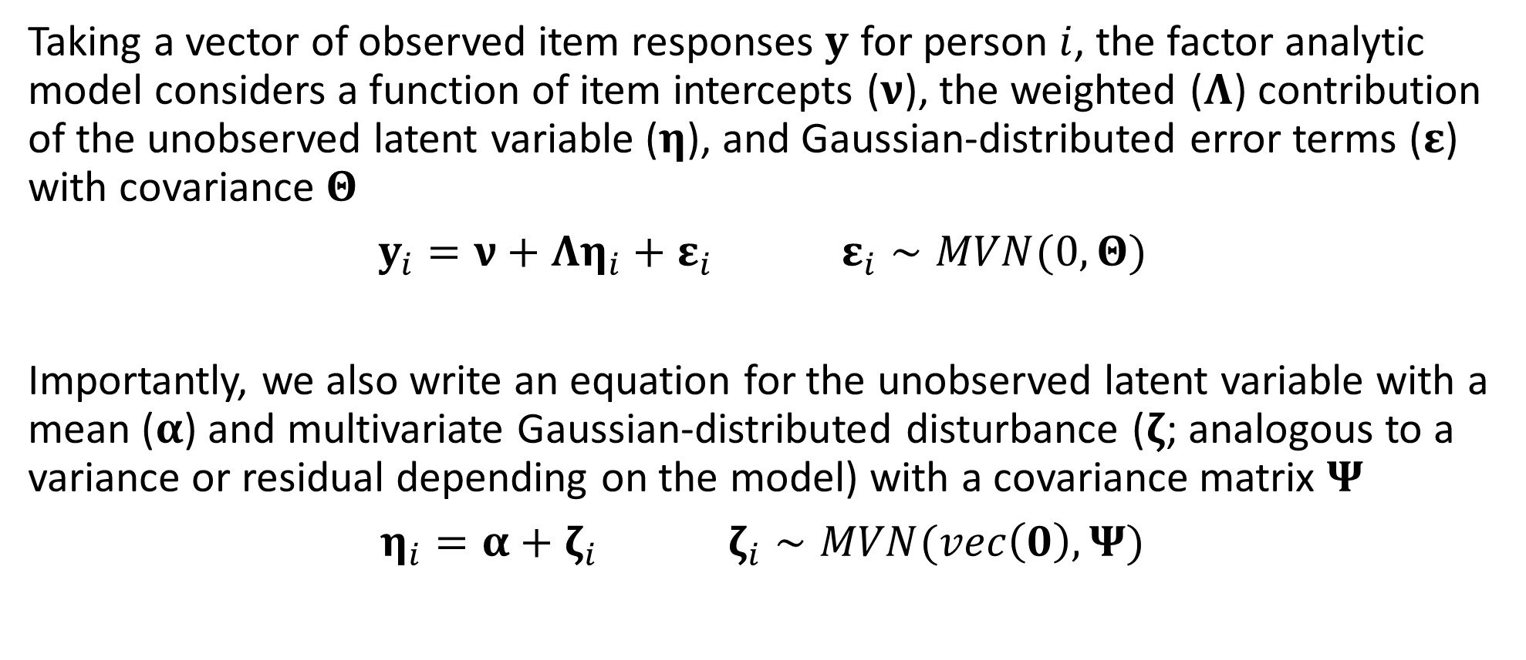
The Factor Analytic Model
Taking a vector of observed item responses $y$ for person $i$, the factor analytic model considers a function of item intercepts ($ν$), the weighted ($Λ$) contribution of the unobserved latent variable ($η$), and Gaussian-distributed error terms ($ε$) with covariance $Θ$
$y_{i}=ν+Λη_{i}+ε_{i}$ $ε_{i}∼MVN(0,Θ)$
Importantly, we also write an equation for the unobserved latent variable with a mean ($α$) and multivariate Gaussian-distributed disturbance ($ζ$; analogous to a variance or residual depending on the model) with a covariance matrix $Ψ$
$η_{i}=α+ζ_{i}$ $ζ_{i}∼MVN(vec\left(0\right),Ψ)$

Slide 6
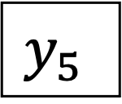
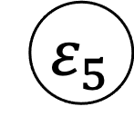
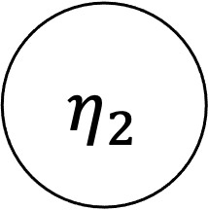
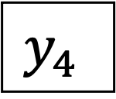
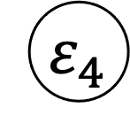
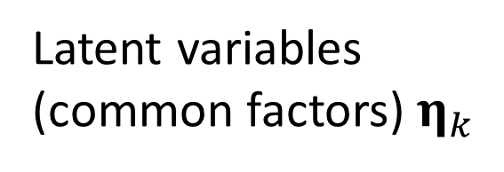
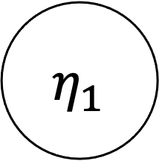
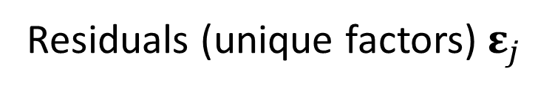
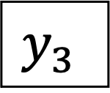
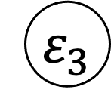
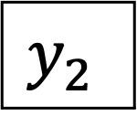
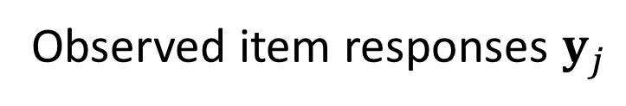

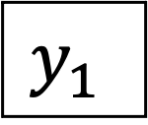
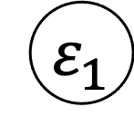
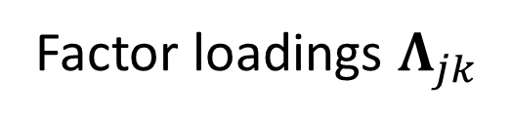
The Factor Analytic Model: Path Model
$${ ε}_{1}$$
$${ ε}_{2}$$
$${ ε}_{3}$$
$${ ε}_{4}$$
$${ ε}_{5}$$
Residuals (unique factors) $ε_{j}$
$$y_{1}$$
$$y_{2}$$
$$y_{3}$$
$$y_{4}$$
$$y_{5}$$
Observed item responses $y_{j}$
Factor loadings $Λ_{jk}$
$${ η}_{1}$$
$${ η}_{2}$$
Latent variables
(common factors) $η_{k}$

Slide 7
Exploratory Factor Analysis
While methodologically distinct, Exploratory Factor Analysis (EFA) shares many of the same goals and approaches as PCA
Determine the number and nature of a set of lower-dimensional components (or factors) that explains “enough” of the variation in a set of items
How do we choose the number of factors?
The biggest difference is now we partition variance into two sources
Common variance: captured by the latent factors
Unique variance: captured by the item residuals (noise/measurement error)
The unique factors (residuals) allow us to get measures of fit

Slide 8
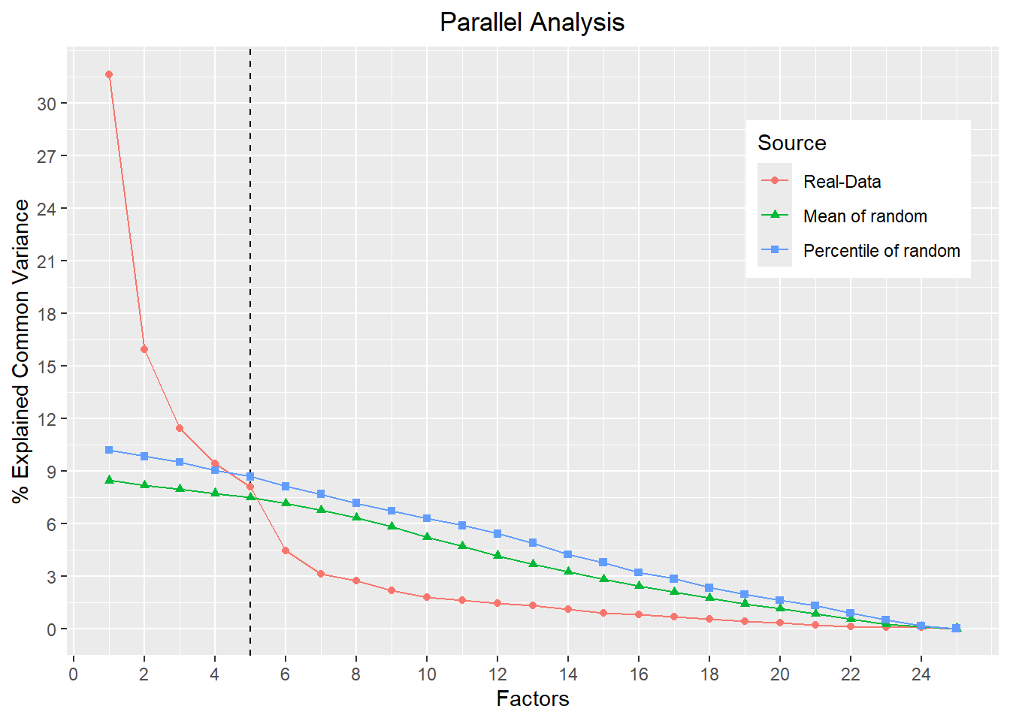
Exploratory Factor Analysis
Procedurally, very similar to PCA
Select the number of factors and fit the model
Examine fit indices (this is different)
Examine the proportion of variance explained by the common factor (scree plot, parallel analysis)
Refit the model based on the indicated number of factors as needed
Substantive interpretation

Slide 9
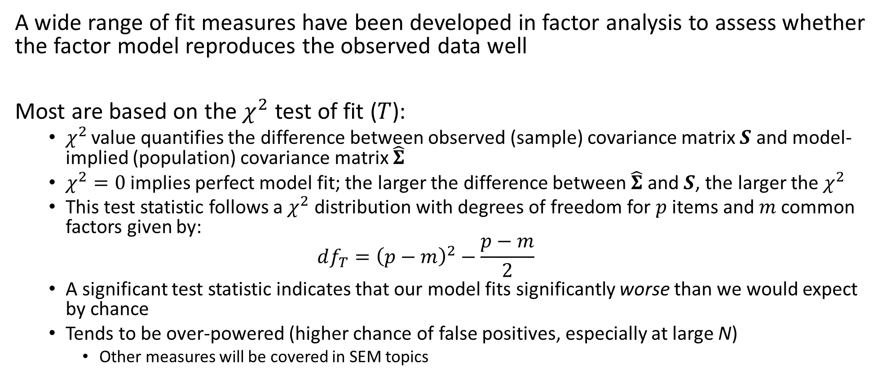
Fit Measures in Factor Analysis
A wide range of fit measures have been developed in factor analysis to assess whether the factor model reproduces the observed data well
Most are based on the $χ^{2}$ test of fit ($T$):
$χ^{2}$ value quantifies the difference between observed (sample) covariance matrix $S$ and model-implied (population) covariance matrix $\hat{Σ}$
$χ^{2}=0$ implies perfect model fit; the larger the difference between $\hat{Σ}$and $S$, the larger the $χ^{2}$
This test statistic follows a $χ^{2}$ distribution with degrees of freedom for $p$ items and $m$ common factors given by:
$$df_{T}={\left(p−m\right)}^{2}−\frac{p−m}{2}$$
A significant test statistic indicates that our model fits significantly worse than we would expect by chance
Tends to be over-powered (higher chance of false positives, especially at large N)
Other measures will be covered in SEM topics

Slide 10
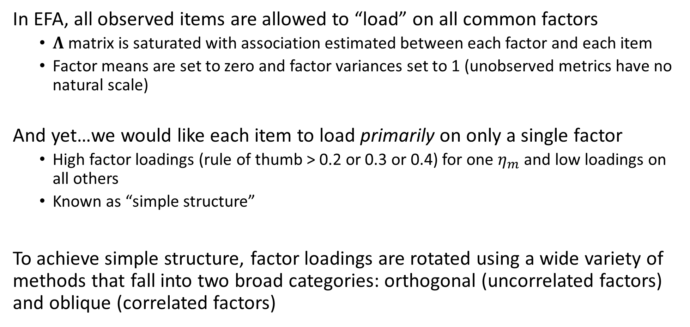
Exploratory Factor Analysis
In EFA, all observed items are allowed to “load” on all common factors
$Λ$ matrix is saturated with association estimated between each factor and each item
Factor means are set to zero and factor variances set to 1 (unobserved metrics have no natural scale)
And yet…we would like each item to load primarily on only a single factor
High factor loadings (rule of thumb > 0.2 or 0.3 or 0.4) for one $η_{m}$ and low loadings on all others
Known as “simple structure”
To achieve simple structure, factor loadings are rotated using a wide variety of methods that fall into two broad categories: orthogonal (uncorrelated factors) and oblique (correlated factors)

Slide 11

Confirmatory Factor Analysis
EFA is similar to PCA in that it is data-driven. It is therefore difficult to use it for testing theoretical hypotheses.
Confirmatory Factor Analysis (CFA) allows to specify a hypothesis on the number of factors in $η$ as well as the pattern of zero and non-zero loadings in $Λ$, such that items only load onto a single factor in a theoretically-meaningful way.

Slide 12
Confirmatory Factor Analysis
Exploratory Factor Analysis
Confirmatory Factor Analysis

Slide 13



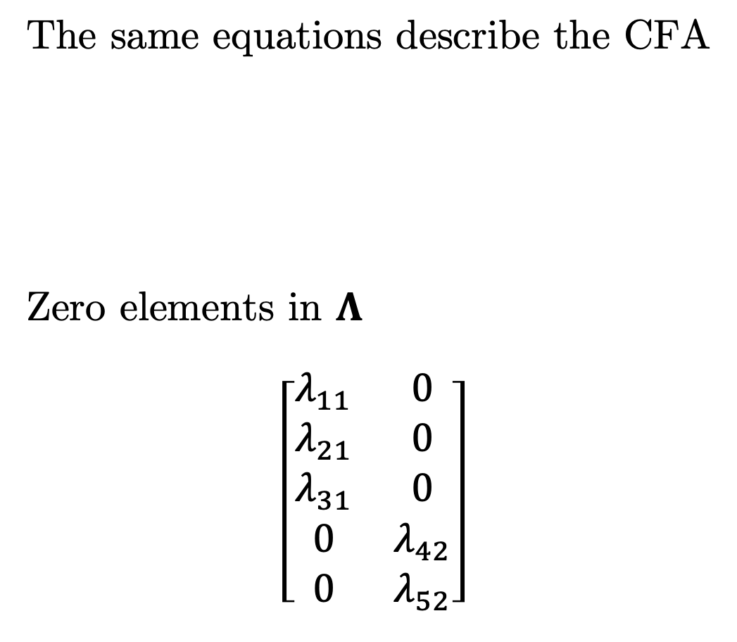
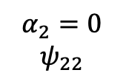

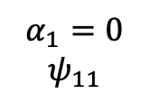


Confirmatory Factor Analysis
The same equations describe the CFA
Zero elements in $Λ$
$$\left[\begin{matrix}λ_{11} & 0 \\ λ_{21} & 0 \\ λ_{31} & 0 \\ 0 & λ_{42} \\ 0 & λ_{52}\end{matrix}\right]$$
Confirmatory Factor Analysis
$y_{i}=ν+Λη_{i}+ε_{i}$ $ε_{i}∼MVN(0,Θ)$
$η_{i}=α+ζ_{i}$ $ζ_{i}∼MVN(vec\left(0\right),Ψ)$
$$λ_{21}$$
$$λ_{11}$$
$$λ_{31}$$
$$λ_{42}$$
$$λ_{52}$$
$$α_{1}=0$$
$$ψ_{11}$$
$$α_{2}=0$$
$$ψ_{22}$$
$$ψ_{21}$$

Slide 14
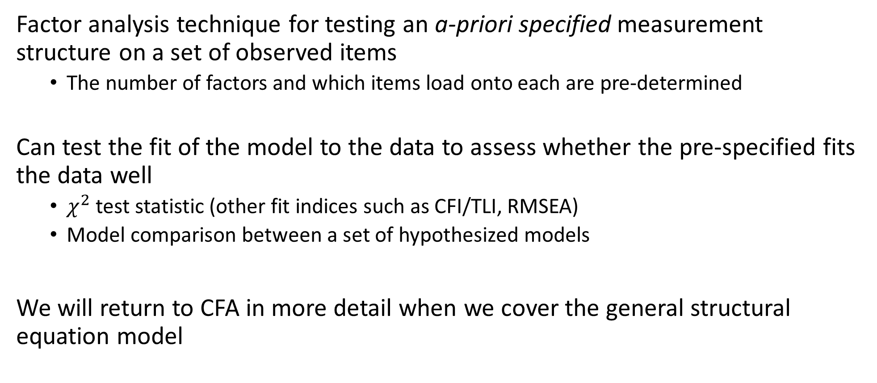
Confirmatory Factor Analysis
Factor analysis technique for testing an a-priori specified measurement structure on a set of observed items
The number of factors and which items load onto each are pre-determined
Can test the fit of the model to the data to assess whether the pre-specified fits the data well
$χ^{2}$ test statistic (other fit indices such as CFI/TLI, RMSEA)
Model comparison between a set of hypothesized models
We will return to CFA in more detail when we cover the general structural equation model

Slide 15
Classical Test Theory as Factor Analysis
You may have noticed similarities between the CFA model and our conceptual diagram for understanding true score and error variance in CTT
We use one-factor CFA as a way to understand classical test theory

Slide 16
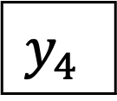
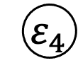


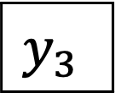
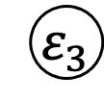


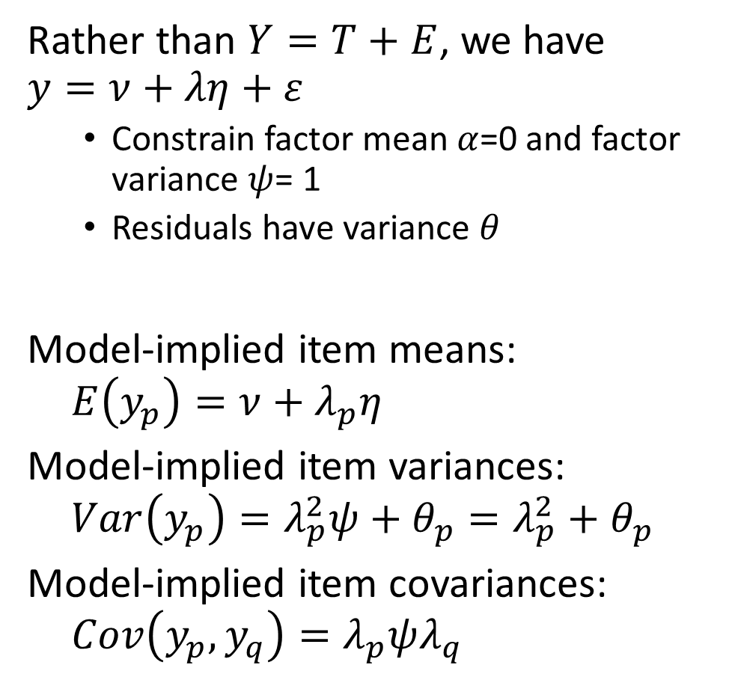

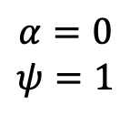
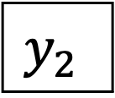
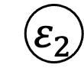

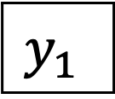


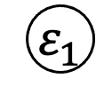

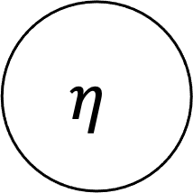
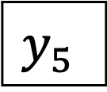


Classical Test Theory as Factor Analysis
Rather than $Y=T+E$, we have $y=ν+λη+ε$
Constrain factor mean $α$=0 and factor variance $ψ$= 1
Residuals have variance $θ$
Model-implied item means:
$$E\left(y_{p}\right)=ν+λ_{p}η$$
Model-implied item variances:
$$Var\left(y_{p}\right)=λ_{p}^{2}ψ+θ_{p}=λ_{p}^{2}+θ_{p}$$
Model-implied item covariances:
$$Cov\left(y_{p}, y_{q}\right)=λ_{p}ψλ_{q}$$
$$θ_{1}$$
$$θ_{2}$$
$$θ_{3}$$
$$θ_{4}$$
$$θ_{5}$$
$${ ε}_{1}$$
$${ ε}_{2}$$
$${ ε}_{3}$$
$${ ε}_{4}$$
$${ ε}_{5}$$
$$y_{1}$$
$$y_{2}$$
$$y_{3}$$
$$y_{4}$$
$$y_{5}$$
$$λ_{2}$$
$$λ_{3}$$
$$λ_{4}$$
$$λ_{1}$$
$$λ_{5}$$
$$η$$
$$α=0$$
$$ψ=1$$

Slide 17


“All models are wrong, but some are useful”
$$y=ν+λη+ε$$
$$θ_{1}$$
$$θ_{2}$$
$$θ_{3}$$
$$θ_{4}$$
$$θ_{5}$$
$${ ε}_{1}$$
$${ ε}_{2}$$
$${ ε}_{3}$$
$${ ε}_{4}$$
$${ ε}_{5}$$
$$y_{1}$$
$$y_{2}$$
$$y_{3}$$
$$y_{4}$$
$$y_{5}$$
$$λ_{2}$$
$$λ_{3}$$
$$λ_{4}$$
$$λ_{1}$$
$$λ_{5}$$
$$η$$

Slide 18
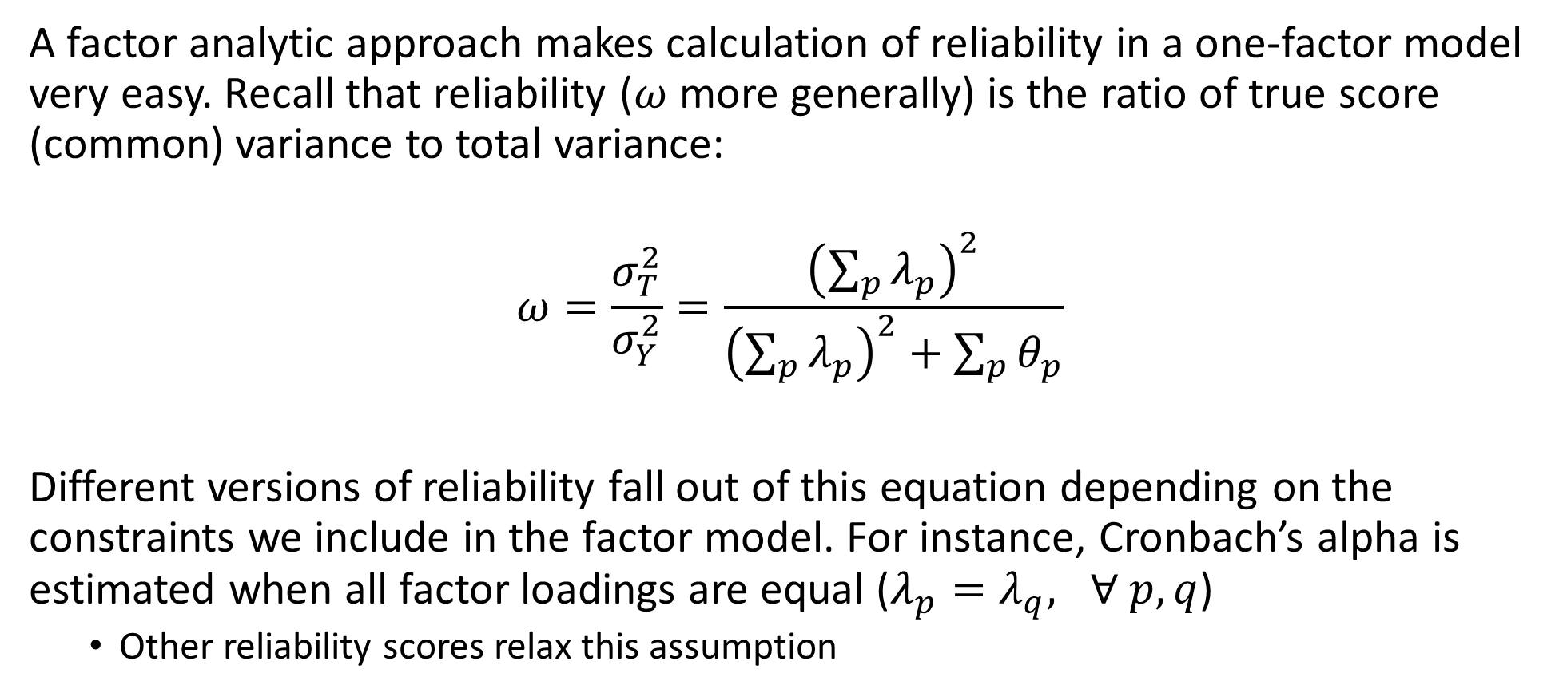
Reliability in Factor Analysis
A factor analytic approach makes calculation of reliability in a one-factor model very easy. Recall that reliability ($ω$ more generally) is the ratio of true score (common) variance to total variance:
$$ω=\frac{σ_{T}^{2}}{σ_{Y}^{2}}=\frac{{\left(\sum_{p}{λ_{p}}\right)}^{2}}{{\left(\sum_{p}{λ_{p}}\right)}^{2}+\sum_{p}{θ_{p}}}$$
Different versions of reliability fall out of this equation depending on the constraints we include in the factor model. For instance, Cronbach’s alpha is estimated when all factor loadings are equal ($λ_{p}=λ_{q}, ∀ p,q$)
Other reliability scores relax this assumption

Slide 19
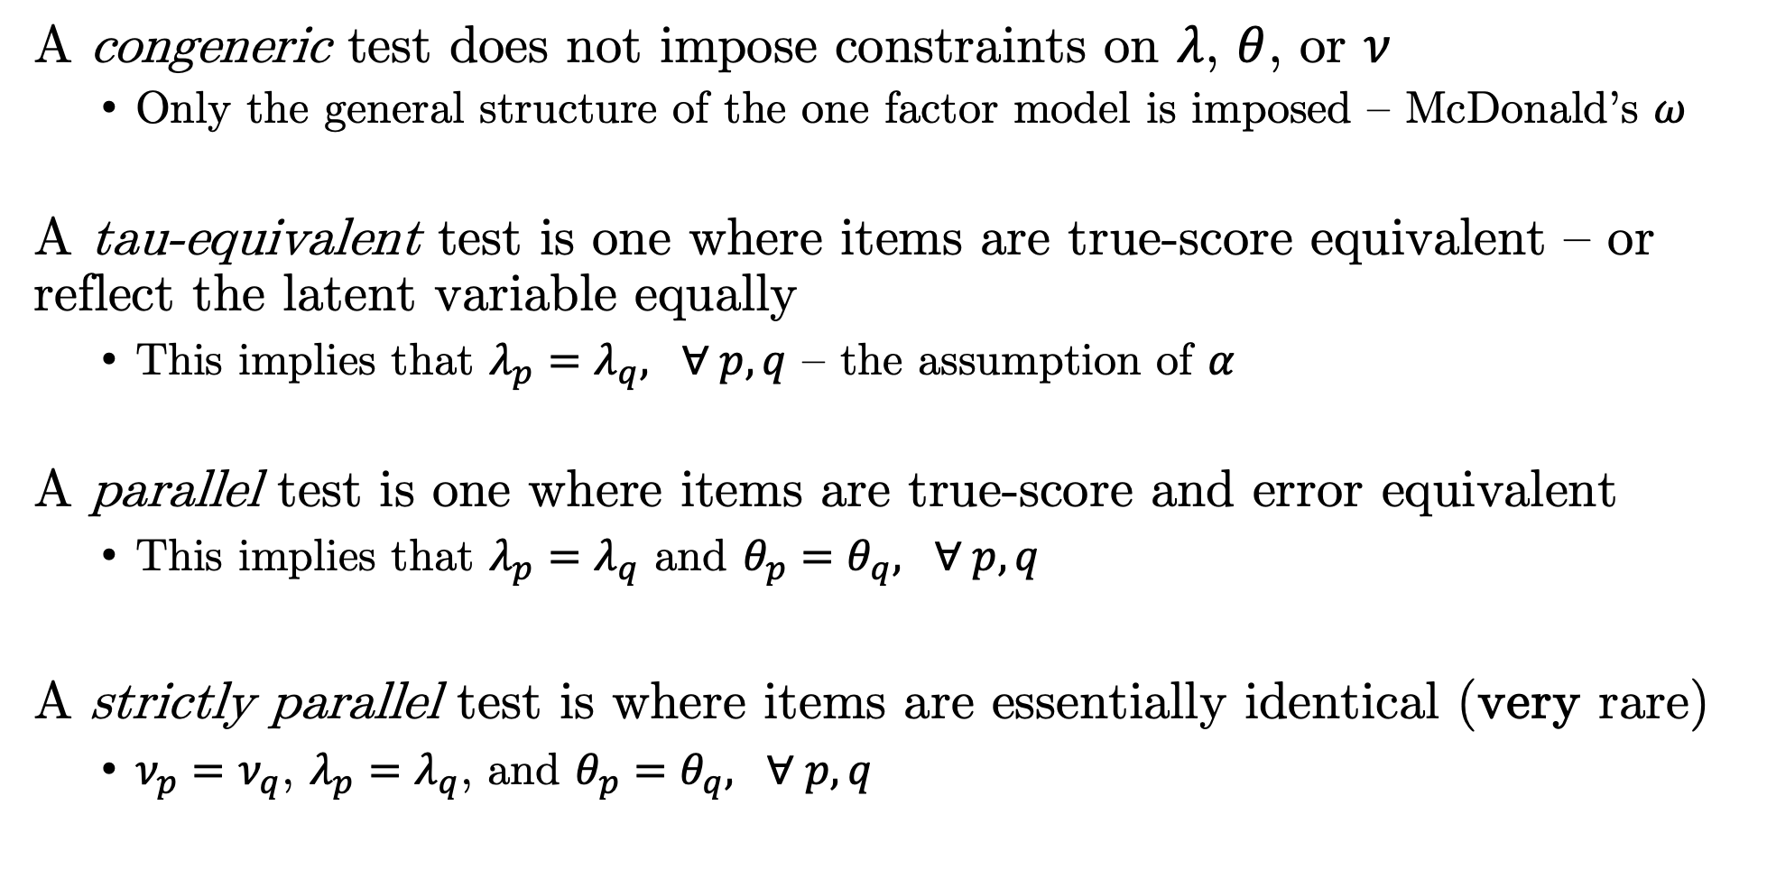
Types of Reliability Models
A congeneric test does not impose constraints on $λ$, $θ$, or $ν$
Only the general structure of the one factor model is imposed – McDonald’s $ω$
A tau-equivalent test is one where items are true-score equivalent – or reflect the latent variable equally
This implies that $λ_{p}=λ_{q}, ∀ p,q$ – the assumption of $α$
A parallel test is one where items are true-score and error equivalent
This implies that $λ_{p}=λ_{q}$ and $θ_{p}=θ_{q}, ∀ p,q$
A strictly parallel test is where items are essentially identical (very rare)
$ν_{p}=ν_{q}$, $λ_{p}=λ_{q}$, and $θ_{p}=θ_{q}, ∀ p,q$

Slide 20
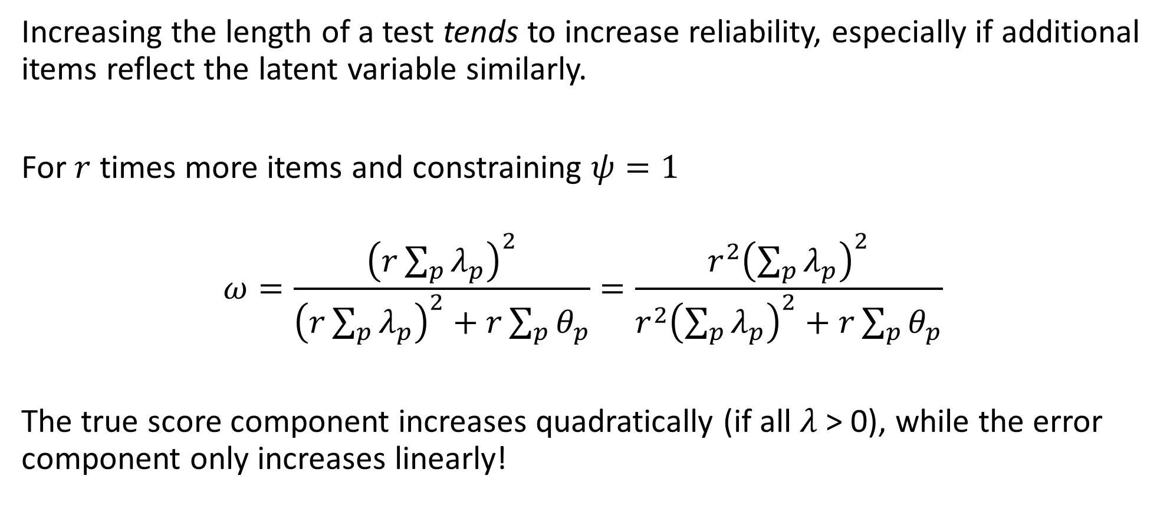
Reliability and Test Lengthening
Increasing the length of a test tends to increase reliability, especially if additional items reflect the latent variable similarly.
For $r$ times more items and constraining $ψ=1$
$$ω=\frac{{\left(r\sum_{p}{λ_{p}}\right)}^{2}}{{\left(r\sum_{p}{λ_{p}}\right)}^{2}+r\sum_{p}{θ_{p}}}=\frac{{r^{2}\left(\sum_{p}{λ_{p}}\right)}^{2}}{{r^{2}\left(\sum_{p}{λ_{p}}\right)}^{2}+r\sum_{p}{θ_{p}}}$$
The true score component increases quadratically (if all $λ$ > 0), while the error component only increases linearly!

Slide 21
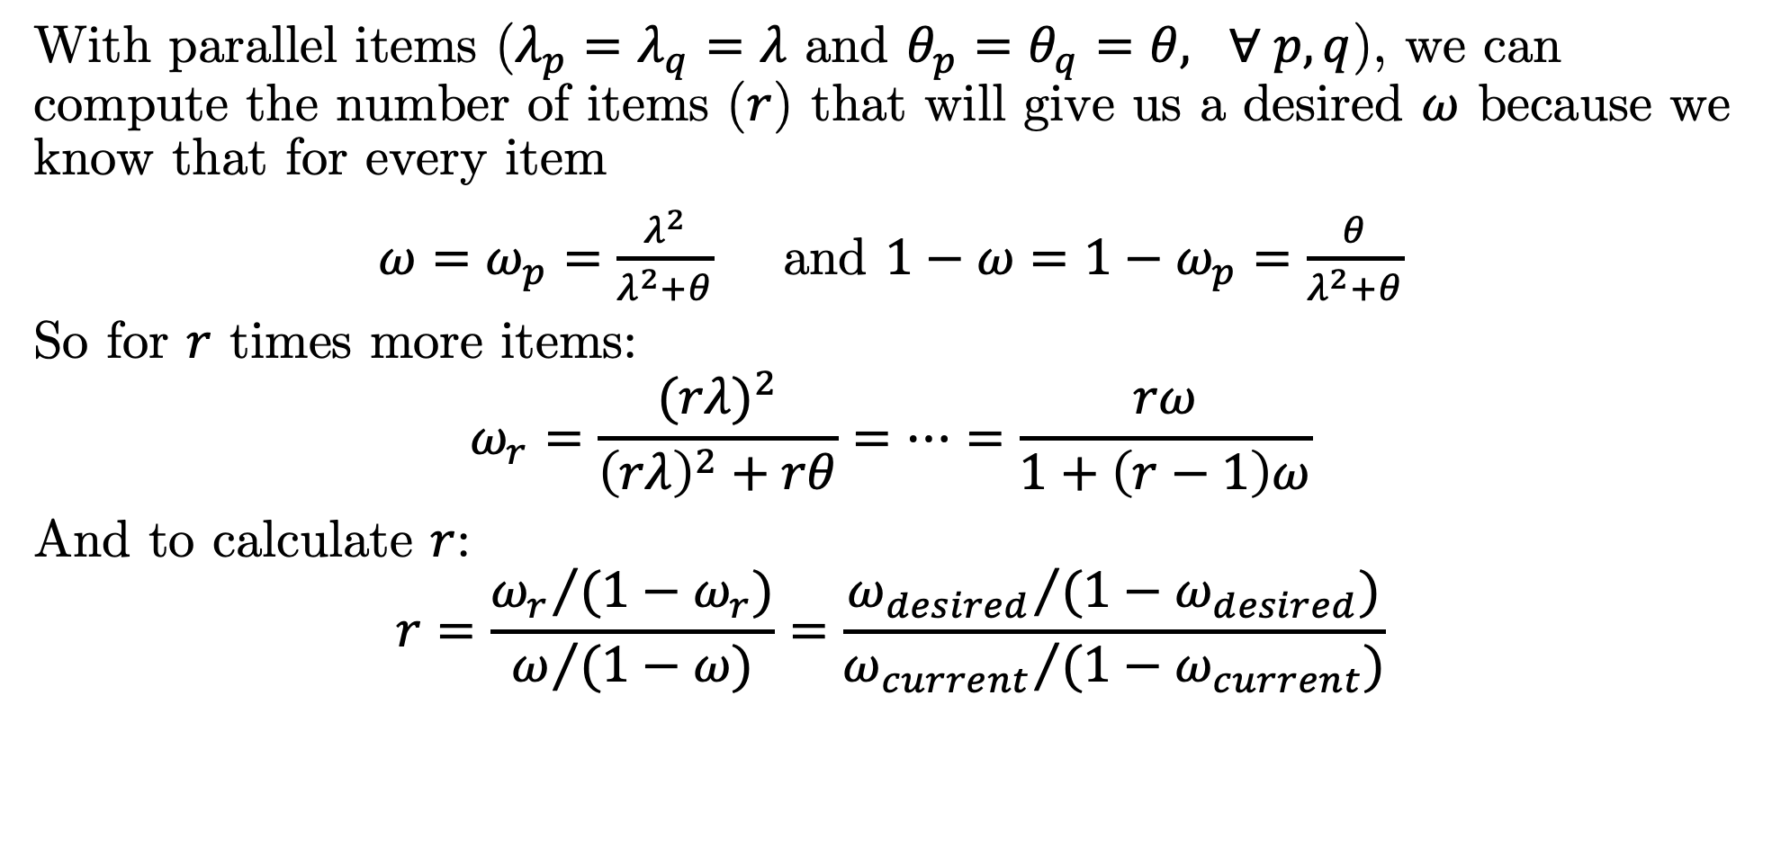
Lengthening a Test to Achieve a Desired $ω$
With parallel items ($λ_{p}=λ_{q}=λ$ and $θ_{p}=θ_{q}=θ, ∀ p,q$), we can compute the number of items ($r$) that will give us a desired $ω$ because we know that for every item
$ω=ω_{p}=\frac{λ^{2}}{λ^{2}+θ}$ and $1−ω=1−ω_{p}=\frac{θ}{λ^{2}+θ}$
So for $r$ times more items:
$$ω_{r}=\frac{{(rλ)}^{2}}{{\left(rλ\right)}^{2}+rθ}=…=\frac{rω}{1+\left(r−1\right)ω}$$
And to calculate $r$:
$$r=\frac{{ω_{r}}/{(1−ω_{r})}}{ω/{(1−ω)}}=\frac{{ω_{desired}}/{(1−ω_{desired})}}{{ω_{current}}/{(1−ω_{current})}}$$

