Slide 1
Psychometrics and Structural Equation Modeling
Item Response Theory I

Slide 2
Topic Overview
Item Response Theory
Models for Binary Items
Latent traits
Linear Probability Model vs. Probit and Logistic Regression
Item Response Models (binary items)
1-3 Parameter Logistic Model
Item and Test characteristics
Item Response Models (ordinal items)

Slide 3
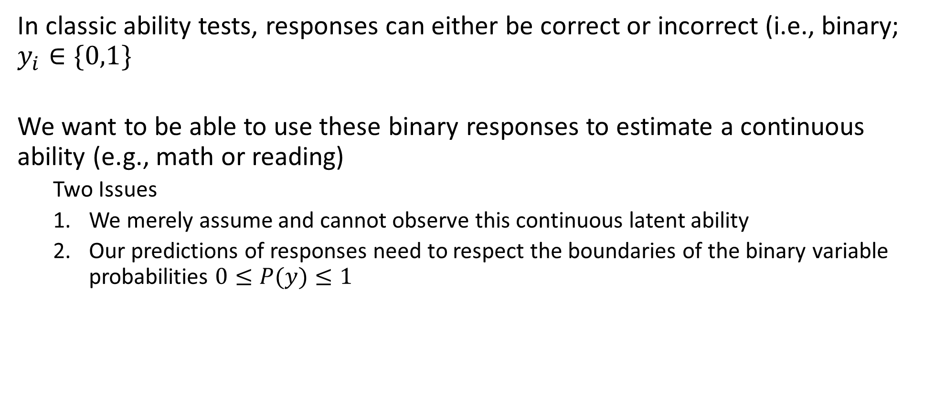
Motivation
In classic ability tests, responses can either be correct or incorrect (i.e., binary; $y_{i}∈\{0,1\}$
We want to be able to use these binary responses to estimate a continuous ability (e.g., math or reading)
Two Issues
We merely assume and cannot observe this continuous latent ability
Our predictions of responses need to respect the boundaries of the binary variable probabilities $0≤P(y)≤1$

Slide 4
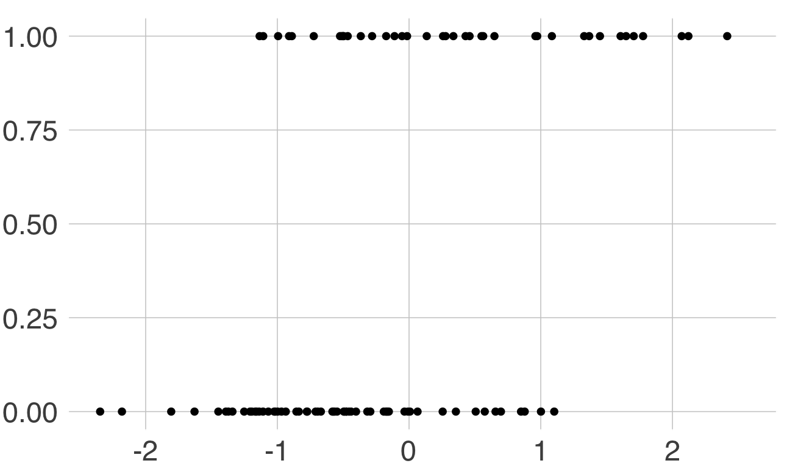


Linear Probability Model
In CTT, we were able to model a continuous true score using CFA – can we adopt this approach and model the probability $P(Y=1)$?
Here we plot the probability of Y=1 for binary data
$F$ is the ability (true) score
P(Y=1)
F

Slide 5
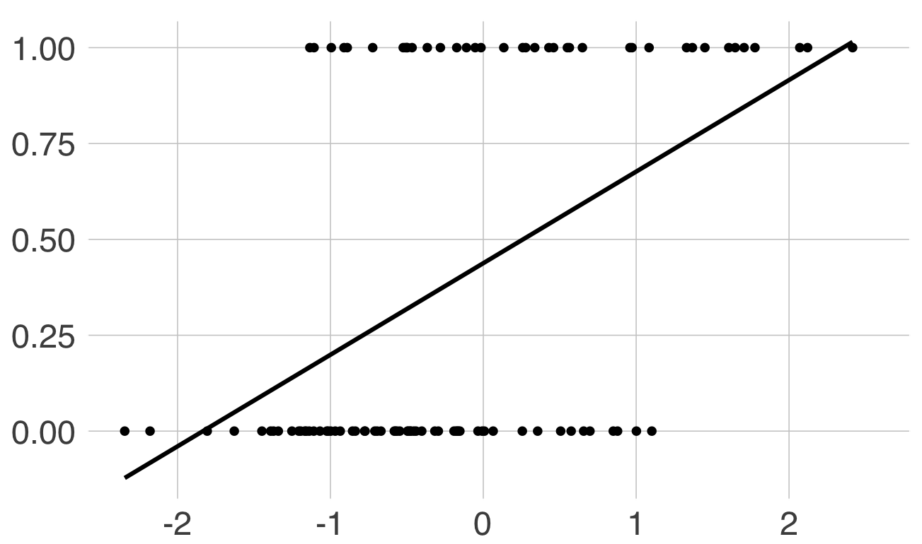

Linear Probability Model
In CTT, we were able to model a continuous true score using CFA – can we adapt this approach and model the probability $P\left(Y=1\right)?$
Issues arising with a linear model
Impossible predicted values
Variance likely not constant
P(Y=1)
F

Slide 6
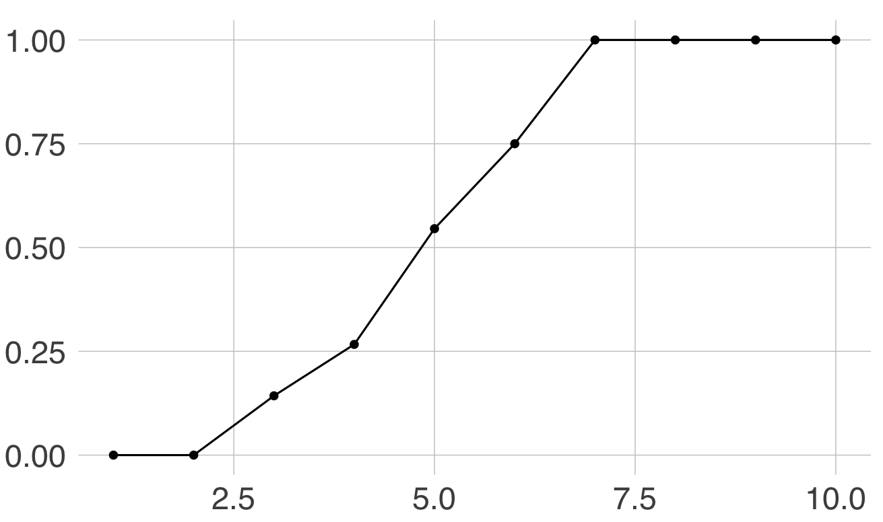

Linear Probability Model
In CTT, we were able to model a continuous true score using CFA – can we adapt this approach and model the probability $P\left(Y=1\right)?$
If we instead plot the % of responses $y=1$ then we get a rough S-shaped curve
From generalized linear regression, we know that we can fit this type of data with a probit or a logistic model instead
P(Y=1)
F

Slide 7
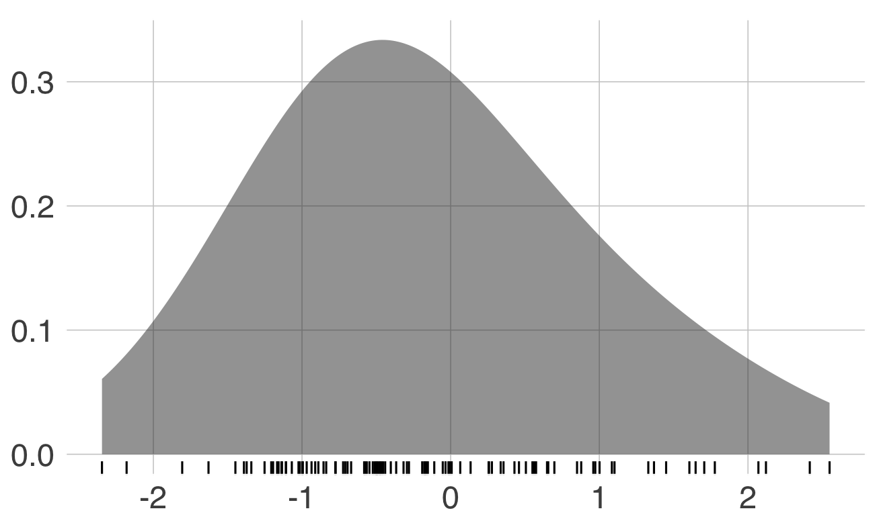
Latent Traits in IRT
Latent traits in IRT are the same as latent traits in factor analysis
Unobserved, Gaussian-distributed, random variables
With binary responses, we need a non-linear link function between the continuous latent trait and the discrete observed response
Popular choices are probit (inverse normal CDF) and logistic
We focus more on the logistic, book focusses more on probit
P(Y=1)
F

Slide 8
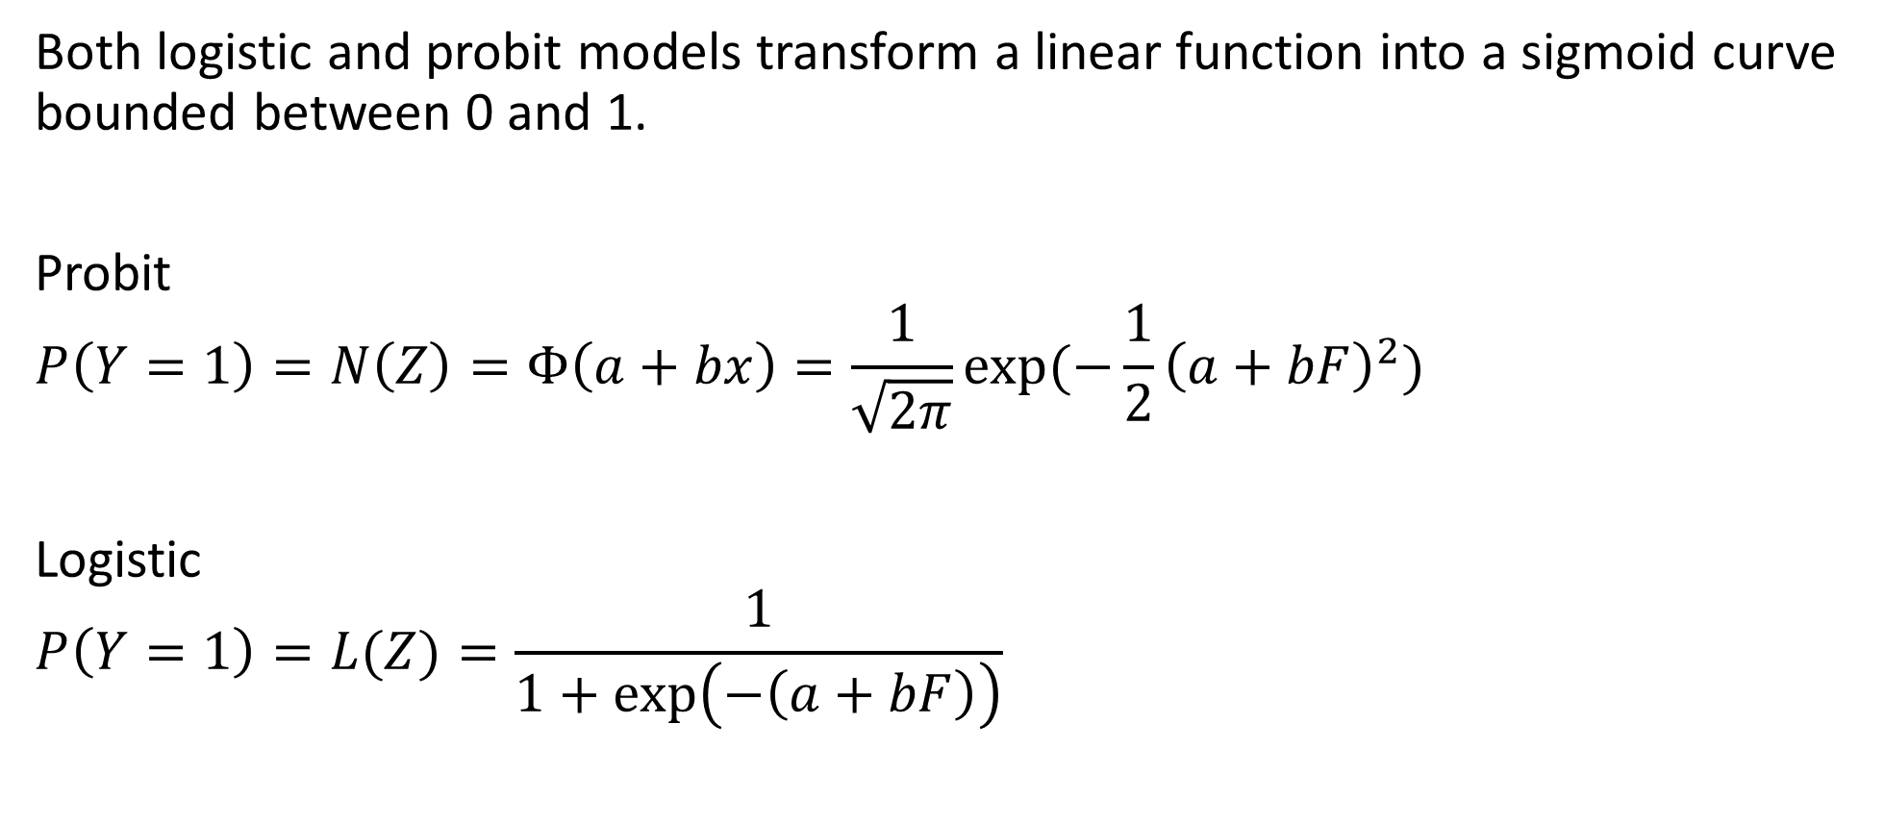
Logistic and Probit Regression
Both logistic and probit models transform a linear function into a sigmoid curve bounded between 0 and 1.
Probit
$$P\left(Y=1\right)=N\left(Z\right)=Φ\left(a+bx\right)=\frac{1}{\sqrt{2π}}exp⁡(−\frac{1}{2}{\left(a+bF\right)}^{2})$$
Logistic
$$P\left(Y=1\right)=L(Z)=\frac{1}{1+\exp\left(−\left(a+bF\right)\right)}$$
Basically logistic regression
Allows for maximum likelihood estimation

Slide 9
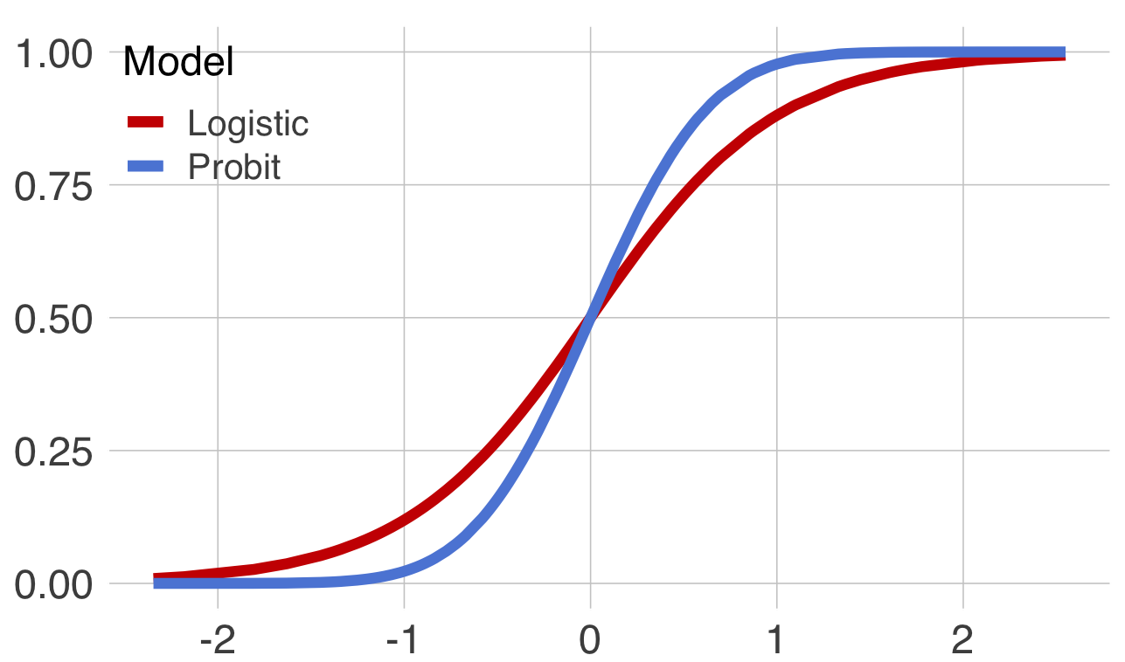
Logistic and Probit Regression
P(Y=1)
F

Slide 10
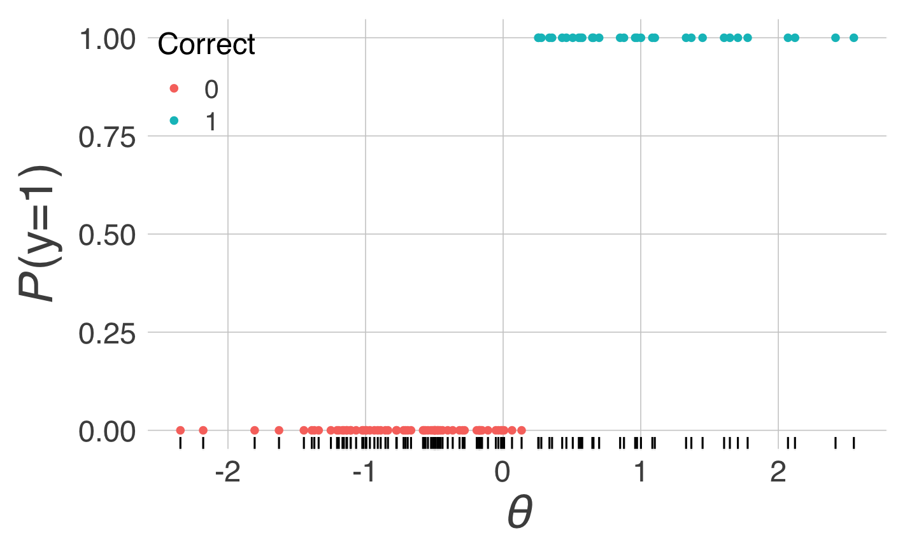
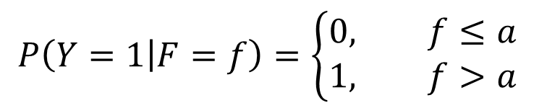
Threshold (Guttman) Model
Simplest model
The threshold is known as the “Difficulty” of the test item
Originally developed in ability tests where the term makes most sense – less so with other traits
Also know as the location parameter
Does this model allow for measurement errors?
P(Y=1)
F
$$P\left(Y=1 | F=f\right)=\left\{\begin{aligned}0, f≤a \\ 1, f>a\end{aligned}\right.$$

Slide 11
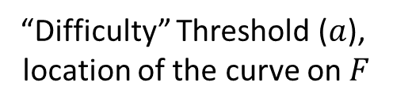
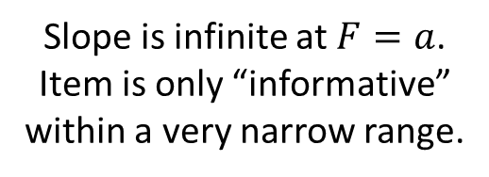
Threshold (Guttman) Model
P(Y=1)
Slope is infinite at $F=a$.
Item is only “informative”
within a very narrow range.
“Difficulty” Threshold ($a$),
location of the curve on $F$
F

Slide 12
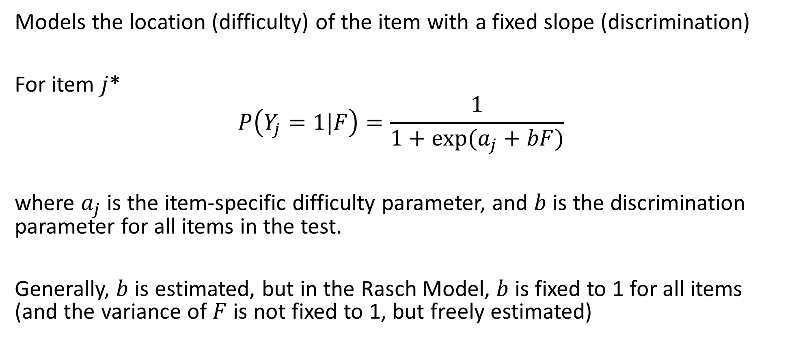
1-Parameter Logistic (Rasch) model
Models the location (difficulty) of the item with a fixed slope (discrimination)
For item $j$*
$$P\left(Y_{j}=1|F\right)=\frac{1}{1+exp⁡(a_{j}+bF)}$$
where $a_{j}$ is the item-specific difficulty parameter, and $b$ is the discrimination parameter for all items in the test.
Generally, $b$ is estimated, but in the Rasch Model, $b$ is fixed to 1 for all items (and the variance of $F$ is not fixed to 1, but freely estimated)
*For these models we use j instead of p to avoid confusion with probabilities

Slide 13
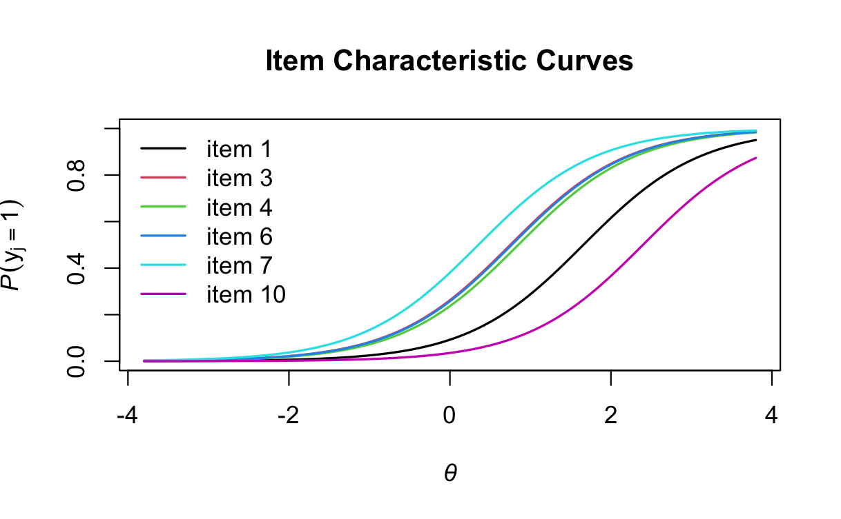

1-Parameter Logistic: Item Characteristic Curves
Once $a_{j}$ and $b$ are estimated, we can plot the probabilities of a correct answer across $F$ for all items
Ideally, we want these curves spread out across the space of $F$
Cf. CTT, where different levels of difficulty would reduce reliability / precision!
P(Y=1)
F

Slide 14
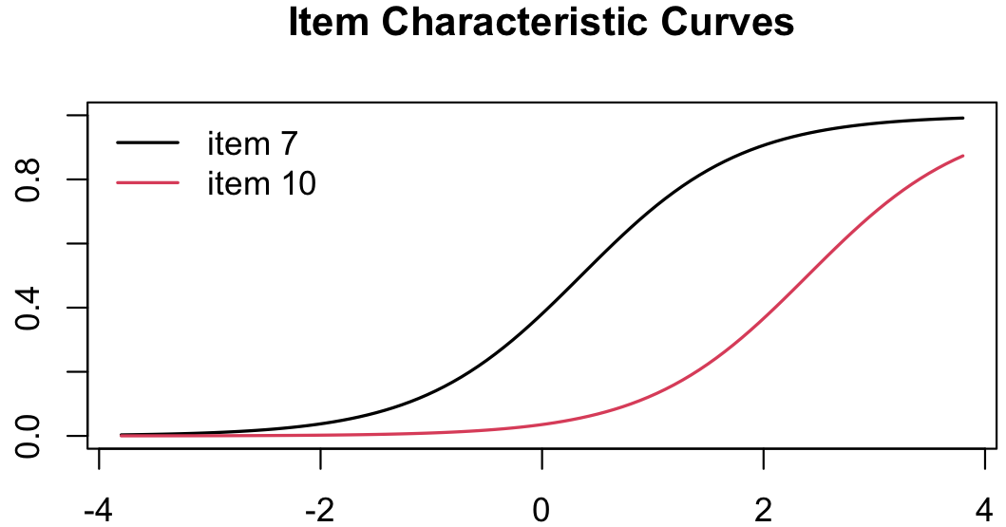




1-Parameter Logistic: Item Characteristic Curves
The difficulty ($a_{j}$) is where the logistic curve implies $P\left(Y_{j}=1|F\right)=0.5$, while the discrimination ($b$) represents the steepness of the curve
$$b=1.38$$
P(Y=1)
$$a_{7}=0.35$$
$$a_{10}=2.40$$
F

Slide 15
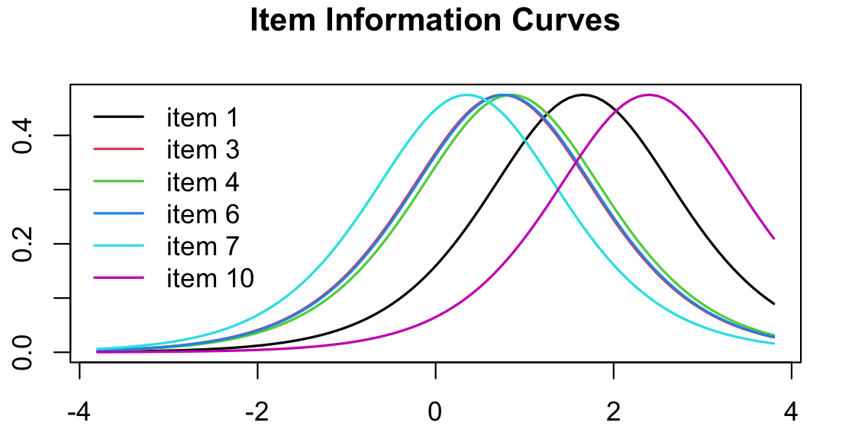
1-Parameter Logistic: Item Information Curves
Indicate how much information the item provides at each level of the latent trait
$$I_{j}\left(F\right)=a^{2}⋅P\left(Y_{j}=1 | F\right)⋅(1−P(Y_{j}=1|F))$$
Information
F

Slide 16
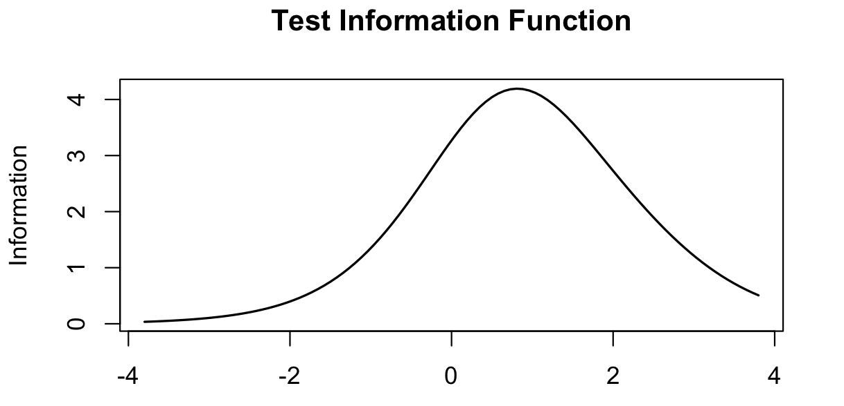
1-Parameter Logistic: Test Information Curve
The sum of the item information curves yields the test information curve
Useful for guiding users in choosing a test for a specific aim
Useful for guiding test developers on where additional items might be necessary, or where items might be removed for shortening tests
F

Slide 17
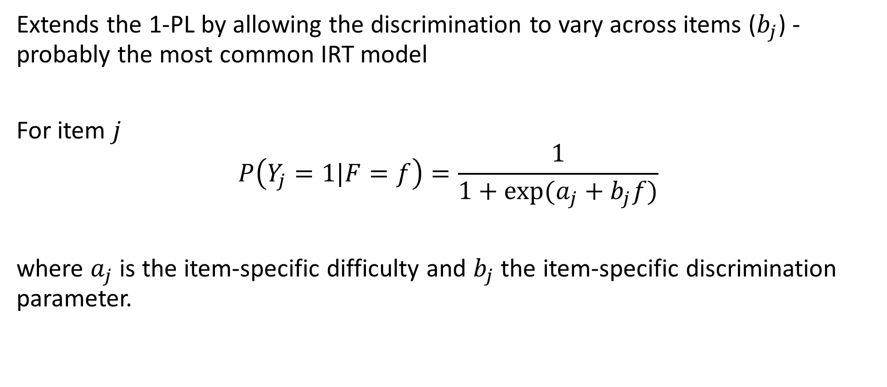
2-Parameter Logistic model
Extends the 1-PL by allowing the discrimination to vary across items ($b_{j}$) - probably the most common IRT model
For item $j$
$$P\left(Y_{j}=1|F=f\right)=\frac{1}{1+exp⁡(a_{j}+b_{j}f)}$$
where $a_{j}$ is the item-specific difficulty and $b_{j}$ the item-specific discrimination parameter.

Slide 18
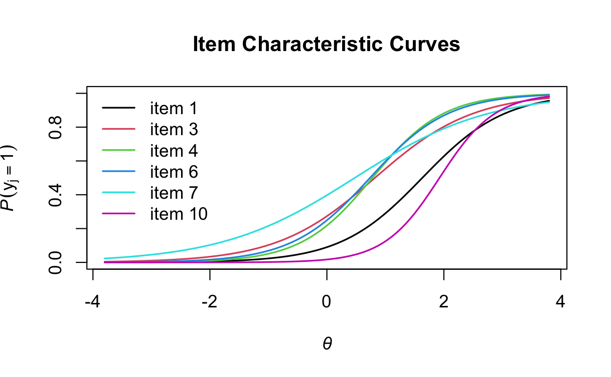
2-Parameter Logistic model: Characteristic Curves
Now different items can be more/less sensitive to changes in ability.
P(Y=1)
F

Slide 19
1- vs. 2-PL
1-PL
2-PL
P(Y=1)
P(Y=1)
F
F

Slide 20
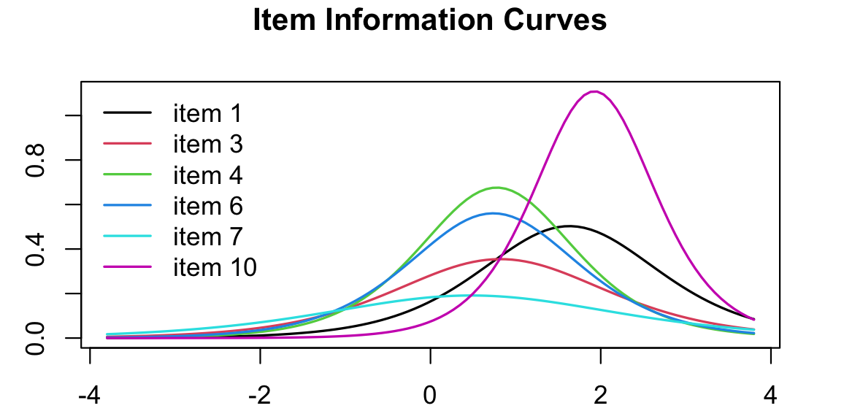
2-Parameter Logistic model: Item Information Curves
$$I_{j}\left(F\right)=a_{j}^{2}⋅P\left(Y_{j}=1 | F\right)⋅(1−P(Y_{j}=1|F))$$
Information
F

Slide 21
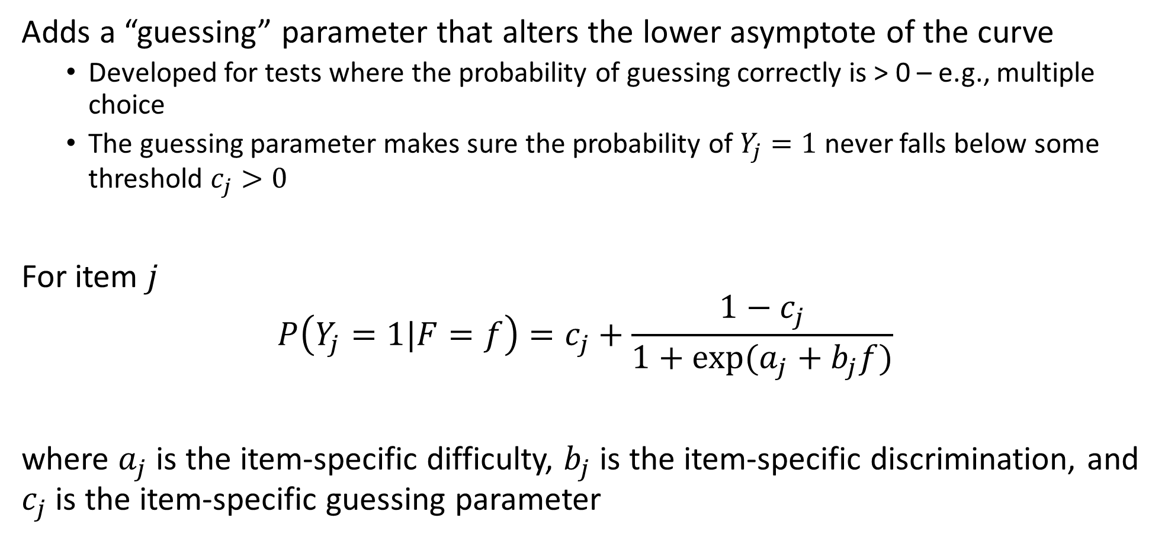
3-Parameter Logistic model
Adds a “guessing” parameter that alters the lower asymptote of the curve
Developed for tests where the probability of guessing correctly is > 0 – e.g., multiple choice
The guessing parameter makes sure the probability of $Y_{j}=1$ never falls below some threshold $c_{j}>0$
For item $j$
$$P\left(Y_{j}=1|F=f\right)=c_{j}+\frac{1−c_{j}}{1+exp⁡(a_{j}+b_{j}f)}$$
where $a_{j}$ is the item-specific difficulty, $b_{j}$ is the item-specific discrimination, and $c_{j}$ is the item-specific guessing parameter

Slide 22
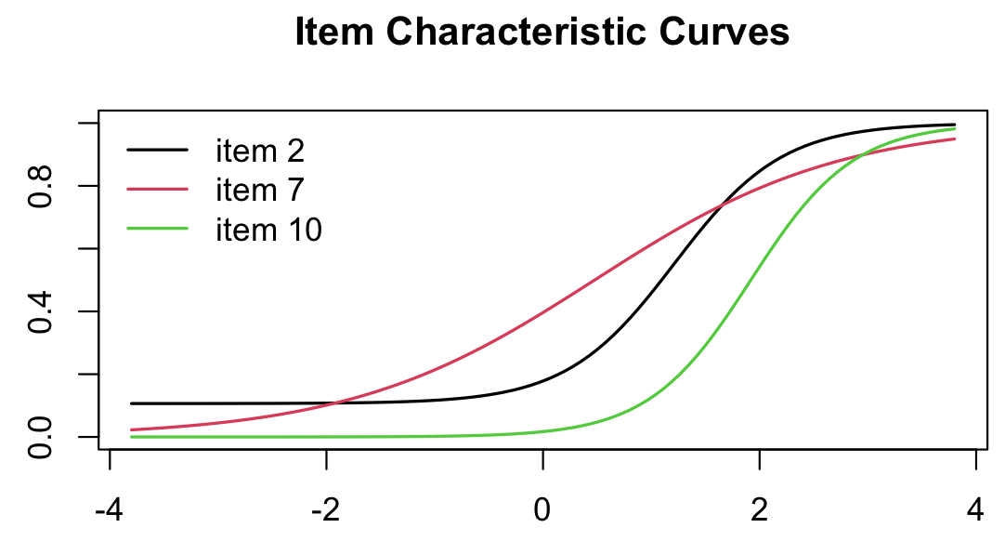
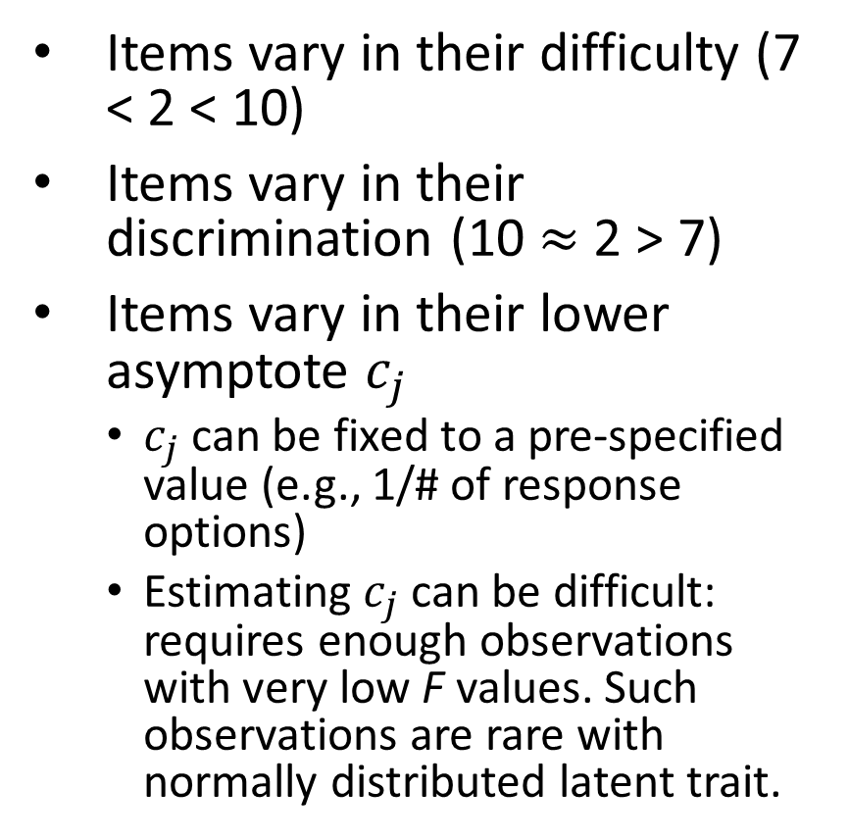

3-Parameter Logistic model
Items vary in their difficulty (7 < 2 < 10)
Items vary in their discrimination (10 $≈$ 2 > 7)
Items vary in their lower asymptote $c_{j}$
$c_{j}$ can be fixed to a pre-specified value (e.g., 1/# of response options)
Estimating $c_{j}$ can be difficult: requires enough observations with very low F values. Such observations are rare with normally distributed latent trait.
P(Y=1)
F
$$P\left(Y_{j}=1|F=f\right)=c_{j}+\frac{1−c_{j}}{1+exp⁡(a_{j}+b_{j}f)}$$
$$I_{j}\left(F\right)=\frac{a_{j}^{2}⋅{\left(P\left(Y_{j}=1 | F\right)−c_{j}\right)}^{2}⋅(1−P(Y_{j}=1|F))}{P\left(Y_{j}=1 | F\right)⋅{\left(1−c_{j}\right)}^{2}}$$

Slide 23
Logistics with More Parameters
Every few years, a paper comes out with a new logistic function with additional that model additional features of the curve
4-PL: upper asymptote (no matter how high ability, there is an upper bound to performance)
5-PL: allows for asymmetries before and after inflection point
We will not address these models in depth for 2 reasons
They are rarely used in practice except in specialized cases
They become increasingly computationally- and data-demanding

Slide 24
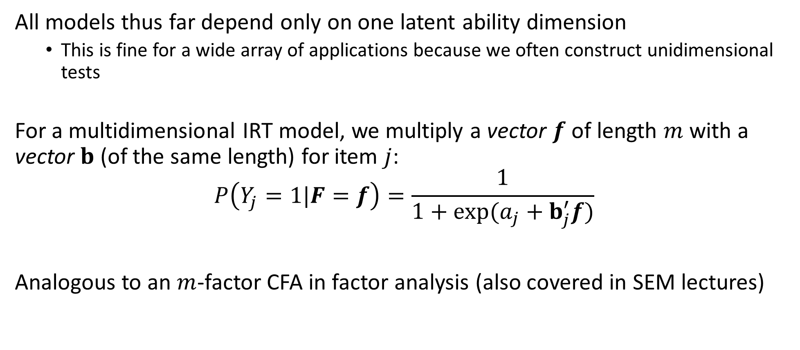
Multidimensional Logistic Models
All models thus far depend only on one latent ability dimension
This is fine for a wide array of applications because we often construct unidimensional tests
For a multidimensional IRT model, we multiply a vector $f$ of length $m$ with a vector $b$ (of the same length) for item $j$:
$$P\left(Y_{j}=1|F=f\right)=\frac{1}{1+exp⁡(a_{j}+b_{j}^{′}f)}$$
Analogous to an $m$-factor CFA in factor analysis (also covered in SEM lectures)

Slide 25
Next week:
Polytomous IRT models (ordered-categorical, Likert items)
Estimation of item and person parameters
More about item and test information
Computerized adaptive testing
Differential item functioning (test bias)

