Slide 1
Citi Bikes in New York
DevUp Capstone Project
April 30, 2018
Marcus Joseph
Notes:
Done

Slide 2
Citi Bike Operating Report for 2017
Thank you for the opportunity to assist Mayor de Blasio’s office in this assessment of Citi Bike ridership.
We admire the success Citi Bike has achieved, as well as your commitment to the millions of people who depend on Citi Bike as a source for reliable transportation and healthy living.
Table of Contents
.
This Citi Bike Operating Report for 2017 from IBM includes a PowerPoint Presentation which outlines some of the assessment’s findings, as well as a GitHub repository and the raw code used in the assessment. This report will deliver best-in-class insights and visuals which address each of the questions from the mayor’s office, listed below:
Table of Contents
I.
Assessing the Data
II.
Top 5 Stations
III.
Trip Durations
Which stations have the most “starts”?
How does duration change with user type?
Which stations make the most popular trips?
How does trip distance & speed differ with gender & age?
What is the most used Citi Bike?
Can we predict a trip’s length?
IV.
Most Popular Trips
V.
Rider Performance
VI.
New York’s Busiest Bike
VII.
Destination Prediction
We appreciate your ongoing partnership with IBM and we look forward to working with you to build an improved Citi Bike experience and a healthier & more efficient New York City!
VIII.
Marcus Joseph
Business Transformation Consultant
IBM
2 | NY Citi Bike
Section I
Notes:
Done

Slide 3
Assessing the Data
Accessing, cleaning, and analyzing the data
Section II
3 | NY Citi Bike
Section II
Notes:
Done

Slide 4
Getting the Data
Manipulating the Data
Assessing the Data
Adjusting for NA’s and Outliers
Section II
Downloading from the Source
The Citi Bike data used in this assessment came from the Citi Bike website (found here). The data is stored in zip files by each year/month (YYYY/MM) as shown below.
After merging the data into a single data frame, further changes were needed when performing some of the requested tasks from mayor Bill de Blasio’s office. The reasoning and specifics regarding the data manipulation can be found in the code’s comments, but some of the highlights include:
Birth Year NA’s
Birth Year outliers (< 1917)
”0” Gender entries
User Types NA’s
Trip Duration outliers
In most cases, removing the NA’s and outliers was deemed the most appropriate method because they comprised a very small amount of the data. On the whole, 0.05180025% of the Citi Bike data is missing (NA).
Citi Bike Data for New York (link)
Data Dimensions & Summary Stats
Sampling the Data
After downloading the data, there was a total of 16,364,657 rows and 15 columns in the data. However, the summary statistics revealed insight into potential outliers which may need further investigation (shown below)
Using a smaller data set for tests
Because the data set is so large, a random sampling of 16,624 rows is sometimes used to perform analysis. This number of rows was chosen because is allows for a 99% confidence level with a +-1 confidence interval.
4 | NY Citi Bike
Section II
Notes:
https://www.citibikenyc.com/system-data
https://s3.amazonaws.com/tripdata/index.html
Done

Slide 5
Top 5 Stations
Which stations have the most “starts”?
Section III
5 | NY Citi Bike
Section III
Notes:
Done

Slide 6
Top 5 Stations
Section III
Station Frequencies
To get the station frequencies (in order to identify the top 5 stations), the stations were all saved as a table in a new data frame. Although there were some outlier stations (incorrect spellings, etc.), they were limited and would not have any significant affect on our top 5 most frequently used stations. Our table data frame is then sorted from most frequent to least frequent, as shown right.
With our top 5 stations in a data frame (along with their frequencies), we can then make visuals such as the bar chart shown right. This visual shows that the “Pershing Square North” station has significantly more users. This is highlighted in red in the far right bar chart visual.
Map of the Top 5 Most Frequented Stations
Top 5 Citi Bike Stations
Shown above is a map of each of the top 5 most frequented stations. This visual gives a glimpse of insight into how station placement affects its activity. 1 of the bike stations is to the north (near the Grand Central Terminal), 3 are more central in the city, and 1 is to the southwest (along the Hudson shore). All of these stations are near public transport or parks.
Start Station Frequency
Top 5 Citi Bike Stations Bar Chart
Top 5 Citi Bike Stations Bar Chart (Pershing Square North is highlighted in red)
6 | NY Citi Bike
Section III
Notes:
done

Slide 7
Trip Durations
How does duration change with user type?
Section IV
7 | NY Citi Bike
Section IV
Notes:
Done

Slide 8
The Relationship between Duration & User Type
Trip Durations
With the data treated (missing data removed and outliers “capped”), the data can now be properly assessed. Ultimately, as shown by the two data frames below, there are significantly more “Subscriber” users but “Customer” users tend to ride farther on average (shown by the mean value).
This is highlighted by the density chart of subscribers, showing that many of the subscribers only ride a short distance (bottom left visual). This may be because subscribers ride more frequently to get to work, school, etc. which may not be as far as the customer riders who may be riding around parks, for tours, or to tourist attractions.
Section IV
Initial Analysis
Upon first analysis, it became apparent that the User Type data had missing values. The table (shown right) shows the number of NA’s in the User Type data which were then removed.
Table Showing NA’s in User Type
Additionally, outliers had a dramatic skewing effect in the Trip Duration data. The Box Plot (shown right) shows the dramatic skew from long trip durations. The longest Citi Bike trip was 9,735,948 seconds (or about 112 days long).
Horizontal Bar Chart of the durations by type of rider goes here
Summary Statistics Data Frame of “Customer” Users
Box Plot of User Type Showing Effect of Outliers
Summary Statistics Data Frame of “Subscriber” Users
Removing the Outliers
To handle the outliers in the Trip Duration data, a ”capping” method was employed. In this method, the extreme points outside the 1.5 * IQR upper limits are replaced by the value of the 95th percentile observations. Likewise, the extreme points of the lower limit are replaced by the value of the 5th percentile. A visual of the Trip Duration by User Type after treating the outliers can be seen via the Box Plot shown right.
Density Chart of ”Subscriber” User Type
Density Chart of ”Customer” User Type
8 | NY Citi Bike
Section IV
Box Plot of User Type after Outliers are Removed
Notes:
Need to finish writing what the data shows and complete the bar graph

Slide 9
Most Popular Trips
Which stations make the most popular trips?
\
Section V
9 | NY Citi Bike
Section V
Notes:
done

Slide 10
Most Popular Trips
Initial Analysis
A similar method to find the top 5 Citi Bike stations was also used to find the most popular trips taken by riders. The process is as follows:
The ”start station name” column and the “end station name” column are combined
While pasting the 2 columns together, a “|” is added to separate the columns
The new column of the pasted start/end stations is put into a table and saved as a data frame
The data frame is sorted by most frequent to least frequent
The top 5 stations are saved into a separate data frame
The start/end stations column is separated back into 2 columns
The most frequented trip is Central Park S & 6 Ave to Central Park S & 6 Ave. This infers that users checked out and returned the bikes to the same station (likely to ride around Central Park). This is also observed in the 4th most popular trip, starting and ending at Grand Army Plaza & Central Park S
Start/End Stations Pasted into one Column
Shown right is a pie chart of the top 5 Citi Bike trips and how they compare to the rest of the trips. This visual shows that the top 5 trips are a very small (< 0%) portion of the total amount of bike trips.
Start/End Stations Separated Back into 2 Columns
Pie Chart of Top 5 Trips vs. All Others
10 | NY Citi Bike
Section V
Notes:
Need to insert pie chart and complete sentence describing it

Slide 11
Rider Performance
How does trip distance & speed differ with gender & age?
Section VI
11 | NY Citi Bike
Section VI
Notes:
done

Slide 12
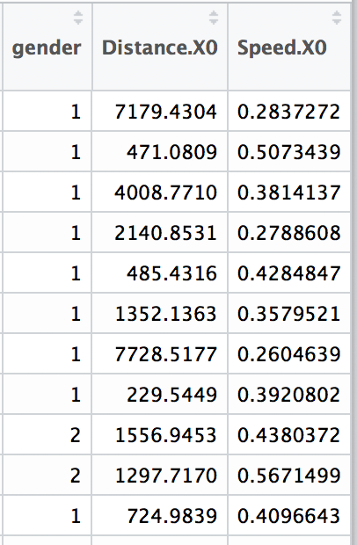


Analysis & Insights
Rider Performance
The scatter plot below shows the relationship between Distance and Birth Year with Gender being represented by the color of the points. The mean (shown by the red line) reveals that age and gender does not have a noticeable effect on biking distance. To further prove this, the correlation between Distance and Birth Year is 0.01439575. The correlation between Distance and Gender is 0.02510722.
The speed column is made by dividing the trip duration and the distance traveled. However, like before. There is not a noticeable relationship between gender, birth year, and speed (as shown by the correlations below).
Section VI
Missing Data & Outliers
Density of Rider Birth Years
With the initial look at the data, it is apparent that 111,245 of the Birth Year data entries are NA. This is .6797882% of the Birth Year data.
Additionally, there are extreme outliers in the data. Because there is a minimum age to reserve a Citi Bike (16 years old), the outliers are primarily on the lower end. For example, the oldest birth year in the data is 1858. Shown right is a visual of the birth years with the red dotted line showing the median year (1982) – note the small number of users claiming their birth year as 1900.
Data Frame with the new Distance & Speed Columns
Correlations between Birth Year, Gender, & Distance
Correlations between Birth Year, Gender, & Speed
)
Visualization Showing the Spread of Birth Years Among Riders
Remedy for NA’s & Outliers
In addition to the missing birth years, the data has 0’s for about 10.36% of the Gender entries. However, about 95.92% of the Gender 0’s were from the same users as a “NA” entries. Thus, it makes sense to simply remove these entries for the analysis because of the high correlation of the erroneous data. Also, birth years before 1917 (+100 year old riders) were removed to alleviate some of the skewing coming from the extreme Birth Year entries.
Calculating Distance Traveled
To calculate the distance between the start/end Citi Bike stations, the “geosphere” package for R was used. This package utilizes the Haversine formula published by R.W Sinnott to calculate the distance between 2 points in meters. This method incorporates the spherical curve of the Earth in its calculation.
Using a random sample of data, the 16,624 rows (mentioned on page 4), the longitude and latitude of the start/end bike stations were both bound into 2 separate data frames. These 2 data frames were then run through the ”geosphere” algorithm. The distance output was then saved as a new column to our original data frame of 16,624 rows (shown far top right).
Scatter Plot of Distance vs Birth Year (with Gender coloring)
12 | NY Citi Bike
Section VI
Notes:
https://help.citibikenyc.com/hc/en-us/articles/115007344188-How-old-do-you-have-to-be-to-ride-
done

Slide 13
New York’s Busiest Bike
What is the most used Citi Bike?
Section VII
13 | NY Citi Bike
Section VII
Notes:
done

Slide 14
New York’s Busiest Bike
NYC’s Most Popular Citi Bike
Of all the 14,204 Citi Bikes, the most popular bike was the Citi Bike ID 25738. This bike was checked out 2,514 times. The top 5 most frequently used Citi Bikes are shown right.
Upon further analysis, it becomes clear that all of the Citi Bikes’ frequencies are in a linear distribution, as shown by the scatter plot visual below.
Data Frame Showing Top 5 Most Popular Bike ID’s
Relating the Most Popular Trips to the Most Popular Bike
Shown bottom right is the top 5 start stations that the most popular Citi Bike (bike ID 25738) was checked out from. Shown bottom left are the stations from the top 5 most popular bike trips. The most popular start station is also the 5th most popular start station for New York’s most popular Citi Bike. The connection between the two is shown by the red arrows below. However, it was only there 19 times, so the popularity of the station may not be as critical to the popularity of the bike. For example, the bike may be more popular because it could have just been in circulation longer. The most popular bike’s total time being ridden in 2017 is 2458242 seconds.
Scatter Plot Showing the Linear Distribution of the Bike ID’s Frequency of use
Data Frame of Most Popular Trip Stations
Data Frame of Most Popular Bike’s Stations
14 | NY Citi Bike
Section VII
Notes:
done

Slide 15
Predicting Trip Length
Can we predict a trip’s length?
Section VIII
15 | NY Citi Bike
Section VIII

Slide 16
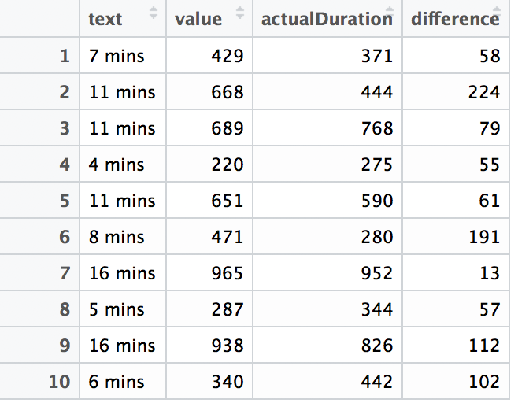
Utilizing API’s (Mapping Route Visual)
Using the same start/end latitude and longitude from the Google API output, Leaflet’s mapping API (shown right) creates an interactive map for the user to zoom in & out and explore the biking route.
The route variable is calculated using the same Google API as before because it incorporates bike paths (as noted earlier). This variable is then plotted onto the Leaflet map, thus creating the visual right.
Predicting Trip Length
Section VIII
Utilizing API’s (Distance & Duration)
In order to create Mayor de Blasio’s proposed new trip prediction feature, the Google Maps Distance Matrix API and the Leaflet mapping API are used.
The Google API is used to predict the distance, duration, and route of getting from any two points on the map. This API was chosen because it incorporates other variables aside from purely distance, such as traffic, preferred streets, & available bike paths.
The Google API (via the “googleway” R package) is used to calculate distance here instead of the “geosphere” package because the Google package provides a more detailed output but is restricted by it’s strict rate limit for immediate mass calculation (but it can be used over a timespan effectively).
Leaflet API Interactive Map showing any Bike Route of 2 points
Shown right is the results of a small test sample used to assess the accuracy of the trip duration prediction. The “value” column is the prediction from the model and the “actualDuration” column is the actual duration of the trip from the data.
The “difference” column is the absolute difference between the prediction and the actual duration. The closest that the prediction came was 13 seconds and the most it was off was 3 minutes and 44 seconds. The mean difference was about 1 minute and 35 seconds.
Below is an example output from the Google API. This example uses the Start Station Latitude of 40.71260 and Start Station Longitude of -73.96264. The respective End Station Latitude/Longitude used is 40.72481 and -73.94753.
Google Maps Distance Matrix API Distance & Duration Output
Data Frame of the Testing Results (”difference”) for predicting Trip Duration
16 | NY Citi Bike
Section VIII

Slide 17
Thank You
Notes:
Done

