Slide 1
Single Contiguous | Static Partitioned Memory Management
Memory
Jobs
Partition Labels
OS
Growing subdivisions?
Partition
Sizes
OS
Growing subdivisions?

Slide 2
Event list
Job Table
Summary Table

Slide 3
Time | Event Type | Partition| Job
Memory
Partition Allocation Table (PAT)
Partition Labels
OS
Etc.
Partition
Sizes
OS
Etc.
Waiting States

Slide 4
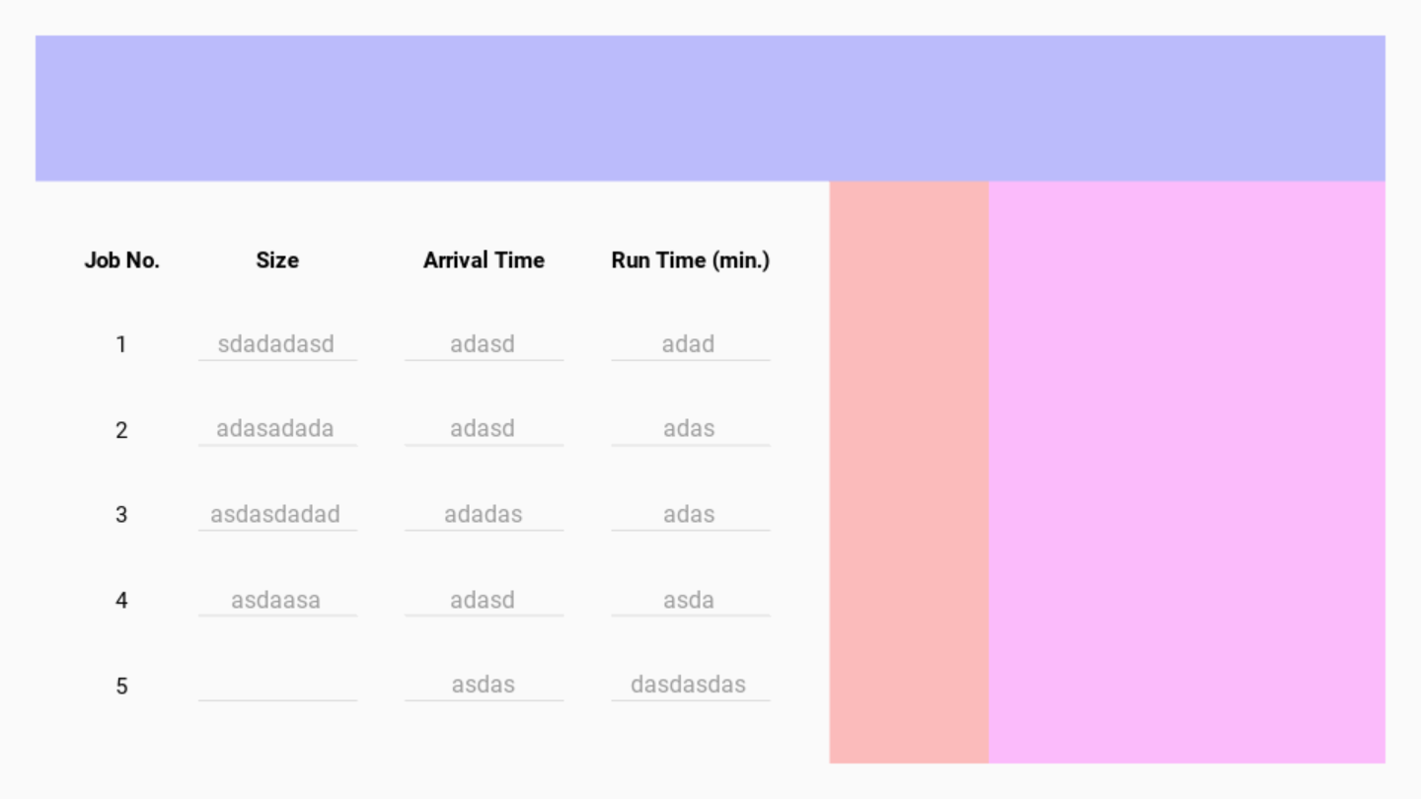

Slide 5
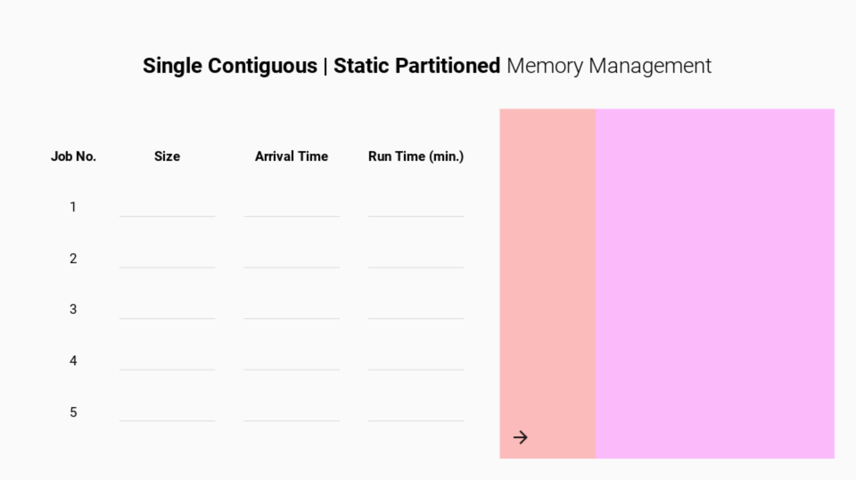

Slide 6
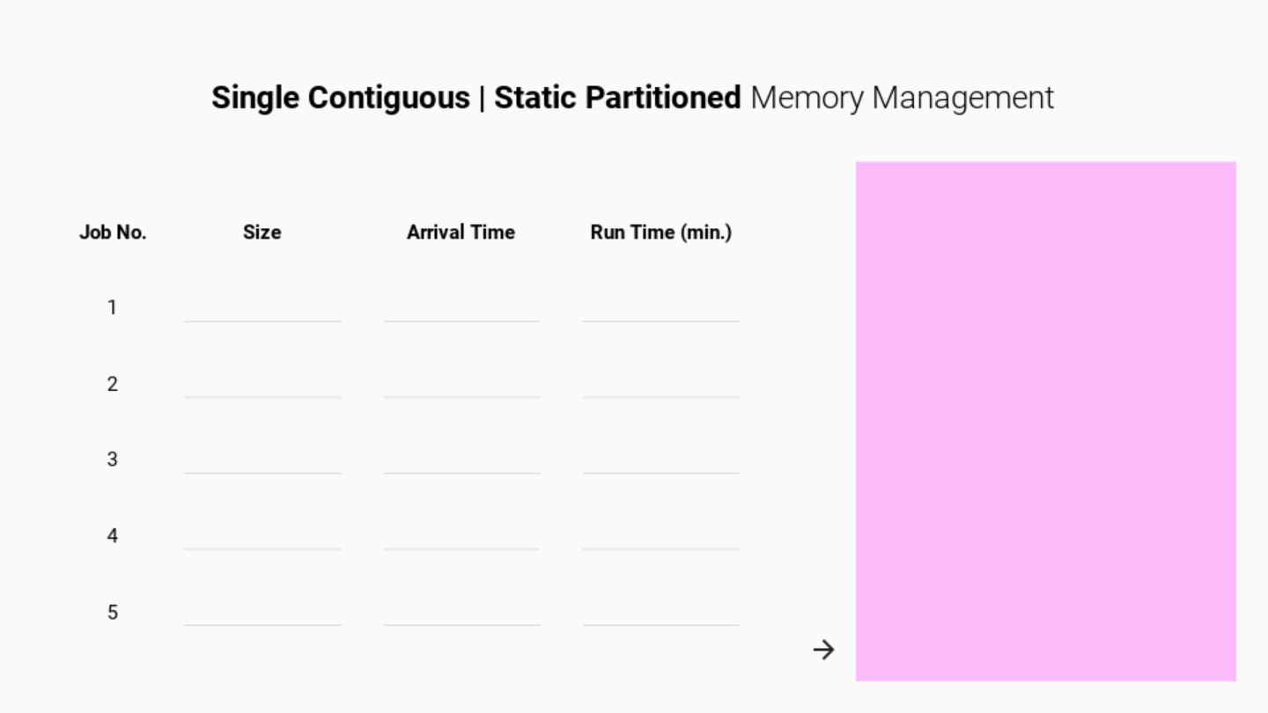

Slide 7
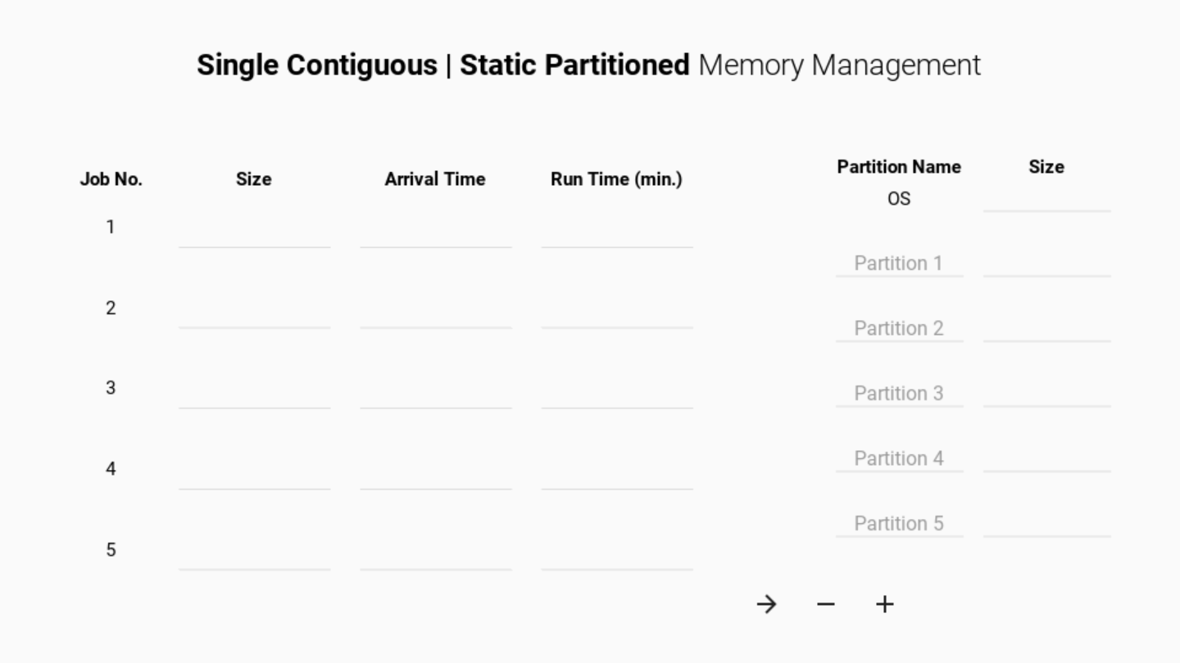

Slide 8
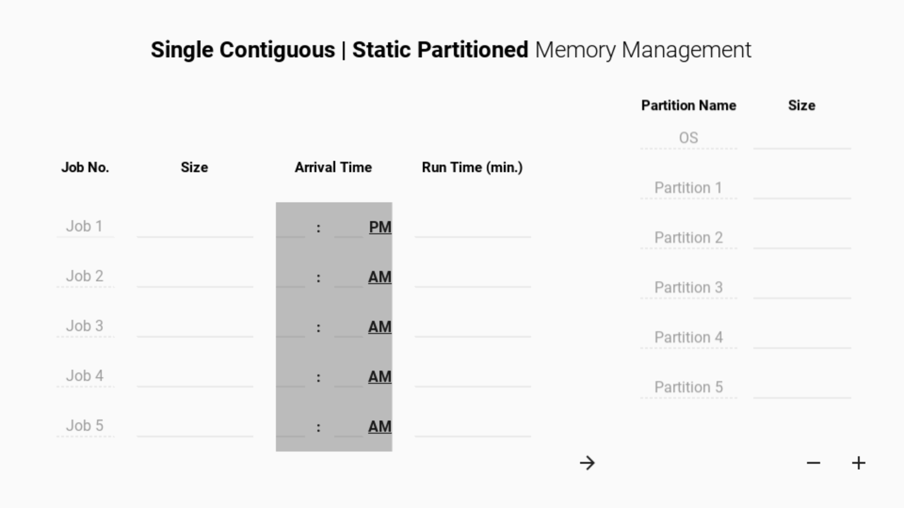

Slide 9
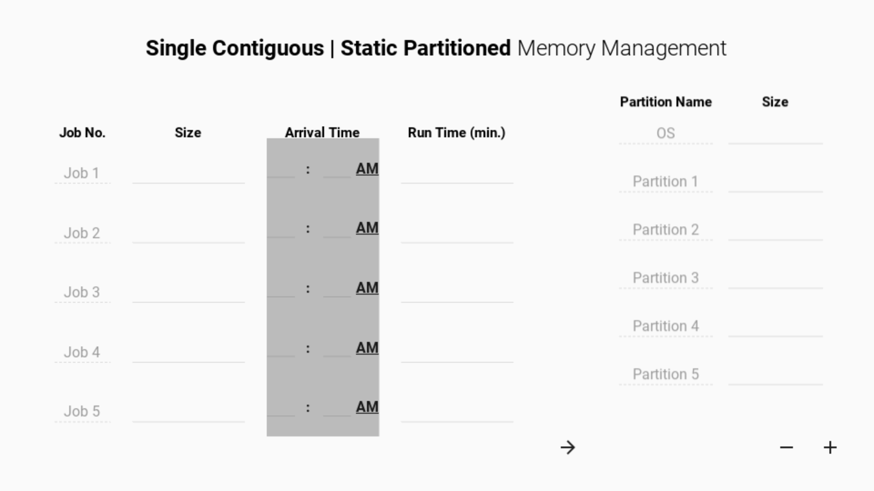

Slide 10


Slide 11
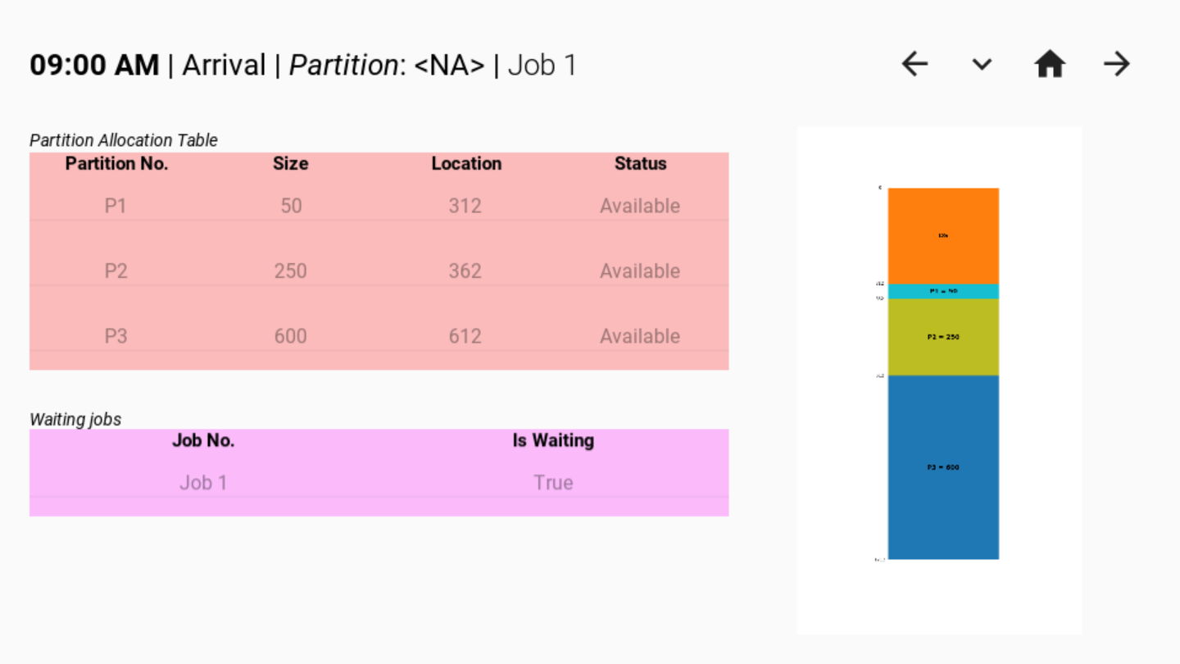

Slide 12
