Slide 1
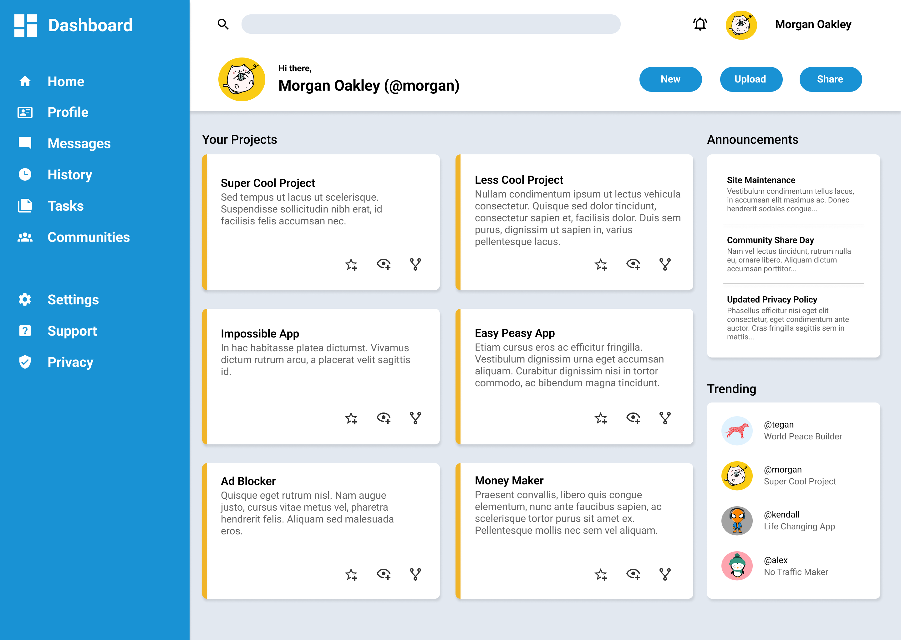

Slide 2
Hi there!
I’m Mark
Personal Info
Coder
Music lover
Let’s talk?
Email
LinkedIn
Twitter
GitHub
GitHub source • Copyright © 2022
Dynamic rainbow topbar
Languages toast icons (or sa projects na lang din?)
Resume
↓ Download

