Slide 1

Unlocking Your Data Potential:
Leveraging Psychology Skills for a Thriving Career in Data Analytics
Dr Mark Andrews
Associate Professor
School of Social Sciences
Nottingham Trent University

Slide 2
You’re More Than a Psychology Graduate
Your three years of studying Psychology have equipped you with sophisticated data analysis skills that are highly valued across industries.
From your your modules in research methods and statistics, you’ve gained skills that companies and organizations actively seek.

Slide 3
Your Technical Skills Are Valuable
During your degree, you’ve mastered:
Data cleaning and preparation
Data visualization
Hypothesis testing
Regression analysis
Survey design and analysis
Experimental design
etc
These are the skills that data analysts use daily in their work.

Slide 4
Real-World Applications
Your skills directly translate to business problems:
What You’ve Done → Real-World Application
Research design → A/B testing for websites
Survey analysis → Customer satisfaction studies
Data visualization → Business intelligence dashboards
Statistical testing → Product performance analysis
Regression models → Sales forecasting

Slide 5
The R Advantage
R is a powerful tool in the business world:
It is open source, powerful, widely used
Used extensively in data science and analytics across many industries
Valued for its ability to
clean complex messy data sets
visualize data
perform all possible statistical analyses
do reproducible analyses

Slide 6
Career Paths Open to You
Your combination of R programming and research skills qualifies you for starting roles such as:
Data Analyst
Market Research Analyst
Healthcare Data Analyst
Business Intelligence Analyst

Slide 7
What Makes You Stand Out
Beyond technical skills, you bring unique strengths:
Understanding of human behavior
Experience interpreting complex data
Strong research methodology background
Critical thinking and problem-solving skills
Ability to communicate complex findings
Experience with real-world data collection

Slide 8
Next Steps?
Highlight your statistical expertise on your CV
Create a portfolio of your R analysis projects (e.g. on GitHub)
Explain your psychology research in business and other terms
Network with data professionals on social media
Create a academic/professional website (e.g. using Quarto in R)
Apply for graduate data analyst positions
But keep upskilling

Slide 9
Further training?
Consider the new MSc in Behavioural Data Science!
We designed this primarily for psychology and social science graduates with
Strong interests in quantitative analysis and a possible data science career.
To enhance technical skills before starting a PhD or professional research role.

Slide 10
Broad Aims of the MSc
Comprehensive Introduction to Advanced Data Analysis
Learn about advanced statistical modeling, computational modeling, and machine learning.
Gain skills in data exploration, visualization, and AI.
Strong Emphasis on Psychological/Behavioural Science Theory
Understand the why behind the data.
Become an expert at linking human cognition and behavior to advanced data analysis techniques.
Professional and Academic Preparedness
Develop independence, initiative, and professional skills.
Build a portfolio demonstrating your analytical capabilities.

Slide 11
Unique Selling Point
“Extract meaningful, theory-based insights from complex human data.”
Integration of Data Science & Psychology
Cutting-edge data science tools with deep theoretical insights.
Not just “how to analyze data,” but why the data behave the way they do.
Career-ready portfolio
Showcase diverse data projects to future employers.
Demonstrate holistic understanding of both data science and behavioral theory.

Slide 12
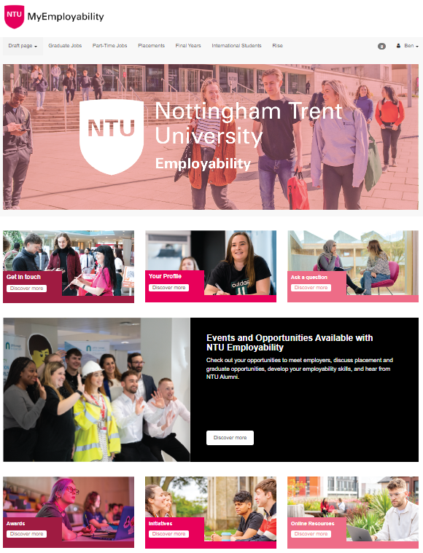

Follow us
MyEmployability
Personalise your employability journey with support whenever you need
Instant CV reviews with CV360
Interview practice with Interview360
Search through hundreds of graduate, placement and part-time opportunities
Advice on a range of employability topics including applications, interviews, job search and more!
https://myemployability.ntu.ac.uk/
Notes:
Core Slide

Slide 13
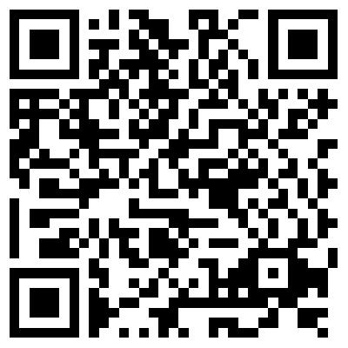
Book an appointment
Take Control of Your Career.
Explore options
Set goals
Improve your CV/Cover Letter
Get advice on Placements
Strengthen Applications
Prepare for Interviews
Build confidence
And much more…
Scan to book
https://rb.gy/htsqtu
https://myemployability.ntu.ac.uk/students/appointments/

Slide 14




Follow us
Visit our Hubs
Easily access expert advice
1-2-1 appointments
A space to work
Coaching appointments
Notes:
Core Slide

Slide 15
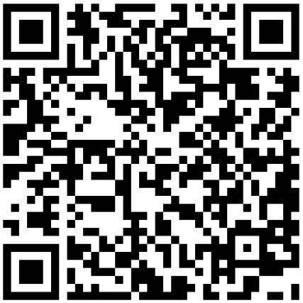
Give us your
feedback

