Slide 1


Teach with R: Data Skills
23rd June, 2022
Emma Mills

Slide 2


Teach with R: Data Skills
23rd June, 2022
Emma Mills

Slide 3
National Data Skills Pilot
Why?
Demand for specialist data skills has tripled since 2013
50% of businesses since 2019 have struggled to recruit adequately skilled people
PG Conversion Courses are running however DCMS want to know where the applicants are coming from and how have they acquired their UG skills
Notes:
DCMS NDSP document

Slide 4
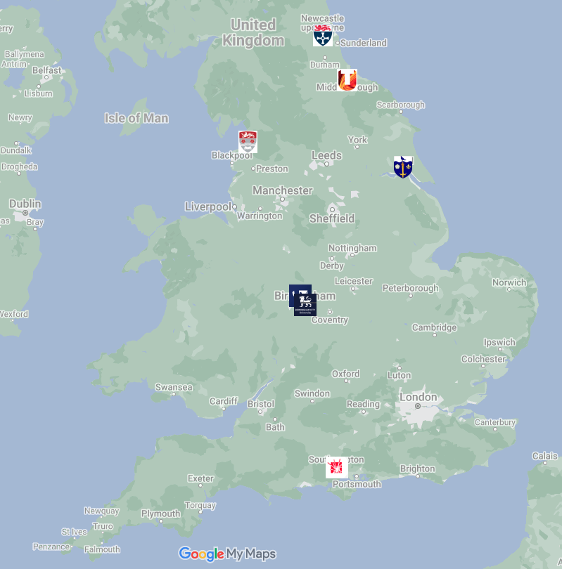
National Data Skills Pilot
Who & Where?
Eligibility criteria:
non-cognate subject
Not computer science, AI or data science
Involved in the PG Conversion Course program
Existing strategic approach
Our ongoing move to R
Seven universities…
Notes:
Newcastle – training the trainers 38 staff across three facutlies – links with employers / industry – using data carpentries
- plans to link to the data science institute
Wolverhampton are reporting on an optional course to students that may in the future become compulsory…not necessarily R
Teeside are working with industry – they want understanding of different types of data, cleaning and visualization skills
Birmingham city believe they see a strong link between attainment and GCSEs

Slide 5
National Data Skills Pilot
What?
test different methods of teaching foundational data skills to undergraduates whose subject does not contain significant data science elements.
understand more about how undergraduate students are acquiring data skills.
provide evidence of the ways they are enabling the development of foundational data skills in non-cognate subjects.
Notes:
The department for digital, culture, media and sport (DCMS) put out a call in August 2021.
Very broad

Slide 6
National Data Skills Pilot
What?
foundational data skills:
data management;
data cleansing, enrichment & modelling,
data visualisation;
quality assurance, validation and data linkage abilities;
statistical methods and data analysis skills.
Notes:
Definition of foundational data skills

Slide 7
National Data Skills Pilot
What?
foundational data skills:
data management;
data cleansing, enrichment & modelling,
data visualisation;
quality assurance, validation and data linkage abilities;
statistical methods and data analysis skills.
Notes:
I know that we cover these during the module on which I teach, so the question becomes to what extent and also is there coverage else where. I know there is in our university but I decided to use the opportunity to delve into our curriculum rather than go wide

Slide 8
Data Skills @ Lancaster Psychology
How?
Curriculum mapping for statistical methods / data skills assessment
Explore any relationship for entry level learning and gender with attainment
Make and complete, with students, skills maps as self-assessment tools
Conduct staff and student focus groups for their thinking / opinions around their learning
Conduct a survey of academic staff who will act as third year dissertation supervisors in 2022-23

Slide 9
Curriculum Mapping

Slide 10
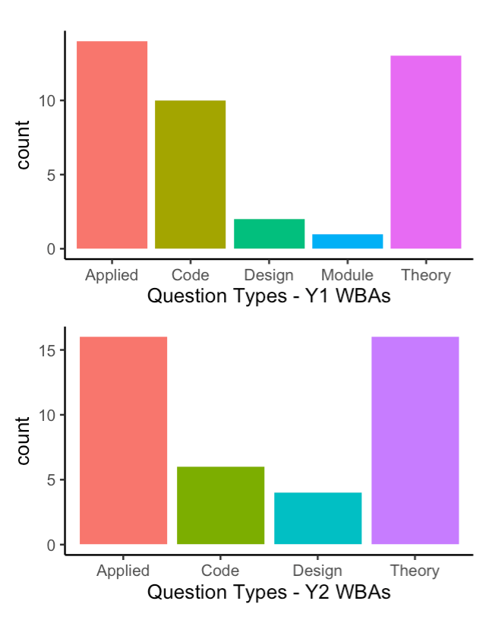
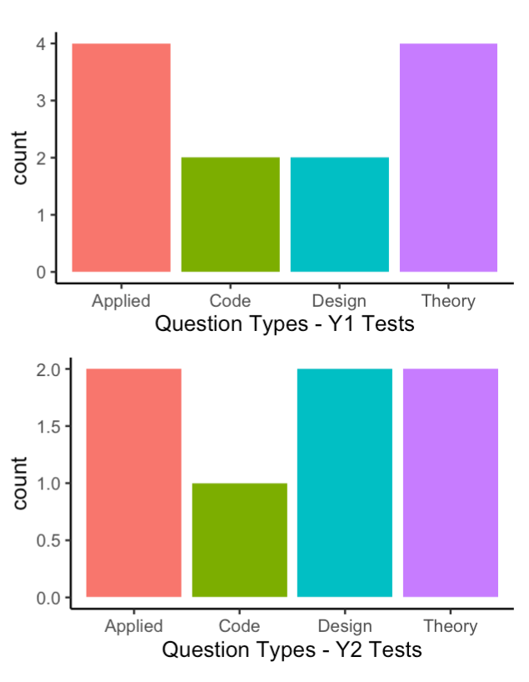
Curriculum mapping

Slide 11
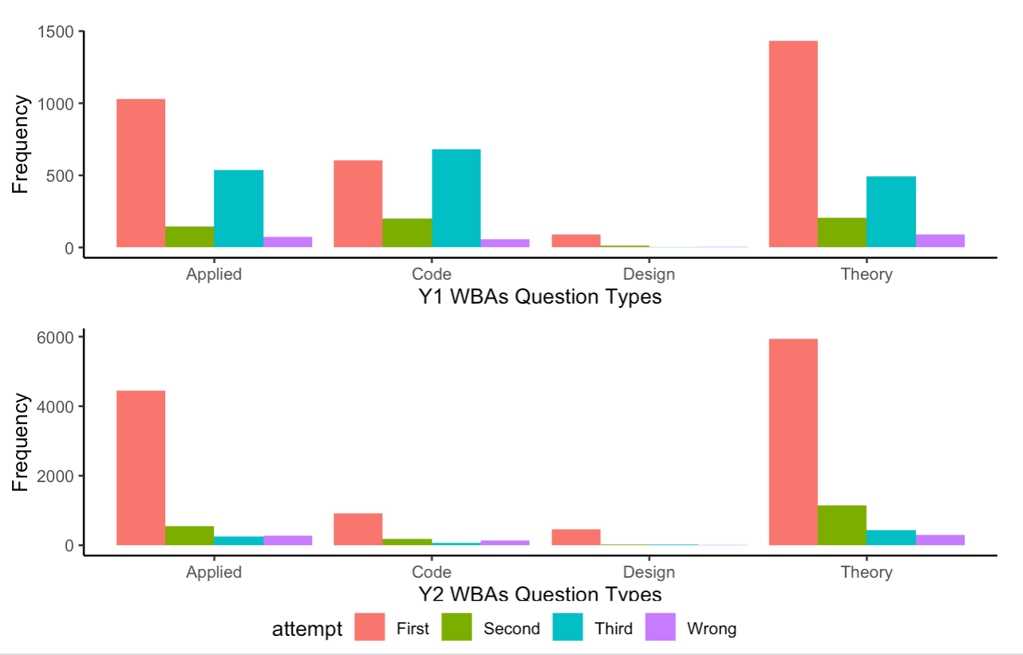
Curriculum mapping
Notes:
WBAs and Class Tests are all a Moodle Quiz multiple choice format
Differences between WBAs & Quizzes are number of attempts and timings
Differences between year 1 and year 2 are number of questions

Slide 12
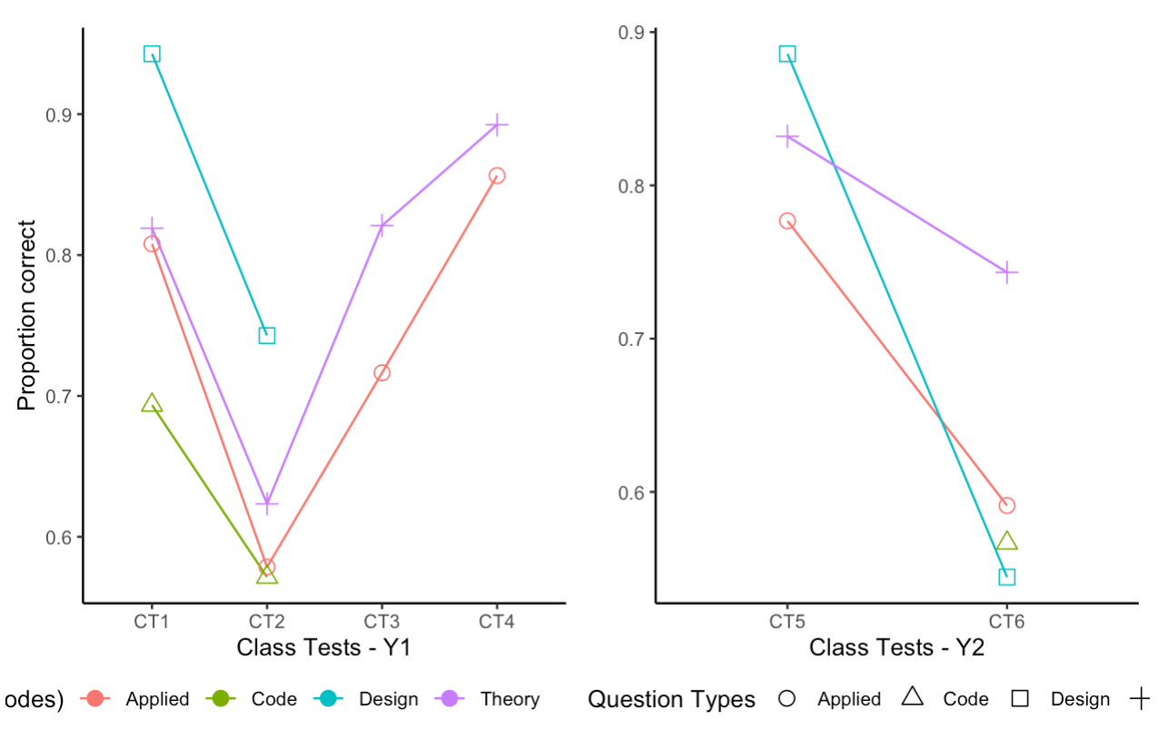
Curriculum mapping
Notes:
By the end of Year 2, attainment in the last statistics module this year for students who have learned through R is almost identical to last year’s cohort who learned through SPSS.

Slide 13
Curriculum Mapping: conclusions
Each staff member assesses statistics in both theoretical and applied ways
Not everyone assesses code for or design of analyses
Code questions are less likely to be answered correctly
Trial and error strategy in WBAs in Year 1
Not so evident in Year 2
Monoculture of assessment
All quizzes
Mainly statistics – we don’t assess functionality of student code writing at any point…

Slide 14
Prior learning & Gender

Slide 15
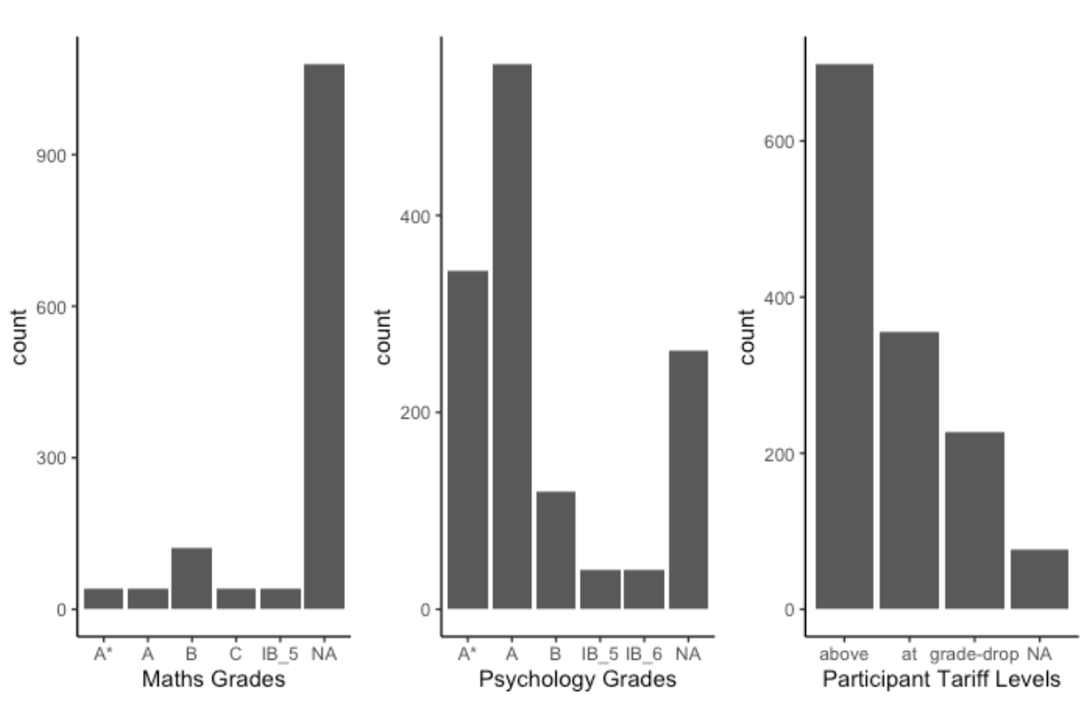
Entry level skills
Notes:
35 Year 1 Students consented to the use of their data; we only have entry data for year 1 – admissions dumps the data at the end of each recruitment cycle.

Slide 16
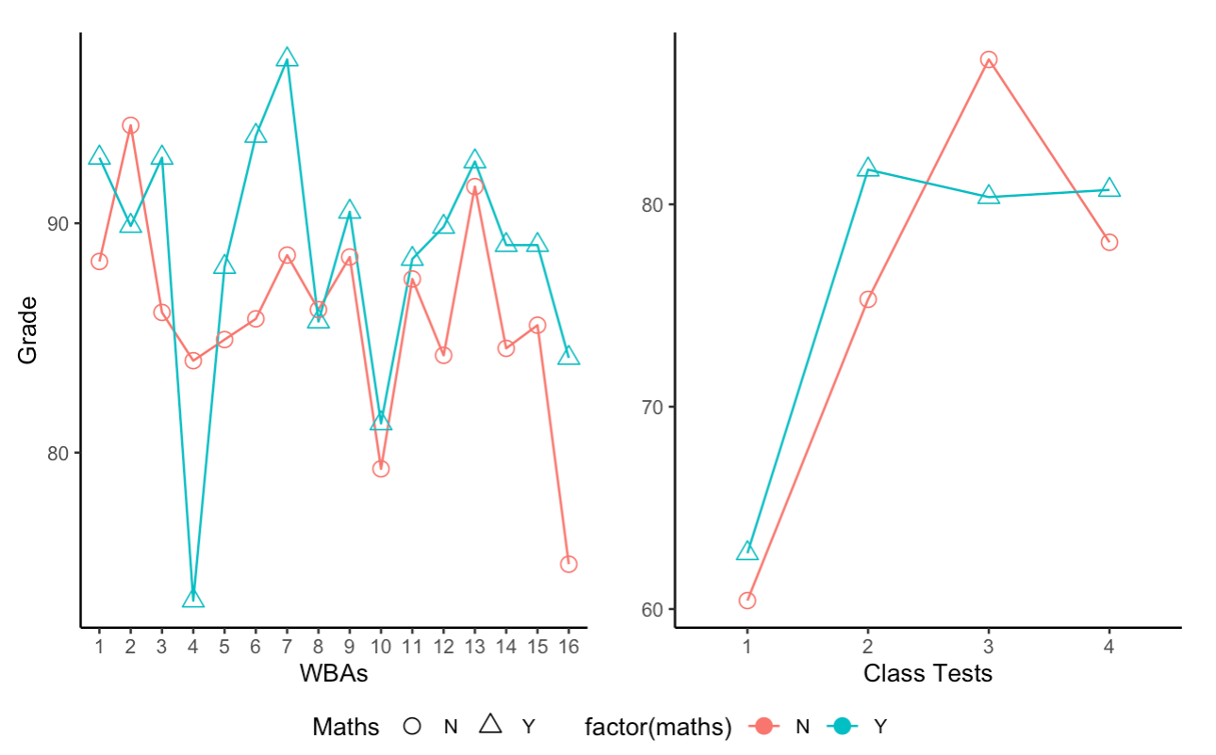
Entry level skills: Maths
Notes:
35 Year 1 Students consented to the use of their data; we only have entry data for year 1 – admissions dumps the data at the end of each recruitment cycle.

Slide 17
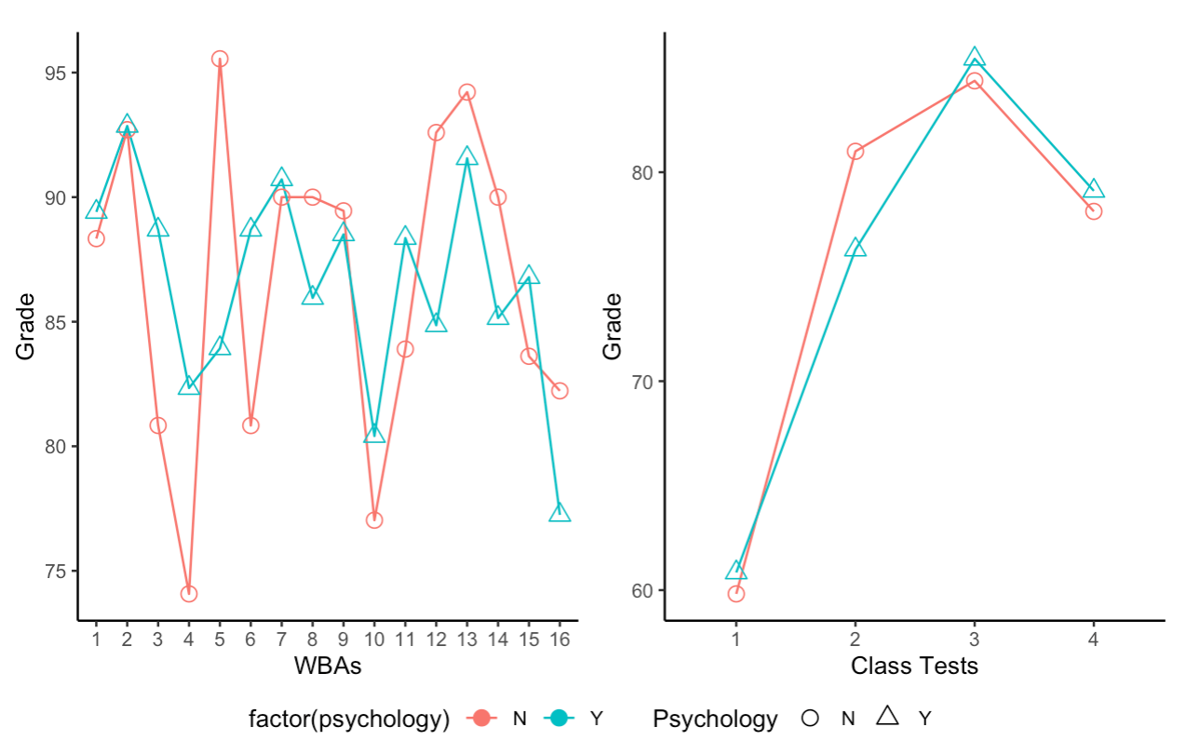
Entry level skills: Psychology
Notes:
35 Year 1 Students consented to the use of their data; we only have entry data for year 1 – admissions dumps the data at the end of each recruitment cycle.

Slide 18
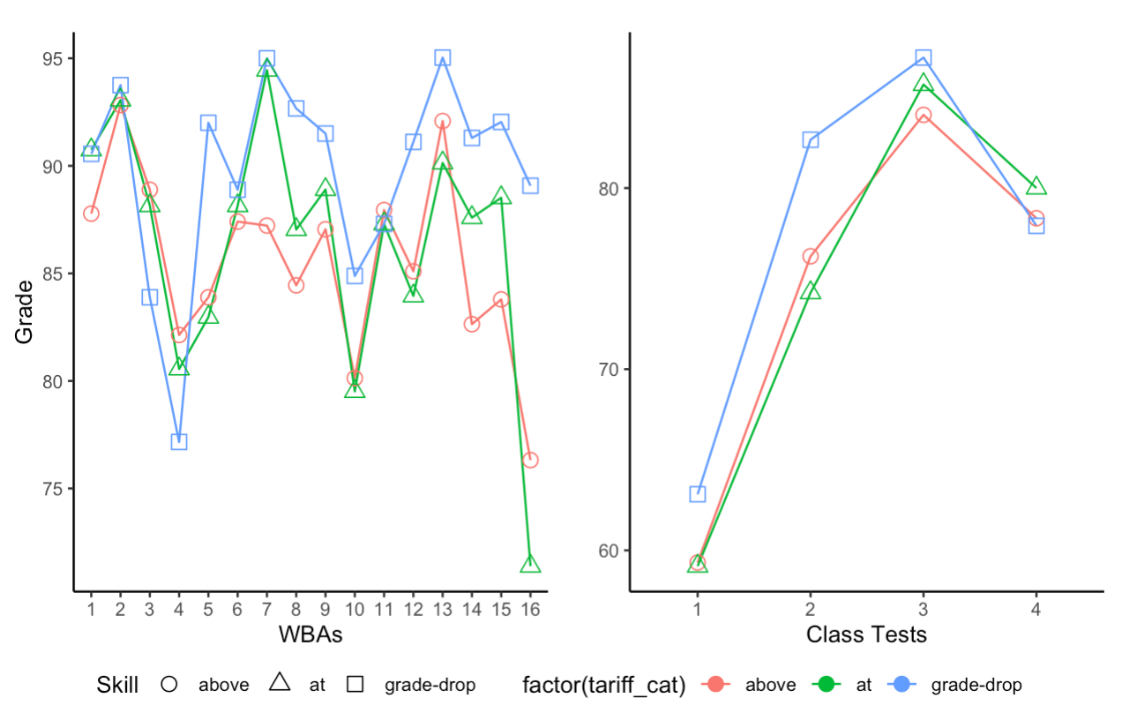
Entry level skills: Tariff points
Notes:
35 Year 1 Students consented to the use of their data; we only have entry data for year 1 – admissions dumps the data at the end of each recruitment cycle.

Slide 19
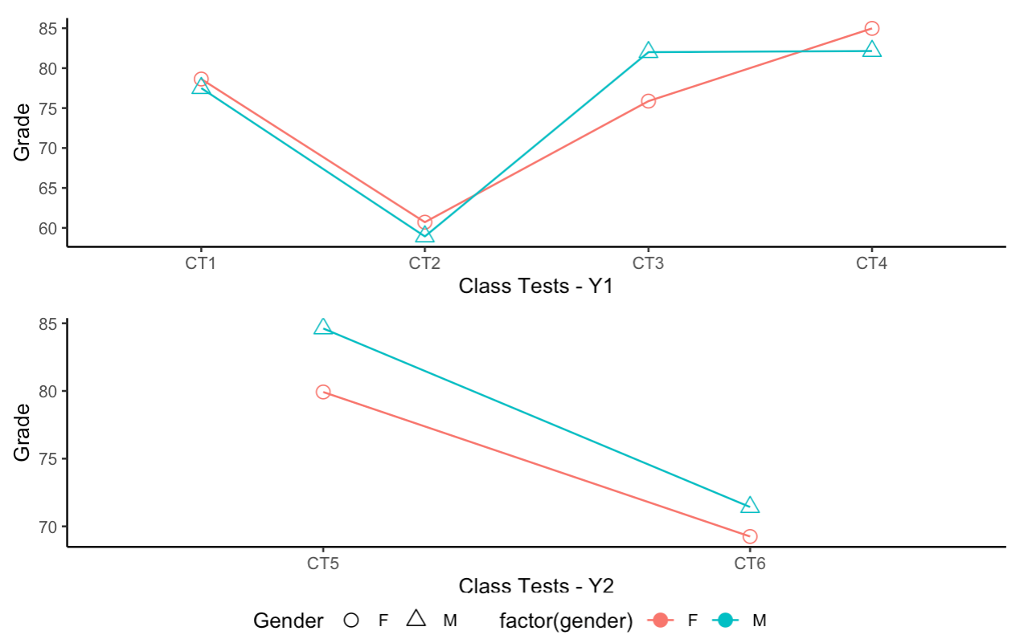
Gender for Class Tests
Notes:
35 Year 1 Students consented to the use of their data; we only have entry data for year 1 – admissions dumps the data at the end of each recruitment cycle.
46 Year 2 Students consented to the use…

Slide 20
Entry level skills / Gender: conclusions
Neither level 3 maths nor psychology provides an advantage for statistics attainment in class tests
(for this year) Students at a lower tariff seem to consistently score higher*
In Year 2, male students appear to consistently score higher than female students*
The two-year programme is a good general introduction to statistics for our psychology students
* not statistically significant

Slide 21
Skills Maps

Slide 22

Skills Map
5 broad areas for assessment
Conceptual framework
Data collection
Data management
Data evaluation
Data application
With further sub-competencies.
It’s nice!

Slide 23

Skills Map
Data to the People created their framework “Databilities”
5000 people across 5 countries in 14 industries
3 labels:
Curious: 45 – 51%
Confident: 40-44%
Coaches: 7%
(but it’s trademarked 😱)

Slide 24
Skills Map
Data Collection
Data discovery and collection
Evaluating & ensuring quality of data & sources
Conceptual Framework
Introduction to data
Data Evaluation
Tools
Basic data analysis
Interpretation
Identifying problems using data
Visualisation
Presenting data verbally
Data driven decision making
Data Management
Organisation
Manipulation
Conversion
Metadata creation & use
Curation, security & re-use
Preservation
Data Application
Critical thinking | Data culture
Data ethics | Data citation
Data sharing | Evaluation decisions based on data
Notes:
Blue = conceptual competencies;
Green = core competencies
Red = advanced competencies

Slide 25
Skills Map: conclusions
No one came!!!
The name of this strand may have been unfamiliar?
Anecdotal evidence from other parts of the department that when interviewed, our graduates don’t make links between the soft skills they learn during their degree and workplace tasks / skills
Some awareness / practice and strategies for surfacing skills may be necessary
I’m going to implement this next year in a different way
Would love it if anyone else was interested in having a go in their department – SPSS or R…it’s all good!

Slide 26
Focus Groups
Notes:
3 focus groups for year 2; 2 for year 1 – small pool for recruitment

Slide 27
Focus Groups: Value
Students felt they could claim “basic” skills at the end of Year 2
Never conceived of working as they do in R before they began learning – could see the value of it
…but didn’t think they would use it in an employment role after university
…they wanted to “help people” and felt working with data was desk work

Slide 28
Focus Groups: Resources
Weekly WBAs “forced” them to practice
Preferred to get questions wrong because getting questions right on the first attempt didn’t make them think and they couldn’t explain why they were right
Hour long labs were too short
Pre-recorded video lectures were useful because they could go through them at their own pace
By the end of year 2, still not ready to help each other – vertical relationships still primary

Slide 29
Focus Group: conclusions
Students want to be on the front line
Don’t appreciate the supporting role of data in the therapeutic settings
Are we ignoring the fact that most of the students will not want to make a career in research?
Not aware of the reach of their skills
Reliant upon staff for solutions
They like the certainty of right or wrong answers
We don’t prepare them to be a resource to each other
We don’t encourage them to share

Slide 30
Staff Survey

Slide 31
Staff Survey
18 / 31 respondents – 1 unfinished
Approximately 1/3 were self-taught in R and RStudio
Government strategy may need to focus on this!
Approximately 1/3 had no R experience
Concerns around staff-student conversations for the conducting of the data analysis of the third-year project
Department strategy will be to out-source this to an R support role
Notes:
Good range of experience – senior researchers to early career researchers

Slide 32
Staff Survey
1/3 | 1/3 | 1/3
5 – 13 years experience Self-taught Use R for research | 1-3 years experience Self-taught Use R for research | No experience
Concerns around staff-student conversations for the conducting of the data analysis of the third-year project
Department strategy will be to out-source this to an R support role
Growth in people who could train the trainers too slow?
Notes:
Good range of experience – senior researchers to early career researchers
Survey was expressly given to those staff with supervising responsibilities for third year dissertation projects – don’t want to poke the bear too often, some staff get very prickly when we talk about R and R experience

Slide 33
Staff Survey
Ranking desirable attributes in graduating Psychology students
Ability to critically appraise research outputs
Effective communication skills (verbal and written)
Depth of knowledge in one or two areas of psychological theory
Ability to carry out a research project
Knowledge and competent use of statistical methods
Knowledge and use of wider data skills practices
Good team work skills
Experience of an applied setting where psychological concepts can be used
Willingness to engage with Open Science practices
Notes:
Good range of experience – senior researchers to early career researchers

Slide 34
Staff Survey
Ranking desirable attributes in graduating Psychology students
Ability to critically appraise research outputs
Effective communication skills (verbal and written)
Depth of knowledge in one or two areas of psychological theory
Ability to carry out a research project
Knowledge and competent use of statistical methods
Knowledge and use of wider data skills practices
Good team work skills
Experience of an applied setting where psychological concepts can be used
Willingness to engage with Open Science practices
Notes:
Good range of experience – senior researchers to early career researchers

Slide 35
Staff Survey
Ranking desirable attributes in graduating Psychology students
Ability to critically appraise research outputs
Effective communication skills (verbal and written)
Depth of knowledge in one or two areas of psychological theory
Ability to carry out a research project
Knowledge and competent use of statistical methods
Knowledge and use of wider data skills practices
Good team work skills
Experience of an applied setting where psychological concepts can be used
Willingness to engage with Open Science practices
Notes:
Good range of experience – senior researchers to early career researchers

Slide 36
Staff Survey: conclusions
Anonymous staff survey but it looks like the staff who are using R are self taught
Teaching the teachers is going to be priority
Opportunity for departmental professional development - does that happen in academia?
Reduced opportunities for rich conversations between staff and students for approximately a third of supervisors
A third of students out-sourced to one person for support?
Potential for reflection of this in project results
And NSS Survey 😱

Slide 37
Summary
Teaching statistics through R appears to yield similar attainment in statistics to being taught through SPSS
So the added value is the learning to code part
They learn an awful lot but don’t realise the currency of this type of learning by the end of their training
Explicit methods are needed to surface the data skills learning
Triangulation of assessment?
Traditional tests
Self assessment tool akin to the skills map
Project based work

Slide 38




Summary
Project based work
Skills mapping through self assessment
Traditional tests

Slide 39
Question time

