Slide 1
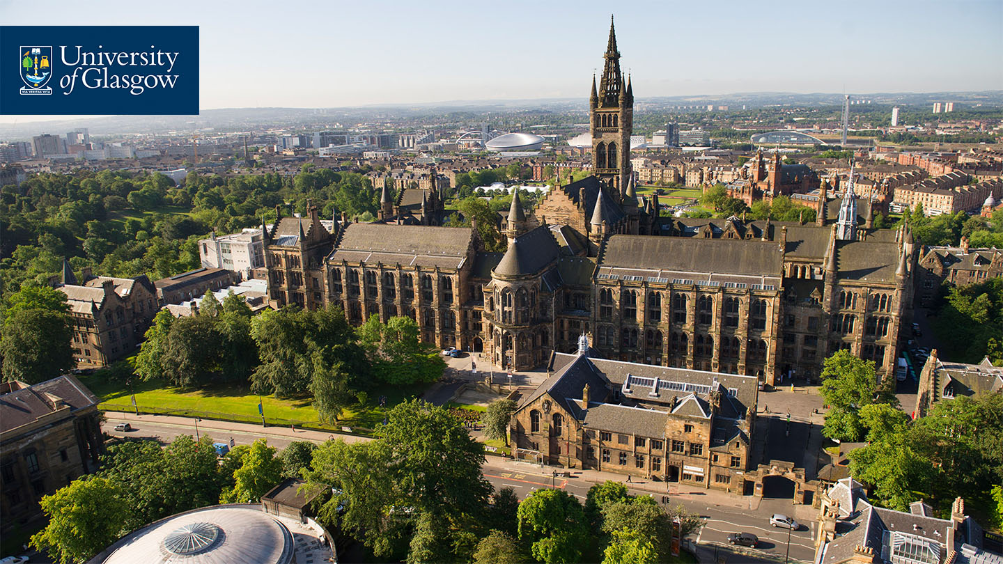
#psyTeachR: Teaching Robust and Reproducible Research Methods
Teaching Statistics with R in Psychology
23 June 2022
Helena Paterson & James Bartlett
School of Psychology and Neuroscience, University of Glasgow
@PatersonHelena / @JamesEBartlett / @UofGPsychNeuro

Slide 2


Welcome!
The Good Stuff/Why we do this
Reproducible Data Skills
Pedagogical Approach & Curriculum
Creating Community
Conclusions & Questions
Dr Helena Paterson
@PatersonHelena

Slide 3
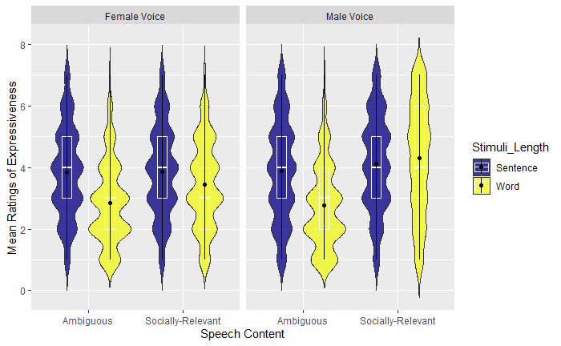
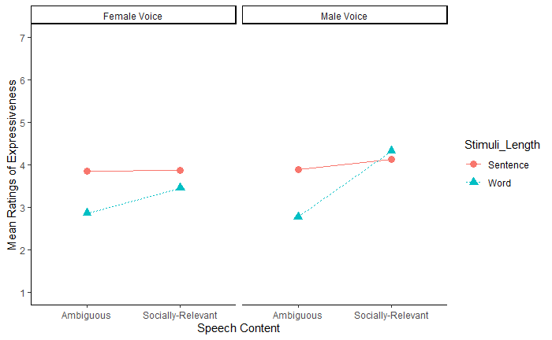
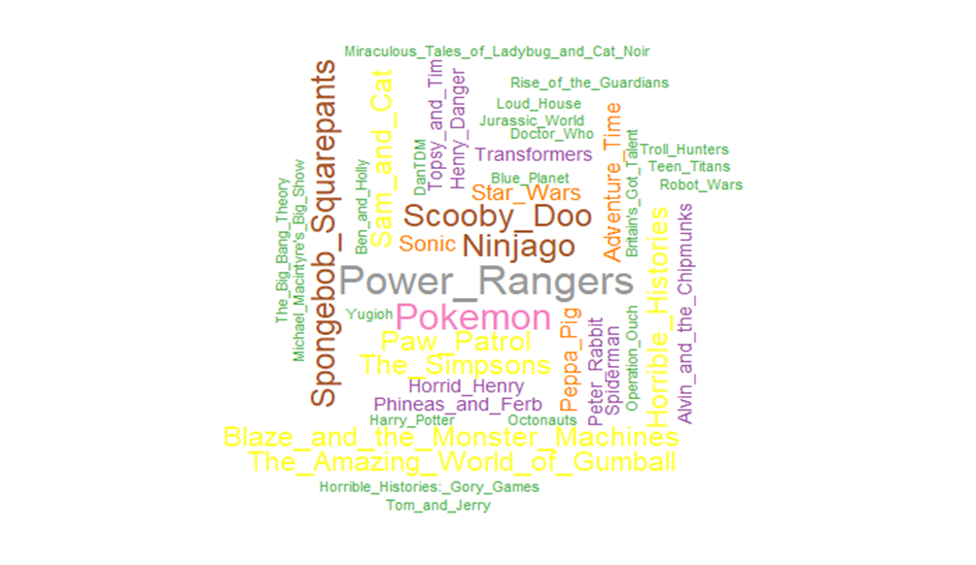
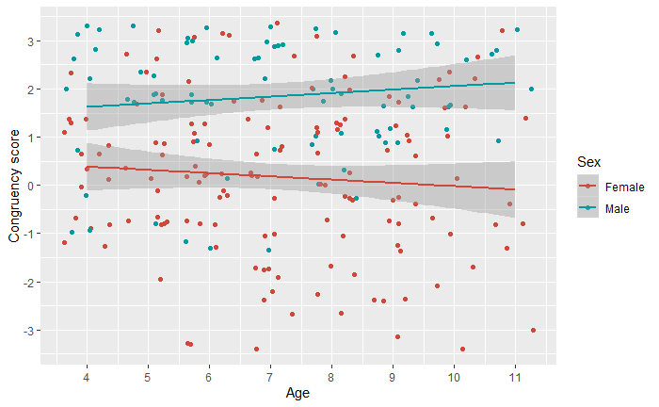
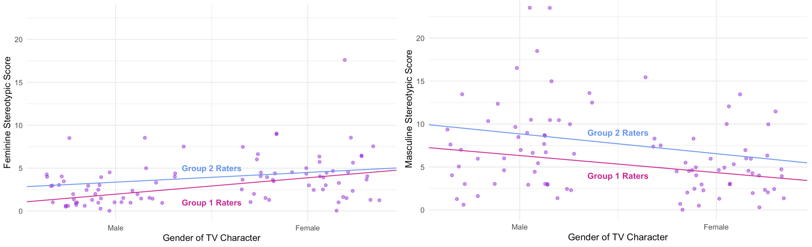
Three Student Projects
Project | Visualisation | Analysis
Perceived Expressiveness of a Speaker’s Voice in relation to Gender, Speech Content, and Stimuli Length |  | Maximal linear mixed-effects model (random slopes for participant and stimuli)
Fun and games with person perception: children's preference for gendered TV shows and characters |  | Descriptive (word clouds) Regression Logistic Regression
Contemporary Children’s TV Programmes Portray Traditional Gender Stereotypes |  | ICC (inter class correlations) Regression
Confidence and skills to take on unfamiliar data, make and execute an analysis plan, communicate the results
Notes:
Level 3 group projects
2500 word write-up
10 weeks
Design, ethics, gather data, analysis, write up a report
First taste of real research

Slide 4
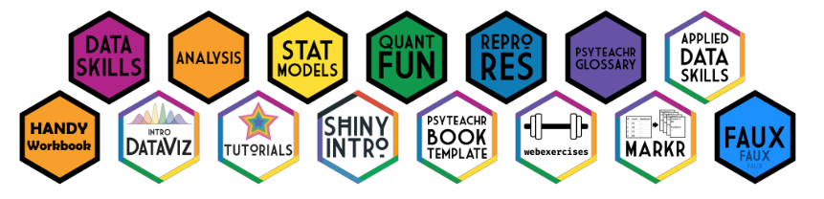
Gifts to the community
Any comprehensive curriculum, review is difficult, but open educational resources can ease the transition.
https://psyteachr.github.io/

Slide 5




Reproducible Data Skills
We teach more than statistics
Notes:
Our curriculum now emphasizes essential ‘data science’ graduate skills that have been overlooked in traditional approaches to teaching, including programming skills, data visualisation, data wrangling and reproducible reports. Students learn about probability and inference through data simulation as well as by working with real datasets.

Slide 6
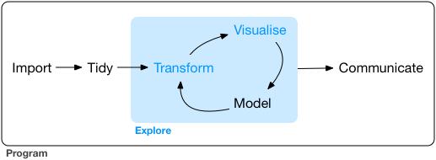
Grolemund & Wickham (2017), R for Data Science
Little Formal Teaching
Traditional Focus
Notes:
Our curriculum now emphasizes essential ‘data science’ graduate skills that have been overlooked in traditional approaches to teaching, including programming skills, data visualisation, data wrangling and reproducible reports. Students learn about probability and inference through data simulation as well as by working with real datasets.

Slide 7
Grolemund & Wickham (2017), R for Data Science
psyTeachR Focus
Notes:
Our curriculum now emphasizes essential ‘data science’ graduate skills that have been overlooked in traditional approaches to teaching, including programming skills, data visualisation, data wrangling and reproducible reports. Students learn about probability and inference through data simulation as well as by working with real datasets.

Slide 8
Our method is to teach computational thinking skills:
breaking problems into small parts
https://psyteachr.github.io/

Slide 9
Analysis pipeline Requires computational skills
Traditional
Current
Import data
Data Processing & Reshaping
Excel, SPSS
Assumption checks
Excel, SPSS
Visualisation & Descriptive
Excel, SPSS
Statistical analysis
SPSS
Reporting
Word processor
Import Data/Simulate data
R: tidyverse
Data Processing & Reshaping
R: tidyverse
Assumption checks
R: Various packages & BaseR
Visualisation & Descriptives
R: tidyverse & others
Statistical Modelling
R: various packages
Reporting
Inline coding and Word processor

Slide 10
Formal Teaching for analysis
Traditional
Current
Assumption checks
Statistical analysis
Reporting
Added bonusses: power analysis
Data simulation
Power analysis
Data importing
Data Processing & Reshaping
Assumption checks
Visualisation & Descriptives
Statistical Modelling
Reporting

Slide 11
What students think analysis is Subjectively from my mentoring discussions
Traditional
Current
Assumption checks
Analysis
Visualisation
Reporting?
Importing data
Power analysis
Data Processing & reshaping
Assumption checks
Visualisation & Descriptives
Statistical Modelling
Reporting

Slide 12
Locus of imposter syndrome
Traditional
Current
Statistical analysis
Coding
(not statistical analysis)

Slide 13
Pedagogical Approach
Build skills gradually and emphasise practice
Build a foundation (processing, visualisation) before analysis
Slow it down: teach a few things well

Slide 14
Coherent UG Curriculum
Yr | Topics | N | Principle Teaching Methods
1 | IDE, RMarkdown, Coding, data processing, visualisation, probability, descriptives | ~500-600 | Lectures in Qual & Quant Methods Lectures in Qual and Quant Analysis (hand calculation) Practical skills course & labs Assessment: Exams, Reports, Homework
2 | Recap L1 skills, simulate data, power, descriptives, inferentials (correlations, regressions, t-tests, ANOVA), the GLM | ~300
3 | Simulation based approach to mixed-effects models, psychometric data | ~150 | Lecture-based course on Stats Modelling Small-scale Quant and Qual projects (Yr3) Options courses Dissertations (Yr4) Assessment: exams, project write-up, practical skills assessment
4 | Advanced topics such as factor analysis, bootstrapping and permutation tests, qualitative methods

Slide 15

Coherent Conversion Curriculum
Semester 1 | Topics | Principle Teaching Methods
1 | IDE, RMarkdown, Coding, data processing, visualisation, probability, descriptives, power, inferentials (correlation, t-test | Lectures in Qual & Quant Methods Lectures in Qual and Quant Analysis Practical skills course & labs Small-scale Quant and Qual projects Assessment: Reports, Homework
2 | Regressions, ANOVA
3 | Dissertation | ~200 students

Slide 16
Creating Community
Dr James Bartlett
@JamesEBartlett

Slide 17

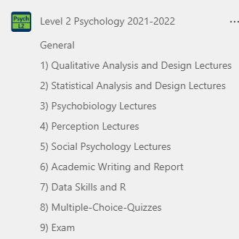
Levels of support
Within courses
In-person labs (co-teaching, live coding)
Group assessment projects (e.g., preregistration)
Course specific Teams channels
Graduate teaching assistant support sessions
Notes:
Practicalities

Slide 18
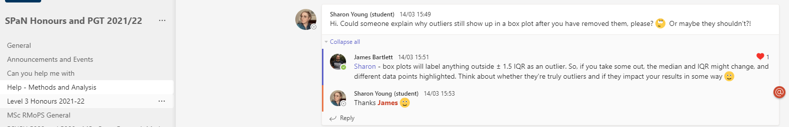
Levels of support
Outside courses
Staff office hours
Data analysis help pages
Notes:
Practicalities

Slide 19
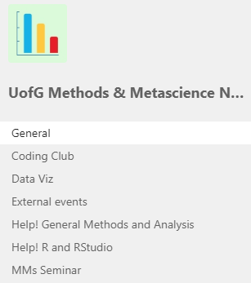
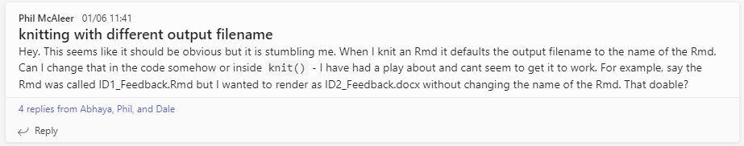
Levels of support
Continuous professional development
Methods and Metascience group
Coding club
Weekly seminars
Analysis support pages
Notes:
Opportunities: Strong statistics and research methods present. Different opportunities for staff and students to learn together.

Slide 20
New starter experiences
Important to attract relevant expertise: “Competency in use of, and teaching of, R”
Focus on data skills / reproducibility (not just R) key: Students have a more rounded workflow when it comes to dissertations
Familiarise yourself with the new materials: What should we expect students to know at their learning stage?
Adapting open educational materials makes it easier to collaborate and advance the content
Notes:
Practicalities
Challenges – like working with SPSS, its not going to be everyone’s strength. Some people are going to be more comfortable than others. So, how can we support existing staff, so they can support their students?

Slide 21
New starter challenges
Unlike point-and-click software, there is not a single way of performing a task: Base R or Tidyverse?
Staff imposter syndrome: Worry about teaching the “right way” –anxious about using methods different to what the students know
….But, the students are confident in their abilities and embrace flexibility

Slide 22
Take home messages
Teaching in this way has given us lots of opportunities
Different levels of support help both staff and students
Embracing open educational materials allows us to move beyond silos towards an integrative approach

Slide 23

The #psyTeachR Community
These changes have truly been a team effort between staff and students
Special mention to:
Dale Barr, Lisa DeBruine, Phil McAleer, Heather Cleland Woods, Emily Nordmann, Carolina Kuepper-Tetzel, & Niamh Stack
@PatersonHelena
@JamesEBartlett @UofGPsychNeuro

Slide 24
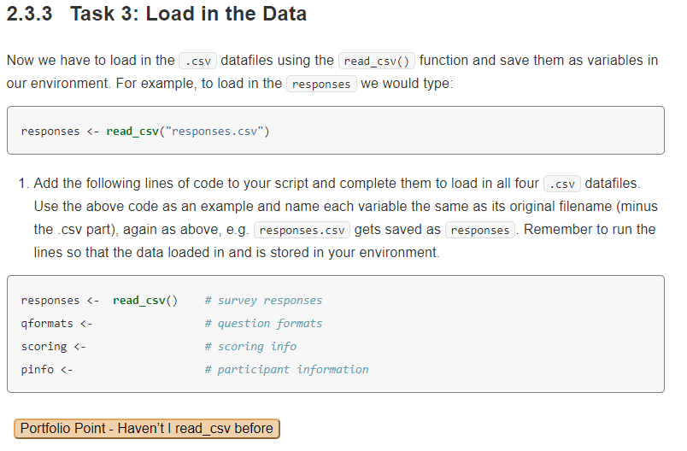
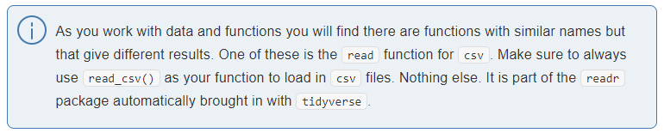
use a novice friendly syntax
real data wherever possible
PreClass, InClass, Assignment
Increase complexity and reduce hints as chapters progress
Integrate theory, research methods, terminology as well as data skills
Allow for formative self-assessment with solutions at the end of each chapter to allow people to check themselves and to move on
https://psyteachr.github.io/ug2-practical

