Slide 1

Perceived barriers to learning R amongst psychology faculty: A focus on motivation
Jenny Terry
Lecturer & Doctoral Researcher
School of Psychology
University of Sussex
Twitter: @jennyterry
Email: jlt26@sussex.ac.uk
Web: www.jennyterry.co.uk

Slide 2
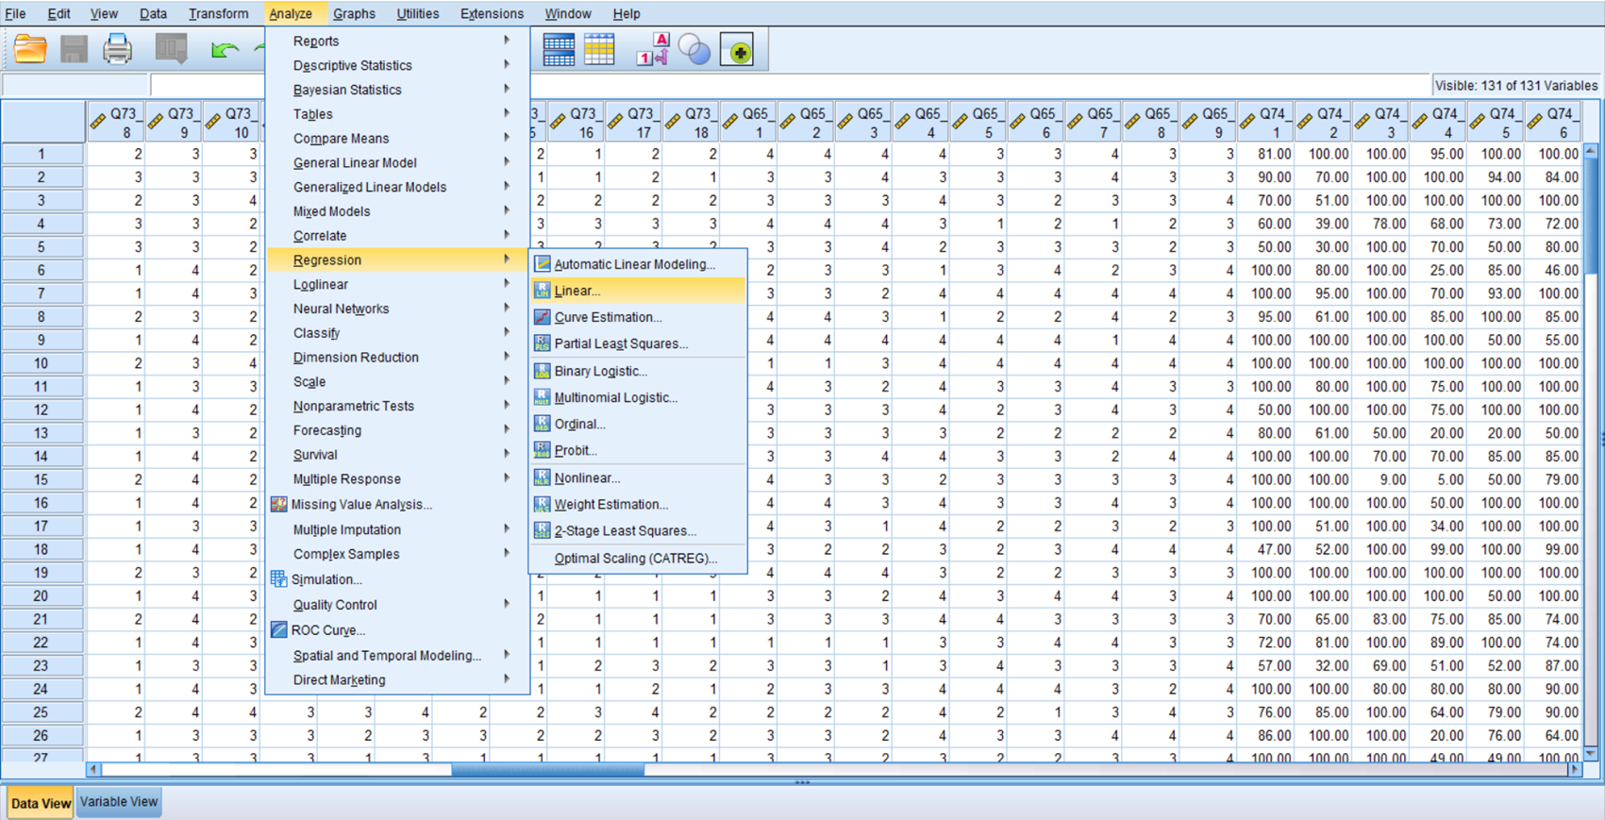
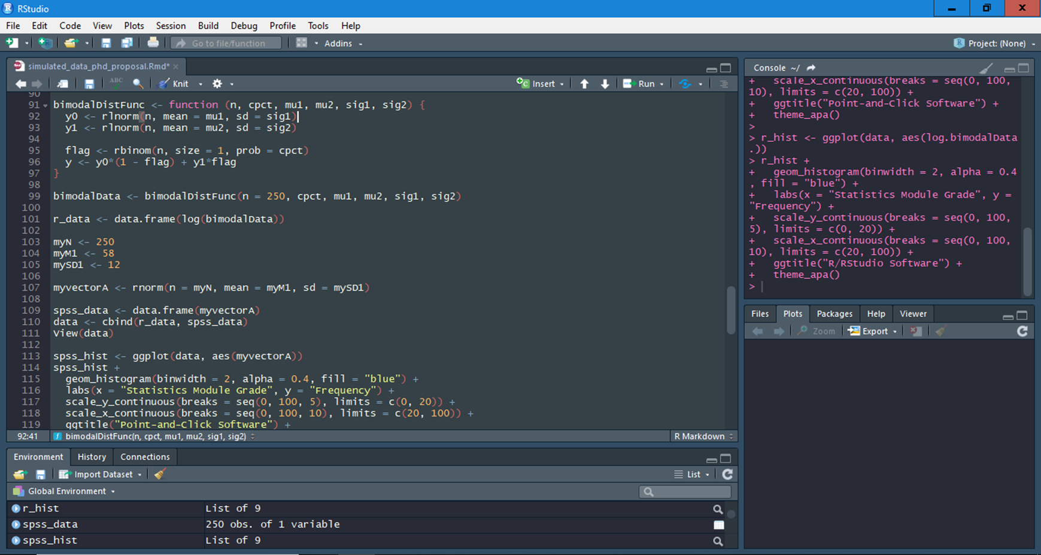


Background
Psychology departments are increasingly considering teaching R instead of IBM SPSS Statistics for data analysis on research methods/statistics modules
Concerns exist over the steep learning curve of R command line interface (right) compared to the relative ease of SPSS’s ‘point and click’ graphical user interface (left)
Research is needed that examines what the concerns are, whether they are valid, and whether/how they can be overcome

Slide 3

The Study
Participants were Psychology teaching staff who had also recently completed introductory R training and were considering the shift to R at UG level
2 x n = 3 ~60-minute semi-structured group interviews & n = 28 qualitative questionnaires
Participants were asked to reflect on their experiences of learning R
Thematic analysis (inductive; semantic)
Themes centered around challenges to be overcome, including:
R vs. ‘point & click’ software
Teaching/learning statistics
Practical resources
Differentiated ability levels
Emotional/attitudinal resources (e.g., motivation)

Slide 4

What do we know about motivation in learning R?
Motivation is argued to be the most important predictor of achievement in higher education (e.g., Biggs & Tang, 2011)
It is suggested that motivation (along with anxiety reduction) could address the key barriers to learning statistics amongst psychology students (e.g., Field, 2010)
Course evaluations indicate students will overcome R’s learning curve, as long as they are motivated (e.g., Poldrack, 2018).

Slide 5
Which factors influenced motivation to learn & persist with R?
Accountability
Value
Self-Efficacy

Slide 6

Accountability: Encourage consistent regular engagement with R
“I needed to know somebody expected me to do something by a certain time because there was just so many other things going on.”
“I don't think there’s any chance that we'll make any progress if we all just carry on trying to do it on our own.”
Barriers:
Accountability was required even for otherwise motivated learners because of competing priorities
For UGs experiencing anxiety/low efficacy, they are more likely to deprioritise R (e.g., Macher, et al., 2015)
Research suggests most students will (understandably) prioritise assessed work (e.g., Ramsden, 2003)
End of module assessments are too far away to generate the required sense of urgency
Possible solutions:
Regular assessed quizzes/tasks
Assessed attendance/participation
Accountability buddies/group work (best for engaged but struggling students)

Slide 7

Value: Ensure students understand why it is important to learn R
“I needed to do robust analyses and you can't do [those] analyses in SPSS”
“I'm less motivated to use R because… I could do it all in SPSS”
“I felt like I was falling behind [my peers] a little bit”
“Students need to know the reasons why they're learning something… they're very outcome driven”
Barriers:
Without perceived value, motivation was low and vice-versa
Premise supported by achievement motivation theories/research (e.g., Control-Value Theory from Pekrun, 2006)
Value was derived from research/teaching needs that will often not apply to UGs
Much of what we teach in R (esp. at the beginning) is quite abstract so its applied relevance is unclear
Possible solutions:
Demonstrate uses of R ‘in the wild’ to show employability gains that are not (just) research-specific
Show students how content/learning objectives map onto assessments
Use research-led/project-based teaching to show how R skills are applied in psychological research

Slide 8

Self-Efficacy: Develop students’ beliefs that they can learn R
“[Successfully learning R] is actually more the confidence than the ability”
“I was falling behind and stressing out, but being reassured that everyone works at their own pace made me want to stay and learn”
“I think [being shown errors are normal] gave me the confidence to try out different things”
Barriers:
Participants needed to believe that they had the capacity to learn
Errors and warnings (and struggling generally) can chip away at self-efficacy
Premise supported by Bandura’s (1997) self-efficacy theory and motivation theories (e.g., Control-Value Theory from Pekrun, 2006)
These theories also propose low self-efficacy can increase anxiety and, in-turn, avoidance
Possible solutions:
Normalise (model) ‘mistakes’ and needing to Google stuff!
Make others’ learning journeys visible to reassure them they’re not alone if struggling at first and can get there in the end
Encourage reflection on their progress & celebrate the little wins
Start with the easy wins

Slide 9




Other: Some final things that could affect motivation to learn R
Time
Students’ may need more time to get to grips with R than point & click software
Support
Students will need more support outside of class
Ensure multiple resources are available outside class too, such as interactive tutorials, helpdesks (student triage?), discussion boards etc.
Anxiety
Existing statistics anxiety could be exacerbated
Allocate enough time in student workload plans for self-guided learning (more time required than SPSS!)
Reduce uncertainty by explaining and showing what is required throughout their courses (e.g., no learning by heart, basic grammar of functional programming is transferable to other tasks)

Slide 10
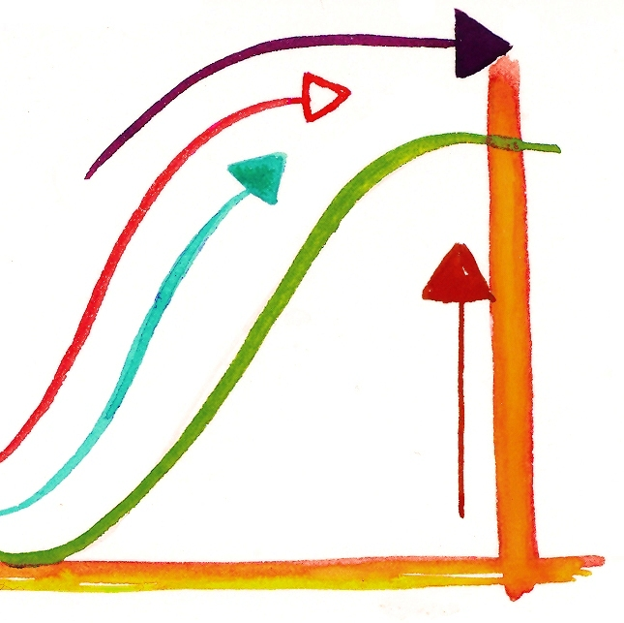
Concluding Thoughts
Teaching R has its own steep learning curve.
It is important to manage student attitudes and emotions as well as the practicalities to maximise students’ chances of success.
We cannot swap everything like for like and expect the same results.
How we best do that is an ongoing empirical question.

Slide 11


Click the logo to find out more about the Researchers of Statistics Education Network!
Jenny Terry
Lecturer & Doctoral Researcher
School of Psychology
University of Sussex
Twitter: @jennyterry
Email: jlt26@sussex.ac.uk
Web: www.jennyterry.co.uk

