Slide 1
Context for the example
Middle-Earth is the fantasy world of the Lord of the Rings trilogy. It has many imaginary races of people, including dwarves, elves, and hobbits.
The villain of the story, Sauron, corrupted these races of people by giving them magical rings that controlled their minds and turned them into monsters.
At the end of the series, Sauron dies as a result of what is called the War of the Rings.

Slide 2
The problem
After the War of the Rings, Middle-Earthian psychologists are concerned about citizens owning rings
If Sauron was not truly dead, ring ownership could lead to anger and aggressive behavior
Gandalf wants to conduct a meta-analysis, summarizing the findings of several randomized controlled trials
Researchers give rings away to the experimental group and give nothing to the control group
Both groups’ aggressiveness is then measured using the Middle-Earthian Measure of Personal Infuriation (MMPI), with a mean of 0 and a SD of 10.
Higher numbers indicate more aggression

Slide 3
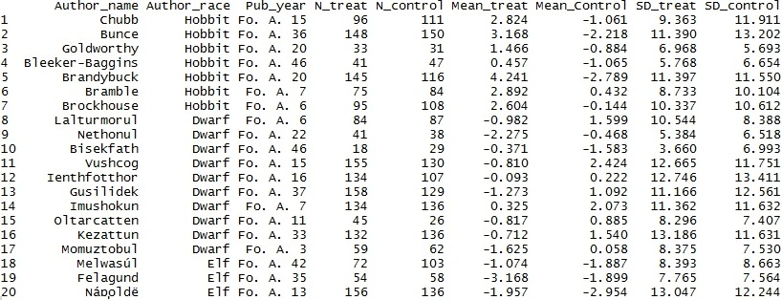
The Data
Humans are not considered to be credible scientists in Middle-Earth due to systemic racism. The official excuse is that they don’t live long enough to go through a graduate program.

Slide 4
Why document author race?
Authors of a certain race usually have subjects of that same race. Additionally there is a possible conflict of interest.
Hobbits were enslaved in the Ring War.
Rings stress hobbits out and make them angry.
Hobbit researchers want a Middle-Earthian ban on rings.
Dwarves like shiny, golden objects.
Rings make dwarves calmer.
Dwarven researchers want there to be more rings.
Elves rarely get upset about anything.
Rings do nothing to elves.
Elven researchers have no conflict of interest.

Slide 5
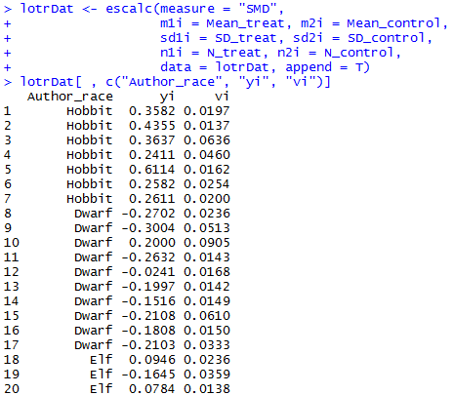
Code: computing effect sizes
Gandalf uses “metafor” package in R to compute a standardized mean difference (“SMD”), and its variance. Append this to the dataset.

Slide 6
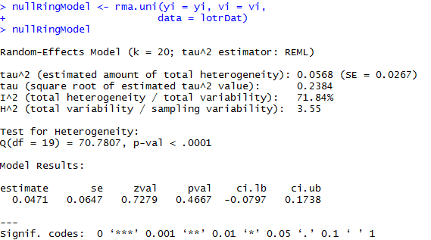
Fitting a random-effects model
Looking at τ², H², and I², it appears that there is a great deal of heterogeneity in the effect size.
The test for heterogeneity is statistically significant; we reject the null hypothesis that the true effects are homogenous across studies.
The model fails to reject the null hypothesis that the average true effect size is equal to zero.

Slide 7
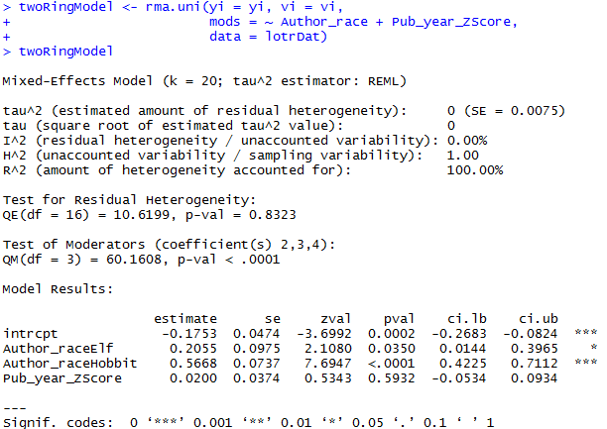
Fitting a mixed-effects model
The “mods =“ argument adds author race and a z-scored publication year.
Looking at τ², H², and I², the software estimates that there is no residual heterogeneity left.
The test for residual heterogeneity is not statistically significant
The omnibus test of moderators is statistically significant
Publication year is not statistically significant.
The effect of author race (for each race) is statistically significant, and can be interpreted as a dummy-coded regression.

