Slide 1










Data Sources
Transformations
Supply Sheets
7:00 am
Contract Costs
Contract Margins
Hours Sheets
Contracts
Payroll
Invoices
Contract Margins/ NPS
Surveys

Slide 2
Transformations
7:45 am
8:00 am
Contract Cost Roll-Ups
Margin Roll-Ups
7:45 am
NPS
Roll-Ups

Slide 3
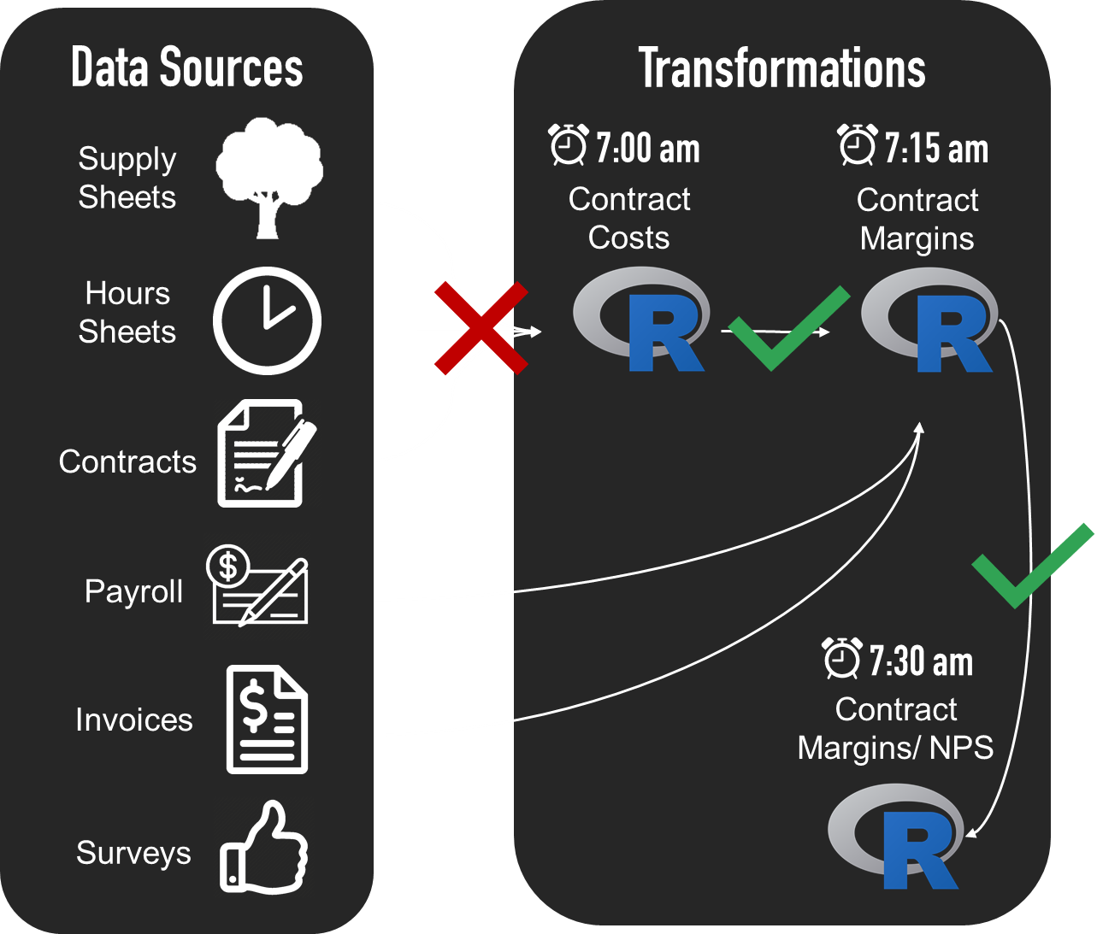
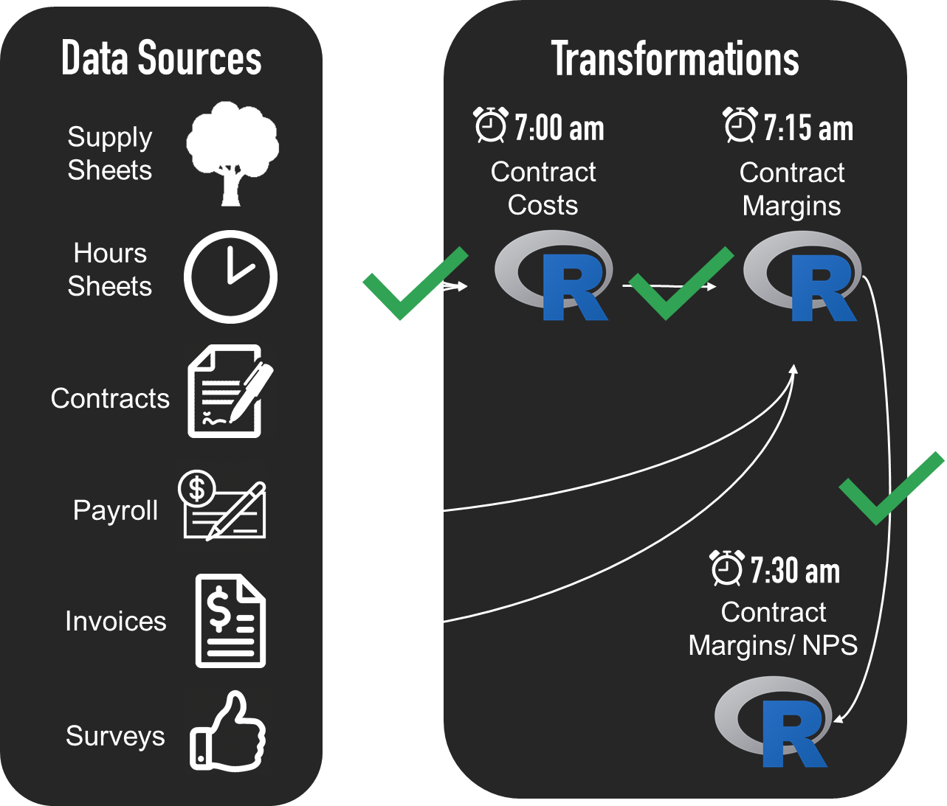
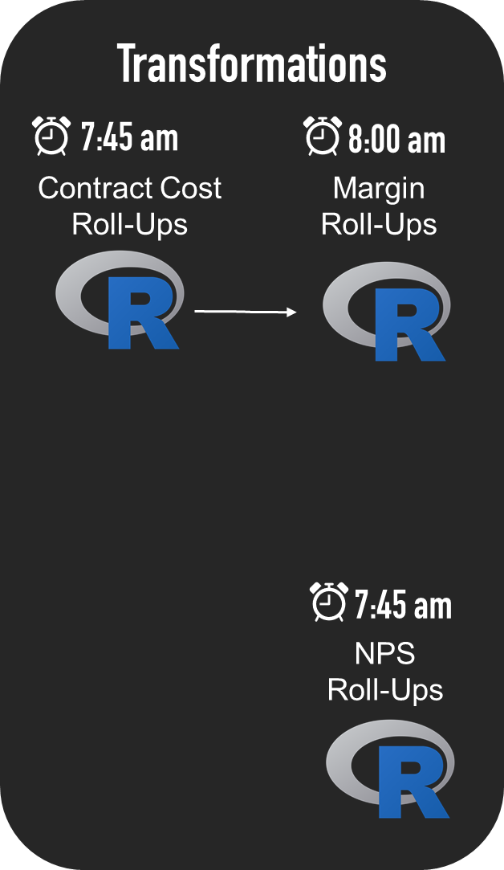
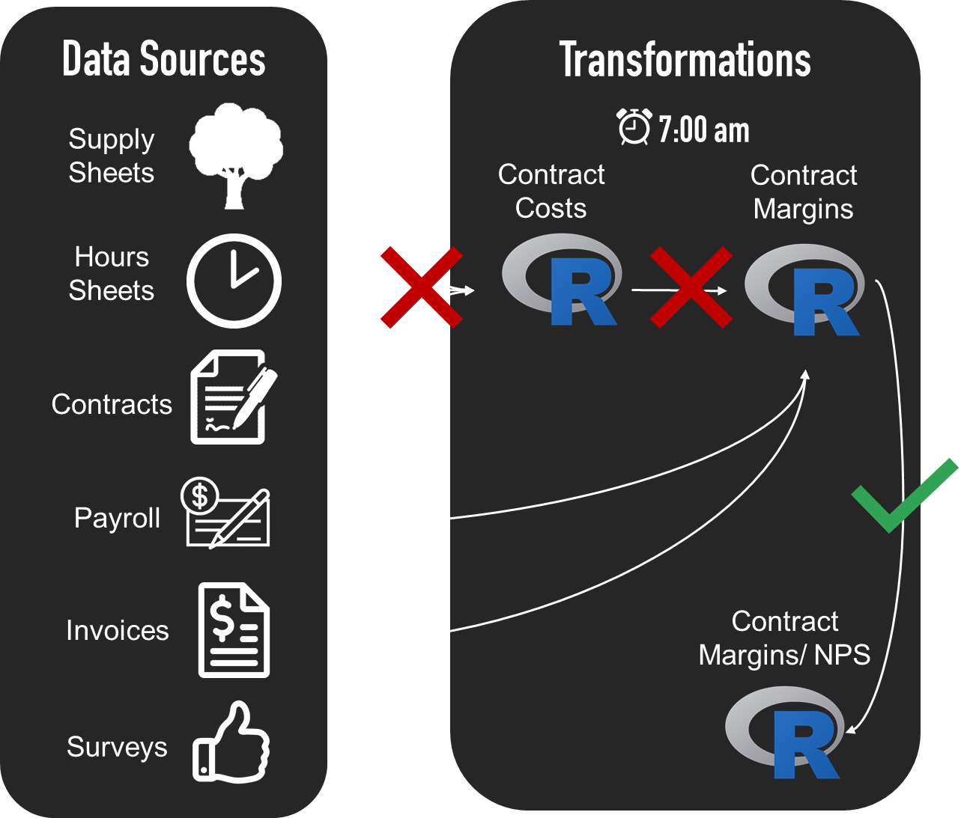
Location 1
Location 2
Location 3

