Slide 1
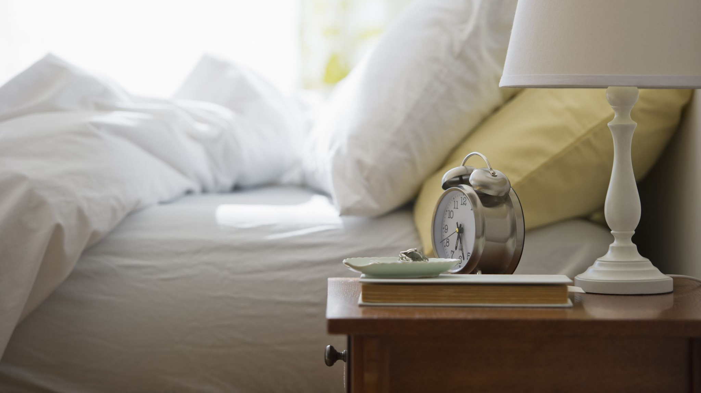
Analysis of Sleep and Lifestyle Habits
Mark Earl, Avery Kuhn-Brooks, Joshua Panchana

Slide 2


Problem Statement
WE ALL NEED TO SLEEP.
WHAT ARE THE FACTORS THAT LEAD TO A GOOD NIGHT’S REST?

Slide 3
Our Dataset
We found a dataset on kaggle.com directly related to our problem.
Features
PersonID, Gender, Age, Occupation, Sleep Duration, Quality of Sleep, Physical Activity Level, Stress Level, BMI Category, Blood Pressure, Heart Rate, Daily Steps, Sleep Disorder

Slide 4
Our Solution
We decided to use the following machine learning models to try and predict quality of sleep and apply PCA to determine what features affect sleep the most.
Linear/Logistic Regression, kNN, Random Forest, Gradient Boosting, Decision Tree

Slide 5
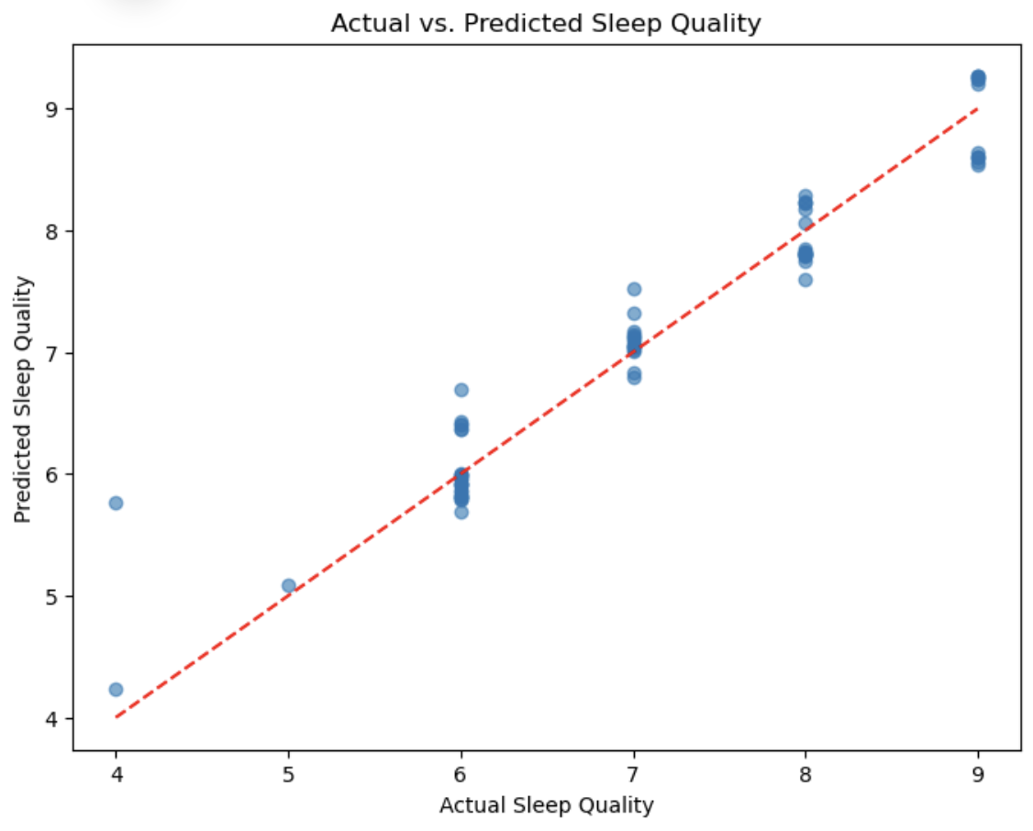
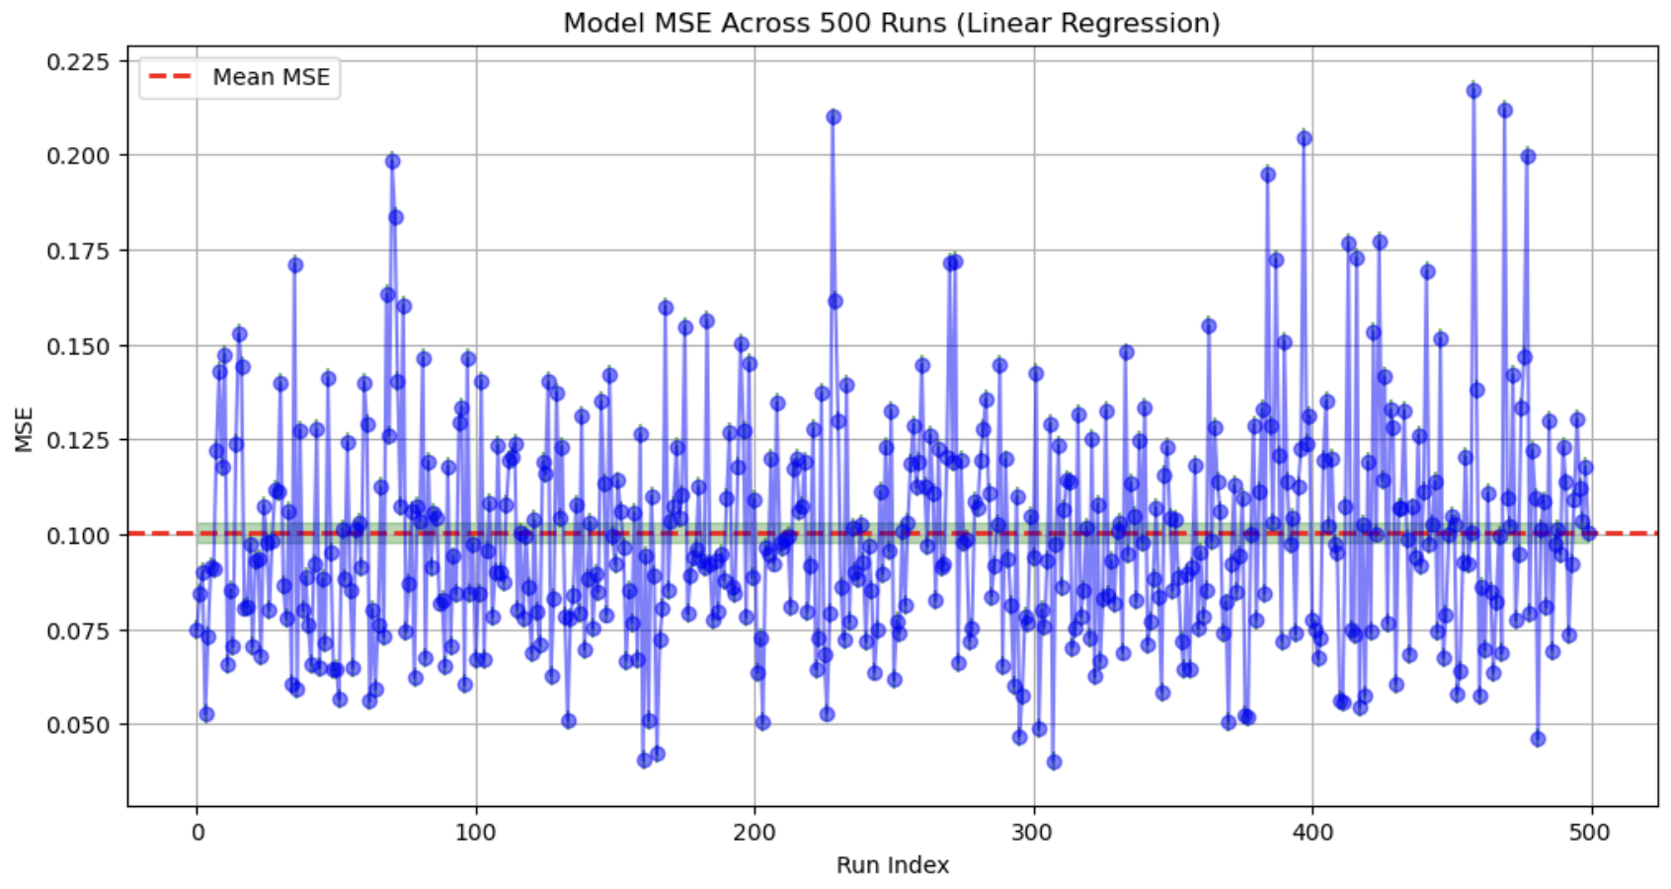
Linear Regression
Features influencing sleep quality: age, gender, BMI, blood pressure, physical activity, smoking, alcohol use, and sleep disorders
Test set R-squared: 0.932448900710167
Achieved a low cross-validation mean squared error (MSE) of 0.099

Slide 6
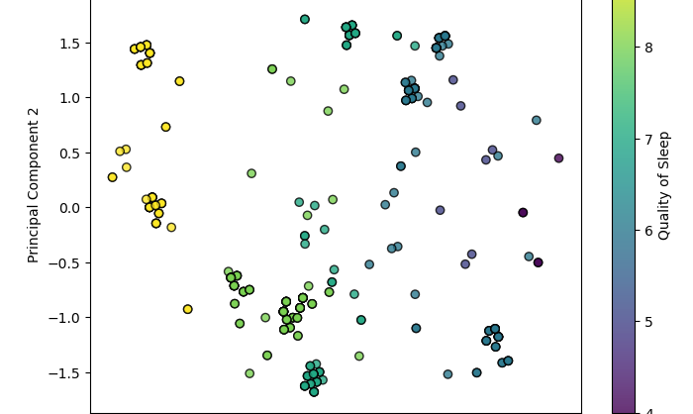
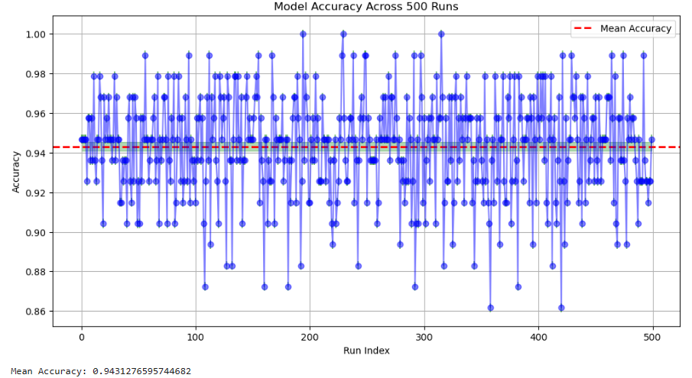
Logistic Regression
Predict: Quality of Sleep (94%)
Important Features: 'Age', 'Sleep Duration', 'Stress Level', 'Physical Activity Level', 'Sleep Disorder'

Slide 7
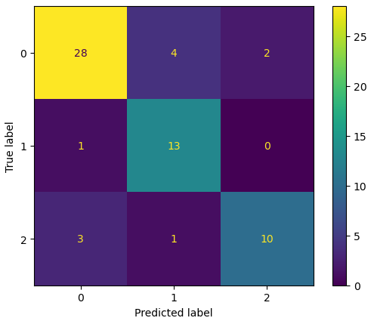
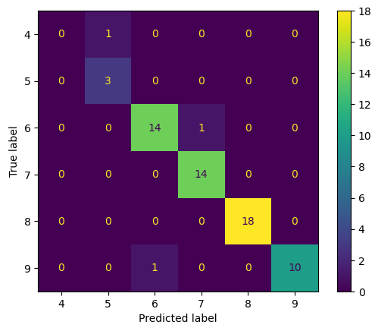
kNN
Predicting Sleep Disorder: 90%
Predicting Sleep Quality: 95%
Grid Search identified k = 5
PCA helped to identify important features

Slide 8
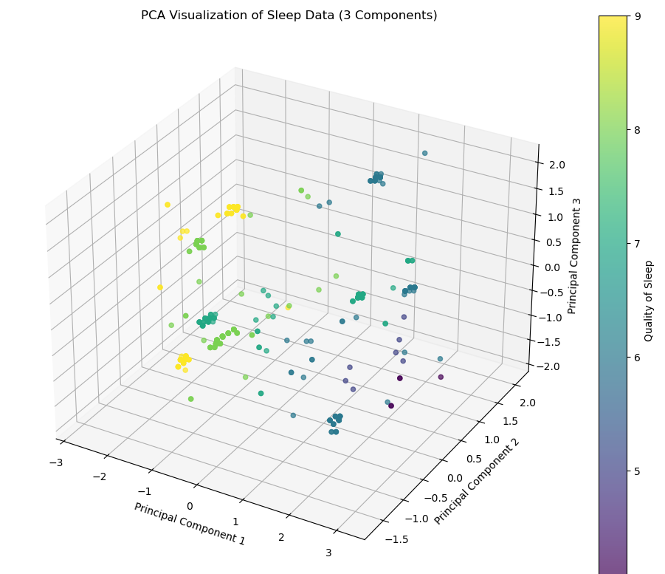
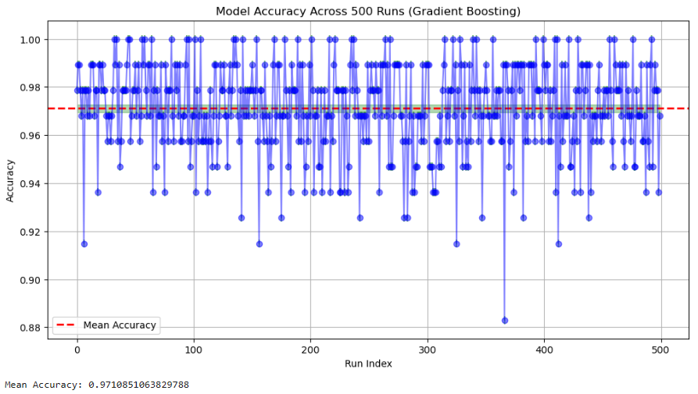
Gradient Boosting
Predict: Quality of Sleep (97%)
Important Features: 'Age', 'Sleep Duration', 'Stress Level', 'Physical Activity Level', 'Sleep Disorder'

Slide 9
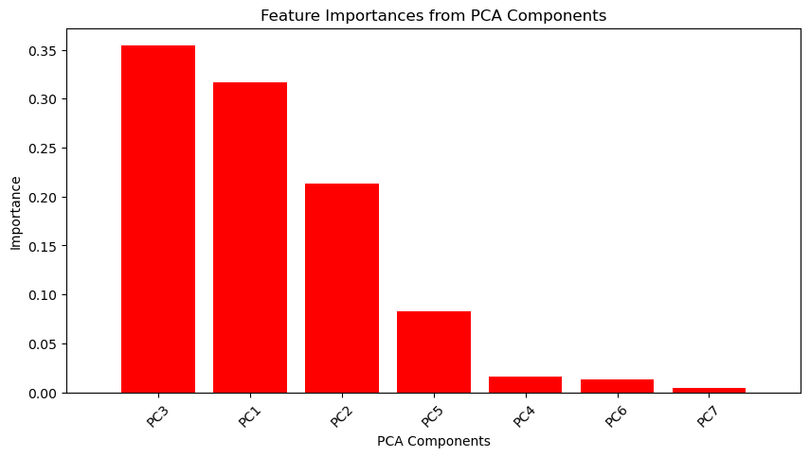
Decision Tree
Used to identify the risk of sleep disorder
Model Accuracy: 90.66%
Most influential features: Age, Daily Steps, Gender, Heart Rate
The principal components highest influence: PC3 (Gender), PC1 (Age), PC2(Daily Steps)

Slide 10
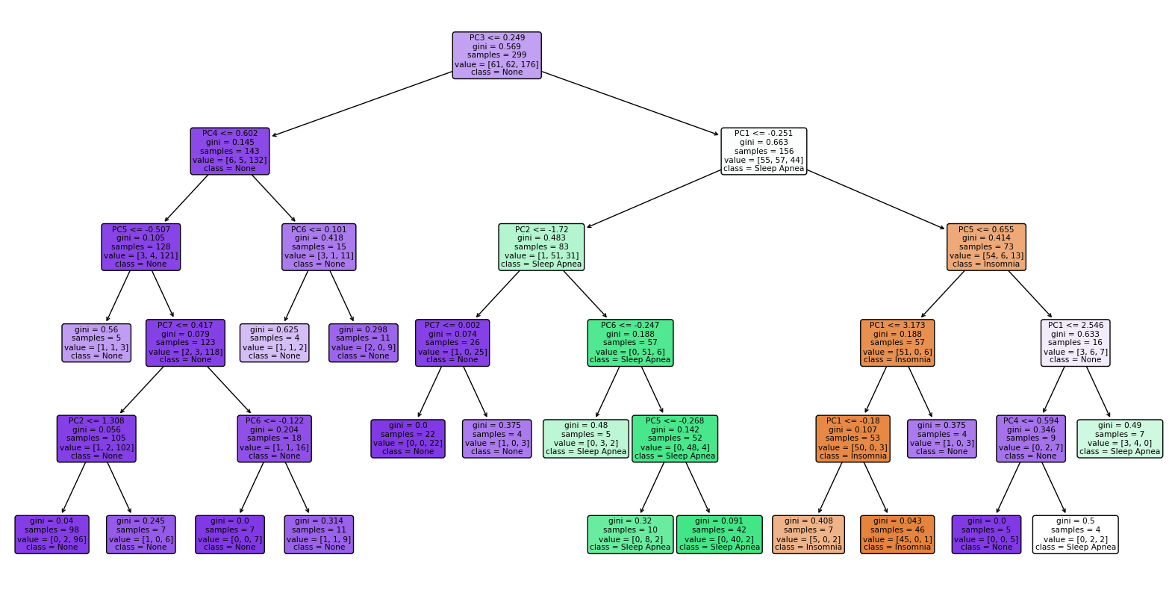

Slide 11
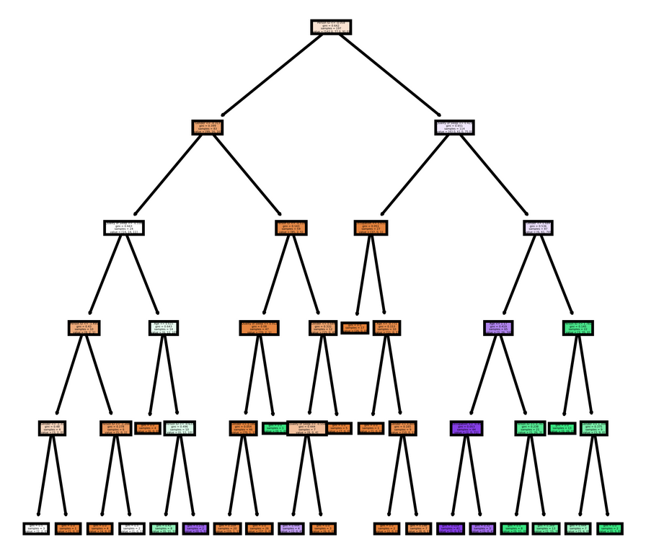
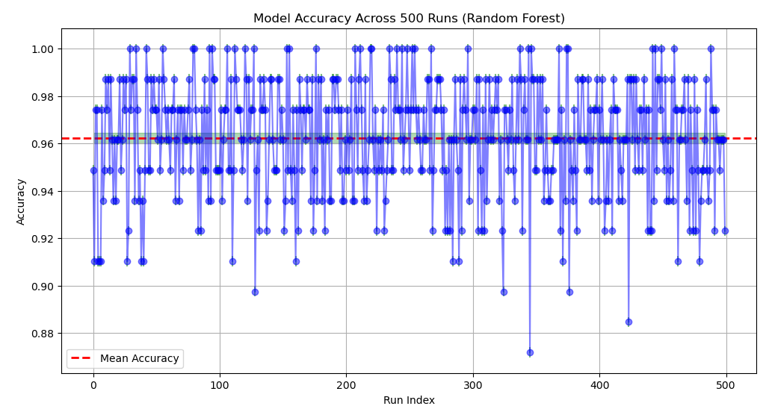
Random Forest
Predicting Sleep Quality: 96%
Random Values used to establish grid search options
Grid Search:
max depth: 6
min_samples_split: 3
n_estimators: 200
criterion: gini

Slide 12
Conclusion
Sleep quality is affected by a combination of lifestyle choices and biological features
Key Influencers: Age, gender, BMI, blood pressure, physical activity, smoking, alcohol use, and existing sleep disorders
Usage of PCA: PCA allowed for simplified models without losing crucial information

