Slide 1
Big Data Final Project
SIC 6
Notes:
Note:

Slide 2
G8
Facilitator
Abdelrahman Mahmoud
Contributors
Assem Ihab Ezzat Mohamed Aly Elgzar
Mark Eskander Sobhy Saeed
Rehab Ahmed Khalifa
Yahya Mahmoud Zakaria Abdallah
Notes:
Note:

Slide 3
Agenda
Introduction
Dataset
Environment Setup
Data processing
Visualizations and monitoring
Conclusion
Notes:
Note:

Slide 4
Introduction
Creating comprehensive dashboard
Ingest real-time Data to spark
Process the data
Save the data to persistent storage
Visualize the stored data

Slide 5
Introduction
tools
GitHub (collaboration Tool)
Docker (environment setup)
Apache Kafka (data ingestion)
Spark (data processing
MongoDB (storage)
Power BI (visualizations)

Slide 6
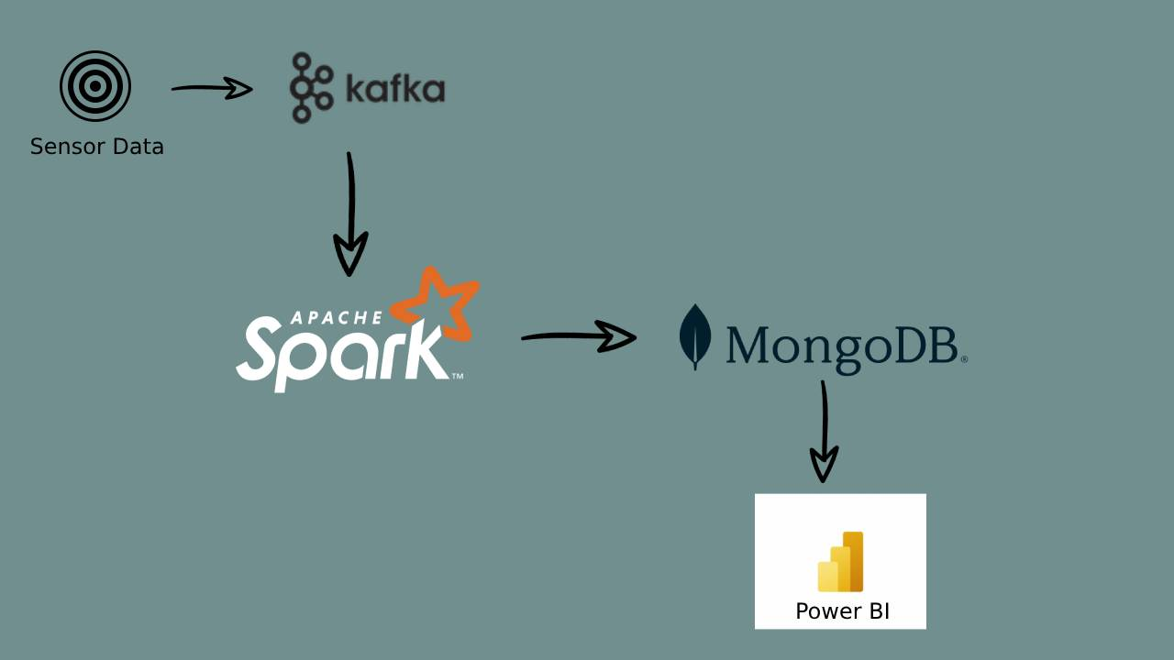
Introduction
Pipeline

Slide 7
Agenda
introduction
Dataset
Environment Setup
Data processing
Visualizations and monitoring
Conclusion
Notes:
Note:

Slide 8
Dataset
LifeSnaps Dataset: 71 participants, 4+ months of data, 71M rows, part of the H2020 RAIS project.
Multi-Modal Data: 35+ data types from Fitbit Sense, surveys, and assessments, covering activity, sleep, stress, and psychology.
Hourly Collection: Data is consistently gathered every hour and daily granularity.
Research Applications: Useful for medical innovations, data privacy, well-being, machine learning, and HCI.

Slide 9
Agenda
introduction
Dataset
Environment Setup
Data Ingestion
Data processing
Visualizations and monitoring
Conclusion
Notes:
Note:

Slide 10



Environment Setup
Creating docker compose file with these images kafka, zookeeper , spark
Creating account on mongo atlas
Setup Power BI locally

Slide 11
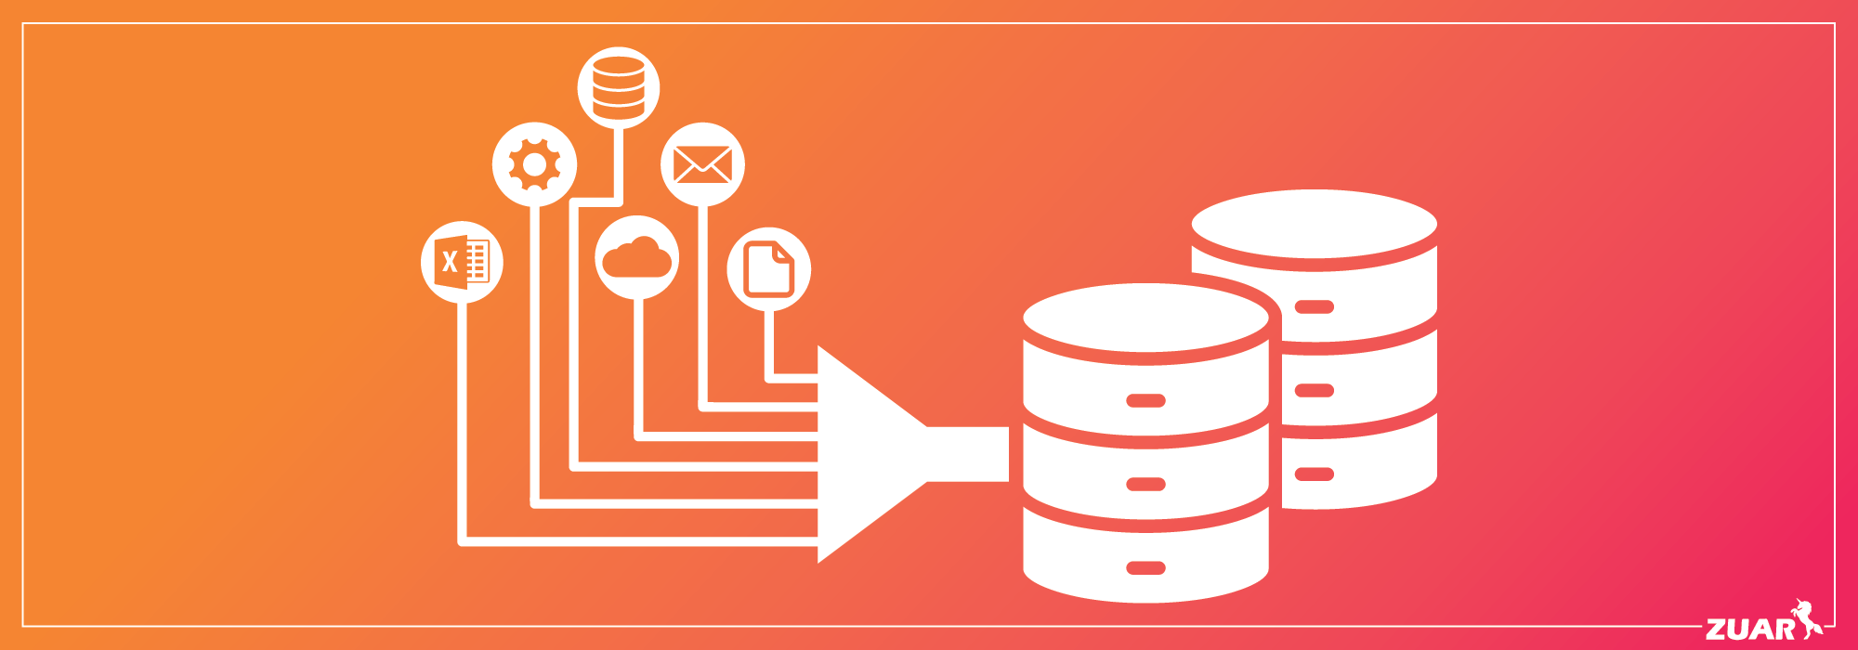
Environment Setup
Start
Start spark and download the maven dependencies
Create
Create kafka topic
Sort
Sort the data and make minimal preprocessing
Ingest
Ingest data using kafka producer

Slide 12
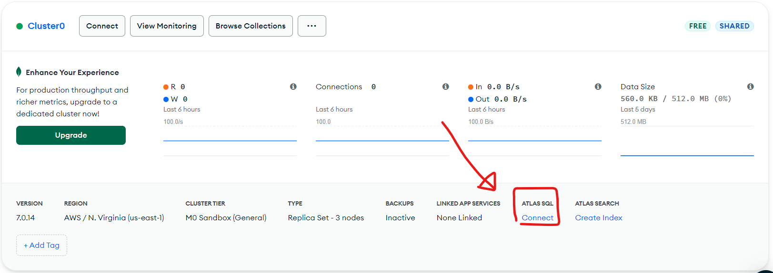
Environment Setup
Data storage
Go to Atlas SQL
Select Power bi connect
Edit the schema

Slide 13
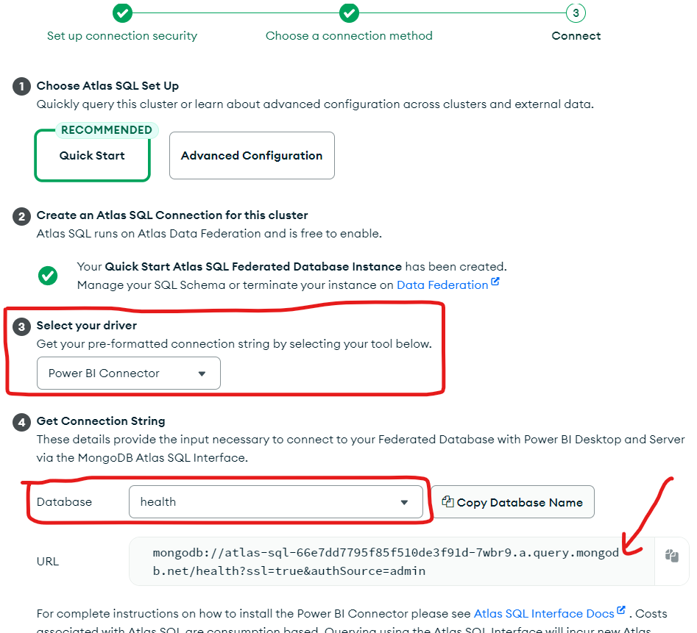
Environment Setup
Cont’d

Slide 14
Agenda
introduction
Dataset
Environment Setup
Data Ingestion
Data Processing
Visualizations and monitoring
Conclusion
Notes:
Note:

Slide 15
Data Ingestion
We used python as a simulator to ingest data from a csv file to Kafka topic
Every 5 seconds new row is sent to Kafka topic from the csv file.
There are few operation done with pandas to make simulator as possible as real streaming data such as sorting by date and time

Slide 16
Agenda
introduction
Dataset
Environment Setup
Data Ingestion
Data processing
Visualizations and monitoring
Conclusion
Notes:
Note:

Slide 17
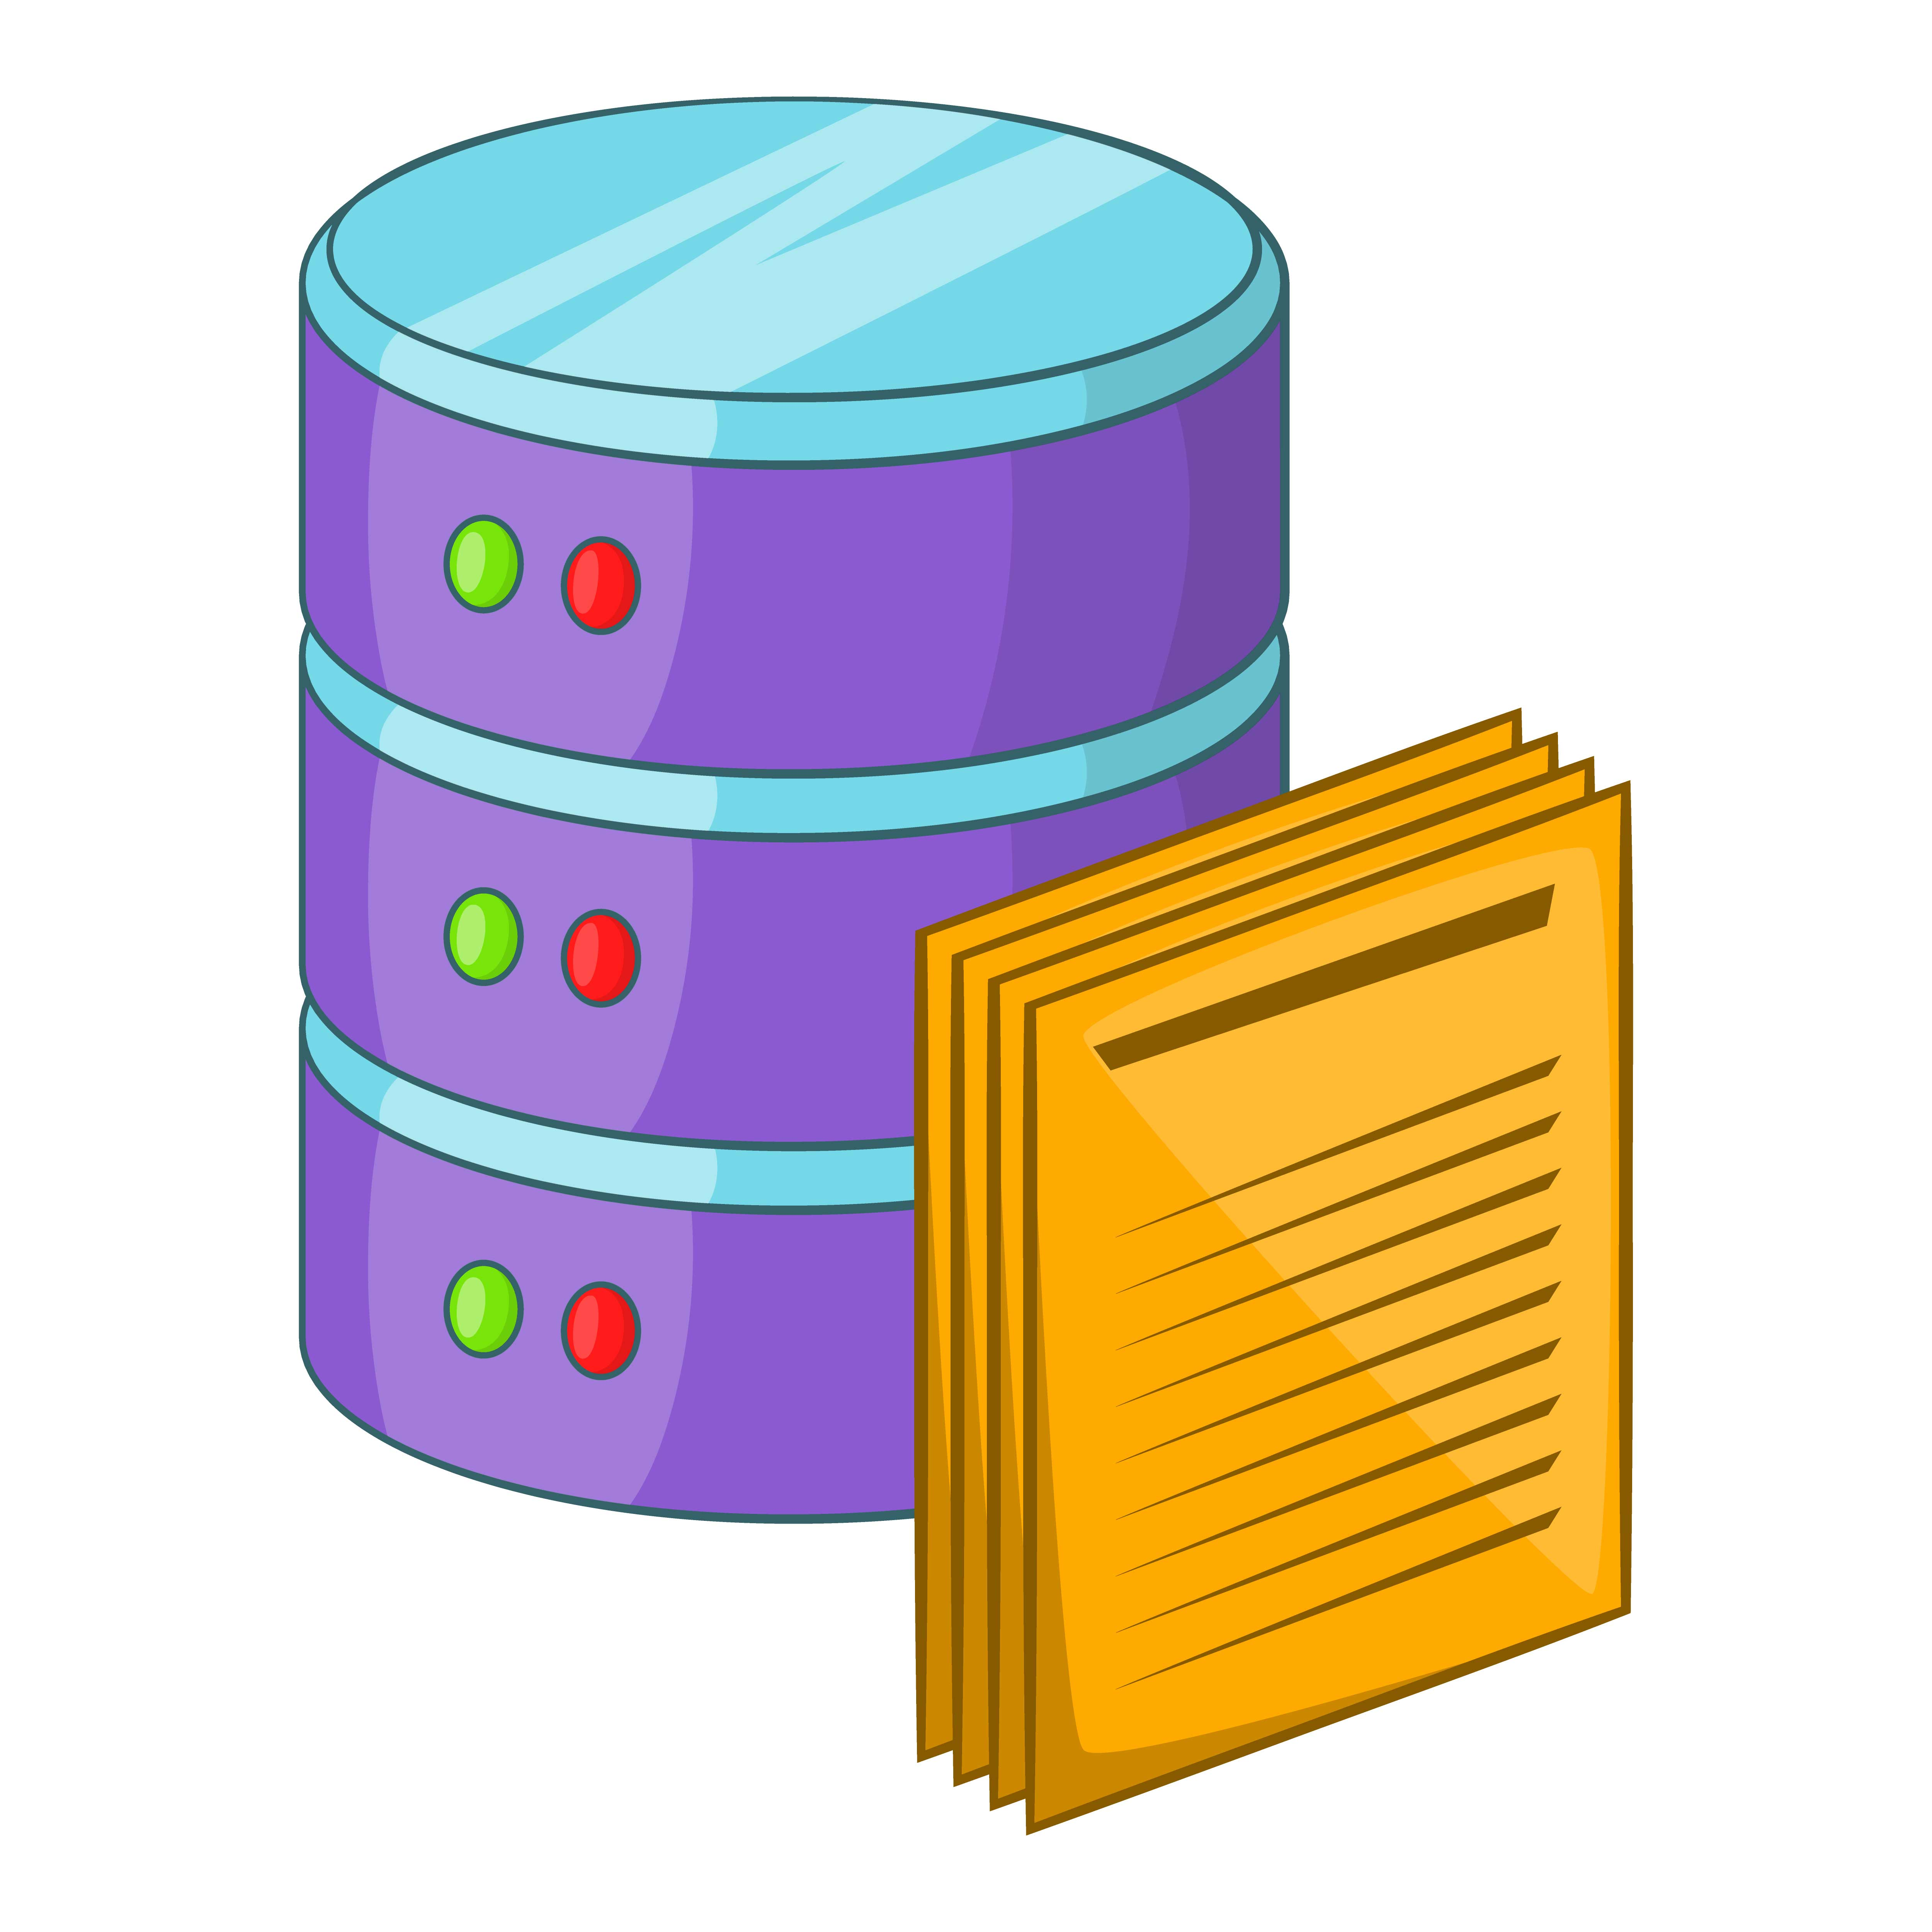
Data Processing
Schema
Handling missing data
Generating time column
Outlier detection and handling using Z-score method

Slide 18
Schema
We extract data from kafka and make all rows as string then we cast each value to its specified data type.
Column name | Data type
id | string
date | Date
hour | double
temperature | double
steps | int
bpm | double
calories | double
distance | double
age | string
gender | string
time | timestamp

Slide 19
Handling missing data
Fill with mode(the most frequent item)
Fill with mean
Fill with random value

Slide 20
Outlier detection and handling using Z-score method
Outlier Detection and Handling :
using the Interquartile Range (IQR) method to maintain data consistency and its quality. For columns such as calories, distance, and steps, outliers are capped.
Z-Score Method:
For bpm, it calculates the mean and standard deviation, and replaces outliers based on z-scores.

Slide 21
Agenda
introduction
Dataset
Environment Setup
Data processing
Visualizations and monitoring
Conclusion
Notes:
Note:

Slide 22

Visualization and monitoring
Date Table
Benefits:
Enhanced time intelligence
Consistent timeseries analysis
Detailed insights
Improved filtering and grouping
Performance optimization

Slide 23
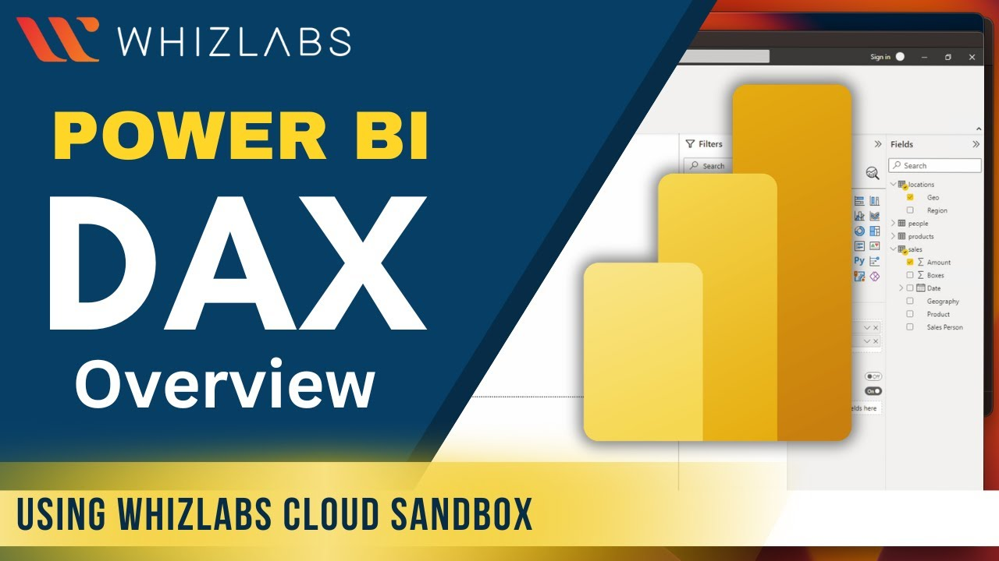



Visualization and monitoring
Date Table
Implementation Details:
combine date and hour to create unique timestamp for each hour
Date : extracted from date time
Hour: range from 0 to 23 etc.
Used DAX

Slide 24
Visualization and monitoring
Realtime charts
Charts
Line chart of BPH (beats per hour)
Total steps of the last day
Total distance in meters in the last 7 days
Distribution of temperature
Filters for date and user

Slide 25
Visualization and monitoring
Report
Insights that could be derived
Top and lowest BPH
Distributions of BMI categories
Ratio of Males to Females
Categorization by age and Gender

Slide 26
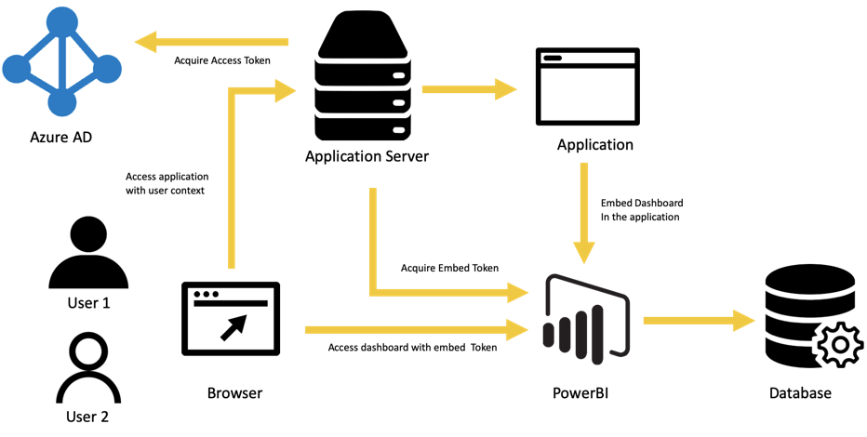
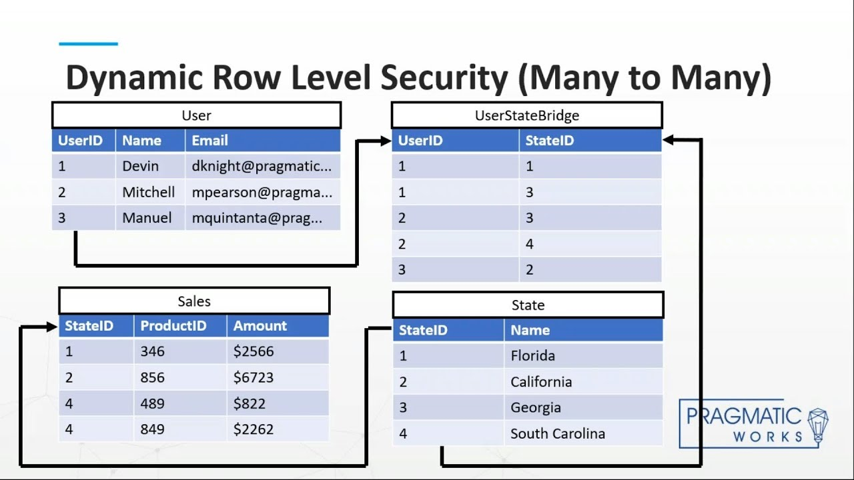
Visualization and monitoring
Row level security (RLS)
Benefits:
Data confidentiality
Compliance
Customized user experience
Scalability

Slide 27
Agenda
introduction
Dataset
Environment Setup
Data processing
Visualizations and monitoring
Conclusion
Notes:
Note:

Slide 28
Conclusion
Real-Time Health Insights: Provides interactive dashboard for proactive health management and decision-making
Enhanced Time-Based Analysis: Date Table with hourly increments offers detailed insights into user behavior and health trends.
Customizable Views: Supports personalized monitoring for both individual and group health data.
Security and Compliance: Row-Level Security ensures data confidentiality and regulatory compliance

