Slide 1



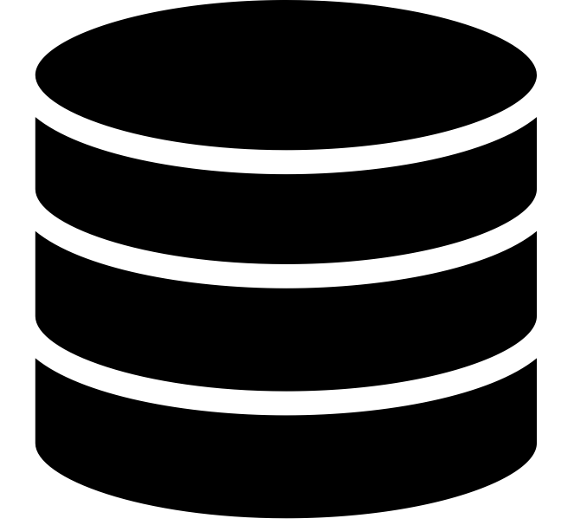

(Integrated ML Function)
Scenario 1
Data Intelligence Cloud
Data Warehouse Cloud
(Data Storage & Preparation)
or
SAP HANA ML
Scenario 2
Scenario 3
Scenario 1 : SAC Integrated ML
Scenario 2 : Native Python (Jupyter)
Scenario 3 : SAP HANA ML
Other Data

